Slide 1
NHSN Antimicrobial Resistance (AR) Option
ARSTF Workgroup #4 – March 1, 2019
Amy Webb, MPH CHES
Public Health Analyst
Contractor for the Division of Healthcare Quality Promotion, CDC

Slide 2
NHSN Structure
NHSN
Patient Safety Component
Healthcare Personnel Safety Component
Biovigilance Component
Long Term Care Facility Component
Dialysis Component
Device-Associated Module
Procedure-Associated Module
MDRO/CDI Module
Antimicrobial Use & Resistance Module
Antimicrobial Use Option
Antimicrobial Resistance Option
Outpatient Procedure Component

Slide 3
Antimicrobial Resistance (AR) Option
Released in July 2014
Purpose:
  Facilitate evaluation of AR data using standardized approach & definitions
  Provide facilities with improved awareness of AR issues to aid in clinical decision making and prioritize transmission prevention efforts
Voluntary reporting
  Not part of CMS Quality Reporting Programs
  *Included as one option for Public Health Registry reporting for Promoting Interoperability (previously Meaningful Use [MU])
  Missouri state requirement (SB 579)
*MU 3 Final Rule: https://www.federalregister.gov/articles/2015/10/16/2015-25595/medicare-and-medicaid-programs-electronic-health-record-incentive-program-stage-3-and-modifications
*NHSN MU3 page: https://www.cdc.gov/nhsn/cdaportal/meaningfuluse.html

Slide 4
Antimicrobial Resistance Data in NHSN
 | AR Option | MDRO Module | Device & Procedure- Associated Modules
Events reported
Type of susceptibility data
Denominator; Metric(s)
Benefits
Drawbacks

Slide 5
Antimicrobial Resistance Data in NHSN
 | AR Option | MDRO Module | Device & Procedure- Associated Modules
Events reported | AR Events from blood, CSF, urine, & lower respiratory specimens
Type of susceptibility data | Over 20 specific organisms; detailed lab test results & final interpretation
Denominator; Metric(s) | # Isolates tested; facility antibiogram with %NS; resistance percentages
Benefits | Wide-spread, ‘whole-house’ coverage; no manual entry
Drawbacks | Requires set-up by vendor/homegrown system

Slide 6
Antimicrobial Resistance Data in NHSN
 | AR Option | MDRO Module | Device & Procedure- Associated Modules
Events reported | AR Events from blood, CSF, urine, & lower respiratory specimens | Laboratory Identified (LabID) & Infection Surveillance Events
Type of susceptibility data | Over 20 specific organisms; detailed lab test results & final interpretation | Positive specimens (i.e., MRSA, CDI, CRE) defined by NHSN criteria
Denominator; Metric(s) | # Isolates tested; facility antibiogram with %NS; resistance percentages | # Patient days; rates # Predicted; SIRs (LabID Only)
Benefits | Wide-spread, ‘whole-house’ coverage; no manual entry | Simplified reporting; LabID MRSA & CDI national benchmarks
Drawbacks | Requires set-up by vendor/homegrown system | Small number of organisms followed

Slide 7
Antimicrobial Resistance Data in NHSN
 | AR Option | MDRO Module | Device & Procedure- Associated Modules
Events reported | AR Events from blood, CSF, urine, & lower respiratory specimens | Laboratory Identified (LabID) & Infection Surveillance Events | CLABSI, CAUTI, pedVAP, pedVAE VAE, SSI Events
Type of susceptibility data | Over 20 specific organisms; detailed lab test results & final interpretation | Positive specimens (i.e., MRSA, CDI, CRE) defined by NHSN criteria | Susceptibility results for specific antibiotics
Denominator; Metric(s) | # Isolates tested; facility antibiogram with %NS; resistance percentages | # Patient days; rates # Predicted; SIRs (LabID Only) | # Isolates tested; facility & national %R
Benefits | Wide-spread, ‘whole-house’ coverage; no manual entry | Simplified reporting; LabID MRSA & CDI national benchmarks | Infection control software; data can be manually entered; national AR data published (%R)
Drawbacks | Requires set-up by vendor/homegrown system | Small number of organisms followed | Only get susceptibility info for events that meet NHSN definitions

Slide 8
Requirements for AR Data Submission
Who Can Participate?
Hospitals* that have:
  Electronic Laboratory Information System (LIS) and
  Admission Discharge Transfer (ADT) System
  Or electronic access to required data elements
  AND
  Ability to collect and package data using HL7 standardized format: Clinical Document Architecture
    Commercial software vendor (https://www.sidp.org/aurvendors)
    Homegrown system
*General acute care hospitals, long-term acute care hospitals (LTAC), inpatient rehabilitation facilities (IRF), oncology hospitals, critical access hospitals enrolled in NHSN & participating in the Patient Safety Component

Slide 9
AR Data Elements
What Data Are Collected?
Two separate file types (similar to MDRO FacWideIN LabID reporting):
  AR Event files – contain all information associated with the individual isolate
    Each AR Event is a separate, individual file
    Reported from all inpatient locations & 3 outpatient location types: ED, pediatric ED & 24-hour observation area
  AR Summary files – contain patient day and admission counts for FacWideIN
    Summary files are not submitted for individual locations

Slide 10
AR Events – What Qualifies?
Event data: Isolate-level susceptibility results for specific organisms
Qualifying isolate criteria for an AR Event:
  Collected from one of four specimen types:
    Invasive:
      Blood
      Cerebral spinal fluid (CSF)
    Non-invasive:
      Urine
      Lower respiratory
  One of over 20 organisms identified (see list on next slide)
  Antimicrobial susceptibility testing must be completed
    Qualifies for submission regardless of susceptibility results

Slide 11
Eligible Organisms
All Acinetobacter species
Candida albicans; auris; glabrata; parapsilosis; tropicalis
Citrobacter amalonaticus; freundii; koseri
All Enterobacter species
Enterococcus faecalis; faecium
Enterococcus spp. (when not specified to the species level)
Escherichia coli
Group B Streptococcus
Klebsiella oxytoca; pneumoniae
Morganella morganii
Proteus mirabilis; penneri; vulgaris
Pseudomonas aeruginosa
Serratia marcescens
Staphylococcus aureus
Stenotrophomonas maltophilia
Streptococcus pneumoniae

Slide 12
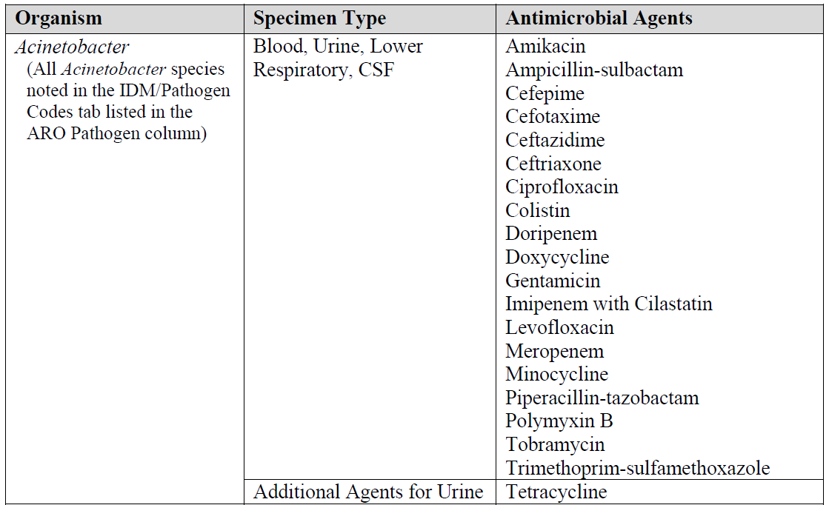
Organism/Agent Combinations
Selected antimicrobial agents are required to be reported/included in the CDA file for each of the organisms per specimen type
  Full list can be found in the NHSN AUR Module Protocol: http://www.cdc.gov/nhsn/PDFs/pscManual/11pscAURcurrent.pdf

Slide 13
AR Event Required Fields
Patient DOB, gender, date admitted to facility, location during specimen collection
Specimen collection date, specimen source
  Blood, CSF, urine, lower respiratory
Organism & antimicrobial susceptibility data for each antimicrobial required for the isolated organism/specimen type
  Sign, value and interpretation for E-test, MIC, and/or Disk diffusion (KB)*
  Final lab interpretation
    S, S-DD, I, R, NS, N
*If available

Slide 14
Requirements for AR Data Submission
Who Can Participate?
Hospitals* that have:
  Electronic Laboratory Information System (LIS) and
  Admission Discharge Transfer (ADT) System
  Or electronic access to required data elements
  AND
  Ability to collect and package data using HL7 standardized format: Clinical Document Architecture
    Commercial software vendor (https://www.sidp.org/aurvendors)
    Homegrown system
*General acute care hospitals, long-term acute care hospitals, inpatient rehabilitation facilities, oncology hospitals, critical access hospitals enrolled in NHSN

Slide 15
SIDP AUR Vendors List*
Actively Reporting
  Asolva
  Cerner
  EPIC
  Ilum Health Solutions
  MedMined
  RL Solutions
  Theradoc
  QC Pathfinder (Vecna)
  Vigilanz
Interested in Reporting
  Bluebird IMS
  Baxter Healthcare (ICNet)
  Lumed with bioMerieux
  Midas (Conduent)
  Sentri7 (Wolters Kluwer)
MU3 Certified
  Allscripts
  Meditech
*Vendor self-reported
Notes:
Missing from the list: Meditech, Allscripts

Slide 16
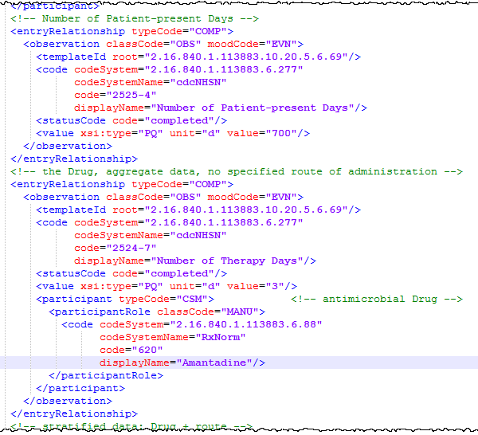
Clinical Document Architecture (CDA)
Data must be uploaded via CDA
  Too much data to enter by hand!
Health Level 7 (HL7) standard
Provides facilities with standardized way to package & upload data
  AU, AR, & HAI
CDA ≠ CSV (Excel)
  CDA uses XML

Slide 17
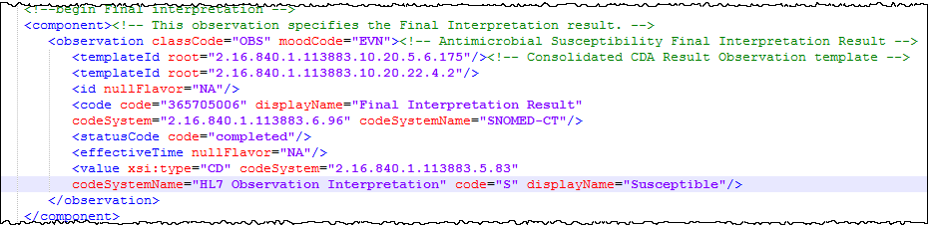
AR Option CDA
Data must be submitted via CDA
Two CDA file types for AR Option:
  Event: 1 CDA file per AR Event (patient & susceptibility data)
  Summary: 1 CDA file with FacWideIN patient day & admission counts

Slide 18
Monthly AR Data Submission
Recommend: Upload within 30 days following the completion of the month
1 CDA file per AR Event & 1 CDA file for summary data
  Example:
    50 separate CDA files for 50 separate AR Events identified per NHSN definitions in the month
    1 CDA for facility-wide summary (patient days and admissions for all inpatient locations combined)
  All CDA files can be uploaded within 1 Zip file
    Maximum: 1000 CDAs or file size of 2 MB per zip file

Slide 19
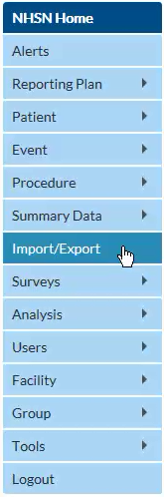
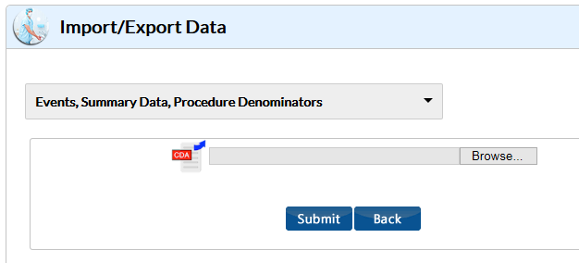
Importing CDA Files into NHSN –
Option #1: Manual Upload
How to upload CDA files: https://www.youtube.com/watch?v=T4DLtimpB5M

Slide 20
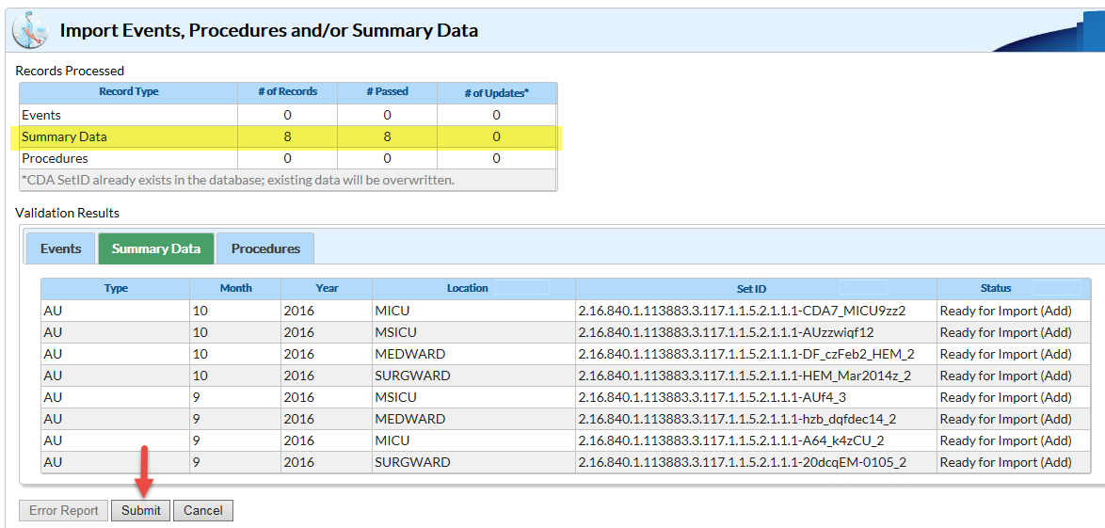
Importing CDA Files into NHSN –
Option #1: Manual Upload (cont.)
Notes:
Revise screenshot with PedMed

Slide 21
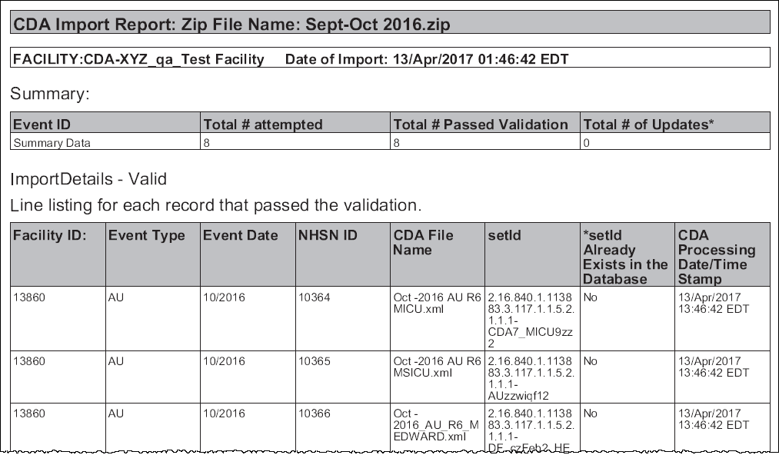
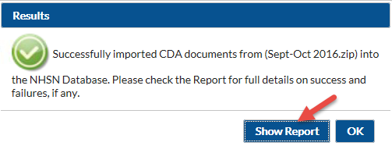
Importing CDA Files into NHSN –
Option #1: Manual Upload (cont.)

Slide 22
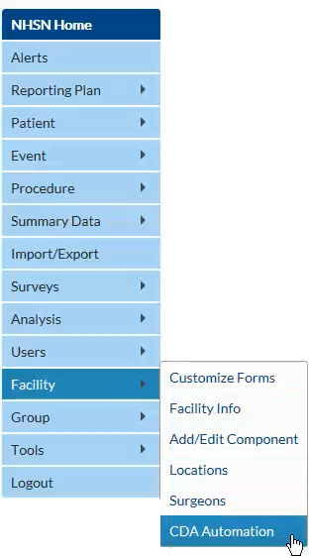
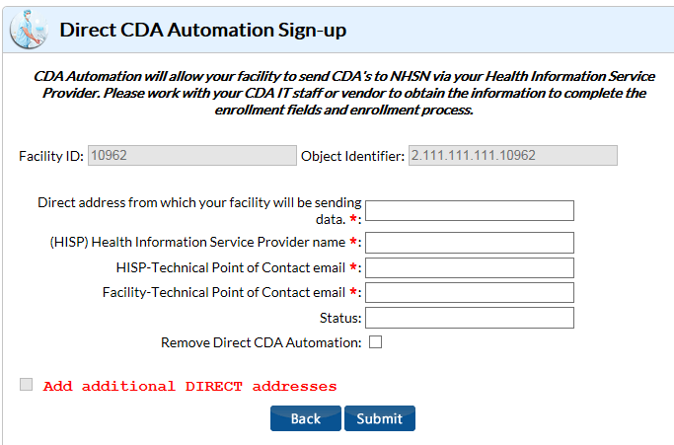
Importing CDA Files into NHSN –
Option #2: Automated Upload
Automatic upload from vendor/IT solution using DIRECT CDA Automation
Must get approval from vendor prior to signing up

Slide 23
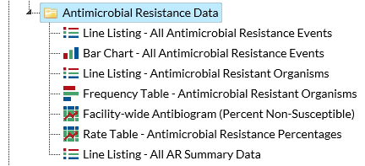
AR Option Report Types
AR Event reports
  Line list, bar chart, antibiogram
AR Organism* reports
  Line list, frequency table, rate table
AR Denominator
  Line list
*Antimicrobial Resistant Phenotype Definitions for AR Option Data: https://www.cdc.gov/nhsn/pdfs/ps-analysis-resources/aur/ar-phenotype-definitions-508.pdf
Notes:
Same as HAI AR definitions except we have three more:
CRE_expanded
Fluconazole-resistant Candida
Drug-resistant Streptococcus pneumoniae

Slide 24
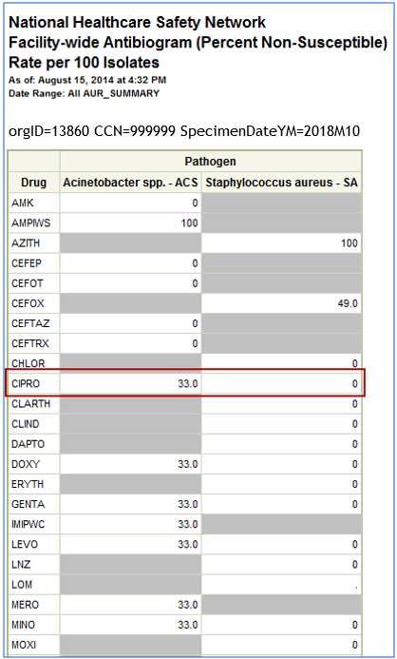
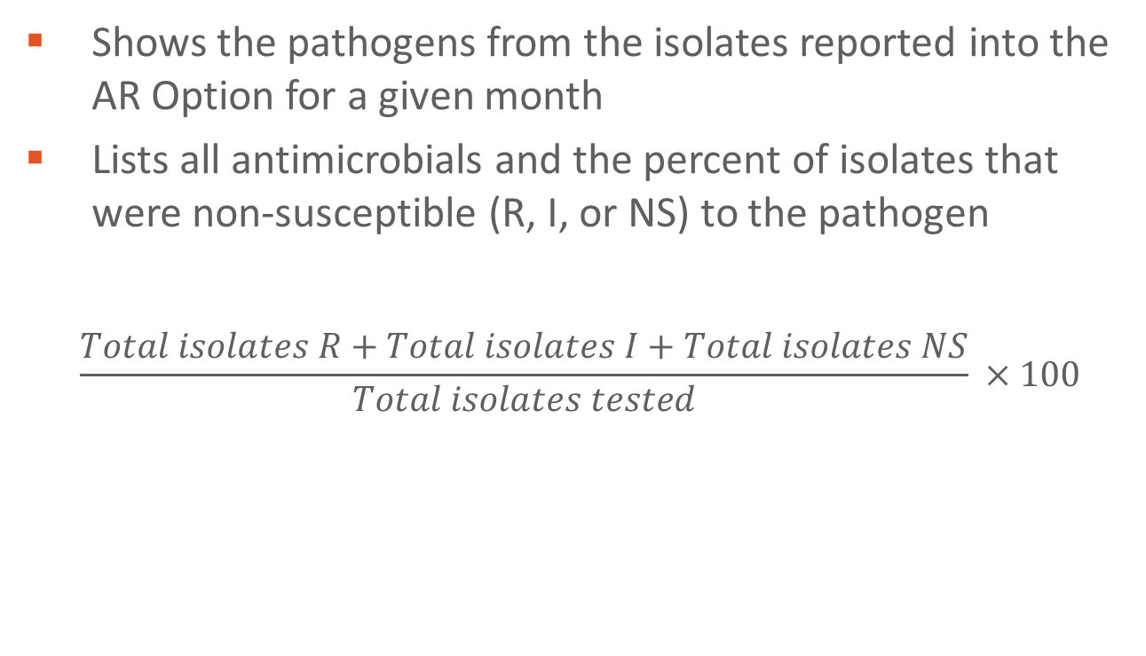
Facility-wide Antibiogram
Shows the pathogens from the isolates reported into the AR Option for a given month
Lists all antimicrobials and the percent of isolates that were non-susceptible (R, I, or NS) to the pathogen
  $$\frac{Total isolates R+Total isolates I+Total isolates NS}{Total isolates tested} ×100$$
*Data for example only
Notes:
Can be generated by month, quarter, half-year, year or cumulative time periods
Can be generated by individual specimen source or by specimen group (invasive vs non-invasive)

Slide 25
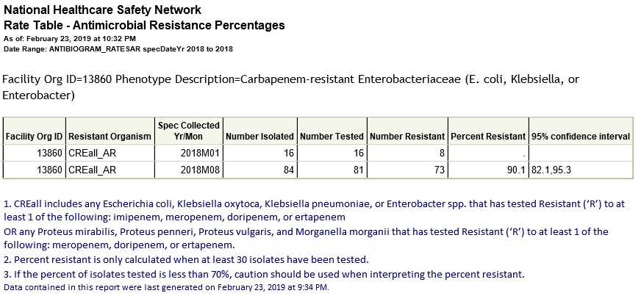
AR Organism Percentages
Displays % of organisms that tested non-susceptible or resistant to certain antimicrobials for each defined phenotype
$\frac{\# organisms NS or R to specific antimicrobials}{\# organisms tested for susceptibilty to specific antimicrobials}$ x 100
*Data for example only

Slide 26
AR Option Reporting Metrics

Slide 27
Reporting Metrics
502 facilities submitted at least one month of data
  From 47 states
  Bed size
    Average = 214
    Median = 175
    Min/Max = 6, 1249
  Teaching status
    Teaching: 63%
      (of all Teaching) Major teaching: 45%
*As of February 1, 2019
Notes:
Vast majority from General Acute Care Hospitals, some critical access.
Missing Maine, North Dakota, Wyoming

Slide 28
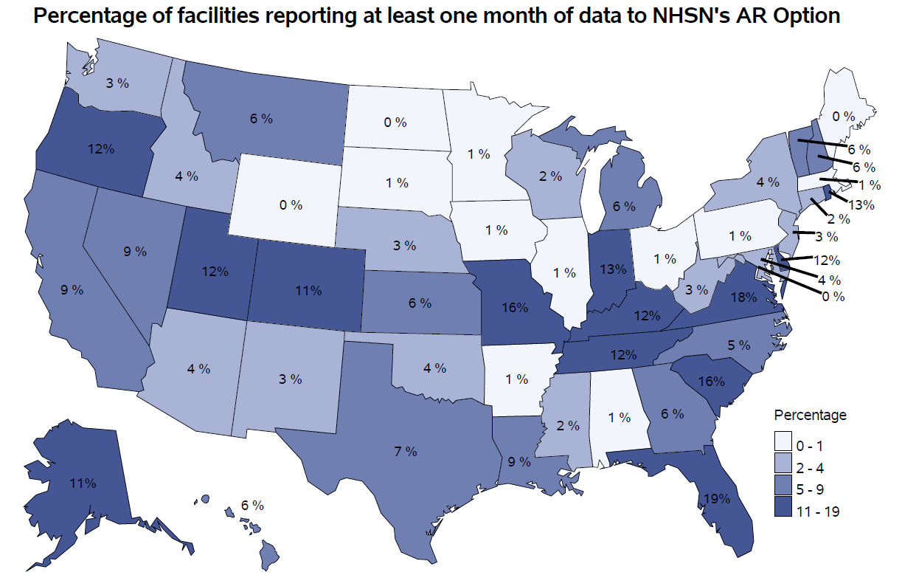
Hospital* participation in AR Option
*Includes all HOSP-* types in NHSN that can submit to AR (General, CAH, Rehab, LTAC, ONC, etc.)
Data as of February 1, 2019

Slide 29
Yearly Submission into the AR Option*
No. of Facilities
Reporting or that have Reported
AR Data
*As of February 1, 2019
Notes:
Feb 28: 517 facilities
7443 total HOSP-* facilities enrolled in NHSN
About 3500 ACH; 1300 CAH

Slide 30
Average Submission Patterns
Data Month/Year | Ever Reporters | Current Reporters (past 3 months) | Continuous Reporters (past 12 months)
Sep 2018 | 401 | 318 | 197
Oct 2018 | 410 | 306 | 202
Nov 2018 | 422 | 309 | 208
Dec 2018 | 452 | 341 | 246
Jan 2019 | 483 | 303 | 236
Feb 2019 | 502 | 323 | 246

Slide 31
AR data submitted to NHSN as of September 2018 — specimen sources, patients, and pathogens
596,295 isolates
  77% urine
  13% blood
  10% lower respiratory
  0.1% CSF
455,907 patients
  94% adults
  72% female
Notes:
As of September, AR database comprise data of 596 thousand isolates from 456 thousand patients. 77% are urine specimens, followed by blood, lower respiratory, and CSF. 94% patients are adults. 72% patients are female.
The most common pathogens are Enterobacteriaceae, followed by Enterococcus, Staph aureus, Pseudomonas, etc.

Slide 32
Submission details
Total AR Events submitted: 881,002
  284,707 events were submitted in the last 5 months
Total patients represented: 651,463
*As of February 1, 2019

Slide 33
What are Facilities doing with AR Data?
Just getting started!
Ability to review:
  Changes in antibiogram over time
  Track number events meeting NHSN AR Option phenotype definitions
  Review specific locations reporting higher numbers of events meeting NHSN AR Option phenotype definitions for infection control purposes

Slide 34
Implementation Process

Slide 35
Steps for Facility Participation in the AR Option
Prerequisite: Electronic LIS or electronic access to lab data
Identify facility lead(s)/champion(s) for AR Option
Gain support!
Gather information on current CDA submission capabilities
  Activate, obtain, or develop system for aggregating and packaging data into CDA files
Validation
Monthly submission

Slide 36
Implementation Lessons Learned
Importance of facility buy in & working together
  Support needed from various different departments of the facility
  Collaboration with IPs (aka experienced NHSN users!)
Nothing is one size fits all
  Each facility may have different timetables & available resources
Importance of validation
  Even more important since data is electronic submission only

Slide 37
Implementation Lessons Learned (cont.)
Access to data
  Vendors pulling susceptibility data from EHR
  Be mindful of suppression of results
Patience
  New type of (non-mandated) reporting into NHSN
  Takes time to work out the bugs
Ask around
  Knowledge gained from other facilities/health systems
  Share success stories

Slide 38
Successful Facilities are (generally)…
Already submitting AU Option data
Part of a health system
Already have software that can submit AR Option data
Larger hospitals (more resources)
Notes:
Only 9 facilities of 517 submitting AR are not also submitting AU

Slide 39
CDC/DHQP Plans for the AR Option Data
Hsiu Wu

Slide 40
What’s Already Happening
Data quality evaluation
Evaluation of participation – characterizing hospitals participating in AR Option by comparing them with the rest of NHSN hospitals
Evaluation of testing and reporting behaviors – selective reporting
Calculation of national epidemiological measurements (%S, prevalence rate, incidence density)
Starting to explore factors associated with AR

Slide 41
Future Plans
Benchmarking model development
  Need increased reference population
  Identify hospital & patient factors potentially associated with AR
AR temporal change assessment
Correlations between AU and AR
  Further taking hospital’s AR burden into AU risk adjustment model
State-level AR Option atlas when sufficient participation is achieved

