Slide 1
Proposed XDRO Registry in TN:
A Tool to Assist in Communication
Marion Kainer MD MPH FRACP FSHEA
ARSTF Workgroup 4 Call, March 29, 2019

Slide 2
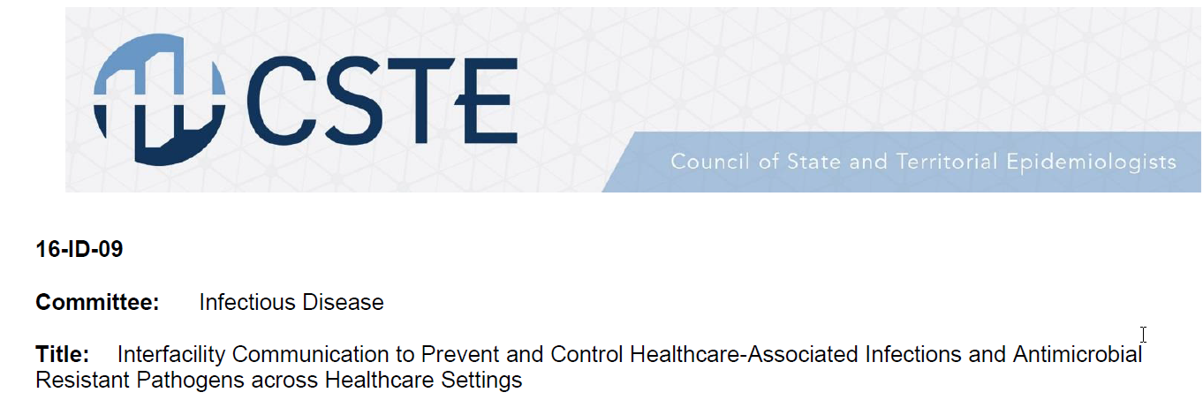
Aim: Address Imperfect Communication
Preventable Transmission of Pathogens
Interfacility Communication
  ~100% say they send it, but only ~ 50% receive it!
What about indirect transfers? (eg via home)

Slide 3
Leverage Existing Infrastructure (NBS)
NBS: communicable disease surveillance system
  Used by 24+ jurisdictions
  “One-stop” destination for ELR
  Able to consume ELR, including complex parent child relationships
  Captures antimicrobial susceptibility data (quantitative (MIC), and interpretation (S/I/R)
  Established on-boarding process
    adherence to standards
  Attach multiple lab reports to a single “case”
  Point in time demographics
  Existing reporting functionality
    including visualization, cluster detection

Slide 4
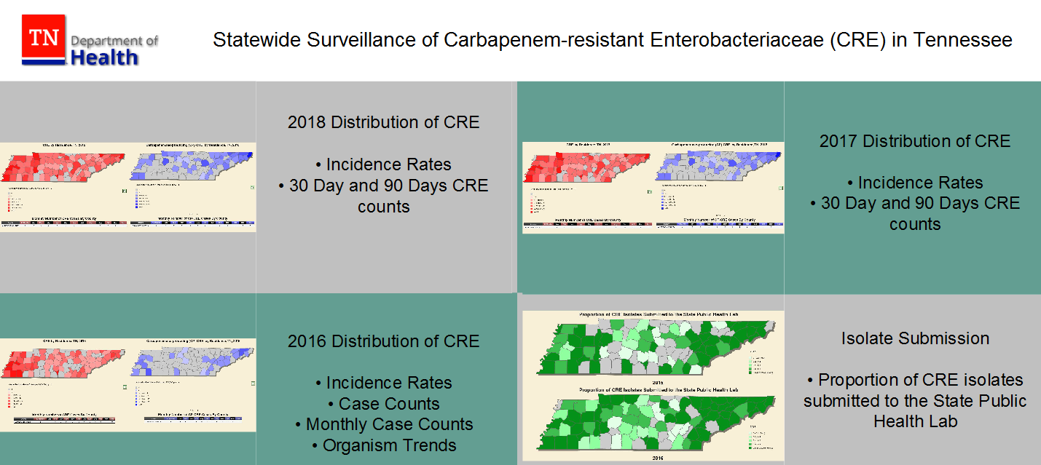
Interactive Dashboard for CRE and CP-CRE

Slide 5
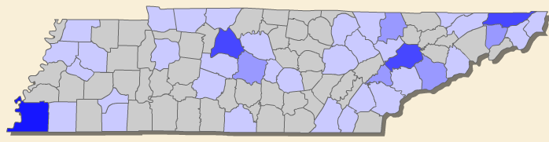
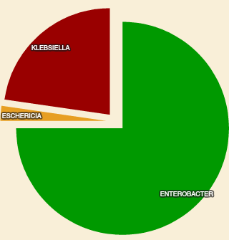
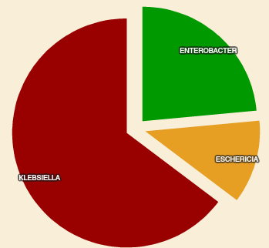
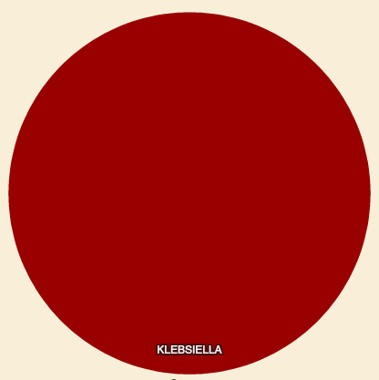
Marked Geographic Variation in CP-CRE Genera TN, 2017 (N=233)
Nashville
Johnson City
Memphis
N=43
N=16
N=5
Enterobacter spp
Klebsiella spp
Klebsiella spp

Slide 6
NBS = Underlying Data Source
Organisms
(Tier 1-3):
Manual Entry by TDH staff:
Case reporting by IPs
Paper labs (fax/mail)
NHSN identified→ contact IP→ paper report
Pan-nonsusceptible organisms
Candida auris
CRE (all genera)
CP-CRPA
VISA/VRSA
    ELR
    TN SPHL/ ARLN
    Clinical Lab
NBS

Slide 7

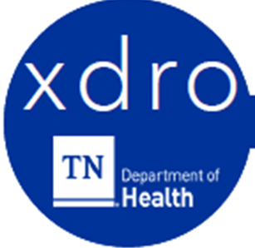

TDH
Mandated Reporting
--------------------------
--------------------------
--------------------------
NBS
API
(Daily Extract/ Refresh)
Manual (phase 1)
Individual query
CSV upload
ADT Feed (phase 2)
XDRO Status
Auto Alerts
Facility A

Slide 8
Data Source
  If do not yet have an event code assigned by CDC (e.g., not nationally notifiable condition or a newly emerging pathogen)
Underlying infrastructure for XDRO Registry
  Developed by Vanderbilt
  Familiarity: TDH has >500 projects utilizing REDCap
  Extract out of the NBS→ Surveillance system agnostic
  Consortium, no cost to underlying software
  Scalability
  Contract at signature stage

Slide 9
Proposed User Interface

Slide 10
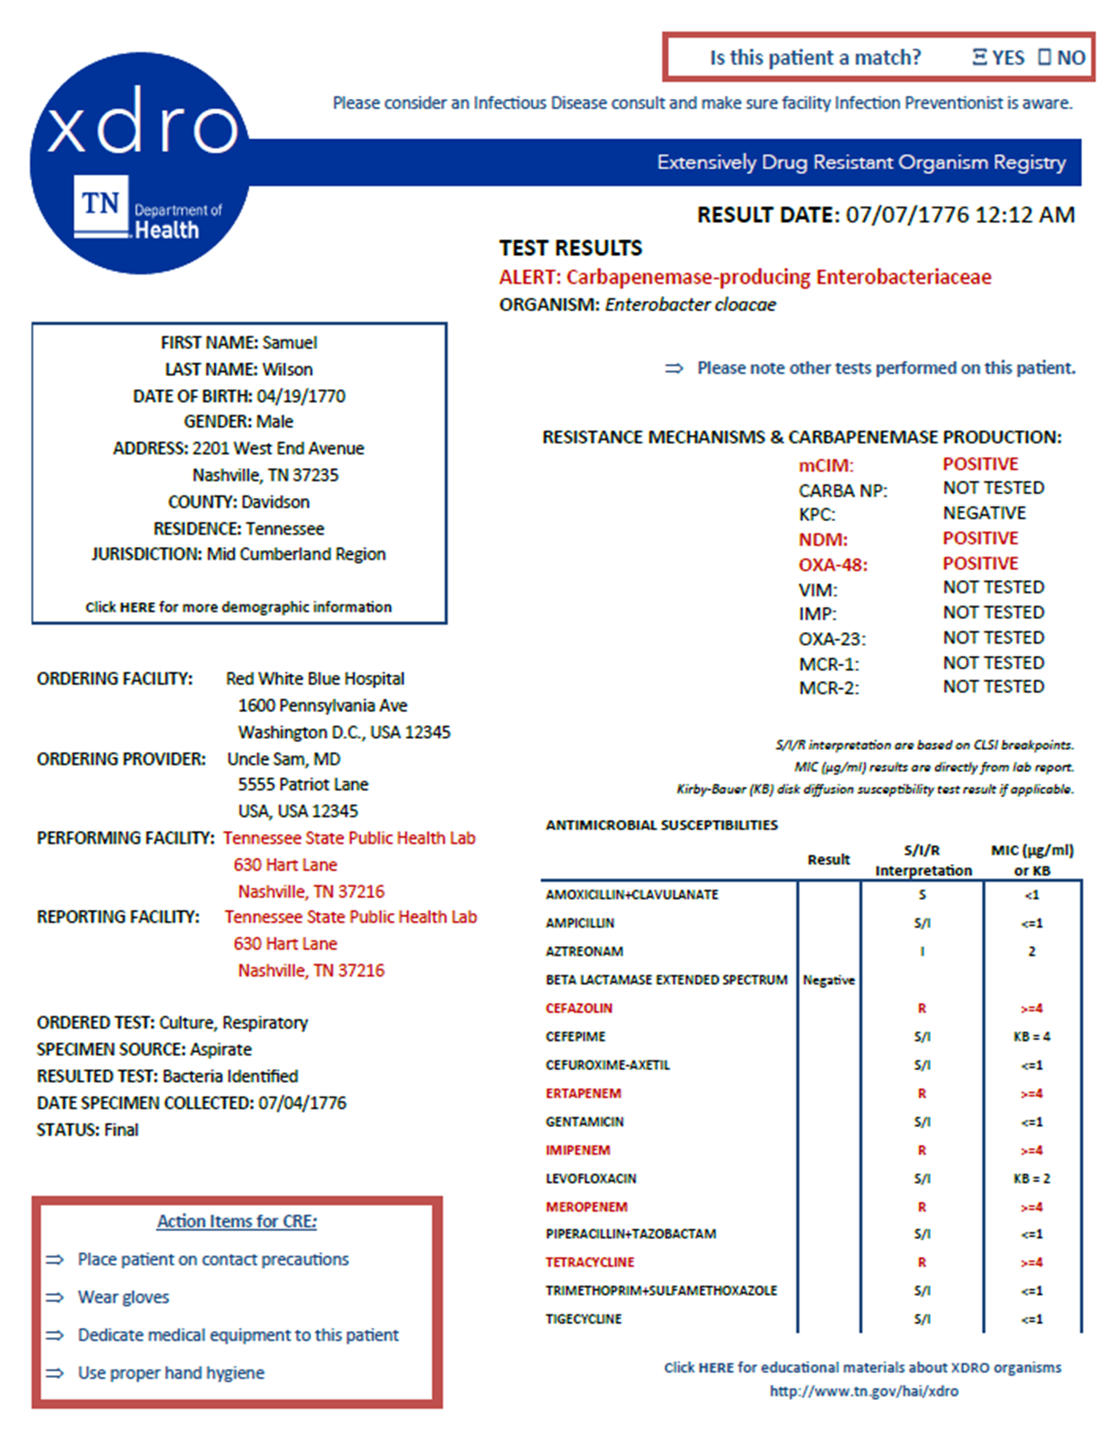

Slide 12
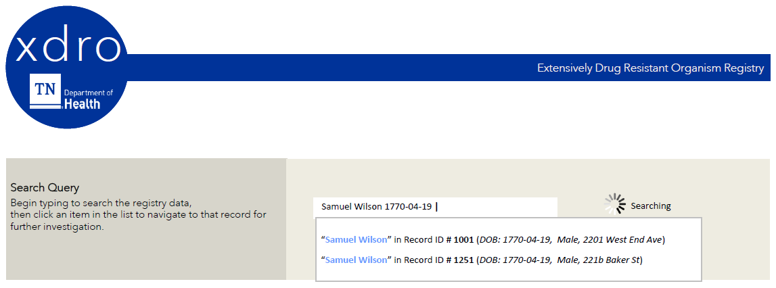
Proposed Manual Query in Search Form

Slide 13
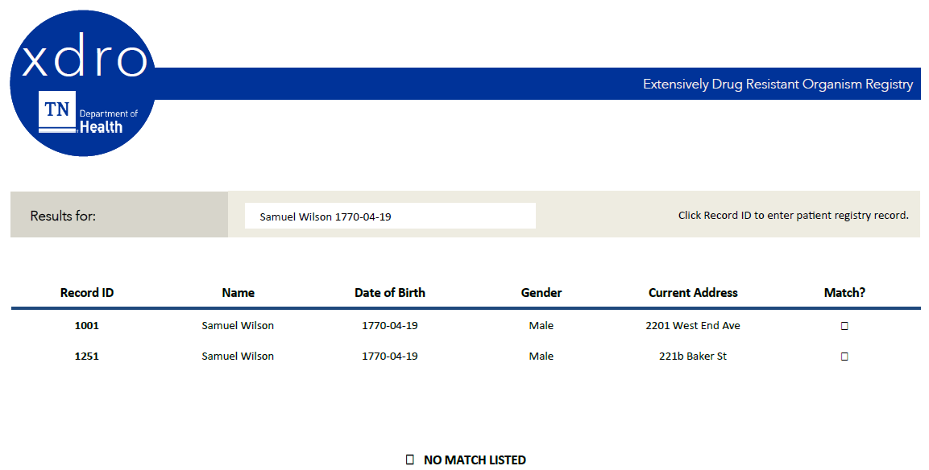
Proposed Results Page User Interface

Slide 15
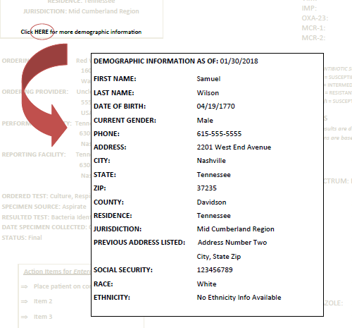
Proposed Demographics- Expanded

Slide 16

Thank You!
Contact
Hai.health@tn.gov
TDH: (615) 741-7247
Report all Outbreaks and
Unusual/ Pan-Resistant Organisms

