Slide 1


Antibiogram Assessment
Anna Baker, HAI Summer Intern, Infectious Disease Section
16 August 2018

Slide 2
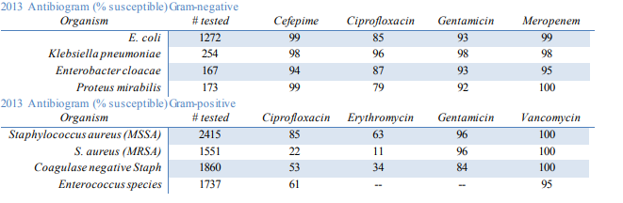
What is an antibiogram?
profile of antimicrobial susceptibility testing results of specific microorganism to series of antimicrobial drugs
generated by the lab using aggregate data from a hospital/healthcare system
data summarized periodically & presented showing % of organisms tested that are susceptible (%S) to a particular antimicrobial drug
Example:

Slide 3
Terms
CLSI: Clinical and Laboratory Standards Institute M39-A4
CSTE: Council of State and Territorial Epidemiologists

Slide 4
Project Goals
Identify exemplary antibiogram usage nationally and internationally through research
To gain information about:
  The manner in which CT labs are creating their antibiograms
  The ways CT hospitals are using antibiograms
  The way HAI programs nationally are using antibiograms
Determine the feasibility and utility of a statewide antibiogram for CT
Inform the CSTE taskforce about gaps in antibiogram usage
Inform CLSI about any improvements that need to be made in the M39 and about shortcomings in recent antibiograms
Possibility: creation of a toolkit for antibiogram usage in hospitals or HAI programs

Slide 5
CLSI M39-A4 Expectations
Cumulative antibiogram at least annually
Only species ≥ 30 isolates
Only first isolate each patient
Only antimicrobial agents routinely tested & those that might be suppressed
Send data through real-time interface or periodically export results
Consistent format (e.g., simple rows and defined columns)
Antimicrobials routinely tested, even if not reported to clinicians

Slide 6
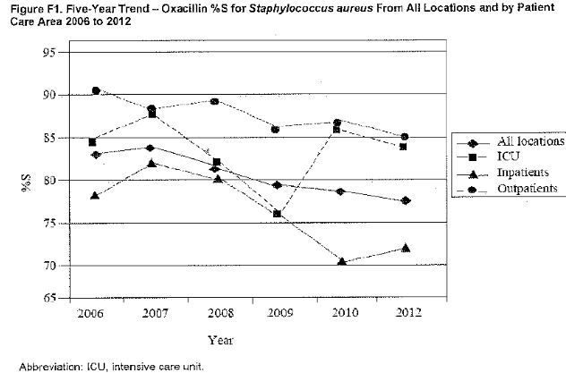
CLSI M39-A4 Suggestions
Desirable patient and specimen information: Refer to handout
Results confirmed before reporting
Reinterpretation of results using interpretive criteria or current breakpoints
  Footnote indicating years changes occurred
If include species <30 isolates, append a note to indicate less statistical validity
Define abbreviations
Prepare separate tables gram-negative, gram-positive
Report available in accessible format
  pocket guide
  pdf/printout on database

Slide 7
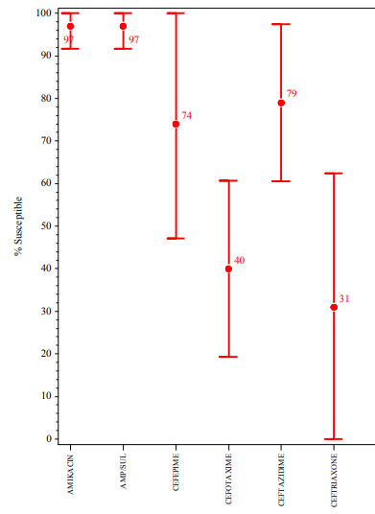
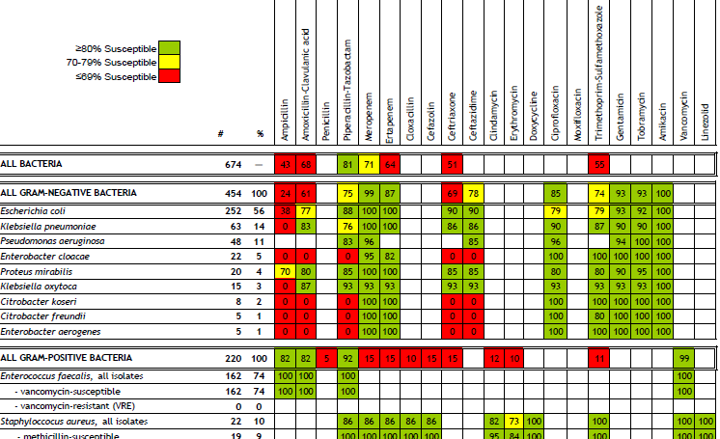
Lit Review – Exemplary Antibiograms around the Country
Massachusetts State Antibiogram
Nebraska State Antibiogram
Pros:
Directly access electronic reports for antibiotic resistance in real time
Electronic sent to a DHHS database daily
DHHS disease experts monitor these daily
Pros:
Inclusion of standard deviation
Easily interpretable
Canada: Country & Provinces Antibiogram
Pros:
Color-coding for ease of interpretation
For large hospitals, antibiograms for ICU & ED are provided in addition to hospital antibiogram
Larger regional analysis provides better ability to trend for antimicrobial stewardship committees at small hospitals
Washington State Interactive Regional Antibiogram
https://www.doh.wa.gov/ForPublicHealthandHealthcareProviders/HealthcareProfessionsandFacilities/AntibioticResistance/Stewardship/Antibiograms

Slide 8
Statewide Analysis Portion
Laboratory Assessment
  Request of Antibiograms
  Response rate antibiograms: 40.9%
  Response rate questions: 31.8%
  Survey on Antibiogram Creation and Laboratory Techniques
  Response rate: 72.7%
  Completion rate: 100%
Hospital Assessment
  Request of Antibiograms
  Response rate antibiograms: 66.7%
  Response rate questions: 80.0%
  Survey of Antimicrobial Stewardship training and Antibiogram Usage
  Response rate: 33.3%
  Completion rate: 100%

Slide 9
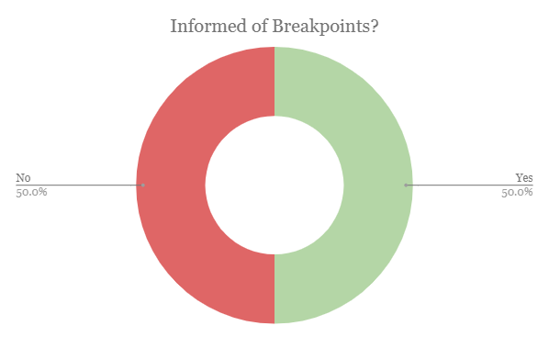
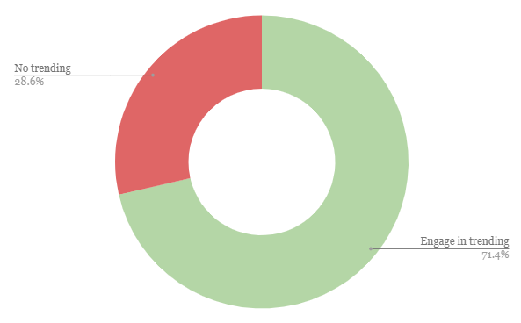
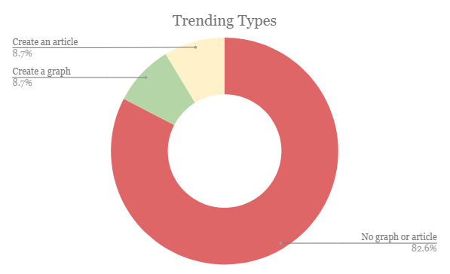


Initial Question Analysis
N = 34/37

Slide 10
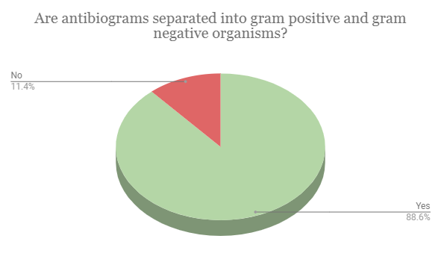
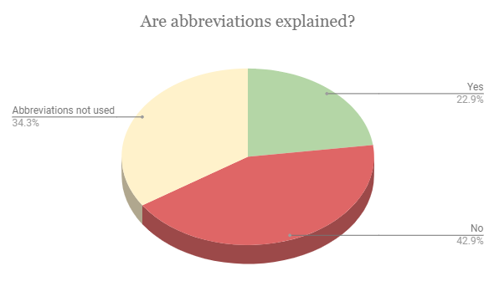
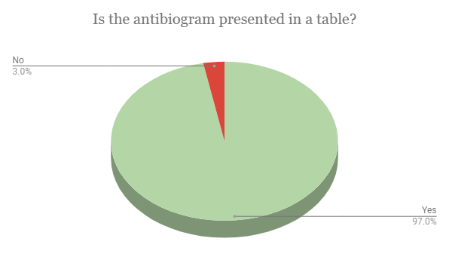
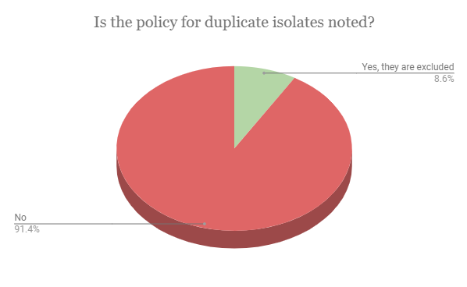
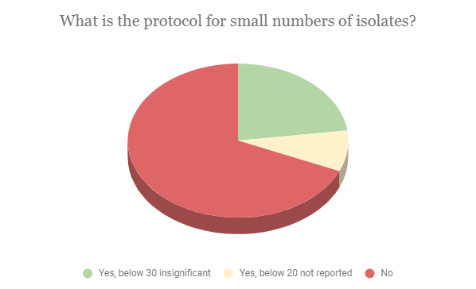
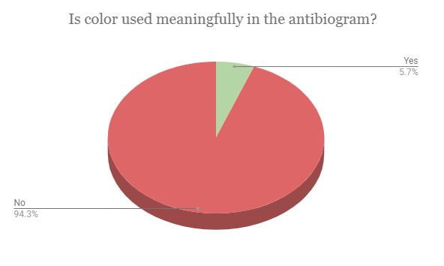
Analysis of Antibiograms – Continued
N = 34/37

Slide 11
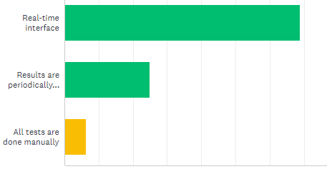
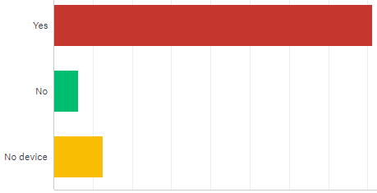
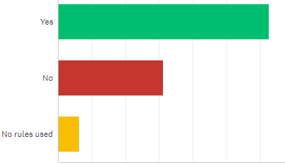
Lab Survey Results
50% of lab computer systems determine updated MIC/zone diameter of past results as breakpoints change, only 12.5% note it on the antibiogram
93.75% engage in either suppression or cascade reporting, defined according to CLSI guidelines as:
“the strategy of reporting antimicrobial susceptibility test results in which secondary agents are only reported if an organism is resistant to primary agents within a particular drug class”
100% of labs use expert rules in the formation of antibiograms (e.g. intrinsic resistance, exceptional phenotypes, & interpretive rules)
Lab Data Processing
Selective Reporting Rules
Suppression & Antibiogram
Note: There is general consistency. Most labs have and utilize testing instruments with selective reporting rules implemented
Note: This question addresses whether or not selective reporting rules are in place on the susceptibility testing instrument.
Note: This question examined whether data that is suppressed on patient reports is included in the calculation of % susceptibility on antibiograms
N = 16/22

Slide 12
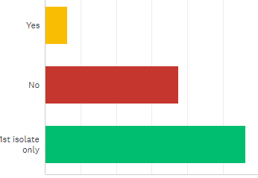
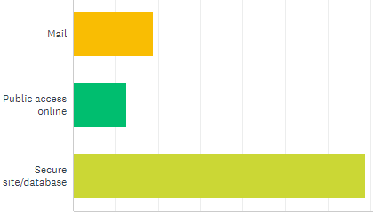
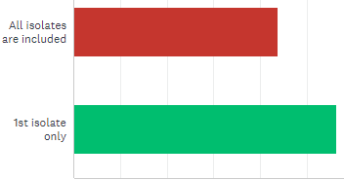
Lab Survey Results, cont.
The majority of labs serve one facility (43.75%) or three facilities (31.25%)
56.25% of labs test for multiple facilities
  18.25% of labs with multiple facilities do not break down antibiogram by facility
Only 87.5% use a standardized method for the creation of an antibiogram
No non-bacterial antibiograms
50% don’t use antibiograms for any purposes beyond reporting (e.g. formulary selection, treatment protocol)
50% include additional drug testing (not universally performed) in cumulative antibiogram
Multiple Isolate Protocol
Duplicate Isolate Notation
Antibiogram Distribution
N = 16/22

Slide 13
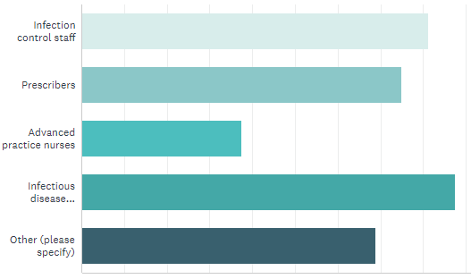
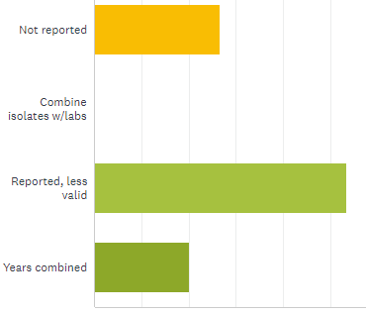
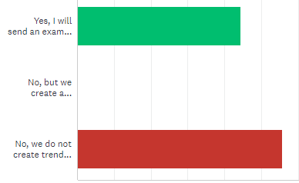
Lab Survey Results, cont.
Antibiogram available to:
N = 16/22
Protocol for Isolates in small quantities
Trend Graphs
Small isolate number open-ended responses:
  No response/unknown: 31.25%
  No limit: 6.25%
  1 isolate: 6.25%
  10 isolates: 6.25%
  30 isolates: 37.5%
  50 isolates: 6.25%

Slide 14
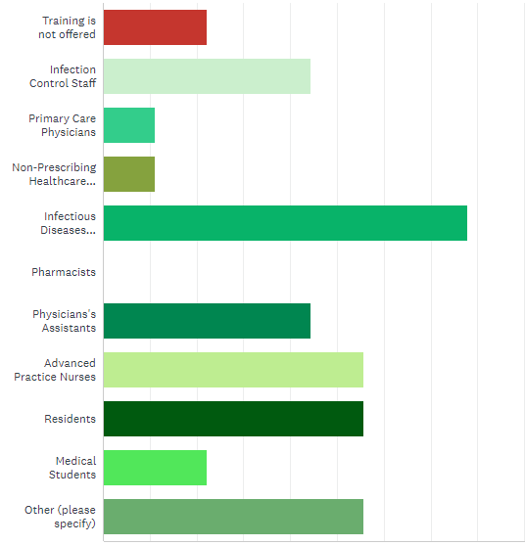
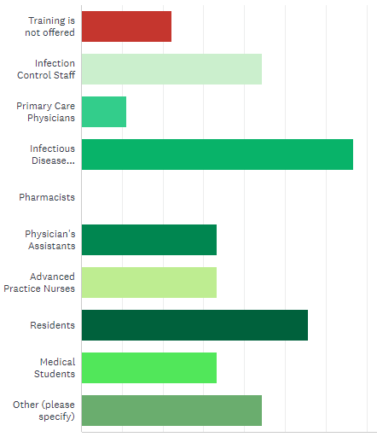


Health Care Facility Survey Results
22.2% of hospitals don’t regularly conduct antimicrobial stewardship training
66.7% overall conduct antibiogram tool (all facility specific)
  85.7% of those who conduct regular antimicrobial stewardship training
Typical Training Participation
Antibiogram Training Participation

Slide 15
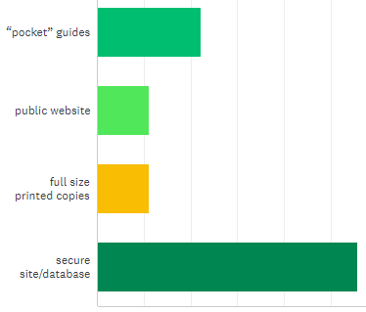
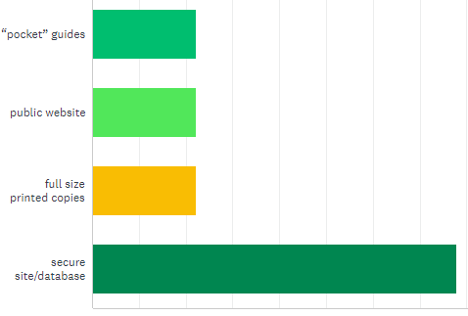
Health Care Facility Survey Results, cont.
N = 9/37
88.9% review annually; 11.1% review biannually
Hospitals rated 4.0/5.0 usefulness
Primary Distribution Method
All Distribution Methods Used

Slide 16
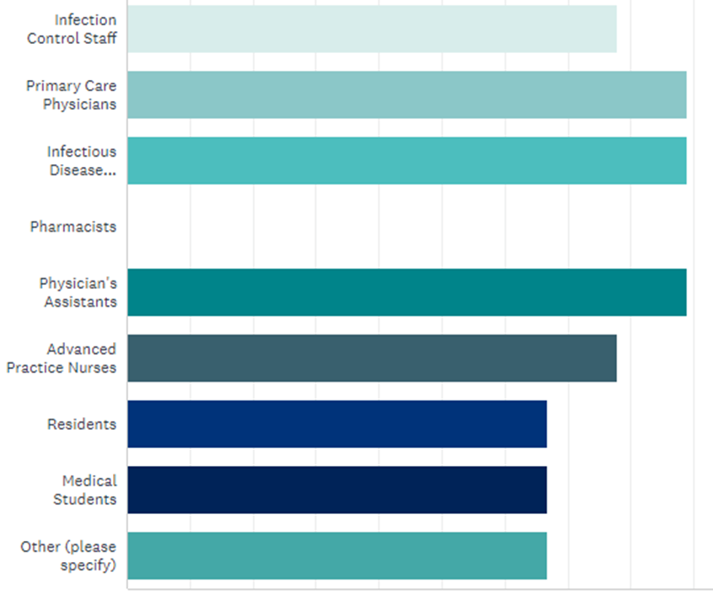
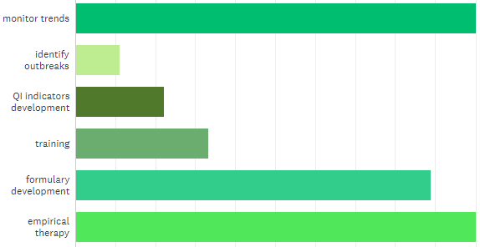

Health Care Facility Survey Results – Antibiogram Usage
Antibiogram Accessibility
Antibiogram Use

Slide 17
Thank you!

