Slide 1


Intentional Self-Directed Firearm Injuries in AZ
A Syndromic Surveillance Data Snapshot

Slide 2



ABOUT
AVERT
AVERT = Advancing Violence Epidemiology in Real Time
Sharing data to improve syndrome definitions, data collection methods, analysis of surveillance data, and presentation and dissemination of findings to inform violence prevention efforts
Strategies:
Increase the timeliness of aggregate reporting of ED visits for firearm (regardless of intent), other violence-related injuries, and mental health conditions
Disseminate surveillance findings in a timely way to the public and key partners working to prevent or respond to violence

Slide 3

METHODS
Data Source: ESSENCE Syndromic Surveillance
Site: Arizona
CCDD: CDC Intentional Self Directed Firearm Injury v1
Years: 2018-2022
Has been emergency: Yes

Slide 4
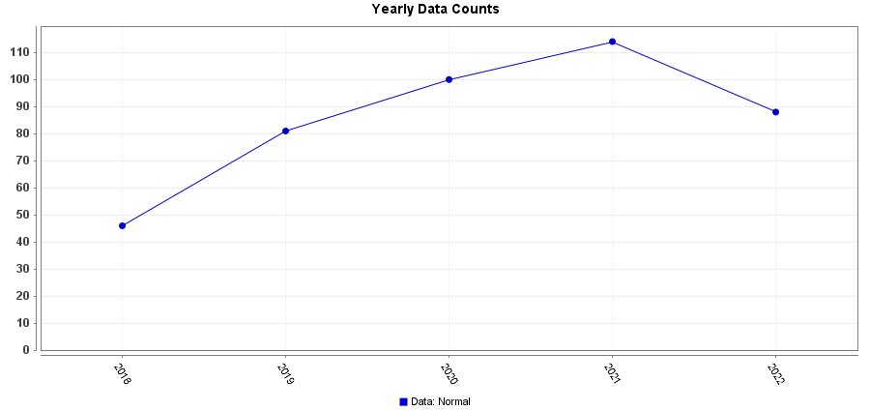
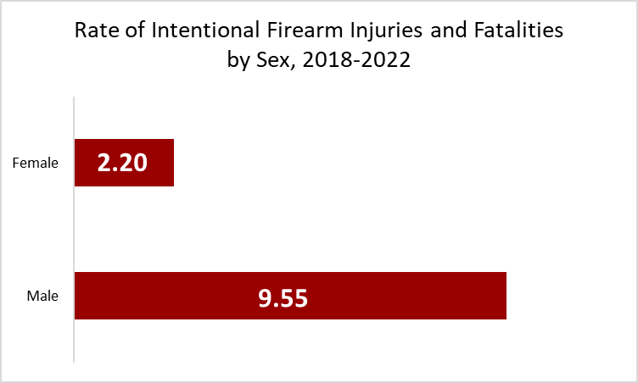
RESULTS
From 2018-2022, a total of 429 fatal and non-fatal intentional self directed firearm injuries were seen according to ESSENCE
SEX
From 2018-2022, there were a total of 343 injuries (80.0%) amongst males and 80 (18.6%) among females.
Males are 4 times more likely to experience an intentional self directed firearm injury
Data Source: ESSENCE 2018-2022
Notes:
In 2020, Arizona attained approximately 98% coverage of emergency departments. This ensured a robust dataset for validation purposes.

Slide 5
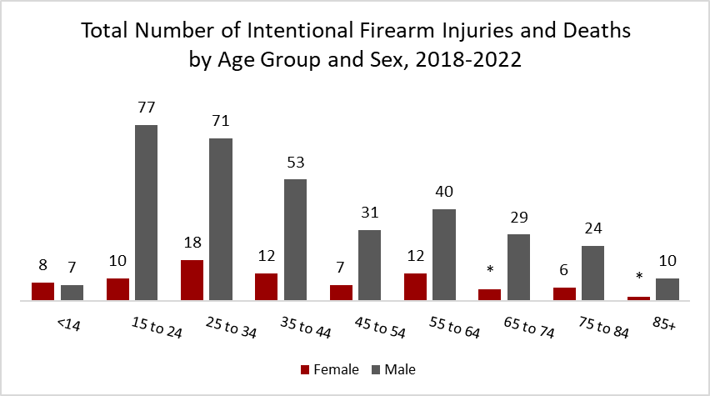
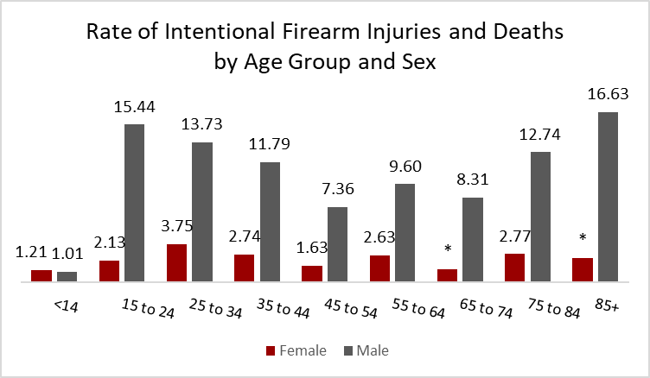
AGE GROUP & SEX
The age group with the highest count of intentional self directed injuries are males aged 15 to 24 (n=77), followed by males aged 25 to 34 (n=71).
Males aged 85+ (16.63 per 100,000) and between the ages of 15-24 (15.44 per 100,000) have the highest rate of intentional self directed firearm injuries
Data Source: ESSENCE 2018-2022
* Indicates count less than 6

Slide 6
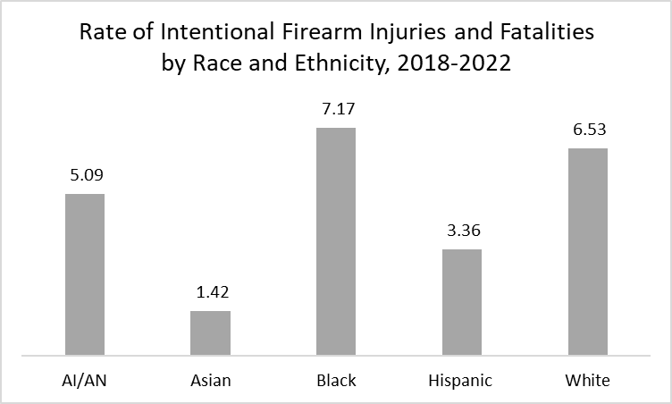
RACE & ETHNICITY
Those who identified as Black/African American saw the highest rate of intentional firearm injury (7.17 per 100,000) followed by those who identified as White (6.53 per 100,000).
There are discrepancies in the race categorization, 11% of cases were categorized as missing, unknown, or mixed race.
Data Source: ESSENCE 2018-2022

Slide 7
Those who experience the highest yearly average rate of fatal and nonfatal intentional firearm injuries…
SUMMARY
Though this syndrome definition is not perfect, we are able to get a snapshot of what intentional firearm injuries look like in Arizona
Males in Arizona experience nearly 4 times the number of fatal and nonfatal intentional firearm injuries compared to females
Male Arizonans ages 85+ and 15-24
Black Arizonans

Slide 8
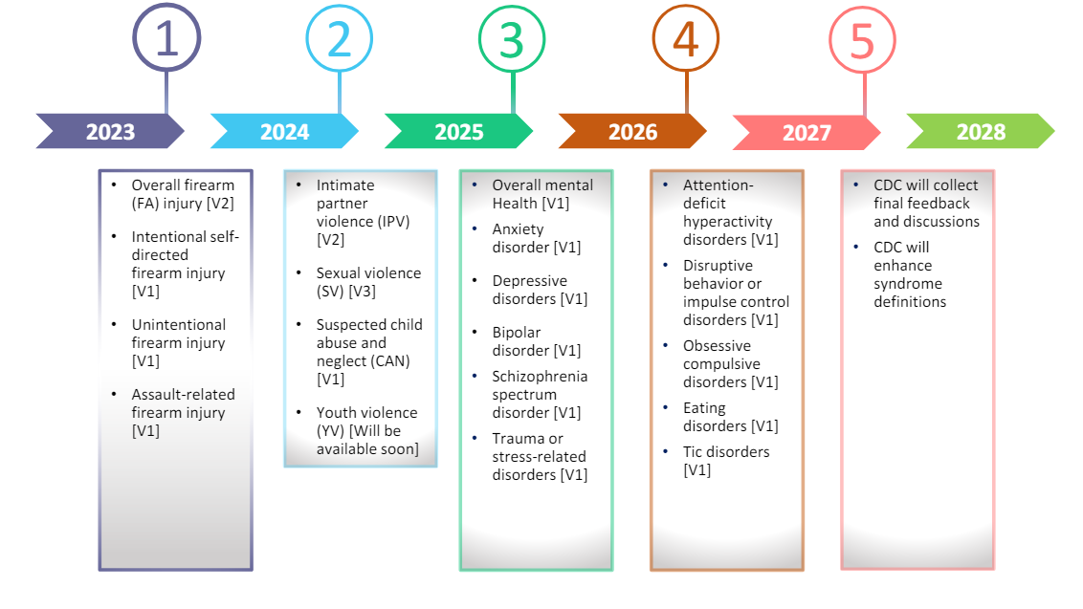
AVERT
VALIDATION SCHEDULE

Slide 9
VALIDATION FINDINGS
In total, 391 visits were reviewed from January 1, 2020 - December 31, 2023
The AZ syndromic team and AZ AVERT team conducted a comprehensive review of all visits from 2020-2023 due to the limited number of visits during that time period.
Positive Predictive Value = 88.265
We did believe this query broadly captures intentional self directed firearm injury
Clear False Positives:
One visit that was death by cop
Some visits did not have related ICD-10 codes, typically included nausea and vomiting due to triage notes including ‘X72’ which is nurse shorthand for symptoms lasting 72 hours
Some visits included ideation, but no actual injury
Notes:
In 2020, Arizona attained approximately 98% coverage of emergency departments. This ensured a robust dataset for validation purposes.
Keywords to Exclude
Post OP
Gun malfunction
Cleaning gun
Got shot, starting shooting
Missed
Unloaded

Slide 10



FUTURE CONSIDERATIONS
An improved syndrome definition will lead to more accurate identification of cases
Free text fields were crucial in determining intent (Triage notes)
Many cases had CCDD coded with intentional and unintentional firearm injury, more education and training for coders
Data Linkage: SyS with HDD
Utilize CDC Intentional Firearm definition to write code and identify cases

Slide 11


THANK YOU
Tessa Saturday, MPH | tessa.saturday@azdhs.gov
Injury & Violence Epidemiologist
Buruea of Assessment & Evaluation

