Slide 1

Syndromic Surveillance and Outbreak Response
Coconino County, 2024

Slide 2
Before we get started…
Thanks to…
  ADHS VPD/Food and Water Teams
  ADHS CI CT
  ADHS SyS
  Maricopa County Surveillance Team
  Counterparts at
    Flagstaff Medical Center
    Tuba City Regional Healthcare Corporation

Slide 3
Coconino Outbreaks - 2024
Measles – Flagstaff, March 2024
Norovirus – Havasu Falls, June, 2024
  Not CCHHS Jurisdiction

Slide 4
2024 Coconino Measles Outbreak
March 2024 – 2 cases of measles reported to CCHHS
  1 confirmed, 1 probable
Measles - highly contagious, can cause severe disease
  Early symptom can be general: Fever, cough, runny nose
  3-7 days after initial symptoms, rash forms
Cases are contagious from 4 days before until 4 days after rash onset
Can remain airborne and infectious for two hours

Slide 5
2024 Coconino Measles Outbreak
Public Health Actions
  Contact Tracing
  Exposure Notification to contacts
  Symptom monitoring of contacts
  Communication with public and partner organizations
Confirmed case visited four public places during infectious period
  ~ 100 exposures

Slide 6



2024 Coconino Measles Outbreak
Early detection of additional measles cases was essential for effective public health response

Slide 7
2024 Coconino Measles Outbreak
Developed “Measles-like” query in NSSP to flag ED visits that could potentially be measles
  CDC pre-defined measles syndrome was too specific
  Relies on CC to mention measles specifically or have a measles DD
CCHHS query was designed to catch measles cases in the early stages of symptom onset

Slide 8
CCHHS Measles-Like Syndrome Definition
CC and DD Category Free Text
^measl^,OR,^measel^,OR,^mees^,OR,^measul^,OR,(,^fever^,AND,^rash^,),or,^rubeola^,or,^B05^,OR,(,^fever^,AND,^coryza^,),OR,(,^fever^,AND,^conjunctivitis^,),OR,(,^fever^,AND,^koplik^,),OR,(,^fever^,AND,^cough^,AND,^rash^,),OR,^CDC Measles CCDD v1^
Also Apply To: Chief Complaint Orig Free Text, Chief Complaint Combo Free Text, Triage Notes Orig
Applied to all facilities in Coconino County

Slide 9
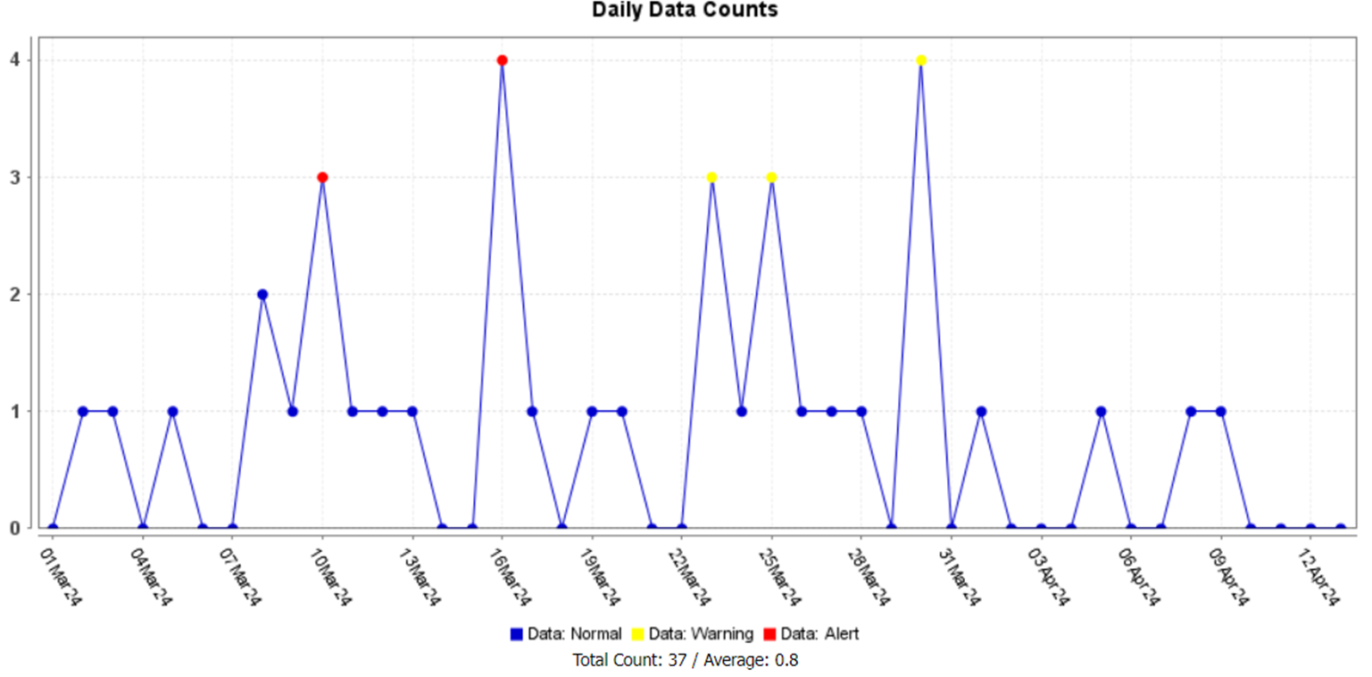
CCHHS Measles-Like Syndrome Time Series, March 1st - April 13th

Slide 10
2024 Coconino Measles Outbreak:
SyS Data into Action
Each ED visit flagged by measles-like query was manually reviewed by CCHHS
CCHHS provided a line list of suspicious visits to ADHS for review
  ADHS reviewed clinically relevant variables in ESSENCE data details to determine if follow-up with health care facility was required
  ADHS leveraged HIE to access medical records for some cases
Facilities were provided ESSENCE ID, medical record number, and personal identifiers
  Requested documentation related to cases that warranted follow-up
  Reviewed with support from ADHS

Slide 11
2024 Coconino Measles Outbreak:
SyS Data into Action
Result of SyS Effort: Proactive Instead of Reactive
Large majority of measles-like syndrome matches that were suspicious had measles testing ordered by provider
Medical record review allowed for early notification to ADHS and ASPHL that samples were submitted for measles testing
CCHHS was able to provide ADHS clinically relevant information regarding submitted samples

Slide 12



SyS : Grand Canyon Surveillance

Slide 13
Grand Canyon Surveillance
CCHHS was able to leverage SyS to identify a case associated with Havasupai unknown GI outbreak (May-June 2024, > 50 cases)
Non-resident, informed LHD resident was affected
Reached out to treating facility request clinical documentation of lab testing and diagnoses
  Norovirus +
Informed ADHS and Havasupai tribe on clinical findings
  Additionally case came back Norovirus +
  State and tribe were able to develop appropriate response

Slide 14
Grand Canyon Surveillance
Surveillance does not need to be limited to health conditions
Grand Canyon is a location of interest
  Acute Injury
  Heat Injury
  Rabies exposure
  GI outbreaks
CCHHS can leverage SyS to monitor ED visits that are associated with the Grand Canyon and use data to inform external partners

Slide 15
Grand Canyon Surveillance: CCHHS Grand Canyon Query
CC and DD Category Free Text
^havasup^,OR,^grand canyon^,OR,!river!,OR,^supai^,OR,!GC!
Also Apply To: Triage Notes Orig, Chief Complaint Combo Free Text

Slide 16
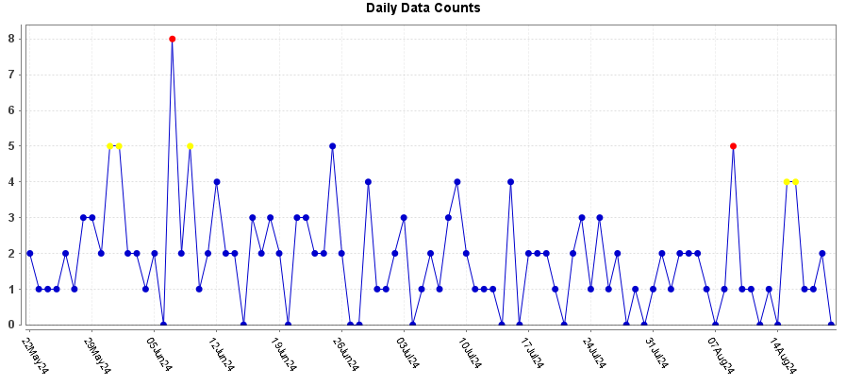
CCHHS Grand Canyon Query Time Series

