Slide 1


Syndromic Surveillance
Exploratory Analysis
AUGUST 21ST 2024

Slide 2



Syndromic Surveillance
Exploratory Analysis
Name
Jurisdiction
Job Title
Favorite Olympic Sport

Slide 3

Exploratory Analysis
Agenda
Intro & Welcome
Updates
  DQ & Onboarding
  NSSP updates
Diamond Shuumz
Presentation
Trending Topics/Questions/Open Mic

Slide 4
Updates
Data Quality
Low Completeness for Free text variables for Banner facilities
  Banner Lindsey and University
  Banner Cave Creek and 7th
No messages from Mt. Graham for 3 days (July 16th-18th)
Yavapai
Summit Facility
Notes:
Banner UC - Cave Creek and 7th St: No messages received in the past 14 days. Clinic has been closed due to provider shortages, this has been submitted to AZDHS.
Banner UC - Lindsay and University: No messages received in the past 38 days. Clinic has been closed due to provider shortages, this has been submitted to AZDHS. This clinic will be permanently closed starting 8/17/24, letter has been submitted to AZDHS.
Yavapai was experiencing Timeliness issues, where approx 60% of messages were late, this
Mt Graham saw a disruption of data from July 16-18th due toMeditech had a system update which most likely interrupted the connection feed, since the data has been backfilled from those missing days
Summit Had A Facility Type Code ERROR
This graph shows completeness from May 1, 2024 to June 25, 2024. There have been improvements in diagnosis code, diagnosis description and admit reason description. These variables are now at around 20% completeness. CDC encourages these variables to be at 80% completeness. There have also been improvements in the completeness of chief complaint and chief complaint text. These variables are now at 99%.
Kingman Regional Medical Center - Has had some delays recently, as of yesterday it has been over 48 hours since a file was sent

Slide 5
Updates
Onboarding
Sage Memorial
La Paz
Benson
Notes:
Sage Memorial-
we have connectivity now for MEDITECH Syndromic Files and to the NSSP.
Has been testing data first batches of Prod data to the site. The files should be there as we confirmed delivery on our side.
Deliveries should continue each hour with Prod data to the staging server.
sending production level data to this location for a data validation review. When sending files please change the file extension to '.HL7' so that our system can process the files.
Production Data being sent is being reviewed to ensure validation and completeness
the report, I want to point out that red/yellow fields need to be addressed as we want to have completeness percentages over 80% with valid submissions.
Benson Hospital Working on- We would want to inform you all that we are working with our development team to know if we can make the Admit reason and Discharge diagnosis field as required. We will keep you updated.
La Paz Regional Hospital to inform you that we are switching EHR systems from CPSI to Meditech.

Slide 6
Updates
Arizona
August 15th IPAC Conference mini AVERT conference occurred.
  Event Featured a deep dive into new data and possibilities from ADHS’s work with CDC’s Advancing Violence Epidemiology in Real-Time (AVERT)
Slides and Recording of event now available
Notes:
IPAC Conference
Event featuring a deeper dive into new data and possibilities from ADHS’ work with CDC’s Advancing Violence Epidemiology in Real-Time (AVERT). AVERT uses ICD-10 codes and medical documentation from hospital and emergency facilities to identify target events within communities, called syndromes. These data can be less accurate than other sources but allow more rapid response to changing trends. We’ll explore upcoming syndromic data definitions that can be utilized and gather input on questions, gaps, and population needs that they can be used to address.
Including Guest speaker Dr. Brooks-Russell associate professor at Colorado School of Public Health and is the director of the Injury, Violence and Prevention Center.

Slide 7
Updates
NSSP
New CCDD categories available
  Acute Hepatitis B V1
  Cholera V1
  Dengue V1
  Ebola v1
  Hemolytic Uremic Syndrome v1
  Malaria v1
  Malburg v1
  Meningococcal Disease v1
  Poliomyelitis v1
  Zika v1
Notes:
The following new ESSENCE CCDD categories that are part of the rapid reportables project, which seeks to create queries for all National Notifiable Diseases defined by the National Notifiable Diseases Surveillance System (NNDSS).will be ready for use:
Acute Hepatitis B v1
Cholera v1
Dengue v1
Ebola v1
Hemolytic Uremic Syndrome (HUS) v1
Malaria v1
Marburg v1
Meningococcal Disease v1
Poliomyelitis v1
Zika v1
All can be found on ESSENCE CCDD category , as well as the Fact Sheets

Slide 8
Updates
NSSP Updates
New Slack Channels
  Emerging -Topics
    Place to Discuss new an emerging health trends or topics of interest
    I.E. updating new queries like Diamond Shruumz
  Share Subcommittee (Syndromic Health Data Access, Reporting and Exchange)
Subject Matter Expert Database
Notes:
Subject Matter Expert Database-This database contains self-identified subject matter experts in a variety of topic areas related to syndromic surveillance. Thank you to all of the CoP members who submitted their information! The database can be viewed at the link. Contains a list of individuals, their jurisdiction, contact information as well as their area of expertise.

Slide 9
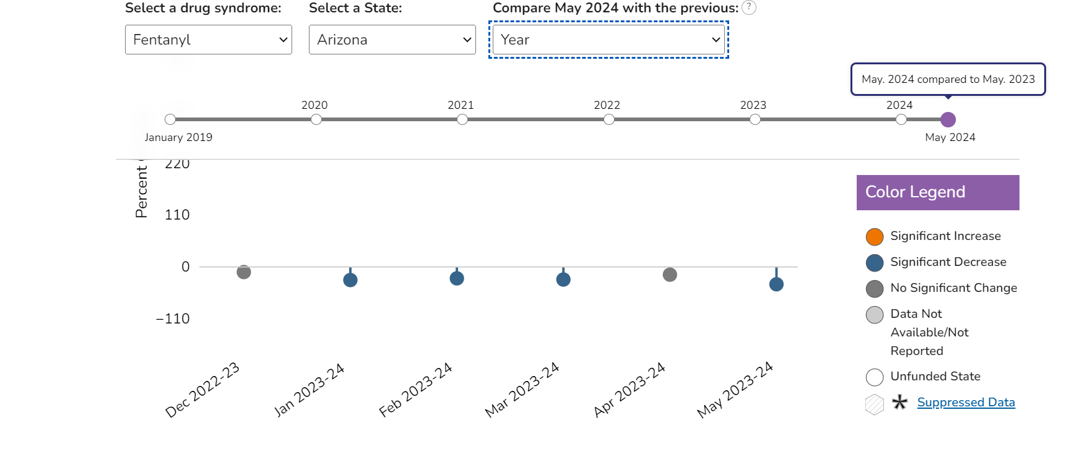
Updates
DOSE Dashboard
Notes:
The DOSE team just launched a new dashboard that features 8 syndrome definitions, ( 4 new syndromes: fentanyl, methamphetamine, cocaine, and benzodiazepine; and 4 revised: all drugs, all opioids, heroin, and all stimulants) for DOSE data from January 2018-May 2024, Historic data on the original four syndrome definitions were updated using revised syndrome definitions. Revised syndrome definitions fully incorporate the nesting of our syndrome definitions and more accurately process EHR data. This dashboard will be updated monthly throughout the OD2A-S NOFO period.
What is new in the DOSE syndromic dashboard:
8 overdose syndromes (4 new, and 4 revised), with % change in rates by month and month/year
New data from July 2023 – March 2024
Expansion from 42 states and District of Columbia to 47 states and the District of Columbia
New diagram depicting nesting of our syndrome definitions:

Slide 10
Using Syndromic Surveillance
Diamond Shruumz Investigation
As of August 16th, 145 total illnesses, including 59 hospitalizations have been reported in 29 U.S. States.
On June 2024 ADHS was notified of persons experiencing health outcomes after ingesting a Diamond Shruumz brand product containing a proprietary blend of mushrooms.
We developed a syndromic surveillance free text query to search ED visits for potential cases.
Major Symptoms include: Seizures, Decreased level of consciousness, respiratory failure
Notes:
Using Syndromic Surveillance for potential case finding in the case of the Diamond Shruumz investigation”
In June 2024, Arizona had the first cluster of four persons requiring medical evaluation and
hospitalization after ingesting a mushroom-infused chocolate bar from the brand Diamond
Shruumz™, contributing to the initiation of a nationwide recall and ongoing public health
response to identify additional cases.
As of August 16th 11 confirmed cases in AZ
Case classification in AZ
A case that has at least one of the following signs/symptoms from the moderate/major clinical effects category OR was hospitalized after product consumption (within 24 hours) OR died with a cause of death related to product consumption.
Major Symptoms:
Seizures, altered level of consciousnes, respiratory failure, confussion, fever or chills, abnormal deep tendon reflexes, clonus, muscle rigitiy
Minor: Symptoms: Nausea, Vomiting, Abdominal pain, Hallucination, uncontrolled movements, abnormal heart rate, high or low blood pressure, excessive sweating or secretions, headache,
Exposure Criteria
A case that reports consuming a Diamond Shruumz-branded microdosing product (chocolate bars, cones, gummies or other) OR another chocolate product marketed as containing mushrooms, during January 1, 2024 through the present.

Slide 11
Diamond Shruumz Investigation
Method:
  Data Source: ESSENCE Syndromic Surveillance
  Site: Arizona
  Syndrome Definition/Query: (,(,^t62.0^,^t620^,t62.0X1A^,),and,(,^trip^,^overdose^,^F1[0-9]^,^t509^,^t50.9^,^t4[03]^,^T3[6-9]^,^T4[0-9]^,^T50^,^T40.7^,^T407^,^T43.[89]^,),),or,(,^shroom^,and,(,^d[iam]ond^,^micro^,^trip^,^high^,^halluc^,^microdose^,^f1[69]^,^r41.82^,r4182^,^r56.9^,^r569^,^r25.8^,^r258^,^t40.9^,^t409^,^91175000^,^229006007^,^overdose^,),),or,^shruumz^,or,^using mush^,^used mush^,^doing mush^,^did mush^,^did some mush^,^taking mush^,^took mush^,^ shroom^,^mushrooms^,^microdosing^,
  Time Frame: January 1st, 2024 - July 1st 2024
Notes:
Initially adapted a free-text query found on the NSSP slack channel and included key words related to investigation such as, diamond shruumz, microdosing, chocolate, ect.
At this time, July first there were already 6 confirmed cases in Arizona
Applied query to the CC and DD Parsed FreeText, Clinical Impressions, Triage Notes Orig, Chief Complaint History and Chief complaint orig
Marked Has been E

Slide 12
Diamond Shruumz
Results
From January 1st, 2024- July 1st 2024
  Returned 189 visit
Examined line level data for each visit
  Initially found 12 visits to meet criteria as a potential case
  Found 4 confirmed cases
  6 visits were sent to PCC
Chief Complaint Text mentioned
  “Eating chocolate bar with hallucinogenic mushroom”
  “EMS for OD of "Diamond Mushroom Chocolates."
  “admits to taking "over the counter microdosing mushrooms"
Notes:
Based on the line level data from visits those that most accurately reflected the consumption or symptomatology details (from the chief complaint or discharge diagnosis) were considered to be related to this outbreak will be considered potential cases.
From Query we found 12 visits to meet criteria as a potential case.
From line level data 4 visits matched up with confirmed cases, by data, hospital, age and description.
Those visits that displayed moderate to major clinical effects were sent to Poison Control Center PCC for medical review. From there PCC would find out if that the visit involved the Diamond Shruumz products, they will reach out to the case to complete the same URL REDCap survey. ADHS will determine the case classification based on the information provided.
Currently 2 confrimed cases found from SyS list

Slide 13
Diamond Shruumz
Summary
Syndromic surveillance is a useful tool in investigations, especially utilizing free text queries to adapt to changing situations.
Next Steps
  Continue to monitor ED visits for other potential cases
  Look Back into 2023
Notes:
Special Thanks to Epi investigation team including
Lead Heather Walker,
Jamaica Dillard,
Laura Rust and Traci Plummer
Also NSSP CoP as well as Gabe Haas for providing updated queries to use for the Diamond Shuumz investigation.

Slide 14


Presentation
Jacob Hojnacki and Coconino County on their work using Syndromic Surveillance

Slide 15

Questions/ Open Forum

Slide 16


THANK YOU
Syndromic Surveillance | syndromicsurveillance@azdhs.gov

