Slide 1

Syndromic Surveillance Roadmap to Success
Arizona Syndromic Surveillance Onboarding Process Overview
ADHS Syndromic Surveillance Program
Eli Price (Electronic Disease Surveillance Program Manager)
Krystal S. Collier (Syndromic Surveillance Program Coordinator)
Yong Wang (HL7 Data Analyst)

Slide 2

Overview of Syndromic Surveillance
What is Syndromic Surveillance?
  Hospital visit information used to monitor the health of a community and discover trends in hospital visits for conditions of interest
    Originally developed for early detection of a large-scale release of a biologic agent (i.e. anthrax)
    Expanded to a wider range of public health concerns
  All ED and inpatient visits from participating facilities
    Not just reportable conditions
  Syndrome-based
    A group of symptoms that consistently occurs together or a condition characterized by a set of associated terms
  Primary fields of interest: chief complaint and diagnosis codes
  “Quick and dirty”
    Timeliness over accuracy, reported multiple times a day
    Information available to public health before a diagnosis and/or lab result

Slide 3
Overview of Syndromic Surveillance
Type of Data Collected
  ED visit & inpatient visit (not outpatient)
  All visit data (i.e. not restricted by reportable conditions)
    Medical record number
    Age
    Race/ethnicity
    Vitals
    NOT: Patient name
Typical Use Cases: Monitoring Disease Trends
  Infectious disease outbreak detection
  Mass gathering surveillance
  ILI surveillance

Slide 4




Overview of Syndromic Surveillance
Syndromic Data Flow
Hospital Reporter
EHR Vendor Hub
Public Health Node
PH Data User

Slide 5
Overview of Syndromic Surveillance
Syndromic Data Flow
Hospital Reporter
EHR Vendor Hub
Public Health Node
PH Data User
Does not replace MEDSIS and other reporting systems in AZ
  Records are not sent/reviewed individually
  Instead, records are sent automatically and public health users look for specific conditions depending on current public health needs
Notes:
MEDSIS: Medical Electronic Diseases Surveillance Intelligence System
https://www.azdhs.gov/preparedness/epidemiology-disease-control/infectious-disease-services/index.php#medsis-home

Slide 6
Overview of Syndromic Surveillance
Syndromic Data Flow
Hospital Reporter
EHR Vendor Hub
Public Health Node
PH Data User
Data Providers will be responsible for ensuring that files are sent to the BioSense Platform (the Public Health Node used in AZ)
Notes:
Hospitals and emergency departments, also referred to as Data Providers.

Slide 7
Overview of Syndromic Surveillance
Syndromic Data Flow
Hospital Reporter
EHR Vendor Hub
Public Health Node
PH Data User
BioSense Platform is a cloud-enabled web application providing commercial hosting, provisioning, and support for SS Data
Data sent to the BioSense Platform is processed and pushed into a tool called ESSENCE, which public health uses to view the data
Notes:
BioSense Platform is a cloud-enabled web application providing commercial hosting, provisioning, and support for SS Data. The National Syndromic Surveillance Program (NSSP) supports the BioSense Platform and improvements in the national public health surveillance infrastructure’s ability to monitor the scope and severity of potential threats to public health. This system ultimately provides a regional and national depiction of multiple health outcomes and syndromes. The BioSense Platform is the reporting method for the State of Arizona to continually receive and maintain SS data reported by hospitals. BioSense Platform is a national system sponsored by the Centers for Disease Control and Prevention
(CDC).

Slide 8
Overview of Syndromic Surveillance
Syndromic Data Flow
Hospital Reporter
EHR Vendor Hub
Public Health Node
PH Data User
Public health uses the ESSENCE tool in the BioSense Platform to view the data
If there is something that public health needs to follow up on, the local public health jurisdiction will reach out to the hospital for follow-up

Slide 9
Onboarding Documents
Data User Agreement (DUA) Contact Request Form
BioSense Platform Data Provider Implementation Resources v2
Arizona Syndromic Surveillance Implementation Guide (AZSSIG), Version 2.0
Hospital Roadmap to SS Success (Check List)
SS Implementation Process (Workflow Diagram)
Hospital Implementation Clinical Questionnaire v5
BioSense Platform MFT Template
Notes:
For additional information about HIPAA Privacy Rule and Public Health, you can reference this link: https://www.cdc.gov/privacyrule/guidance/PRPH.htm
For additional information about the Data Use Agreement, please contact syndromicsurveillance@azdhs.gov

Slide 10
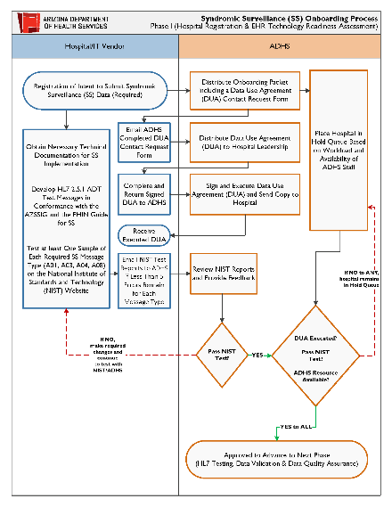
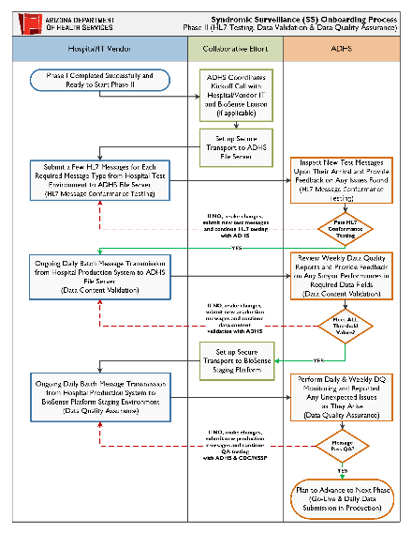
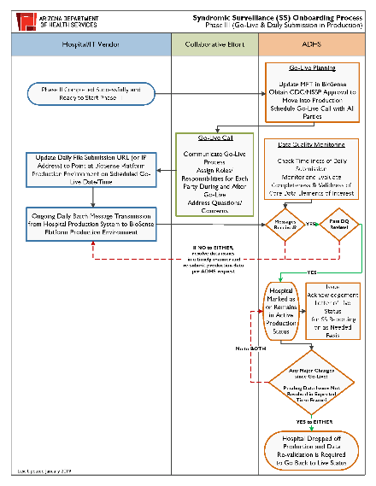
Implementation Process
“Swim Lanes”
  Each of the columns specifies who is responsible for which part of the onboarding process
Hospital/IT Vendor
ADHS
Collaborative Effort

Slide 11
Implementation Process
Phase I: Preparation
  Hospital Registration
  EHR Technology Readiness Assessment
  Onboarding Kick-Off
Phase II: Testing
  HL7 Message Conformance Testing
  Data Content Validation
  Data Quality Assurance
Phase III: Production
  Go-Live
  Daily Data Submission in Production
  Drop Off & Revalidation

Slide 12
PHASE I: Preparation
Hospital Registration
EHR Technology Readiness Assessment
Onboarding kick-off

Slide 13
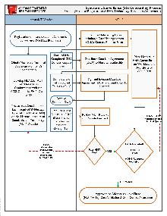
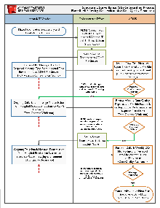
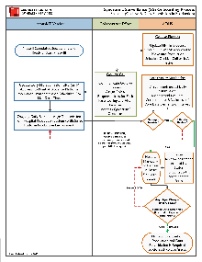
Registration & Data Use Agreement
PHASE I
Go to ADHS Meaningful Use/Promoting Interoperability Home Page to register your intent to submit Syndromic Surveillance (SS) data.
Complete Data Use Agreement (DUA) contact form and send to ADHS to initiate the DUA process. The DUA will then be distributed to hospital leadership for review and signature.
Hospital leadership and data managers are encouraged to learn how your hospital’s SS data is being collected, evaluated, shared, and stored on cloud-based public health surveillance system.
  BioSense Platform
  National Syndromic Surveillance Program (NSSP) Fact Sheet
ADHS will send a copy of executed DUA to hospital partner after it has been signed by both parties and is made effective.
Hospital will be placed in ADHS SS implementation hold queue pending DUA execution status, EHR readiness assessment results and ADHS resource availability.
PHASE II
PHASE III
Notes:
Registration of Intent: Active Engagement, Option 1, from the Centers for Medicare and Medicaid Services Promoting Interoperability Programs.
Data Use Agreement: Hospitals sign a Data Use Agreement (DUA) with ADHS to submit SS data to the BioSense Platform. Local Public Health Jurisdictions (LPHJs) sign a DUA with ADHS before gaining access to the data reported by hospitals. The signing of DUAs completes the legal and administrative duties associated with SS data exchange. LPHJs and ADHS are granted access
to the data in two formats: 1) a Visualization Site; 2) the data stored in the jurisdictional database view. The jurisdictional database view is a state-controlled area which contains all the SS data reported by Arizona hospitals to BioSense Platform. ADHS and LPHJs staff will utilize this information to support fulfillment of the CDC’s Ten Essential Public Health
Services.

Slide 14
EHR Readiness Assessment
PHASE I
Obtain necessary technical documentation for SS implementation
  Arizona Syndromic Surveillance Implementation Guide (AZSSIG), Version 2.0
  Public Health Information Network (PHIN) Messaging Guide for Syndromic Surveillance: Emergency Department, Urgent Care, Inpatient and Ambulatory Care Settings, Release 2.0 (April 2015)
  Erratum to the CDC PHIN 2.0 Implementation Guide August 2015
  NIST Clarifications and Validation Guidelines for Syndromic Surveillance Certification Testing, Version 1.6, October 2017
Develop HL7 2.5.1 ADT test messages in conformance with the AZSSIG and the PHIN Guide for SS
Test at least one sample of each required message type (A01, A03, A04, A08) on the National Institute of Standards and Technology (NIST) website
Continue NIST testing until less than 5 errors remain for each message type then email NIST test reports to ADHS for review
PHASE II
PHASE III

Slide 15
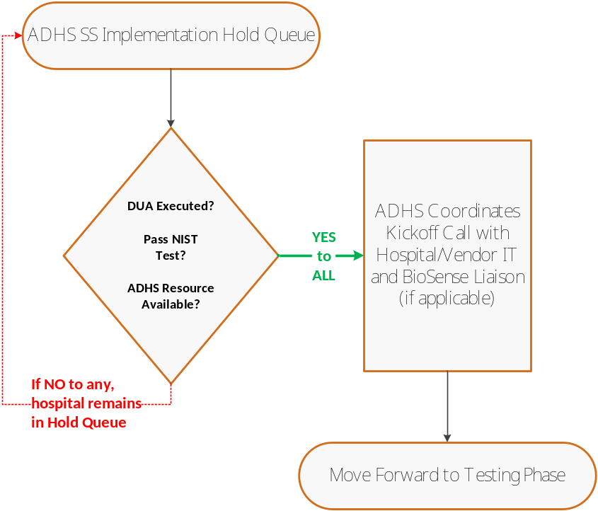
Onboarding Kick-Off
PHASE I
ALL of the following conditions have to be met in order for hospital partner to move forward to the next phase
  DUA has been executed
  NIST test completed successfully
  ADHS resource available per ADHS work prioritization orders
Special considerations for ADHS onboarding work prioritization process
  Visit volume
  Geographic representation
  Facility type
  EHR/SS reporting product readiness
ADHS will contact the next targeted hospital partner and coordinate the Kick-Off call to begin testing and validation
PHASE II
PHASE III

Slide 16
PHASE II: TESTING
HL7 Message Conformance Testing
Data Content Validation
Data Quality Assurance

Slide 17
Kick-Off Meeting
PHASE I
ADHS will send invitation to your hospital implementation team and any IT/EHR vendor staff you deem appropriate for the Kick-Off call
Kick-Off meeting agenda may include but not limited to the following topics
  ADHS onboarding process overview
  Project expectations
  Review questions in Hospital Implementation Clinical Questionnaire
  Re-confirm the designated Data Manager and Primary Technical Assistance
  Coordinate date to submit test messages to ADHS sFTP server
PHASE II
PHASE III

Slide 18
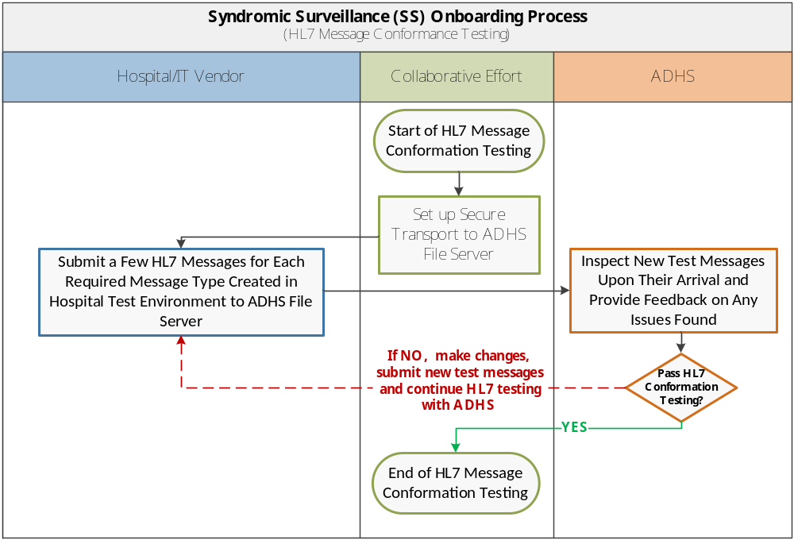
HL7 Message Conformance Testing
PHASE I
Source Data: HL7 2.5.1 ADT messages of each required message type (A01, A03, A04, A08) developed using test or training data in batch format
Sending System: Hospital Testing Environment
Receiving System: ADHS sFTP File Server
Batch File Submission Frequency: At least one batch file is required for each iteration of testing and feedback with ADHS until completion
PHASE II
Evaluation Scheme
Objective: Assessing test messages developed by hospital partners to ensure their conformance with the HL7 specifications from Arizona Syndromic Surveillance Implementation Guide (AZSSIG) & Public Health Information Network (PHIN) Messaging Guide for Syndromic Surveillance
Software Tool/Method: HL7 analyzer tool built locally for HL7 ADT message inspection and error detection; List of errors reported as well as desired data output will be provided in message feedback to hospital partner to implement necessary changes
Completion Criteria:
  No major HL7 structural errors found in ALL message types
  Proven capability to send ALL required data elements in accordance with AZSSIG & PHIN Guide for SS
PHASE III

Slide 19
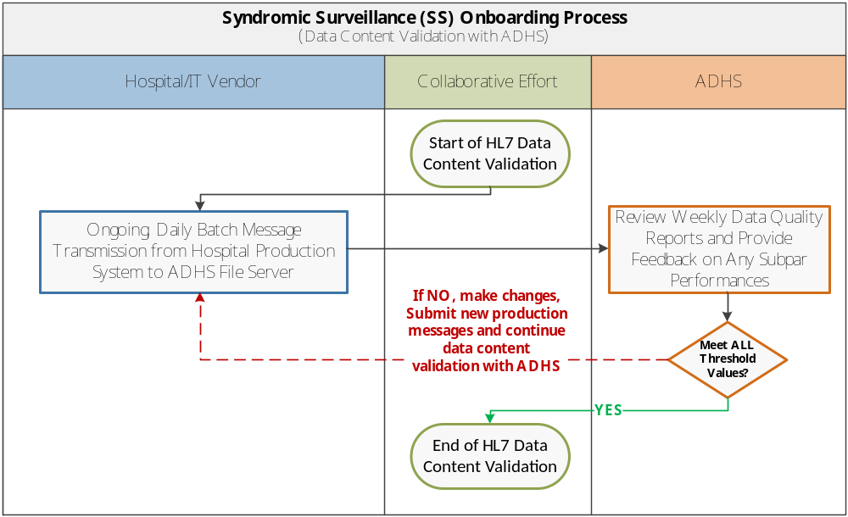
Data Content Validation with ADHS
PHASE I
Source Data: HL7 2.5.1 ADT messages of each required message type (A01, A03, A04, A08) created using production data in batch format
Sending System: Hospital Production Environment
Receiving System: ADHS sFTP File Server
Batch File Submission Frequency: One batch file expected for every 6 hour at minimum
PHASE II
Evaluation Scheme
Objective: Evaluating data quality for SS data elements of interest found in hospital production messages in terms of their completeness & validness
Software Tool/Method: Weekly HL7 data quality reports generated By R-based SS HL7 data content validation process scheduled to run on local workstation; Subpar performance in ANY required data field will be flagged in the results sent back to hospital partner for immediate attention and improvement
Completion Criteria:
  Percentage of completeness and validness for ALL core data elements of interest consistently meet or exceed pre-determined threshold values tailored to hospital capabilities
PHASE III

Slide 20
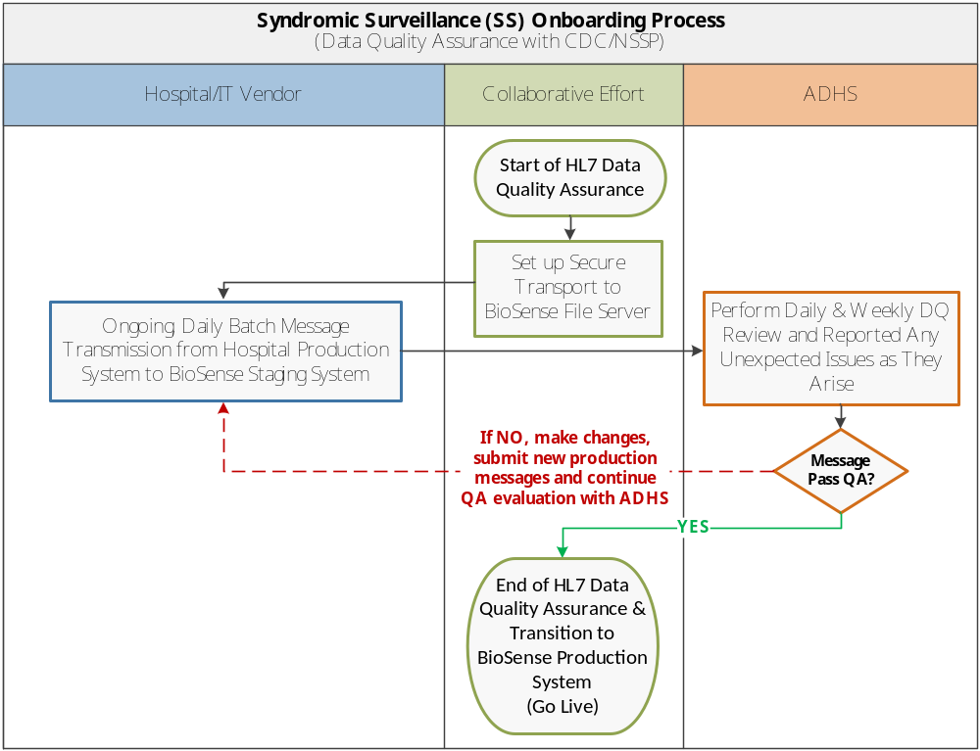
Data Quality Assurance with CDC/NSSP
PHASE I
Source Data: HL7 2.5.1 ADT messages of each required message type (A01, A03, A04, A08) created using production data in batch format
Sending System: Hospital Production Environment
Receiving System: ADHS sFTP File Server
Batch File Submission Frequency: One batch file expected for every 6 hour at minimum
Evaluation Scheme
Objective: Ensure consistent & timely data submissions in CDC/NSSP BioSense Platform as well as same level of data quality consistency found in hospital production messages as observed in validation with ADHS
Software Tool/Method: NSSP staging data quality reports in conjunction with locally implemented data quality monitoring applications; Any unexpected drop in daily file submissions or/and data quality measures will be promptly reported back to hospital partner for timely remedial actions
Completion Criteria:
  Batch file submissions meet timeliness requirement for production usage for a minimal of 30 days consecutively
  Percentage of completeness and validness for ALL core data elements of interest consistently meet or exceed ADHS production targets
PHASE II
PHASE III

Slide 21
Pre Go-Live Checklist
PHASE I
Hospital is able to send consistent and timely daily files to BioSense Platform for at least 30 days consecutively
Pre-determined completeness and validness goals for ALL core data elements of interest were consistently met or exceeded in NSSP’s weekly DQ reports
Data quality for ALL core data elements of interest consistently meet or exceed ADHS production goals
PHASE II
PHASE III

Slide 22
PHASE III: PRODUCTION
GO-LIVE
Daily Data Submission in Production
Drop OFF
Data Re-Validation Process

Slide 23
Go-Live Planning (ADHS)
PHASE I
Update Master Facility Table (MFT) in BioSense
  Ensure all facility information on record is up to date
  Facility status changed from “Onboarding” to “Active”
Obtain CDC/NSSP approval to move into BioSense Production Platform
  Create JIRA ticket for CDC/NSSP support team to review MFT changes implemented by ADHS
  Two forms of approvals needed to be documented in order to move forward
    ICF Onboarding Team
    NSSP Analytic Data Management Team
Schedule Go-Live call with all parties to
  Communicate the Go-Live process
  Assign roles/responsibilities for each party during and after Go-Live
  Answer questions from partners
PHASE II
PHASE III

Slide 24
Go-Live Call
PHASE I
A Go-Live call is required to make sure everyone is on the same page before the hospital is moved into BioSense Production Environment. Participants include:
  ADHS Syndromic Surveillance staff
  Vendor (optional)
  Local Public Health jurisdiction
  Hospital – include Infection Prevention
  NSSP team
One of the main goals is to connect everyone and make sure hospital infection control team understands this data is being sent to public health agency (PHA) and they may be contacted about it if a case follow up is required
  MRN is the ID used to communicate with infection control
PHASE II
PHASE III

Slide 25
Sample Go-Live Call Agenda
PHASE I
Arizona Department of Health Services Ongoing Submission
  Overview of the CDC/NSSP BioSense Platform
  Review of Syndromic Surveillance
  Future impact to the hospital of the BioSense System – When will we contact you?
  Data Sources and Data Sharing
    Data Providers submitting syndromic surveillance data to the BioSense System
      Hospital System A
    Users of the BioSense System
      State Level: Arizona Department of Health Service staff
      Local Public Health Jurisdictions (LPHJs) Level: County Public Health Staff
Local Public Health Jurisdictions
  BioSense Liaisons
    Local County Department of Public Health: Friendly Liaison
  Next Steps
PHASE II
PHASE III

Slide 26
Go-Live Activities
PHASE I
Hospital partner/vendor hub support team to update daily file submission URL (or IP Address) to point at BioSense Production Platform on scheduled Go-Live date/time
Hospital partner to notify ADHS once the first batch of production files were transmitted to BioSense Production Platform
ADHS to confirm the arrival of the transmitted files at the receiving end
ADHS to issue Acknowledgement Letter of Live Status to hospital partner upon first batch of production filed processed successfully in BioSense Production Platform
ADHS to work with CDC/NSSP onboarding data support them to reprocess any Qualified hospital visit data received in BioSense Staging Platform over the data quality assurance stage (if applicable)
PHASE II
PHASE III

Slide 27
Daily Data Submission in Production
PHASE I
Hospitals to maintain consistent and timely daily data submissions to BioSense Production Platform
ADHS to perform daily monitoring to ensure hospital data is received in timely manner and the number of visits reported meets certain threshold value derived from historical reporting data
ADHS to run weekly data quality reports for ALL production facilities
  Check Except table for unexpected data processing errors
  Watch for % completeness & % validness to drop for key fields
ADHS to promptly report any undesired findings to hospital/vendor data support team for timely resolution
PHASE II
PHASE III

Slide 28
Production Drop Off & Re-validation
PHASE I
At any given time, an established production facility can be dropped off BioSense Production Platform at the discretion of ADHS Syndromic Surveillance Program Manager, if one of following scenarios happens:
  Major SS reporting requirement changes per updated CDC/NSSP guidelines
  Change of EHR vendor or/and SS reporting product
  Major software upgrade that could compromise quality of data in daily submissions
  Change of ownership or affiliation with its parent healthcare network that requires changes in their daily file submissions
  Addition of any urgent care clinics, stand alone emergency departments, microhospitals*
  Removal of any hospitals, urgent care clinics, stand alone emergency departments, microhospitals*
  Any major data quality issues reported by ADHS not addressed to satisfaction within expected timelines
  No daily data submission activity for over 90-day period
Facilities that have dropped off production may be required to repeat all or certain tasks from any onboarding phases as deemed necessary in order to complete their re-validation process and resume their reporting in BioSense Production Platform
PHASE II
PHASE III
Notes:
*Data Managers should notify ADHS of any of the above mentioned scenarios in advance of the event taking place.
Addition or removal of new facilities, patient classes, and/or facility types will impact the data received in production.

Slide 29

Questions/Comments/Suggestions
We welcome suggestions and comments to help us to improve your onboarding experiences!
Please send all your inquires to syndromicsurveillance@azdhs.gov

