Slide 1
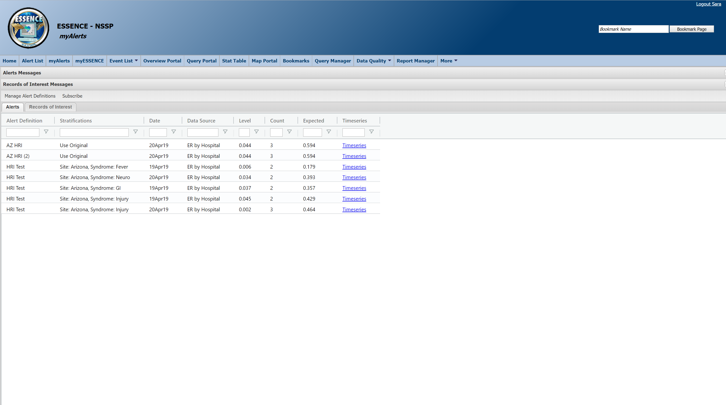
Welcome to myAlerts! This is a quick guide that will show you some useful features that will (hopefully) make your work go a lot smoother.
This is the home page for myAlerts. We’ll go through an example of how to set up an alert and then how to subscribe to and view alerts.
From the ESSENCE Quick Start Guide, myAlerts serves 2 purposes:
Creation of custom alerts for syndrome, subsyndromes, or free-text queries by various stratifications or threshold criteria
Creation of Records of Interest. The purpose of Records of Interest is to return encounter details that match you query criteria (e.g., the word or code for anthrax)

Slide 2
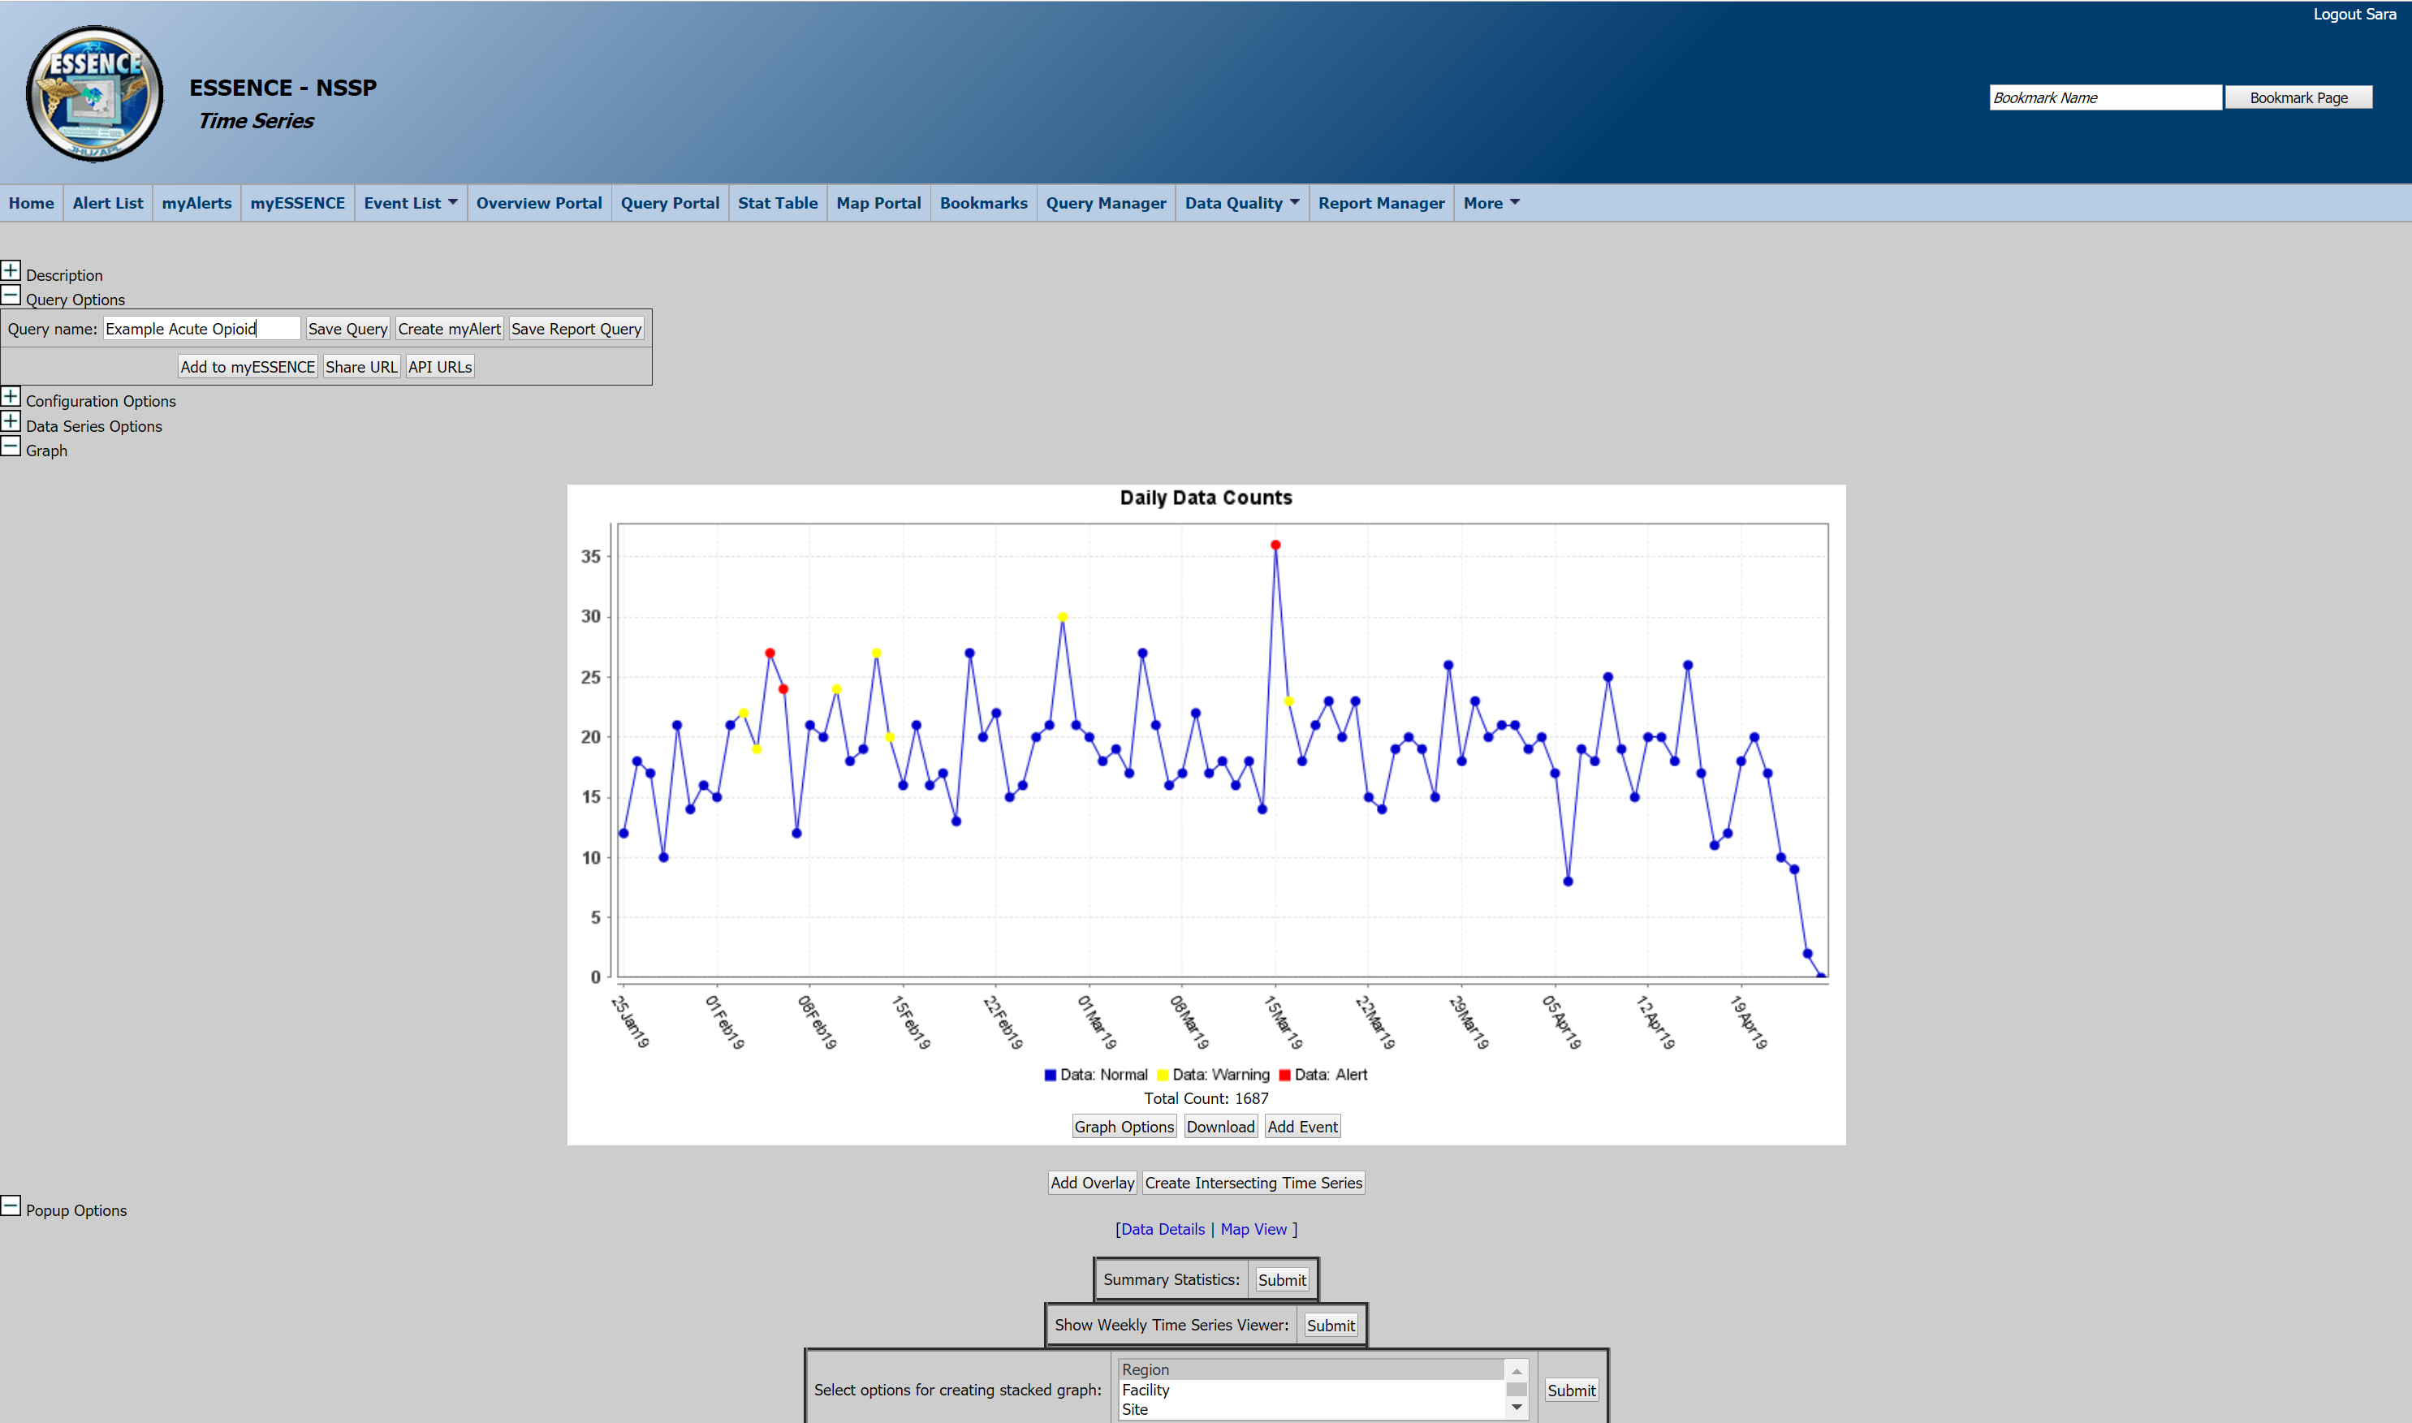
From a Time Series, take a look at the Query option tab. First, type in a name for your query (choose something descriptive so you know what your alerts are) and click the button that says “Create myAlert”.

Slide 3
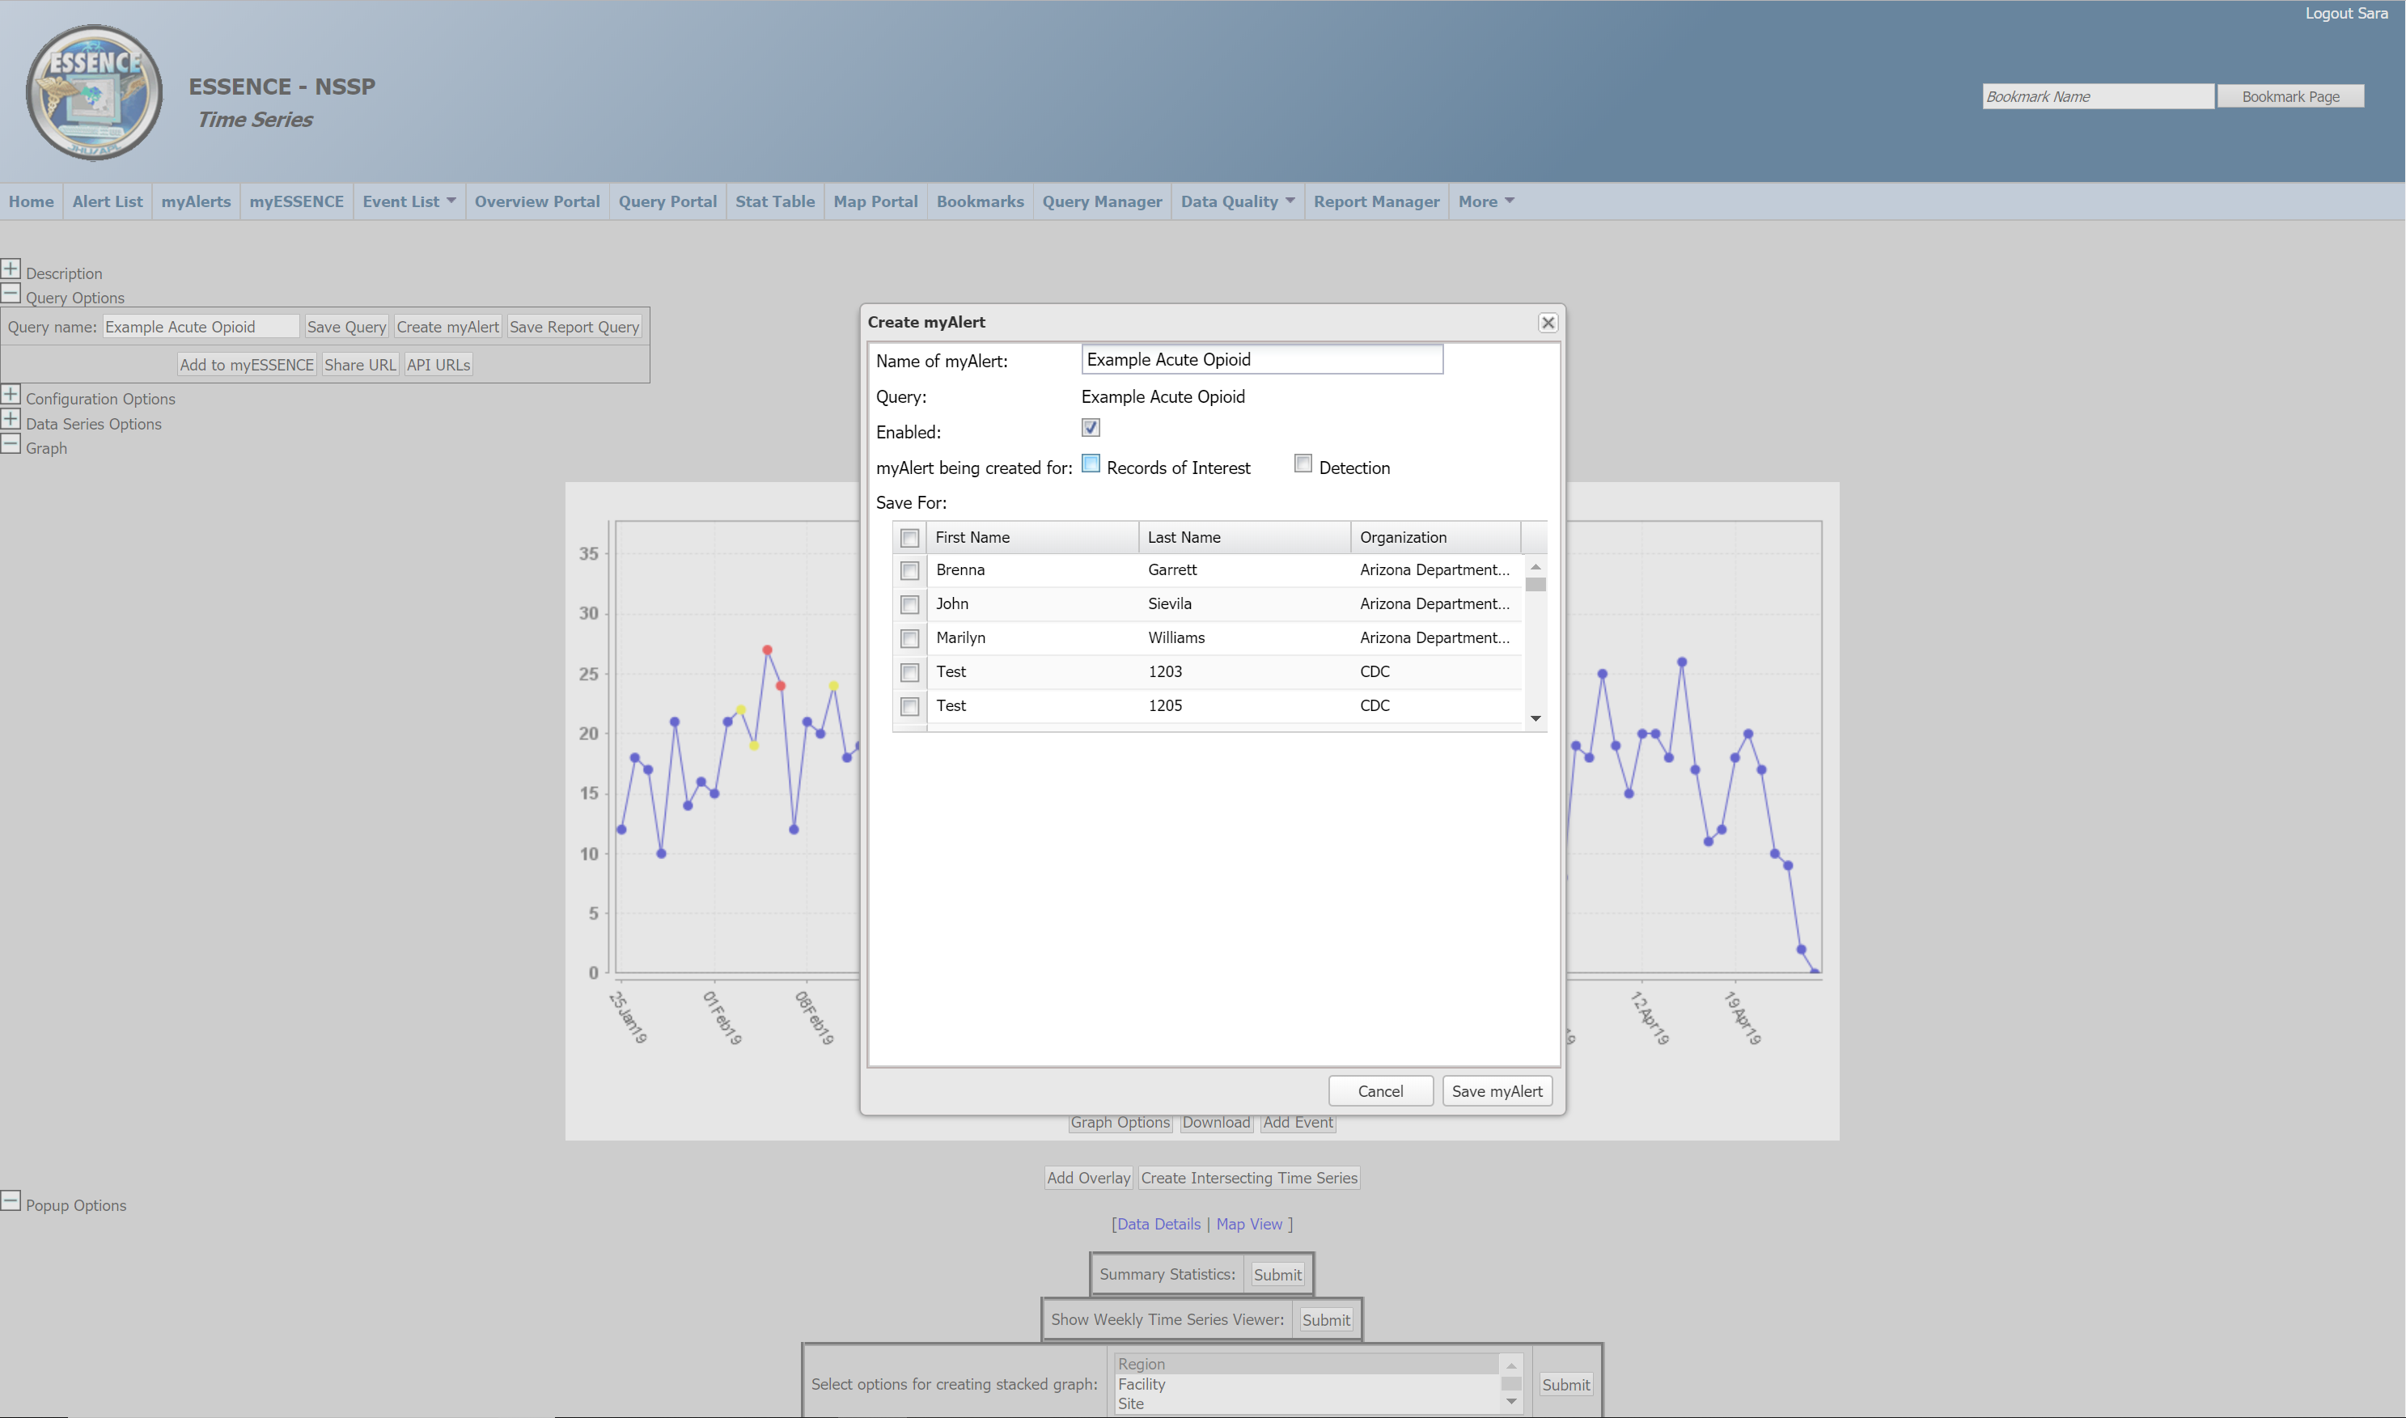
This will open a pop-up window to create the alert.
Records if interest will return a line list of visits that match that query
Detection sets a threshold (either a set number or a statistical threshold value)

