Slide 1
myESSENCE

Slide 2
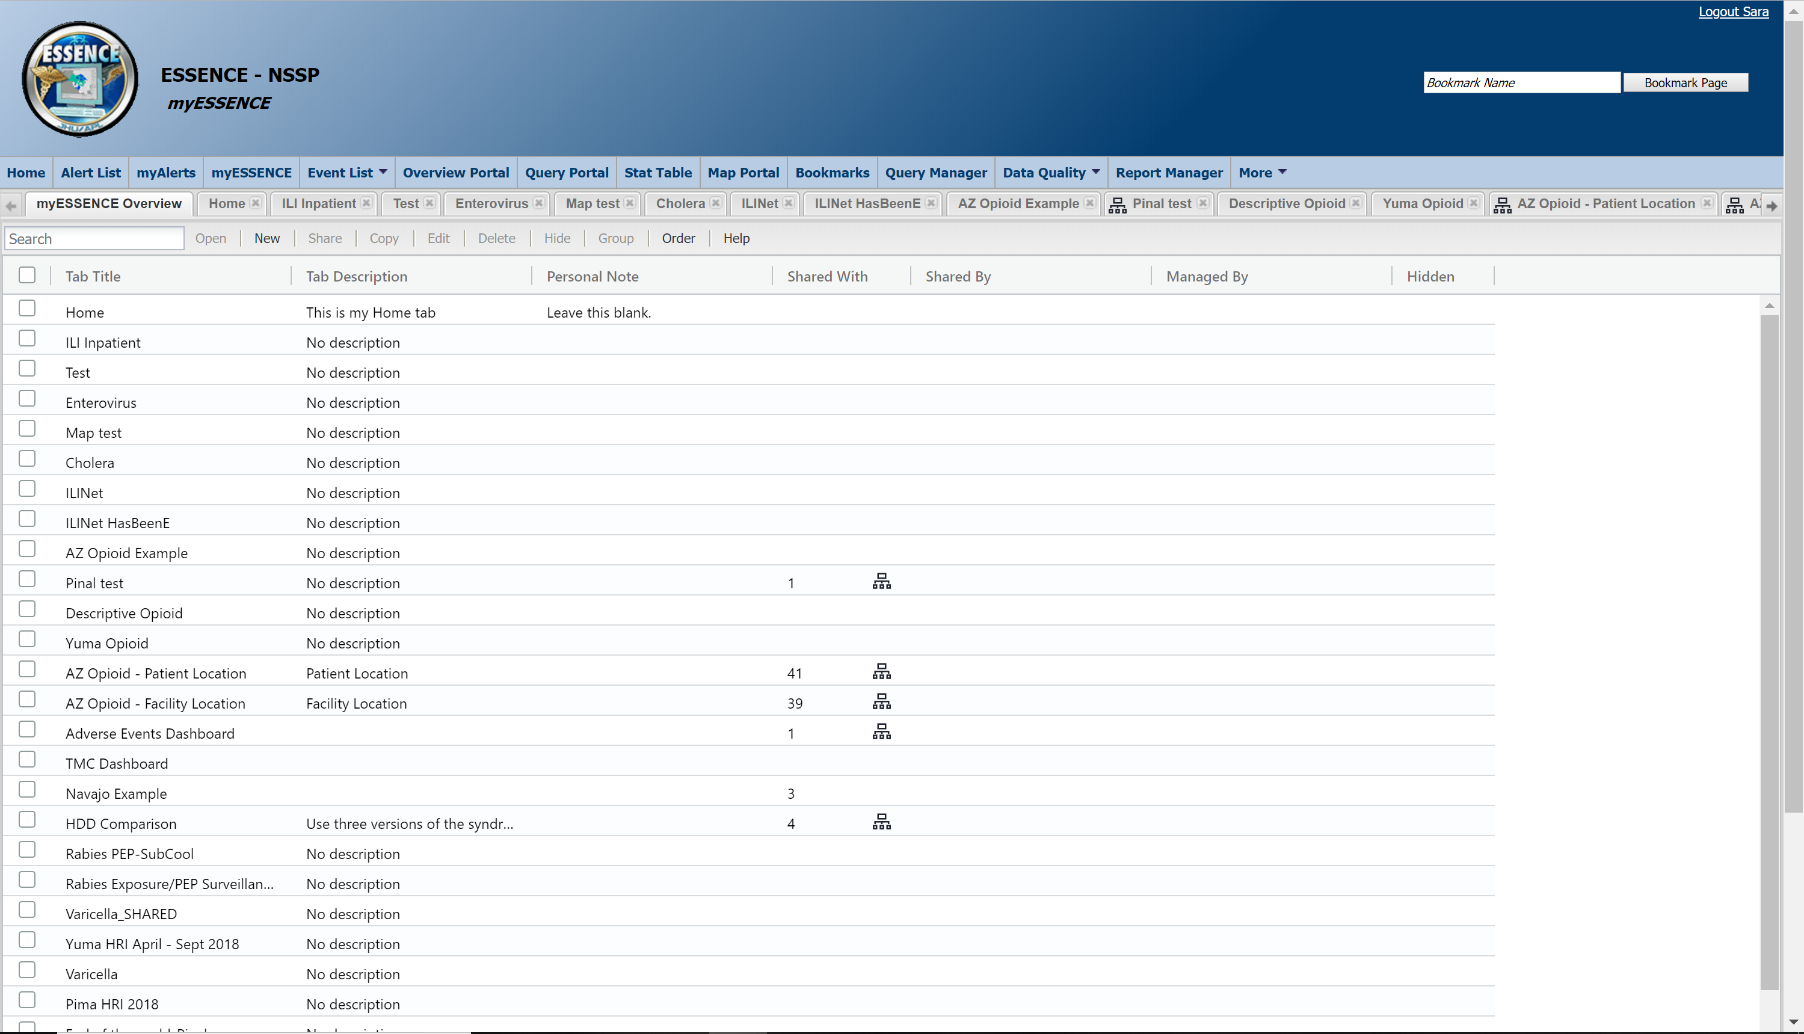
This is the myESSENCE Overview tab. It provides a high-level view of all the tabs you have in your myESSENCE.

Slide 3
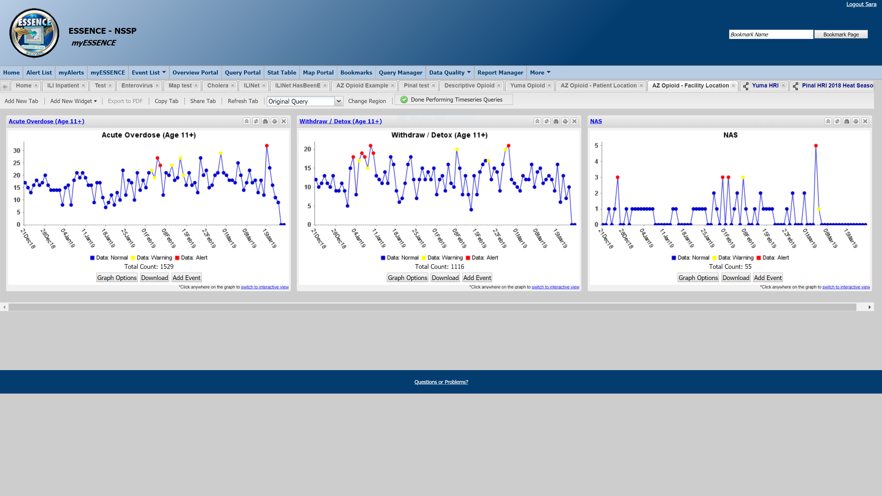
Welcome to myESSENCE! This is a quick guide that will show you some useful features that will (hopefully) make your work go a lot smoother.
This is what a tab (or dashboard) in myESSENCE looks like. This one is the “AZ Opioid – Facility Location” dashboard which has been shared with you. Check your myESSENCE and look for the tab. If it isn’t there, email syndromicsurveillance@azdhs.gov.

Slide 4
My ESSENCE Overview Tab
Search
Share
Create

Slide 5
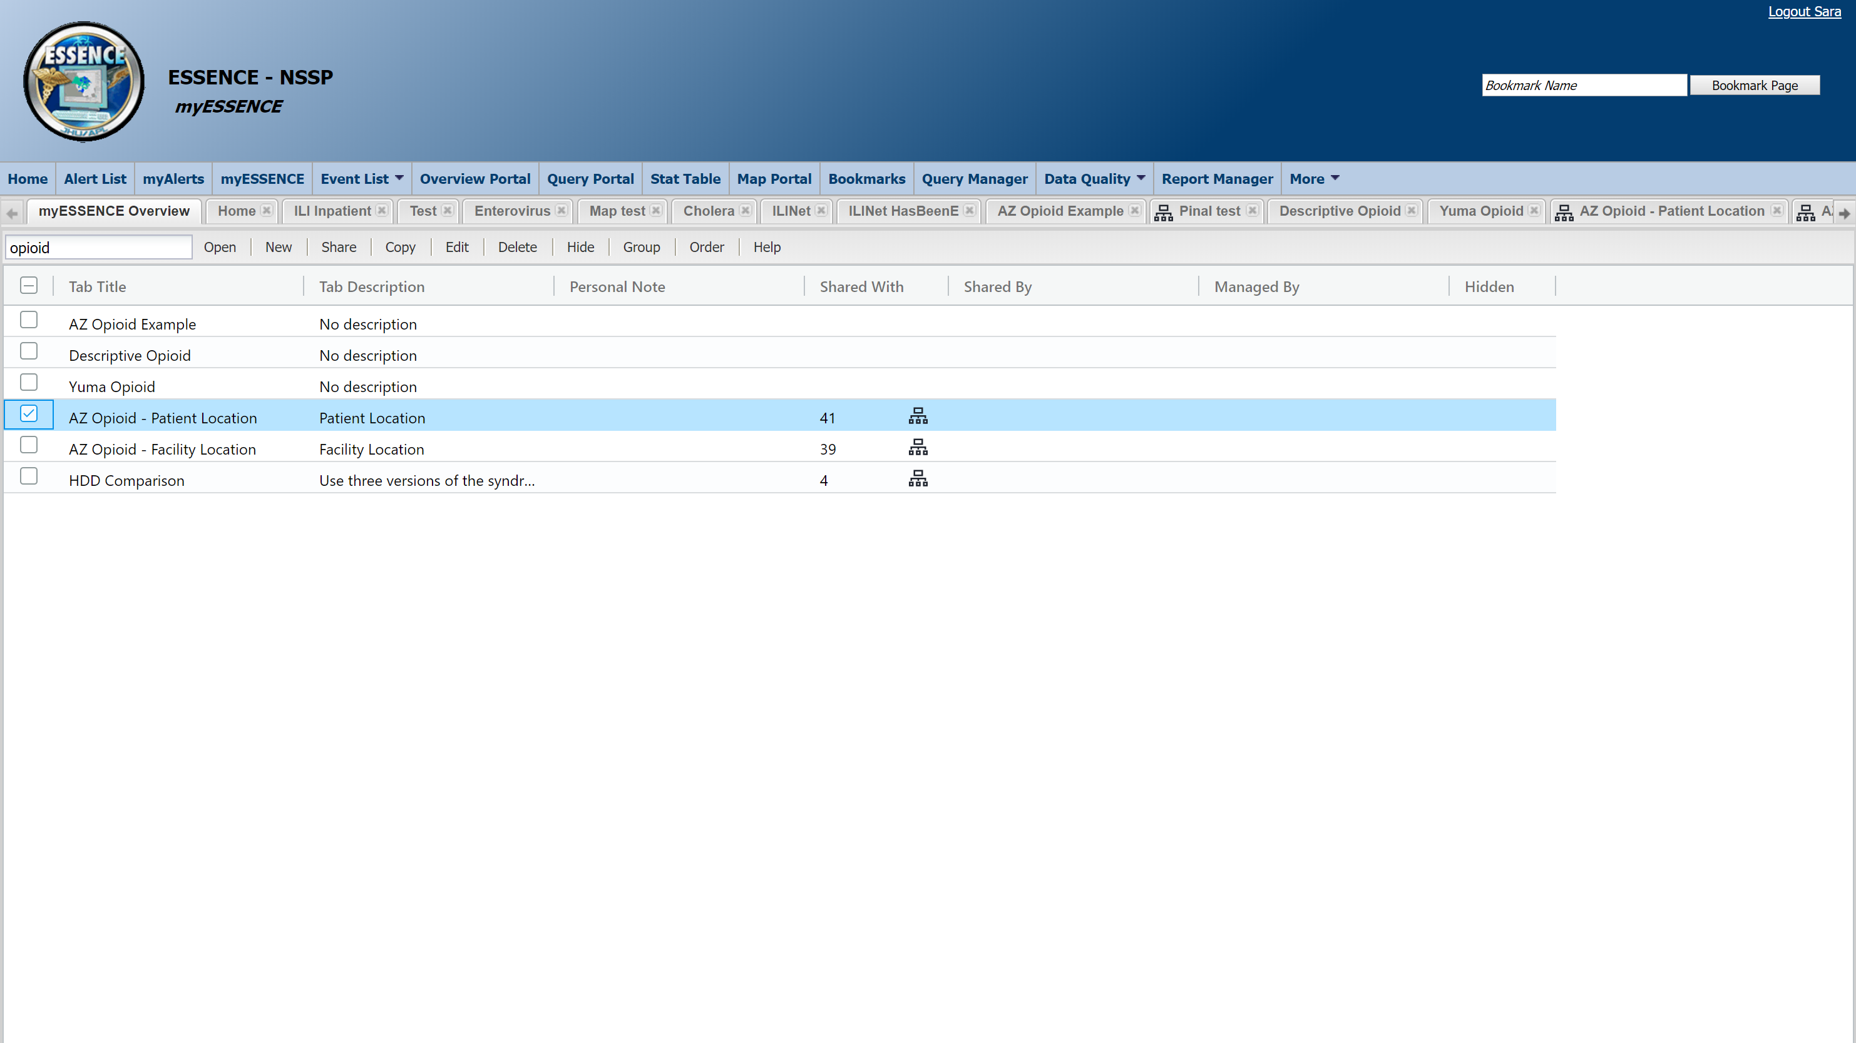
Use the Search bar to find a specific tab you already have.
Double clicking in any of the columns will show you the details. Double clicking the title will take you to that tab/dashboard.

Slide 6
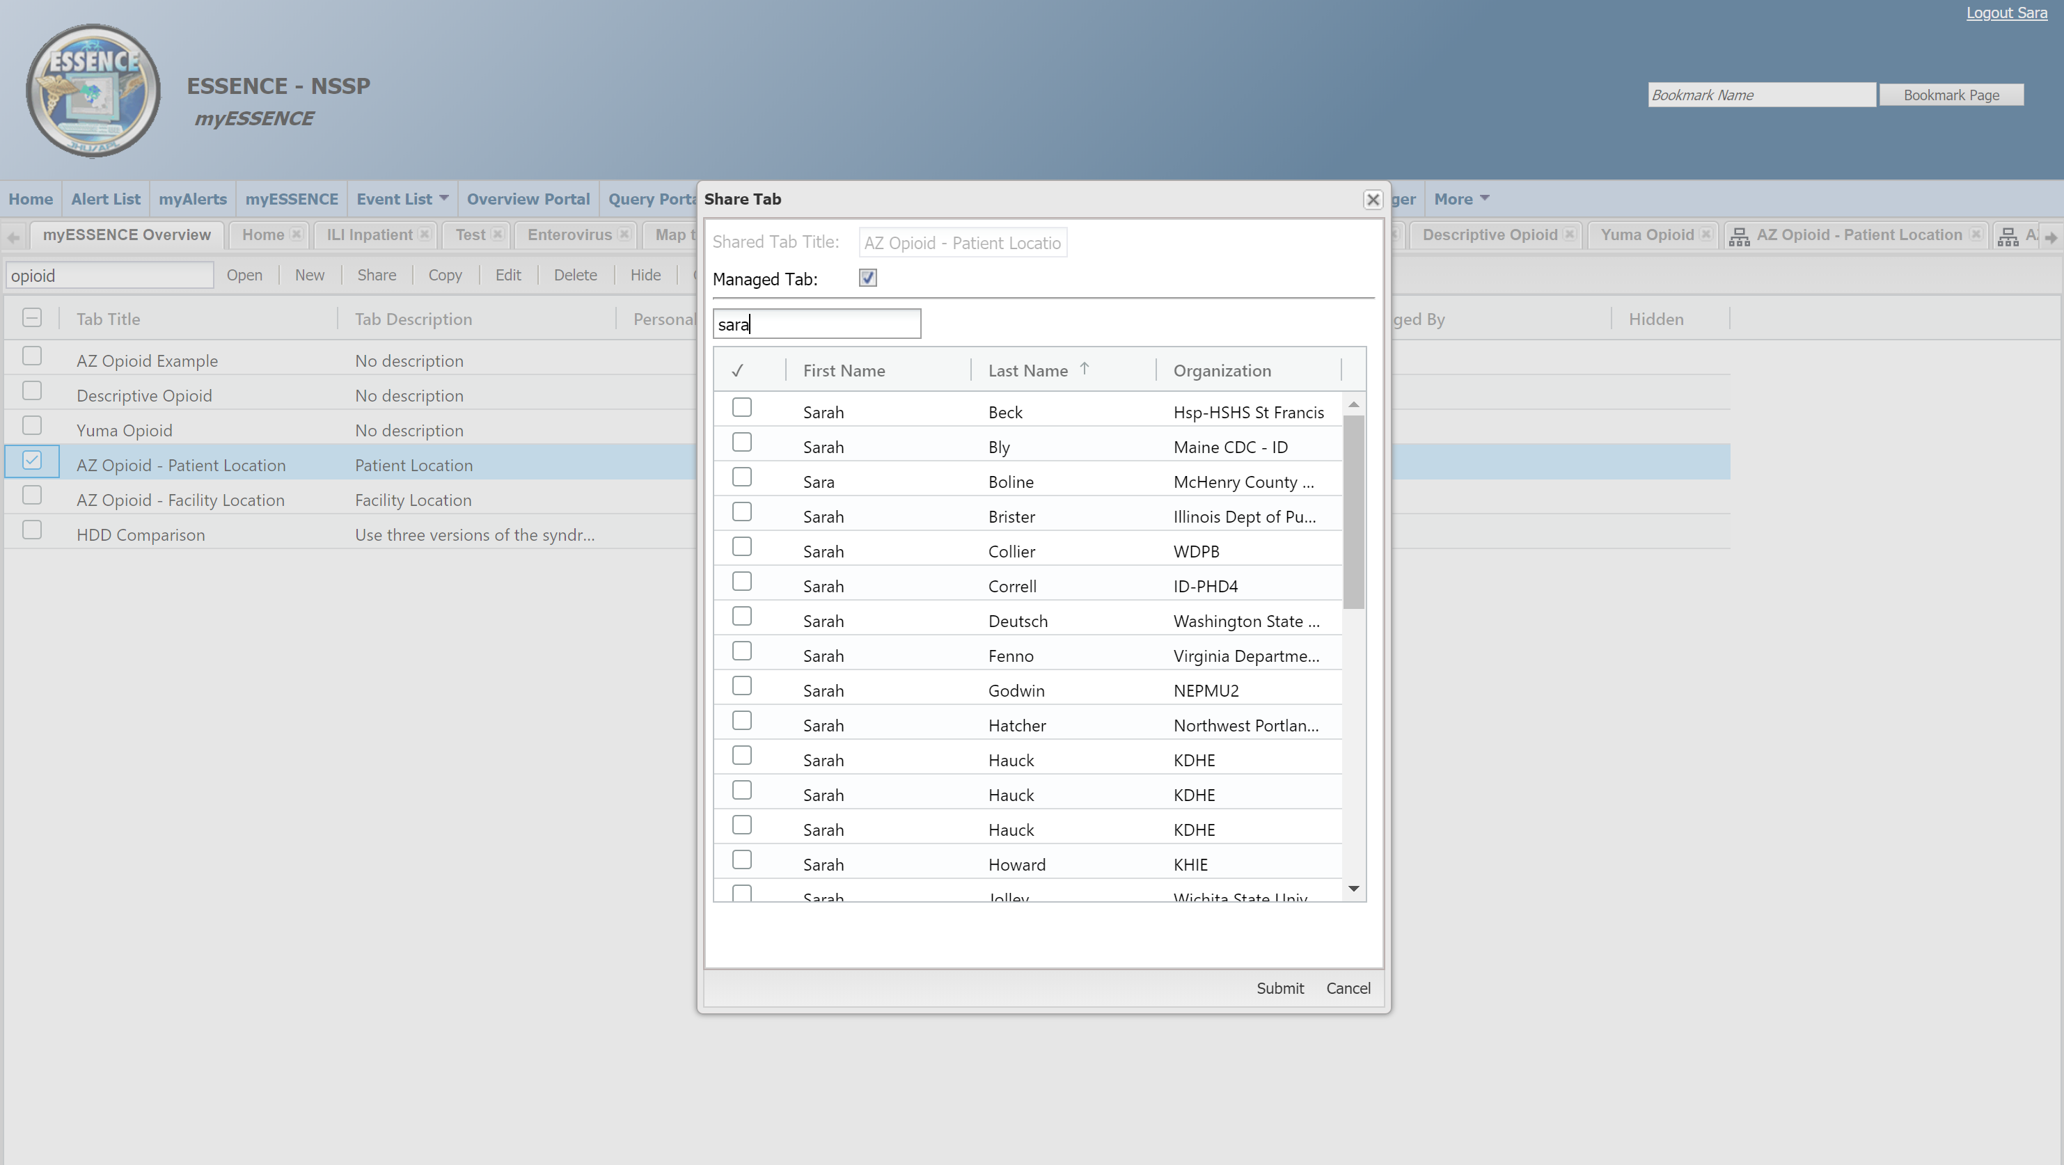
Select a tab to Share it. When you click Share, a box will pop up allowing you to choose a title, whether it’s a managed tab, and who to share it with. If it is a managed tab, the title will be the existing title.
A managed tab is one that is maintained by another user. Any changes to the managed tab can only be made by the person managing that tab, and any changes made will automatically update for all of the people the managed tab is shared with. A non-managed tab is the equivalent of making a copy – it won’t be updated or changed unless you make changes to it.

Slide 7
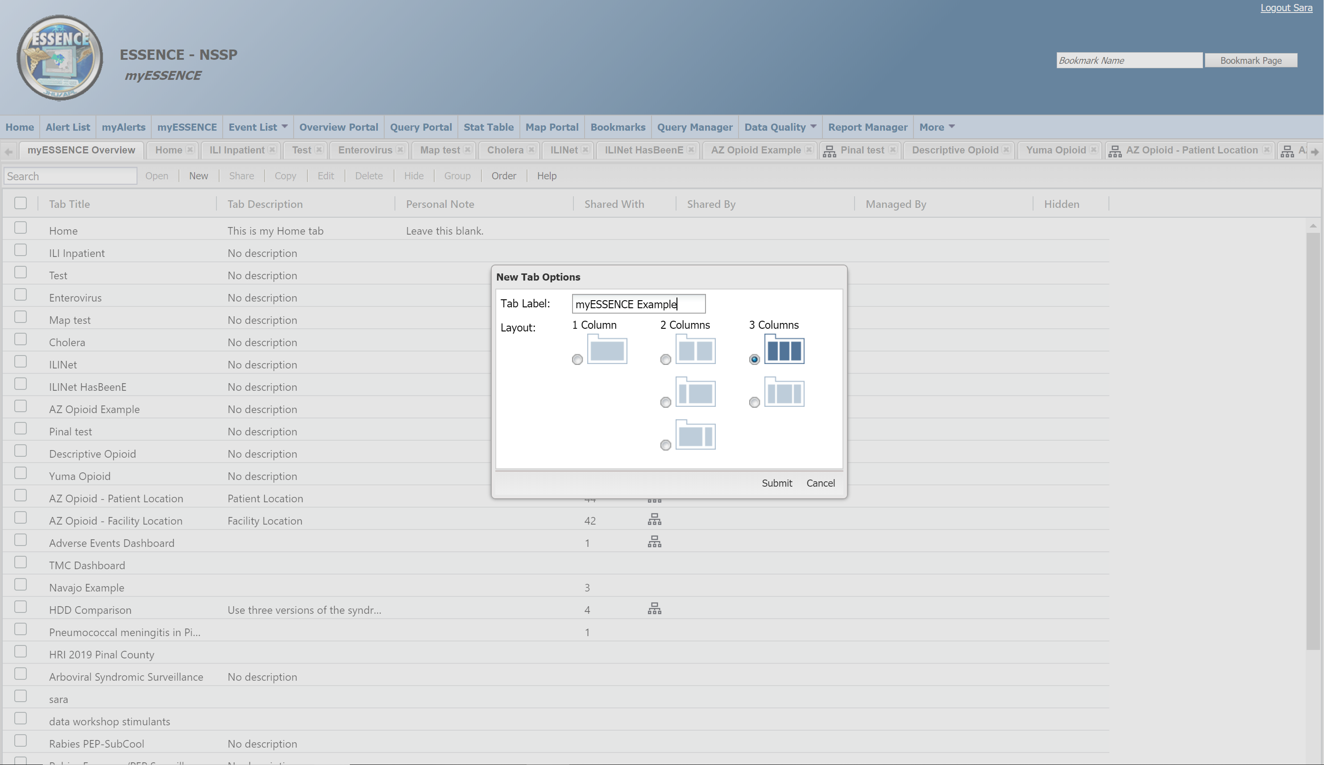
To add items to a dashboard, you must first create a new tab within myESSENCE. Do this by clicking the “New” button just to the right of the search bar.
Choose a descriptive name for your tab and select the number of columns. You can’t change these after the tab is created.
Tip: Include information about the health condition, datasource (Patient Location or Facility Location), and time period if relevant. You can also add in additional information to the Tab Description after the tab is created.

Slide 8
My ESSENCE Overview Tab

Slide 9
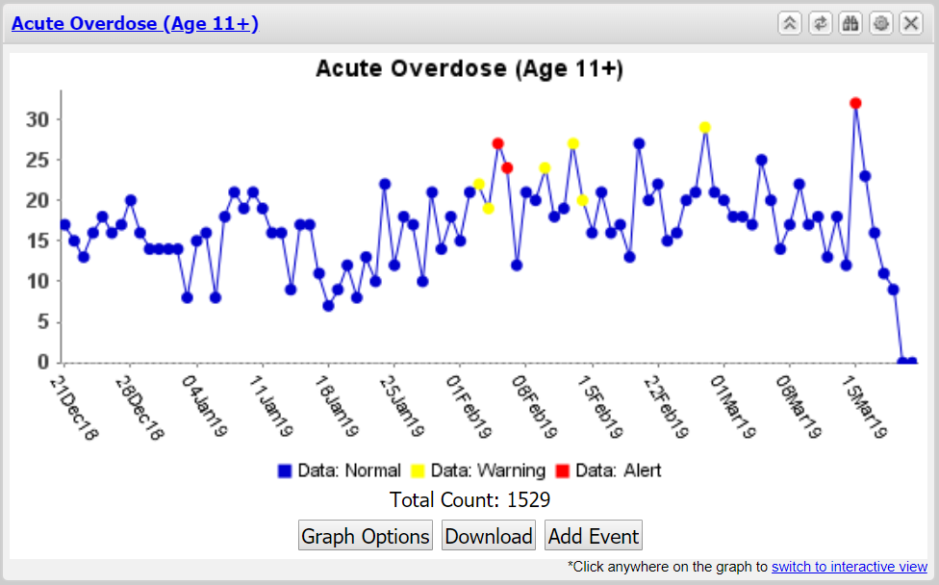
Each box containing a graph is called a widget.

Slide 10
By clicking on the blue title at the top left of the widget, it will take you to the Time Series output that you would see if you ran the same query from the Query portal in ESSENCE.

Slide 11
To see a quick summary of the query fields selected for the graph, click on the button on the top right of the widget that looks like a pair of binoculars.

Slide 12
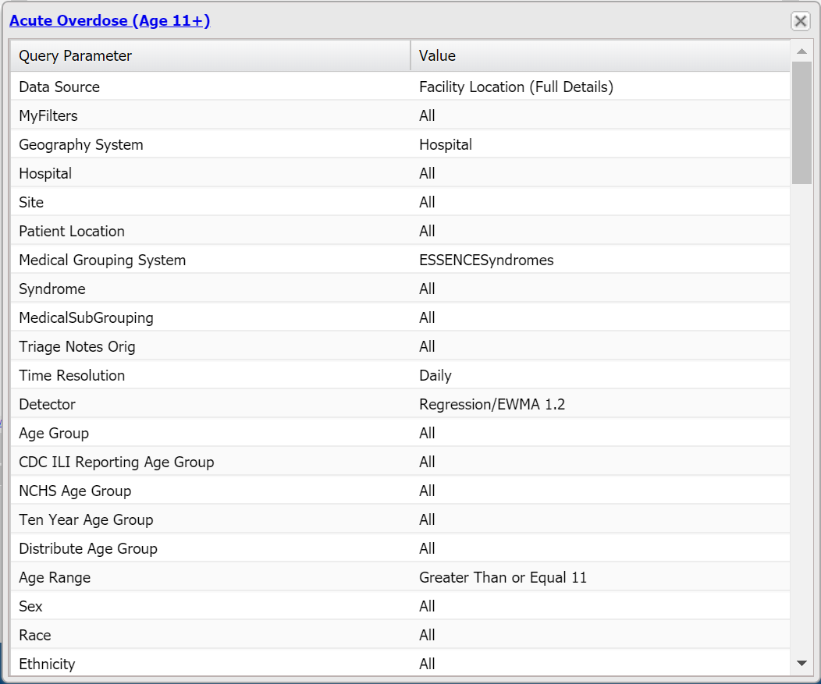
This will open a new small window in your dashboard with two columns. On the left are the query parameters (or fields) and on the right are the values or inputs for each of those fields.

Slide 13
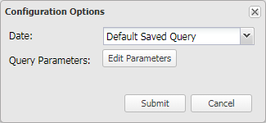
To change the settings on the widget, click on the button on the top right of the widget that looks like a gear. This will bring up a popup that says “Configuration options” at the top.
NOTE: If the dashboard/tab shared with you is managed, this icon will not appear.

Slide 14
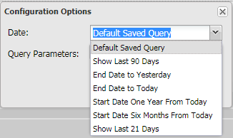
ESSENCE automatically selects “Last 90 Days” for the Date field. If you specified a date range other than the default 90 days in your query, you should always update this to “Default Saved Query” so your dates reflect what you selected in your query.

Slide 15
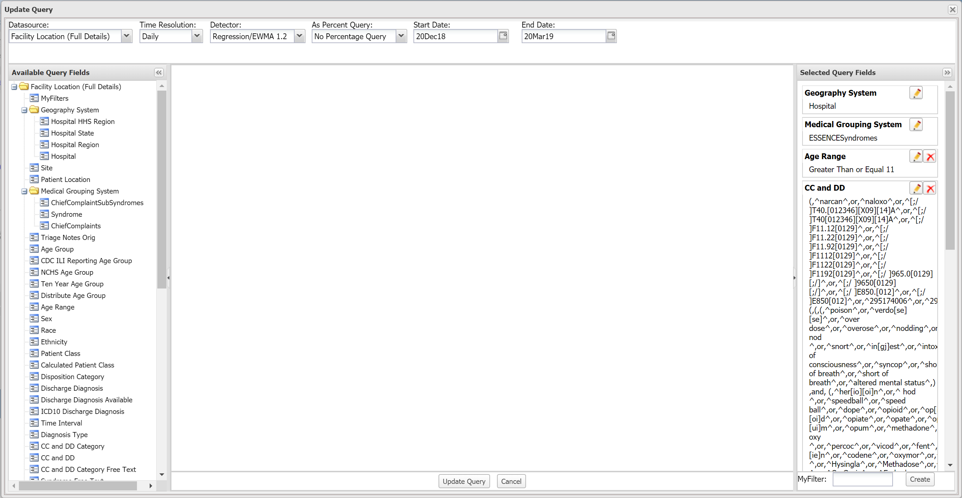
Clicking the “Edit Parameters” button will bring up an “Update Query window that will allow you to make changes to the query for that widget. From here you can also see what query fields were selected.

