Slide 1
Syndromic Surveillance
in Arizona

Slide 2
What is Syndromic Surveillance?

Slide 3
Hospital and Urgent Care visit information used to monitor the health of a community and discover trends in hospital visits for a disease or condition of interest
Notes:
*The primary focus has been to collect ED and Inpatient data from hospitals. As syndromic surveillance expands, we are starting to collect data from urgent care clinic associated with hospitals as well.
AZ is considered a BioSense only state, meaning we use the BioSense Platform as our syndromic surveillance system.

Slide 4
All ED, Inpatient and Urgent Care visits from participating facilities
………………………………………....
Not just reportable data
Notes:
Not just reportable data: we’re not looking at every record as they come in
Instead, we look at the data by syndrome

Slide 5
Syndrome-based
………………………………………....
A group of symptoms that consistently occurs together or a condition characterized by a set of associated terms
Notes:
We can look for those terms in a few different fields that get reported to us, the two primary ones are….

Slide 6
Chief complaints
and
Diagnosis codes
Notes:
What a patient tells a provider about why they’re at the hospital
Diagnosis codes, includes admit, working, and final diagnosis codes
These are the primary fields used to look at the data. In NSSP ESSENCE, we can use national syndrome definitions called Chief Complaint and Discharge Diagnosis Categories or CCDD Categories.

Slide 7
“Quick and Dirty”
………………………………………....
Timeliness over accuracy
Reported at least daily
Available before diagnosis, lab results
Notes:
Reported at least daily - “Quick and dirty”
Timeliness over accuracy
This does not mean that data quality is not valued and part of criteria facilities must meet for approval by ADHS and NSSP before going live into the BioSense Platform Production Environment.
It does mean that this is a timely data source and the goal of the system is to receive data in timely frequency. Out goal is to get facilities reporting every hour, so that public health has the ability to respond to emerging events and have the ability to conduct follow up. Sometimes this can mean that public health can conduct follow up even when the patient is still being treated in the healthcare facility.
Available before diagnosis and lab results
This can be important for public health follow up related to mitigation, prevention and control activities. Dependent on what the need is, the syndromic data can have information about different parts of the patient visit prior to other surveillance systems receiving information that is reportable.
Examples could include waiting period for laboratory data to be reporting through Electronic Laboratory Reporting System and the fields collected in the syndromic data can provide information in procedures about a lab test performed. The triage notes may also contain information about the lab result. Diagnosis codes are updated throughout the patient encounter. The syndromic surveillance data may have diagnosis data available prior to another surveillance system like the Hospital Discharge Database (HDD) in AZ. The ability to see information about the diagnosis codes throughout the patient encounter or visit can also provide information about the reason the patient is being treated but later the diagnosis codes may change for billing purposes. Examples where this has been observed is for Heat-Related Illness.

Slide 8
Multiple records per visit
………………………………………....
Message sent for updates
Deduplicated by visit
Average of 147, 147 messages per day
Notes:
Multiple records per visit
Message sent every time visit information is updated
Messages deduplicated by visit
AZ receives an average of 147, 147 processed messages per day as of 05/21/2021
The volume of messages is really meant to show how much data is being sent electronically and automatically from facilities to the BioSense Platform. The NSSP Data Quality Dashboard was used to pull this metric.
NSSP Data Quality Dashboard:
https://www.cdc.gov/nssp/biosense/docs/BioSense_Data_Quality_Dashboard.2020.pdf
https://knowledgerepository.syndromicsurveillance.org/nssp-data-quality-dq-dashboard-demo

Slide 9
Demographic and clinical data
………………………………………....
Medical Record Number
Visit ID
Date of Birth/Age
Race/Ethnicity
Chief Complaint
Clinical Impression
Admit Reason
Triage Notes
Diagnosis
Vitals
Insurance
Procedures
Notes:
This is not an exhaustive list of all the fields collected or available in the AZ data in NSSP ESSENCE.
AZ Syndromic Surveillance Implementation Guide: https://www.azdhs.gov/documents/preparedness/epidemiology-disease-control/meaningful-use/syndromic-surveillance/az-ss-implementation-guide.pdf
NSSP Data Dictionary: https://www.cdc.gov/nssp/biosense/docs/NSSP-Data-Dictionary-508.xlsx

Slide 10
Partially de-identified
………………………………………....
Names removed during processing
Notes:
Name are removed by the facility or their electronic health record vendor before sending to the BioSense Platform.
We say partially de-identified because we do collect fields like Medical Record Number. This is used to conduct follow up with facilities on visits of interest found in NSSP ESSENCE. The Medical Record Number is the primary identifier used to give to the facility when requesting additional information via email, phone or through a medical records request. Other identifiers such as Date of Birth and Visit ID can also be used for follow up.
The Medical Record Number and Date of Birth can also be used to confirm if a reportable disease or condition is present in our reportable disease and condition/case management system. called MEDSIS.
MEDSIS: https://www.azdhs.gov/preparedness/epidemiology-disease-control/infectious-disease-services/index.php#medsis-home

Slide 11
What is Syndromic Surveillance NOT?

Slide 12
Arizona
Syndromic Surveillance
≠
MANDATORY
Notes:
Rules, Administrative Codes, Legislation:
No AZ state rules or administrative codes
Participation is through
CMS Incentive Programs Promoting Interoperability Rules
ONC Health IT Certification Program Rules
CMS: https://www.cms.gov/Regulations-and-Guidance/Legislation/EHRIncentivePrograms
ONC: https://www.healthit.gov/topic/certification-ehrs/about-onc-health-it-certification-program

Slide 13

Arizona
Syndromic Surveillance
≠
IHS Syndromic Surveillance
Notes:
IHS Syndromic Surveillance
IHS SS is just respiratory
Tribal facilities can report to IHS syndromic registry. RPMS is the Electronic Health Record System they use.

Slide 14
Arizona
Syndromic Surveillance
≠
COMPREHENSIVE
Notes:
Comprehensive
Not all hospitals in AZ can or do participate
Currently have 87 facilities in 14 counties
Represents 92% of all ED visits that occur in AZ
Represents 96% of all Inpatient visits that occur in AZ

Slide 15
Current Facilities in Production
Apache County
White Mountain Regional Medical Center
Coconino County
Flagstaff Medical Center
Page Hospital
Cochise County
Canyon Vista Medical Center
Copper Queen Community Hospital
Douglas Emergency Department
Northern Cochise Community Hospital
Gila County
Banner Payson Medical Center
Cobre Valley Regional Medical Center
Graham County
Mt. Graham Regional Medical Center
La Paz County
La Paz Regional Hospital
Mohave County
Havasu Regional Medical Center
Kingman Regional Medical Center
Kingman Regional Medical Center - Hualapai Mountain Campus
Valley View Medical Center
Western Arizona Regional Medical Center
Navajo County
Little Colorado Medical Center
Summit Regional Healthcare Medical Center
Pima County
Banner University Medical Center South
Banner University Medical Center Tucson
Carondelet Marana Hospital
Carondelet St. Joseph’s Hospital
Carondelet St. Mary’s Hospital
Carondelet St. Raphael’s Emergency Center
Northwest Emergency Center at Marana
Northwest Emergency Center at Vail
Northwest Medical Center
Northwest Medial Center Sahuarita
Oro Valley Hospital
Tucson Medical Center
Pinal County
Banner Goldfield Medical Center
Banner Ironwood Medical Center
Banner Casa Grande Medical Center
Florence Hospital
Santa Cruz County
Carondelet Holy Cross Hospital
Yavapai County
Verde Valley Medical Center
Verde Valley Medical Center-Sedona Campus
Yavapai Regional Medical Center East Campus
Yavapai Regional Medical Center West Campus
Yuma County
Yuma Regional Medical Center

Slide 16
Current Facilities in Production
Gila County
Banner Urgent Care - Beeline and Hwy 260
Navajo County
Banner Urgent Care - White Mtn and Hwy 260
Banner Urgent Care - Old Linden and Deuce Of Clubs
Pima County
TMC Urgent Care - Main Campus
TMC Urgent Care - Rincon Health Campus
Banner Urgent Care - Prince and Campbell
Banner Urgent Care - Golf Links and Kolb
Banner Urgent Care - Broadway and Craycroft
Banner Urgent Care - Ina and Thornydale
Pinal County
Dignity Health Urgent Care - Maricopa
Banner Urgent Care - Ironwood and Ocotillo
Banner Urgent Care - Gary and Empire
Banner Urgent Care - Mcmurray and Arizona

Slide 17
Current Facilities in Production
Maricopa County
Abrazo Arizona Heart Hospital
Abrazo Arrowhead Campus
Abrazo Buckeye Emergency Center
Abrazo Cave Creek Hospital
Abrazo Central Campus
Abrazo Mesa Hospital
Abrazo Peoria Emergency Center
Abrazo Scottsdale Campus
Abrazo Surprise Hospital
Abrazo West Campus
Arizona General Hospital - Ahwatukee Emergency Room
Arizona General Hospital - Chandler Emergency Room
Arizona General Hospital - Chandler McQueen Emergency Room
Arizona General Hospital - Glendale Emergency Room
Arizona General Hospital - Glendale Camelback Emergency Room
Arizona General Hospital - Gilbert Emergency Room
Arizona General Hospital - Goodyear Emergency Room
Arizona General Hospital - Laveen
Arizona General Hospital - Mesa
Arizona General Hospital - Mesa-Baseline Emergency Room
Arizona General Hospital - Mesa Emergency Room
Arizona General Hospital - San Tan Valley Emergency Room
Arizona General Hospital - Surprise Emergency Room
Arizona General Hospital - Tempe Emergency Room
Banner Baywood Medical Center
Banner Boswell Medical Center
    Banner Del E. Webb Medical Center
Banner Desert Medical Center
Banner Estrella Medical Center
Banner Gateway Medical Center
Banner Heart Hospital
    Banner Ocotillo Medical Center
    Banner Thunderbird Medical Center
    Banner University Medical Center Phoenix
    Chandler Regional Medical Center
    Deer Valley Medical Center
    John C. Lincoln Medical Center
    Mayo Clinic Hospital
    Maryvale Emergency Center
    Mercy Gilbert Medical Center
    Mountain Vista Medical Center
    O.A.S.I.S Hospital
    Scottsdale Osborn Medical Center
    Scottsdale Shea Medical Center
    Scottsdale Thompson Peak Medical Center
    Sonoran Health and Emergency Center
    St. Joseph’s Hospital and Medical Center
    St. Joseph’s Westgate Medical Center
    Tempe St. Luke’s Medical Center
    Valleywise Health Medical Center
    Wickenburg Community Hospital

Slide 18
Current Facilities in Production
Maricopa County
Dignity Health Urgent Care - Gilbert
Dignity Health Urgent Care - Ahwatukee
Dignity Health Urgent Care - Queen Creek
Banner Urgent Care - Warner and Cooper
Banner Urgent Care - Pima and 87th
Banner Urgent Care - Higley and Ray
Banner Urgent Care - Gilbert and Queen Creek
Banner Urgent Care - Rural and Guadalupe
Banner Urgent Care - Gilbert and Southern
Banner Urgent Care - Bell and 32nd
Banner Urgent Care - Greenway and 64th
Banner Urgent Care - Val Vista and Guadulupe
Banner Urgent Care - Cactus and 75th
Banner Urgent Care - Higley and Pecos
Banner Urgent Care - Bell and 43rd
Banner Urgent Care - Rural and Elliot
Banner Urgent Care - Mcclintock and Southern
Banner Urgent Care - Dobson and Guadalupe
Banner Urgent Care - Litchfield and Indian School
Banner Urgent Care - Northern and 43rd
Banner Urgent Care - Higley and Southern
Banner Urgent Care - Scottsdale and Shea
Banner Urgent Care - Higley and Queen Creek
Banner Urgent Care - Lindsay and University
Banner Urgent Care - Arizona and Elliot
Banner Urgent Care - 67th and Beth
Banner Urgent Care - Crismon and Southern
Banner Urgent Care - Alma School and Queen Creek
Banner Urgent Care - Deer Valley and 83rd
Banner Urgent Care - Bell and Reems
Banner Urgent Care - Higley and Baseline
Banner Urgent Care - Van Buren and Avondale
Banner Urgent Care - Gilbert and Mckellips
Banner Urgent Care - Johnson and Meeker
Banner Urgent Care - Camelback and 7th St
Banner Urgent Care - Indian School and 32nd St
Banner Urgent Care - Cave Creek and 7th St
Banner Urgent Care - Glendale and 19th Ave
Banner Urgent Care - Central and Washington
Banner Urgent Care - Sarival and Yuma

Slide 19
Increasing Hospital Representation
Notes:
Important note about surveillance systems:
Different surveillance systems are just that: different
One is not inherently better than another
Different systems are more applicable in certain situations than others
Syndromic surveillance is one piece of a much larger surveillance picture

Slide 20
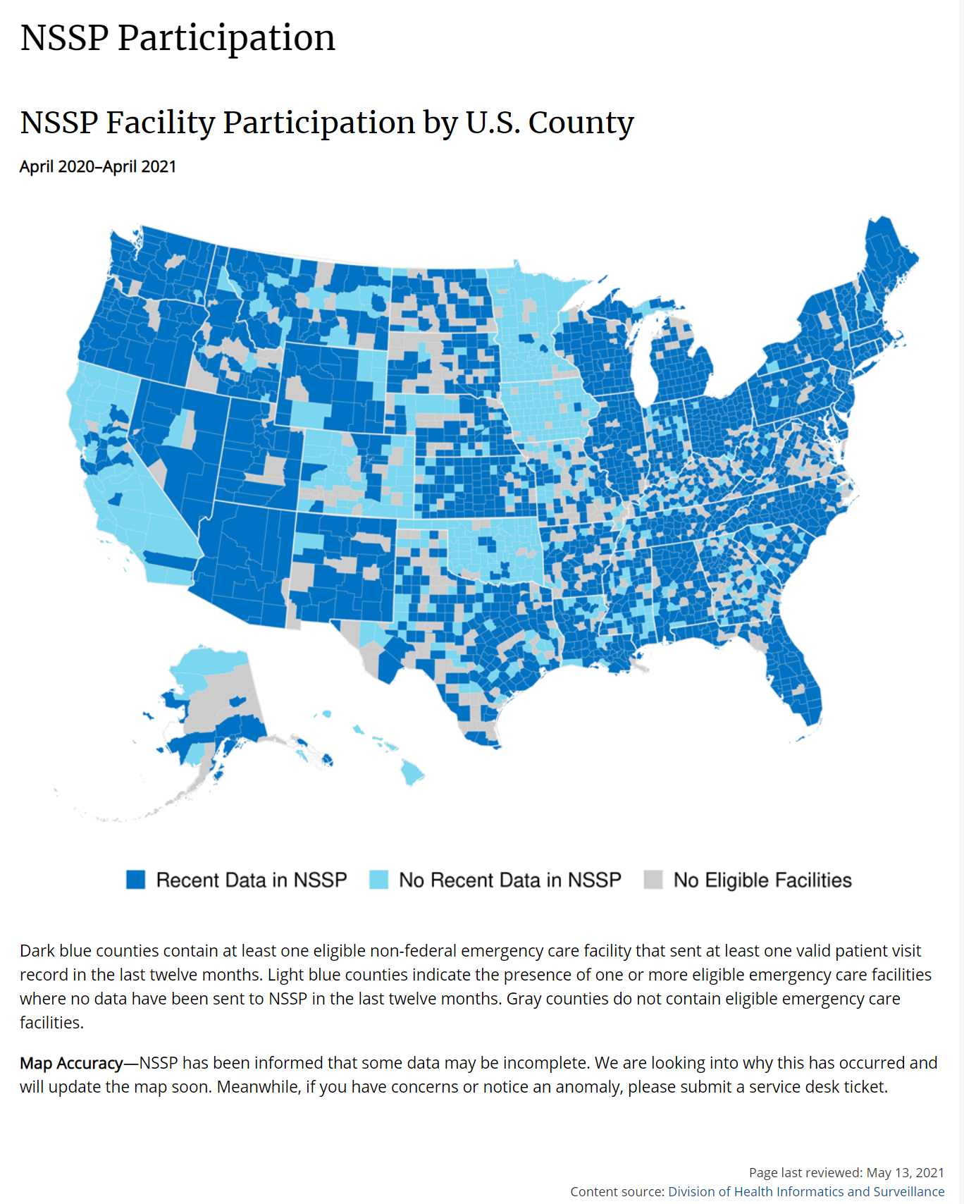
Notes:
NSSP Participation: https://www.cdc.gov/nssp/participation-coverage-map.html

Slide 21
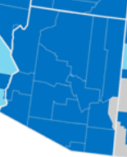
Coverage
143 facilities in 14 counties
96% of all ED visits
97% of all Inpatient visits
Notes:
NSSP Participation: https://www.cdc.gov/nssp/participation-coverage-map.html
This map is showing that at least 1 ED facility in every county where an ED facility is located, is submitting data to the BioSense Platform.
AZ Coverage:
143 facilities in 14 counties
90 ED and Inpatient Hospitals
53 Urgent Care Clinics Associated with Hospitals
96% of all ED visits that occur in AZ
97% of all Inpatient visits that occur in AZ

Slide 22
Focus on Hospitals
………………………………………....
Acute care hospitals with EDs | Inpatient Care Setting | Urgent Care Clinics
Stand-alone EDs | Heart Hospital | Associated with Hospitals
Free-standing EDs | Rehabilitation Hospital | Independent
Microhospitals | Surgical Specialty Hospital
Notes:
For purposes of CMS Promoting Interoperability focused on collecting data from hospitals with an Emergency Care Setting first, an Inpatient Care Setting, and Urgent Care Clinics associated with a hospital, and independent urgent care clinics.
During the onboarding process, hospital partners are asked if they have stand-alone ED’s, free-standing EDs, and Microhospitals that will be able to send data as part of the implementation. Each facility is asked for a unique identifier like an NPI or OID and for a unique physical address.
NPI: https://npiregistry.cms.hhs.gov/
OID: http://www.hl7.org/OID/

Slide 23
Limited participation in the AZ system:
………………………………………....
Federal (DoD)
Notes:
ADHS is expanding the facility type of data in the system. As new updates are available, ADHS will share information about the data available in the system and any characteristics to take into consideration.

Slide 24
Not participating in the AZ system:
………………………………………....
Federal (VA, etc)
Tribal facilities on RPMS reporting syndromic surveillance to IHS
Notes:
Facilities that use RPMS as their electronic health record system are meeting their requirement for MU/PI, so they don’t need to send us data. We would welcome it if they were interested in sending it.
ADHS is expanding the facility type of data in the system. As new updates are available, ADHS will share information about the data available in the system and any characteristics to take into consideration.

Slide 25
Facility Types
………………………………………....
Emergency Care
Inpatient Practice Setting
Urgent Care
Notes:
Able to follow patient from ED to admission and discharge
Can analyze more severe patients better
Due to the way data is uploaded into the BioSense Platform, the hospitals that have a Emergency Care Setting and Inpatient Care Setting are added to the Master Facility Table a certain way. The Emergency Care Setting is the Primary Facility and the Inpatient Care Setting is then associated with the Emergency Care Setting primary facility. This means that when looking at facility type or patient class in the system, there can be overlap for patient encounters that begin in the Emergency Care Setting and that overlap with the Inpatient Care Setting. It is important to note this in any limitation or caveat language.
It also is important to think about when filtering the data in NSSP ESSENCE in the Query Portal.

Slide 26
Patient Class ………………………………………....
Emergency
Inpatient
Outpatient
Notes:
Able to follow patient from ED to admission and discharge
Can analyze more severe patients better
Due to the way data is uploaded into the BioSense Platform, the hospitals that have a Emergency Care Setting and Inpatient Care Setting are added to the Master Facility Table a certain way. The Emergency Care Setting is the Primary Facility and the Inpatient Care Setting is then associated with the Emergency Care Setting primary facility. This means that when looking at facility type or patient class in the system, there can be overlap for patient encounters that begin in the Emergency Care Setting and that overlap with the Inpatient Care Setting. It is important to note this in any limitation or caveat language.
It also is important to think about when filtering the data in NSSP ESSENCE in the Query Portal.

Slide 27
Data Flow

Slide 28
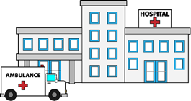



AZ Syndromic Data Flow
Hospital Reporter
EHR Vendor Hub
Public Health Node
PH Data User
Notes:
AZ uses the national syndromic surveillance system as our syndromic surveillance system.
BioSense Platform is a cloud-enabled web application providing commercial hosting, provisioning, and support for SS Data. The National Syndromic Surveillance Program (NSSP) supports the BioSense Platform and improvements in the national public health surveillance infrastructure’s ability to monitor the scope and severity of potential threats to public health. This system ultimately provides a regional and national depiction of multiple health outcomes and syndromes. The BioSense Platform is the reporting method for the State of Arizona to continually receive and maintain SS data reported by hospitals. BioSense Platform is a national system sponsored by the Centers for Disease Control and Prevention
(CDC).
BioSense Platform: https://www.cdc.gov/nssp/overview.html#BioSense
BioSense Platform Data Flow: https://www.cdc.gov/nssp/biosense/docs/NSSP-Data-Flow-Explanation-Handout-508.pdf
https://knowledgerepository.syndromicsurveillance.org/biosense-platform-data-flow-part-1-data-ingestion-biosense-platform
https://knowledgerepository.syndromicsurveillance.org/data-flow-and-data-quality-nssp-new-site-onboarding-window-fall-2020-webinar-2
https://knowledgerepository.syndromicsurveillance.org/biosense-platform-data-flow-part-3-legacy-data-conversion-and-transition-plan

Slide 29



LPHJ
(Local Public Health Jurisdiction)
Hospital
Notes:
CDC’s BioSense Platform is the hospital syndromic surveillance system used by ADHS
ADHS does not receive the production data directly
ADHS partners with LPHJs and hospitals to manage system users

Slide 30





LPHJ
(Local Public Health Jurisdiction)
Hospital
Notes:
ADHS works directly with hospital/EHR vendor technical teams
During onboarding
Maintaining feeds and data quality
LPHJs work directly with hospitals
AZ is home rule state and the LPHJs are responsible for the investigation and follow up
During follow up on specific cases identified
When determining if public health action needs to take place
Hospital
Users are given access to their hospital facility or healthcare system data
Can use same tools that public health uses to visualize and analyze data in NSSP ESSNCE

Slide 31
Collaboration
Notes:
To help run the program

Slide 32
AZ BioSense Community of Practice
………………………………………....
ADHS and LPHJ staff, hospital IT and infection control staff
Meet bi-monthly
Provide direction on system use
Notes:
When started, this group helped formulate the process for how we collect and share data in AZ
Provide opportunities for
Stakeholder engagement
User feedback
Data Provider feedback
Collaboration on projects
Resource and knowledge sharing

Slide 33
AZ BioSense Opioid Workgroup
………………………………………....
ADHS and LPHJ staff involved in opioid surveillance and response
Meet monthly
Notes:
Primarily focused on LPHJ work, but we also have some hospital staff that attend calls

Slide 34
Exploratory Analysis Subgroup
………………………………………....
For data analysts to focus on special projects
Meet monthly

Slide 35
Data Access

Slide 36
Rules are discussed and created by the AZ BioSense Community of Practice
Notes:
AZ BioSense Workgroup is now the AZ BioSense Community of Practice. Initially the rules for data access were created by the AZ BioSesne Workgroup. As data sharing is ongoing and living practice this role has transitioned to AZ BioSense Community of Pracitce.

Slide 37
Data Use Agreements
………………………………………....
Includes security and acceptable use of data

Slide 38
Data Use Agreements
………………………………………....
healthcare systems/hospitals have a DUA with ADHS
counties have a DUA with ADHS
statewide DUA with CDC NSSP
Notes:
Hospitals as data contributors
Counties as LPHJs

Slide 39
Data Access Rules for Local Public Health Jurisdictions (LPHJs)
………………………………………....
LPHJs are responsible for their jurisdiction’s data
LPHJ users only have access to data for:
  Patients that are residents located in their jurisdiction
  Facilities located in their jurisdiction
Notes:
ADHS and the BioSense Workgroup can create additional rules to access data for special projects or events.
A determination will be made if a Data Use Agreement is necessary based upon the scope of the project or event.
Example 1: Gila County requested access to their data to Maricopa County for a specific project they were working on together.
Example 2: Maricopa County requested access be given to members of the NSSP Team for assistance during the enhanced surveillance period during the 2017 NCAA Final Four Basket Ball Tournament and associated events occurred in Maricopa County.

Slide 40
Data Access Rules for Facilities
………………………………………....
Facilities’ are responsible for their facilities’ data
Facility users only have access to data for:
  Facilities located in their jurisdiction
Notes:
ADHS and the BioSense Workgroup can create additional rules to access data for special projects or events.

Slide 41
Case Example:
ILI Patient
Notes:
Hospitals generate HL7 messages through their electronic health record (EHR) vendor
For every patient admit, discharge, registration, update
Vendors send batches of messages in a file to the system
Processing into BioSense Platform

Slide 42
On March 25th a 78 year old male goes to Miracle Care Medical Center Emergency Department with fever, shortness of breath, sore throat, and difficulty breathing.

Slide 43
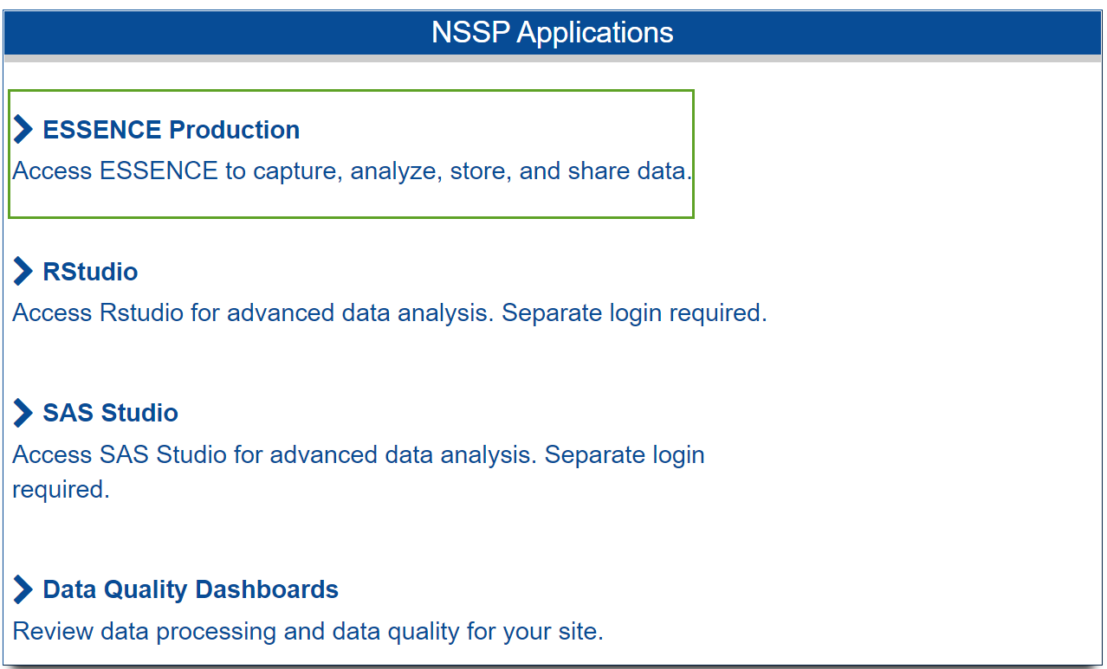
Notes:
ADHS uses the BioSense Platform to access the data
All public health users can see their jurisdiction and national data aggregated by HHS region
The BioSense Platform refers to the group of applications used to access SS data
Most users will access the data through the ESSENCE application
RStudio is a common tool used by the ADHS SS team to look at the back end of the data

Slide 44
ILI CCDD v1:
………………………………………....
(,^fever^,andnot,^denies fev^,andnot,^shot^,andnot,^afeb^,andnot,^no fev^,andnot,^no temp^,or,^chill^,or,^pyrexia^,or,^ febrile^,or,^high temp^,or,^elevated temp^,andnot,^denies any elevated temp^,andnot,^no elevated temp^,or,^feeling hot^,or,^feels hot^,or,^fvr^,andnot,^denies fvr^,andnot,^no fvr^,),and,(,^cough^,andnot,^denies cough^,or,^sore th[o|r][a|o][a|r]t^,or,^soreth[o|r][a|o][a|r]t^,or,^strep^,or,^pharyn^,or,^upper resp^,),or,(,^[;/ ]J09^,or,^[;/ ]J10^,or,^[;/ ]J11^,or,^[;/ ]487.[018];^,or,^[;/ ]487[018];^,or,^[;/ ]487.[018],or,^[;/ ]487[018],or,^[;/ ]488.[018][19];^,or,^[;/ ]488[018][19];^,or,^[;/ ]488.[018][19],or,^[;/ ]488[018][19],or,^442696006^,or,^442438000^,or,^6142004^,or,^195878008^,or,^influenza^,andnot,^vaccin^,andnot,^shot^,andnot,^immunizat^,or,^ flu ^,andnot,^shot^,andnot,^stomach^,andnot,^vaccin^,andnot,^immuniza^,or,^flu like^,or,^flulike^,or,^flu symptom^,),andnot,^[;/ ]A08.4^,andnot,^[;/ ]A084^
Notes:
Patient came in with fever, shortness of breath, and difficulty breathing
CCDD: chief complaint and discharge diagnosis

Slide 45
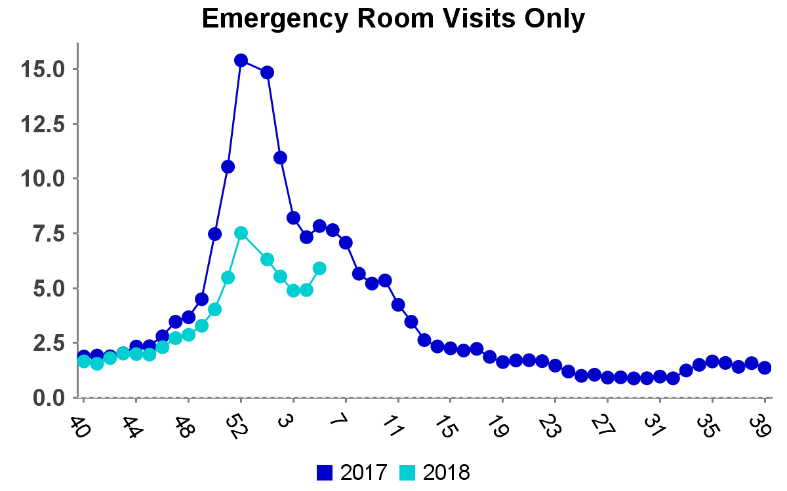
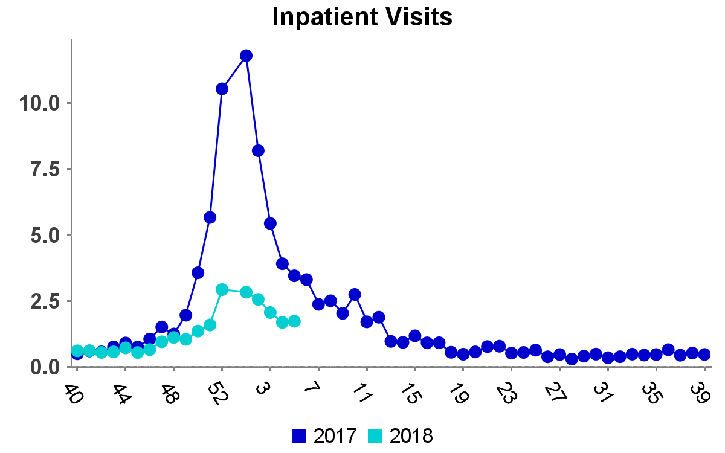
Time Series:
………………………………………....
% ILI
% ILI

Slide 46
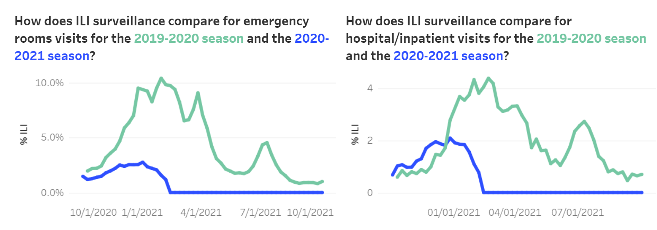
ADHS Flu Dashboard:
………………………………………....
https://www.azdhs.gov/preparedness/epidemiology-disease-control/flu/index.php#surveillance-influenza-season

Slide 47
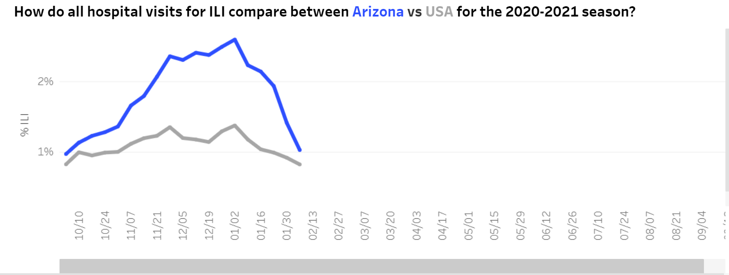
ADHS Flu Dashboard:
………………………………………....
https://www.azdhs.gov/preparedness/epidemiology-disease-control/flu/index.php#surveillance-influenza-season

Slide 48
ADHS COVID-19 Dashboards:
………………………………………....
Hospital COVID-like and Influenza-like Illness
School Dashboard*
Businesses Dashboard*

Slide 49
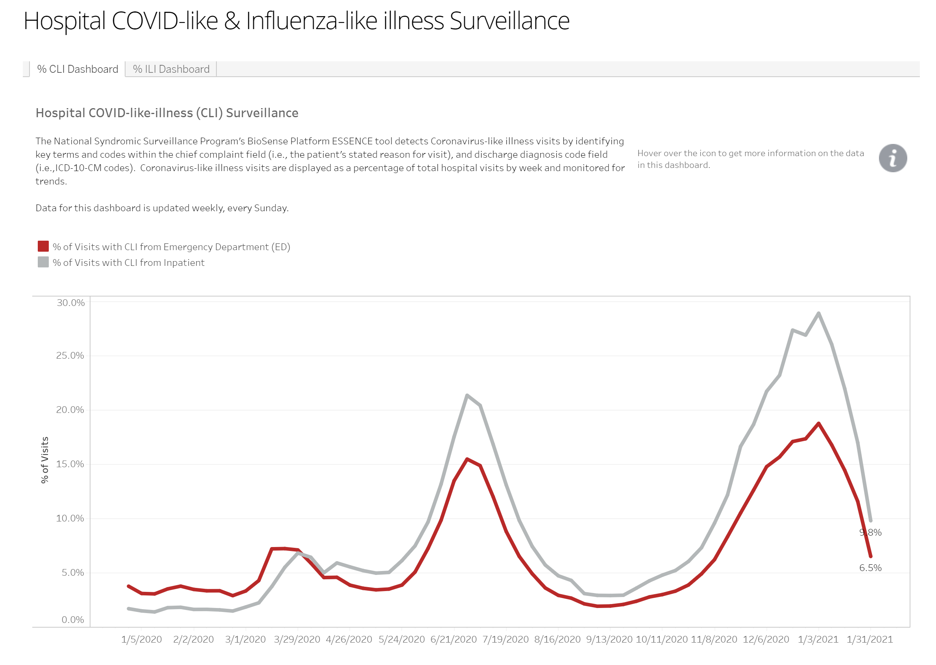
Notes:
Data Dashboard: https://www.azdhs.gov/preparedness/epidemiology-disease-control/infectious-disease-epidemiology/covid-19/dashboards/index.php

Slide 50
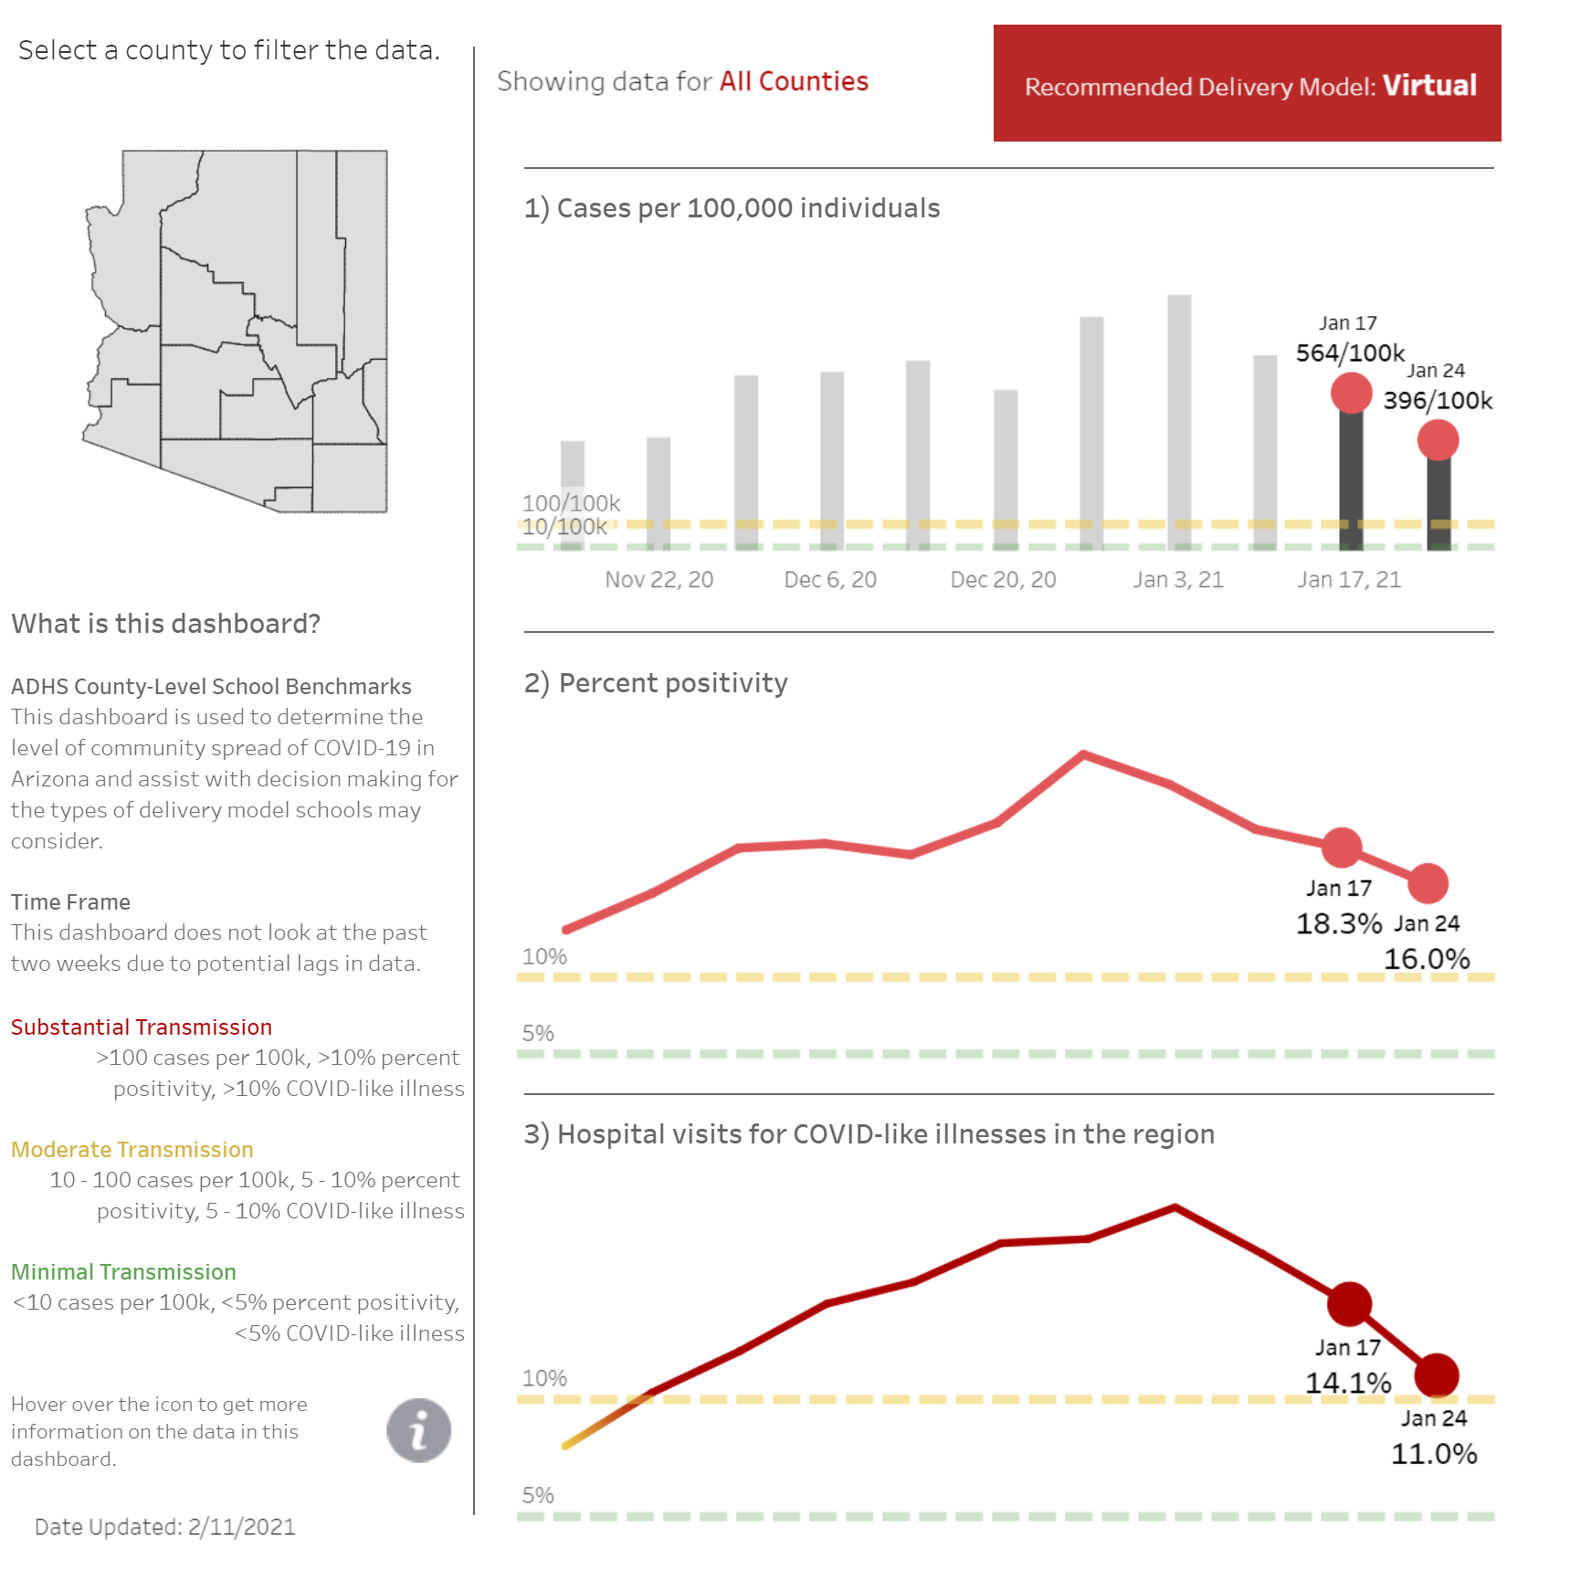
Notes:
School Dashboard:
*No longer in use for this part of the COVID response but was at a prior point in the pandemic.
Used to inform decisions on reopening schools.

Slide 51
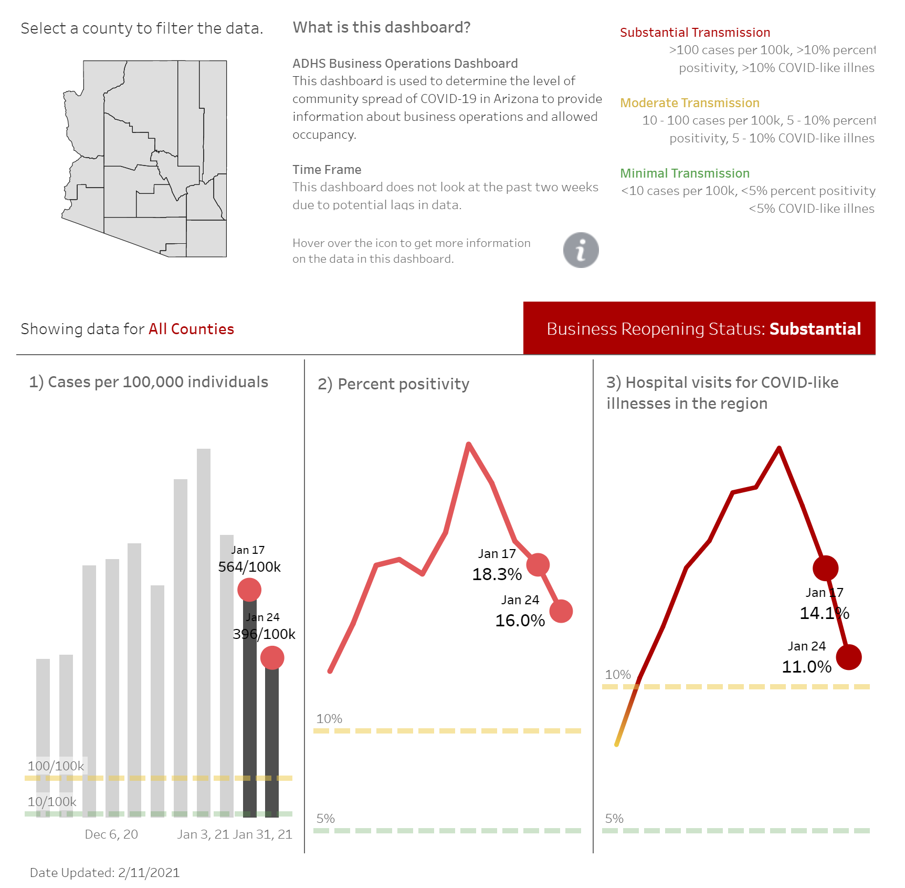
Notes:
Businesses Dashboard: https://www.azdhs.gov/preparedness/epidemiology-disease-control/infectious-disease-epidemiology/index.php#novel-coronavirus-community
*No longer in use for this part of the COVID response but was at a prior point in the pandemic.
Used for making decisions on reopening businesses and communities.

Slide 52
MCDPH COVID-19 Dashboard:
………………………………………....
Hospital COVID-like Illness

Slide 53
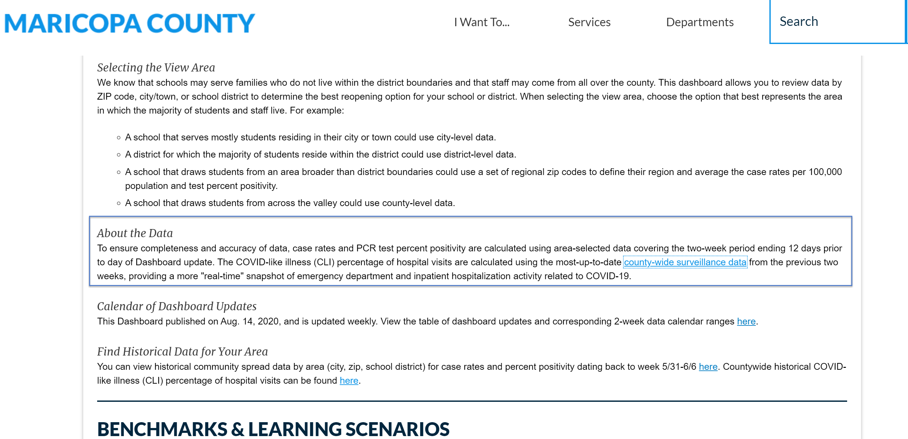
Notes:
CLI Dashboard:
https://www.maricopa.gov/5594/School-Metrics#using
http://phcovid.maricopa.gov/
You can also see an example of how Maricopa County is sharing their COVID-like Illness data.

Slide 54
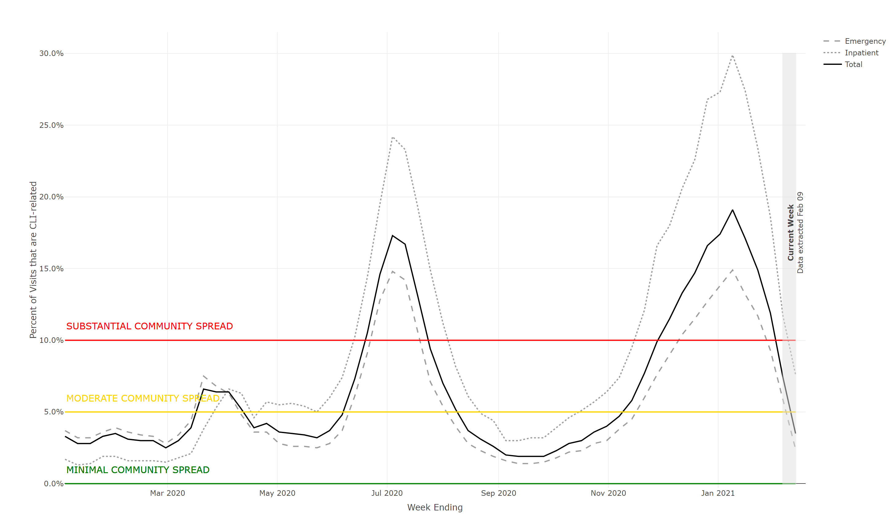
Notes:
CLI Dashboard: http://phcovid.maricopa.gov/

Slide 55
Other Use Cases

Slide 56
Other Use Cases
Event & Mass Gathering Surveillance:
Super Bowl
Tostitos Fiesta Bowl
Cheez-It Bowl
Waste Management Phoenix Open
NCAA Final Four Basketball Tournament
Copa Soccer Tournament
Presidential Visit
March Madness Music Festival
Infectious Disease:
Arboviral Diseases
Influenza-like Illness
Varicella
Rocky Mountain Spotted Fever
Acute Flaccid Myelitis
Rabies
Hep A
COVID-19
Climate and Environmental Health:
Heat-related Illness
Cold-related Illness
Wildfires
Injury:
Overdoses-Opioid, Heroin, Stimulants, All Drugs
Suicide Ideation and Attempts
Sexual Violence
Intimate Partner Violence
Domestic Violence

Slide 57

Event/Mass Gathering
………………………………………....
Monitor hospital visits during events for increases in disease or injury
Notes:
Super Bowl
Tostitos Fiesta Bowl
Cheez-It Bowl
Waste Management Phoenix Open
NCAA Final Four Basketball Tournament
Copa Soccer Tournament
Presidential Visit
March Madness Music Festival
Abstracts:
https://knowledgerepository.syndromicsurveillance.org/surveillance-mass-gatherings-ncaa-final-four-2017-maricopa-county-Arizona
https://knowledgerepository.syndromicsurveillance.org/enhanced-animal-surveillance-super-bowl-xlix-maricopa-county-arizona-2015

Slide 58

Heat-Related Illness
………………………………………....
Better understanding of where/when events occur
Also working on Cold-Related Illness
Notes:
Success story: https://www.surveillancerepository.org/surveillance-heat-related-illness-among-pinal-county-residents-arizona
Abstracts:
https://knowledgerepository.syndromicsurveillance.org/improved-identification-and-assessment-heat-related-illnesses-pinal-county-az
https://knowledgerepository.syndromicsurveillance.org/enhanced-surveillance-heat-related-illness-pinal-county

Slide 59
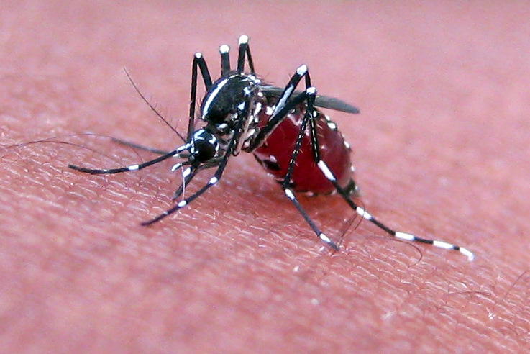
Arboviral Diseases
………………………………………....
Identify cases for follow up
Notes:
Success story: https://www.surveillancerepository.org/syndromic-surveillance-arboviral-diseases-arizona

Slide 60
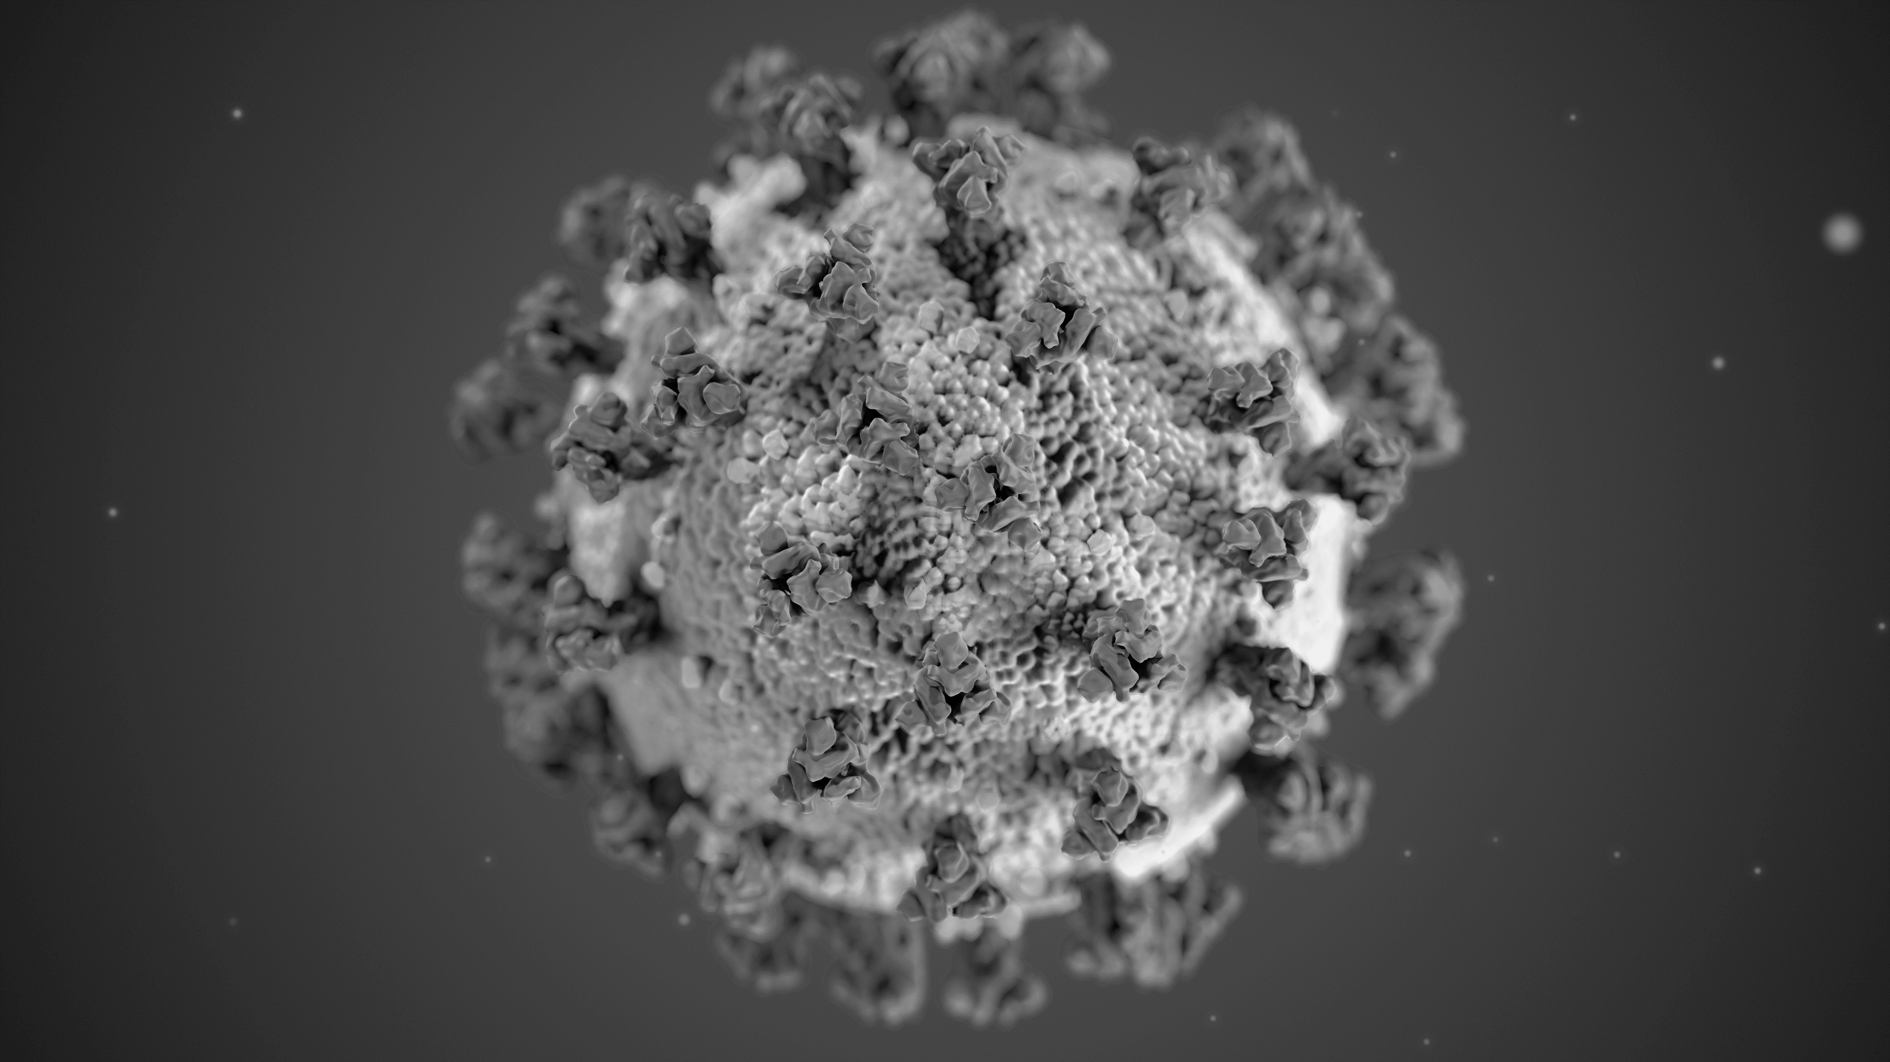
COVID-19
………………………………………....
Early alert detection of emergent condition
Severity of hospitalizations
Trends of community spread of disease

Slide 61
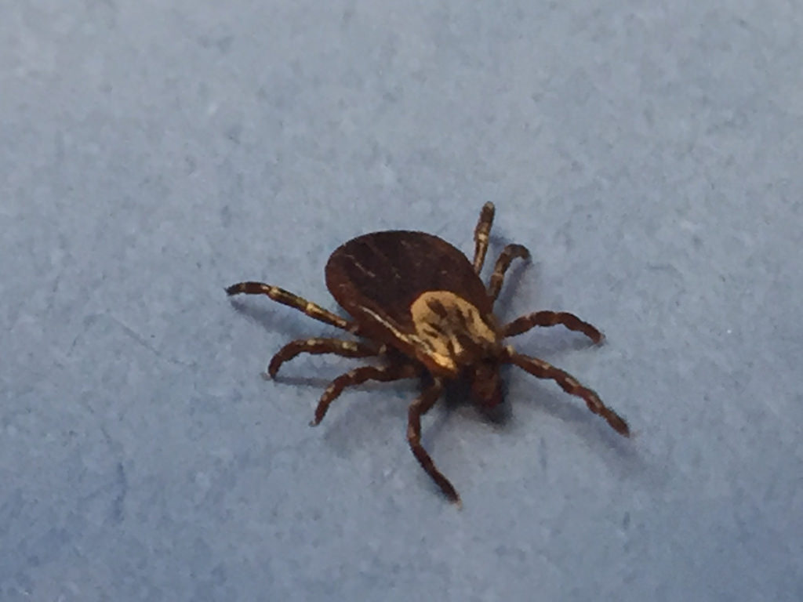
Rocky Mountain Spotted Fever
………………………………………....
Continuity of care
Notes:
Success story: https://www.surveillancerepository.org/monitoring-transfer-patients-rocky-mountain-spotted-fever-tribal-lands-facilities-maricopa-county
SPHERR Subcommittee Call 9/7/2018: https://vimeo.com/288808322

Slide 62

Opioid Overdose
………………………………………....
Identify Cases for follow up
Prevention of overdoses
Notes:
CDC DOSE: https://www.cdc.gov/drugoverdose/data/nonfatal/case.html

Slide 63
THANK YOU!
syndromicsurveillance@azdhs.gov | 602-542-6002
azhealth.gov
@azdhs
facebook.com/azdhs

