Slide 1

From Essence to Tableau- Developing a Heat Dashboard
From Essence to Tableau- Developing a Heat Related Illness (HRI) Dashboard
Exploratory Analysis Subgroup- Aug 17, 2022
Jamaica Dillard, MPH
Niki Lajevardi Khosh, MPH
From Essence to Tableau Developing a Heat Illness Dashboard
Exploratory Analysis Subgroup
Jamaica Dillard, MPH
Niki Lajevardi-khosh, MPH

Slide 2

Train Staff
Monitor
Internal/External
Act
HRI Dashboard
Data Visualization
Analyze
Collaborate
Communicate

Slide 3
HRI Emergency Room Query
ESSENCE filters used to identify emergency department (ED) Visits in Arizona facilities in Arizona residents:
  Datasource: Facility Location (full details)
  Start Date: May 1
  End Date: September 30
  Hospital State: AZ
  Patient Location: All AZ Counties
  CC and DD Category: Heat-related Illness v2
  Patient Class: Emergency
  Facility Type: Emergency

Slide 4
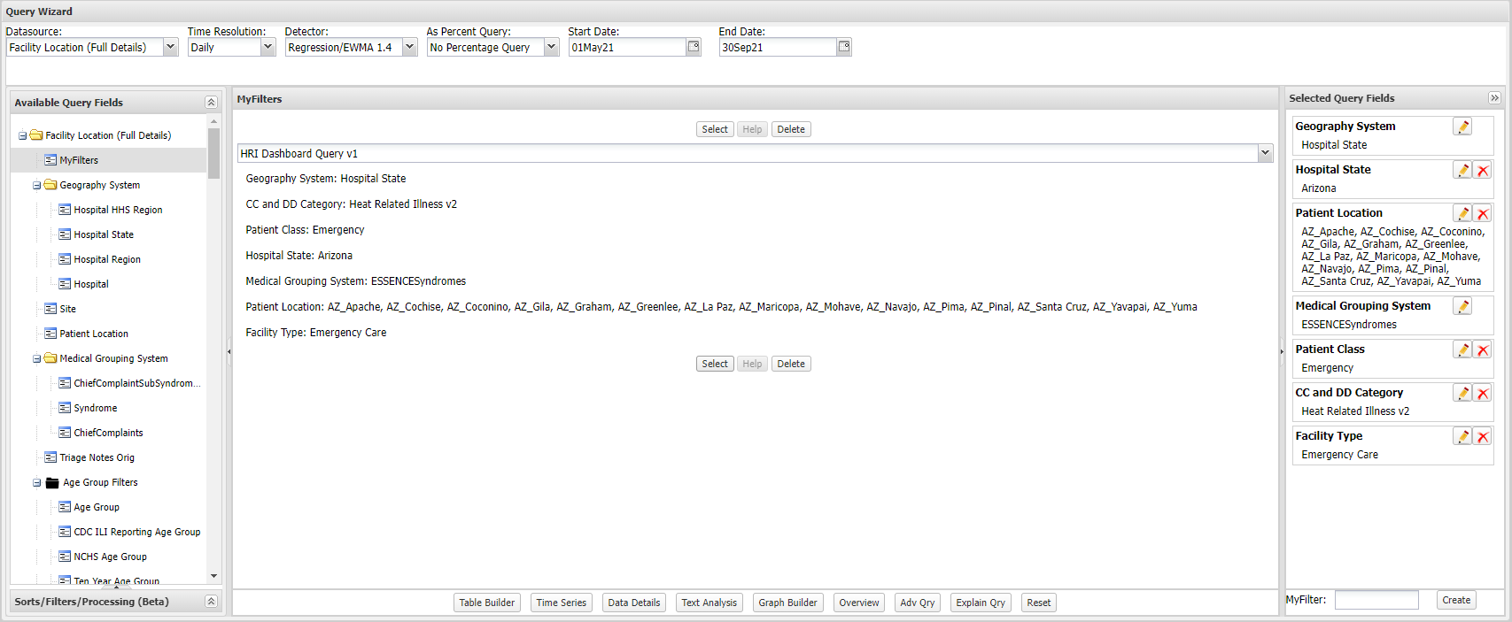

Slide 5
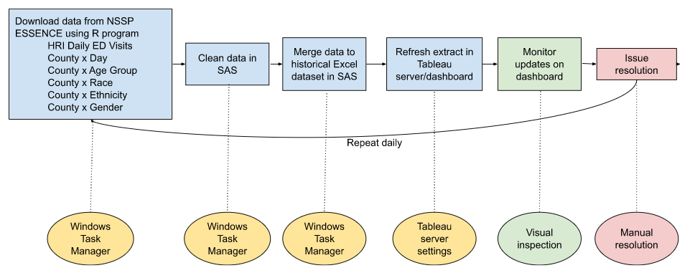
HRI Dashboard Data Workflow

Slide 6
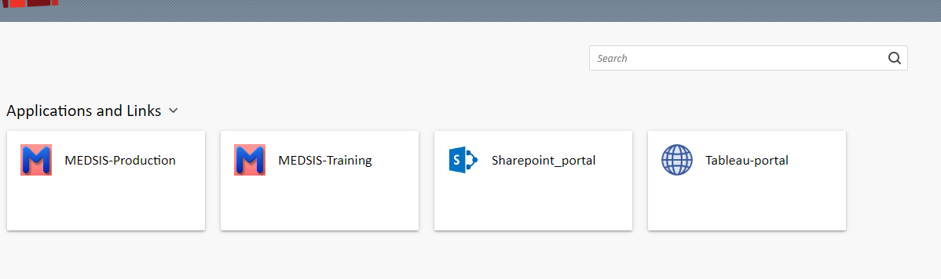
Access to the HRI Dashboard
HRI dashboard available on the Local Public Health Server via the Health Services Portal
  Permission is granted automatically once user logs in
1-2 users from each local jurisdiction will have access to the dashboard
Viewers can view statewide data and data for their respective jurisdictions

Slide 7
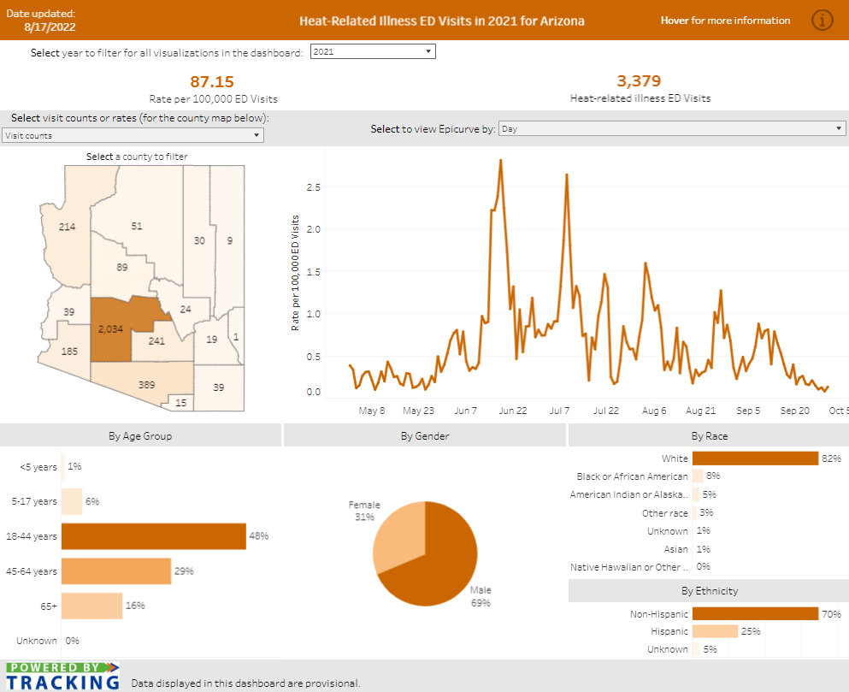
Dashboard Demonstration

Slide 8

Evaluation

