Slide 1
Exploratory Analysis
October 19th

Slide 2
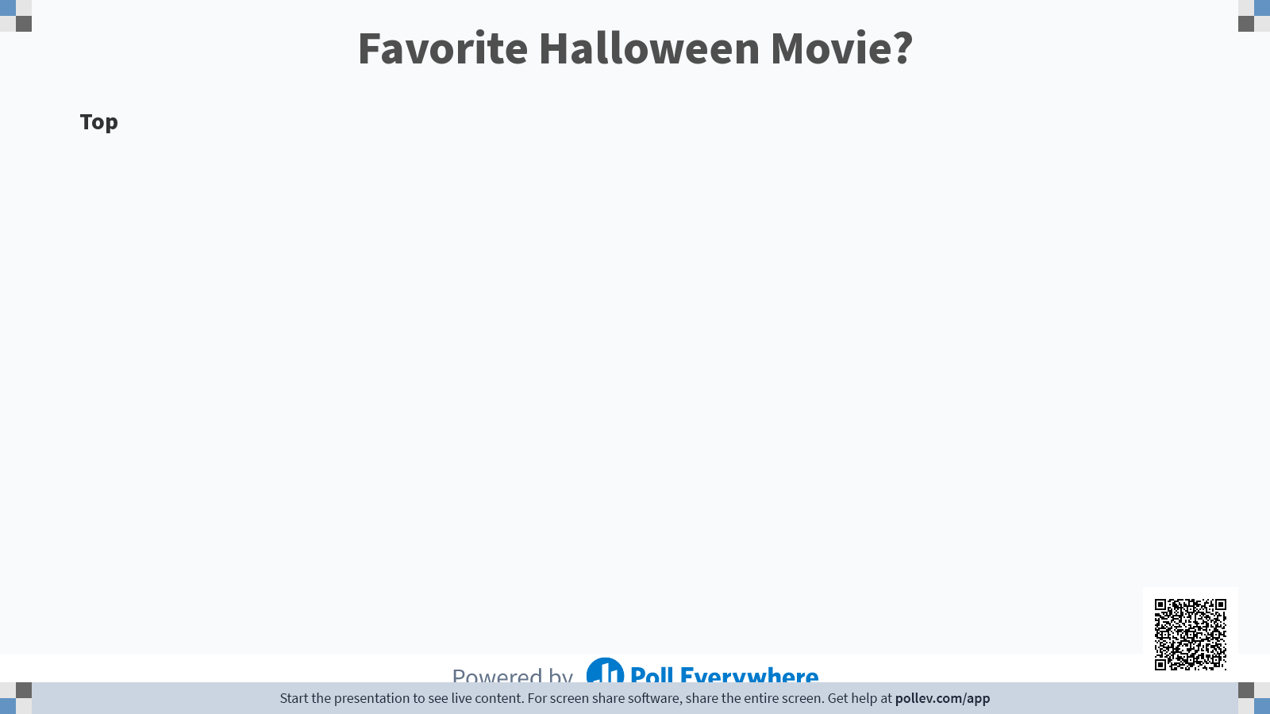

Slide 3

Agenda
Introduction & Welcome
Updates
  NSSP
  Arizona
  Call for Workgroup
  Drowning Query
Presentations
  Opioid Dashboard
  Infant Formula Shortage Response
Questions/Open Mic
Closing

Slide 4
Updates: NSSP
Syndromic Surveillance Symposium
  Registration Now Open
  Register By November 14th
  Dates: December 6th and 7th from 10:45AM - 3:00 PM and December 8th from 10:45 AM - 1:30 PM
Updates to AMC & Dashboard
  DQ Dashboard Updated
  Now alert system on BioSense page about what is going on
  Updates to Adding new users and adding facilities to MFT

Slide 5
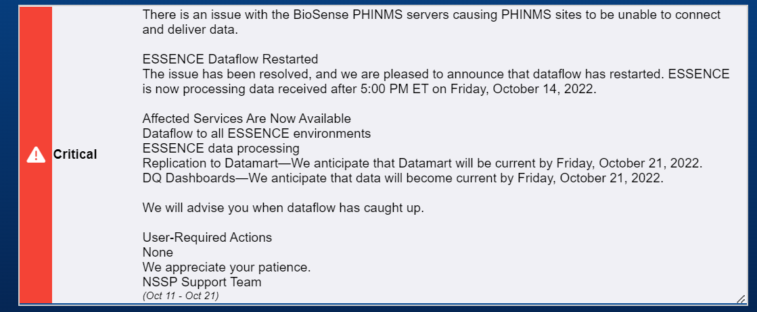
Dashboard Update

Slide 6
Updates: Arizona
Onboarding
  Still undergoing a re-validation of Arizona General Hospitals and Northwest Medical as they undergo a EHR vendor switch.
  Awaiting responses from Benson, Sage, and Yavapai for Hl7 Data
Data Quality
  No issues with validity
  Seven Facilities saw low timeliness
  There was low completeness amongst urgent care clinics
  We have reached out to affected facilities.

Slide 7

Call for Workgroup
Super bowl happening on February 12th, 2023 at the State Farm Stadium
Call for Maricopa County and State users who want to join our workgroup for events around the Superbowl.
Monthly meetings leading up to the event
Send me an email: rachel.berg@azdhs.gov

Slide 8
Drowning Data
CDC has a unintentional drowning CCDD Category, this query was developed to identify initial visits for unintentional drownings in Emergency Departments.
CDC Unintentional Drowning v1
There is also an example of a free text query that can be applied to the Discharge Diagnosis Category
(,^drown^,or,^submer[gs]^,or,^under water^,),andnot,(,^feel[s] like^,or,^suicid[ea]^,or,^sensation^,or,^cast^,),or,^;9941^,or,^;T751^,or,^;E910^,or,^;W67^,or,^;W69^,or,^;W73^,or,^;W74^,or,^Y21^,or,^W65^

Slide 9
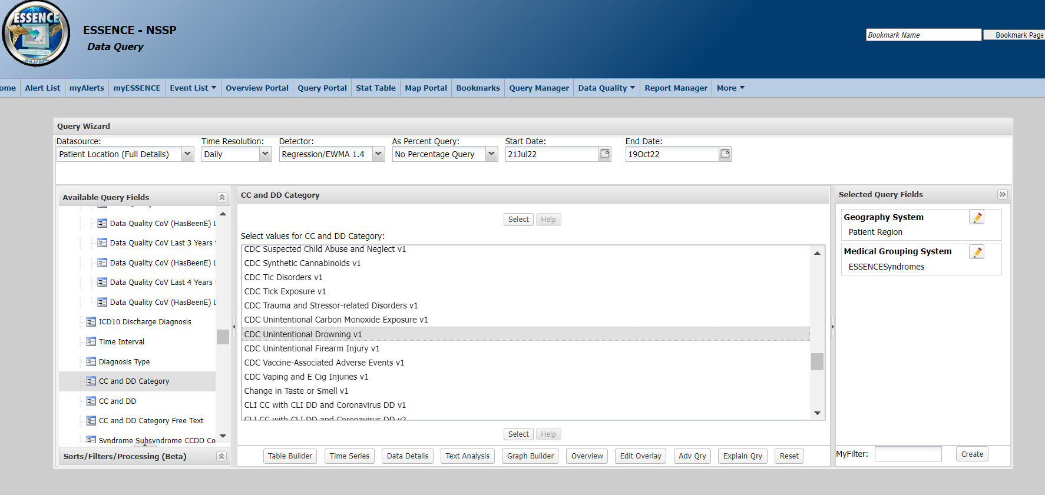
Drowning-CCDD

Slide 10
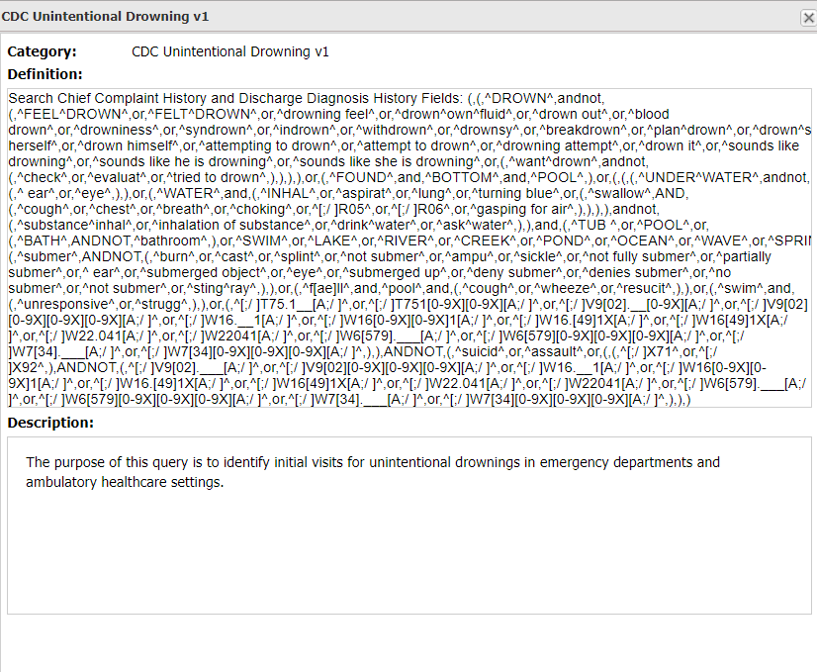

Slide 11
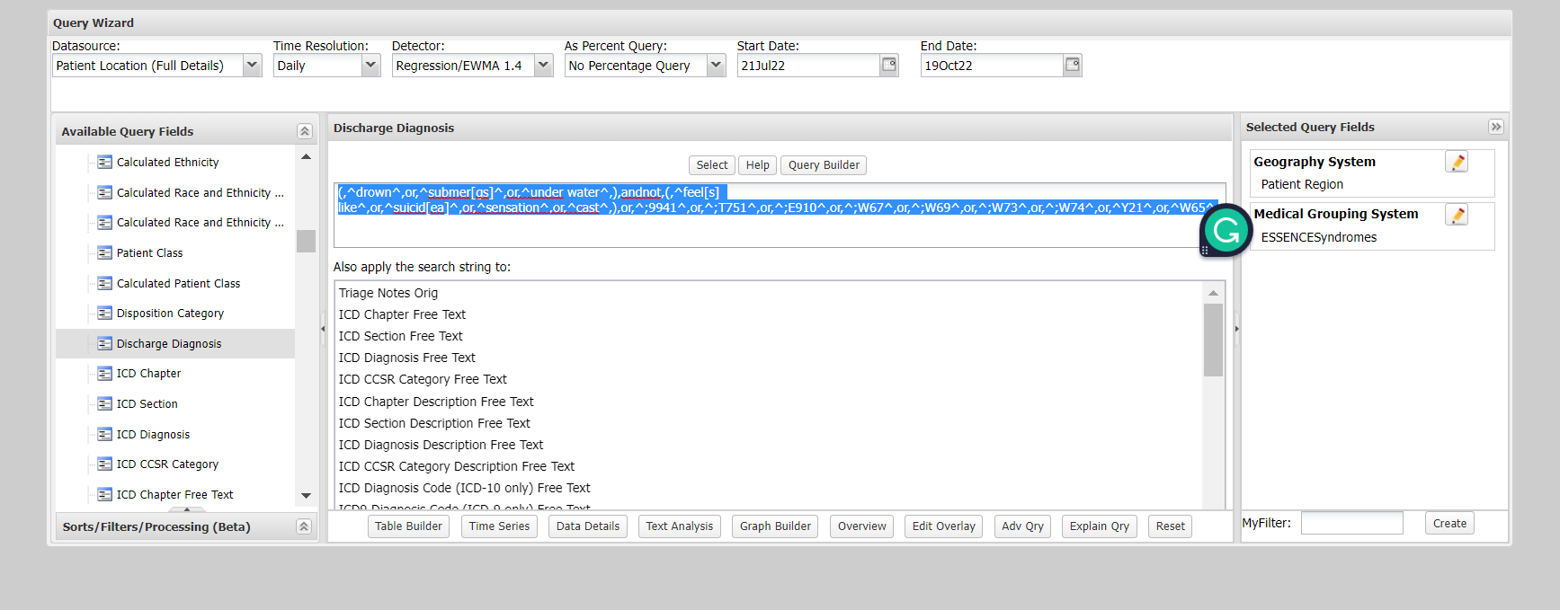
Drowning- Discharge Diagnosis

Slide 12
Presentations
Opioid Dashboard-Lubaba Tasnim

Slide 13
Presentation
Use of Syndromic Surveillance for the Infant Formula Shortage Response - Shayne Gallaway & Samantha Davidson

Slide 14
Use of Syndromic Surveillance for the Infant Formula Shortage Response
Samantha Davidson, MS
Shayne Gallaway, PhD, MPH
Infant Formula Shortage, Impact Monitoring Team

Slide 15
Brief Overview
Timeline
  Formula Recall/Production
  Media Attention
Health Response Operation Center (HROC)
  Structure
  Roles
Guidance
Direction

Slide 16
Data Types
What do we know to help inform Arizona mothers and families?
Availability of formula
Assistance needed by families/infants
Health outcomes

Slide 17
Data Sources
GIS
WIC
Hotlines
Syndromic Surveillance (ESSENCE)

Slide 18
Syndromic Surveillance Dashboard Design
Query Language
NSSP Collaboration
Dashboard Development

Slide 19
Syndromic Surveillance Monitoring Process
Updated the Impact Monitoring Team’s “Dashboard” on a weekly basis
  Every Monday Pull Previous Week’s Data
    Sunday-Saturday
Will monitor intermittently as ADHS response comes to an end

Slide 20
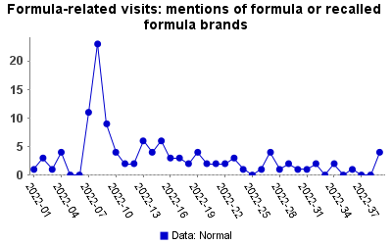
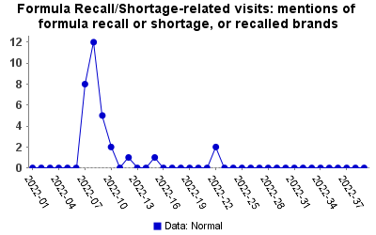
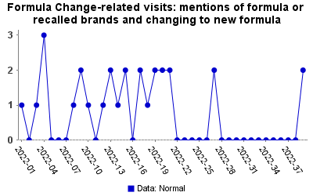
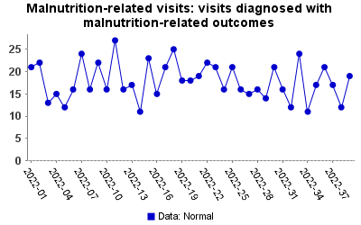
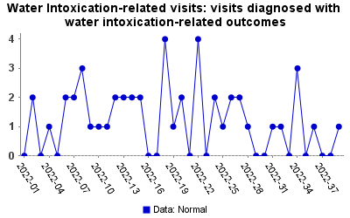
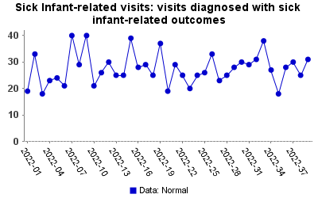
AZ ESSENCE
Week Ending October 1st (as of October 3rd)
Summary: Nothing significant to report; no emerging trends during previous week
(POC: Shayne Gallaway, Sam Davidson, Glenda Ramirez; Impact Monitoring Team)
Notes:
Mention that we consistently had nothing significant to report since starting this in June (week 2022-22), but had the numbers spiked, this would have been our only tool to observe health outcomes from the shortage

Slide 21
Lessons Learned/Best Practices
Engage early with key stakeholders
Leverage key information for multiple purposes
Multiple-roles/users with access to ESSENCE

Slide 22
Questions
Have you used the Handbook since it has been published?
Do you think it would be beneficial work with university partners and share syndromic surveillance data?
What questions do you have about using syndromic data this month?

Slide 23
Upcoming Dates
NSSP CoP October 26th at 9:00-10:30
  Every 4th Wednesday of the month
Arizona Community of Practice November 30th at 1:30PM
Syndromic Surveillance Symposium December 6th-8th
Exploratory Analysis December 21st at 1:30
  Every other month on the 3rd Wednesday

Slide 24

Thank you!
syndromicsurveillance@azdhs.gov

