Slide 1

Exploratory Analysis
April 19th 2023

Slide 2
Agenda
Introduction
Updates
  Arizona
  NSSP
ACE’s Dashboard
Syndrome Definition Creation
Open Mic/Questions
Closing

Slide 3
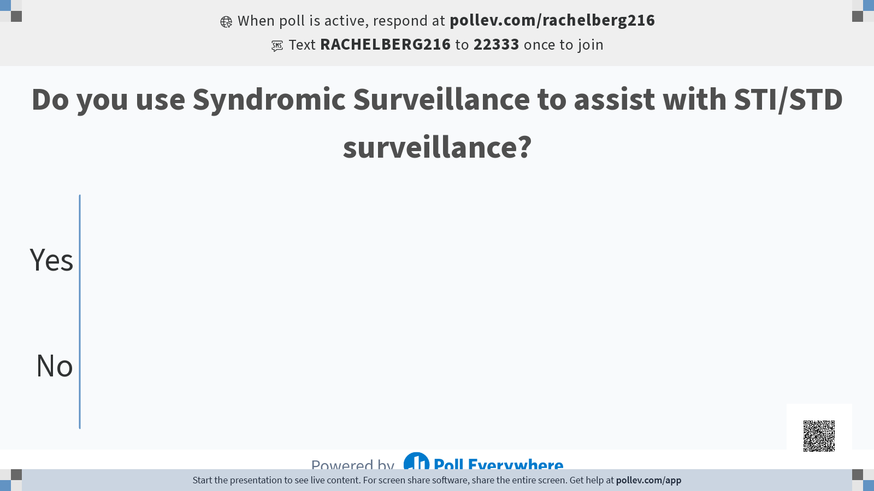

Slide 4
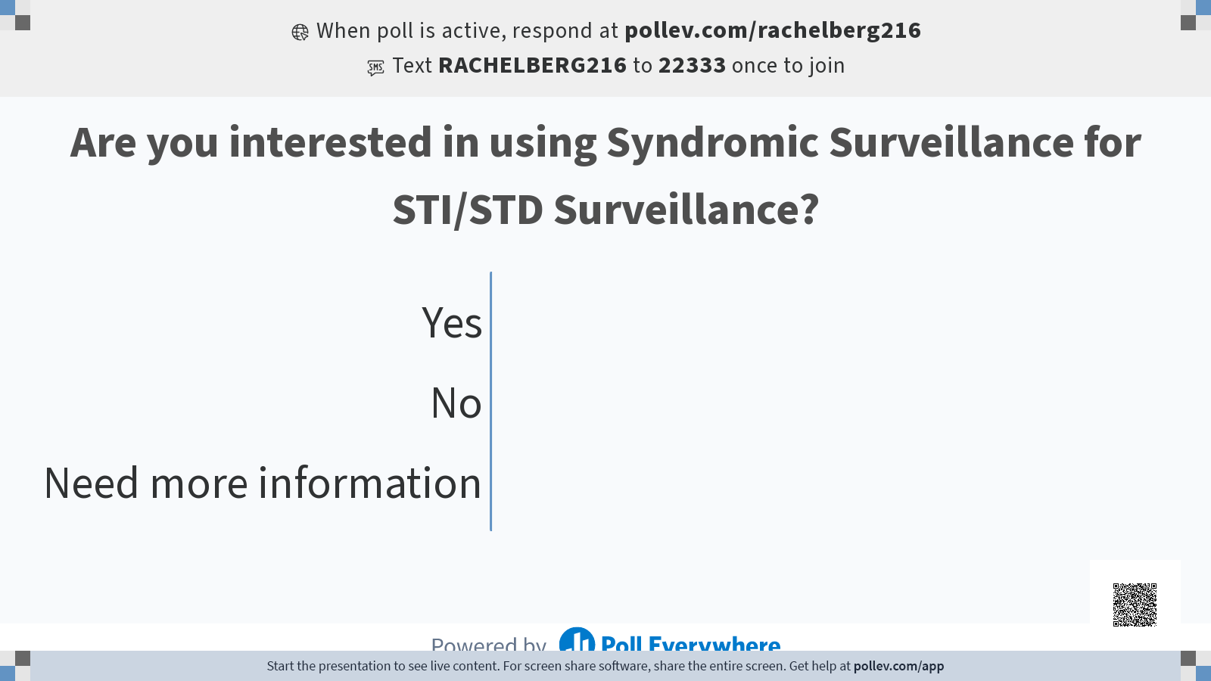

Slide 5
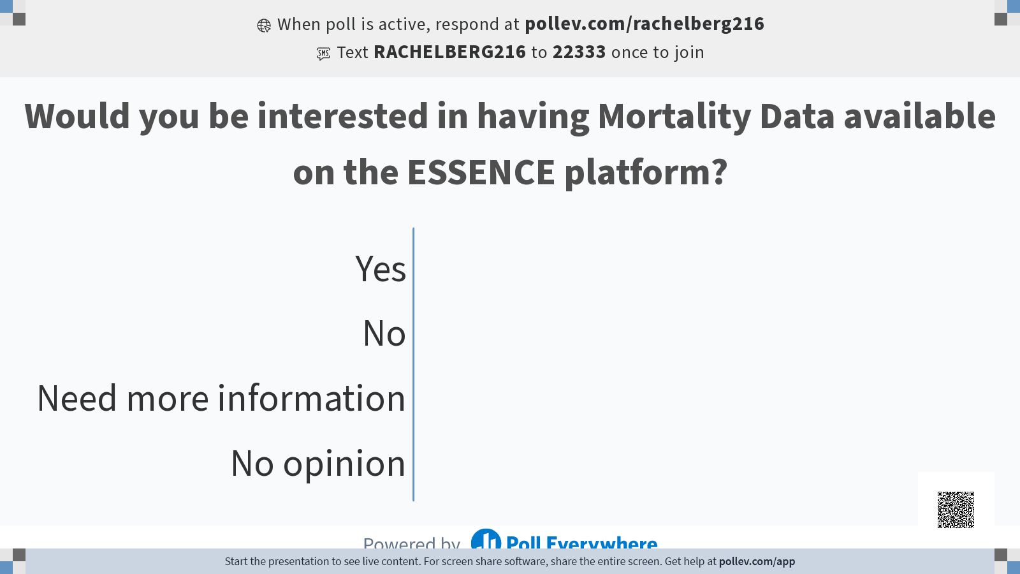

Slide 6
Updates: Arizona
Onboarding
  Benson & Sage
  Dignity Health - New Data Validation start date late April
  Recently Met with NSSP onboarding team about onboarding freestanding Urgent care centers
Data Quality
  Still waiting for response from NSSP about Low CC string length for Banner Health facilities

Slide 7
Data Quality Report
Completeness (03/15/23 to 04/15/23)
Banner Facilities
St Joseph’s Hospital and Medical
Mercy Gilbert Medical Center
Chandler Regional Medical Center
Summit Regional Medical Center
Validity (03/15/23 to 04/15/23)
Facility Type Code exceptions:
Summit Healthcare Regional Medical Center (0%)
Chandler Regional Medical Center (66%)
Mercy Gilbert Medical Center (68%)
St Joseph Hospital and Medical Center (85%)
Timeliness (03/15/23 to 04/15/23)
These parent organizations have issues with timeliness:
· Dignity Health

Slide 8
Syndromic Team
Presenting the Ace’s dashboard and working with anyone interested in implementing using the dashboard
Exploring the possibility of onboarding mortality data
Creation of training, specifically around overdose and drug surveillance
Syndrome Validation for Youth and Community Violence

Slide 9
Updates: NSSP
Next NSSP Community of Practice Meeting will happen on April 26 at 9 AM
2 new Syndrome Definition Fact sheets have been published on the Knowledge Repository. Chicken Pox and Broad Acute Respiratory Illness.
Currently CDC is working on developing the following syndromes, Boating Injuries, Confirmed Child abuse and neglect, initial visits for head injury, pedestrian injury, persons identifying as transgender, persons with diabilities, suicide attempt version 2.

Slide 10
NSSP New Workgroup
Public Use Data Set Workgroup , looking for co-leads and is in the planning stages, if you would like to be a co-lead of this workgroup reach out to James Muncy of CSTE.
Purpose: Explore questions and considerations that go along with the public presentation and release of data and information that are products of performing syndromic surveillance.
Develop a collective response to these that is informed by the community who works most closely with these data.
Notes:
Deliverables: Framework for an initial public use dataset from emergency department data including variables, usage recommendations, documentation of data provenance and footnotes, ect
Best Practices document that outlines important considerations around the public sharing of syndromic surveillance data and information
Sucess stories of how publicly shared data has been used

Slide 11
NSSP Updates
Reminder: New Subcommittee: Analytic Tools for Routine Health Surveillance, meets monthly second Thursday each month.
Sex Trafficking syndrome validation,soon there will be a factsheet available, be on the lookout for that
Notes:
The topic will be the Moving Epidemics Method (MEM) for computing intensity levels from multi-year baselines of influenza or RSV (or potentially other seasonal outcomes) visits, including methods for detecting out-of-season behavior using seasonal temporal detectors
Focus on providing each LHJ local intensity thresholds.
Another sesion focused on Anomaly Detection and Trend Classification

Slide 12
Marburg Virus
Travel Mentions (Tanzania and Eq. Guinea-specific for MVD)
^Tanzania^,or,^equatorial guinea^,andnot,(,^taking trip to^,or,^travel consult^,or,^traveling to^,or,^immun^,or,^;Z7184^,or,^;Z298^,)
CCDD Definition: targeting Marburg virus disease
(,(,^marb[uae]rg[ v]^,or,^marb[uae]rg,or,!ravn!,or,^lake vi[kc]toria^,or,^[;/ ]a98.3^,or,^[;/ ]a983^,or,^[;/ ]77503002^,or,^[;/ ]788872004^,or,^[;/ ]766246000^,),andnot,(,^marburg variant^,or,^marburg heart score^,or,^marburg risk^,or,^ravn alaska^,or,^ravn air^,),)
Broad definition that may be useful:
Travel Mentions (Broad approach including Africa and neighboring countries of Tanzania and Eq. Guinea)
(,!africa!,ANDNOT,(,^south Africa^,or,^west Africa^,or,^taking trip to Africa^,or,^Africa trip^,),OR, ^tanzania^,OR,^uganda^,OR,!kenya!,OR,!rwanda!,OR,^burundi^,or,^equatorial guinea^,or,^cameroon^,or,^gabon^,),ANDNOT,(,^traveling to^,or,^travel consult^,OR,^;Z7184^,OR,^;Z298^,OR,^malaria^,OR,^;B5[0-4]^,OR,^typhoid^,OR,^;A010^,)
CCDD broad definition: with discharge diagnosis for other viral hemorrhagic fever (a98) included.
(,(,^marb[uae]rg[ v]^,or,^marb[uae]rg,or,!ravn!,or,^lake vi[kc]toria^,or,^;a98^,or,^[;/ ]77503002^,or,^[;/ ]788872004^,or,^[;/ ]766246000^,),andnot,(,^marburg variant^,or,^marburg heart score^,or,^marburg risk^,or,^ravn alaska^,or,^ravn air^,),)
Notes:
NSSP Team has created a few initial query ideas to help look at the Marburg Virus. If you are interested in assisting with improving this, look to the NSSP slack channel under general to see the discussion

Slide 13
R scripts on Basecamp / Training videos
The Syndromic Surveillance Symposium to the Basecamp under Training Resources tab, along with some new essence training information, as well as the query development guide, the new guide to using R with ESSENCE API.
Also added R script from Opioid dashboard and flu dashboard, note, these might need to be updated every time NSSP does an update.

Slide 14
Adverse Childhood Experiences (ACEs) Dashboard
AZ Syndromic Surveillance Team

Slide 15
Agenda
What is ACEs?
ACEs Dashboard
Next steps

Slide 16
Adverse Childhood Experiences (ACEs)
Adverse Childhood Experiences refer to specific kinds of adversity and traumatic events during childhood and adolescence (0-17 years). ACEs impact the health, wellbeing, and quality of life for children, families, and communities in Arizona. Since the 1990s, extensive research has shown how elevated stress and trauma experienced early in life can have detrimental and long-term effects on the quality of life into adulthood.

Slide 17
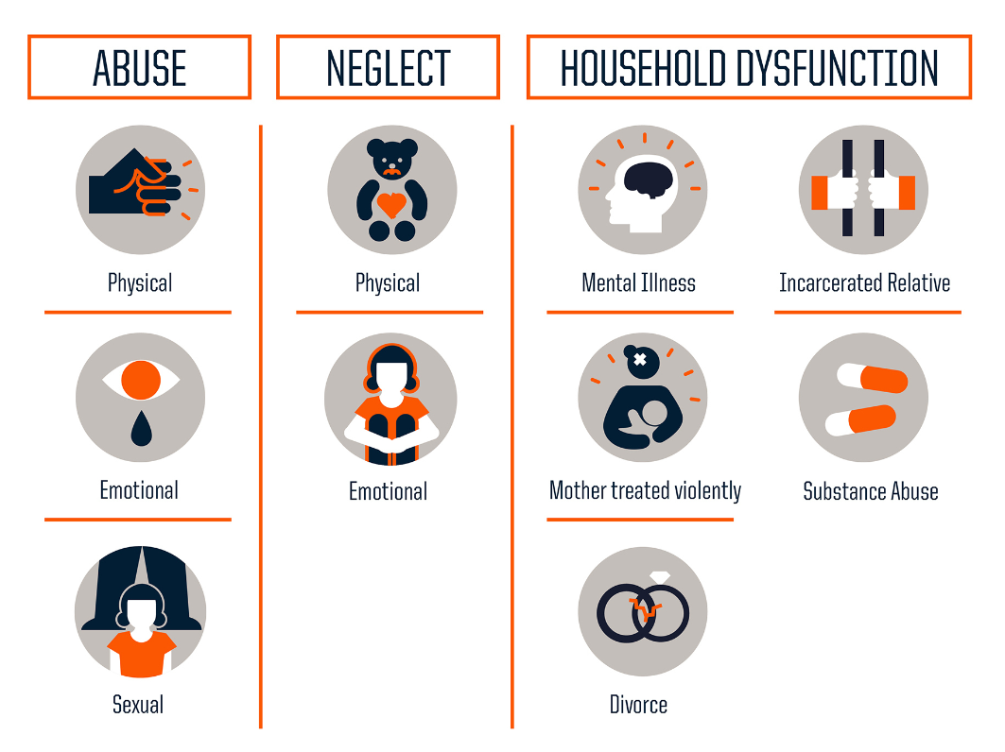
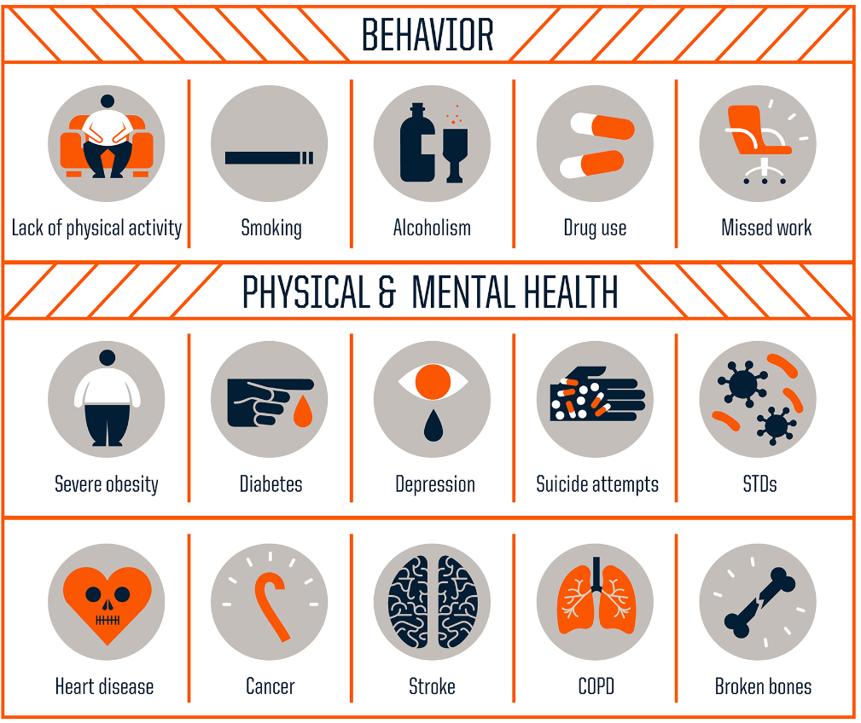
What are ACEs?

Slide 18
ACEs Impact in Arizona
Between 2014 and 2016, Arizona has continually ranked as one of the top ten states with the worst child wellbeing outcomes. In 2019, the Arizona Department of Health Services issued an ACE action plan to address ACES in Arizona. The three primary objectives of the ACE plan are to:
1) reduce the number of ACES children experience
2) evaluate Arizona’s data to understand the factors contributing to high ACE exposure in children
3) mitigate the adverse health outcomes resulting from ACES.

Slide 19
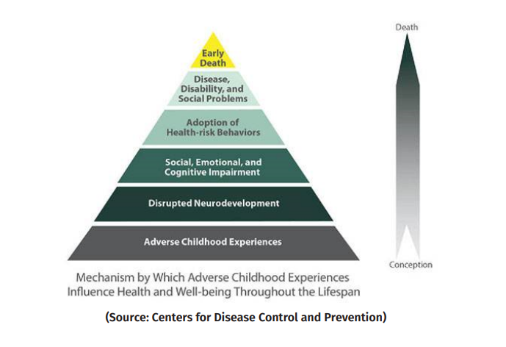
The original ACE Study was conducted in 1995-1997 by the U.S. Centers for Disease Control and Prevention (CDC) and Kaiser Permanente Health Care Organization in California. More than 9,000 adults in the Kaiser network were surveyed about their exposure to abuse and household dysfunction during childhood.

Slide 20
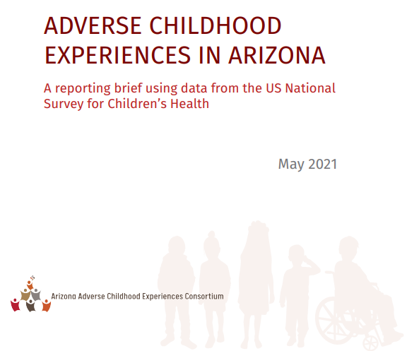
All information from the presentation is from the Adverse Childhood Experience in Arizona brief from the AZ Department of Health Services and AZ Adverse Childhood Experience Consortium.

Slide 21
ACEs Dashboard
Split into three categories
Direct Experience of Adverse Childhood Experiences
  Ace’s experienced by a child under 18 years of age that lend to direct measurement at patient or visit level.
Household and Community Challenges among adults
  This section looks at phenomena in adults over 18 as a indirect way to measure community and household challenges
Potential Outcomes of Adverse Childhood Experiences
  A possible way to measure potential real time outcomes of ACEs
Notes:
Only certain types of Ace’s can be directly measured using Syndromic Surveillance Emergency department data source.
Childhood abuse and neglect, childhood sexual violence, childhood firearm injury, childhood experiences of homelessness
Can only be assessed indirectly to gauge general adult household burden, Only looking at adults over 18 to measure: Mental Health conditions, Suicide related visits, drug overdose and alchohol misuse, adult sexual violence, intimate partner violence, and firearm injury
Childhood mental health, childhood substance abuse, childhood sucicide related, queries that have been linked to ace’s previously, among kids and adolescents.

Slide 22
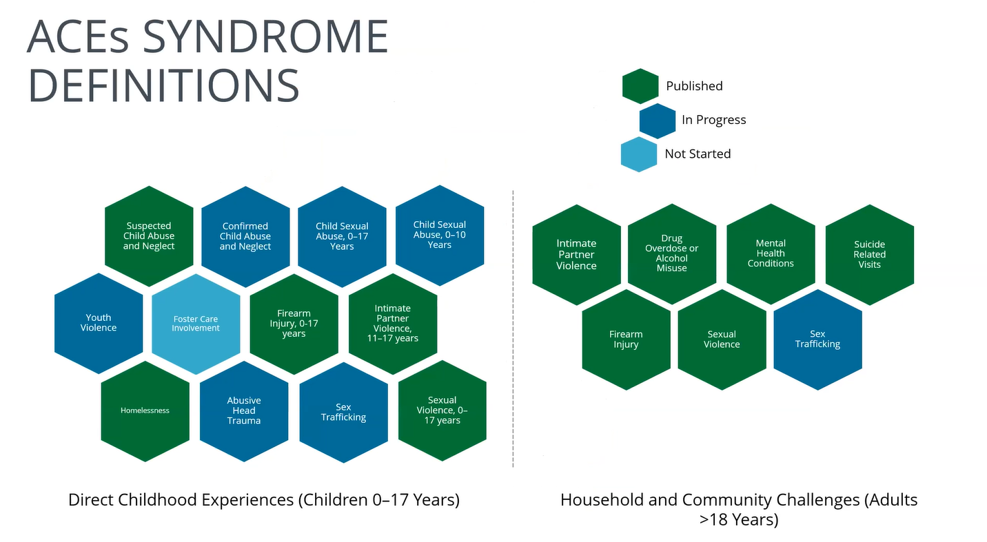
Ace’s Dashboard
Notes:
Status of various definitions, all syndrome definitions are patient visit level data and all are CCDD CDC Definitions that either have a fact sheet or explanation of the defintion in the available in ESSENCE.
Already validated syndrome definitions

Slide 23
Syndrome Definitions
Suspected Child Abuse:
Homelessness:
Firearm Injury:
Intimate Partner Violence:
Sexual Violence:
Drug Overdose and
Alcohol misuse
Suicide related visits:
  Suicide ideation and suicide attempt
Mental health conditions
  Anxiety Disorders, Depressive Disorders, Trauma and Stressor Disorders, ED Disorders
Notes:
Suspected Child Abuse- The purpose of the suspected child abuse and neglect (sCAN) syndromic surveillance definition is to monitor trends in childhood maltreatment in emergency departments and ambulatory healthcare settings. For the purposes of this syndromic definition, suspected child abuse or neglect are categorized as visits related to suspected or confirmed physical, sexual, or emotional abuse; and physical or emotional neglect as perpetrated by parents, caregivers, or an authorized custodian of the child. Acts of violence perpetrated by peers, siblings, or intimate partners are excluded from the sCAN definition.
Firearm injury: Created by partners in the CDCs National Center for Injury Prevention and Control to support states and jurisdictions to query visits related to an initial encounter of a firearm injury, including the following types: unintentional, intentional self-directed, assault, legal intervention, terrorism, and undetermined intent.
Intimate partner violence: The query was developed by NSSP and CDC Division of Violence Prevention. It was developed to assist rape prevention coordinators and project officers in doing sexual violence and intimate partner violence surveillance using syndromic surveillance. An ESSENCE CCDD category has been created and its called Intimate Partner Violence v1.
Sexual Violence-The query was updated and developed in collaboration with NSSP & CDC Division of Violence Prevention for a version 2 of the Sexual Violence syndrome. The syndrome is intended for rape prevention coordinators for their surveillance work at local and state health departments. The query has been added to the CCDD category and is named Sexual Violence v2.
Drug Overdose-CDC scientists first started developing the definition using guidance from the United States Drug Enforcement Administration, Council of State and Territorial Epidemiologists, and the Substance Abuse and Mental Health Services Administration. First, International Classification of Diseases, 10th Revision (ICD-10-CM) and 9th Revision Clinical Modification (ICD-9-CM), and Systematized Nomenclature of Medicine (SNOMED) diagnosis codes indicating an acute drug poisoning were identified; this was followed by identifying and adding overdose terms that could be presented in the chief complaint free text. Finally, drug terms indicating that any type of drug was involved in the overdose, also that could be presented in the chief complaint free text, were identified and added. The definition was developed to be inclusive of all drug types, not specifically those that may be illicit versus prescription
Suicide related-This query was created as a collaboration between the ISDS Syndrome Definition Committee (SDC) members with input from the CDC, Division of Violence Prevention. The query includes keywords and discharge diagnosis codes (ICD 10, ICD 9, and SNOMED) for self-harm, suicide ideation and suicide attempt. The query has been evaluated using national and local data from several states and counties. The results from the evaluations can be found on the slides and recordings from the monthly meetings, located on the SDC page. The group is currently working on documenting the creation process in a guidance document.
Mental Health-The purpose of this query is to identify visits among persons experiencing mental illness in emergency departments and ambulatory healthcare settings. This includes capturing visits where there are acute mental health crises (i.e., the sole or primary reason for the visit is only related to mental health) as well as visits where mental health conditions are present (defined as coded in the discharge diagnosis or mentioned in the chief complaint text) but may not be the sole reason for the visit.
Updated v1 on 12/16/21 to add ICD-10-CM F32.A (Depression, unspecified).
Anxiety Disorders=The purpose of this query is to identify visits among persons experiencing mental illness in emergency departments and ambulatory healthcare settings. This includes capturing visits where there are acute mental health crises (i.e., the sole or primary reason for the visit is only related to mental health) as well as visits where mental health conditions are present (defined as coded in the discharge diagnosis or mentioned in the chief complaint text) but may not be the sole reason for the visit.
Depressive Disorders: The purpose of this query is to identify visits among persons experiencing mental illness in emergency departments and ambulatory healthcare settings. This includes capturing visits where there are acute mental health crises (i.e., the sole or primary reason for the visit is only related to mental health) as well as visits where mental health conditions are present (defined as coded in the discharge diagnosis or mentioned in the chief complaint text) but may not be the sole reason for the visit. Updated v1 on 12/16/21 to add ICD-10-CM F32.A (Depression, unspecified).
Eating Disorders: The purpose of this query is to identify visits among persons experiencing mental illness in emergency departments and ambulatory healthcare settings. This includes capturing visits where there are acute mental health crises (i.e., the sole or primary reason for the visit is only related to mental health) as well as visits where mental health conditions are present (defined as coded in the discharge diagnosis or mentioned in the chief complaint text) but may not be the sole reason for the visit.
Trauma : The purpose of this query is to identify visits among persons experiencing mental illness in emergency departments and ambulatory healthcare settings. This includes capturing visits where there are acute mental health crises (i.e., the sole or primary reason for the visit is only related to mental health) as well as visits where mental health conditions are present (defined as coded in the discharge diagnosis or mentioned in the chief complaint text) but may not be the sole reason for the visit.

Slide 24
Let’s Dive into the Dashboard

Slide 25
Questions?
Notes:
Are all the adults parents?
Usages of the dashboards?

Slide 26

Next steps….
Read the Adverse Childhood Experience in Arizona brief - aces-brief-az-may-2021.pdf (azdhs.gov)
We will share ACEs dashboard user manual when available.
You can share the dashboard with other members of your team.
Discuss the implementation or usage of the dashboard with your team.
Please reach out to the AZ SyS email (syndromicsurveillance@azdhs.gov) regarding questions on how to implement the ACEs dashboard.
Create a public facing dashboard for ACEs within AZDHS.
Notes:
aces-brief-az-may-2021.pdf (azdhs.gov)

Slide 27
How to Create a Syndrome Definition
List out alternative names, causes, and symptoms for disease or condition
See what work has been already been done to avoid duplicate work
  Check the Syndrome Definition Library, check the Knowledge Repository for syndrome definition fact sheets
Search for topics in the NSSP Community of Practice Slack platform and knowledge repository,
Search ICD-10 codes List symptoms and other free text query criteria related to condition. Also list appropriate negation.
Put terms in ESSENCE syntax
Review Syntax
Notes:
Wanted to talk about how NSSP is always validating Syndrome Definitions but you don’t have to wait on the official CDC definition to be able to use ESSENCE. There is actually a CDC guide on how to develop queries, so I thought we could review it together.
List out alternative names, causes, and symptoms for disease or condition
See what work has been already been done to avoid duplicate work
Check the Syndrome Definition Library, check the Knowledge Repository for syndrome definition fact sheets
Search for topics in the NSSP Community of Practice Slack platform and knowledge repository,
Search ICD-10 codes When selecting one, note that ICD-10-CM
List symptoms and other free text query criteria related to condition. Also list appropriate negation.
Put terms in ESSENCE syntax
Review Syntax
https://www.cdc.gov/nssp/documents/guides/Query-Development-Job-Aid-508-FCx.pdf

Slide 28
Essence Syntax
In ESSENCE, the wildcard is the “^” symbol, called a caret.
_ Underscores: A placeholder indicating that something must be present in the position.
[ ] Brackets: Placeholders that specify items that can be present in a position.
“OR” statements are the most basic way to use multiple query terms in ESSENCE. Many queries and data explorations start with a basic search for “SYMPTOM #1” OR “SYMPTOM #2.”
“AND” statements are another way to use multiple query terms to craft a syndrome definition in ESSENCE. Terms linked by an “AND” statement look for visits that meet more than one criteria.
“ANDNOT” statements, also referred to as negations, exclusions, or exclusionary statements, are a common way to specify what you do not want your query to return.
Parentheses: Complex syndrome definitions often use parentheses to group terms and apply statements in different ways. “ANDNOT” statements are frequently used alongside parenthetical groupings.
Notes:
A caret in a free-text ESSENCE query can represent a search for anything, everything, and nothing—and all at the same time! If a user submitted a Chief Complaint free-text query of only a caret, the query would return all visits.
Brackets are commonly used in discharge diagnosis (DD) queries. DD codes frequently begin with a bracketed list of punctuation to ensure you get the start of a DD code and that your queried text won’t appear in the middle. Underscores are also useful in DD queries.
applied to terms separated by a comma, but a best practice is to include all operators to improve troubleshooting and readability when sharing syndrome definitions.
“AND” statements do not specify the order the terms appear or location within the field queried. “AND” operators follow the same format as “OR” statements and must be surrounded by commas. The correct query format for THIS, and THAT, and THERE follows: THIS,AND,THAT,AND,THERE

Slide 29
Free Text ESSENCE Syntax
Free Text Querying is Syntax Based
Free Text Queries are not case sensitive
Free text querying syntax : AND, OR, ANDNOT
Order of Operations
  Parenthesis
  AND/ANDNOT (left to right
  OR (left to right)
Tip Use query builder to visualize operational grouping of logic
  ,(,^cough^,or,^fever^,),andnot,^cold^,),and,^flu^
Notes:
,(,^cough^,or,^fever^,),andnot,^cold^,),and,^flu^
Note the common practice of enclosing a free-text term within two carets. This ensures that despite the location or order, the terms cough, fever, or flu will appear in the Chief Complaint and be applied correctly.
For short text segments like the preceding ^flu^ example, surrounding text in carets increases the power of your query by allowing a single term to return text related to FLU and inFLUenza; however, these short text segments can also appear within other words like FLUid, reFLUx, or inFLUence. The example above solves this problem by linking ^Flu^ to other terms with an “And” operator to help narrow down results.
https://www.cdc.gov/nssp/tech-tips/free-text-coding/part1.html

Slide 30
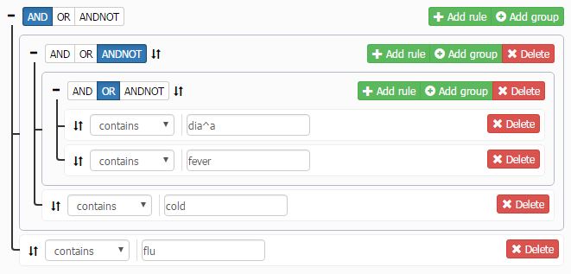
Example
(,(,^dia^a^,or,^fever^,),andnot,^cold^,),and,^flu^

Slide 31
Example Drowning and Submersion Syndrome Definition
Discharge Diagnosis
W16.__1 – W16 codes for any external cause of morbidity involving a fall, jump, or dive into specific types of water. The 1 in the 6th place of this code indicates the external cause caused drowning or submersion
W16.[49]1X – W16 codes that end with 41X or 91X involve fall, jump, or dive into unspecified water
Y21 – This is an event of undetermined intent code involving drowning and submersion
X71 – Intentional self-harm by drowning and submersion
V90 – Drowning and submersion due to accident to watercraft
W65 – Accidental drowning and submersion while in bath-tub
W67 – Accidental drowning and submersion while in swimming-pool
W69 – Accidental drowning and submersion while in natural water
W73 – Other specified cause of accident non-transport drowning and submersion
W74 – Unspecified cause of accidental drowning and submersion
X92 – Assault by drowning and submersion
W22.041 – Striking against wall of swimming pool causing drowning and submersion
V92 – Drowning and submersion due to accident on board watercraft
T75.1 – Unspecified effects of drowning and nonfatal submersion
Notes:
NSSP–ESSENCE Chief Complaint SubSyndrome “DrowningOrSubmersion.” This syndrome uses the Chief Complaint field, searching for one or more of the following terms: DROWN, DROWNED, DROWNING, SUBMERSION, SUBMERGE, or UNDER WATER.
This DrowningOrSubmersion ESSENCE SubSyndrome does not leverage other fields and sometimes captures a few false positives and misses true drowning or submersion visits, so there is room for improvement. Keep in mind, however, that the subsyndrome in ESSENCE captures intended ED visits quite well. In this walkthrough, we are improving upon an already successful syndrome definition.
https://www.cdc.gov/nssp/drowning-and-submersion-syndrome-definitions.html

Slide 32
Keywords
Drown
Submer
  Bottom of Pool
  Water in Lungs
  Unresponsive in Pool
  Underwater
  Inhaled water
  Sink
  Found pool, tub, bath, swim
  Specific Bodies of water
Notes:
The subsyndrome currently being used provided an excellent starting point. We looked at the two terms that have a major influence over how data returns for this syndrome: DROWN and SUBMER.
SUBMER appears to work very well. After a quick review, we noticed some false positives but nearly all true positives.
DROWN (when searched as a free-text query) already negates some false positives that are artifacts of the way ESSENCE’s fuzzy-matching algorithms work. These are, for example, false positives from Chief Complaints like “molar recently CROWNED” or misspelled words like “patient DROWSING from meds.” Two other negations were selected for common false positives FEEL DROWN and FELT DROWN.
Next, we reviewed CCQV Chief Complaint Query Validation tool - data to identify other drowning-related key terms. We focused on text contained in positive visit data and other Chief Complaint text indicating possible drownings, submersion, and related location or activities.
BOTTOM OF POOL – A lot of unintended visits are due to patients hitting their heads on the bottom of a pool. Most true positive visits already have a positive ICD-10 code. What seems to capture the rest is the code ^FOUND^BOTTOM^POOL^ or ^NOTE^BOTTOM^POOL^.
WATER IN LUNGS – The code ^WATER^LUNG^ returns a lot of visits (878), and a quick review revealed that most are not the visit types we intend to capture. Also, the crossover between WATER^LUNGS and the identified ICD-10 is only 35 (4%) ED visits across CCQV data from January through November 2018. For reference, the term ^SUBMER^ returns 737 visits during the same period, and the crossover between these data and the ICD-10 positive visits is 363 (49%). We chose to not include this term because it pulls too many false positives, and the likelihood that a portion of true-positives will be captured by other terms and codes.
UNRESPONSIVE IN POOL – The code ^UNRESPONSIVE^,and,^POOL^ doesn’t return many visits. After removing ICD-10-positive cases and spot checking the remaining data, about half the returned visits referred to a true “pool” accident whereas the half referred to a pool of bodily fluids. We decided not to use this term.
UNDERWATER – The code ^Under^Water^ returns a lot of false positives. Most true positives were already picked up by the ICD-10 portion. A lower false positive count can be achieved with the code ^UNDER^WATER^,and,(,^TUB^,or,^POOL^,or,^BATH^,or,^SWIM^,or,^LAKE^,or,^POND^,or,^OCEAN^,or,^WAVE^,).
INHALED WATER – The code ^INHALE^WATER^ appears to be working alright, but improvements were made similar to the UNDERWATER term to create ^WATER^,and,^INHAL^,and,(,^TUB^,or,^POOL^,or,^BATH^,or,^SWIM^,or,^LAKE^,or,^POND^,or,^OCEAN^,or,^WAVE^,).
SINK – This term brings up an excessive number of bathroom sinks and is not a good term for the intent of this query.
FOUND POOL, TUB, BATH, SWIM – A brief review of the returns for these terms showed a lot of false positives. Other than the already discussed ^FOUND^BOTTOM^POOL^ or ^NOTE^BOTTOM^POOL^, these terms were excluded.
We encourage others to tailor this definition to the types of bodies of water in their regions. Some ideas could be assessing terms like Rocks, Logs, Rip Tides, Currents, Rivers, and Creeks.

Slide 33
Drowning and Submersion syndrome definition
(,^DROWN^,andnot,(,^FEEL^DROWN^,or,^FELT^DROWN^,),),or,(,(,^NOTE^,or,^FOUND^,),and,^BOTTOM^,and,^POOL^,),or,(,(,(,^UNDER^WATER^,),or,(,^WATER^,and,^INHAL^,),),and,(,^TUB^,or,^POOL^,or,^BATH^,or,^SWIM^,or,^LAKE^,or,^POND^,or,^OCEAN^,or,^WAVE^,),),or,(,^[;/ ]W16.__1^,or,^[;/ ]W22.041^,or,^[;/ ]T75.1^,or,^[;/ ]W16[0-9]_1^,or,^W16.[49]1X^,or,^W16[49]1X^,or,^[;/ ]W22041^,or,[;/ ]^T751^,or,^[;/ ]Y21^,or,^[;/ ]X71^,or,^[;/ ]V90^,or,^W6[579]^,or,^[;/ ]W7[34]^,or,^[;/ ]X92^,or,^[;/ ]V92^,)

Slide 34

Questions / Open Mic

Slide 35
Next meetings
NSSP CoP : April 26th
Exploratory Analysis: June 21st

Slide 36

Thank you!
Syndromicsurveillance@azdhs.gov

