Slide 1

Exploratory Analysis
October 18th, 2023

Slide 2
Agenda
Intro
Onboarding
  AZ General
  Sage & Benson
Data Quality
  August
  September
NSSP updates
  Reminders
  New Member Orientation
  Update 2.10
  Respiratory Dashboard
Presentation
Questions

Slide 3
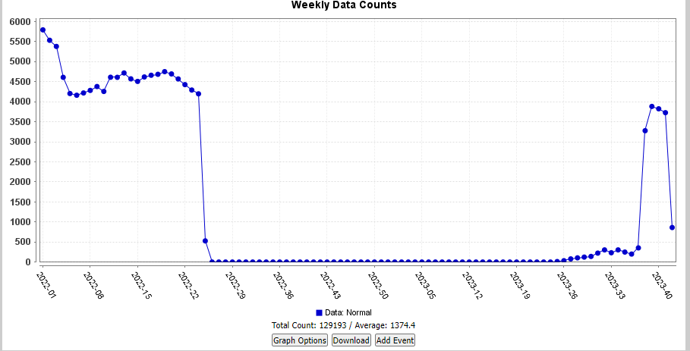
Onboarding-Dignity Health
Az General Hospital Dignity Health now live
Awaiting on Cerner to send back-log files from when the sites were being re-validated.
Notes:
June 2022, the AZ General Hospitals ceased using the Evident CPSI SS Solution and initiated the transition to the Cerner HealthSentry solution. Consequently, we temporarily deactivated the existing AZ General Hospitals facilities in BioSense until the Cerner feed was fully established. I'm pleased to inform you that as of September this year, Cerner-Dignity Health has resumed production, and we are now receiving real-time data.
AZ General Laveen and Mesa
AZ General ER’s - Ahwatukee, Chandler, Chandler Mcqueen, Gilbert, Glendale, goodyear, Mesa emergency, mesa baseline, san tan, surprise and tempe.

Slide 4
Onboarding- Benson & Sage
Benson
Still waiting for them to improve completeness before it can be moved to production.
Sage
No updates
Notes:
Benson Hospital - Waiting for them to improve the following before they can be moved into production ○ Chief Complaint Text is currently at 28.34% for completeness ○ Diagnosis code and description is currently at 39.41% for completeness ○ Admit Reason Description is currently at 21.66% for completeness

Slide 5
Data Quality: August
Completeness:
Summit Healthcare Regional Medical Center
Tuba City Regional Medical Center
Dignity Health
Steward Mesa Hospital
Validity:
Summit Health Regional Medical Center
Dignity Health
Timeliness
Dignity Health
Notes:
Completeness
· Summit Healthcare Regional Medical Center
o Facility type code
o Patient class
o Admit reason description
o Diagnosis code
o Diagnosis description
· Tuba City Regional Medical Center
o Admit reason description
§ Lorine with Tuba City said they will be fixing the issue at the beginning of August [7/31/23]
§ The Tuba City team is still working on the completeness of the admit reason description [8/15/23]
· Dignity Health
o Admit reason description
§ Contacts at Dignity Health have examined the issue. Said they are looking into it. [7/27/23]
§ Reached out to Dignity Health for an update [8/15/23]
· Steward Mesa Hospital
o Reached about low completeness in patient class, diagnosis code, chief complaint text, and patient zip. [8/31/23]
Validity
· Summit Health Regional Medical Center
o Facility type code and patient class code do not match.
· Dignity Health
o Facility type code and patient class code do not match.
§ Contacts at Dignity Health have examples of the issue. Said they are looking into it.
§ In contact with Theresa Abner. Amy Peterson is on FML with unknown date of return [8/15/23]
Timeliness
· Dignity Health

Slide 6
Data Quality September
Completeness
Summit Healthcare Regional Medical Center
Tuba City Regional Medical Center
Dignity Health
Banner Health Facilities
Validity
Summit Health Regional Medical Center
Dignity Health
Timeliness
Dignity Health
Notes:
Completeness
· Summit Healthcare Regional Medical Center
o Facility type code
o Patient class
o Admit reason description
o Diagnosis code
o Diagnosis description
all at or below 11% completeness
· Tuba City Regional Medical Center
o Admit reason description
§ Lorine with Tuba City said they will be fixing the issue at the beginning of August [7/31/23]
§ The Tuba City team is still working on the completeness of the admit reason description [8/15/23] [10/15/23]
The completeness for Admit_Reason_Description is hovering around 7%.
· Dignity Health
o Admit reason description
§ Contacts at Dignity Health have examined the issue. Said they are looking into it. [7/27/23]
§ Reached out to Dignity Health for an update [8/15/23] [10/03/23][10/15/23]
Are there any updates on this matter. I included our most recent data quality report from September 15, 2023 to October 15, 2023. The completeness for admit reason description is hovering around 60%.
Banner:
During our bi-weekly data run, the AZ SyS team observed low completion for some Banner facilities. I attached Excel documents below with the Banner facilities with low completion along with other information.
We are aware that some variables, such as chief complaint text (OBX) and diagnosis description (DG1), take longer to fill- usually 1 to 3 weeks. Therefore, data from the document below was pulled from 09/15/23 to 10/15/23. The idea is that the completeness of the facilities in the Excel document are at their final phase.
We also noticed that the diagnosis code validity was low for several Banner facilities. I also include an image below with more information. The low validity for diagnosis code for these facilities indicates that many messages associated with the visit lack a diagnosis code (DG1). We realize that all messages will not have a diagnosis code, but we wanted to know if this metric could be improved.
Validity
· Summit Health Regional Medical Center
o Facility type code and patient class code do not match.
· Dignity Health
o Facility type code and patient class code do not match.
§ Contacts at Dignity Health have examples of the issue. Said they are looking into it.
§ In contact with Theresa Abner. Amy Peterson is on FML with unknown date of return [8/15/23]
Ask for updates [10/15/23]
Timeliness
Dignity Health facilities are no longer in the red category.
Mt. Graham
experienced a drop in flow from end of september but its back due to data breach

Slide 7

NSSP: Reminders
NSSP Community of Practice Meeting has been moved to Wednesday November 1st.
Vendor Patches on October 19th
Syndromic Surveillance Symposium Registration now open.
  December 5-7, free virtual
Notes:
BioSense Platform Monthly Patching Reminder:
Vendor patches will be applied to the onboarding and production BioSense Platform environments.
These servers will start going offline on Thursday, October 19, 2023, at 12:00 am et.
Servers will be restarted several times during the update window.
We plan to complete all work on Thursday, October 19, 2023, by 8:00 am et.
We will send you a closeout email when activities are complete.
Effect on Services:
These tasks will require restarting some onboarding and production BioSense Platform servers several times. The following services will not be available during this update window:
Access & Management Center (AMC)
Data Quality Dashboard
ESSENCE data processing
ESSENCE Web application
Posit Workbench (formerly RStudio Workbench)
SAS Studio
User-Required Actions:
None
Registration for the 2023 Syndromic Surveillance Symposium is OPEN, and we ask that participants register by November 20, 2023. All interested participants must register for the event in advance by completing the registration form.
The 2023 Syndromic Surveillance Symposium's schedule will offer several opportunities to exchange ideas with colleagues through trainings, presentations, and informal breaks. Full session details will be shared closer to the event date and are subject to change.

Slide 8
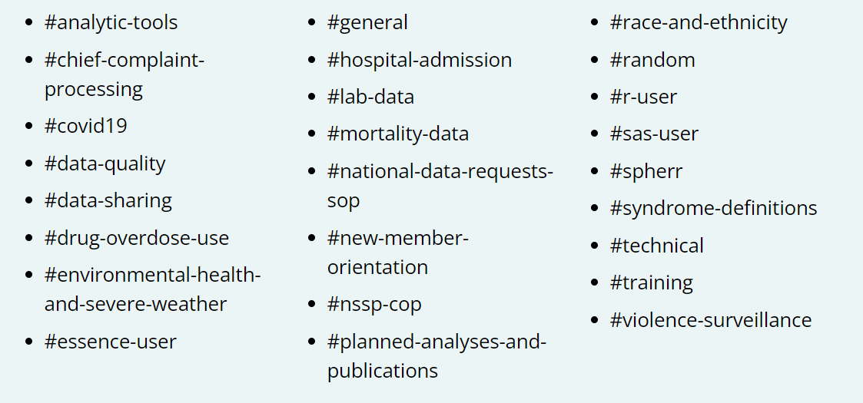
NSSP: New Member Orientation
New Member Orientation August 16th
If you missed it, there is a recording available and slides are available for viewing.
Upcoming Orientations will be held once per quarter
New Slack Channel for new members
Notes:
If you missed it, the recording
and slides are available for viewing. Upcoming orientations will be held once per quarter and CSTE will send invites to new NSSP CoP members.

Slide 9
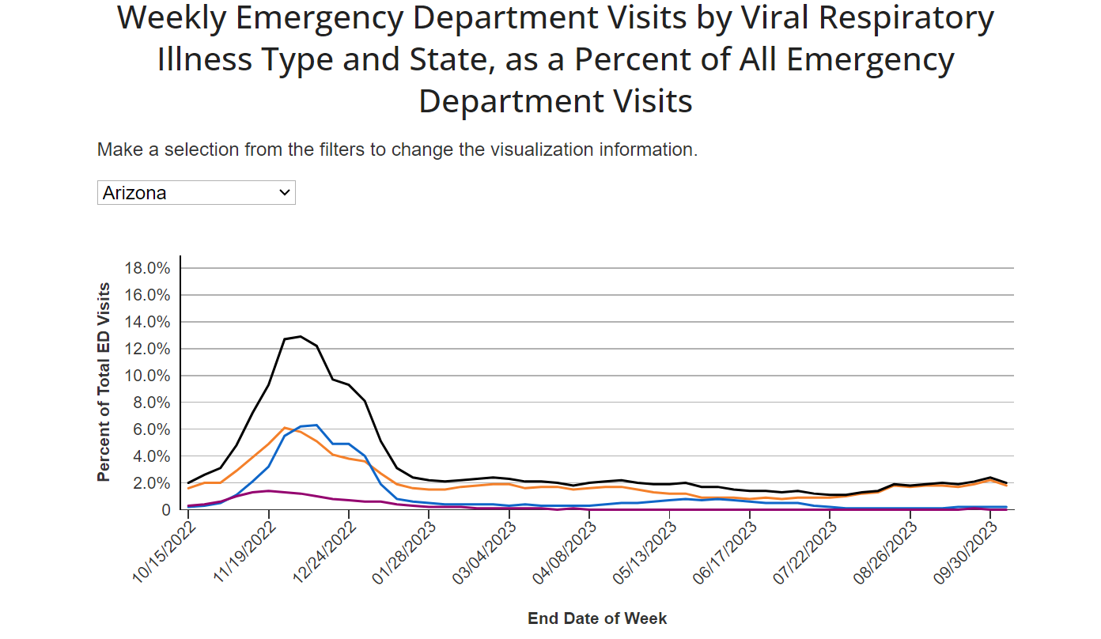
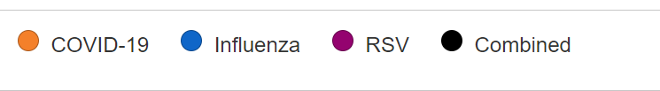
Notes:
Possible for White House to ask for County Level Data
Might need to change existing DUA and Data Service Agreements
MOU coming soon
CDC is launching a new tool for the public presentation of NSSP data in support of national respiratory surveillance. The new tool will allow users to view data from
emergency department (ED) visits with COVID-19, influenza, and respiratory syncytial
virus (RSV) diagnoses at the state level drawn from the National Syndromic Surveillance
Program (NSSP). These data are currently visualized at the national level by age group
(https://www.cdc.gov/ncird/surveillance/respiratory-illnesses/index.html) and, for COVID-19, to
the state level on the COVID tracker website. The new tool will display trends in state-level
percent of total ED visits for each condition (i.e., number of COVID-19 diagnosis visits out of the
total number of ED visits across all causes) as well as the combined category (i.e., total number
of COVID-19, RSV, and Influenza diagnosis visits combined out of the total number of ED visits
across all causes). We plan to expand the age-stratified visualizations for these conditions from
the current national trend to include trends by state. These data will be updated weekly in sync
with existing websites containing similar data

Slide 10
Update 2.10 to Access and Management Center
AMC updates
Internal and External User Accessibility Testing (UAT)
Data Quality Analytics and Visualization
Internal and External UAT
PRESS
Notes:
AMC Updates
Internal and External UAT
Manage Users tab: Added capability to capture User Type
Data Access tab:
Added framework for eventual addition of a new data source: National Notifiable Diseases Surveillance System (NNDSS)
Implemented pagination for Data Table
Added “Emergency Response” access flag
Reports tab:
Added a filter to remove NSSP Rules
Implemented pagination for Data Table
Internal UAT Only
Admin tab: Added a PIV Usage Report to support Operations Team
Manage Users tab: Added capability to disable login after a period of inactivity
MFT tab:
Added Office of the National Coordinator for Health IT (ONC) Certified Health IT Product List (CHPL) identification
Added capability to check for Duplicate Primary Facility Addresses
DQAV Updates
Internal and External UAT
Added initial version of NSSP PRESS, which allows dynamic sharing of information between NSSP and sites
Maintain a corpus of reports for NSSP community use
Provide user interface (UI) for manual publication management
Build UI on application programming interface (API) that can be leveraged to automate publication
Refine and enhance DQDB filtering:
Create extract, transform, and load pipeline for dashboard enhancement: Modify existing tables to aggregate completeness, validity, and timeliness metrics for C_Patient_Class by facility
Added capability to apply filters to C_Patient_Class
NSSP PRESS: Collaboration at its Best in a Shared Reporting Environment!
Whether you’re searching for a specific report, exploring new reports, or accessing NSSP-published data, we’re confident the new NSSP Publication & Reporting Enterprise for Syndromic Surveillance (PRESS) will revolutionize collaboration.
Unlike shared drives, code repositories, and other file hosting services, NSSP PRESS provides an association-focused, metadata-rich toolbox for contextualizing and connecting reports, authors, and audiences.
NSSP PRESS uses content tags, report categorization, user subscriptions, scheduled and serialized releases, and custom affinity groups. Public health agencies and constituents can build communities around centralized and interrelated content.
Initially, using your existing AMC credentials, you’ll be able to get dynamic, data-driven content NSSP publishes. Access NSSP PRESS from a menu item at the NSSP Dashboards URL
.

Slide 11


Slide 12
ACEs Dashboard
Hospital Visits Related to Aces

Slide 13
Beginning of Project:
Original Dashboard created by CDC with guidance from Dr. Elizabeth Swedo and Kayla Anderson.
Adverse and positive childhood experiences have a profound impact on lifespan health and well-being.
The goal of the dashboard is to build a comprehensive approach to adverse and positive childhood experiences surveillance.

Slide 14
Overview:
Timely data that inform our understanding of ACEs can guide timely, impactful action to prevent and mitigate the impact of ACEs.
Near real-time data on indicators of ACEs can be used to identify specific trends in ACEs very proximally to their occurrence.
  Allowing for a better understanding of risk and protective factors
  Also allowing for more timely interventions and prevention strategies
Additionally, syndromic surveillance data can be examined at a much more local level than traditional ACEs surveillance data (i.e. population-based surveys)
  Enables identification of specific populations
    Demographic
    Socio-behavioral
    Geographic
All to inform tailored prevention efforts and a better understanding of local risk and protective factors.

Slide 15
Background: Creation of Dashboard
Objective: Recreate the CDC Dashboard for public access in collaboration with the Tableau Team.
Data Integration Process:
Utilized pre-existing R code from the Suicide Encounters Dashboard.
Extracted CCDD syndromes related to ACEs from ESSENCE.
Data was cleaned in R and set up for periodic data updates in Task Manager.
Data Transformation:
Transferred cleaned data from R to an SQL silo for Tableau Team compatibility.
Collaboration:
Regular meetings with the Tableau Team to define specific Dashboard requirements.
Feedback and Improvements:
Engaged with the ADHS ACEs team for feedback and incorporated enhancements.
Implemented changes for enhanced dashboard clarity and user-friendliness.

Slide 16
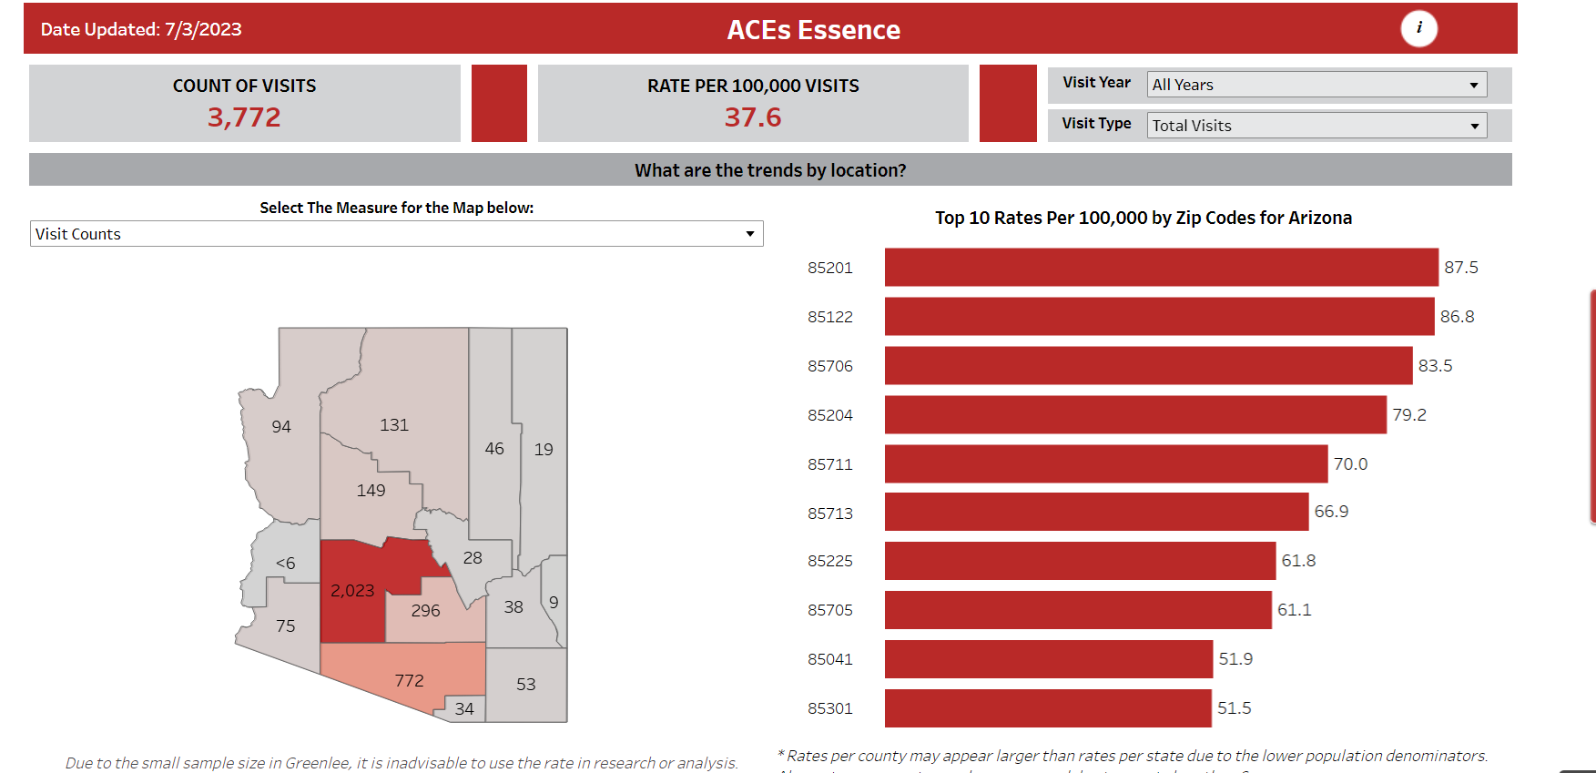
What the Dashboard first looked like

Slide 17
Current Dashboard
Data Updates:
Updated every Thursday.
The displayed data does not reflect the current week.
The last two weeks' data is provisional and subject to change due to Data Quality.
Data Visualization:
Map display showcasing Visits by county.
County-specific rates per 100,000.
Additional rates per 100,000 data available for zip codes.
Directly Measured ACEs:
Identifiable ACEs based on hospital visit data.
Demographic Insights:
Comprehensive demographic breakdown available.

Slide 18
Next Steps:
Components of a comprehensive approach to adverse and positive childhood experiences surveillance include:
  Revisiting definition and measurement
  Generating and using uniform definitions for adverse and positive childhood experiences across data-collecting efforts
  Conducting youth-based surveillance of adverse and positive childhood experiences
  Using innovative methods to gather and analyze near real-time data
  Leveraging available data, including from administrative sources; and integrating data on community and societal-level risk and protective factors for adverse childhood experience, including social and health inequities such as racism and poverty, as well as policies and conditions that create healthy environments for children and families.

Slide 19
Call for feedback
Emails:
bin.suh@azdhs.gov
cheyenne.pearson@azdhs.gov
alexis.griffin@azdhs.gov
rachel.berg@azdhs.gov

Slide 20

Notes:
NSSP CoP meeting trying to focus on Jurisdictional Overview, Would anyone like be a part of a presentation on Arizona?
Also If anyone is presenting at the Symposium would you like to practice your presentation before the symposium and receive feedback from peers?
Finally, has anyone had a chance to test out the xylazine introduced last meeting/

Slide 21
Thank you!
@syndromicsurveillance@azdhs.gov

