Slide 1
Adverse Childhood Experiences:
Root Cause Surveillance Dashboard
Syndromic Surveillance Exploratory Analysis
October 18, 2023
Cheyenne Pearson | Epidemiologist

Slide 2
Dashboard Creation
Recognize importance of social determinants of health in ACEs
National Center for Injury Prevention and Control, Division of Violence Prevention
  Risk/protective factors for ACEs
Created a matrix for determining what indicators to include in dashboard
  Public health involvement
  Public health impact
  Ease of access to data
Notes:
We really wanted to recognize and highlight the importance of various SDOH in ACEs. ADHS SMEs created a working group in order to determining what indicators to include in the dashboard. Risk and protective factors for ACEs identified by the CDC were chosen. A matrix was created that outlined risk and protective factors at both the community and individual level. These were then evaluated for three criteria.. Public health action (lead? involved? not involved?), overall public health impact (high, medium, low) and how easy it is to capture the data for surveillance (easy, medium, hard). These indicators were then scored amongst those three categories and the top scoring indicators were included in the first iteration of the dashboard. We did not want to limit data to just that which comes internally from the agency, but also include external data in a one-stop-shop dashboard where end users can look at various social determinants of health that are related to ACEs.

Slide 3
Where does the data come from?
Household SNAP recipients: ACS 5 year estimates
Child SNAP recipients: AZ Dept Economic Security
Free/reduced lunch: AZ Dept Education
Children living in poverty: ACS 5 year estimates
Unemployment Rates: US Bureau of Labor Statistics
TANF Recipients: AZ Dept Economic Security
Individuals with a birth in the last 12 months by education: ACS 5 year estimates
Single Parents: ACS 5 year estimates
Students Experiencing Homelessness: US Dept Education
AHCCCS Members: AHCCCS
Health Insurance Coverage: ACS 5 year estimates
Notes:
So where does all this data come from? We will take a look at the dashboard in a moment, but here are the various data points included. We have several indicators on the dashboard from many different data sources. Some are updated monthly and some are updated annually. Data currently is pulled from the American Community Survey, Arizona Department of Economic Security, Arizona Department of Education, US Bureau of Labor Statistics, US Department of Education, and AHCCCS.

Slide 4
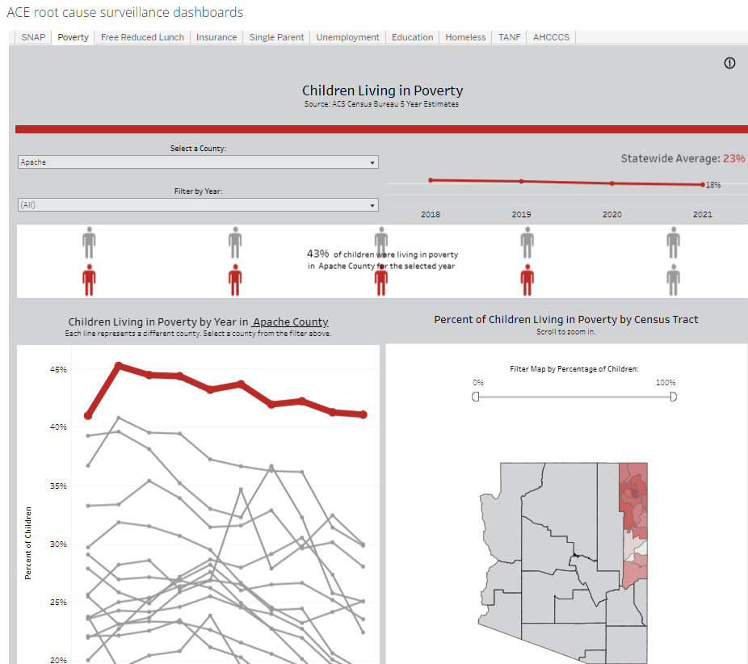
Dashboard Overview
Root Cause Surveillance Dashboards
Notes:
The root cause surveillance dashboards are really 10 dashboards in one, with detailed data about one indicator for each dashboard. Let’s visit the link for a quick walk through, and I can also drop it in the chat. https://www.azdhs.gov/operations/strategic-initiatives/adverse-childhood/dashboards/index.php#ace-surveillance
Each dashboard has statewide KPIs at the top, to assist in comparison of smaller geographic locations to statewide metrics over the years. Most dashboards are filterable by county, year or date, and percent of children affected. As I mentioned there is both trend data and geographical data. The smallest geographic unit included is by census tract for some indicators.
-Walk thru each. Free or reduced lunch eligibility and students experiencing homelessness also have data available by school district. Health insurance data is reported by both no coverage/some coverage and type.

Slide 5
Next Steps
Making connection clear between ACEs and these social determinants of health
Decreasing amount of data on dashboards, with ability to select type of data to view
  Easier navigation
Notes:
Initial feedback on the dashboards was very helpful. Some of the major next steps to revise the dashboards include adding in BRFSS data about ACEs to the root cause surveillance dashboards so users can make clear connections and relationships between the two. Future iterations may include other data sources such as the Arizona Youth Survey. Additionally some of the dashboards are overwhelming with a lot of data and visuals on one page, so keeping all the same visualizations (nothing is going away!) but allowing users to select from a dropdown if they would like to see more detailed trend data, geographical data, etc. We also plan on adding in some contextual statements to establish the association between ACEs and these various indicators. These social determinants of health will also be organized into ACE and positive childhood experiences based off of whether they are truly a risk or protective factor.

Slide 6
We would love your feedback!

