Slide 1
Seasonal Trends in Emergency Department Visits for Mental and Behavioral Health Conditions Among Children and Adolescents Aged 5-17 Years – United States, January 2018 – June 2023
Radhakrishnan L, Carey K, Pell D, et al.
Presentation by Hollie Watson-Smith
Notes:
https://www.cdc.gov/mmwr/volumes/72/wr/mm7238a3.htm?s_cid=mm7238a3_e&ACSTrackingID=USCDC_921-DM113495&ACSTrackingLabel=New%20in%20MMWR%3A%20Mental%20and%20behavioral%20health%20conditions%20in%20children%2C%20mercury%20poisoning%2C%20and%20more&deliveryName=USCDC_921-DM113495

Slide 2
MMWR Link

Slide 3
Multi-Sector Collaboration
Centers for Disease Control and Prevention – multiple departments
New Mexico Department of Health
University of North Carolina, Chapel Hill
Jr. Children’s Hospital at Vanderbilt
District of Columbia Department of Health
University of Maryland School of Public Health
District of Columbia Office of the State Superintendent of Education
Kentucky Department for Behavioral Health
Kansas Department of Health
Colorado Department of Public Health and Environment
Tri-County Health Department
Arapahoe County Public Health Department
Tennessee Department of Mental Health and Substance Abuse Services
Tennessee Department of Health
SAMHSA
U.S. Department of Education
Notes:
Our lead investigator at the CDC began by reaching out to contacts she was aware of that were doing work in behavioral health surveillance and prevention. The idea was to have a group of representation from as many levels as possible.
As a group, we had SMEs in Epi/data, behavioral health, education.

Slide 4
What is already known?
Previous studies have looked at prevalence/incidence of overall mental health, suicide-related behaviors, and drug overdoses
  Found that mental and behavioral health conditions are common among school-aged youth
Most school districts have summer and winter breaks.
  Is there a temporal relationship between visits for MBHCs and school semesters?
Notes:
In MMWR articles, the first thing in the summary is “What is already known about this topic”.
We know from previous studies that mental and behavioral conditions are a growing concern coming out of the COVID-19 pandemic, and we know that these conditions are common. Our lead had previously published a MMWR about the relationship of pediatric emergency department visits for MBHCs and the temporal relationship to the COVID-19 pandemic. From initial review of data, they observed a potential temporal relationship with school semesters.
We know that most school districts have breaks ranging from a few weeks to a few months, in the summer and winter. From this, we came to our question. Is there a temporal relationship between pediatric emergency department visits for MBHCs and the school semester?

Slide 5
Syndrome Definitions
Healthcare Cost and Utilization Project (HCUP) Clinical Classifications Software Refined (CCSP) had existing definitions using ICD-10 codes
27 distinct conditions were originally looked at
  8 met reliability criteria
    depressive disorders
    suicidal ideation or self-harm
    trauma- and stressor-related disorders
    cannabis-related disorders
    lifestyle or life management factors
    mood disorders
    poisoning by drugs – initial encounter
    symptoms of mental and substance use conditions
Notes:
https://hcup-us.ahrq.gov/toolssoftware/ccsr/dxccsr.jsp
The Healthcare Cost and Utilization Project (HCUP) has the Clinical Classifications Software Refined (CCSP) that has existing syndrome definitions based on ICD-10 codes.
We found 27 distinct conditions that fell under the umbrella of mental and behavioral health.
From this, analyses were conducted for reliability of the data: and eight met that criteria.

Slide 6
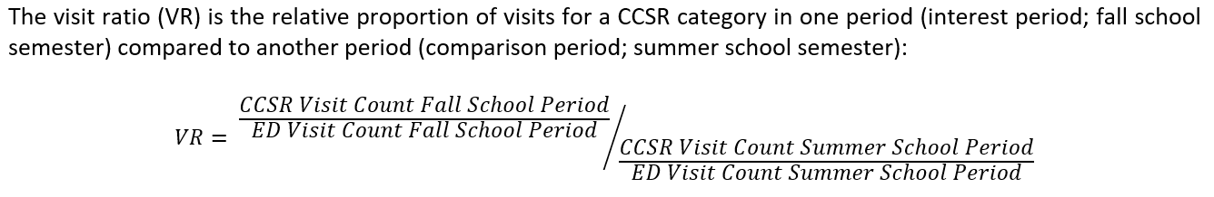
Emergency Department Visit Ratios
Ratios were found for each CCSR category by age group, by year, and by time period
  Both Fall and Spring was compared to the preceding summer
Overall counts were also analyzed
Notes:
Our study aimed to look at the comparison of ED visits in the fall semester period vs. in the summer period. (We would also look at the spring semester period vs. the summer period).
We separated by age group 5-9, 10-14, 15-17. Our intention was to try and highlight different school aged groups (elementary, middle/junior high, and high school).
The count of CCSR visits during the fall/spring semester was divided by the total number of ED visits for that age group in that same time period. This gives us the proportion of visits that were for CCSR. After we divided by the proportion of the visits for that CCSR in that age group during the summer period. This was conducted for each CCSR category, in each age group, over a five school-year span. So a visit ratio greater than 1, indicates a higher proportion in the fall/spring compared to the preceding summer.
Both fall and spring were compared to the preceding summer.
In the MMWR, we also present the data as counts and changes of the count by time period.

Slide 7
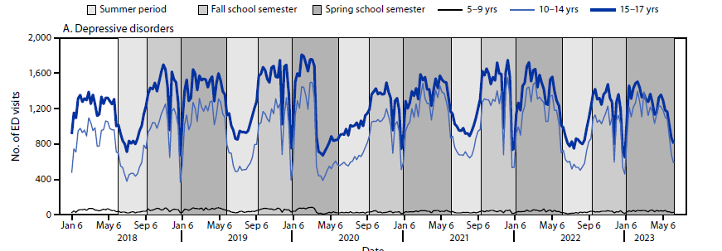
Depressive Disorders
Ages 10-14 (VR 1.19 – 1.95)
Ages 15-17 (VR 1.16 - 1.60)
(Increased VR for all semesters: Fall 2018 – Spring 2023)
Notes:
Depressive disorders included ICD-10 codes for mood disorder, major depressive disorder, premenstrual dysphoric disorder, dysthymic disorder, postpartum depression

Slide 8
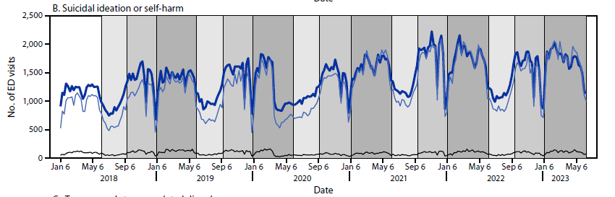
Suicidal Ideation or Self-Harm
Ages 10-14 (VR 1.13 – 2.00)
Ages 15-17 (VR 1.15 – 1.74)
(Increased VR for all semesters: Fall 2018 – Spring 2023)
Notes:
This definition includes ICD-10 codes for ideations, non-suicidal self harm, suicide attempts, intentional poisonings, intentional self-harm by asphyxiation, drowning/submersion, firearm, etc.

Slide 9
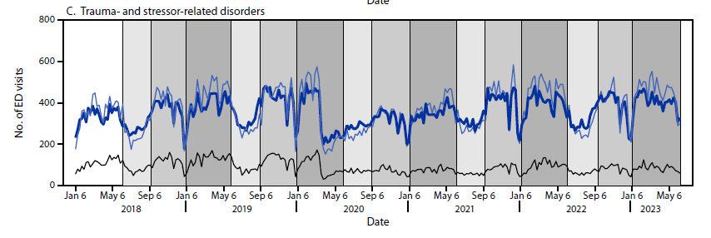
Trauma- and Stressor- Related Disorders
Ages 10-14 (VR 1.07 – 1.62)
Ages 15-17 (VR 1.05 – 1.43)
(Increased VR for all semesters: Fall 2018 – Spring 2023)
Notes:
ICD-10 codes include acute stress reaction, post traumatic stress disorder, adjustment disorder, prolonged grief disorder, reactions to severe stress, disorders of dissociation and depersonalization

Slide 10
Other CCSPs
10-14 and 15-17 age groups
Increases in spring semesters compared to the preceding summer
  Lifestyle or life management factors
  Mood disorders
  Poisoning by drugs
  Symptoms of mental and substance use conditions
Visit ratios for cannabis-related disorders were inconsistent across all five years
Increases were seen for 5-9 age group but had very small counts
Notes:
Lifestyle/life management factors: Z codes like high risk behaviors, antisocial behaviors, problems related to lifestyle, stress
Symptoms of mental and substance use conditions: R codes for symptoms like nervousness, anger, unhappiness, etc.

Slide 11
Why might visit ratios be higher?
Increased stressors…
  Transitioning to new school year
  Attending new school
  Academic performance/testing
  Bullying/peer victimization
School-based screenings may occur, increasing referrals
Conditions may be recognized by school staff or if students disclose – whereas they are not observed in the summer
Increased social interactions

Slide 12
Limitations
NSSP is a convenience sample, not nationally representative
NSSP ED visits are for visits, not individuals
Only looking at ED visits, not outpatient
School year schedules vary by state and region
  Potential for misclassification
HCUP codes are not mutually exclusive
  ICD-10 codes may be in multiple conditions

Slide 13
Next Steps
Regional comparisons (narrow in on school schedules)
Time of semester (beginning, midterms, finals?)

Slide 14
Thanks to all authors involved!
Lakshmi Radhakrishnan, MPH¹; Kelly Carey, MPH¹; Kathleen P. Hartnett, PhD¹; Aaron Kite-Powell, MS¹; Marissa Zwald, PhD²; Kayla N. Anderson, PhD²; Rebecca T. Leeb, PhD³; Kristin M. Holland, PhD²; Abigail Gates, MSPH¹; Jourdan DeVies, MS⁴; Amanda R. Smith, PhD^{1,5}; Katharina L. van Santen, MSPH⁴; Sophia Crossen, MS⁶; Michael Sheppard, MS¹; Samantha Wotiz, MPH⁷; Amelia G. Johnson, DrPH⁸; Amber Winn, MPH⁸; Hannah L. Kirking, MD⁸; Rashon I. Lane, PhD, MA⁹; Rashid Njai, PhD¹⁰; Loren Rodgers, PhD¹; Craig W. Thomas, PhD¹¹; Karl Soetebier, MAPW¹; Jennifer Adjemian, PhD¹

