Slide 1

Exploratory Analysis
February 21st, 2024

Slide 2
Agenda
Introduction
Updates
  Onboarding
  Data Quality
  NSSP
OD2A
Respiratory Virus Activity Level Dashboard
Presentation
Questions
Next Meetings
End
Notes:
Presentation from Maricopa’s Climate and Health Team on HRI

Slide 3
Updates: Data Quality 1/15/24-2/15/24
Banner Facilities saw low completion rates along with low validity for Diagnosis Codes.
No messages have been received for Banner UC - McClintock and Southern for 56 days.
  The McClintock and Southern location is dealing with fire damage, so it is temporarily closed and still undergoing repairs.
Tuba City experienced low completion rates for admit reason descriptions.
Summit experienced low completion rates and errors with facility type codes.
Notes:
Tuba city updated that the change should go into production next week. I will follow up to see if the change fixes the low completion issue. Banner University Medical Center -South Campus
Banner Desert Medical Center
Banner Estrella Medical Center
Banner Thunderbird Medical Center
Banner Del E Webb Medical Center
Banner Boswell Medical Center
Banner Baywood Medical Center
Banner University Medical Center - phoenix campus
Banner Universiry Medical Center -Tucson Campus
Banner Gateway Medical Center
Banner Heart Hospital
Banner Urgent Care -Mcmurray And Arizola
Banner Urgent Care- Bell and Reems
Banner Urgent Care-Crismon and Southern
Banner Urgent Care-Sarivale and Yuma
Gary and Empire
Cactus and 75th
Higley and Queen Creek
Van Buran and Avondale
Rural and Guadalupe
Ironwood and Ocotillo
Glendale and 19th
Indian School and 32nd st
Scottsdale and Shea
Warner and Cooper
Johnson and Meeker
Dobson and Guadalupe
Bell and 32nd
Camelback and 7th st
Alma school and Queen Creek
Higley and Baseline
Central and Washington
Old Linden and Deuce of Clubs
Bell and 43rd
Pima and 87th
Greenway and 64th
Ina and Thornydale
Higley and Southern
White Mtn and Hwy 260
Prince and Campbell
Higley and Pecos
Deer Valley and 83rd
Northern and 43rd
Beeline and Hwy 260
Prince and Campbell
Deer Valley and 83rd
Gilbert and Mckellips
Rural and Elliot
Higley and Southern
Northern and 43rd
Gilbert and Southern
Golf Links and Kolb
Cave Creek and 7th st
Lindsey and University

Slide 4
Updates: NSSP
BioSense Platform Unscheduled Dataflow Interruption:
The BioSense Platform will undergo unscheduled maintenance to rebuild the ESSENCE data cubes for new CCDD categories, starting on Wednesday, February 21, 2024, at 3:00 pm et. Dataflow will be paused during maintenance. Access to ESSENCE will be available, but data will be static. We expect maintenance to be complete and dataflow to resume by 4:00 pm et.
Please continue to send your data as usual, but remember that data will not process through ESSENCE during this maintenance window.
The new CCDD categories are:
CDC Suspected Child Abuse and Neglect v1
CDC Youth Violence v1
Effect on Services:
Dataflow to production ESSENCE environment
ESSENCE data processing

Slide 5

Updates-NSSP
CSTE Conference
When June 9th - 13th in Pittsburgh Pennsylvania
Registration now open

Slide 6
Grant Opportunity
Strengthening Public Health Systems and Services through National Partnership to Improve and Protect the Nation’s Health
  This “umbrella” cooperative agreement will support up to 45 organizations that work with governmental public health and other sectors, over five years, to provide capacity-building assistance within the public health system.
  This funding will provide capacity-building assistance to:
    Increase the knowledge, skill, and ability to deliver essential public health services,
    Improve organizational and systems capacity and capability to address prioritized, equity-based public health priorities, and
    Strengthen the nation's public health infrastructure and performance.
  Estimated Application Due Date: March 25, 2024
  Estimated Award Date: August 1, 2024
Notes:
Hear at ADHS we hope to connect with the Health Equity Team and the Woman and Children’s Buearu

Slide 7
DOSE Technical Briefs Now Available
CDC Benzodiazepine Overdose v2 Parsed
CDC Fentanyl Overdose v2 Parsed
CDC Heroin Overdose v5 Parsed
CDC Opioid Overdose v4 Parsed
CDC All-drug v3 Parsed
CDC Stimulant Overdose v2 Parsed
CDC Cocaine Overdose v2 Parsed
CDC Methamphetamine Overdose v1 Parsed
Notes:
The CDC DOSE team has developed 8 technical briefs based on four updated syndrome definitions (all drug, all opioid, heroin, and all stimulants) and four new syndrome definitions (benzodiazepine, cocaine, fentanyl, and methamphetamine).
In the december meeting of the EA, we covered the updates to Benzondiasepine, Fentayl, heroin, and opioid overdose definitions,
This meeting we will be covering the Methanphetamine, cocaine, stimulant and all drug definitions.

Slide 8
CDC Methamphetamine Overdose v1 Parsed
Definition: CDC Methamphetamine Overdose v1 Parsed
Definition Description: The Methamphetamine Overdose v1 Parsed syndrome definition was designed to identify ED visits for suspected nonfatal methamphetamine-involved overdoses of unintentional or undetermined intent. The query relies on data in two fields from ED visit records to identify encounters that meet the definition criteria:
  the chief complaint free text field, may include terms indicating a methamphetamine-involved overdose or poisoning, as well as relevant exclusion terms (e.g., terms such as withdrawal without acute intoxication, etc., which would exclude ED visit records from this syndrome definition)
  the discharge diagnosis parsed field, which includes (ICD-9-CM) , (ICD-10-CM)or (SNOMED-CT) diagnosis codes, with descriptive code text removed, may indicate an acute methamphetamine-involved overdose or poisoning of unintentional or undetermined intent
Use Cases: Trend Monitoring, Early Outbreak Detection and case finding
Development: Built off of the Stimulants v3 syndrome definition to capture only overdoses that indicated methamphetamine involvement.
Notes:
Definition Purpose: To assist state, local, tribal, territorial, and federal public health practitioners in monitoring emergency department (ED) visits for suspected nonfatal methamphetamine-involved overdoses.
New or Revised Definition: New
Within CDC’s National Syndromic Surveillance Program (NSSP) ESSENCE the syndrome query is applied to the Chief Complaint Discharge Diagnosis (CCDD) Parsed field, which combines these two fields of interest. Additional ED visit records may be identified by this query if they include both a chief complaint free text term indicating methamphetamine involvement and a diagnostic code that indicates an acute drug or stimulant overdose or poisoning.
Justification for Development: This definition was developed to help public health practitioners track and understand trends of nonfatal methamphetamine-involved overdoses treated in EDs in near real-time. Understanding trends in methamphetamine-involved nonfatal overdoses is important for the development of evidence-based prevention strategies. Data Source During Development: ED visits
Development Methods: Members of the CDC’s Drug Overdose Surveillance and Epidemiology (DOSE) team in the Division of Overdose Prevention (DOP) developed this definition by building off the Stimulants v3 syndrome definition4 to capture only overdoses that indicated methamphetamine involvement. First, ICD-10-CM diagnosis codes indicating acute methamphetamine poisoning of unintentional or undetermined intent were identified. Additional ICD-10-CM, ICD-9-CM and SNOMED-CT diagnosis codes indicating acute stimulant or psychostimulant poisoning of unintentional or undetermined intent were identified. Next, overdose terms and methamphetamine-specific terms that could be presented in the chief complaint free text field were identified. Lastly, exclusion terms were identified (e.g., terms indicating withdrawal without acute intoxication, etc.) to avoid incorrectly capturing encounters that were not due to a methamphetamine-involved overdose.

Slide 9
CDC Methamphetamine Overdose v1 Parsed
Parsed field is used to query both the diagnosis codes and chief complaint free text with exclusions (as necessary) to develop the syndrome definition.
  Automatic inclusion:
    If a diagnosis code indicating an acute methamphetamine poisoning of unintentional or undetermined intent is present, the ED visit is automatically included.
  Conditional inclusion:
    If the ED visit does not include a diagnosis code for methamphetamine poisoning, the visit is not automatically included. In these instances, the visit is captured only if it includes the following two components and no exclusion terms:
      chief complaint text indicating methamphetamine involvement AND
      chief complaint text indicating an overdose or poisoning OR
      diagnosis code indicating a stimulant/amphetamine overdose or poisoning or diagnosis code indicating poisoning by unspecified drugs (T50.901A or T50.904A).
    The exclusion terms are applied to the chief complaint text only when the automatic inclusion criteria are not met.
Notes:
Validation Methods: Members of the CDC DOSE team piloted the draft definition by manually reviewing records that were captured using a broader query (e.g., any records with the character string “meth”) and comparing this to records that were captured using the full draft definition. Multiple iterations of the draft definition were tested, and the inclusion and exclusion terms were refined with each round of review. The definition was shared with CDC NSSP staff who reviewed the query syntax and made suggestions for improvement. The definition was further refined according to these suggestions and then shared with 48 jurisdictions participating in CDC’s DOSE program for review and feedback. The comment period was open for one month, and 10 jurisdictionssubmitted feedback during this period. Overall, feedback was positive, and suggestions for revisions focused on query term refinement of inclusion and exclusion criteria. The development team considered all feedback, made additional revisions, and then finalized the definition. Consideration was given to inclusion of ED visits with F15.1 codes. However, F15.1 codes were ultimately not included in the definition, as manual record review demonstrated that these codes indicated methamphetamine use but did not clearly indicate an acute poisoning or overdose event.
The Chief Complaint Discharge Diagnosis (CCDD) Parsed field is used to query both the diagnosis codes and chief complaint free text with exclusions (as necessary) to develop the syndrome definition. • Automatic inclusion: o If a diagnosis code indicating an acute methamphetamine poisoning of unintentional or undetermined intent is present, the ED visit is automatically included. 4 CDC Stimulant Overdose v3 definition: https://knowledgerepository.syndromicsurveillance.org/cdc-stimulants-v3 3 • Conditional inclusion: o If the ED visit does not include a diagnosis code for methamphetamine poisoning, the visit is not automatically included. In these instances, the visit is captured only if it includes the following two components and no exclusion terms: 1) chief complaint text indicating methamphetamine involvement AND 2a) chief complaint text indicating an overdose or poisoning OR 2b) diagnosis code indicating a stimulant/amphetamine overdose or poisoning or diagnosis code indicating poisoning by unspecified drugs (T50.901A or T50.904A). o The exclusion terms are applied to the chief complaint text only when the automatic inclusion criteria are not met.
Limitations: The definition was developed to capture suspected nonfatal methamphetamine-involved overdoses treated in EDs. However, it is subject to both misclassification and under/overreporting for several reasons, including limited point-of-care confirmatory testing to identify the drug(s) involved in the overdose, and reliance on self-report, bystander reports, and/or clinical presentations to determine the drug(s) involved in an overdose. The codes provided in the discharge diagnosis field from the ED visit record do not necessarily represent the final diagnosis of a patient and should be considered preliminary. Additionally, some hospitals may enter all diagnosis codes from a patient’s entire medical history, including codes for previous methamphetamine-involved overdose visits; the definition may incorrectly capture such encounters that were not for a true methamphetamine-involved overdose and thus result in overreporting. Finally, methamphetamine-involved overdoses may be more difficult to identify than overdoses involving opioids due to a wide range of associated symptoms, including some that may overlap with mental health disorders. The team attempted to identify all appropriate inclusion and exclusion terms to capture any suspected nonfatal methamphetamine-involved overdoses while avoiding capturing encounters that were not for an acute methamphetamine-involved overdose or poisoning, but it is possible that some of these encounters were erroneously captured, leading to overreporting.

Slide 10
CDC Methamphetamine Overdose v1 Parsed
Limitations
  Limited availability of point-of-care confirmatory testing for identifying drugs involved in overdoses.
  Reliance on self-report, bystander reports, and clinical presentations to determine the drugs involved.
  Discharge diagnosis codes from ED visits may not reflect final diagnoses, serving as preliminary indicators.
  Some hospitals enter all diagnosis codes from a patient's medical history, potentially including unrelated encounters, leading to overreporting.
  Difficulty in distinguishing methamphetamine-involved overdoses from other conditions due to overlapping symptoms, especially with mental health disorders.
Notes:
Limitations: The definition was developed to capture suspected nonfatal methamphetamine-involved overdoses treated in EDs. However, it is subject to both misclassification and under/overreporting for several reasons, including limited point-of-care confirmatory testing to identify the drug(s) involved in the overdose, and reliance on self-report, bystander reports, and/or clinical presentations to determine the drug(s) involved in an overdose. The codes provided in the discharge diagnosis field from the ED visit record do not necessarily represent the final diagnosis of a patient and should be considered preliminary. Additionally, some hospitals may enter all diagnosis codes from a patient’s entire medical history, including codes for previous methamphetamine-involved overdose visits; the definition may incorrectly capture such encounters that were not for a true methamphetamine-involved overdose and thus result in overreporting. Finally, methamphetamine-involved overdoses may be more difficult to identify than overdoses involving opioids due to a wide range of associated symptoms, including some that may overlap with mental health disorders. The team attempted to identify all appropriate inclusion and exclusion terms to capture any suspected nonfatal methamphetamine-involved overdoses while avoiding capturing encounters that were not for an acute methamphetamine-involved overdose or poisoning, but it is possible that some of these encounters were erroneously captured, leading to overreporting.

Slide 11
CDC Cocaine Overdose v2 Parsed
CDC Cocaine Overdose V2 Parsed
Definition Description: The CDC Cocaine Overdose v2 Parsed definition was designed to be used to identify ED visits for suspected nonfatal cocaine-involved overdoses of unintentional or undetermined intent. The query relies on data in two fields from ED visit records to identify encounters that meet the definition criteria:
  the chief complaint free text field, may include terms indicating a cocaine-involved overdose or poisoning, as well as relevant exclusion terms (e.g., terms indicating cocaine withdrawal without acute intoxication, etc., which would exclude ED visit records from this syndrome definition), and
  the discharge diagnosis parsed field, which includes (ICD-9-CM), (ICD-10-CM), (SNOMED-CT) diagnosis codes and may indicate an acute cocaine overdose or poisoning of unintentional or undetermined intent. Within ESSENCE, the syndrome query is applied to the Chief Complaint Discharge Diagnosis (CCDD) Parsed field, which combines these two fields of interest.
Revision of Cocaine Overdose v1
Use Cases: Trend Monitoring, Early Outbreak detection and case finding
Notes:
Definition Purpose: To assist state, local, tribal, territorial, and federal public health practitioners in monitoring emergency department (ED) visits for suspected nonfatal cocaine-involved overdose using syndromic surveillance data.
New or Revised Definition: Revision of Cocaine Overdose v1
Date Added to ESSENCE: January 2024
Within ESSENCE, the syndrome query is applied to the Chief Complaint Discharge Diagnosis (CCDD) Parsed field, which combines these two fields of interest.
Justification for Development: There have been rapid increases in cocaine-involved overdose deaths during the previous decade4 and especially from 2019–2020, with the rate of drug overdose deaths involving cocaine increasing by 22%. 5 Previous studies have shown that suspected nonfatal cocaineinvolved overdoses and those cocaine overdoses co-involving opioids have followed seasonal patterns, with increased numbers in spring/summer months and declines in fall/winter months. 6 Continued monitoring of nonfatal cocaine-involved overdoses is important for understanding the landscape of the most recent drug overdose trends. Data Source During Development: ED visits

Slide 12
CDC Cocaine Overdose v2 Parsed
Validation Methods:
  NSSP team used R code to convert the syntax from previous Cocaine overdose version
    From CCDD field to CCDD parsed field
  CDC team incorporated corrections and improvements to syntax logic and piloted draft definition by manual review,
  Compared previous overdose counts and records before and after syntax conversions
Automatic inclusion
  If a diagnosis code indicating a cocaine overdose/poisoning is present, the ED visit is automatically included in the syndrome.
Conditional inclusion
  If the ED visit does not include a diagnosis code for cocaine poisoning, then the visit is not automatically included in the syndrome.
  The visit is captured only if it includes two components:
    chief complaint text indicating an overdose, poisoning, or symptoms of a potential cocaine-involved overdose AND
    chief complaint text indicating cocaine involvement
    OR an ICD-10-CM code for cocaine abuse/dependence/use with intoxication (e.g., F14.12).
  The list of exclusions is applied to the chief complaint text only when a discharge diagnosis code is not present for cocaine overdose.
Notes:
Development Methods: This is the same logic as for the CCDD Category CDC Cocaine Overdose v1 syndrome definition, but it is adapted to query the CCDD Parsed field, which mainly removes extraneous text from the discharge diagnosis portion of the CCDD field. Because of differences between the CCDD and CCDD Parsed fields, query results may be different between versions 1 and 2 of the cocaine overdose syndrome definitions. CDC scientists first started developing overdose definitions using lessons learned from jurisdictions funded by CDC’s Overdose Data to Action (OD2A) and Enhanced State Opioid Overdose Surveillance (ESOOS) Programs. First, International Classification of Diseases, 9th Revision, Clinical Modification (ICD9-CM) and 10th Revision, Clinical Modification (ICD-10-CM), and Systematized Nomenclature of Medicine – Clinical Terms (SNOMED-CT) diagnosis codes indicating an acute cocaine poisoning were identified; this was followed by identifying and adding overdose terms that could be presented in the chief complaint free text. Finally, overdose and cocaine terms that appeared in ED visit chief complaint text were iteratively added to the definition syntax and validated.
Validation Methods: Three methods were employed to validate this new definition. 1) CDC scientists from the NSSP team used R code to convert the syntax from (A) the previous Cocaine Overdose versions that queried the Chief Complaint Discharge Diagnosis (CCDD) field to (B) syntax that would effectively query the Chief Complaint Discharge Diagnosis (CCDD) Parsed field. These conversions focused on changes to diagnostic code formatting within the syntax. The DOSE team verified that the syntax converted correctly (i.e., did not eliminate codes or terms that were intended to capture cocaine-involved overdose). 2) The CDC DOSE team incorporated corrections and improvements to the syntax logic and piloted the draft definition by manually reviewing records that were captured after aforementioned conversion of syntax. This process was done iteratively with the proposed changes and the DOSE team met and discussed visit reviews and incorporated the inclusion and exclusion terms. Terms that were associated with ED visits classified as true suspected overdoses were retained.. 3) The DOSE team evaluated the draft definition by comparing overdose counts and reviewing records that were captured before and after aforementioned conversion of syntax. Overall aggregate counts over time comparing CDC All Cocaine Overdose v1 and CDC All Cocaine Overdose v2 Parsed showed only minimal differences in counts, which were an anticipated outcome of the syntax conversion process
For Consideration: With the opioid query, CDC identified several non-poisoning ICD-10-CM codes for inclusion in the syndrome definition (e.g., F11 codes). CDC also explored the inclusion of the cocaine F codes (i.e., F14) in this definition. CDC explored these codes and found that, without additional information (e.g., other codes for cocaine overdose; chief complaint terms describing cocaine use and overdose), these ICD-10-CM codes did not always identify visits with acute cocaine-involved overdoses. Because the differentiation between poisoning and intoxication is unclear, CDC chose to consider the specific F-codes that include “with intoxication” in conjunction with cocaine-involved overdose symptoms. The team attempted to identify drug names used for cocaine, such as coke and crack; however, it is likely that some drug names and slang terms should be added to the next version of the definition. It is also important to consider that persons treated for cocaine-involved overdoses in EDs may have co-used other drugs.

Slide 13
CDC Cocaine Overdose v2 Parsed
Limitations
  Limited availability of point-of-care confirmatory testing for identifying drugs involved in overdoses.
  Reliance on self-report, bystander reports, and clinical presentations to determine the drugs involved.
  Discharge diagnosis codes from ED visits may not reflect final diagnoses, serving as preliminary indicators.
  Some hospitals enter all diagnosis codes from a patient's medical history, potentially including unrelated encounters, leading to overreporting.
  Difficulty in distinguishing cocaine-involved overdoses from other conditions due to overlapping symptoms with cardiovascular health and mental-health involved ED visits.
Notes:
Limitations:The nonfatal cocaine-involved syndrome definition was developed to capture suspected nonfatal cocaine-involved overdoses treated in EDs. However, it is subject to both misclassification and under/overreporting for several reasons, including limited point-of-care confirmatory testing to identify the drug(s) involved in the overdose, and reliance on self-report, bystander reports, and/or clinical presentations to determine the drug(s) involved in an overdose. The codes provided in the discharge diagnosis field from the ED visit record do not necessarily represent the final diagnosis of a patient and should be considered preliminary. Additionally, some hospitals may enter all diagnosis codes from a patient’s entire medical history, including codes for previous cocaine-involved overdose visits; the definition may incorrectly capture such encounters that were not for a true cocaine-involved overdose and thus result in overreporting. It is not possible in syndromic data to determine the primary reason for a patient’s visit, as syndromic data lack a primary diagnosis field. Therefore, all terms and codes are considered equally (i.e., not in any priority) regardless of what order they are in the record. Finally, cocaine-involved overdoses may be more difficult to identify than opioid overdoses and thus reported in chief complaints due to the diverse range of associated symptoms, including some that may overlap with cardiovascular health and mental health-involved ED visits. Future studies where provider triage notes are available may help further validate the use of chief complaints and discharge diagnoses to identify nonfatal cocaine-involved overdose visits in syndromic data.

Slide 14
CDC All Stimulant Overdose v4 Parsed
CDC All Stimulate Overdose v4 Parsed
The CDC All Stimulant Overdose v4 Parsed syndrome definition was designed to be used to identify ED visits for suspected nonfatal stimulant-involved overdoses of unintentional or undetermined intent. The query relies on data in two fields from ED visit records to identify encounters that meet the definition criteria:
  Chief Complaint and Discharge Diagnosis Codes
Use Cases: Trend Monitoring, Early Outbreak detection and case finding
Use of stimulants and stimulate-involved overdoses, including cocaine and methamphetamine, continue to rise in US; stimulant-involved overdose deaths increased rapidly from 2012 to 2020
Notes:
Definition Purpose: To assist state, local, tribal, territorial, and federal public health practitioners in monitoring emergency department visits for suspected nonfatal stimulant-involved overdoses using syndromic surveillance data.
New or Revised Definition: Revision of CDC All Stimulant Overdose v3
Date Added to ESSENCE: January 6, 2023
Definition Description: The CDC All Stimulant Overdose v4 Parsed syndrome definition was designed to be used to identify ED visits for suspected nonfatal stimulant-involved overdoses of unintentional or undetermined intent. The query relies on data in two fields from ED visit records to identify encounters that meet the definition criteria: (1) the chief complaint free text field, which is a processed version of the reported chief complaint and may include terms indicating a stimulant-involved overdose or poisoning, as well as relevant exclusion terms (e.g., terms indicating stimulant withdrawal without acute intoxication, etc., which would exclude ED visit records from this syndrome definition), and (2) the discharge diagnosis parsed field, which includes International Classification of Diseases, Clinical Modification, 9th Revision (ICD-9-CM), 1 International Classification of Diseases, Clinical Modification, 10th Revision (ICD-10-CM), 2 or Systematized Nomenclature of Medicine – Clinical Terms (SNOMED-CT) 3 diagnosis codes, with descriptive code text removed, and which may indicate an acute stimulant-involved overdose or poisoning of unintentional or undetermined intent
. Within ESSENCE, the syndrome query is applied to the Chief Complaint Discharge Diagnosis (CCDD) Parsed field, which combines these two fields of interest.
Justification for Development: The use of stimulants and stimulant-involved overdoses, including cocaine and methamphetamine, continue to rise in United States; stimulant-involved overdose deaths increased rapidly from 2012 to 2020. 4,5 This definition was developed to help public health practitioners track and understand overall trends of nonfatal stimulant-involved overdoses treated in EDs in near real-time. These encompass stimulants that are illegal (e.g., cocaine, methamphetamine) as well as legal prescription medications (e.g., attention-deficit/hyperactivity disorder [ADHD] treatment).

Slide 15
CDC All Stimulant Overdose v4 Parsed
Definition was revised to
  Adapt the CDC All Stimulate Overdose v3 definition syntax to query the newly developed CCDD parsed field, which removed text from Discharge Diagnosis portion of CCDD
  Nest logic for CDC Cocaine Overdose v2 Parsed and CDC Methamphetamine Overdose v1 Parsed Definitions within the CDC All Stimulant Overdose v4 Parsed definition to ensure capture of ED visits for suspected stimulant-involved overdoses by the CDC Stimulant Overdose v4 Parsed definition
  Revise the query syntax to incorporate corrections to logic and other identified improvements
NSSP team used R code to convert the syntax from previous Stimulant overdose version
  From CCDD field to CCDD parsed field
CDC team incorporated corrections and improvements to syntax logic and piloted draft definition by manual review,
Compared previous overdose counts and records before and after syntax conversions
Notes:
Development Methods: This revision was developed to serve three purposes: (1) Adapt the CDC All Stimulant Overdose v3 definition syntax to query the newly developed CCDD Parsed field, which removes extraneous text from the discharge diagnosis portion of CCDD, (2) nest the logic for CDC Cocaine Overdose v2 Parsed and CDC Methamphetamine Overdose v1 Parsed definitions within the CDC All Stimulant Overdose v4 Parsed definition to ensure capture of ED Visits for suspected stimulant-involved overdoses by the CDC Stimulant Overdose v4 Parsed definition, and (3) revise the query syntax to incorporate corrections to logic and other identified improvements. CDC NSSP staff used R code to update the syntax to meet CCDD Parsed field requirements. The CDC DOSE team reviewed the revisions and compared total visits captured by CCDD and CCDD Parsed versions of the definition, with a focus on diagnosis codes, to ensure correct restructuring. The initial CDC All Stimulant Overdose definition6 development began with the DOSE team reviewing guidance from the United States Drug Enforcement Administration (DEA), Council of State and Territorial Epidemiologists (CSTE), and the Substance Abuse and Mental Health Services Administration (SAMHSA). First, ICD-9-CM, ICD-10-CM, and SNOMED-CT diagnosis codes indicating an acute stimulant poisoning were identified. Finally, overdose and stimulant terms that appeared in ED visit chief complaint text were iteratively added to the definition syntax and validated.
Validation Methods: Three methods were employed to validate this new definition. 1) CDC scientists from the NSSP team used R code to convert the syntax from (A) the previous Stimulant Overdose versions that queried the Chief Complaint Discharge Diagnosis (CCDD) field to (B) syntax that would effectively query the Chief Complaint Discharge Diagnosis (CCDD) Parsed field. These conversions focused on changes to diagnostic code formatting within the syntax. The The CDC DOSE team incorporated corrections and improvements to the syntax logic and piloted the draft definition by manually reviewing records that were captured after aforementioned conversion of syntax. This process was done iteratively with the proposed changes and the DOSE team met and discussed visit reviews and incorporated the inclusion and exclusion terms. Terms that were associated with ED visits classified as true suspected overdoses were retained. 3) The DOSE team evaluated the draft definition by comparing overdose counts and reviewing records that were captured before and after aforementioned conversion of syntax. Overall aggregate counts over time comparing CDC All Stimulant Overdose v3 and CDC All Stimulant Overdose v4 Parsed showed only minimal differences in counts, which were an anticipated outcome of the syntax conversion process

Slide 16
CDC All Stimulant Overdose v4 Parsed
Automatic inclusion:
  If a diagnosis code (ICD-9-CM, ICD-10-CM, and/or SNOMED-CT) indicating a stimulant poisoning is present, the ED visit is automatically included in the syndrome.
  The ED visit is automatically included in the syndrome definition if the ED visit meets one or more of the nested drug overdose definitions:
    CDC Cocaine Overdose v2 Parsed
    CDC Methamphetamine Overdose v1 Parsed
Conditional inclusion:
  If the ED visit does not include a diagnosis code for stimulant poisoning or overdose of unintentional or undetermined intent, then the visit is not automatically included. In these instances, the visit is captured only if it includes two components and no exclusion terms:
  chief complaint text indicating an overdose or poisoning
  chief complaint text indicating stimulant involvement
  OR the SNOMED CT code for stimulant abuse.
The exclusion terms are applied to the chief complaint text only when a discharge diagnosis code is not present for stimulant poisoning.
Limitations: Similar to Methamphetamine and Cocaine, stimulant-involved overdoses may be more difficult to identify than opioid-involved overdoses and thus reported in chief complaints due to the diverse range of associated symptoms, including some that may overlap with cardiovascular health and mental health-involved ED visits.
Notes:
Definition Fields and Structure: The CCDD Parsed field is used to query both the diagnosis codes and chief complaint free text with exclusions (as necessary) to develop the syndrome definition. • Automatic inclusion: o If a diagnosis code (ICD-9-CM, ICD-10-CM, and/or SNOMED-CT) indicating a stimulant poisoning is present, the ED visit is automatically included in the syndrome. o The ED visit is automatically included in the syndrome definition if the ED visit meets one or more of the nested drug overdose definitions: ▪ CDC Cocaine Overdose v2 Parsed ▪ CDC Methamphetamine Overdose v1 Parsed • Conditional inclusion: o If the ED visit does not include a diagnosis code for stimulant poisoning or overdose of unintentional or undetermined intent, then the visit is not automatically included. In these instances, the visit is captured only if it includes two components and no exclusion terms: 1) chief complaint text indicating an overdose or poisoning AND 2) chief complainttext indicating stimulant involvementOR the SNOMEDCT code for stimulant abuse. o The exclusion terms are applied to the chief complainttext only when a discharge diagnosis code is not present for stimulant poisoning.
For Consideration: With the separate opioid query, the DOSE team identified several non-poisoning ICD10-CM codes for inclusion in the syndrome definition (e.g., F11 codes indicating opioid abuse, dependence, or use). Similarly, the team also explored the inclusion of the stimulant abuse, dependence, or use F codes (i.e., F14 and F15) in this stimulant definition during the initial syndrome development. However, our analysis showed that these codes were not identifying acute overdose visits and instead were being coded correctly as stimulant use/abuse/dependence. The team attempted to identify most drug names used for stimulants; however, it is likely that some additional drug names and slang terms will be added to a future version of the definition. Additionally, the CDC Methamphetamine Overdose v1 Parsed and CDC Cocaine Overdose v2 Parsed definitions are nested within the CDC All Stimulant Overdose v4 Parsed syndrome definition; thus, terms and names for cocaine and methamphetamine and specific overdose terms that included in those queries are not described here for the CDC All Stimulant Overdose v4 Parsed syndrome definition
Limitations: The definition was developed to capture suspected nonfatal stimulant-involved overdoses treated in EDs. However, it is subject to both misclassification and under/overreporting for several reasons, including limited point-of-care confirmatory testing to identify the drug(s) involved in the overdose, and reliance on self-report, bystander reports, and/or clinical presentations to determine the drug(s) involved in an overdose. The codes provided in the discharge diagnosis field from the ED visit record do not necessarily represent the final diagnosis of a patient and should be considered preliminary. Additionally, some hospitals may enter all diagnosis codes from a patient’s entire medical history, including codes for previous stimulant-involved overdose visits; the definition may incorrectly capture such encounters that were not for a true stimulant-involved overdose and thus result in overreporting. It is not possible in syndromic data to determine the primary reason for a patient’s visit, as syndromic data lack a primary diagnosis field. Therefore, all terms and codes are considered equally (i.e., not in any priority) regardless of what order they are in the record. Finally, stimulant-involved overdoses may be more difficult to identify than opioid-involved overdoses and thus reported in chief complaints due to the diverse range of associated symptoms, including some that may overlap with cardiovascular health and mental health-involved ED visits. For example, someone with heart palpitations and stimulant use may have been treated at an ED for cardiac symptoms and used a prescription stimulant as directed. This scenario could be captured as a stimulant-involved overdose. Future studies where provider triage notes are available may help further validate the use of chief complaints and discharge diagnoses to identify nonfatal stimulant-involved overdose visits in syndromic data. The team attempted to identify all appropriate inclusion and exclusion terms to capture any suspected nonfatalstimulant-involved overdose while avoiding capturing encounters that were not for an acute stimulant-involved overdose or poisoning; however, it is possible that some of these encounters were erroneously captured, leading to overreporting.

Slide 17
CDC All Drug Overdose v3 Parsed
All Drug Overdose v3 Parsed
  Revised from CDC All Drug V2
The CDC All Drug Overdose v3 Parsed syndrome definition was designed to be used to identify ED visits for suspected nonfatal drug overdoses of unintentional or undetermined intent. The query relies on data in two fields from ED visit records to identify encounters that meet the definition criteria: chief complaint and discharge diagnosis codes
Use Cases: Trend Monitoring, Early Outbreak Detection and case finding
Fatal and nonfatal drug overdoses are at historic levels in United States. This definition was developed to help public health practitioners track and understand overall trends of nonfatal drug overdoses treated in EDs in near real-time. These encompass drugs that are illegal and legal (prescription, over the counter, etc.).
Notes:
: Revision of All Drug Overdose v2 Date Added to ESSENCE: January 16, 2024 Definition Description: The CDC All Drug Overdose v3 Parsed syndrome definition was designed to be used to identify ED visits for suspected nonfatal drug overdoses of unintentional or undetermined intent. The query relies on data in two fields from ED visit records to identify encounters that meet the definition criteria: (1) the chief complaint free text field, which is a processed version of the reported chief complaint and may include terms indicating a drug overdose or poisoning, as well as relevant exclusion terms (e.g., terms indicating withdrawal without acute intoxication, etc., which would exclude ED visit records from this syndrome definition), and (2) the discharge diagnosis parsed field, which includes International Classification of Diseases, Clinical Modification, 9th Revision (ICD-9-CM), 1 International Classification of Diseases, Clinical Modification, 10th Revision (ICD-10-CM), 2 and/or Systematized Nomenclature of Medicine – Clinical Terms (SNOMED-CT) 3 diagnosis codes, with descriptive text removed, and which may indicate an acute drug overdose or poisoning of unintentional or undetermined intent. Within ESSENCE, the syndrome query is applied to the Chief Complaint Discharge Diagnosis (CCDD) Parsed field, which combines these two fields of interest.
Justification for Development: Fatal and nonfatal drug overdoses are at historic levels in United States. 4 This definition was developed to help public health practitioners track and understand overall trends of nonfatal drug overdoses treated in EDs in near real-time. These encompass drugs that are illegal and legal (prescription, over the counter, etc.). Data Source During Development: ED visits Development Methods: This revision was developed to serve three purposes: (1) Adapt the CDC All Drug Overdose v2 definition5 syntax to query the newly developed CCDD Parsed field which removes extraneous text from the discharge diagnosis portion of CCDD, (2) nest the logic for CDC All Opioid Overdose v3 Parsed, All Stimulant Overdose v4 Parsed, and Benzodiazepine Overdose v2 Parsed definitions within the CDC All Drug Overdose definition to ensure capture of ED Visits for suspected drug overdoses by the All Drug Overdose definition, and (3) revise the query syntax to incorporate corrections to logic and other identified improvements. CDC NSSP staff used R code to update the syntax to meet CCDD Parsed field requirements. The CDC DOSE team reviewed the revisions and compared total visits captured by CCDD and CCDD Parsed versions of the definition, with a focus on diagnostic codes, to ensure correct restructuring. The CDC All Drug Overdose v2 syntax was reorganized to place exclusion terms with the relevant inclusion terms and group terms drug and overdose terms within the definition. Cannabis terms were removed from query syntax during validation of the definition, as CDC scientists conducting the review determined that cannabis terms in the chief complaint field were associated with intoxication and not poisoning or overdose. The ICD-10-CM code for poisoning by cannabis, T40.711A, was kept. A limited set of synthetic cannabinoid terms, which were determined to be associated with poisonings and which could be present in the chief complaint field, were retained. Drug terms included in the now nested All Opioid Overdose v4 Parsed, All Stimulant Overdose v3 Parsed, and Benzodiazepine Overdose v2 Parsed syndrome definitions were removed from themain body of the All Drug Overdose syntax. The initial All Drug Overdose definition development began with the DOSE team reviewing guidance from the United States Drug Enforcement Administration (DEA), Council of State and Territorial Epidemiologists (CSTE), and the Substance Abuse and Mental Health Services Administration (SAMHSA). First, ICD-9-CM, ICD-10-CM, and SNOMED-CT diagnosis codes indicating an acute drug poisoning were identified; this was followed by overdose terms in the chief complaint text. Finally, drug terms indicating that any type of drug was involved in the overdose were added. The definition was developed to be inclusive of overdoses involving all drug types, including both illegal and prescription drugs. Validation Methods: Three methods were employed to validate this new definition. 1) CDC scientists from the NSSP team used R code to convert the syntax from (A) the previous All Drug Overdose versions that queried the Chief Complaint Discharge Diagnosis (CCDD) field to (B) syntax that would effectively query the Chief Complaint Discharge Diagnosis (CCDD) Parsed field. These conversions focused on changes to diagnostic code formatting within the syntax. The DOSE
team verified that the syntax converted correctly (i.e., did not eliminate codes or terms that were intended to capture stimulant-involved overdose). 2) The CDC DOSE team incorporated corrections and improvements to the syntax logic and piloted the draft definition by manually reviewing records that were captured after aforementioned conversion of syntax. This process was done iteratively with the proposed changes and the DOSE team met and discussed visit reviews and incorporated the inclusion and exclusion terms. Terms that were associated with ED visits classified in review as true suspected overdoses were retained. 3) The DOSE team evaluated the draft definition by comparing overdose counts and reviewing records that were captured before and after aforementioned conversion of syntax. Overall aggregate counts over time comparing CDC All Drug Overdose v2 and CDC All Drug Overdose v3 Parsed showed only minimal differences in counts, which were an anticipated outcome of the syntax conversion process. Definition Fields & Structure: The CCDD Parsed field is used to query both the Discharge Diagnoses Parsed and Chief Complaint Free Text fields. • Automatic inclusion: o The ED visit is automatically included in the syndrome definition if the ED visit includes: ▪ If a diagnosis code indicating an acute unintentional or undetermined intent drug poisoning is present, and/or ▪ Mention of overdose in the chief complaint text. o The ED visit is automatically included in the syndrome definition if the ED visit meets one or more of the nested drug overdose definitions: ▪ CDC All Opioid Overdose v3 Parsed ▪ CDC All Stimulant Overdose v4 Parsed ▪ CDC Benzodiazepine Overdose v2 Parsed • Conditional inclusion: o If the ED visit does not include a diagnosis code for drug poisoning of unintentional or undetermined intent, an overdose term, or meet the criteria for one or more of the nested drug overdose definitions, the visit is captured only if it includes two components and no exclusion terms: 1) chief complaint text indicating an overdose or poisoning, AND 2) chief complaint text indicating drug involvement o The exclusion terms are applied to the chief complaint text only when the automatic inclusion criteria are not met. For Consideration: First, the CDC All Opioid Overdose v4 Parsed, CDC All Stimulant Overdose v4 Parsed, and CDC Benzodiazepine Overdose v2 Parsed syndrome definitions are nested within the All Drug Overdose v3 Parsed syndrome definition; thus, everything included in those queries and their associated sub-queries (Heroin and Fentanyl are sub-queries for All Opioid; Methamphetamine and Cocaine are subqueries for All Stimulant) are also included in the All Drug Overdose v3 Parsed syndrome definition. Second, many drug names included in this version of the definition with necessary exclusions (e.g., “PCP” is a drug but also an abbreviation used for “primary care physician”). Third, the DOSE team identified drug names, including popular brand or slang terms, that were found in chief complaint text and will routinely review this syndrome definition to identify any additional drug names and slang terms to add to a future version of the definition. This is especially true as new drugs enter the market. Limitations: This definition was developed to capture suspected nonfatal drug overdoses treated in EDs. However, it is subject to both misclassification and under/overreporting for several reasons, including 4 limited point-of-care confirmatory testing to identify the drug(s) involved in the overdose and reliance on self-report, bystander reports, and/or clinical presentations to determine the drug(s) involved in an overdose. The codes provided in the discharge diagnosis field from the ED visit record do not necessarily represent the final diagnosis of a patient and should be considered preliminary. Additionally, some hospitals may enter all diagnosis codes on a patient’s entire medical history that are not indicative of the current visit, thus resulting in overreporting if codes for historical drug use/abuse/dependence are included. Signs and symptoms of drug overdose may present differently depending on the drug(s) used; however, this revision decreases the potential impact of this limitation by nesting sub-queries in the All Drug Overdose v3 Parsed syndrome definition instead of merging all sub-query terms into syndrome definition syntax. It is not possible in syndromic data to determine the primary reason for a patient’s visit, as syndromic data lack a primary diagnosis field. Therefore, all terms and codes are considered equally (i.e., not in any priority) regardless of what order they are in the record. For some records with multiple descriptions and codes of symptoms and diseases, it may not be possible to determine the exact reason why a patient has entered care at an ED; it is dependent on the chief complaint terms and discharge diagnosis codes provided. For example, someone with shortness of breath and drug use may have been treated at an ED for asthma symptoms and used a prescription opioid as directed. This scenario could be captured as a drug overdose; however, these records were relatively uncommon. Future studies where provider triage notes are available may help validate the use of chief complaints and discharge diagnoses to identify drug overdose visits in syndromic data.

Slide 18
CDC All Drug Overdose v3 Parsed
The definition was developed to
  Adapt the CDC All Drug Overdose v2 definition5 syntax to query the newly developed CCDD Parsed field which removes extraneous text from the discharge diagnosis portion of CCDD,
  nest the logic for CDC All Opioid Overdose v3 Parsed, All Stimulant Overdose v4 Parsed, and Benzodiazepine Overdose v2 Parsed definitions within the CDC All Drug Overdose definition to ensure capture of ED Visits for suspected drug overdoses by the All Drug Overdose definition,
  revise the query syntax to incorporate corrections to logic and other identified improvements.
NSSP team used R code to convert the syntax from previous Drug overdose version
  From CCDD field to CCDD parsed field
CDC team incorporated corrections and improvements to syntax logic and piloted draft definition by manual review,
Compared previous overdose counts and records before and after syntax conversions
Notes:
Development Methods: This revision was developed to serve three purposes: (1) Adapt the CDC All Drug Overdose v2 definition5 syntax to query the newly developed CCDD Parsed field which removes extraneous text from the discharge diagnosis portion of CCDD, (2) nest the logic for CDC All Opioid Overdose v3 Parsed, All Stimulant Overdose v4 Parsed, and Benzodiazepine Overdose v2 Parsed definitions within the CDC All Drug Overdose definition to ensure capture of ED Visits for suspected drug overdoses by the All Drug Overdose definition, and (3) revise the query syntax to incorporate corrections to logic and other identified improvements. CDC NSSP staff used R code to update the syntax to meet CCDD Parsed field requirements. The CDC DOSE team reviewed the revisions and compared total visits captured by CCDD and CCDD Parsed versions of the definition, with a focus on diagnostic codes, to ensure correct restructuring. The CDC All Drug Overdose v2 syntax was reorganized to place exclusion terms with the relevant inclusion terms and group terms drug and overdose terms within the definition. Cannabis terms were removed from query syntax during validation of the definition, as CDC scientists conducting the review determined that cannabis terms in the chief complaint field were associated with intoxication and not poisoning or overdose. The ICD-10-CM code for poisoning by cannabis, T40.711A, was kept. A limited set of synthetic cannabinoid terms, which were determined to be associated with poisonings and which could be present in the chief complaint field, were retained. Drug terms included in the now nested All Opioid Overdose v4 Parsed, All Stimulant Overdose v3 Parsed, and Benzodiazepine Overdose v2 Parsed syndrome definitions were removed from themain body of the All Drug Overdose syntax. The initial All Drug Overdose definition development began with the DOSE team reviewing guidance from the United States Drug Enforcement Administration (DEA), Council of State and Territorial Epidemiologists (CSTE), and the Substance Abuse and Mental Health Services Administration (SAMHSA). First, ICD-9-CM, ICD-10-CM, and SNOMED-CT diagnosis codes indicating an acute drug poisoning were identified; this was followed by overdose terms in the chief complaint text. Finally, drug terms indicating that any type of drug was involved in the overdose were added. The definition was developed to be inclusive of overdoses involving all drug types, including both illegal and prescription drugs.

Slide 19
CDC All Drug Overdose v3 Parsed
Automatic inclusion:
  The ED visit is automatically included in the syndrome definition if the ED visit includes:
  If a diagnosis code indicating an acute unintentional or undetermined intent drug poisoning is present, and/or
  Mention of overdose in the chief complaint text.
    The ED visit is automatically included in the syndrome definition if the ED visit meets one or more of the nested drug overdose definitions:
      CDC All Opioid Overdose v3 Parsed CDC
      All Stimulant Overdose v4 Parsed
      CDC Benzodiazepine Overdose v2 Parsed
Conditional inclusion:
  If the ED visit does not include a diagnosis code for drug poisoning of unintentional or undetermined intent, an overdose term, or meet the criteria for one or more of the nested drug overdose definitions, the visit is captured only if it includes two components and no exclusion terms:
    chief complaint text indicating an overdose or poisoning,
    chief complaint text indicating drug involvement
The exclusion terms are applied to the chief complaint text only when the automatic inclusion criteria are not met.
Notes:
Definition Fields & Structure: The CCDD Parsed field is used to query both the Discharge Diagnoses Parsed and Chief Complaint Free Text fields. • Automatic inclusion: o The ED visit is automatically included in the syndrome definition if the ED visit includes: ▪ If a diagnosis code indicating an acute unintentional or undetermined intent drug poisoning is present, and/or ▪ Mention of overdose in the chief complaint text. o The ED visit is automatically included in the syndrome definition if the ED visit meets one or more of the nested drug overdose definitions: ▪ CDC All Opioid Overdose v3 Parsed ▪ CDC All Stimulant Overdose v4 Parsed ▪ CDC Benzodiazepine Overdose v2 Parsed • Conditional inclusion: o If the ED visit does not include a diagnosis code for drug poisoning of unintentional or undetermined intent, an overdose term, or meet the criteria for one or more of the nested drug overdose definitions, the visit is captured only if it includes two components and no exclusion terms: 1) chief complaint text indicating an overdose or poisoning, AND 2) chief complaint text indicating drug involvement o The exclusion terms are applied to the chief complaint text only when the automatic inclusion criteria are not met.
For Consideration: First, the CDC All Opioid Overdose v4 Parsed, CDC All Stimulant Overdose v4 Parsed, and CDC Benzodiazepine Overdose v2 Parsed syndrome definitions are nested within the All Drug Overdose v3 Parsed syndrome definition; thus, everything included in those queries and their associated sub-queries (Heroin and Fentanyl are sub-queries for All Opioid; Methamphetamine and Cocaine are subqueries for All Stimulant) are also included in the All Drug Overdose v3 Parsed syndrome definition.
Second, many drug names included in this version of the definition with necessary exclusions (e.g., “PCP” is a drug but also an abbreviation used for “primary care physician”). Third, the DOSE team identified drug names, including popular brand or slang terms, that were found in chief complaint text and will routinely review this syndrome definition to identify any additional drug names and slang terms to add to a future version of the definition. This is especially true as new drugs enter the market.

Slide 20
CDC All Drug Overdose v3 Parsed
Considerations
  All drug syndrome definitions are nested under all drug
  Many durg names included in version of definition
  DOSE team identified drug names, including popular brand names or slang terms found
    Will update in future versions
Limitations
  Limited availability of point-of-care confirmatory testing for identifying drugs involved in overdoses.
  Reliance on self-report, bystander reports, and clinical presentations to determine the drugs involved.
  Discharge diagnosis codes from ED visits may not reflect final diagnoses, serving as preliminary indicators.
  Some hospitals enter all diagnosis codes from a patient's medical history, potentially including unrelated encounters, leading to overreporting.
  some records with multiple descriptions and codes of symptoms and diseases, it may not be possible to determine the exact reason why a patient has entered care at an ED; it is dependent on the chief complaint terms and discharge diagnosis codes provided
Notes:
For Consideration: First, the CDC All Opioid Overdose v4 Parsed, CDC All Stimulant Overdose v4 Parsed, and CDC Benzodiazepine Overdose v2 Parsed syndrome definitions are nested within the All Drug Overdose v3 Parsed syndrome definition; thus, everything included in those queries and their associated sub-queries (Heroin and Fentanyl are sub-queries for All Opioid; Methamphetamine and Cocaine are subqueries for All Stimulant) are also included in the All Drug Overdose v3 Parsed syndrome definition. Second, many drug names included in this version of the definition with necessary exclusions (e.g., “PCP” is a drug but also an abbreviation used for “primary care physician”). Third, the DOSE team identified drug names, including popular brand or slang terms, that were found in chief complaint text and will routinely review this syndrome definition to identify any additional drug names and slang terms to add to a future version of the definition. This is especially true as new drugs enter the market.
Limitations: This definition was developed to capture suspected nonfatal drug overdoses treated in EDs. However, it is subject to both misclassification and under/overreporting for several reasons, including 4 limited point-of-care confirmatory testing to identify the drug(s) involved in the overdose and reliance on self-report, bystander reports, and/or clinical presentations to determine the drug(s) involved in an overdose. The codes provided in the discharge diagnosis field from the ED visit record do not necessarily represent the final diagnosis of a patient and should be considered preliminary. Additionally, some hospitals may enter all diagnosis codes on a patient’s entire medical history that are not indicative of the current visit, thus resulting in overreporting if codes for historical drug use/abuse/dependence are included. Signs and symptoms of drug overdose may present differently depending on the drug(s) used; however, this revision decreases the potential impact of this limitation by nesting sub-queries in the All Drug Overdose v3 Parsed syndrome definition instead of merging all sub-query terms into syndrome definition syntax. It is not possible in syndromic data to determine the primary reason for a patient’s visit, as syndromic data lack a primary diagnosis field. Therefore, all terms and codes are considered equally (i.e., not in any priority) regardless of what order they are in the record. For some records with multiple descriptions and codes of symptoms and diseases, it may not be possible to determine the exact reason why a patient has entered care at an ED; it is dependent on the chief complaint terms and discharge diagnosis codes provided. For example, someone with shortness of breath and drug use may have been treated at an ED for asthma symptoms and used a prescription opioid as directed. This scenario could be captured as a drug overdose; however, these records were relatively uncommon. Future studies where provider triage notes are available may help validate the use of chief complaints and discharge diagnoses to identify drug overdose visits in syndromic data

Slide 21
Respiratory Virus Activity Level Dashboard
In December, Ken Komatsu, the State Epidemiologist, met with county partners at the ALHOA meeting. During the meeting, he shared the proposed sub-state HSA regions, indicating the counties represented and the facilities included in each HSA region.
After the meeting and upon hearing feedback from counties, Ken decided to opt out of sharing this sub-state data with the CDC.
  “We have robust surveillance for COVID-19, flu, and RSV in Arizona which is shared with the public through established dashboards and reports. “

Slide 22
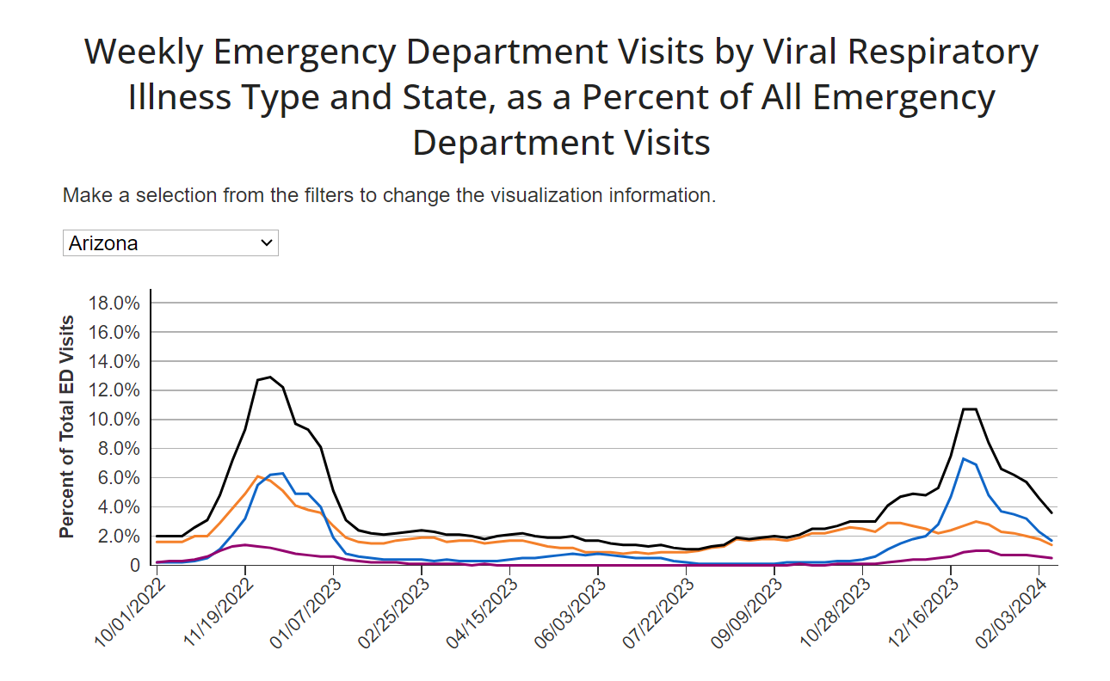

Slide 23
In January, an NSSP representative reached out to possibly continue the conversation about the presentation of sub-state level data for the Respiratory Illness Dashboard.
NSSP expressed interest in developing an approach to show sub-state data in a way that works best for Arizona’s priorities.
They reiterated that they currently use Health Service Area Regions (HSAs) and shared an updated version of the report on how the data would be displayed.

Slide 24
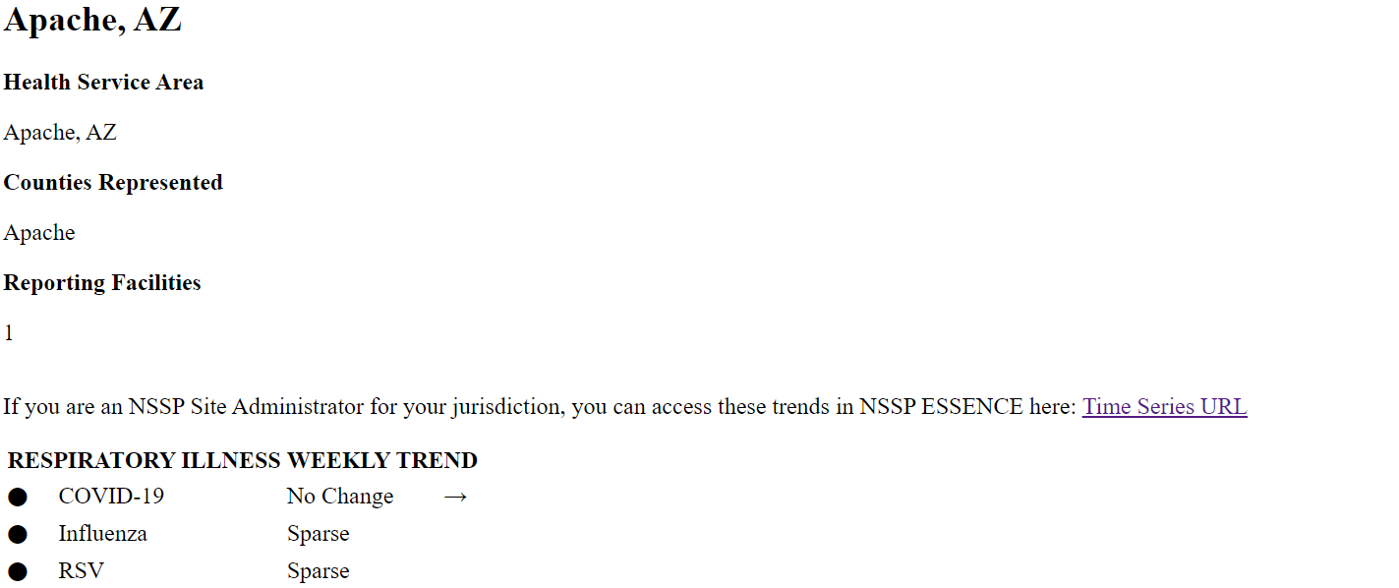
HSA Region- Apache

Slide 25
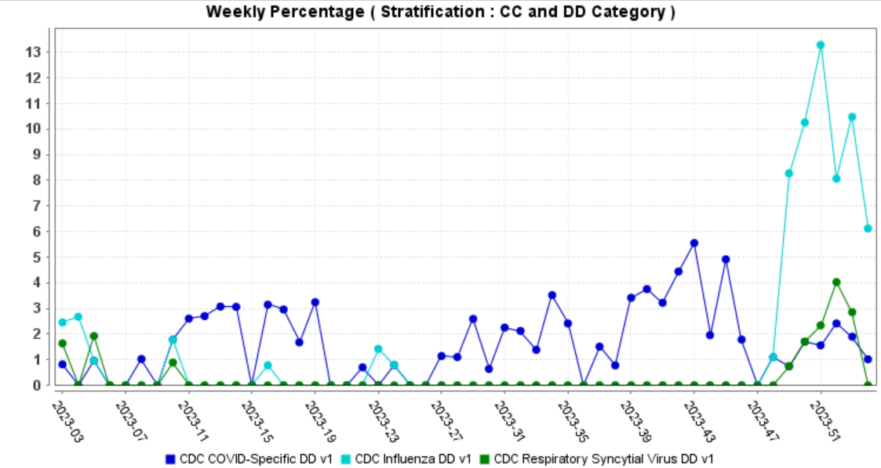
Notes:
White Mountain Regional Medical Center

Slide 26
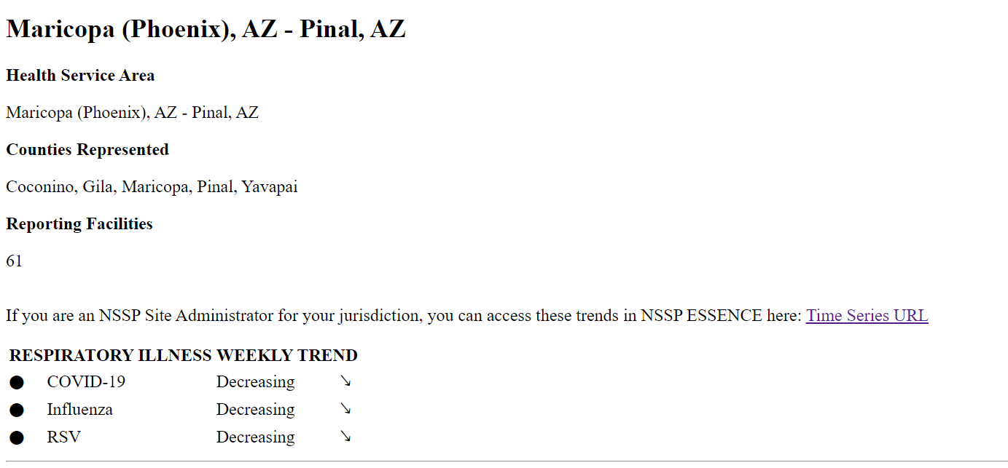
HSA Region Maricopa

Slide 27
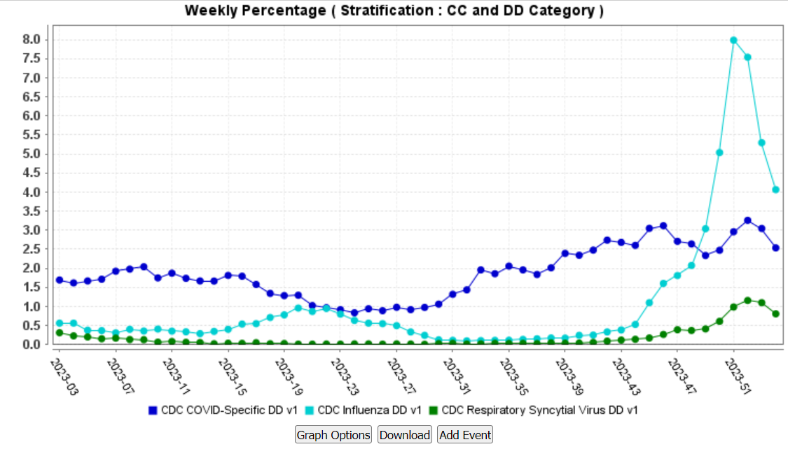
Notes:
1.Banner Baywood Medical Center
2.Banner Boswell Medical Center
3.Banner Casa Grande Medical Center
4.Banner Del E. Webb Medical Center
5. Banner Desert Medical Center
6.Banner Estrella Medical Center
7.Banner Gateway Medical Center
8.Banner Goldfield Medical Center
9.Banner Ironwood Medical Center
10.Banner Thunderbird Medical Center
11. Banner University Medical Center - Phoenix Campus
12. Tempe St Luke's Hospital
13. Mountain Vista Medical Center
14. Banner Page Hospital
15. St Joseph's Hospital and Medical Center
16. St Joseph's Westgate Medical Center
17. Yavapai Regional Medical Center - East Campus
18.Yavapai Regional Medical Center - West Campus
19. Banner Payson Medical Center
20. Chandler Regional Medical Center
21. Mercy Gilbert Medical Center
22. Deer Valley Medical Center
23. John C. Lincoln Medical Center
24. Scottsdale Osborn Medical Center
25. Scottsdale Shea Medical Center
26.Scottsdale Thompson Peak Medical Center
27. Abrazo Arizona heart hospital
28. Abrazo Arrowhead Campus
29. Abrazo Buckeye Emergency Center
30. Abrazo Cave Creek Hospital
31. Abrazo Central Campus
32. Abrazo Peoria Emergency Center
33. Abrazo Scottsdale Campus
34. Abrazo Surprise Hospital
35. Abrazo West Campus
36. AZ General Hospital - Ahwatukee Emergency Room
37 Arizona General Hospital - Chandler McQueen Emergency Room
38. Arizona General Hospital - Gilbert Emergency Room
39. Arizona General Hospital - Glendale Camelback Emergency Room
40. Arizona General Hospital - Goodyear Emergency Room
41. Arizona General Hospital - Mesa Emergency Room
42. Arizona General Hospital - Mesa-Baseline Emergency Room
43. Arizona General Hospital - San Tan Valley Emergency Room
44. Arizona General Hospital - Surprise Emergency Room
45. Arizona General Hospital - Tempe Emergency Room
46. Arizona General Hospital Laveen
47. Arizona General Hospital Mesa
48. Banner - Ocotillo Medical Center
49. Cobre Valley Regional Medical Center
50. Dignity Health Urgent Care - Ahwatukee
51. Dignity Health Urgent Care - Gilbert
52. Dignity Health Urgent Care - Maricopa
53. Flagstaff Medical Center
54. Florence Hospital
55. HonorHealth Sonoran Crossing Medical Center
56. Mayo Clinic Hospital
57. Steward Mesa Hospital
58. Tuba City Regional Health Care Corporation
59. Valleywise Health Medical Center
60.Valleywise Emergency - Maryvale
61. Verde Valley Medical Center
62. Verde Valley Medical Center - Sedona Campus
63. Wickenberg Community Hospital

Slide 28
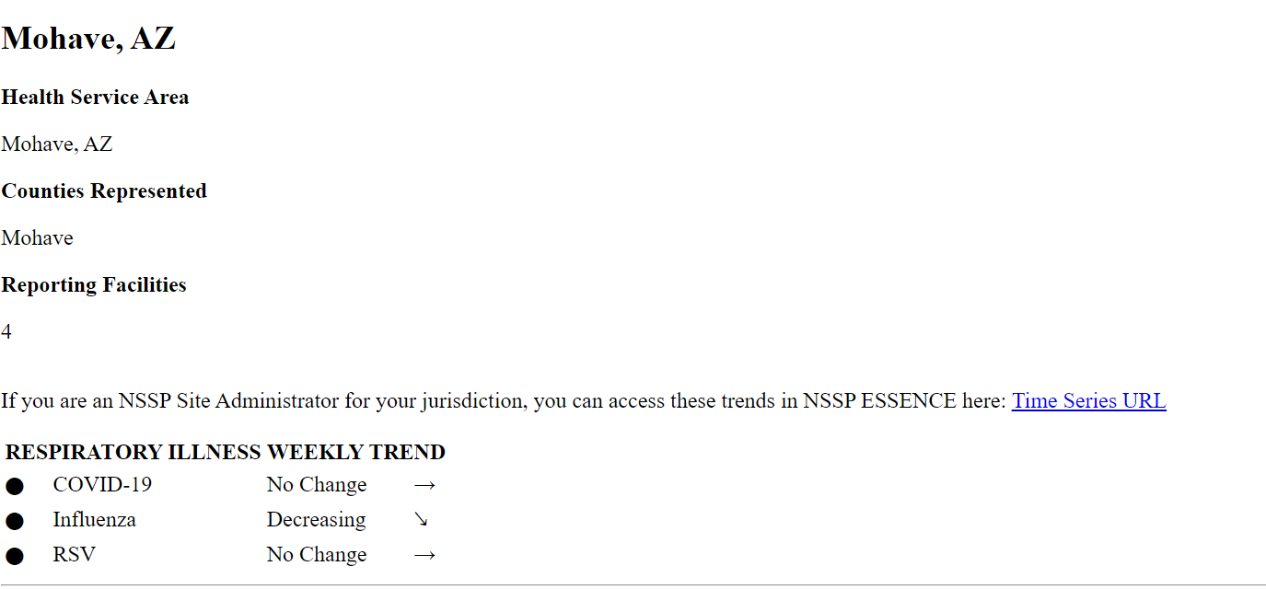
HSA Region- Mohave

Slide 29
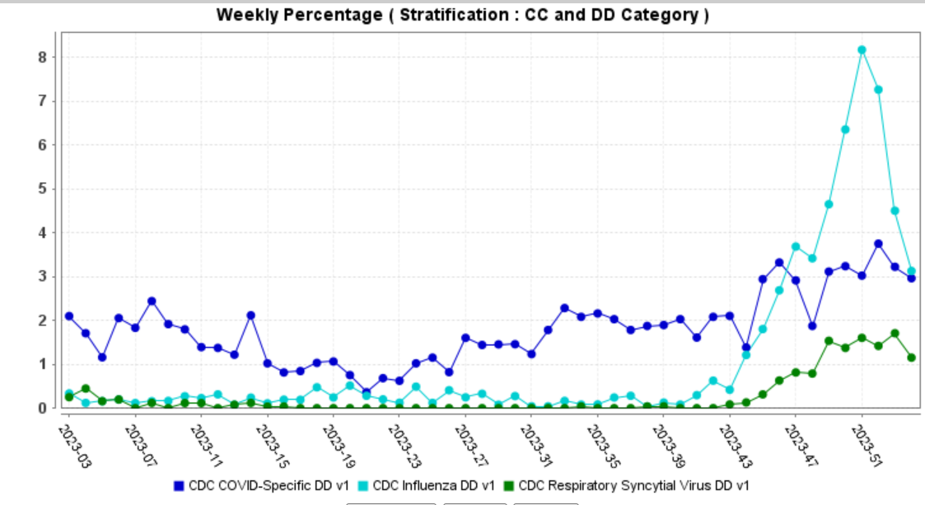
Notes:
Havasu Regional Medical Center
Valley View Medical Center
Kingman Regional medical Center
Western Arizona Regional Medical Center

Slide 30
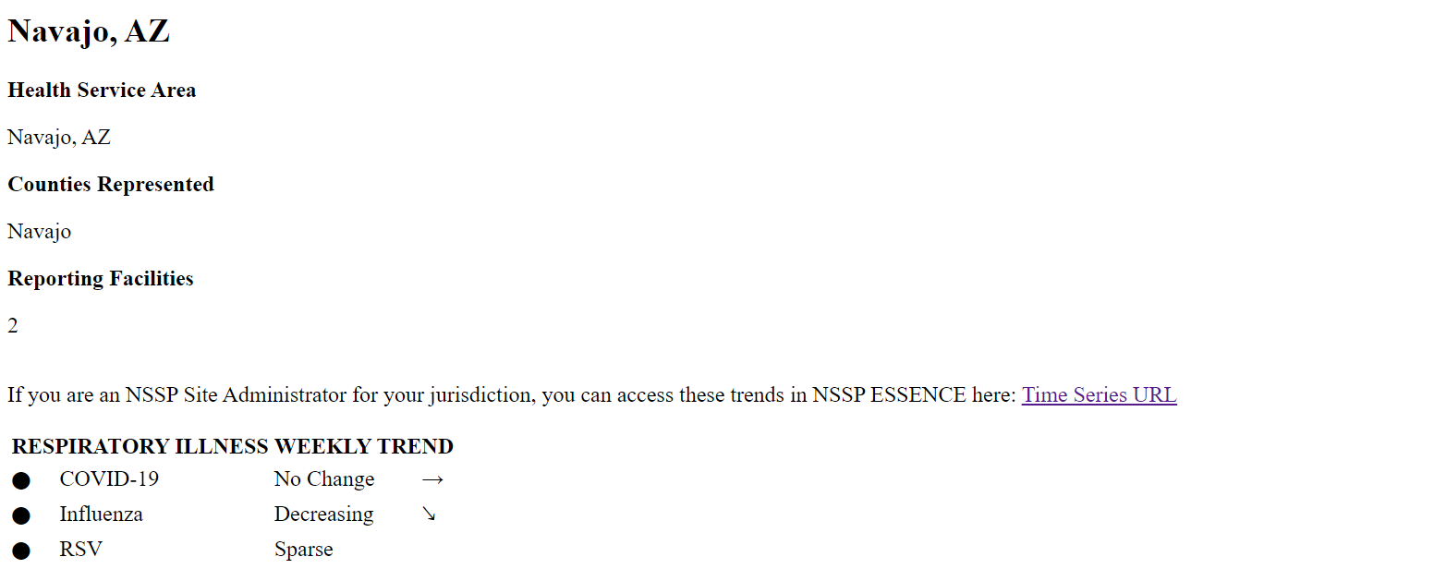
HSA Region Navajo

Slide 31
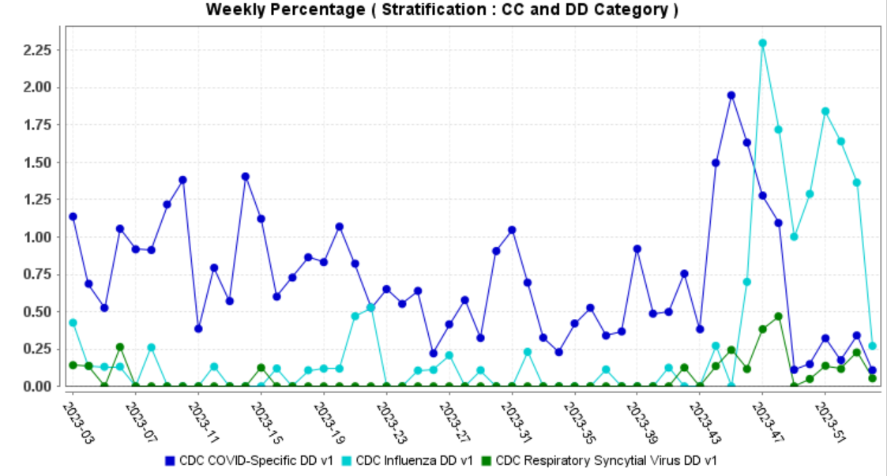
Notes:
Little Colorado Medical Center
Summit Healthcare Regional Medical Center

Slide 32
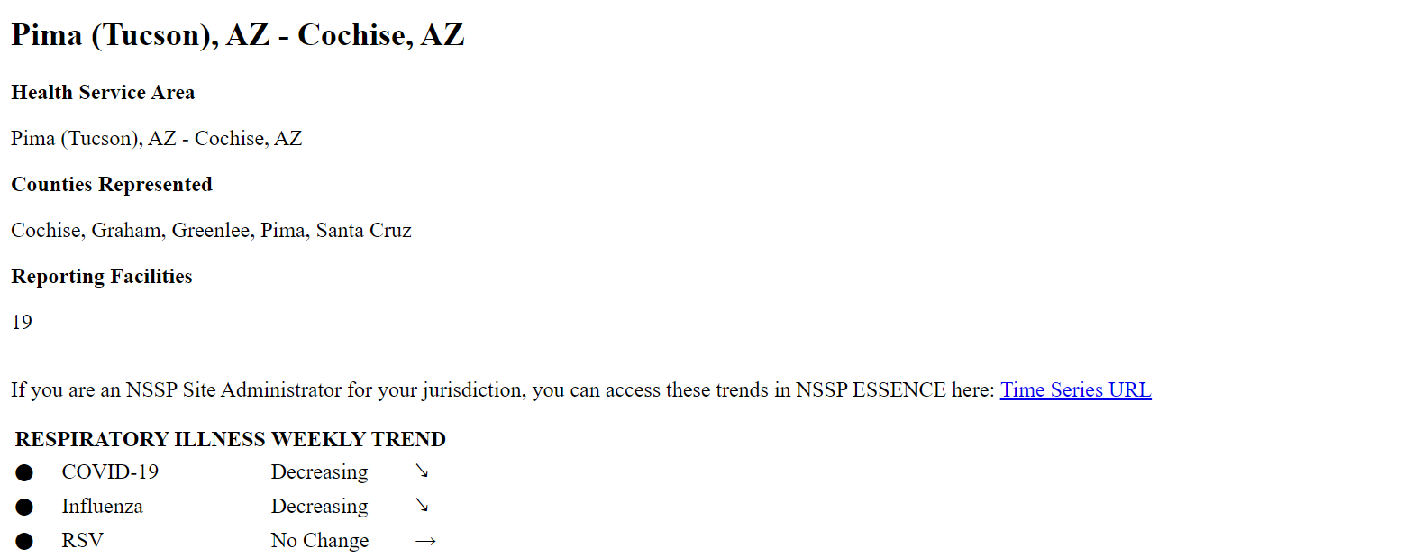
HSA Region - Pima

Slide 33
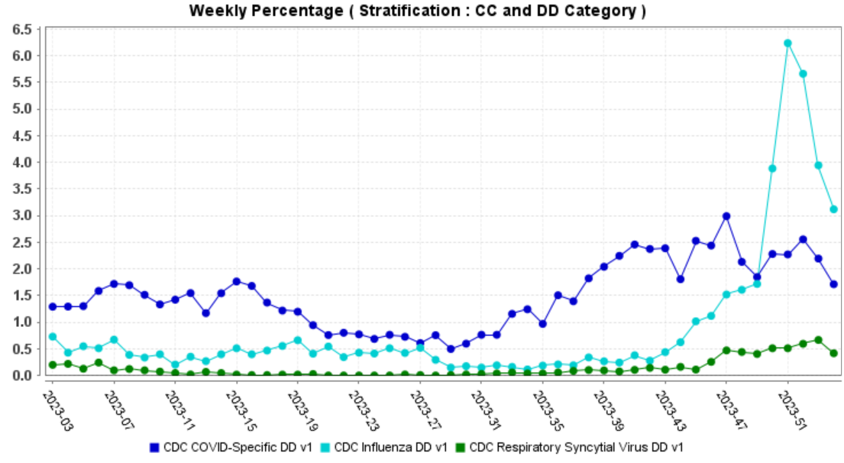
Notes:
1.Banner University Medical Center-South Campus
2.Canyon Vista Medical Center
3.Banner University Medical Center -Tucson Campus
4.Carondelet Marana Hospital
5.Carondelet St. Raphael’s Emergency Center
6.Copper Queen Community Hospital
7.Copper Queen Community Hospital Douglas ED
8.Holy Cross Hospital
9/Mt Graham Regional Medical Center
10.Northern Cochise Community Hospital
11.Northwest Emergency Center at Marana
12.Northwest Emergency Center at Vail
13.Northwest Medical Center
14.Northwest Medical Center at Sahuarita
15.Northwest Medical Center Houghton
16.Oro Valley Hospital
17. St. Joseph’s Hospital
18.St. Mary’s Hospital
19. Tucson medical Center

Slide 34
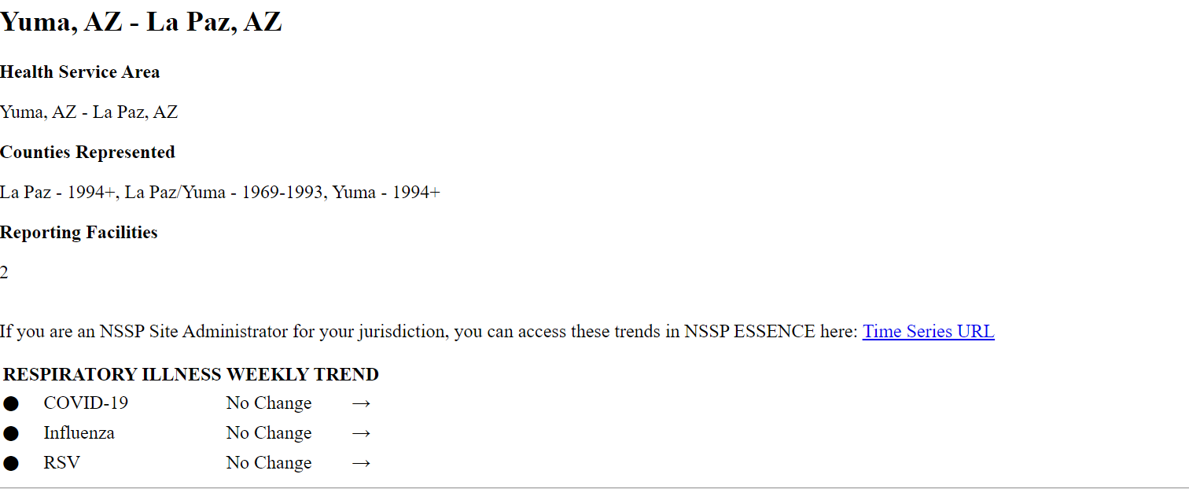
HSA Region-Yuma

Slide 35
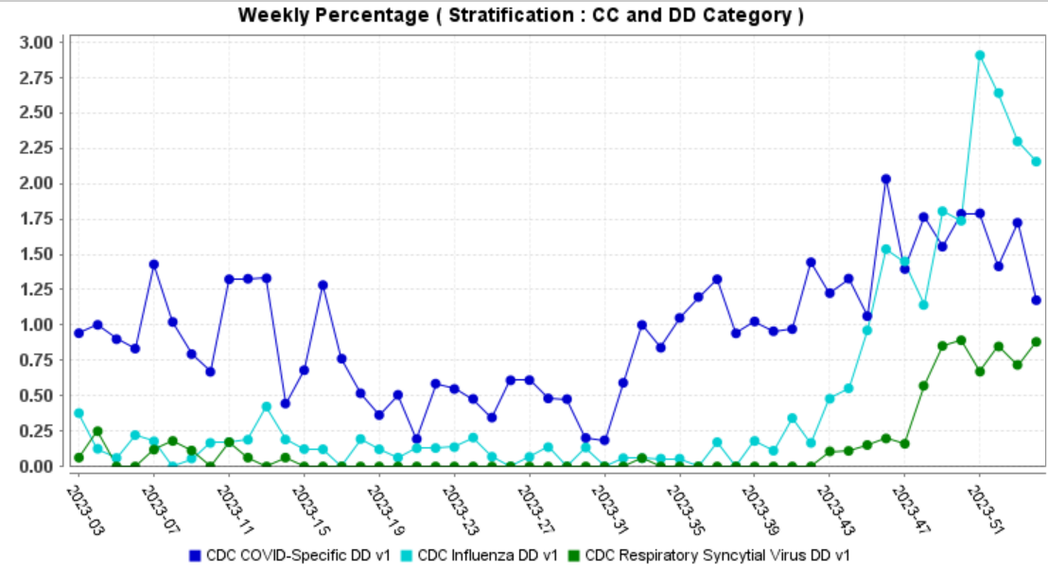
Notes:
La Paz Regional Hospital
Yuma Regional Medical Center

Slide 36
Wesley Kortuem, working on creating CSAs (Community Statistical Areas) as a a sub-state alternative.
Community Statistical Areas (CSAs) were built by ADHS in 2023 to act as rational sub-county boundaries to represent Arizona’s communities while also providing population denominators conducive to statistical analysis and patient confidentiality.
Notes:
Represent today’s communities.
Built in 2023
Align with existing political boundaries whenever possible
Maintain populations conducive to statistical analysis and patient confidentiality.
Are built with a repeatable rule based methodology.
CSAs are built from 2020 US Census Tracts
Federal requirement
No CSA should have an area greater than 7500 square miles
All CSAs should have a 2020 population greater than 10,000 but less than 200,000
CSAs should follow existing political boundaries as closely as possible
CSAs should not cross county lines
Tribal CSAs are exempt from population and area minimum and maximum rules.
Tribal CSAs can cross county lines.
Incorporated cities can cross county lines.
139 communities (126 in 2010)
The average CSA has a population of 51,450 and an area of 820 square miles
58 Metro Phoenix CSAs
20 Metro Tucson CSAs

Slide 37

Presentation

Slide 38

Questions

Slide 39
Next Meetings
NSSP Community of Practice Feb 28th
Arizona Exploratory Analysis April 17th
Arizona Community of Practice May 22nd

Slide 40
Thank you
@syndromicsurveillance@azdhs.gov

