Slide 1
HL7 Overview
AZ Syndromic Surveillance

Slide 2
HL7 in Syndromic Surveillance
Syndromic surveillance is a process that regularly and systematically uses health and health-related data in near "real-time" to make information available on the health of a community.
HL7 is a set of international standards for the exchange of electronic health information.
HL7 Messages are used to facilitate the exchange of syndromic surveillance data between different health information systems

Slide 3
Admission, Discharge and Transfer (ADT) Message Structure
This is specific to the Admission, Discharge, and Transfer (ADT) use case specifications for data exchange of Syndromic Surveillance elements from healthcare providers to Public Health. A file is comprised of a single batch containing an unlimited number of messages. Within each message is a series of segments which possess their own attributes. For example, a single message may contain an unlimited number of observations, diagnoses and procedures.

Slide 4
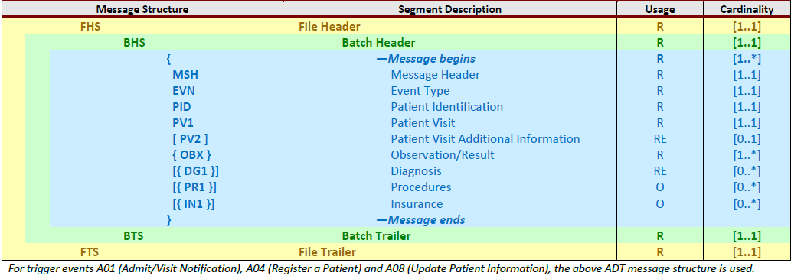
A01(Admit/Visit Notification), A04(Register Patient), A08(Update Patient) Message Structure
If hospital is sending a A01, A04, or A08 HL7 data, the message structure indicated below is required. Note these trigger events require a different order for the OBX, DG1, and PR1 segments within the message structure when compared to A03 (Discharge/End Visit)

Slide 5
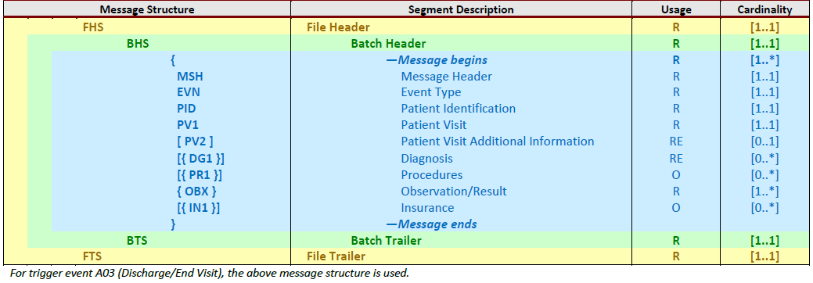
A03 (Discharge/End Visit)
If the facility is sending an A03 (Discharge/End Visit) message, the message structure indicated below is required. Note this trigger event requires a different order for the OBX, DG1, and PR1 segments within the message structure in comparison to A01, A04 & A08 Table.

Slide 6
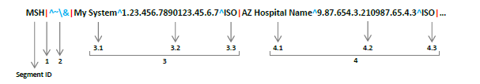
How to read HL7 Segments
The segment begins with a three-letter segment ID that determines the arrangement of contents throughout the rest of the segment. MSH-1 indicates the field separator and MSH-2 indicates the set of delimiter values. Designating special characters in the first two fields of MSH establishes delimitation rules throughout the message, allowing MSH-3 and all subsequent segments to be separated using the appropriate delimiter values.
In the case of batch messaging protocol, delimiter values also appear in the first two fields of the file header (FHS) and batch header (BHS) segments. Special characters must always be positioned in the fixed order shown below.

Slide 7
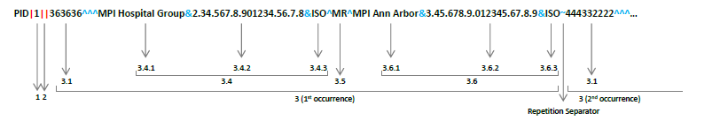
How to read HL7 Segments Cont’d
It is important to note that PID-1 is the value populated after the first field separator. This is because the delimiter values are already established in the MSH segment, which precedes the PID segment. PID-2 is not present since there is no populated value between the enclosing field separators. PID-3 is a large field comprised of components and subcomponents, all of which are separated by the designated delimiters. PID-3.2 and 3.3 are not present for the same reason that applies to PID-2. PID-3.4 and 3.6 are each divided into three subcomponents. A repetition separator marks the end of the first occurrence of PID-3 as well as the beginning of the second occurrence, which begins with its own first component.

Slide 8
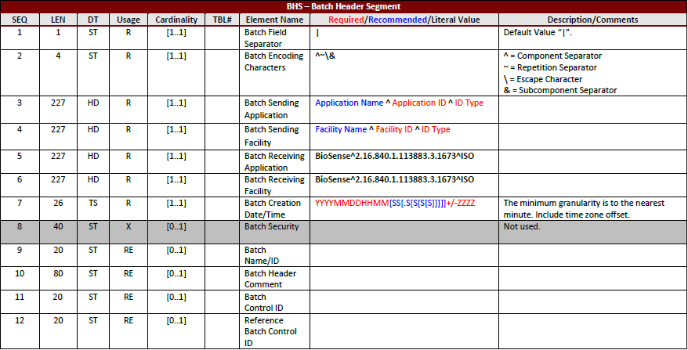
FHS – File Header Segment
This segment is used as the lead-in to a file (group of batches).

Slide 9
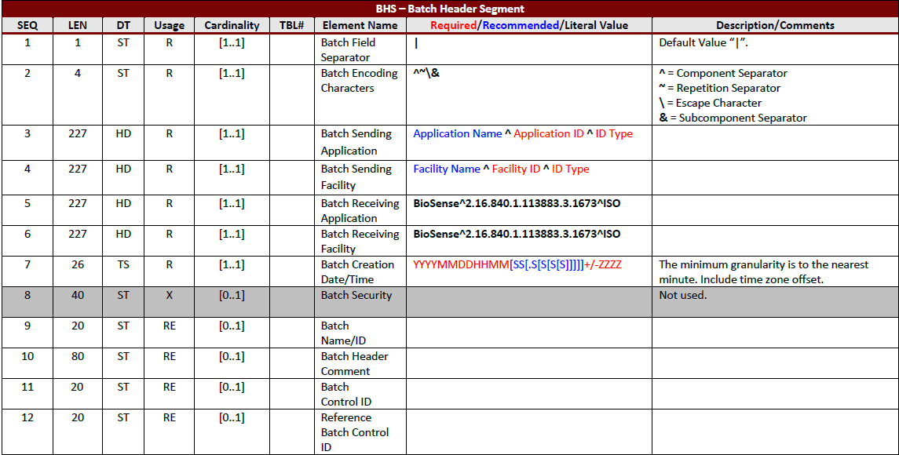
BHS – Batch Header Segment
This segment is used as the lead-in to a batch (group of messages).

Slide 10
MSH – Message Header Segment
The MSH segment is used to define the intent, source, destination, and some specifics of the syntax of the message. This segment includes identification of message delimiters, sender, receiver, message type, timestamp, etc.
MSH-3 – Sending Application
MSH-4 – Sending Facility
MSH-7 – Date and Time of Message
MSH-9 – Message Type (ADT_A01/A03/A04 or A08)
MSH-10 – Message Control ID (Unique identifier)
MSH-11 – Processing ID
MSH-12 – Version (2.5.1)
MSH-21 – Message Profile Identifier

Slide 11

EVN – Event Type Segment
The EVN segment is used to communicate trigger event information to receiving applications.
EVN-1 – Event Type Code
EVN-2 – Recorded Date/Time
EVN-7 – Event Facility

Slide 12
PID – Patient Identification Segment
This segment provides basic demographics regarding the subject of the laboratory observation.
PID-3 – Patient Identifier List (The Medical Record number used in the 1st component of the CX data type)
PID-5 – Patient Name (Syndromic Surveillance uses the Patient ID number to uniquely identify the patient)
PID-7 – Date/Time of Birth (YYYYMMDDHHMM)
PID-8 – Administrative Sex (Gender)
PID-10 – Race (Race^Description^CDCREC)
PID-11 – Patient Address (Street Address^Other Desig^City^State^ZIP Code^Country^Address Type ^^County)
PID-18 – Patient Account Number (Identifier^^^Assigning Authority Name & ID & ID Type^Identifier Type^ Assigning Facility Name & ID & ID Type)

Slide 13
PID - Patient Identification Segment Cont’d
PID-22 – Ethnic Group (Ethnicity ^ Description^CDCREC)
PID-29 – Patient Death Date/Time (YYYYMMDDHHMM[SS[.S[S[S[S]]]]]+/-ZZZZ)
PID-30 – Patient Death Indicator (Yes/No Indicator)
PID-33 – Last Update Date/Time (YYYYMMDDHHMM[SS[.S[S[S[S]]]]]+/-ZZZZ)
PID-34 – Last Update Facility (Facility Name^Facility ID^ID Type)

Slide 14
PV1 – Patient Visit Segment
The PV1 segment is used by Registration/Patient Administration applications to communicate information on a visit-specific basis.
PV1-2 – Patient Class (PHVS_PatientClass_SyndromicSurveillance)
PV1-3 – Assigned Patient Location (Point of Care)
PV1-4 – Admission Type
PV1-6 – Prior Patient Location (Point of Care)
PV1-7 – Attending Doctor (Person Identifier)
PV1-10 – Hospital Service
PV1-14 – Admit Source (PHVS_AdmitSource_HL7_2x)
PV1-15 – Ambulatory Status
PV1-19 – Visit Number (Identifier ^^^ Assigning Authority Name & ID & ID Type)

Slide 15
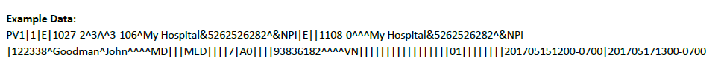
PV1- Patient Visit Segment Cont’d
PV1-36 – Discharge Disposition (Required for ADT_A03 & ADT_A08 (if patient discharged) message types. Element not supported in ADT_A01 & ADT_A04 messages.
Element not supported
PV1-44 – Admit Date/Time (YYYYMMDDHHMM[SS[.S[S[S[S]]]]]+/-ZZZZ)
PV1-45 – Discharge Date/Time (A03 Message Type Only)

Slide 16

PV2 – Patient Visit – Addt’l Info Segment
The PV2 segment is a continuation of visit-specific information and is the segment where the Admit Reason is passed.
PV2-3 – Admit Reason (Identifier ^ Text ^ Coding System or Free Text Documented.
PHVS AdministrativeDiagnosis_ICD-10CM or PHVS_Disease_CDC

Slide 17
OBX – Observation/Result Segment
This segment is used to transmit observations related to the patient and visit.
OBX-1 – Set ID
OBX-2 – Value Type
OBX-3 – Observation Identifier
OBX-5 - The OBX-5 field is used to transmit a variety of observations related to the patient and the visit. Reportable observations are available based on Data Type.
(Date of Onset, Triage Note, Clinical Impression, Medication List, Chief Complaint, Height, Weight, Travel History, BMI, Initial Temperature, Age, Systolic Blood Pressure, etc.)
OBX-6 – Units (Required if OBX-2 is NM. Defines units for pulse oximetry, temperature, age, etc. Refer to OBX-5 details for coding systems.)
OBX-11 – Observation Result Status
OBX-14 – Date/Time of Observation (YYYYMMDDHHMM[SS[.S[S[S[S]]]]]+/-ZZZZ)

Slide 18
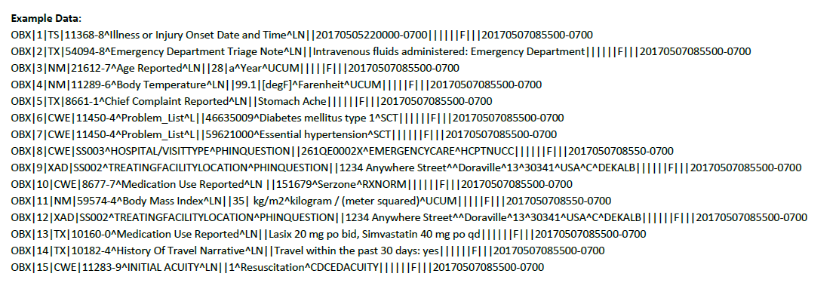
OBX – Observation/Result Example Data

Slide 19

DG1 – Diagnosis Segment
The DG1 segment contains patient diagnosis information of various types. Syndromic Surveillance supports Admitting, Working and Final Diagnosis types.
DG1-1 – Set ID – (DG1|1|…)
DG1-3 – Diagnosis Code (Identifier ^ Description ^ Coding System)
DG1-5 – Diagnosis Date/Time (YYYYMMDDHHMM[SS[.S[S[S[S]]]]]+/-ZZZZ)
DG1-6 – Diagnosis Type
DG1-15 – Diagnosis Priority

Slide 20

PR1 – Procedures Segment
This segment is used to carry information relative to various types of procedures performed.
PR1-1 – Set ID (PR1|1|…)
PR1-3 – Procedure Code (Identifier ^ Description ^ Coding System)
PR1-5 – Procedure Date and Time (YYYYMMDDHHMM[SS[.S[S[S[S]]]]]+/-ZZZZ)

Slide 21
IN1 – Insurance Segment
The IN1 segment contains insurance policy coverage information necessary to produce properly pro-rated patient and insurance bills.
IN1-1 – Set ID
IN1-2 – Insurance Plan ID
IN1-3 – Insurance Company ID
IN1-15 – Plan Type

Slide 22


BTS – Batch Trailer Segment
BTS-1 – Batch Message Count
BTS-2 – Batch Comment
FTS – File Trailer Segment
FTS-1 – File Batch Count
FTS-2 – File Trailer Comment

