Slide 1


Exploratory Analysis
April 17th 2024.

Slide 2



Agenda
Welcome
Updates
    NSSP
    Arizona
Presentations
    HL7
    AVERT
Questions/Open Forum
Notes:
AVERT= Advancing Violence Epidemiology in Real-Time

Slide 3

Updates: NSSP
Syndromic Surveillance Symposium
Final Event Packet for the 2023 Syndromic Surveillance Symposium now available on the Knowledge Repository and Arizona Basecamp website.
Notes:
The 2023 Syndromic Surveillance Symposium Final Event Packet includes track-specific content annotated with recordings and slides. The Symposium Final Event Packet will be added to Knowledge Repository in the near future.
Can be found on Knowledge Repository and Basecamp- Community of Practice

Slide 4

Updates: NSSP
NSSP Vendor Patches
Notes:
BioSense Platform Monthly Patching Reminder:
Vendor patches will be applied to the onboarding and production BioSense Platform environments.
These servers will start going offline on Thursday, April 18, 2024, at 12:00 am et.
Servers will be restarted several times during the update window.
We plan to complete all work on Thursday, April 18, 2024, by 8:00 am et.
We will send you a closeout email when activities are complete.
Effect on Services:
These tasks will require restarting some onboarding and production BioSense Platform servers several times. The following services will not be available during this update window:
Access & Management Center
Data Quality Dashboard
ESSENCE data processing
ESSENCE Web application
Posit Workbench (formerly RStudio Workbench)
SAS Studio
User-Required Actions:
None

Slide 5
Updates: NSSP
ASTHO Defining Disability
Defining Disability for Syndromic Surveillance: Data to Action
Healthcare providers, medical coders, syndromic surveillance experts, and public health agency staff are encouraged to attend to acquire the tools to leverage data-driven approaches to enhance healthcare outcomes for people with disabilities.
This webinar will be held virtually via Zoom, featuring presentations and live discussions.
April 29th 1PM AZ time
Notes:
ASTHO will host a webinar and technical assistance office hour offering a unique perspective on defining disability. The discussions will show how this definition of disability can be used to promote health for people with disabilities during public health emergencies. ASTHO and Thought Bridge panelists will explain how viewing disability as a demographic can help to better understand the disparate impact of public health emergencies on people with disabilities.
Healthcare providers, medical coders, syndromic surveillance experts, and public health agency staff are encouraged to attend to acquire the tools to leverage data-driven approaches to enhance health outcomes for people with disabilities. Both the webinar and office hour will be held virtually via Zoom, featuring presentations and live discussions.
Don't wait – secure your spot today!
Webinar: April 29 | 4 - 5 p.m. ET

Slide 6
Updates: NSSP
New Continuing Education Credit
A new, free CE activity is available from MMWR and Medscape.
The CE activity discusses trends in U.S. cannabis-involved emergency department visits among people under age 25 during the COVID-19 pandemic.
Participants will get a better understanding of how to assess overall trends in cannabis-involved ED visits during the COVID-19 pandemic.
Notes:
CDC scientists aimed to understand trends in cannabis-involved ED visits among youth during the pandemic.
Collaboration initiated between CDC’s National Center for Injury Prevention and Control (NCIPC) and the National Syndromic Surveillance Program (NSSP).
The study focused on trends in cannabis-involved emergency department visits.
Over 90% of cannabis-involved ED visits in persons aged <25 were among 15–24-year-olds.
Cannabis-involved ED visit rates among youths aged ≤10 exceeded pre-pandemic levels.
Rate of cannabis-involved ED visits among females aged 11–14 surpassed males early in the pandemic.
This suggests differing coping strategies by sex during the pandemic.
While supported in literature, this study was the first to show acute increase in cannabis-involved ED visits during COVID-19 among youth.
Importance of raising clinicians’ awareness of increasing cannabis-involved ED visits for early diagnosis.
Importance of informing adults to store cannabis products safely to prevent access by children.
Communities can implement evidence-based programs to improve coping and problem-solving skills among young people to decrease substance use.
CDC’s monitoring of ED data enables quick response to emerging health threats.
Monitoring helps identify subgroups within the population at greatest risk of adverse events.

Slide 7
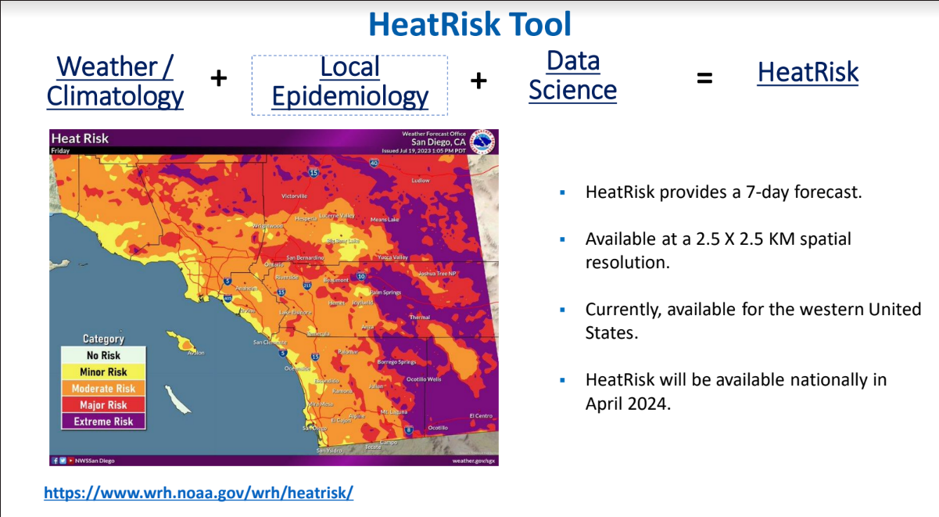
Updates: NSSP
HRI Workgroup testing Heat Risk Tool
Notes:
The NSSP team is working with CDC’s National Center for Environmental Health (NCEH) to convene a workgroup in which NSSP and public health jurisdictions can exchange ideas, local response plans, and heat-related analyses. If you’ve used ED data for a heat-related response or want to get involved, please email your contact information to NSSP@cdc.gov, and we’ll send you an invitation to join. One of the first discussion topics will be a new heat-risk tool that the National Weather Service created in partnership with NCEH. The NCEH is especially interested in working with jurisdictions to evaluate and refine this prototype using local emergency department data.
Goal of Workgroup to evaluate performance or HeatRisk using historical state and/or county-level NSSP data.
Incorporate state and sub-state data for the purpose of these collaborative data-use projects.
The NWS HeatRisk Prototype is a color-numeric-based index that provides a forecast risk of heat-related impacts to occur over a 24-hour period. HeatRisk takes into consideration:
How unusual the heat is for the time of the year
The duration of the heat including both daytime and nighttime temperatures
If those temperatures pose an elevated risk of heat-related impacts based on data from the CDC

Slide 8
Updates: NSSP
New Syndrome Definitions
New CCDD Categories in NSSP ESSENCE. On February 21, 2024, CDC added two Chief Complaint Discharge Diagnoses categories to ESSENCE: (1) Suspected Child Abuse and Neglect v1 and (2) CDC Youth Violence v1. On March 7, 2024, we added another category: CDC Asthma CCDD v1.
Syndrome Definitions Added to Knowledge Repository. The new definitions are Youth Violence v1, All Drug Overdose v3 Parsed, Cocaine Overdose v2 Parsed, Stimulant Overdose v4 Parsed, and Methamphetamine Overdose v1 Parsed.
Syndrome Definitions in the Works
  Sexually transmitted infections: chlamydia, gonorrhea, syphilis, and congenital syphilis
  Reportable conditions: simple versions of ~83 new CCDD categories, including dengue, malaria, paralytic polio, cholera, Hepatitis B, Marburg, rabies PEP administered, Meningococcal disease, Mumps, Hemolytic uremic syndrome, Zika (non-congenital), Zika (congenital), and Ebola
  Cardiovascular conditions (broad), myocardial infarction, and stroke
  Asthma v2
Notes:
New CCDD Categories in NSSP ESSENCE. On February 21, 2024, CDC added two Chief Complaint Discharge Diagnoses categories to ESSENCE: (1) Suspected Child Abuse and Neglect v1 and (2) CDC Youth Violence v1. On March 7, 2024, we added another category: CDC Asthma CCDD v1.
Syndrome Definitions Added to Knowledge Repository. The new definitions are Youth Violence v1, All Drug Overdose v3 Parsed, Cocaine Overdose v2 Parsed, Stimulant Overdose v4 Parsed, and Methamphetamine Overdose v1 Parsed.
Syndrome Definitions in the Works
Sexually transmitted infections: chlamydia, gonorrhea, syphilis, and congenital syphilis
Reportable conditions: simple versions of ~83 new CCDD categories, including dengue, malaria, paralytic polio, cholera, Hepatitis B, Marburg, rabies PEP administered, Meningococcal disease, Mumps, Hemolytic uremic syndrome, Zika (non-congenital), Zika (congenital), and Ebola
Cardiovascular conditions (broad), myocardial infarction, and stroke
Asthma v2

Slide 9
Updates: Arizona
Onboarding
Benson Hospital
  Still need to improve admit reason, diagnosis code and diagnosis type in order to be moved to production.
Sage Memorial Hospital
Notes:
Admit Reason: 59.26%
Diagnosis Code: 59.26%
Diagnosis Type: 59.26%
Race: 96.3% (Please review)
Ethnic Group: 96.3% (Please review)
Admit Reason, Diagnosis Code and Diagnosis Type as those values are still under the threshold,
SAge to review the NIST Reports and ensure they are under the number of allowed errors.

Slide 10
Updates: Arizona
Data Quality
Data Quality for 03-01-24 to 04-01-24
Summit saw low completeness with diagnosis code, diagnosis description and facility type code
Banner had low chief complaint, diagnosis code, and diagnosis description
Yavapai and Valley Verde had intermediate performance: percentage of visits received is greater than 30% to 80%) for timeliness

Slide 11

HL7 Overview
Presentations
Surveillance for Advancing Violence Epidemiology in Real-Time (AVERT) Grant with the Arizona Department of Health Services

Slide 12
Updates: Arizona
Maternal Health Queries
We are interested in exploring queries related to maternal health and potentially establishing an alerting system and dashboard in the future. Specifically, we are seeking information on the following topics:
  Pregnancy-related emergencies
  Preeclampsia
  Hemorrhage
  Pregnancy and intimate partner violence
We would greatly appreciate your input and suggestions on how to effectively examine maternal health in Arizona. If you have any ideas or have worked on any of the aforementioned topics, please feel free to share your insights
Notes:
We are interested in exploring queries related to maternal health and potentially establishing an alerting system and dashboard in the future. Specifically, we are seeking information on the following topics:
Pregnancy-related emergencies
Preeclampsia
Hemorrhage
Pregnancy and intimate partner violence
We would greatly appreciate your input and suggestions on how to effectively examine maternal health in Arizona. If you have any ideas or have worked on any of the aforementioned topics, please feel free to share your insights

Slide 13
Updates: Arizona
Topics of Interest
MPox Clade 1
  CDC monitoring of ED data for Changes in Mpox
H5N1
Measles
Overdose ED Visits Dashboard
  New CDC Syndrome Definitions
Notes:
MPox Clade 1-CDC Monitoring of ED Data for Changes in Mpox
Due to international concern about a new clade, CDC will begin monitoring and using emergency department (ED) data (diagnoses) at the substate level for mpox.
CDC currently accesses substate ED visit data (diagnoses) through NSSP for mpox, COVID-19, influenza, and RSV.
CDC also accesses substate data through funded agreements specific to other conditions such as for overdose, violence, and mental health.
Bird Flu
H5N1 Bird Flu: Current Situation Summary | Avian Influenza (Flu) (cdc.gov)
CDC is currently responding to H5N1 Highly Pathogenic Avian Influenza, including human infection as well as regions with infected livestock.
NSSP has been involved in producing regional time series on ILI, Influenza DD, and Conjunctivitis from ED data and Influenza A testing statistics out of both commercial laboratory data sets.
In general, trends observed are as expected, and no unexpected changes or patterns have been noted.
Conversations have been held with specific jurisdictions already, and methods can be shared. Also, willing to engage with other sites that may have related responses.
Happy to share queries and ways to quickly select regions in ESSENCE. Also, mentioning the Word Alerts template in the RNSSP package that can help detect recent changes in code/term usage in visits.
Measles
Coconino county collaborated with Maricopa and ADHS to utilize ESSENCE to examine potential measles cases from visits.

Slide 14

Questions/Open Forum

Slide 15


THANK YOU
Syndromic Surveillance | syndromicsurveillance@azdhs.gov

