Slide 1

CIFOR Clearinghouse and Promotion Update
<?xml version="1.0"?><AllQuestions />
<?xml version="1.0"?><AllResponses />
<?xml version="1.0"?><Settings><answerBulletFormat>Numeric</answerBulletFormat><answerNowAutoInsert>No</answerNowAutoInsert><answerNowStyle>Explosion</answerNowStyle><answerNowText>Answer Now</answerNowText><chartColors>Use PowerPoint Color Scheme</chartColors><chartType>Horizontal</chartType><correctAnswerIndicator>Checkmark</correctAnswerIndicator><countdownAutoInsert>No</countdownAutoInsert><countdownSeconds>10</countdownSeconds><countdownSound>TicToc.wav</countdownSound><countdownStyle>Box</countdownStyle><gridAutoInsert>No</gridAutoInsert><gridFillStyle>Answered</gridFillStyle><gridFillColor>255,255,0</gridFillColor><gridOpacity>50%</gridOpacity><gridTextStyle>Keypad #</gridTextStyle><inputSource>Response Devices</inputSource><multipleResponseDivisor># of Responses</multipleResponseDivisor><participantsLeaderBoard>5</participantsLeaderBoard><percentageDecimalPlaces>0</percentageDecimalPlaces><responseCounterAutoInsert>No</responseCounterAutoInsert><responseCounterStyle>Oval</responseCounterStyle><responseCounterDisplayValue># of Votes Received</responseCounterDisplayValue><insertObjectUsingColor>Red</insertObjectUsingColor><showResults>Yes</showResults><teamColors>Use PowerPoint Color Scheme</teamColors><teamIdentificationType>None</teamIdentificationType><teamScoringType>Voting pads only</teamScoringType><teamScoringDecimalPlaces>1</teamScoringDecimalPlaces><teamIdentificationItem></teamIdentificationItem><teamsLeaderBoard>5</teamsLeaderBoard><teamName1></teamName1><teamName2></teamName2><teamName3></teamName3><teamName4></teamName4><teamName5></teamName5><teamName6></teamName6><teamName7></teamName7><teamName8></teamName8><teamName9></teamName9><teamName10></teamName10><showControlBar>All Slides</showControlBar><defaultCorrectPointValue>0</defaultCorrectPointValue><defaultIncorrectPointValue>0</defaultIncorrectPointValue><chartColor1>187,224,227</chartColor1><chartColor2>51,51,153</chartColor2><chartColor3>0,153,153</chartColor3><chartColor4>153,204,0</chartColor4><chartColor5>128,128,128</chartColor5><chartColor6>0,0,0</chartColor6><chartColor7>0,102,204</chartColor7><chartColor8>204,204,255</chartColor8><chartColor9>255,0,0</chartColor9><chartColor10>255,255,0</chartColor10><teamColor1>187,224,227</teamColor1><teamColor2>51,51,153</teamColor2><teamColor3>0,153,153</teamColor3><teamColor4>153,204,0</teamColor4><teamColor5>128,128,128</teamColor5><teamColor6>0,0,0</teamColor6><teamColor7>0,102,204</teamColor7><teamColor8>204,204,255</teamColor8><teamColor9>255,0,0</teamColor9><teamColor10>255,255,0</teamColor10><displayAnswerImagesDuringVote>Yes</displayAnswerImagesDuringVote><displayAnswerImagesWithResponses>Yes</displayAnswerImagesWithResponses><displayAnswerTextDuringVote>Yes</displayAnswerTextDuringVote><displayAnswerTextWithResponses>Yes</displayAnswerTextWithResponses><questionSlideID></questionSlideID><controlBarState>Expanded</controlBarState><isGridColorKnownColor>True</isGridColorKnownColor><gridColorName>Yellow</gridColorName></Settings>
<?xml version="1.0"?><AllAnswers />
CIFOR Council Meeting
Minneapolis, MN
Sept. 26-28, 2016
Notes:
1

Slide 2

CIFOR Website Trends
*As of Sept 7
Notes:
2
A session is the activity that a user with a unique IP address spends on a Web site during a specified period of time.
6,206 sessions as of Sept. 7, 2016.

Slide 3
CIFOR Website Trends
*As of Sept. 7
Notes:
3
An estimate of the percentage of first time visits by sessions. % is level throughout the year and indicates that most visitors are new users.
2009 – 85.
2010 – 85%
2011 – 81.1%
2012-81.6%
2013 – 83.2
2014- 83.2
2015 – 82.5
2016 – 66.10% as of Sept 7

Slide 4
Top Traffic Sources: 2015 vs. 2016
*As of Sept. 7.
Notes:
4
Organic search – including search terms for Cifor, cifor toolkits, CIFOR spelled out
2015
Direct
Organic
Social (0.5%)
Referral
CDC.gov
NEHA
CSTE
Apec.org (asia pacific economic cooperation—food safety cooperation forum) –links cifor toolkit
NACCHO.org
2016:
Organic search - including search terms for Cifor, cifor toolkits, CIFOR spelled out
Direct to CIFOR website
Social (0.1)
Referral
Cdc.gov (35.33%)
NACCHO Healthy people Healthy places blog (4.42%)
Wire restaurant (3.93%)
NEHA 3.31%
Michigan.gov 2.83%

Slide 5
Top Pages Based on Unique Page Views
*As of Sept. 7.
Notes:
5
List the top pages according to percentages-unique pageviews
“other” – other webpages on the CIFOR webpage
OUE page emerged as one of the top 7 pages viewed in 2016. Otherwise, top pages for 2015 and 2016 are pretty consistent – clearinghouse, landing page, toolkit, guidelines, industry, current projects page.

Slide 6
Clearinghouse Trends
Notes:
6
*Numbers reflect annual views not cumulative.
2008 834
2009 4357
2010 13637
2011 12697
2012 17,383
2013 41,086
2014 82,411
2015 95,945
2016* 62,322 as of Sept 7, 2016

Slide 7
Clearinghouse Statistics
<?xml version="1.0"?><AllQuestions />
<?xml version="1.0"?><AllResponses />
<?xml version="1.0"?><Settings><answerBulletFormat>Numeric</answerBulletFormat><answerNowAutoInsert>No</answerNowAutoInsert><answerNowStyle>Explosion</answerNowStyle><answerNowText>Answer Now</answerNowText><chartColors>Use PowerPoint Color Scheme</chartColors><chartType>Horizontal</chartType><correctAnswerIndicator>Checkmark</correctAnswerIndicator><countdownAutoInsert>No</countdownAutoInsert><countdownSeconds>10</countdownSeconds><countdownSound>TicToc.wav</countdownSound><countdownStyle>Box</countdownStyle><gridAutoInsert>No</gridAutoInsert><gridFillStyle>Answered</gridFillStyle><gridFillColor>255,255,0</gridFillColor><gridOpacity>50%</gridOpacity><gridTextStyle>Keypad #</gridTextStyle><inputSource>Response Devices</inputSource><multipleResponseDivisor># of Responses</multipleResponseDivisor><participantsLeaderBoard>5</participantsLeaderBoard><percentageDecimalPlaces>0</percentageDecimalPlaces><responseCounterAutoInsert>No</responseCounterAutoInsert><responseCounterStyle>Oval</responseCounterStyle><responseCounterDisplayValue># of Votes Received</responseCounterDisplayValue><insertObjectUsingColor>Red</insertObjectUsingColor><showResults>Yes</showResults><teamColors>Use PowerPoint Color Scheme</teamColors><teamIdentificationType>None</teamIdentificationType><teamScoringType>Voting pads only</teamScoringType><teamScoringDecimalPlaces>1</teamScoringDecimalPlaces><teamIdentificationItem></teamIdentificationItem><teamsLeaderBoard>5</teamsLeaderBoard><teamName1></teamName1><teamName2></teamName2><teamName3></teamName3><teamName4></teamName4><teamName5></teamName5><teamName6></teamName6><teamName7></teamName7><teamName8></teamName8><teamName9></teamName9><teamName10></teamName10><showControlBar>All Slides</showControlBar><defaultCorrectPointValue>0</defaultCorrectPointValue><defaultIncorrectPointValue>0</defaultIncorrectPointValue><chartColor1>187,224,227</chartColor1><chartColor2>51,51,153</chartColor2><chartColor3>0,153,153</chartColor3><chartColor4>153,204,0</chartColor4><chartColor5>128,128,128</chartColor5><chartColor6>0,0,0</chartColor6><chartColor7>0,102,204</chartColor7><chartColor8>204,204,255</chartColor8><chartColor9>255,0,0</chartColor9><chartColor10>255,255,0</chartColor10><teamColor1>187,224,227</teamColor1><teamColor2>51,51,153</teamColor2><teamColor3>0,153,153</teamColor3><teamColor4>153,204,0</teamColor4><teamColor5>128,128,128</teamColor5><teamColor6>0,0,0</teamColor6><teamColor7>0,102,204</teamColor7><teamColor8>204,204,255</teamColor8><teamColor9>255,0,0</teamColor9><teamColor10>255,255,0</teamColor10><displayAnswerImagesDuringVote>Yes</displayAnswerImagesDuringVote><displayAnswerImagesWithResponses>Yes</displayAnswerImagesWithResponses><displayAnswerTextDuringVote>Yes</displayAnswerTextDuringVote><displayAnswerTextWithResponses>Yes</displayAnswerTextWithResponses><questionSlideID></questionSlideID><controlBarState>Expanded</controlBarState><isGridColorKnownColor>True</isGridColorKnownColor><gridColorName>Yellow</gridColorName></Settings>
<?xml version="1.0"?><AllAnswers />
Top 5 Tools: 2013 vs. 2014 vs. 2015
Tool | Views
CIFOR Toolkit Focus Area 8: Environmental Health Investigation | 1395
CIFOR Guidelines for Foodborne Disease Outbreak Response | 611
Automated Control Call Sheet Generator | 508
After Action Report - Castleberry | 501
ASTHO Summary of FSMA Provisions and Statement of Support | 481
Tool | Views
Routine Campylobacter Interview Form | 891
Assess. of Foodborne Illness Outbreak Response and Investigation Capacity | 800
After Action Report - Castleberry | 774
CIFOR Guidelines for Foodborne Disease Outbreak Response | 770
Automated Control Call Sheet Generator | 688
Tool | Views
CIFOR Toolkit Focus Area 11: Food Recall | 1,297
After Action Report - Castleberry | 923
CIFOR Guidelines for Foodborne Disease Outbreak Response | 915
Assess. of Foodborne Illness Outbreak Response and Investigation Capacity | 786
ASTHO Protection & Security Advocacy Document | 772
Notes:
7
As of the end of 2015…
After Action Report – Castleberry has been in the top 5 tools for the past 5 years. So far is 6th most viewed in 2016.
CIFOR Guidelines has been in the top 5 tools for the past 3-4 years.
Assess. of Foodborne Illness Outbreak Response and Investigation Capacity has been in top 5 tool for the past 2-3 years
CIFOR Toolkit Focus Area 11: Food Recall popped up as number 1 tool viewed in 2015. It was not in the top 5 the previous 5 years. (In top 9 tools if looking at all tools viewed 2010-2015) ---was not featured on the CIFOR website landing page. The spotlight on Area 11 was put up after it popped as top viewed tools in September 2015.

Slide 8
Clearinghouse Statistics
Top 5 Tools: 2015 vs. 2016*
Tool | Views
CIFOR Toolkit Focus Area 11: Food Recall | 1,297
After Action Report - Castleberry | 923
CIFOR Guidelines for Foodborne Disease Outbreak Response | 915
Assess. of Foodborne Illness Outbreak Response and Investigation Capacity | 786
ASTHO Protection & Security Advocacy Document | 772
Tool | Views
Product Tracing in Epidemiologic Investigations of Outbreak | 1,966
CIFOR Guidelines for Foodborne Disease Outbreak Response | 577
CIFOR Toolkit Focus Area 11: Food Recall | 553
CDC National Hypothesis Generating Questionnaire | 544
After Action Report - Castleberry | 541
As of Sept. 7, 2016
Notes:
8
So far in 2016, the relatively recent released Product tracing in epidemiologic investigations of outbreak white paper is top tool. Has been featured on cifor landing page for a few months. The CDC National Hypothesis Generating Questionnaire was uploaded on 5/2015, but this is the first time it has entered the top 5 tools viewed.

Slide 9
Clearinghouse Statistics
Top 5 Tools (2011-2016)
Tool | Views
CIFOR Guidelines for Foodborne Disease Outbreak Response | 3,534
CIFOR Toolkit Focus Area 11: Food Recall | 3,432
CIFOR Toolkit Focus Area 8: Environmental Health Investigation | 3,355
After Action Report - Castleberry | 3,321
Gastroenteritis Questionnaire | 3,151
As of Sept. 7, 2016
Notes:
9
CIFOR guidelines and toolkit focus area 11 were featured on the spotlight throughout the years; however other tools were not featured.

Slide 10
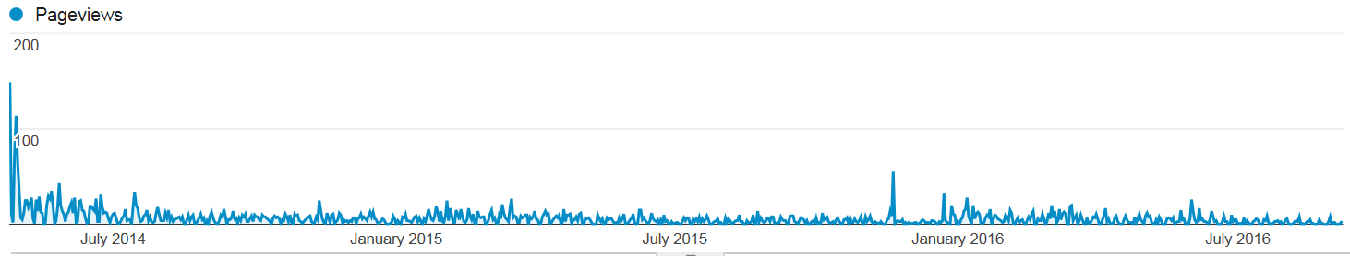
Second Edition of CIFOR Guidelines
Total Page Views Since April 25, 2014 Release: 5,613
Highest # of Views:4/25/14 (474) and 4/28/14(73)
Clearinghouse Page Views Since Release: 1,998
*As of Sept. 7, 2016
Notes:
10
Highest views occurred shortly after release and marketing efforts
Unable to view stats for who click on guidelines chapters and whole document on webpage – will enable this function on next CIFOR website.

Slide 11
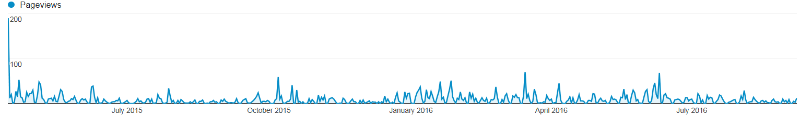
Second Edition of CIFOR Toolkit
Total Page Views Since April 15, 2015 Release: 4,610
Highest # of Views:4/15/15 (190)
Clearinghouse Page Views Since Release: 877
*As of Sept. 7, 2016
Notes:
11
Highest view on release date.
Clearinghouse views 877, but should be noted that the toolkit is available by chapters and sections on the toolkit as well. Some individual chapters have views that range from 900-1700 views.

Slide 12
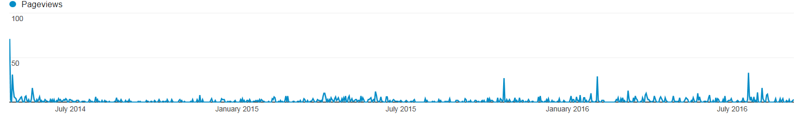
CIFOR Metrics
Total Page Views Since April 25, 2014 Release: 1,474
Highest # of Views: 4/25/14(71) and 7/19/16(33)
Clearinghouse Page Views Since Release: 1,428(Full)/1,408(Abridged)/205(entry tool)
*As of Sept. 7, 2016
Notes:
12
Full = Full version of the “Development of Target Ranges”
Abridged = abridged version of the “development of target ranges”
CIFOR released the two versions at the same time in April 2014.
C-met entry tool went live on Feb 3- saw small uptick to 29 views and on July 19, 2016.

Slide 13
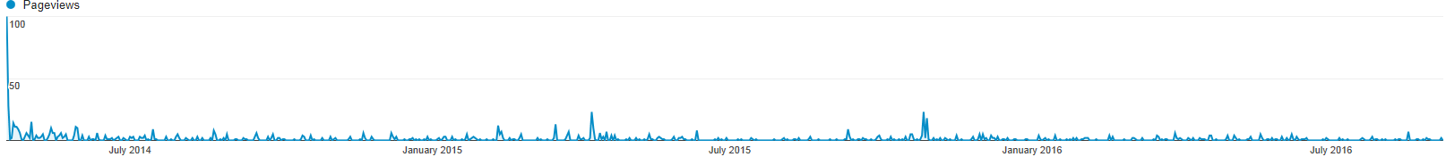
Lab-Epi Software
Total Page Views Since April 4, 2014 Release: 1,441
Highest # of Views: 4/17/14(100) and 4/4/14 (34)
Clearinghouse Page Views Since Release: 1,215
*As of September 7, 2016
Notes:
13
Highest views occurred shortly after release and marketing efforts.
Small upticks on April 2015 and October 2015 to 23 views

Slide 14
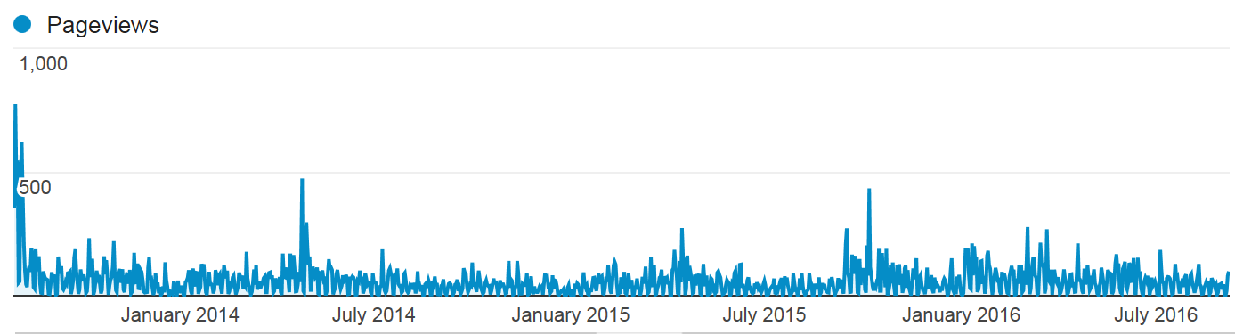
CIFOR Industry Guidelines
Total Page Views Since July 30, 2013 Release: 5,790
Highest # of Views: July 31, 2013 (774) and Aug 6, 2013 (623)
Clearinghouse Page Views Since Release: 2,095
*As of Sept. 7, 2016.
Notes:
14
Highest views occurred shortly after release and marketing efforts.
Few upticks – April 25, 2014 (474) and Oct7, 2015 (434)

Slide 15
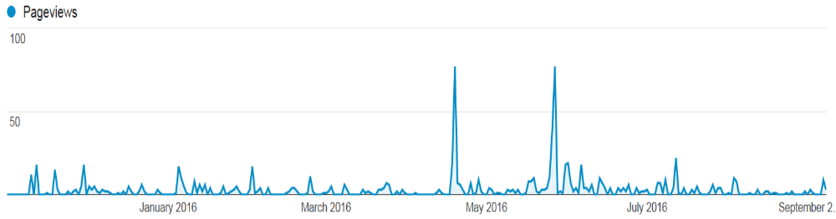
CIFOR OUE
Total Page Views Since November 2015: 920
Highest # of Views: April 19, 2016(77) and May 27, 2016 (77)
Clearinghouse Page Views Since Release: 378
*As of Sept. 7, 2016.
Notes:
15

Slide 16
CIFOR Website Updates
Notes:
16
***waiting for Kendria to provide updates

Slide 17
CIFOR Promote Team
Initial key priorities for the Promote Development Team:
  Conduct an assessment and an approved marketing strategy
  Update the CIFOR website
  Develop webinars and training about CIFOR products
Notes:
17
***waiting for Kendria to provide updates

Slide 18
CIFOR Promote Team Updates
  3 calls to-date:
    Website
    Flyers
    Identifying additional team members
    Drafted an RFP for marketing strategy consultant
Notes:
18
***waiting for Kendria to provide updates

