Slide 1
Are you Ready for the Worst?
CIFOR Industry Guidelines
Foodborne Illness Response Guidelines for Owners, Operators and Managers of Food Establishments
<name>
<title>
<date>

Slide 2
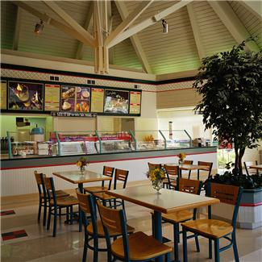
Host: Consumer meals away from home
945,000 restaurant locations served more than 70 billion meals and snacks (NRA, 2008)
62% of outbreaks (4380 of 7057) associated with restaurants
  13% (926 outbreaks) linked to catered events
    (NORS 2008-2017)
Notes:
A review of foodborne outbreaks in the seven states participating in CDC’s Foodborne Disease Active Surveillance Network (FoodNet)
2005, 41% of all food spending on food away from home 26% in 1970
Today’s estimates now place the number of restaurants at over 1 million in the US

Slide 3
Think foodborne illnesses can never happen in your firm?
SOURCE | PATHOGEN | FOOD | AFFECTED | COST
Processor/Restaurants (1993) | E.. Coli O157 | Ground Beef | -73 stores -500+ cases ill -4 deaths | $160 million (lost w.in 18 months following outbreak
Processor (2009) | Salmonella | Peanut Butter | -43 states -700+ cases ill -9 deaths | $1 Billion+ (under-estimated)
Importer (2008) | Salmonella | Peppers (first believed to be tomatoes) | -43 states and DC -1,442 cases -2 deaths | $300 million (loss to farmers, farm workers, distributor, retailers)
Notes:
Because people are eating out a lot, they are depending on the firms to provide safe food.
However, even if a food facility does everything right, a problem out of their control can still affect them.
Examples of larger outbreak; most will not happen like this. Most are smaller outbreaks with a handful of people affected. But use this as an example of how what can happen and that things can get out of control quickly if proper procedures and employee hygiene are not in place.
Restaurant=Jack in the Box reported that in the 18 months following the outbreak the company lost approximately $160 million.
Retail=PCA peanut product recall

Slide 4
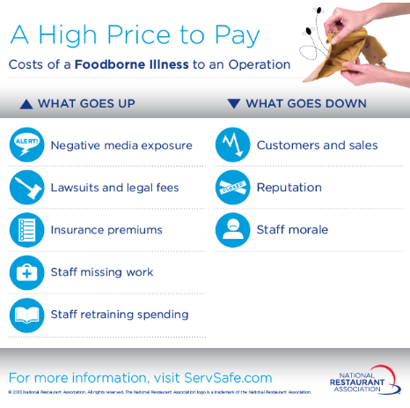
Notes:
There can be a very high price to pay if a firm experiences an outbreak, their reputation and their bottom line can be seriously affected and some of these consequences may be unavoidable.
In addition to economic and employment factors, it can affect the lives of your customers, sometimes with tragic results.

Slide 5
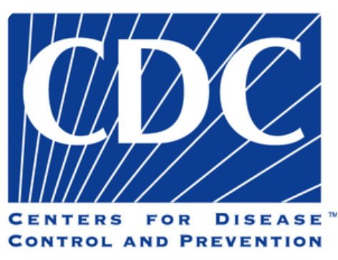
Incidence of Foodborne Diseases
Every year in the U.S., foodborne diseases cause an estimated:
  47.8 million illnesses
  >1,000 reported outbreaks
  128,000 hospitalizations
  3,000 deaths
  52% of known sources of foodborne illness occur in the retail setting
Notes:
In 2011, it was estimated that illnesses resulting from the major foodborne pathogens in the United States cost upwards of US $5 to 6 billion in medical costs and lost productivity. In 2008, USDA’s Economic Research Service estimated that one case of hemolytic uremic syndrome (or HUS), which is a severe complication of infection with E. coli O157:H7, cost $41,000, if the patient did not develop end stage renal disease and $6 to 7 million, if the patient developed end stage renal disease. Of note, none of these estimates include the costs of investigating these illnesses (or the places implicated as their source) or the costs of prevention and control efforts by local and state food safety agencies.
Outbreaks of foodborne diseases also are quite common. Based on data reported to CDC in 2011, during a single year, approximately more than 1,000 foodborne outbreaks. About 6% of foodborne disease outbreaks are multi-jurisdictional, that is they affect residents in multiple states or counties. Note: These numbers are based on the outbreaks that were detected and reported to CDC and may not be representative of all outbreaks.
CDC has not produced an economic impact assessment for foodborne illness based on the new 2010 estimates. However, it has estimated the impact of salmonella based on the new estimates to be $365 million per year in direct medical costs. Salmonella is only one of the top five most frequent culprits of foodborne disease outbreaks.
These estimates do not include the cost to industry.

Slide 6
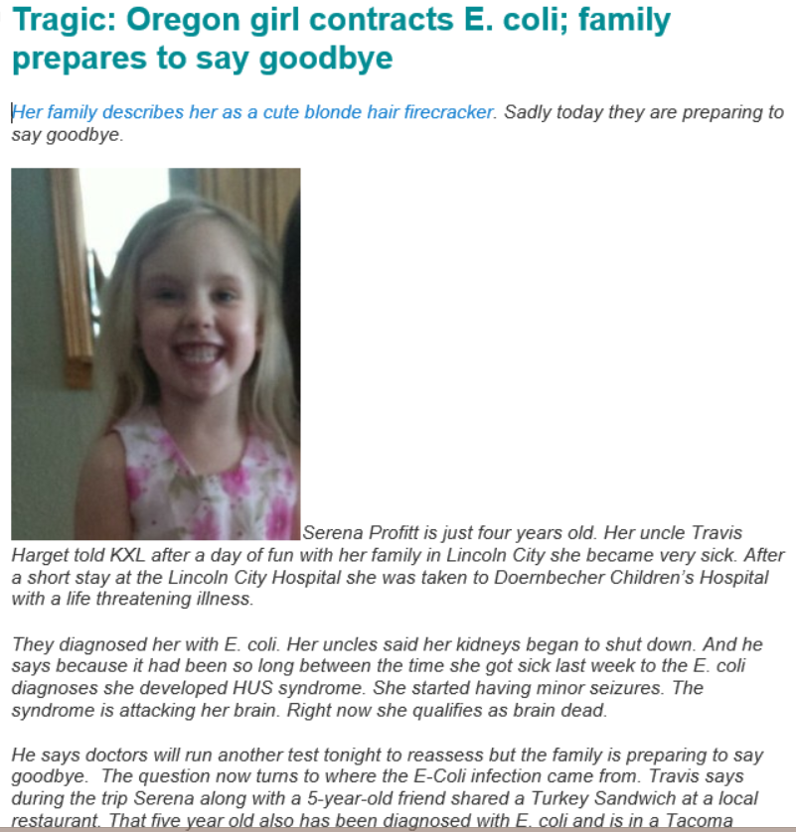
Notes:
These statistics from CDC on illnesses and deaths may seem a little exaggerated or abstract, but regardless of whether they are to be believed, every illness can have real consequences
This was an article on Food Safety News on Sept 9, 2014. (Read through the article aloud, pausing for effect where appropriate)
Presenter note: Let the audience know that Serena died the day after this article was published. She was someone’s little girl, so food safety and rapid response matters.

Slide 7


Investigation partners
Public Health/Regulatory agencies
provide expertise in -
    Environmental health
    Epidemiology
    Laboratory
Called “3 legs of the stool” of investigation
Industry is the “4th leg”
Notes:
Government has a responsibility to investigate foodborne illnessese, outbreaks and public health issues. Typically their investigation team is made up of professionals with expertise in environmental health, epidemiology and lab analysis.
Three-legged stool
Industry-important partners during a foodborne illness investigation
Provide factual information
Cooperate with investigators
Implement control measures quickly

Slide 8
Essential truths
Food service operators want happy customers
Operators don’t intend to make people ill
Health departments are responsible to investigate causes of illness in their jurisdictions
Investigators may solve an outbreak faster with your help-
May determine your firm is NOT the one that caused the problem
Protect your customers
Protect your bottom line
Notes:
Foodborne illness associated with your firm hurts customers and you. It’s bad for business
However, the best way to deal with it to potentially minimize its effect on consumers and your business is to work closely with the regulatory agency, be quick and responsive, take active control measures as necessary and keep additional people from getting sick.

Slide 9
Working Together
Importance of Industry and Government working together
  Industry Provides much insight into an outbreak
    Food source, distribution
    Procedures and processes
    Menu item composition
    Employee attitudes, compliance, contact information, schedules, illness history
    Any unusual occurrences
Notes:
That’s another reason why it’s important for industry and government to work together early and as transparently s possible.
Supply and distribution patterns – FL tomatoes and S. Saintpaul
Industry knows
their menu builds and operations
Formulations and processing practices
Info from Industry is vital for outbreak hypothesis testing
Mechanisms for withdrawing/recalling products from the marketplace.
Source of information about products and practices under investigation – assist in records and systems information
Can respond quickly to establish control measures or implement corrective actions, product withdrawals or recalls in an organized fashion
Some have expertise in microbiology and food safety research
Industry may also be included in sharing “lessons learned” once an investigation is over

Slide 10
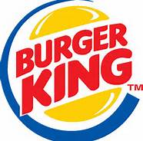




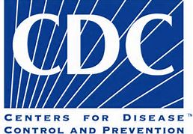

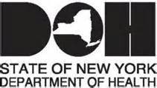
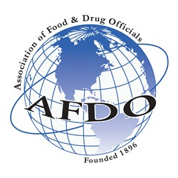






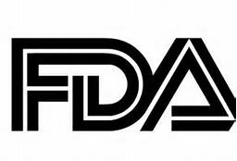
Notes:
The Council to Improve Foodborne Outbreak Response (or CIFOR) is a multi-disciplinary working group (Local, State and Federal government officials) convened in 2006 to increase collaboration across the country and across relevant areas of expertise in order to reduce the burden of foodborne illness in the United States. They work to develop (and share) model programs, processes, and other products that facilitate investigation and control of foodborne disease outbreaks and improve performance and coordination in foodborne disease outbreaks across all levels of government.
In recognition of the importance of educating and including industry in the investigative process, in 2009, a CIFOR workgroup comprised of representatives from the food industry and local, state and Federal government began work on creating simple, easy to use guidelines and tools specific for industry response to foodborne illness.
Up until this point, there really wasn’t a lot of comprehensive resources out there for independent operators. They were at the mercy of the investigators and attorneys with little information to help them navigate and participate in an investigation.

Slide 11

CIFOR Industry Guidelines
Released in 2013
Flow Diagram and Protocol
14 Tools
5 more Tools-Incorporate 5 FDA Posters
Notes:
Takes industry through the possible steps of an outbreak and gives them simple tools to use to organize information and provide it to investigators
NEW! Provide industry with outbreak guidance and tools encouraging industry to take an active role in outbreak prevention, response and investigation
Took 3 ½ years, 1000+ hours put in by industry and government
Lots of large corporate entities have their response plans in place already, so this may not be as useful for them.

Slide 12
CIFOR Industry Guidelines Content
Contents in the CIFOR Industry Guidelines include both information and tools centered on the following topics:
Outbreak Investigation Prep —Recommendations
Handling illness complaints and notifications
Supplier information for tracebacks
Food Establishment Self-Assessment
Media Interactions
Store Closure and Reopening Procedures
Control measures
Terms and Definitions
Notes:
Resource has simple guidance on the outbreak process followed by regulators and what a food operator can expect during an investigation. It provides information that operators can use to put together a basic plan in advance of an food illness response and
Employee Communications Meeting
Employee Listing
Employee Health Assessment Form
Product Sampling Procedure
Sample Chain of Custody
Distributor and Supplier Information Form
Food Flow Chart
Employee Workstation Schematic

Slide 13
What can you do?
Educate yourself and staff on safe food handling-how and why
Work cooperatively with health department
Be proactive on complaints and reports of illness
Familiarity with Industry Guidelines BEFORE a crisis hits
Notes:
Go over points

Slide 14
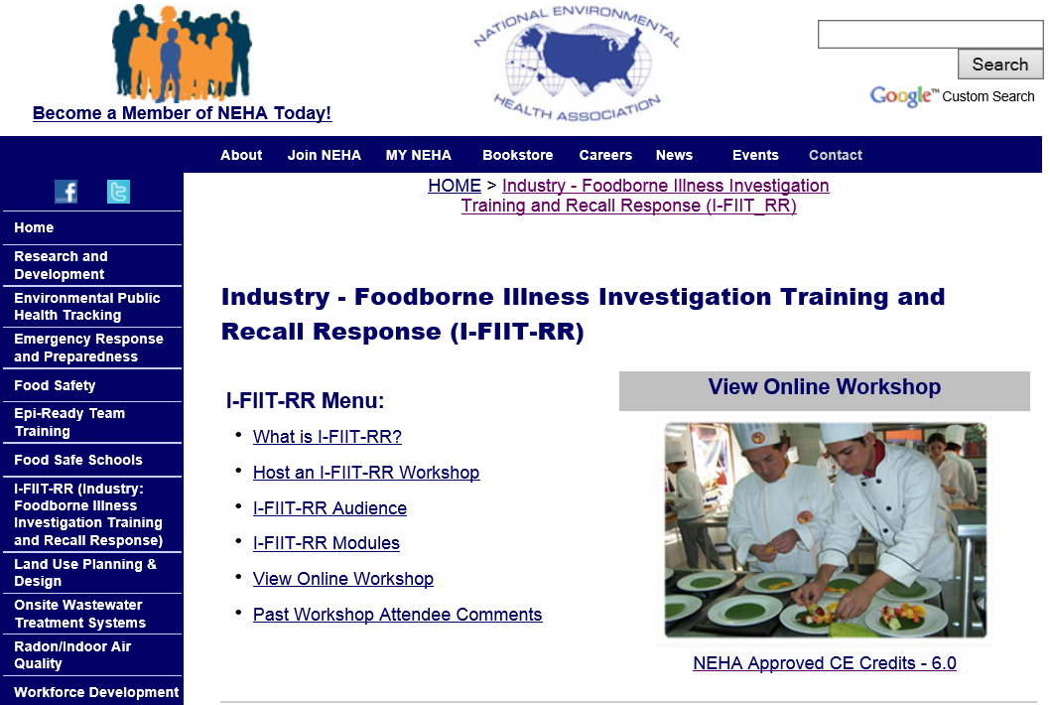
http://www.neha.org/ifiit/index.html
Notes:
Industry-Foodborne Illness Investigation Training and Recall Response (I-FIIT-RR) was a 1 day face-to-face workshop designed to bring together food industry representatives and their appropriate local and state regulatory officials. This is done in an effort to create stronger working relationships prior to a potential foodborne incident occurring, so that if and when it does, the foundation is already set for a collaborative effort. Additionally, the workshop will provide a better understanding and clarification of recall response and an outbreak investigation process by identifying roles and responsibilities, discussing early detection strategies, and establishing and implementing control measures based on model practices. By providing this training, I-FIIT-RR aims to assist industry and regulatory officials in producing a more rapid, efficient, and effective response to food recalls and foodborne illness incidents.
Now a free online workshop found at this website.

Slide 15
For more information about CIFOR Guidelines
CIFOR Industry Guidelines
http://cifor.us/products/industry
For more information, contact:
Lisa Hainstock
hainstockl@Michigan.gov
Notes:
15

