Slide 1
Are you Ready for the Worst?
CIFOR Industry Guidelines
Foodborne Illness Response Guidelines for Owners, Operators and Managers of Food Establishments
<name>
<title>
<date>

Slide 2
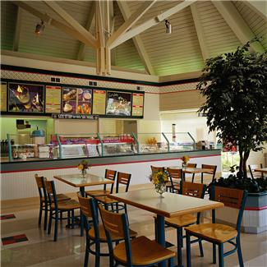
Host: Consumer meals away from home
945,000 restaurant locations served more than 70 billion meals and snacks (NRA, 2008)
62% of outbreaks (4380 of 7057) associated with restaurants
  13% (926 outbreaks) linked to catered events
    (NORS 2008-2017)
Notes:
A review of foodborne outbreaks in the seven states participating in CDC’s Foodborne Disease Active Surveillance Network (FoodNet)
2005, 41% of all food spending on food away from home 26% in 1970
Today’s estimates now place the number of restaurants at over 1 million in the US

Slide 3
Think foodborne illnesses can never happen in your firm?
SOURCE | PATHOGEN | FOOD | AFFECTED | COST
Processor/Restaurants (1993) | E.. Coli O157 | Ground Beef | -73 stores -500+ cases ill -4 deaths | $160 million (lost w.in 18 months following outbreak
Processor (2009) | Salmonella | Peanut Butter | -43 states -700+ cases ill -9 deaths | $1 Billion+ (under-estimated)
Importer (2008) | Salmonella | Peppers (first believed to be tomatoes) | -43 states and DC -1,442 cases -2 deaths | $300 million (loss to farmers, farm workers, distributor, retailers)
Notes:
Because people are eating out a lot, they are depending on the firms to provide safe food.
However, even if a food facility does everything right, a problem out of their control can still affect them.
Examples of larger outbreak; most will not happen like this. Most are smaller outbreaks with a handful of people affected. But use this as an example of how what can happen and that things can get out of control quickly if proper procedures and employee hygiene are not in place.
Restaurant=Jack in the Box reported that in the 18 months following the outbreak the company lost approximately $160 million.
Retail=PCA peanut product recall

Slide 4
Definitions
Foodborne Illness
  Illness transmitted to people by food
Foodborne Disease Outbreak (CDC, 2011)
  two or more persons experience a similar illness after ingestion of a common food, and epidemiologic analysis implicates the food as the source of the illness
Notes:
Just want to give you some basic definitions as we move forward, so you can differentiate between illnesses and actual outbreaks

Slide 5
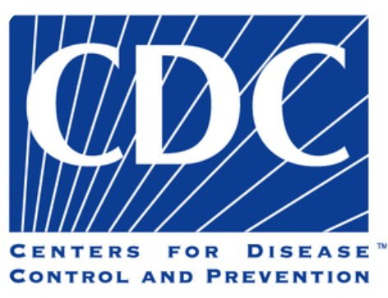
Incidence of Foodborne Diseases
Every year in the U.S., foodborne diseases cause an estimated:
  47.8 million illnesses
  >1,000 reported outbreaks
  128,000 hospitalizations
  3,000 deaths
  52% of known sources of foodborne illness occur in the retail setting
Notes:
Based on location of exposure to the food, 2008-2017 NORS data: 8,491 outbreaks with this data recorded: 281 (3.3%) were multistate exposure and 270 (3.2%) were multicounty exposure within a single state. All the rest were single county in a single state.
Based on location of residency, 2008-2017 NORS data: 33% of foodborne outbreaks affected residents in multiple states or multiple counties in a state.
CDC has not produced an economic impact assessment for foodborne illness based on the new 2010 estimates. However, it has estimated the impact of salmonella based on the new estimates to be $365 million per year in direct medical costs. Salmonella is only one of the top five most frequent culprits of foodborne disease outbreaks. These estimates do not include the cost to industry.
In 2011, it was estimated that illnesses resulting from the major foodborne pathogens in the United States cost upwards of US $5 to 6 billion in medical costs and lost productivity. In 2008, USDA’s Economic Research Service estimated that one case of hemolytic uremic syndrome (or HUS), which is a severe complication of infection with E. coli O157:H7, cost $41,000, if the patient did not develop end stage renal disease and $6 to 7 million, if the patient developed end stage renal disease. Of note, none of these estimates include the costs of investigating these illnesses (or the places implicated as their source) or the costs of prevention and control efforts by local and state food safety agencies.

Slide 6
Disease Detection Pyramid
Reported to health dept / state / CDC
Disease confirmed
Lab tests for organism
Specimen obtained
Person seeks care
Person becomes ill
Population exposure
Source: Centers for Disease Control and Prevention
Notes:
6
Make the point that for every lab confirmed case reported to CDC, often we are dealing with the ‘tip of iceberg’ → very few cases actually get reported.
Whether confirmed or unconfirmed
Go through levels
Salmonella – 1 case reported at top of pyramid for every 29.3 cases occurring in the US
E. coli O157:H7 – 1 cases reported at top of pyramid for every 26.1 cases occurring in the US
When you look at the number of confirmed cases on the previous slide and then consider this pyramid, it means that there may have been thousands of more cases we never new about.

Slide 7
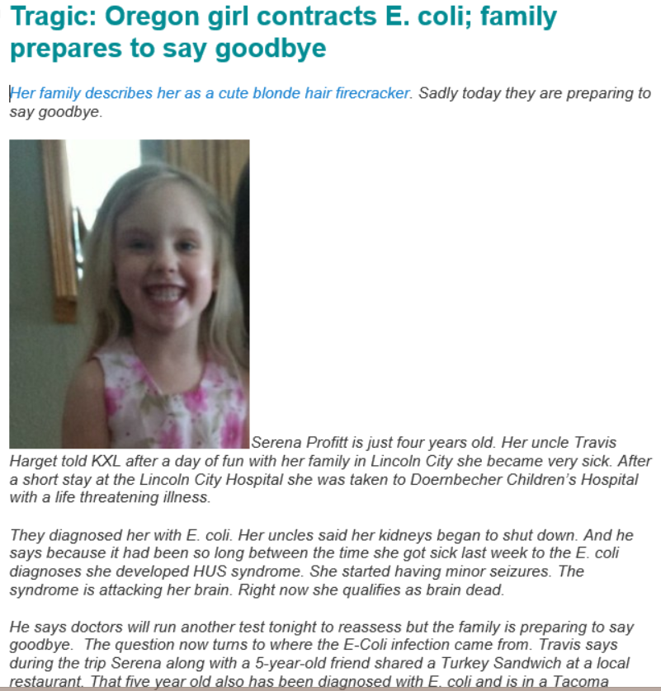
Notes:
These statistics from CDC on illnesses and deaths may seem a little exaggerated or abstract, but regardless of whether they are to be believed, every illness can have real consequences
This was an article on Food Safety News on Sept 9, 2014. (Read through the article aloud, pausing for effect where appropriate)
Let the audience know that Serena died the day after this article was published. She was someone’s little girl, so food safety and rapid response matters.

Slide 8
Essential Truths….
Food service operators want happy customers
Operators don’t intend to make people ill
Health departments are responsible to investigate causes of illness in their jurisdictions
Notes:
If the worst happens and people do get sick and suspect your facility or food, health authorities and regulators have to respond

Slide 9


Investigation partners
Public Health/Regulatory agencies
provide expertise in -
    Environmental health
    Epidemiology
    Laboratory
Called “3 legs of the stool” of investigation
Industry is the “4th leg”
Notes:
Government
Responsibility to investigate all outbreaks and public health issues
Work directly with food establishments during outbreak or recall
Shame on us as regulators if we leave industry out of the party.
Industry
Provide factual information
Cooperate with investigators
Implement control measures quickly

Slide 10
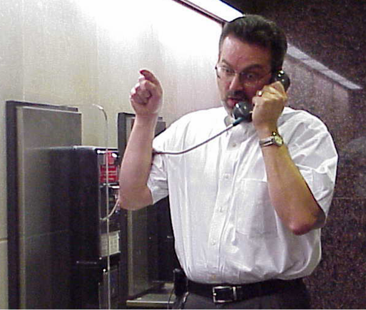


How are outbreaks detected?
Industry initiated-complaints, etc. may indicate something is, or could be, going on
Notes:
Most often, illness reports/complaints come to the LHD via
Consumer complaints
Required reporting by physicians and labs
However, even though the restaurant or operator typically finds out from the LHD, they may find out something weird is going on before that happens based on calls from their customers
They should be contacting the LHD if they feel something’s suspicious or might lead to a potential outbreak

Slide 11
Working Together
Importance of Industry and Government working together
  Industry Provides much insight into an outbreak
    Food source, distribution
    Procedures and processes
    Menu item composition
    Employee attitudes, compliance, contact information, schedules, illness history
    Any unusual occurrences
Notes:
That’s another reason why it’s important for industry and government to work together early and as transparently s possible.
Supply and distribution patterns – FL tomatoes and S. Saintpaul
Industry knows
their menu builds and operations
Formulations and processing practices
Info from Industry is vital for outbreak hypothesis testing
Mechanisms for withdrawing/recalling products from the marketplace.
Source of information about products and practices under investigation – assist in records and systems information
Can respond quickly to establish control measures or implement corrective actions, product withdrawals or recalls in an organized fashion
Some have expertise in microbiology and food safety research
Industry may also be included in sharing “lessons learned” once an investigation is over

Slide 12





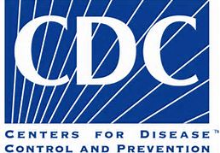










Notes:
The Council to Improve Foodborne Outbreak Response (or CIFOR) is a multi-disciplinary working group convened in 2006 to increase collaboration across the country and across relevant areas of expertise in order to reduce the burden of foodborne illness in the United States. They work to develop (and share) model programs, processes, and other products that facilitate investigation and control of foodborne disease outbreaks and improve performance and coordination in foodborne disease outbreaks across all levels of government.
In 2009,CIFOR workgroup comprised of representatives from the food industry and local, state and Federal government for the purpose of creating guidelines and tools specific for industry response to foodborne illness.
Project Summary:
Task group sought out, documented, compiled, and consolidated best practices for retail food establishments (single operators/chains) on responding to foodborne illness reports and investigations.
Charge:
Develop guidelines and tools to guide retail food establishments through a foodborne disease outbreak investigation.

Slide 13

CIFOR Industry Guidelines
Released in 2013
Flow Diagram and Protocol
14 Tools
5 more Tools-Incorporate 5 FDA Posters
Notes:
Takes industry through the possible steps of an outbreak and gives them simple tools to use to organize information and provide it to investigators
NEW! Provide industry with outbreak guidance and tools encouraging industry to take an active role in outbreak prevention, response and investigation
Took 3 ½ years, 1000+ hours put in by industry and government
Lots of large corporate entities have their response plans in place already, so this may not be as useful for them.
However, before this was developed, there really wasn’t a lot of comprehensive resources out there for independent operators. They were at the mercy of the investigators and attorneys with little information to help them navigate and participate in an investigation.

Slide 14
CIFOR Industry Guidelines Content
Contents in the CIFOR Industry Guidelines include both information and tools centered on the following topics:
Outbreak Investigation Prep —Recommendations
Handling illness complaints and notifications
Supplier information for tracebacks
Food Establishment Self-Assessment
Media Interactions
Store Closure and Reopening Procedures
Control measures
Terms and Definitions
Notes:
Other tools:
Employee Communications Meeting
Employee Listing
Employee Health Assessment Form
Product Sampling Procedure
Sample Chain of Custody
Distributor and Supplier Information Form
Food Flow Chart
Employee Workstation Schematic

Slide 15
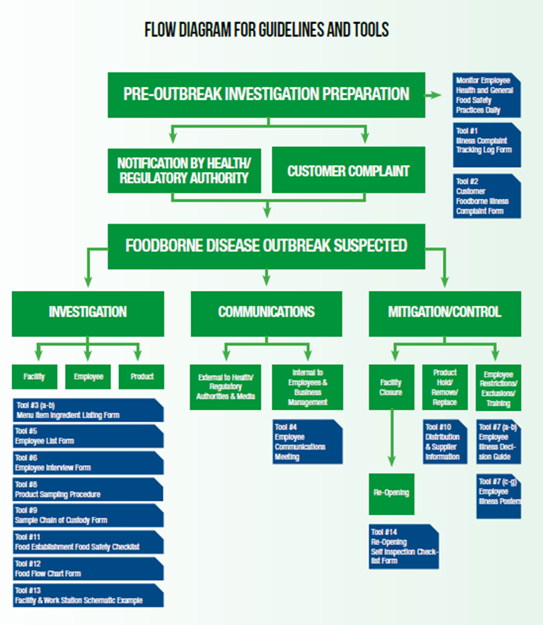
Notes:
Speaker: Refer them to page 26 flow chart – Shows the basic steps of most outbreak investigations and where the various tools that were developed might be useful.
Before you get scared, remember, not all of these tools may be necessary depending on the situation, but if you need them, they’re there.

Slide 16
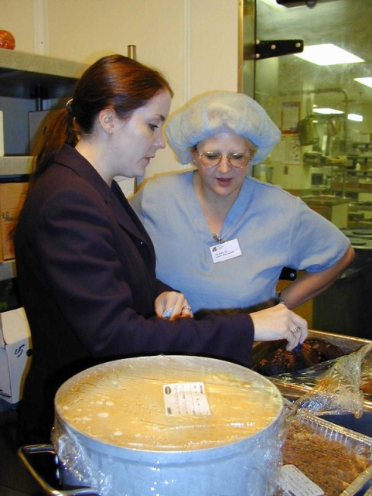
Positive and Proactive Steps Retail Food Establishments Can Take to Prepare
Have an emergency contact list-among others
  Inspector - Employees
  Legal representation -Suppliers/Distributors
  Corporate leadership -QA officer
Spokesperson
Recordkeeping
  Employee duties/schedules
  Shipments
  Reservations/parties
  Complaint log
Notes:
Identifying industry needs and guidance for working quickly and transparently with health & Ag officials investigating an outbreak
Manage the issue protecting public health and limiting business impact

Slide 17
When should I contact the Health Department?
Two or more illness complaints for similar time frame, especially if different parties
Illness reports involving large groups
Sick employees-
  a diagnosis of or exposure to Norovirus, Hep A, Shigella,
  Salmonella, or EC O157 or other,
  Multiple workers with GI illness symptoms, especially if they worked while ill;
Used product that was later recalled due to illness
Notes:
Restaurants may get complaints all of the time. Some LHDs may want you to report absolutely everything, but resource intensive for you and them. Trick is to record information and review regularly to know what the ‘triggers’ are for reporting to the LHD.
Nothing more aggravating to LHD than when they receive a complaint from a consumer and call the restaurant to find out that they had been receiving other calls in addition to this person and didn’t let the LHD.
Food Code will require firms to report ill employees or imminent PH hazards, such as suspected outbreaks to the regulatory authority
WHY is early contact important if an issue is suspected?
Could be first indication of bigger problem that needs immediate investigation and quick control measures
Delaying response could get more people ill, especially if the problem is somewhere up the supply chain and contaminated products are distributed elsewhere
People may need to get quick medical treatment, ie HAV

Slide 18
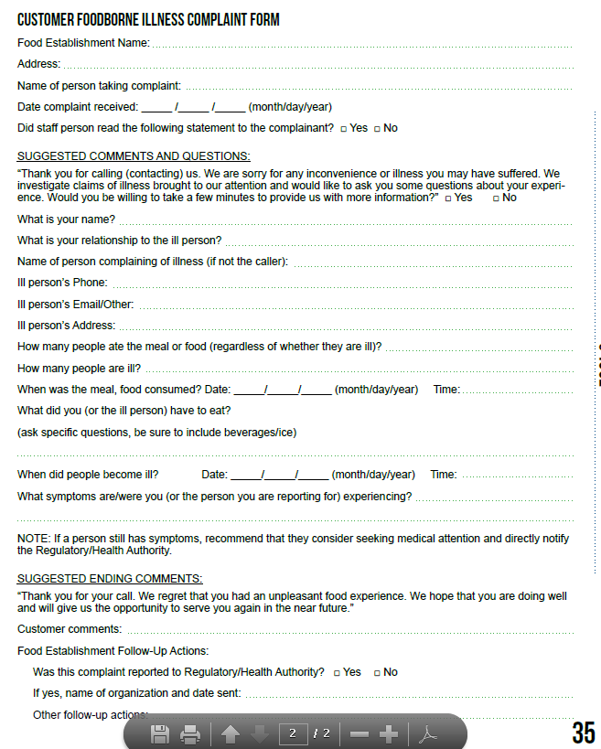
Tool #2 Customer illness complaint form
Notes:
This is a way to record information from a consumer alleging illness from eating at your establishment. Can be easily shared with LHD for followup

Slide 19
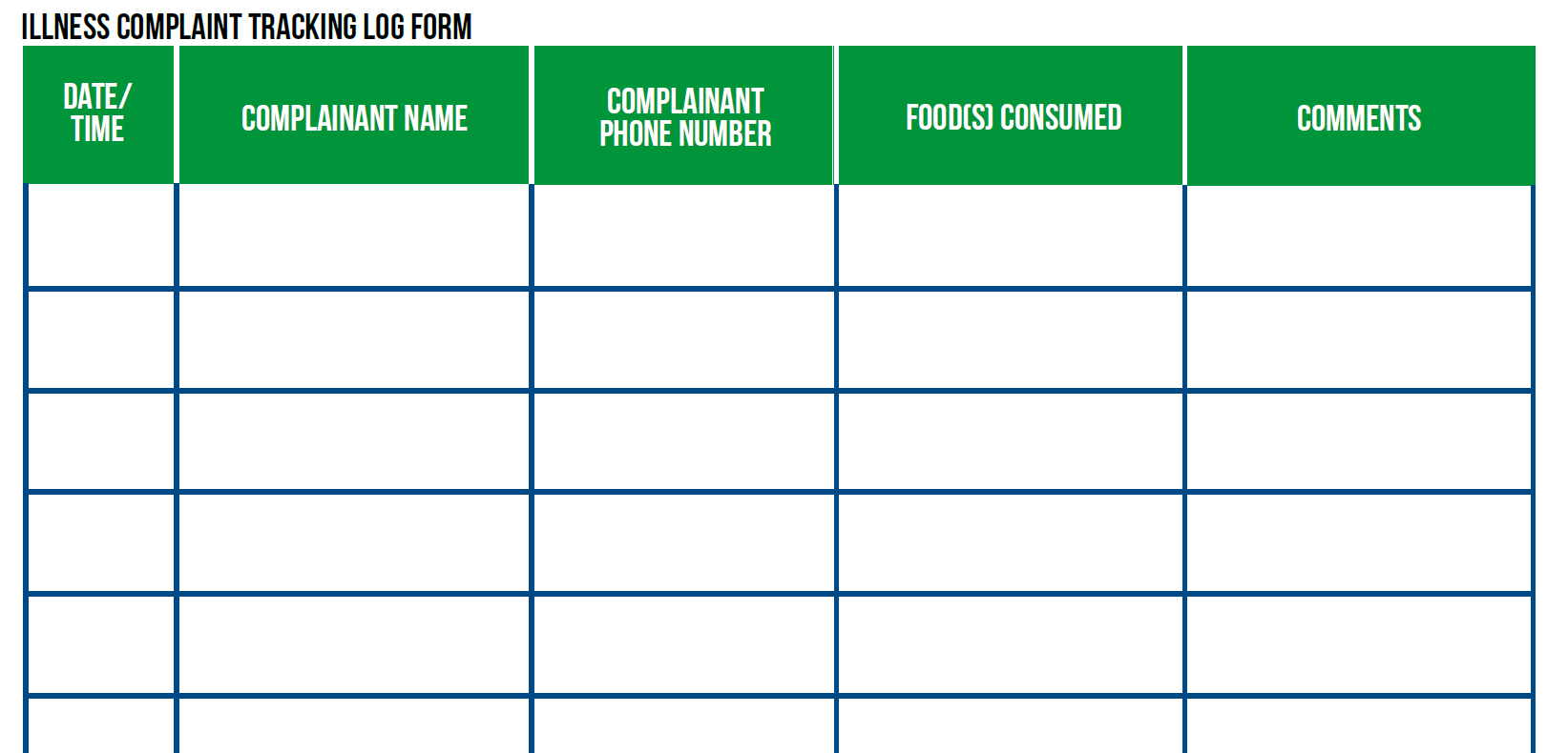
Tool #1 Complaint tracking log
Notes:
Log can help to keep track of complaints over time, so you can see if there is a cluster of illnesses or other things that might indicate there may be a problem

Slide 20
Information of interest to health department
If a menu item is suspected, what are the ingredients and where did they come from?
-Tool #3A & 3B Menu ingredient list form
-Tool #10 Distributor & Supplier Info Form
Employees-illness, duties, schedules, etc
  -Tool #5 Employee list form
  -Tool #6 Health Assessment
  -Tool #7A & 7B – Illness Decision trees
Notes:
Besides knowing about fbi complaints, if the LHD is investigating and a certain menu item is suspected, they’ll want to know the ingredients and where did you get them during the time frame of interest
Also may want to know about:
Large orders/catering – may ask for customer contacts
Employee health and work schedule*
Any leftover implicated food -
Possible food and/or clinical specimens*
Supplier/distributor information and records*
Communications – media and employee*
On the decision tree, if you find out you have employees who were sick or are sick right now, can use to determine if they should be restricted or excluded (ie sent home) to prevent more illnesses

Slide 21
Tools - During an Outbreak
If contamination prior to delivery is suspected, where did the food come from and when?
  Tool #10 Distributor & Supplier Info form
If contamination in the restaurant is suspected, how was the food handled and prepared?
  Tool #12 Food Flow Chart form
Media questions-tips
Notes:
As we discussed previously, if a contaminated product or ingredient is suspected, they’ll want copies of your records, etc.
If there is a suspicion that the contamination happened at the restaurant, they’ll want to know how it is prepared and who prepared it during the time frame in question
The protocol has some tips on how to deal with the media and coordinate your message with the LHD if it’s necessary to go public

Slide 22
Tools That can be used for Prevention??
Employee health
  5 FDA posters
  Illness Decision Guide
Food Establishment Food Safety Checklist
Self Inspection Checklist
Notes:
Not all of the tools are for response only. Some can be used to help educate your employees, make determinations on if or how a sick employee can work, and keep tabs on how well you’re doing in terms of processes and equipment operation

Slide 23
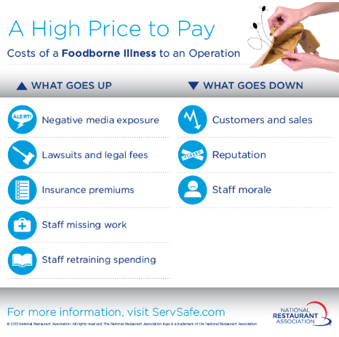
Notes:
There can be a very high price to pay if a firm experiences an outbreak, their reputation and their bottom line can be seriously affected and some of these consequences may be unavoidable.
In addition to economic and employment factors, it can affect the lives of your customers, sometimes with tragic results.

Slide 24
Essential truths
Food service operators want happy customers
Operators don’t intend to make people ill
Health departments are responsible to investigate causes of illness in their jurisdictions
Investigators may solve an outbreak faster with your help-
May determine your firm is NOT the one that caused the problem
Protect your customers
Protect your bottom line
Notes:
Foodborne illness associated with your firm hurts customers and you. It’s bad for business
However, the best way to deal with it to potentially minimize its effect on consumers and your business is to work closely with the LHD, be quick and responsive, take active control measures as necessary and keep additional people from getting sick.

Slide 25
What can you do?
Educate yourself and staff on safe food handling-how and why
Work cooperatively with health department
Be proactive on complaints and reports of illness
Familiarity with Industry Guidelines BEFORE a crisis hits
Notes:
Go over points

Slide 26
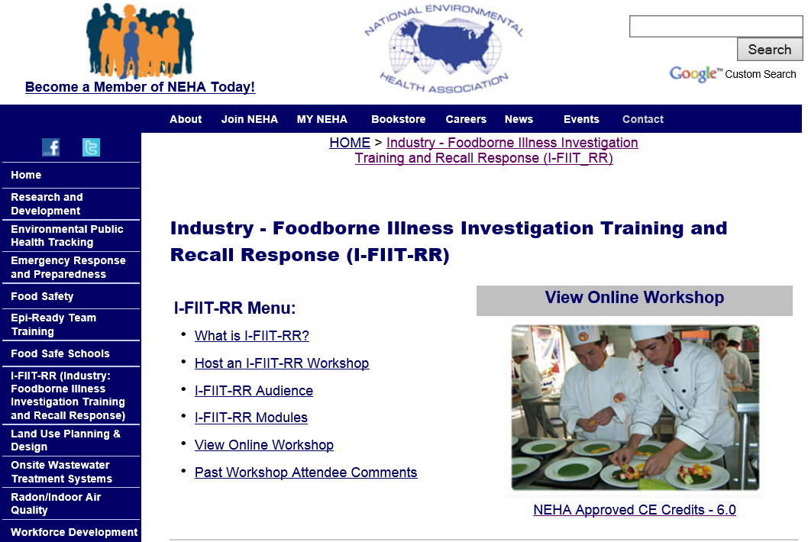
http://www.neha.org/ifiit/index.html
Notes:
Industry-Foodborne Illness Investigation Training and Recall Response (I-FIIT-RR) was a 1 day face-to-face workshop designed to bring together food industry representatives and their appropriate local and state regulatory officials. This is done in an effort to create stronger working relationships prior to a potential foodborne incident occurring, so that if and when it does, the foundation is already set for a collaborative effort. Additionally, the workshop will provide a better understanding and clarification of recall response and an outbreak investigation process by identifying roles and responsibilities, discussing early detection strategies, and establishing and implementing control measures based on model practices. By providing this training, I-FIIT-RR aims to assist industry and regulatory officials in producing a more rapid, efficient, and effective response to food recalls and foodborne illness incidents.
Now a free online workshop found at this website.

Slide 27
For more information about CIFOR Guidelines
CIFOR Industry Guidelines
http://cifor.us/products/industry
For more information, contact:
Lisa Hainstock
hainstockl@Michigan.gov
Notes:
27

