Slide 1
Outbreak Reporting Legal Assessment
Alexa Limeres, JD
Public Health Analyst
Division of Healthcare Quality Promotion, CDC

Slide 2
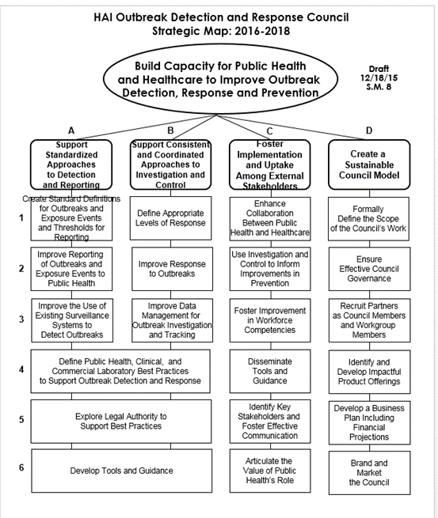
Purpose of Assessment
Analyze the legal landscape of reporting
Explore statutory “outbreak” definitions
Compare with Workgroup A guidance
Capture data for future assessments
Help ASTHO informational interviews

Slide 3
Presentation Outline
Explain rubric for collection: what was captured from state law
Present examples of state outbreak reporting requirements
Discuss how these requirements inform the ASTHO interviews
Discuss how this type of work can be furthered

Slide 4
What We Collected
How outbreak definitions tie to outbreak reporting
  Looked at Disease Reporting Regulations in all 50 states
  Captured any definition for “outbreak,” “cluster,” “epidemic”
  Captured language that mandates reporting of an “outbreak,” “cluster,” “epidemic,” etc.
    By a healthcare provider to the health department/public health authority
  Captured when to report that outbreak
  PDF of full statute
Notes:
What is a Disease Reporting Regulation?
Location in the Regs where the authorities of the State Public Health Department’s Authorities are defined
Different than statutes in the way they are promulgated- both have the force of law
Statutes passed by legislators, and give agencies the power to pass their legislation in regulations
Regulations passed by the agencies, so they contain more detail
PDFs can/will be organized and hopefully given to ASTHO for fuller context
Note: some states have integrated their HAI legislation into their disease reporting regs
For some which did not, I checked their HAI legislation, and did not usually find outbreak as a topic/term.

Slide 5
What We Excluded
Disease Reporting Statutes
Entities Required to Report:
  What constitutes a health care provider for purposes of reporting
  Others: schools, correctional facilities, blood banks
Methods of Reporting:
  Distinctions regarding lab reporting
Different types of outbreak reporting
  Instances of norovirus outbreak reporting requirements
  Instances of influenza reporting requirements
Other catch-all phrases:
  Disease of public health significance
  Public health emergency reporting
Authority of the Health Department to Respond to an Outbreak
Reporting between public health authorities
  Local health department reporting to state health department
Notes:
Montana had a regulation on gastroenteritis outbreak reporting

Slide 6
Examples: Typical Outbreak Definition
Large majority of States had Similar Outbreak Definitions
  Usually define outbreak by increased rate for a specific geographic region
  Some refer to the need for there to be more than one case, some say an outbreak can be one case
New York
  10 NYCRR 2.2. Definitions
  (d) An outbreak is defined as an increased incidence of disease above its expected or baseline level. As the number of cases which indicate the presence of an outbreak vary according to the infectious agent, size and type of population exposed, previous exposure or lack of exposure to the disease, and time and place of occurrence, the expected or baseline level of disease shall be assessed by hospitals and their infection control committees as directed in section 405.11 of this Title. While an outbreak usually involves several cases of illness (e.g., food-borne poisoning, influenza), it may consist of just one case for certain rare and/or serious diseases (e.g., botulism, measles).
Kansas
  K.A.R. 28-1-1 Definitions
  (i) “Epidemic (or outbreak)” means the occurrence in a community or region of cases of an illness clearly in excess of normal expectancy and derived from a common or propagated source.
Utah
  U.A.C. R386-702. Communicable Disease Rule.
  (a) “Outbreak” means an increase in incidence of disease, or two or more cases of disease with a common exposure.

Slide 7
Examples: Typical Outbreak Definition
New Jersey
  N.J.A.C. 8:57–1.3 Definitions
  “Outbreak” means any unusual occurrence of disease or any disease above background or endemic levels. Endemic level refers to the usual prevalence of a given disease within a geographic area.
Massachusetts
  105 CMR 300.020: Definitions
  Outbreak or Cluster. The occurrence in a community, facility, workplace or region of cases of an illness clearly in excess of the number of cases usually expected. The number of cases indicating an outbreak or cluster will vary according to the infectious agent or the site conditions/hazards, size and type of population exposed, previous experience or lack of exposure to the disease, and time and place of occurrence. Outbreaks or clusters are therefore identified by significant increases in the usual frequency of the disease in the same area, among the specified population, at the same season of the year.

Slide 8
Examples: Typical Outbreak Reporting
Large majority of states required reporting of outbreaks immediately
  Some allowed one business day to report
Oklahoma
  Okla. Admin. Code 310:515-1-3. Diseases to be reported immediately
  The following diseases must be reported by any health practitioner or laboratory personnel to the OSDH electronically via the secure web-based Public Health Investigation and Disease Detection of Oklahoma system or by telephone (405-271-4060 or 800-234-5963) immediately upon suspicion, diagnosis, or testing as specified in the “Oklahoma Disease Reporting Manual”.
    (12) Outbreaks of apparent infectious disease.

Slide 9
Examples: Mention of HAI/AR Outbreaks
1 state requires reporting of HAI/AR Outbreaks Specifically
North Dakota
  NDAC 33-06-01-01. Reportable conditions.
  The following designated reportable conditions must be reported to the state department of health by the persons designated in chapter 33-06-02. If any reportable condition is designated by an asterisk, an appropriate sample or isolate must be submitted to the division of microbiology (public health laboratory) in addition to the required report.
    42. Nosocomial outbreaks in institutions.
Notes:
Note: nosocomial outbreaks were not defined, however distinguished from Foodborne and Waterborne outbreaks that were required to be reported separately
North Dakota, Eff date was Jan 1, 2011 - BUT – looking at regulatory history, it appears this language was in the previous version of the reg. And unfortunately, I don’t have access to previous regs in Westlaw.
Utah, outbreak language has been in 2012 update (oldest I could find) – eff date June 15, 2012
Utah
U.A.C. R386-702. Communicable Disease Rule.
(cccc) Any outbreak, epidemic, or unusual or increased occurrence of any illness that may indicate an outbreak or epidemic. This includes suspected or confirmed outbreaks of foodborne disease, waterborne disease, meningitis, encephalitis, disease caused by antimicrobial resistant organisms, any infection that may indicate a bioterrorism event, or of any infection that may indicate a public health hazard.
Virginia
Conditions identified by an asterisk (*) require immediate communication to the local health department by the most rapid means available upon suspicion or confirmation, as defined in subsection C of this section. Other conditions should be reported within three days of suspected or confirmed diagnosis.
*Outbreaks, all (including but not limited to foodborne, healthcare-associated, occupational, toxic substance-related,
and waterborne)

Slide 10
Examples: No Definition for “Outbreak”
9 state disease reporting chapters did not define outbreak
  Alabama, Alaska, Arkansas, Florida, Georgia, Iowa, Louisiana, Mississippi, Vermont
Alabama
  Ala. Admin. Code r. Ch. 420-4-1, App. I
  Immediate, Urgent Disease/Condition—Report to the County or State Health Department by electronic means as specified by the Department or by telephone within 24 hours of presumptive diagnosis
    Outbreaks of any kind
    As determined by the reporting healthcare provider
Notes:
Not define outbreak or other term
Note- these state regs had no definition, but DID require reporting

Slide 11
Examples: No Outbreak Reporting Requirement
2 states had no reporting requirement or definition for outbreak
  North Carolina
  New Mexico
    N.M. Admin. Code 7.4.3 CONTROL OF DISEASE AND CONDITIONS OF PUBLIC HEALTH SIGNIFICANCE
    C. Emergency reporting of diseases or conditions: The following diseases, confirmed or suspected, require immediate reporting by telephone to the epidemiology and response division at (505) 827-0006.
      (f) other illnesses or conditions of public health significance.
Notes:
Defined as no requirement to report outbreaks (or other term)
There were some states that did not include their disease reporting list in law, but only incorporated by reference.
Note- for those regulations where I could not find a reporting requirement, I did check the disease reporting statutes. Also checked online reporting list to confirm.
still- could be wrong, method was not exhaustive.

Slide 12
Points for Further Discussion
What is it about the text of these requirements that we want to analyze?
  If we want to review efficacy for best practices:
    What makes a reporting requirement better or worse?
    Do you know of an experience where statutory language influenced the reporting of and/or response to an outbreak?
What other pieces of legislation relate to CORHA’s work?
  Do we want to analyze the health department’s authority to respond to an outbreak?
Notes:
This has all been food for thought. I know that there are portions of those examples that might bring up issues for each of you. What we need is to discuss those issues in a way that can apply to each legislation.
If you took issue with a reporting healthcare provider being able to “determine” an outbreak on their expertise- think about how to explain this problem, and how we would look for a distinction in other laws.

