Slide 1
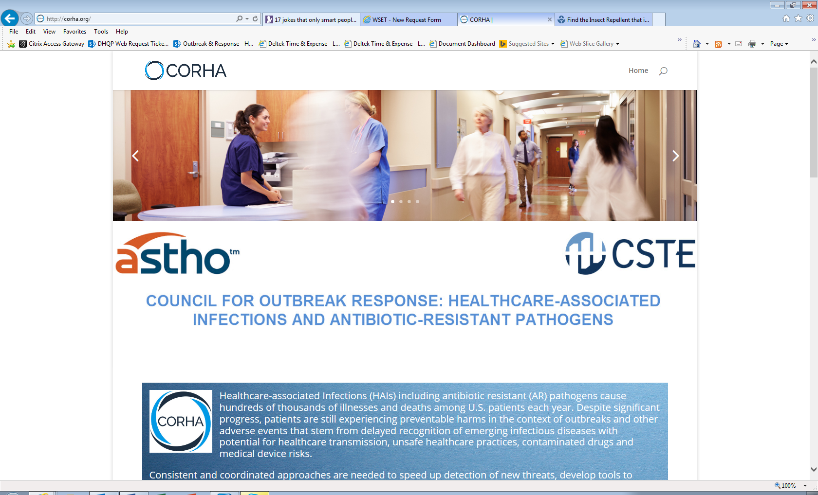

COUNCIL FOR OUTBREAK RESPONSE:
HEALTHCARE-ASSOCIATED INFECTIONS & ANTIMICROBIAL-RESISTANT PATHOGENS
In-Person Meeting
May 4-5,2017

Slide 2
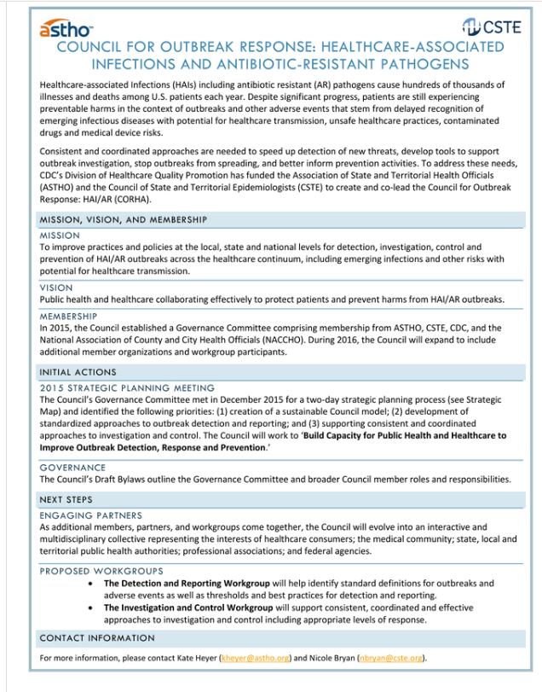


CORHA Communication Products
Branding, Marketing and Public Relations
Current Materials
Logo
One Pager
Talking Points
Website
COUNCIL FOR OUTBREAK RESPONSE: HEALTHCARE-ASSOCIATED INFECTIONS & ANTIMICROBIAL-RESISTANT PATHOGENS

Slide 3

CORHA Communication Products
Branding, Marketing and Public Relations
Phase 1
Letterhead
CORHA Email Address
Rollout Plan to Promote Website
Prepared Responses for Inquiries
Update Talking Points (roll of CORHA)
Rollout Plan to Promote New Workgroup Products and Tools
Presentation Templates (PowerPoint, Posters)
COUNCIL FOR OUTBREAK RESPONSE: HEALTHCARE-ASSOCIATED INFECTIONS & ANTIMICROBIAL-RESISTANT PATHOGENS

Slide 4

CORHA Communication Products
Branding, Marketing and Public Relations
Phase 2
Information Packet for New Members
Style Guide/Policies and Procedures for Website and Communication Materials
Social Media Sites and Community Engagement
Website Management
COUNCIL FOR OUTBREAK RESPONSE: HEALTHCARE-ASSOCIATED INFECTIONS & ANTIMICROBIAL-RESISTANT PATHOGENS

Slide 5
CORHA Communication Products
Branding, Marketing and Public Relations
Website Review
COUNCIL FOR OUTBREAK RESPONSE: HEALTHCARE-ASSOCIATED INFECTIONS & ANTIMICROBIAL-RESISTANT PATHOGENS

Slide 6
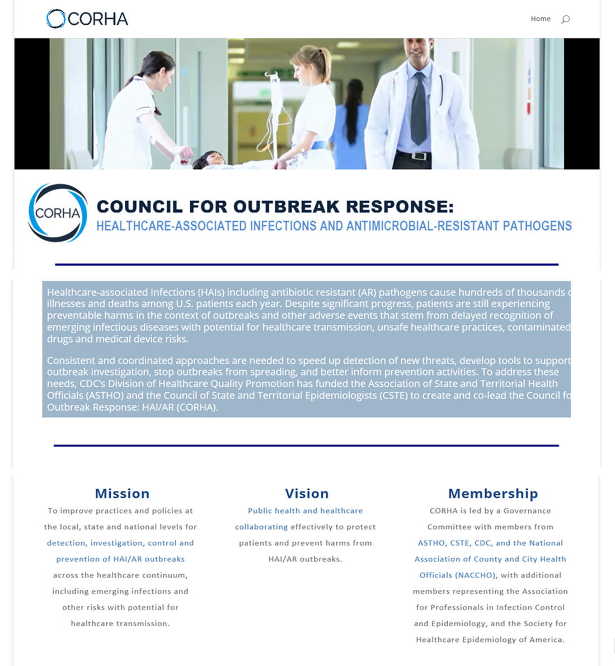

Slide 7
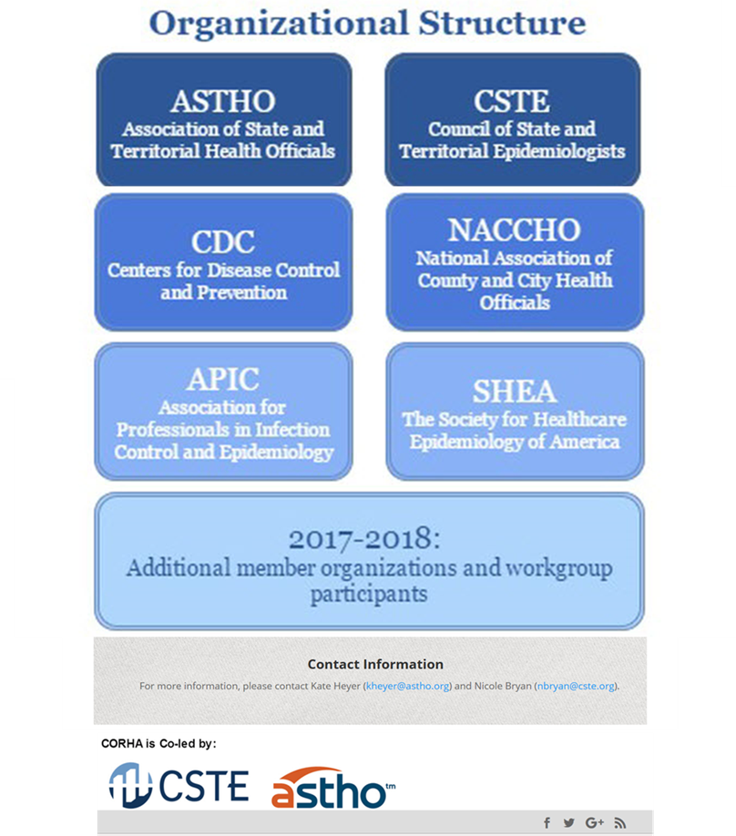

Slide 8

CORHA Communication Products
Branding, Marketing and Public Relations
Discussion:
Suggestions/Questions
Additional Materials/Potential Needs
Volunteers
Small Informal Communications Workgroup
COUNCIL FOR OUTBREAK RESPONSE: HEALTHCARE-ASSOCIATED INFECTIONS & ANTIMICROBIAL-RESISTANT PATHOGENS

