Slide 1

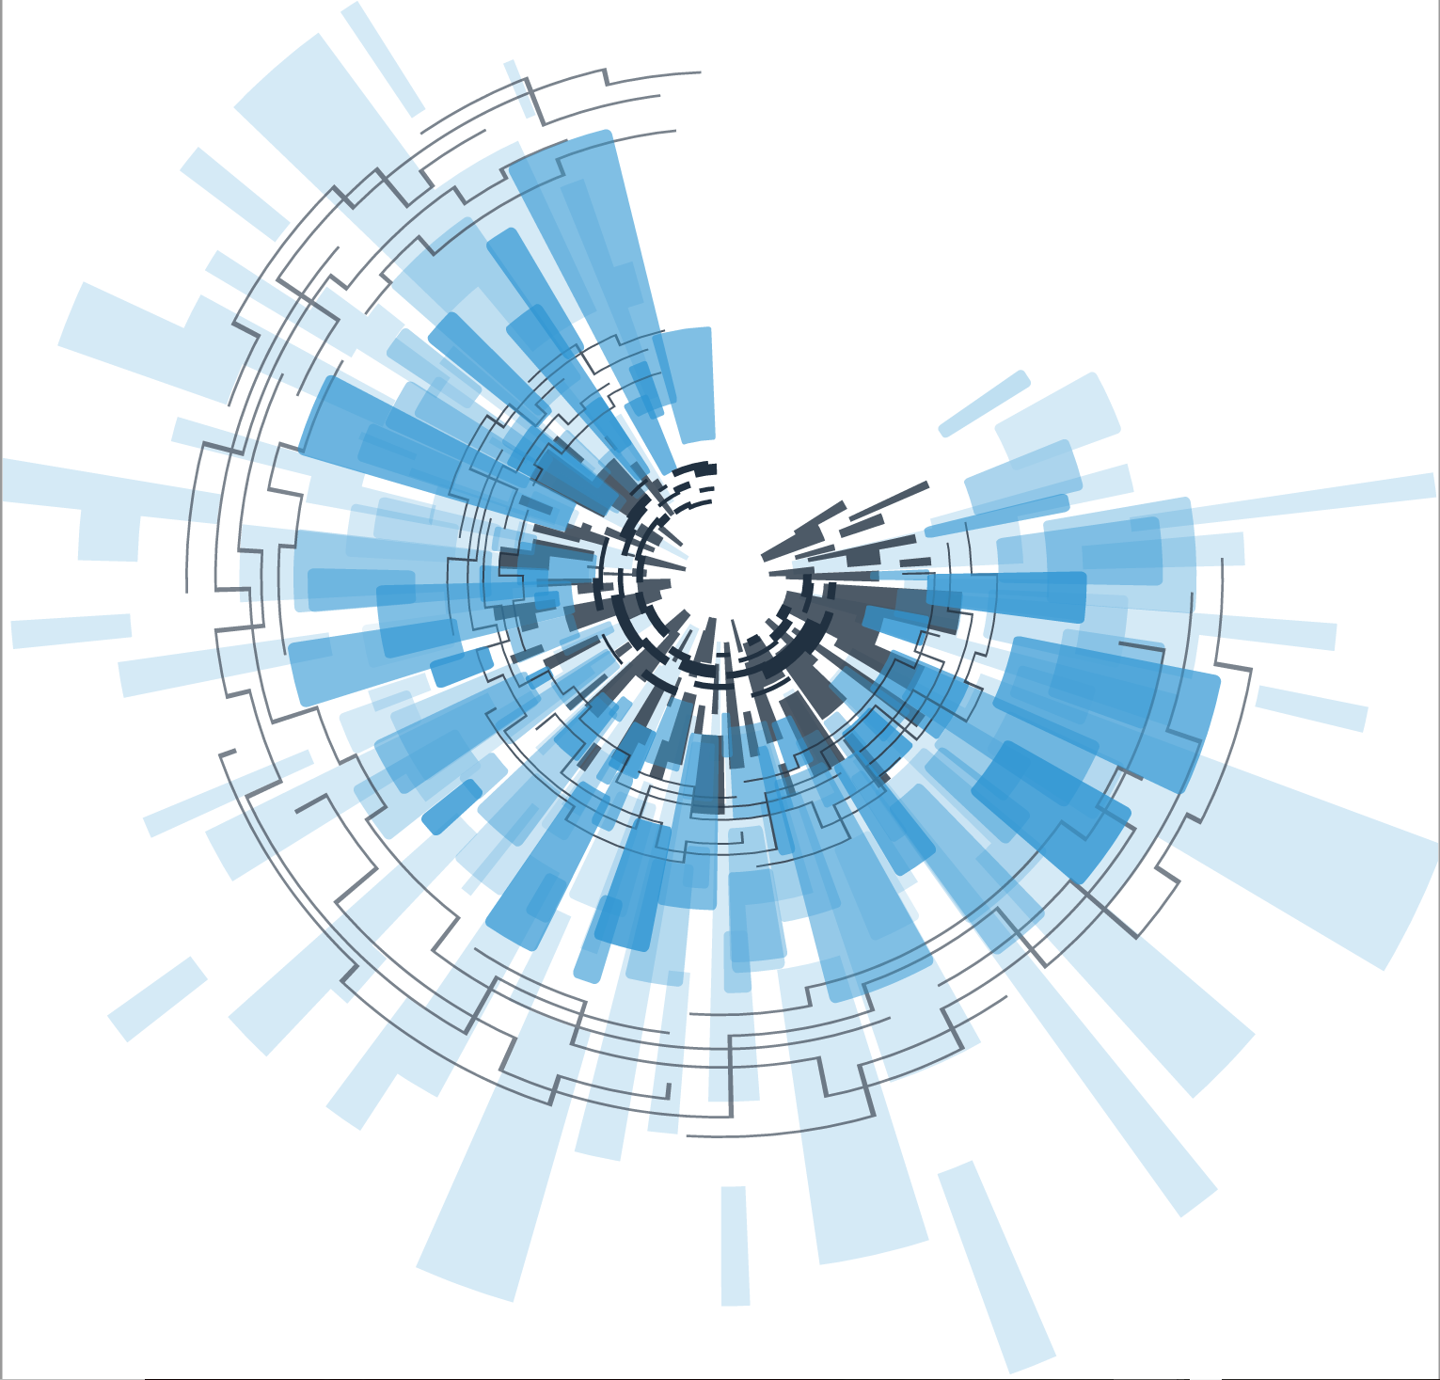
CIFOR to CORHA
Rachel L. Stricof
rstricof@gmail.com

Slide 2

Council to Improve Foodborne Outbreak Response (CIFOR) Model for CORHA
Chapter 1 – Overview
Chapter 2 – Fundamental Concepts of Public Health Surveillance and Disease
Chapter 3 – Planning and Preparation
Chapter 4 – Disease Surveillance and Outbreak Detection
Chapter 5 – Investigation of Clusters and Outbreaks
Chapter 6 – Control Measures
Chapter 7 – Special Considerations for Multijurisdictional Outbreaks
Chapter 8 – Performance Indicators for HAI/AR Programs
Chapter 9 – Legal Preparedness for Surveillance and Control of Outbreaks

Slide 3
Broad Focus
Outbreaks
Clusters
Sentinel cases – HAI or emerging antimicrobial resistance
Serious breach in infection control practice

Slide 4
Key Elements for Success
Summary of activities that may be involved
Communication and coordination
Multijurisdictional considerations
Preliminary assessment
Standardize data collection
Protecting privacy of individuals, patients and their families

Slide 5
Investigation Procedures
Establish the existence of an outbreak
Verify diagnosis
Establish case definition and classification criteria
Create line list or database
Identification of cases
Data collection and analysis – descriptive and analytic, if indicated
Environmental assessment based upon epidemiologic findings
Implementation of prevention and control measures

Slide 6
Coordination is key---Consider ICS
Assembling and ensuring the right team and resources are available
Coordinating investigation activities
Monitoring the status of all components
Interpreting and communicating findings
Summarize findings
Debriefing at the end
  Lessons learned
  Recommendations for abatement, monitoring and prevention
Distribute/publish report

Slide 7
How can your work inform or link into this chapter?

Slide 8
Workshops
Workgroup A
Workgroup B
Focus on CIFOR – Chapter 4
Surveillance and outbreak detection
  Pathogen-specific surveillance
  Body site-specific surveillance
  Syndromic surveillance
  Complaint systems
  Astute clinicians
Role of public health
Dissect the Chapter 5 revision
Content needs
Inconsistencies
Inform/link
LIVING DOCUMENT

Slide 9
What chapters or components would be most helpful to develop further or in the future?

Slide 10
Council to Improve Foodborne Outbreak Response (CIFOR) Model for CORHA
Chapter 1 – Overview
Chapter 2 – Fundamental Concepts of Public Health Surveillance and Disease
Chapter 3 – Planning and Preparation
Chapter 4 – Disease Surveillance and Outbreak Detection
Chapter 5 – Investigation of Clusters and Outbreaks
Chapter 6 – Control Measures
Chapter 7 – Special Considerations for Multijurisdictional Outbreaks
Chapter 8 – Performance Indicators for HAI/AR Programs
Chapter 9 – Legal Preparedness for Surveillance and Control of Outbreaks

