Slide 1


Council for Outbreak Response:
Healthcare-Associated Infections
Antibiotic-Resistant Pathogens
Joe Perz
CORHA Governance Committee Member
APHL Infectious Disease Committee Meeting
January 31st, 2018

Slide 2

APHL Invitation to join CORHA
CORHA has invited APHL to join the council as a member organization
APHL will have an official council member representative
CORHA requests that APHL contribute to the leadership of a new Laboratory Workgroup

Slide 3
Presentation Outline
Background
Introduction to CORHA
  Mission & Vision
  Structure & Strategic Map
  Products
Laboratory Workgroup

Slide 4
Outbreak Investigation and Response Activities
Core public health function, central to prevention
  Original State HAI Programs, Plans and Grants (2009)
Outbreaks and other adverse event investigations in healthcare
  Identify unsafe products and practices
  Inform and motivate broader HAI/AR prevention efforts
Variable capacities for detecting and responding to possible HAI/AR outbreaks in healthcare settings
  Health Department, Facility, and Laboratory levels
Need: strengthen, standardize HAI/AR response activities nationally
  → CDC funded CSTE and ASTHO to create a council modeled on CIFOR

Slide 5
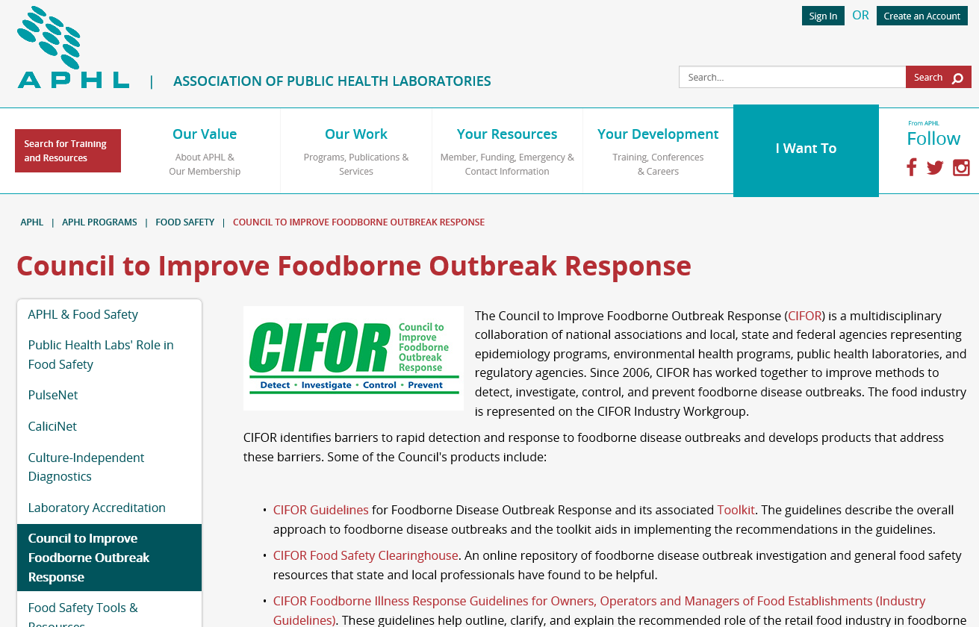
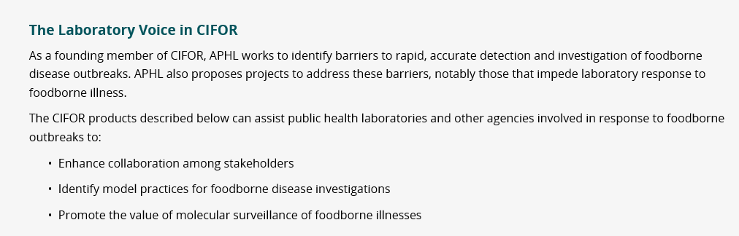

Slide 6
CORHA: Recognizing Laboratory as Essential to HAI/AR Outbreak/Response Activities
Variety of laboratory activities contribute to HAI/AR outbreak/response activities
  Diagnostics → signal detection (launch investigation)
  Diagnostics → case finding (support investigation)
  Relatedness testing → signal detection (launch investigation)
  Relatedness & Environmental testing (support investigation)
Notes:
PH, clinical, commercial, academic lab partners

Slide 7
Council for Outbreak Response:
Healthcare-Associated Infections & Antibiotic-Resistant Pathogens
(CORHA)
To improve practices and policies at the local, state and national levels for detection, investigation, control and prevention of HAI/AR outbreaks across the healthcare continuum, including emerging infections and other risks with potential for healthcare transmission.
Mission
Vision
Public health and healthcare collaborating effectively to protect patients and prevent harms from HAI/AR outbreaks.

Slide 8

CORHA Structure
ASTHO
Gerd Clabaugh, Iowa
CSTE
Marion Kainer, Tennessee
Governance Committee
CDC
Joe Perz,
DHQP
NACCHO
Dawn Terashita, Los Angeles County
ASTHO
Nirav Shah, Illinois (beginning in 2018)
Joseph Miner, Utah
CDC
Elizabeth Mothershed, DHQP
CSTE
Wendy Bamberg, Colorado
Erin Epson, California
NACCHO
Sri Seshadri, Barren River District
Member Organizations
FDA
APIC
Linda Greene
CMS
Patti Meier
FDA
Julia Marders
SHEA
Waleed Javaid
Notes:
Should this be a stacked venn?

Slide 9
CORHA Strategic Map
2016 – 2018
Central Challenge
Build Capacity for Public Health
and Healthcare to Improve Outbreak
Detection, Response and Prevention
Strategic Priorities
Support
Standardized Approaches to Detection and Reporting
Support Consistent and Coordinated Approaches to Investigation & Control
Foster Implementation and Uptake Among External Stakeholders
Create a Sustainable Council Model
2 Initial Workgroups
1. Outbreak Detection and Reporting
2. Outbreak Investigation and Control

Slide 10
Build Capacity for Public Health
and Healthcare to Improve Outbreak
Detection, Response and Prevention
A
B
C
D
Support Standardized
Approaches to
Detection and Reporting
Support Consistent and
Coordinated Approaches
to Investigation and
Control
Foster Implementation
and Uptake Among
External Stakeholders
Create a
Sustainable
Council Model
Standardize Outbreak
& Adverse Event
Definitions &
Thresholds for Reporting
Define Appropriate
Levels of Response
Enhance
Collaboration
Between Public
Health and Healthcare
Formally
Define the Scope
of the Council’s Work
1
Improve Reporting
of Outbreaks and
Exposure Events to
Public Health
Improve Response
to Outbreaks
Use Investigation and
Control to Inform
Improvements in
Prevention
Ensure
Effective Council
Governance
2
Improve the Use of
Existing Surveillance
Systems to
Detect Outbreaks
Improve Data
Management for
Outbreak Investigation
and Tracking
Foster Improvement
in Workforce
Competencies
Recruit Partners
as Council Members
and Workgroup
Members
3
Define Public Health, Clinical, and
Commercial Laboratory Best Practices
to Support Outbreak Detection and Response
Disseminate
Tools and
Guidance
Identify and
Develop Impactful
Product Offerings
4
Explore Legal Authority to
Support Best Practices
Identify Key
Stakeholders and
Foster Effective
Communication
Develop a Business
Plan Including
Financial
Projections
5
Develop Tools and Guidance
Articulate the
Value of Public
Health’s Role
Brand and
Promote
the Council
6

Slide 11
Detection and Reporting
Workgroup
Investigation and
Control Workgroup
Original Workgroups
Standardize Outbreak & Adverse Event
Definitions & Thresholds for Reporting
Define Appropriate
Levels of Response
Improve Reporting of Outbreaks and
Exposure Events to Public Health
Improve Response
to Outbreaks
Improve the Use of Existing Surveillance
Systems to Detect Outbreaks
Improve Data Management for
Outbreak Investigation and Tracking
Define Public Health, Clinical, and Commercial Laboratory Best Practices
to Support Outbreak Detection and Response
New (2018) Workgroups
Explore Legal Authority to Support Best Practices
Develop Tools and Guidance
Notes:
Let’s redraw and zoom in

Slide 12

CORHA Product Offerings
  High-level outputs related to strategic objectives
  E.g., Best practices for improve detection of potential outbreaks using existing data sources
  E.g., Laboratory best practices to support outbreak detection and investigations
  E.g., Suggestions for improving data management for outbreak investigation and response activity tracking
  Suite of condition- or event-specific reference tools
  Threshold for reporting and investigation
  Suggestions on how to improve reporting
  Suggestions on how to improve the use of existing surveillance data for detection
  Tools for investigation
  Suggestions for standardized control measures

Slide 13
Laboratory Workgroup Charge (Draft)
Promote and support improvement of laboratory response to healthcare-associated infection outbreaks
Define public health, clinical, and commercial laboratory best practices to support outbreak detection and response
Improve collaborations with healthcare facilities and state/local public health departments

Slide 14

Questions or Comments

Slide 15
CORHA: Leveraging AR Taskforce and ARLN
AR Taskforce and ARLN are complementary to CORHA
  Enhanced surveillance supports Detection and also Investigation
While AR threats are part of CORHA, our council is concerned with HAI outbreak/response more broadly

