Slide 1

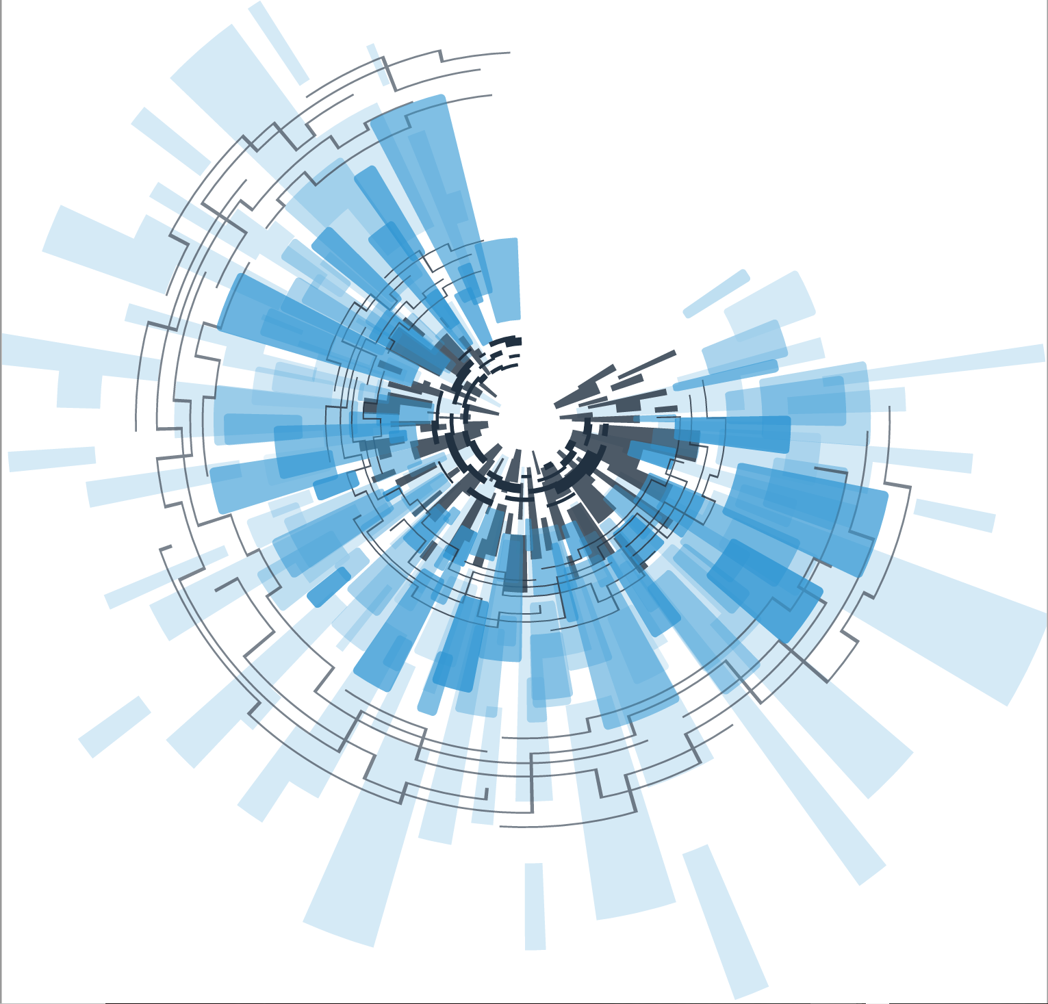
Council for Outbreak Response:
Healthcare-Associated Infections
Antibiotic-Resistant Pathogens
Joe Perz
CORHA Governance Committee Member
APHL Infectious Disease Committee Meeting
January 31st, 2018

Slide 2

APHL Invitation to join CORHA
CORHA was invited APHL to join the council as a member organization
APHL will have an official council member representative
CORHA request for APHL to contribute to leading our new Laboratory Workgroup
Notes:
Bottom lineup front…

Slide 3
CORHA: Recognizing Laboratory as Essential to HAI/AR Outbreak/Response Activities
Variety of laboratory activities contribute to HAI/AR outbreak/response activities
  Diagnostics → signal detection (launch investigation)
  Diagnostics → case finding (support investigation)
  Relatedness testing → signal detection (launch investigation)
  Relatedness & Environmental testing (support investigation)
Notes:
PH, clinical, commercial, academic lab partners

Slide 4
Detection and Reporting
Workgroup
Investigation and
Control Workgroup
Original Workgroups
Standardize Outbreak & Adverse Event
Definitions & Thresholds for Reporting
Define Appropriate
Levels of Response
Improve Reporting of Outbreaks and
Exposure Events to Public Health
Improve Response
to Outbreaks
Improve the Use of Existing Surveillance
Systems to Detect Outbreaks
Improve Data Management for
Outbreak Investigation and Tracking
Define Public Health, Clinical, and Commercial Laboratory Best Practices
to Support Outbreak Detection and Response
New (2018) Workgroups
Explore Legal Authority to Support Best Practices
Develop Tools and Guidance
Notes:
Let’s redraw and zoom in

Slide 5
Laboratory Workgroup Charge (Draft)
Promote and support improvement of laboratory response to healthcare-associated infection outbreaks
Define public health, clinical, and commercial laboratory best practices to support outbreak detection and response
Improve collaborations among
  laboratory partners
  healthcare facilities
  state/local public health departments

Slide 6
Leveraging APHL Experience and Strengths
CIFOR founding member
AR Taskforce and ARLN
  Complementary to CORHA
  Enhanced surveillance supports Detection and also Investigation
While AR threats are part of CORHA, our council is concerned with HAI outbreak/response more broadly
Input on workgroup membership (n~10)
  Co-chairs; Wg-A; Wg-B; Academic lab, Commercial lab, others…

Slide 7

Questions or Comments

