Slide 1


Council for Outbreak Response:
Healthcare-Associated Infections
Antibiotic-Resistant Pathogens
High-Level Guidance Development:
Draft Roadmap
Joe Perz, DrPH MA
CDC/DHQP
CORHA Governance Committee Member
May 23, 2018

Slide 2

CORHA Products Reflect Strategic Map (D-4, C-4, AB-6)
Support Standardized Approaches to Detection and Reporting
Support Consistent and Coordinated Approaches to Investigation & Control
D-4
Identify and Develop Impactful Product Offerings
Standardize Outbreak & Adverse Event
Definitions & Thresholds for Reporting
Define Appropriate
Levels of Response
Improve Reporting of Outbreaks and
Exposure Events to Public Health
Improve Response
to Outbreaks
C-4
Disseminate Tools and Guidance
Improve the Use of Existing Surveillance
Systems to Detect Outbreaks
Improve Data Management for
Outbreak Investigation and Tracking
Define Public Health, Clinical, and Commercial Laboratory Best Practices
to Support Outbreak Detection and Response
Explore Legal Authority to Support Best Practices
AB-6
Develop Tools and Guidance
Notes:
Let’s redraw and zoom in

Slide 3

CORHA Product Offerings
  Suite of condition- or event-specific reference tools
  Threshold for reporting and investigation (A-1)
  Suggestions on how to improve reporting (A-2)
  Suggestions on how to improve the use of existing surveillance data for detection (A-3)
  Tools for investigation (B-1,2)
  Suggestions for standardized control measures (B-2)
Completed prototype for Scabies
Other examples in pipeline include C. auris, CRE, CDI, NTM

Slide 4
CORHA Product Offerings
  Searchable clearinghouse
  HAI/AR outbreak response abstracts from select annual meetings
  Investigation tools and resources
  Users will be able to submit materials for consideration

Slide 5
CORHA Product Offerings
  High-level guidance/tools related to strategic objectives
  E.g., Best practices for improved detection of potential outbreaks using existing data sources (A-3)
  E.g., Laboratory best practices to support outbreak detection and investigations (AB-4)
  E.g., Suggestions for improving data management for outbreak investigation and response activity tracking (B-3)
Notes:
In addition to condition or pathogen-specific guidance and tools, we would like to address our strategic objectives in a more general or over-arching sense…

Slide 6
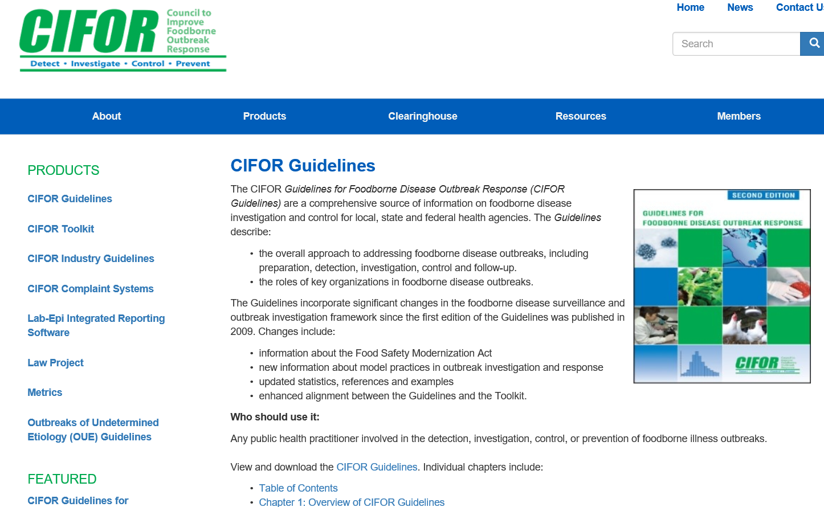
CORHA High Level Guidance: CIFOR Model
//cifor.us/products/guidelines

Slide 7
CORHA High Level Guidance: Draft Roadmap
  Aim – foundational reference for HAI/AR outbreak detection, reporting, investigation and control
  Audience – public health, healthcare and other stakeholders
  Opportunity – completed HLG will serve as principal CORHA product and means to advance our mission and vision
Notes:
B2 – anyone seeking to improve HAI/AR response….

Slide 8
CORHA High Level Guidance: Format & Approach
  Chapter Structure – logical progression from planning to performance and from basic to advanced topics
  Format – web and digital platforms (w/ print options)
  Phasing – will deviate from order in which proposed chapters/modules appear in the overall HLG outline
Notes:
B2 – living doc concept….

Slide 9
CORHA High Level Guidance: Draft Outline
1: Overview
2: Fundamental Concepts
3: Planning and Preparation**
4: Detection and Reporting*
5: Investigation of HAI/AR Outbreaks***
6: Laboratory Best Practices in Support of HAI/AR Outbreak Response^
7: Special Consideration for Multi-Jurisdictional Outbreaks
8: Performance Indicators
9: Legal Considerations
Supplement: Communications, Media, Public Reporting, Notification and Disclosure
Supplement: Medical Product Investigations
Supplement: Infection Control Breach Investigations
Notes:
B2 – living doc concept….
Explain * and ^

Slide 10
CORHA High Level Guidance: Participation/Roles
  Council member(s) at-large: ideas and advice (a) overall HLG content and format, and (b) content and outline for individual chapters
  Writing Team: drafting and editing
  Review Team: advice on content and outline plus feedback on drafts
  Governance Committee: vetting
  Voting Members: final review and approval
Notes:
B2 – hands on….

Slide 11
HLG Development and Review Process
A. Chapter Selection & Prioritization
B. Chapter Outline
C. Chapter Development
Writing Team
D. Periodic Chapter Review and Edits
E. Leadership Review
Final Chapter
Writing/Review Teams
Review Team
CORHA Members
F. Final Review and Approval
CORHA Voting Members
Governance Committee
Governance Committee
CORHA Members
Governance Comm.
Writing Team

Slide 12
CORHA HLG – Feedback/Discussion
  Part 1. Process
  Part 2. Overall HLG content and format
  Part 3. Content and outline for selected chapters (11:45)

Slide 13
CORHA High Level Guidance: Draft Outline
1: Overview
2: Fundamental Concepts
3: Planning and Preparation**
4: Detection and Reporting*
5: Investigation of HAI/AR Outbreaks***
6: Laboratory Best Practices in Support of HAI/AR Outbreak Response^
7: Special Consideration for Multi-Jurisdictional Outbreaks
8: Performance Indicators
9: Legal Considerations
Supplement: Communications, Media, Public Reporting, Notification and Disclosure
Supplement: Medical Product Investigations
Supplement: Infection Control Breach Investigations
Notes:
B2 – living doc concept….
Explain * and ^

Slide 14

Thank You
The findings and conclusions in this report are those of the authors and do not necessarily represent the official position of the Centers for Disease Control and Prevention.

