Slide 1


Council for Outbreak Response:
Healthcare-Associated Infections
Antibiotic-Resistant Pathogens
Joe Perz, DrPH MA
CDC/DHQP
CORHA Governance Committee Member
Spring SHEA Meeting
April 18, 2018
Updated May 2018 by CORHA Staff

Slide 2

Problem
Despite significant progress, patients still experience preventable harms in the context of outbreaks and other adverse events that stem from emerging infectious diseases with potential for healthcare transmission, unsafe healthcare practices, contaminated drugs, and medical devices

Slide 3
Outbreak Investigation and Response Activities
Core function, central to patient safety and health protections
Outbreaks and other adverse event investigations in healthcare
  Identify unsafe products and practices
  Inform and motivate broader HAI/AR prevention efforts
Public health, regulatory and healthcare partners: roles and responsibilities
Variable capacities for detecting and responding to possible HAI/AR outbreaks in healthcare settings
  Health Department, Facility, and Laboratory levels
Notes:
Partners share many responsibilities

Slide 4
Need
More systematic and consistent approach to healthcare outbreak response, from signal detection to investigation and control

Slide 5


Slide 6
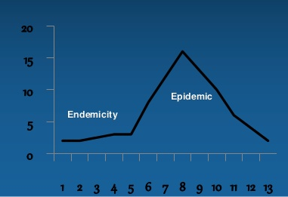
  Basic Tenet: sooner we become aware of a potential problem, the more opportunity to attenuate harms
Notes:
Basic tenet for public health and really any kind of endeavor where one seeks to maintain high levels of quality

Slide 7
A Useful Mantra
Sooner
Faster
Better
Smaller

Slide 8
A Useful Mantra
Sooner – can we do a better job of detecting and communicating signals that might represent an uncontrolled or unacceptable risk to patients – one that could take the form of an outbreak
Faster – can we respond to those signals more quickly
Better – can we do a better job assessing the situation and implementing any necessary controls or actions
Smaller – can we reduce impacts and harms using this type of proactive approach

Slide 9
What do we mean by “Response” in the context of HAIs and AR Threats?
Response refers to efforts to assist with assessment and investigation of specific, acute HAI/AR risks.
These risks can take various forms:
  outbreaks
  clusters of infections
  sentinel cases (e.g., HAI or emerging AR threat), or
  a serious breach in infection control practice

Slide 10
HAI/AR Response Activities
– Investigation Goals and Activities
  Investigation goals
    Rule out larger problem
    Rule out uncontrolled risk
  Investigation activities
    Case finding
    Assessments of infections control and care delivery practices
    Evaluate transmission potential/mechanisms
    Implement control measures
Notes:
Internal and external record review
patient notification (“recall”) considerations
Evaluate transmission mechanisms
Perform risk assessment

Slide 11
Guiding Principles
Commitments to:
Diligent follow through
  Communicate actions/findings
    key stakeholders
    timely
  Apply findings and lessons
  System improvements
  – prevent recurrence
  – increase vigilance
Swift actions
  Identify cause
  Contain threat
  Prevent harm

Slide 12
CORHA Formation
CDC’s Division of Healthcare Quality Promotion funded the Association of State and Territorial Health Officials (ASTHO) and the Council of State and Territorial Epidemiologists (CSTE) to co-lead the Council for Outbreak Response: HAI/AR (CORHA)

Slide 13
Council for Outbreak Response:
Healthcare-Associated Infections & Antibiotic-Resistant Pathogens
To improve practices and policies at the local, state and national levels for detection, investigation, control and prevention of HAI/AR outbreaks across the healthcare continuum, including emerging infections and other risks with potential for healthcare transmission.
Mission
Vision
Public health and healthcare collaborating effectively to protect patients and prevent harms from HAI/AR outbreaks.

Slide 14

CORHA Structure
ASTHO
Gerd Clabaugh, Iowa
CSTE
Marion Kainer, Tennessee
Governance Committee
CDC
Joe Perz,
CDC/DHQP
NACCHO
Dawn Terashita, Los Angeles County
Member Organizations
SHEA
APIC
APHL
FDA
CMS
FDA
Notes:
Should this be a stacked venn?

Slide 15

CORHA Product Offerings
  Suite of condition or event-specific reference tools
  Threshold for reporting and investigation
  Suggestions on how to improve reporting
  Suggestions on how to improve the use of existing surveillance data for detection
  Tools for investigation
  Suggestions for standardized control measures
Completed prototype for Scabies
Other examples in pipeline include C. auris, CRE, CDI, NTM

Slide 16
CORHA Product Offerings
  Searchable clearinghouse
  HAI/AR outbreak response abstracts from select annual meetings
  Investigation tools and resources
  Users will be able to submit materials for consideration

Slide 17
CORHA Product Offerings
  High-level guidance related to strategic objectives
  E.g., Best practices for improve detection of potential outbreaks using existing data sources
  E.g., Laboratory best practices to support outbreak detection and investigations
  E.g., Suggestions for improving data management for outbreak investigation and response activity tracking

Slide 18
CORHA Strategic Map
Build Capacity for Public Health
and Healthcare to Improve Outbreak
Detection, Response and Prevention
A
B
C
D
Support Standardized
Approaches to
Detection and Reporting
Support Consistent and
Coordinated Approaches
to Investigation and
Control
Foster Implementation
and Uptake Among
External Stakeholders
Create a
Sustainable
Council Model
Standardize Outbreak
& Adverse Event
Definitions &
Thresholds for Reporting
Define Appropriate
Levels of Response
Enhance
Collaboration
Between Public
Health and Healthcare
Formally
Define the Scope
of the Council’s Work
1
Improve Reporting
of Outbreaks and
Exposure Events to
Public Health
Improve Response
to Outbreaks
Use Investigation and
Control to Inform
Improvements in
Prevention
Ensure
Effective Council
Governance
2
Improve the Use of
Existing Surveillance
Systems to
Detect Outbreaks
Improve Data
Management for
Outbreak Investigation
and Tracking
Foster Improvement
in Workforce
Competencies
Recruit Partners
as Council Members
and Workgroup
Members
3
Define Public Health, Clinical, and
Commercial Laboratory Best Practices
to Support Outbreak Detection and Response
Disseminate
Tools and
Guidance
Identify and
Develop Impactful
Product Offerings
4
Explore Legal Authority to
Support Best Practices
Identify Key
Stakeholders and
Foster Effective
Communication
Develop a Business
Plan Including
Financial
Projections
5
Develop Tools and Guidance
Articulate the
Value of Public
Health’s Role
Brand and
Promote
the Council
6

Slide 19
CORHA Strategic Map
Central Challenge
Build Capacity for Public Health
and Healthcare to Improve Outbreak
Detection, Response and Prevention
Strategic Priorities
Support
Standardized Approaches to Detection and Reporting
Support Consistent and Coordinated Approaches to Investigation & Control
Foster Implementation and Uptake Among External Stakeholders
Create a Sustainable Council Model
2 Initial Workgroups
1. Outbreak Detection and Reporting
2. Outbreak Investigation and Control

Slide 20
CORHA Strategic Map – Priorities A and B
Support Standardized Approaches to Detection and Reporting
Support Consistent and Coordinated Approaches to Investigation & Control
Workgroups
Standardize Outbreak & Adverse Event
Definitions & Thresholds for Reporting
Define Appropriate
Levels of Response
Improve Reporting of Outbreaks and
Exposure Events to Public Health
Improve Response
to Outbreaks
Improve the Use of Existing Surveillance
Systems to Detect Outbreaks
Improve Data Management for
Outbreak Investigation and Tracking
Define Public Health, Clinical, and Commercial Laboratory Best Practices
to Support Outbreak Detection and Response
Explore Legal Authority to Support Best Practices
Develop Tools and Guidance
Notes:
Let’s redraw and zoom in

Slide 21
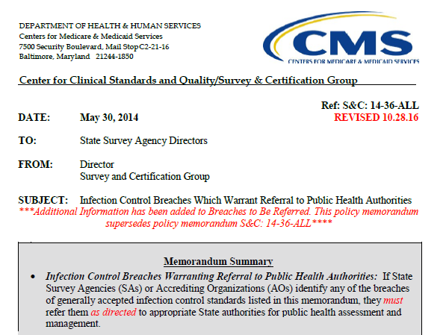
Example – Serious Infection Control Breach Reporting Requirement
Trigger for Reporting is clearly spelled out
Includes reuse of injection equipment and breakdowns in reprocessing or sterilization
Provides opportunity for health department to assess, assist and intervene
Elevates these practices
Notes:
Something we can try to emulate
--- helps to take the guesswork out
--- discretion is good but too much is problematic

Slide 22
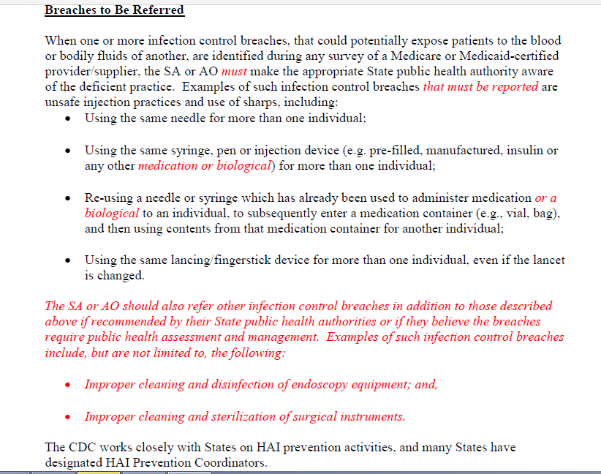

Slide 23
CORHA Strategic Map – Priorities A and B
Support Standardized Approaches to Detection and Reporting
Support Consistent and Coordinated Approaches to Investigation & Control
Workgroups
Standardize Outbreak & Adverse Event
Definitions & Thresholds for Reporting
Define Appropriate
Levels of Response
Improve Reporting of Outbreaks and
Exposure Events to Public Health
Improve Response
to Outbreaks
Improve the Use of Existing Surveillance
Systems to Detect Outbreaks
Improve Data Management for
Outbreak Investigation and Tracking
Define Public Health, Clinical, and Commercial Laboratory Best Practices
to Support Outbreak Detection and Response
Explore Legal Authority to Support Best Practices
Develop Tools and Guidance
Notes:
Let’s redraw and zoom in

Slide 24
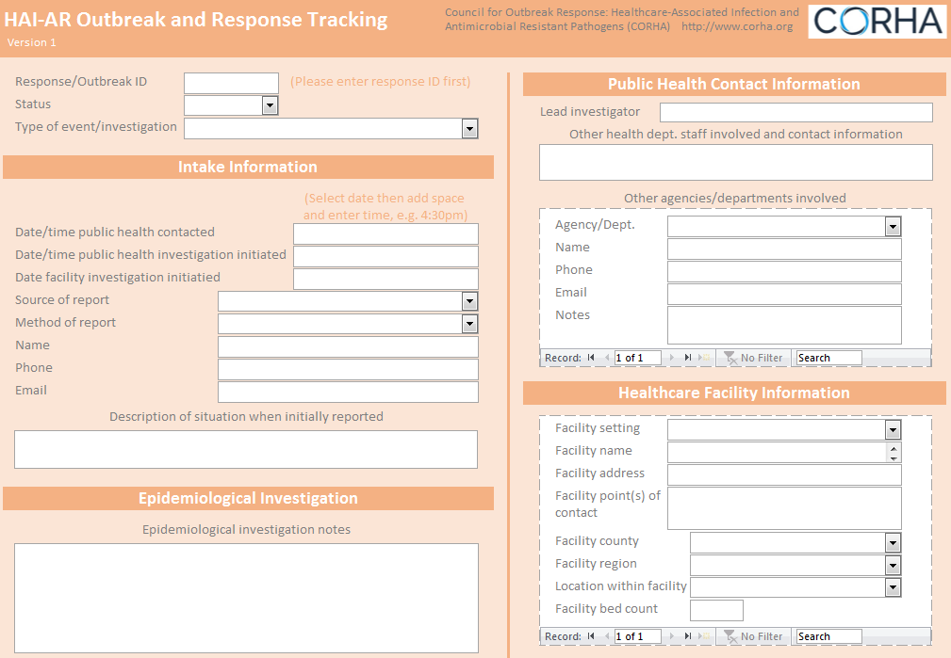
CORHA Response Activity Tracking System
  Developed to help health departments and large healthcare systems with tracking summary data from responses activities
  Builds on recent evaluation of health department HAI/AR program evaluation which showed high levels of Response Activity but variable approaches to recording, tracking and analyzing this information
  Materials include a sample database (provided in the form of a downloadable Microsoft Access file) and data dictionary

Slide 26
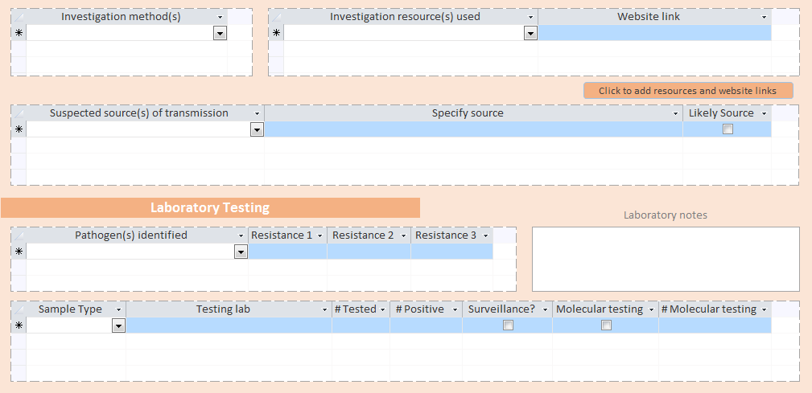

Slide 27
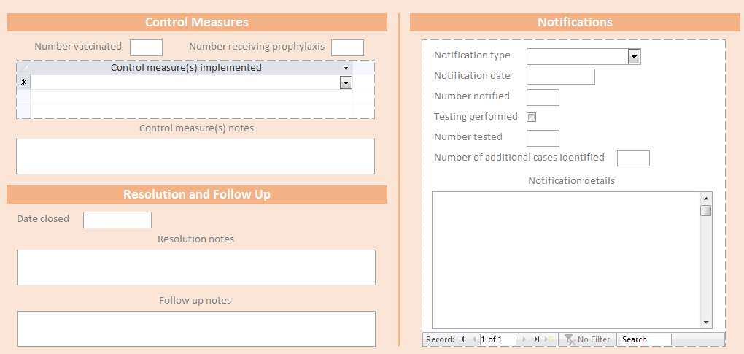

Slide 28
CORHA Strategic Map – Priorities A and B
Support Standardized Approaches to Detection and Reporting
Support Consistent and Coordinated Approaches to Investigation & Control
Workgroups
Standardize Outbreak & Adverse Event
Definitions & Thresholds for Reporting
Define Appropriate
Levels of Response
Improve Reporting of Outbreaks and
Exposure Events to Public Health
Improve Response
to Outbreaks
Improve the Use of Existing Surveillance
Systems to Detect Outbreaks
Improve Data Management for
Outbreak Investigation and Tracking
Define Public Health, Clinical, and Commercial Laboratory Best Practices
to Support Outbreak Detection and Response
Explore Legal Authority to Support Best Practices
Develop Tools and Guidance
Notes:
Let’s redraw and zoom in

Slide 29
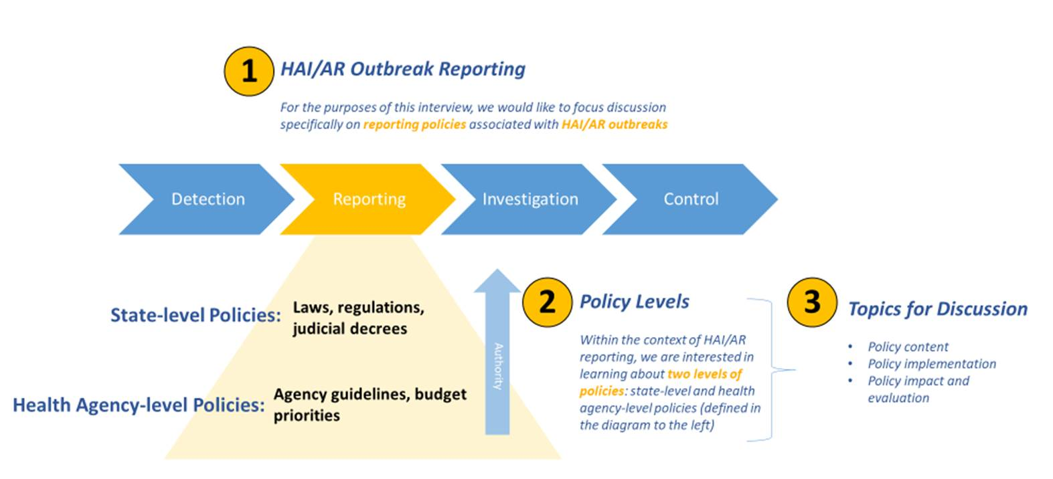

ASTHO-led Evaluation of State HAI/AR Outbreak Reporting Policies and Practices
Notes:
ASTHO explore the nature of your state’s healthcare-associated infections and antibiotic-resistant pathogen outbreak reporting policy(ies) and build upon the HAI/AR outbreak response capacities assessment that your state health department participated in as part of the ICAR program

Slide 30
Detection and Reporting
Workgroup
Investigation and
Control Workgroup
Original Workgroups
Standardize Outbreak & Adverse Event
Definitions & Thresholds for Reporting
Define Appropriate
Levels of Response
Improve Reporting of Outbreaks and
Exposure Events to Public Health
Improve Response
to Outbreaks
Improve the Use of Existing Surveillance
Systems to Detect Outbreaks
Improve Data Management for
Outbreak Investigation and Tracking
Define Public Health, Clinical, and Commercial Laboratory Best Practices
to Support Outbreak Detection and Response
New (2018) Workgroups
Explore Legal Authority to Support Best Practices
Develop Tools and Guidance
Notes:
Let’s redraw and zoom in

Slide 31
CORHA: Recognizing Laboratory as Essential to HAI/AR Outbreak/Response Activities
Variety of laboratory activities contribute to HAI/AR outbreak/response activities
  Diagnostics → signal detection (launch investigation)
  Diagnostics → case finding (support investigation)
  Relatedness testing → signal detection (launch investigation)
  Relatedness & Environmental testing (support investigation)
Notes:
PH, clinical, commercial, academic lab partners

Slide 32
Laboratory Workgroup Charge (Draft)
Promote and support improvement of laboratory response to healthcare-associated infection outbreaks
Define public health, clinical, and commercial laboratory best practices to support outbreak detection and response
Improve collaborations with healthcare facilities and state/local public health departments

Slide 33
Some Other Topics/Issues CORHA is Working On
  Medical Product Investigations
  Drug Diversion
  Patient Notification and Public Disclosure
  Workforce capacity/training
  Advice on Planning and Preparation

Slide 34
CORHA – Summary
  The Council is evolving and aims to provide a practical forum for the healthcare community, consumers, public health authorities, and professional associations to address the challenges of HAI/AR outbreak response
  Largely dependent on in-kind contributions (thanks)
  Engage with us:
    Website – corha.org
    CORHA Member Organizations can provide path to workgroup participation

Slide 35

Thank You
The findings and conclusions in this report are those of the authors and do not necessarily represent the official position of the Centers for Disease Control and Prevention.

