Slide 1
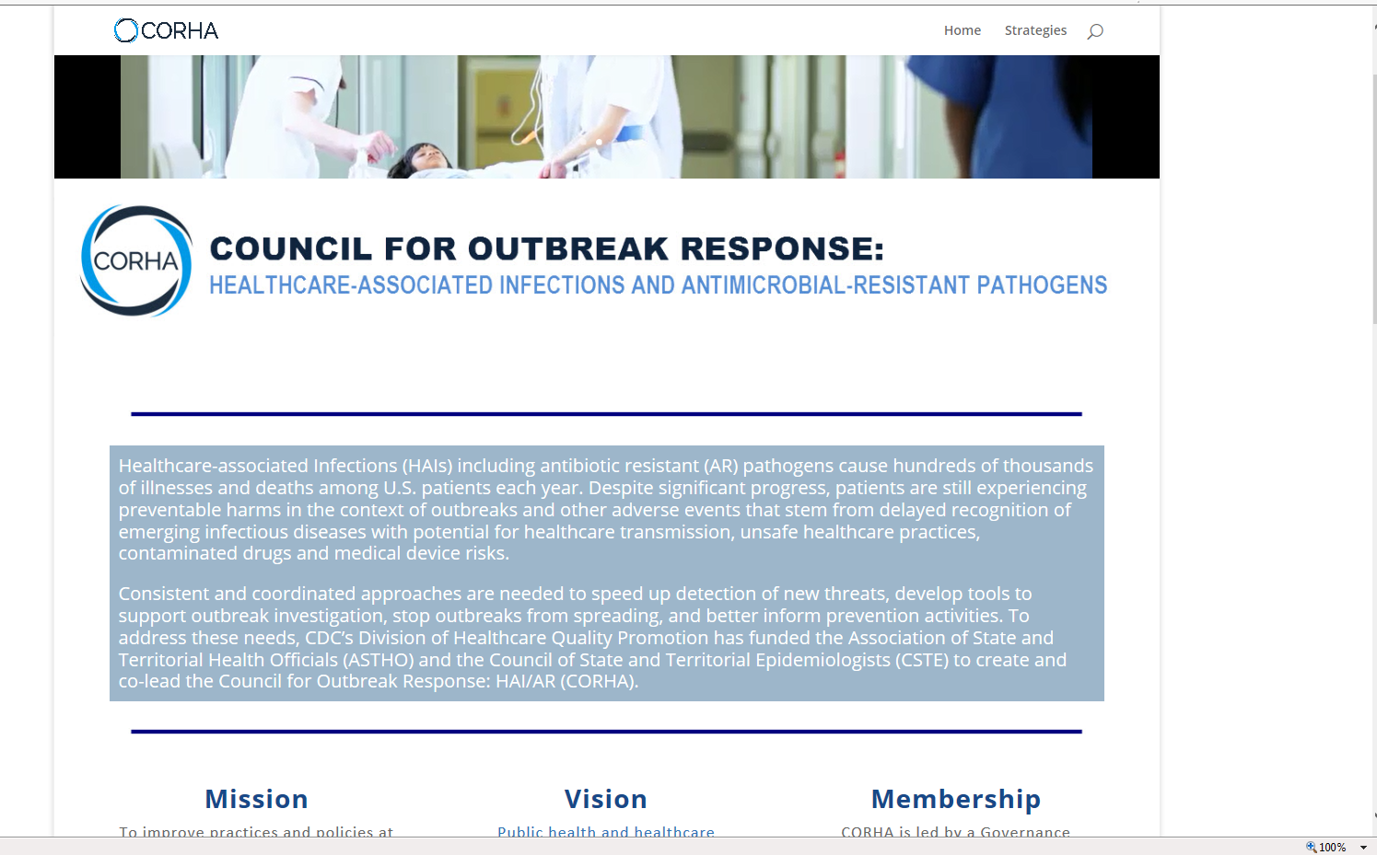

Add buttons for Resources, About Us, and Contact Us
Position/reduce this box to make space for the “connect with CORHA” subscription box
Connect with CORHA
Sign up to receive CORHA updates, tools and resources.
When people click on the graphic it should take them to another page where they can sign up to become part of our subscription list

Slide 2
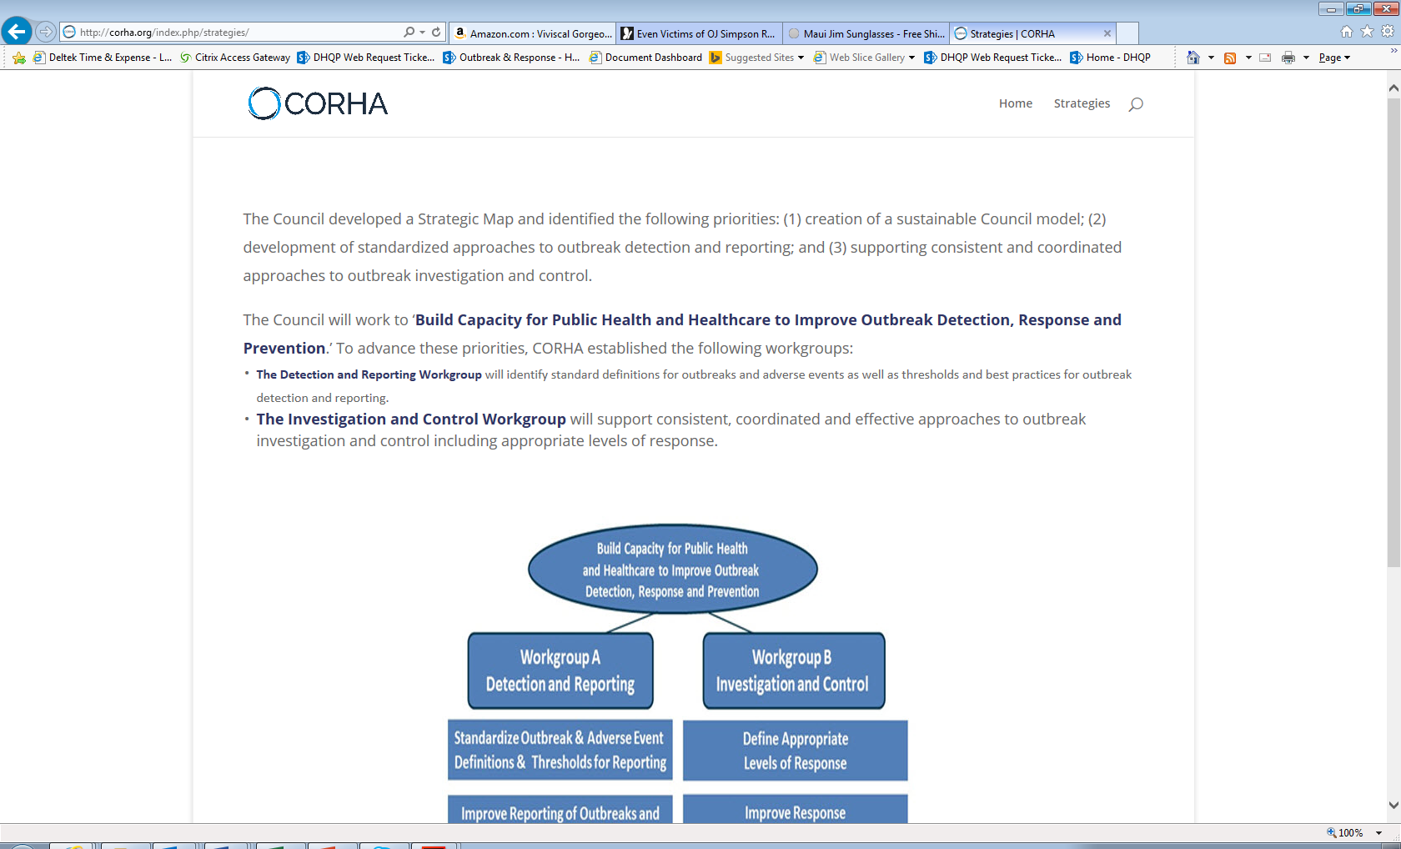
NEW PAGE
Add this wording
Add buttons for Resources, About Us, and Contact Us
COUNCIL FOR OUTBREAK RESPONSE:
HEALTHCARE-ASSOCIATED INFECTIONS AND ANTIBIOTIC-RESISTANT PATHOGENS
This page will remain hidden from public view until there are work products to post
Tools/Workgroup Products

Slide 3
NEW PAGE
Add this wording
Add buttons for Resources, About Us, and Contact Us
COUNCIL FOR OUTBREAK RESPONSE:
HEALTHCARE-ASSOCIATED INFECTIONS AND ANTIBIOTIC-RESISTANT PATHOGENS
Resources
CDC/SHEA Outbreak Response Training Program (ORTP) (Link: http://ortp.shea-online.org/)
Upcoming Webinar: Beating the Media Crush (Link: http://ortp.shea-online.org/webinars/webinar-beating-the-media-crush/)
Recorded Webinar: Conflict Management (Link: http://ortp.shea-online.org/webinars/webinar-conflict-management/)
Recorded Webinar: Communicating During a Crisis (Link: http://ortp.shea-online.org/webinars/webinar-communicating-during-a-crisis/)

Slide 4
NEW PAGE
Add this wording
Add buttons for Resources, About Us, and Contact Us
COUNCIL FOR OUTBREAK RESPONSE:
HEALTHCARE-ASSOCIATED INFECTIONS AND ANTIBIOTIC-RESISTANT PATHOGENS
About Us
The Council for Outbreak Response: Healthcare Associated Infections and Antimicrobial Resistance (CORHA) is composed of several interacting components: The Governance committee, Additional Member Organizations, Federal Liaison Member Organizations, and Workgroups. Together, these entities constitute the Full Cou8nicl which functions as the main body of CORHA. The Governance committee functions as the leadership for CORHA, providing guidance and advocacy.
CORHA Governance Committee Member Representatives
Gerd Clabaugh, MPA
Director at the Iowa Department of Public Health
Organizational Affiliation: ASTHO
Marion Kainer, MD, MPH, FRACP, FSHEA
Director of HAIs and AMR program at the TN Department of Health
Organizational Affiliation: CSTE
Dawn Terashita, MD, MPH
Medical Epidemiologist at the LA County Department of Public Health
Organizational Affiliation: NACCHO
Joseph Perz, DrPH, MA
Quality Standards and Safety Team Lead at the CDC
Organizational Affiliation: CDC
add photos and web links
Link name to: http://www.astho.org/Directory/Member-Bios/Iowa/
Link Name to: https://www.healthlawyers.org/Events/Biographies/Pages/KainerMarion.aspx
Link name to: https://www.passporthealthusa.com/locations/ca/los-angeles/executive-team/
Link name to: https://www.cdc.gov/media/releases/2012/docs/dpk-unsafe-injections-Perz-bio.pdf

Slide 5
NEW PAGE
Add this wording
Add buttons for Resources, About Us, and Contact Us
COUNCIL FOR OUTBREAK RESPONSE:
HEALTHCARE-ASSOCIATED INFECTIONS AND ANTIBIOTIC-RESISTANT PATHOGENS
Subscription page
Connect with CORHA
Sign up to receive CORHA updates, tools and resources
First Name
Last Name
Organization
Email Address

