Slide 1


Council for Outbreak Response: Healthcare-Associated Infections Antimicrobial-Resistant Pathogens
How CORHA is Developing Standards on Notification and Disclosure of Clusters and Outbreaks
Marion A. Kainer, MD, MPH| Tennessee Department of Health; CORHA Governance Committee Member
Maureen R. Tierney, MD, MSc| Nebraska DHHS, Division of Public Health; CORHA Policy Workgroup Co-Chair
Joseph F. Perz, DrPH, MA| CDC, Division Healthcare Quality Promotion, CORHA Governance Committee Member
Spring SHEA Meeting​
April 24, 2019

Slide 2
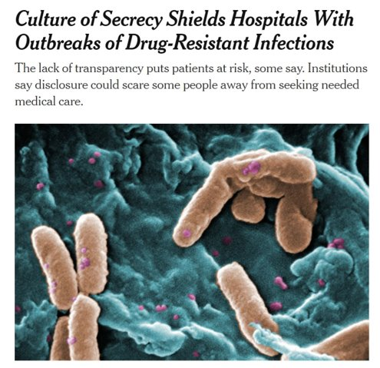
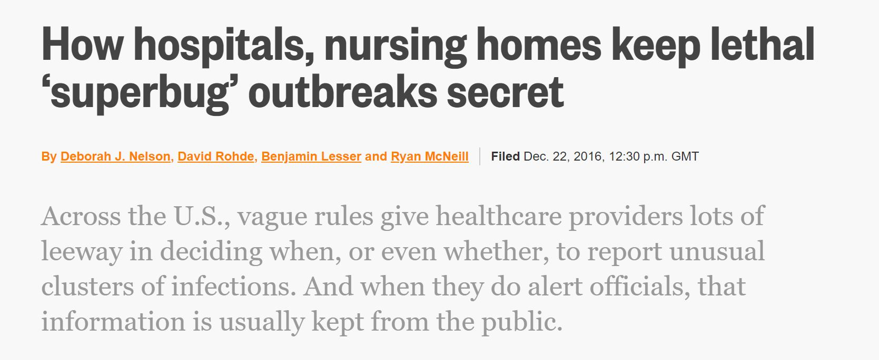

Why Discuss This Now?
Increasing pushes for transparency and disclosure
  NYTimes article April 8, 2019
  Reuters article, December 22, 2016
PH, ID and Epi Communities have been working on this complicated issue
CORHA working on developing guidance for communicating on outbreaks with consistency based on principles transparency, right to know, avoidance of harm

Slide 3
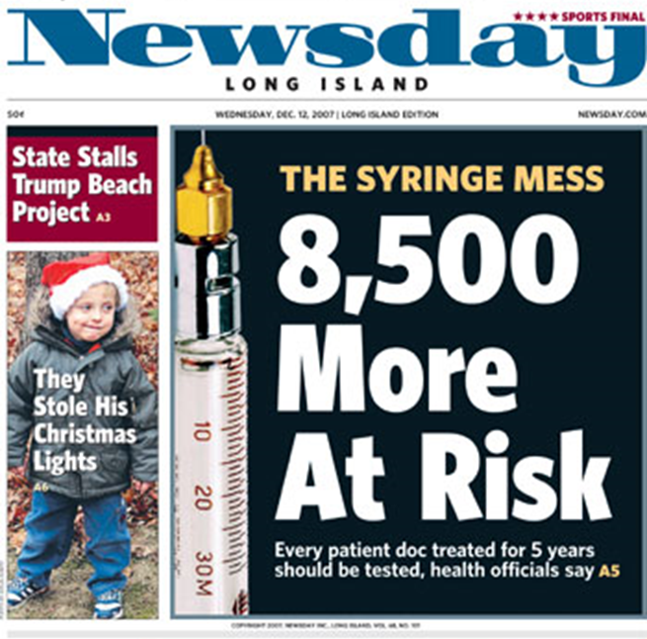
Background
Outbreaks of infections are a regular occurrence within healthcare facilities
We lack standards for HAI outbreak patient notification and public disclosure
Practices vary widely
Public disclosure is uncommon and often incidental (e.g., stemming from large-scale patient notification or clinic closure)

Slide 4
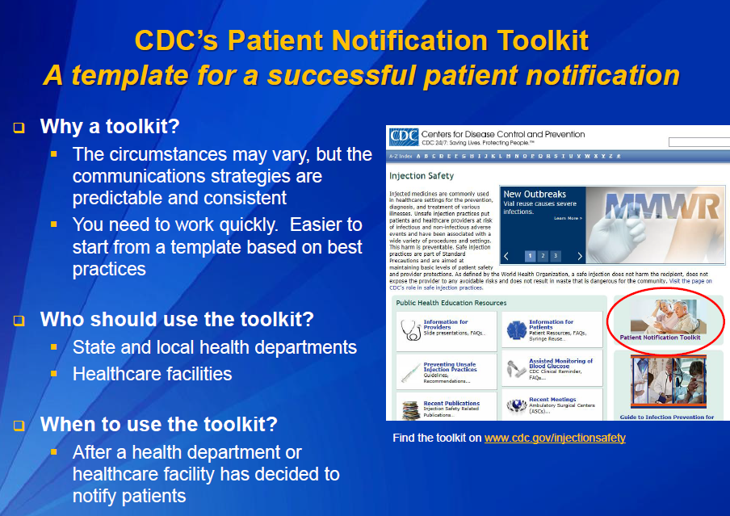
Existing Platform – Bloodborne Pathogen Risks
Established expectations for triggering patient notification in the context of both
  hepatitis outbreaks
  ‘category A’ infections control breaches (e.g., syringe reuse)
Recognizes patient’s right to know about exposure which might have altered their health status
Guidance on how to execute
www.nphic.org/Content/Conferences/2013/NCHCMM/Presentations/Brinsley-RainischKristin.pdf

Slide 5
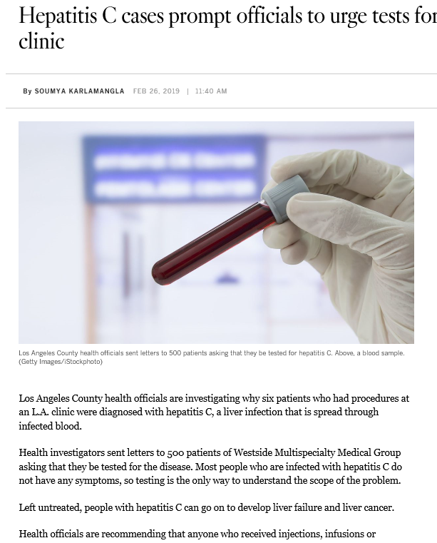

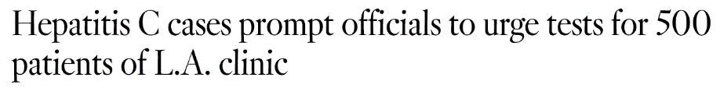
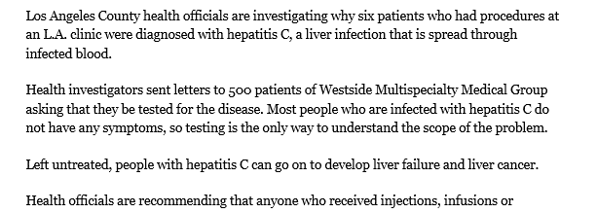
https://www.latimes.com/local/california/la-me-ln-hepatitis-la-clinic-20190226-story.html

Slide 6
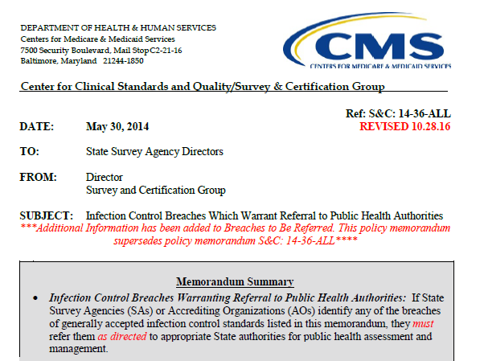

Example – Serious Infection Control Breach Reporting Requirement
Trigger for Reporting is clearly spelled out
Includes reuse of injection equipment and breakdowns in reprocessing or sterilization
Provides opportunity for health department to assess, assist and intervene
Elevates these practices
Notes:
Something we can try to emulate
--- helps to take the guesswork out
--- discretion is good but too much is problematic

Slide 7
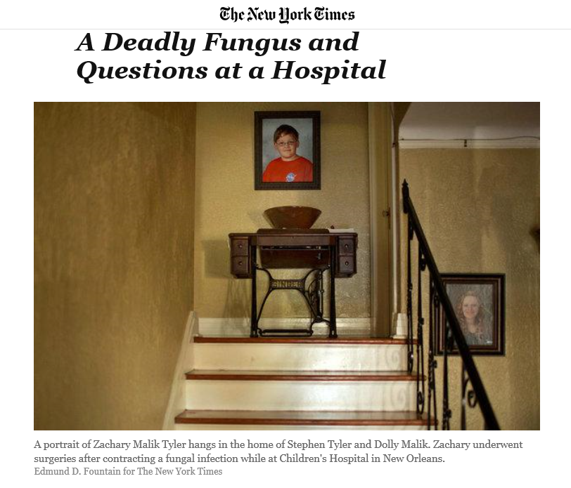
April 28, 2014
The children died of various causes between August 2008 and July 2009 during an outbreak of a flesh-eating fungal infection, mucormycosis, most likely spread by bed linens, towels or gowns, according to a medical journal. The disclosure this month caused new pain for the families of the children and raised troubling questions about how the infections came about, why doctors did not connect the cases until more than 10 months after the first death, and what obligation the hospital had to inform parents — and the community — of the outbreak.
https://www.nytimes.com/2014/04/29/us/a-deadly-fungus-and-questions-at-a-hospital.html

Slide 8
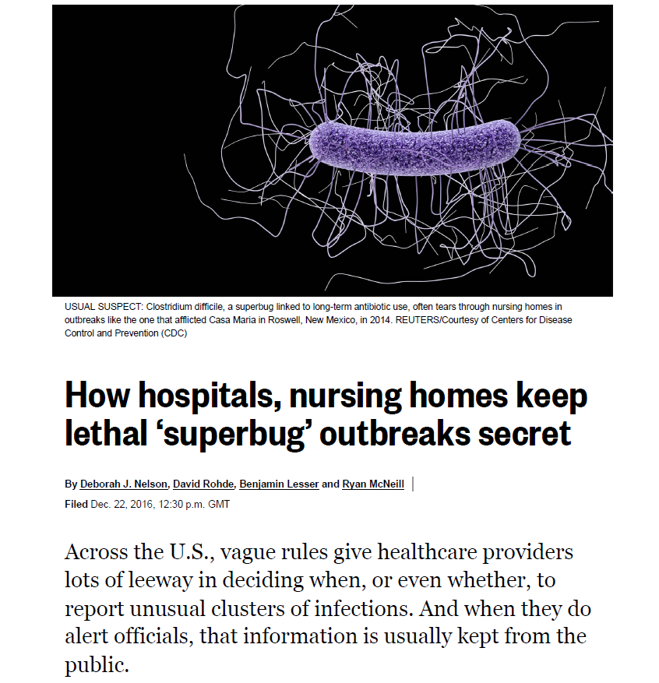
https://www.scientificamerican.com/article/how-hospitals-nursing-homes-keep-lethal-superbug-outbreaks-secret/

Slide 9
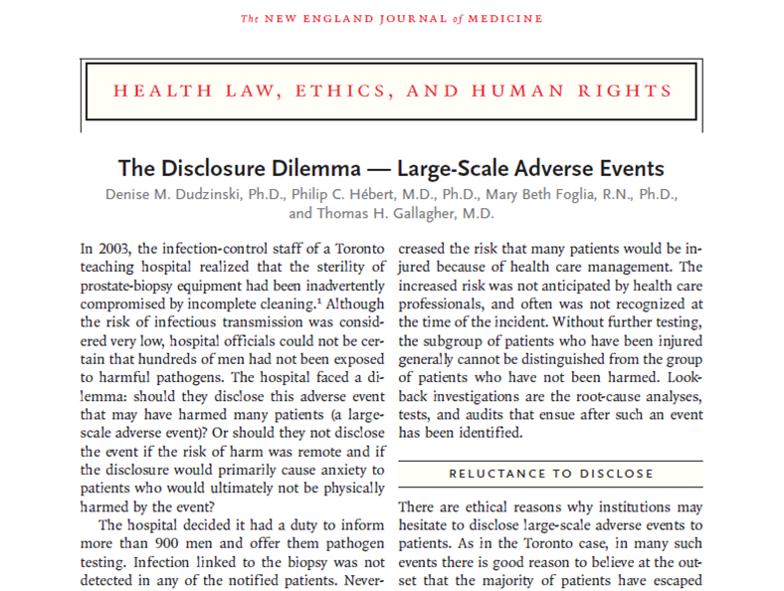
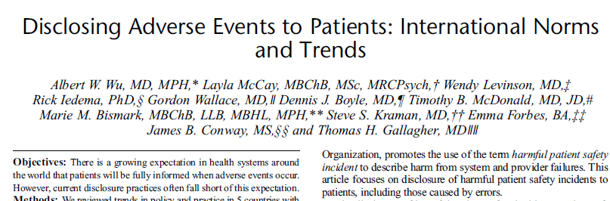
Increasing Demand for Transparency in Healthcare

Slide 10
Examples of Public Disclosure Policy- Adverse Events
Veterans Affairs guidelines “to ensure consistent practice in disclosing to patients…the occurrence of adverse events related to the patient’s clinical care”(VHA Handbook 1004.08, Disclosure of Adverse Events to Patients, 2012)
University of Michigan Model
  Full disclosure of adverse events
  Based on AHRQ CANDOR Toolkit
  5 years post implementation: fewer lawsuits and lower litigation/compensation costs
  https://www.uofmhealth.org/michigan-model-medical-malpractice-and-patient-safety-umhs

Slide 11
International Examples -- Australia
Australian Open Disclosure Framework
  Developed by Australian Commission on Safety and Quality in Health Care (2013)
  “Flexible framework designed to be used by health service organisations in all settings and sectors”
  Open disclosure
    “A patient and consumer right”
    “An open discussion with a patient about an incident(s) that resulted in harm to that patient while they were receiving health care”

Slide 12
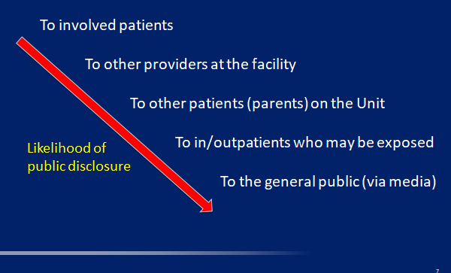

Levels of Notification and Disclosure

Slide 13
Notification and Disclosure are Influenced by Different Perspectives and Principles
Patients- desire for knowledge if/how they have been harmed or if they are at risk
Providers/institution- often not comfortable disclosing
Public health- disease control and containment
Media-public right to know, tell a story
Ethical principles

Slide 14
Two Questions
What is best? (Utility – maximize benefits versus risks; and efficiency)
What is right? (other Ethical Principles such as beneficence, autonomy, justice)

Slide 15
Ethical Principles
Utility – maximize benefits and efficiency; acts are right because they promote well-being of individuals and the community
Autonomy – letting individuals make their own choices based on their values and preferences
Respect – transparency and truth telling
Beneficence –moral duty to act in patient’s best interest
Non-maleficence-No intentional harm
Justice – equity; also procedural justice: a fair process for making important

Slide 16
Utility of Notifying/Disclosing
Identify additional outbreak-associated infections
Facilitate appropriate management & prevention by patients and providers
Allows patients to make informed choices
Encourages mutual trust (respect) between patients and the healthcare system
New or serious threat that is causing widespread concern; counter misinformation
Informs other facilities of a problem that also may affect them, facilitating preventive action

Slide 17
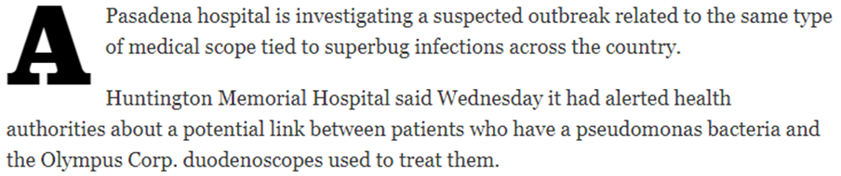

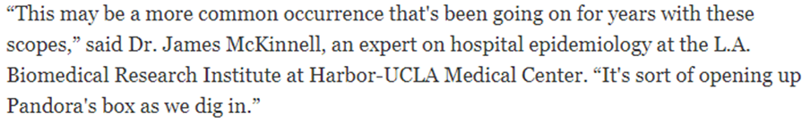

Disclosure as Warning to Other Facilities

Slide 18
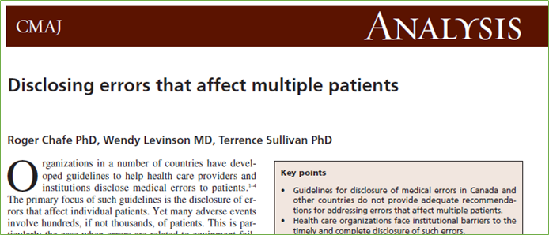
Utility of Not Disclosing (Publicly)
Patient privacy considerations
Encourages hospitals to report outbreaks [? vs. already a requirement]
Avoids controversy when hospital and public health disagree about an outbreak occurring
Maintains patient trust in the healthcare system [??]
Avoids “unnecessary” patient concern
Prevents patients from making “bad” decisions
Avoids media pressure and inaccuracies

Slide 19
Autonomy and Respect
“Each patient should be given a fair chance to protect himself or herself from exposure to infection and to assume that a hospital is exercising its best efforts on his or her behalf in this area.”
--Patient’s perspective, letter to LA times 4/22/15

Slide 20
Autonomy: Bioethicists' Perspective
“There are relatively few bioethicists who argue that respect for autonomy is not the preeminent value governing the actions of healthcare providers”
-- Daniel Callahan, Co-founder of the Yale-Hastings
Program in Ethics and Health Policy
“[In bioethics, autonomy occupies a place] at the top of the moral mountain.”
--Daniel Callahan, Co-founder of the Yale-Hastings
Program in Ethics and Health Policy

Slide 21
Beneficence
All professionals have the foundational moral imperative of doing right. In the context of the professional-client relationship, the professional is obligated to, always and without exception, favor the well-being and interest of the client. (Kinsinger,J Ch Human,2009, 16.)
What to do when there are competing acts of beneficence based on perspective-individual’s best interest versus public best interest (PCP vs PH doc)
Where does the facility best interest stand-ability to continue to provide care while avoiding spreading risk

Slide 22
Patient’s Best Interest
Disclosure
Paternalism
Educate
Autonomy

Slide 23
Justice as an Ethical Principle Related to Disclosure
Justice
  equity: treating like situations alike
  procedural justice: a fair process for making important decisions – may include transparency, community engagement, inclusiveness, accountability.
The Principle of Justice in Healthcare
Justice in health care is usually defined as a form of fairness, or as Aristotle once said, "giving to each that which is his due.“…… that some goods and services are in short supply, there is not enough to go around, thus some fair means of allocating scarce resources must be determined (TR McCormick Ethics In Medicine, U of Wash School of Medicine 2013.)

Slide 24
Council for Outbreak Response:
Healthcare-Associated Infections and Antimicrobial Resistance
(CORHA) Background and Overview
Despite significant progress, patients still experience preventable harms in the context of outbreaks and other adverse events that stem from emerging infectious diseases with potential for healthcare transmission, unsafe healthcare practices, contaminated drugs, and medical devices

Slide 25

​
CDC’s Division of Healthcare Quality Promotion funded the Association of State and Territorial Health Officials (ASTHO) and the Council of State and Territorial Epidemiologists (CSTE) to co-lead the
Council for Outbreak Response: HAI/AR (CORHA)
Mission
To improve practices and policies at the local, state and national levels for detection, investigation, control and prevention of HAI/AR outbreaks across the healthcare continuum, including emerging infections and other risks with potential for healthcare transmission.
Vision
Public health and healthcare collaborating effectively to protect patients and prevent harms from HAI/AR outbreaks.

Slide 26

CORHA Structure
ASTHO
Gerd Clabaugh, Iowa
CSTE
Marion Kainer, Tennessee
Governance Committee
CDC
Joe Perz,
CDC/DHQP
NACCHO
Dawn Terashita, Los Angeles County
Member Organizations
SHEA
APIC
APHL
FDA
CMS
FDA
Notes:
Should this be a stacked venn?

Slide 27
CORHA Product Offerings
  Suite of condition- or event-specific reference tools including…
  High-level guidance related to strategic objectives
  E.g., Best practices for improve detection of potential outbreaks using existing data sources
  E.g., Laboratory best practices to support outbreak detection and investigations
  E.g., Suggestions for improving data management for outbreak investigation and response activity tracking
  E.g., Best practice guidance on patient notification and public disclosure regarding healthcare facility clusters and outbreaks

Slide 28
CORHA Workgroup Framework
Detection and Reporting
Workgroup
Investigation and
Control Workgroup
Original Workgroups
Standardize Outbreak & Adverse Event
Definitions & Thresholds for Reporting
Define Appropriate
Levels of Response
Improve Reporting of Outbreaks and
Exposure Events to Public Health
Improve Response
to Outbreaks
Improve the Use of Existing Surveillance
Systems to Detect Outbreaks
Improve Data Management for
Outbreak Investigation and Tracking
Define Public Health, Clinical, and Commercial Laboratory Best Practices
to Support Outbreak Detection and Response
New (2018) Workgroups
Explore Ethical and Regulatory Legal Authority to Support Best Practices
Develop Tools and Guidance
Notes:
Build Capacity for Public Health and Healthcare to Improve Outbreak Detection, Response and Prevention
Briefly introduce the strategic map with emphasis on the central challenge
Describe how central challenge led to the structure of the Workgroups

Slide 29

CORHA Policy Workgroup
Charge: To address the legal, ethical and policy considerations related to HAI outbreaks, including those caused by AR pathogens, and make recommendations to policy makers at all levels to improve the detection, reporting, investigation, control and prevention of HAI/AR outbreaks. Policy Workgroup members will conduct activities to:
  Improve policy and legal standards for reporting, investigation, notification and disclosure of HAI/AR outbreaks and exposure events.
  Explore options to enhance legal authority and policy options to support best practices.

Slide 30
CORHA Policy Workgroup
Launched Fall 2018
Policy Workgroup membership include, or soon plans to include representation from the following perspectives:
Legal counsel, Patient advocates, Healthcare epidemiologists, Public health professionals, Ethicists, Journalists/Reporters, Pathogen-specific experts
Workgroup builds off earlier CORHA efforts to evaluate HAI reporting practices

Slide 31
The Process
Review what has been done in policy as discussed above plus
  Washington state
  ASTHO
Review legal process
Seek guidance of experts
Create a framework
  For immediate notification in a small or at the beginning of an outbreak
  For notification with an expanded outbreak
  For public disclosure
Involve ethicists
Involve journalists

Slide 32
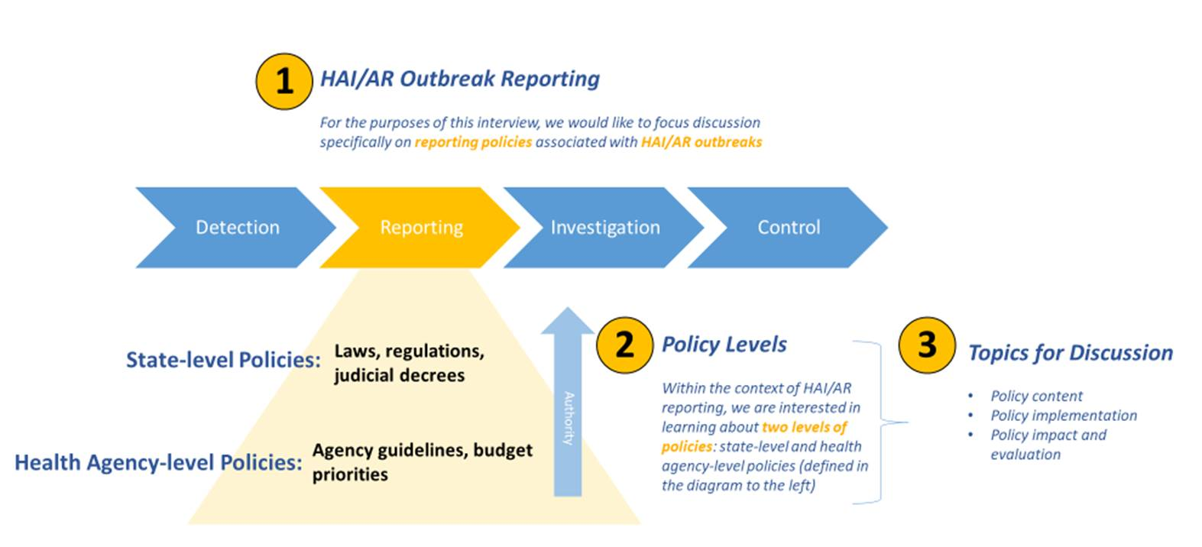
ASTHO-led Evaluation of State HAI/AR Outbreak Reporting Policies and Practices
Notes:
ASTHO explore the nature of your state’s healthcare-associated infections and antibiotic-resistant pathogen outbreak reporting policy(ies) and build upon the HAI/AR outbreak response capacities assessment that your state health department participated in as part of the ICAR program

Slide 33
Legal Scan of HAI Outbreak Reporting Laws
HAI outbreak reporting requirements differ by state, and reporting HAI outbreaks to PH influenced by state statutes, administrative codes, and internal HD policies.
From 2017 to 2018, a Policy Analyst from CDC’s Division of Healthcare Quality Promotion conducted a legal scan on state laws requiring outbreak reporting from healthcare facilities to state and local health departments.
Reporting requirements that used similar terms to outbreak such as “cluster,” “epidemic,” and “unusual occurrence” were also included.
Most states have a requirement in their disease reporting regulations to report outbreaks
  Most states have a very broad requirement, like Oklahoma:
    Why its broad- you can see, “outbreak” isn’t defined
  Some states make it clear that HAI outbreaks are required to be reported
    Tennessee, Nebraska
    North Dakota: 42. Nosocomial outbreaks in institutions.
  Some states define what an “outbreak” or “cluster” is- giving the facilities guidance on reporting

Slide 34
Guiding Principles for HAI Outbreak Notification and Disclosure-COHRA Policy Workgroup
Notification of harm
Duty to warn
Assessment of risk
Need to know
Good epidemiology
Timeliness
Risk benefit
Decisions based on science and when science is lacking, expert opinion and judgment
Notification and disclosure are not punitive

Slide 35
Other Considerations in Developing Guidance
Notification versus disclosure:
  Notification: informing patients and providers who are or may be affected
  Disclosure: informing the public more broadly
Engage hospitals in the process
Importance of education with both notification and disclosure (patients, public, press)
Be comfortable considering ethical issues

Slide 36
Guiding Principles: Immediate and Expanded Notification, and Public Disclosure of HAI Outbreaks
Who to Notify
When to Notify
How to Notify
What to Notify
Why to Notify or Justification
Who has been infected
Who has been exposed
Who has been potentially exposed
Who is at risk for future exposure
*HAI outbreak notification and disclosure is not punitive

Slide 37
Where are we in the process
Framework for Immediate Notification close to complete
Framework for Expanded Notification in process
Framework for public disclosure-being developed
Involving ethicists and journalists-in the near future
Obtaining your input today and in the coming weeks

Slide 38
CORHA – Summary
  The Council is evolving and aims to provide a practical forum for the healthcare community, consumers, public health authorities, and professional associations to address the challenges of HAI/AR outbreak response
  Largely dependent on in-kind contributions (thanks)
  Engage with us:
    Website: www.corha.org
    SHEA and other CORHA Member Organizations can provide path to workgroup participation
Notes:
Are we ready for the website to be launched publicly?

Slide 39

Thank You
The findings and conclusions in this report are those of the authors and do not necessarily represent the official position of the Centers for Disease Control and Prevention.

Slide 40
Disclosure of Commercial Entities
“CDC has a long-standing practice of regularly disclosing names
of commercial entities implicated in infectious disease outbreaks
in order to protect public health. These disclosures have helped
the public reduce their health risks and have helped commercial
entities improve the safety of their practices and products. As
each situation is unique, it is important that CDC programs
evaluate whether to identify an implicated entity on a case-by-
case basis working in partnership with affected states and other
partners.”
Notes:
Parking lot

Slide 41
CORHA Product Offerings
  Suite of condition- or event-specific reference tools
  Threshold for reporting and investigation
  Suggestions on how to improve reporting
  Suggestions on how to improve the use of existing surveillance data for detection
  Tools for investigation
  Suggestions for standardized control measures
Completed prototype for Scabies
Other examples in pipeline include C. auris, CRE, CDI, NTM
Notes:
Parking lot

