Slide 1

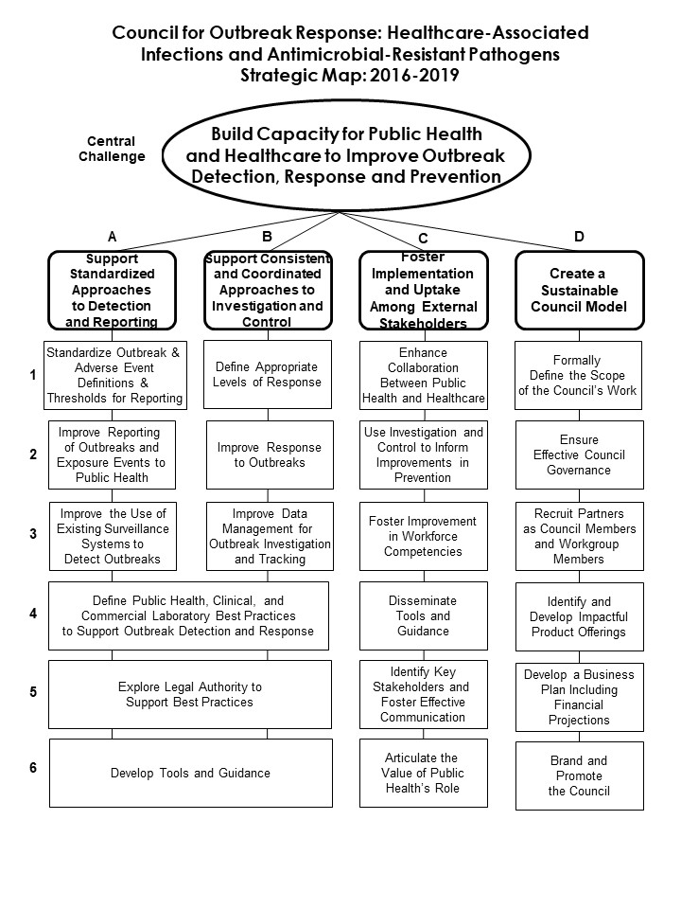
Council for Outbreak Response: Healthcare-Associated Infections and Antimicrobial Resistant Pathogens (CORHA) Progress and Updates
Marion A. Kainer, MD, MPH¹, Joseph F. Perz, DrPH, MA², Gerd Clabaugh, MPA³, Dawn Terashita, MD MPH⁴
¹Tennessee Department of Health, ²Centers for Disease Control and Prevention, ³Iowa Department of Public Health, ⁴Los Angeles County Department of Public Health
Background
CORHA Results from Progress
Future Directions
Healthcare-Associated Infections (HAI) and Antimicrobial Resistant (AR) pathogens can lead to preventable mortality in patients each year. Despite significant progress, patients continue to experience infections due to outbreaks and adverse events stemming from delayed recognition of emerging infectious diseases with potential for transmission, unsafe practices, contaminated drugs, and medical device risks. Coordinated approaches are needed to catalyze detection of new threats, develop tools to support investigation, stop outbreaks from spreading, and better inform prevention activities.
CORHA High-Level Guidance – will highlight best-practices and comprehensive reference for HAI/AR outbreak detection, investigation, lab, policy, and performance indicators, applicable to settings across public health and the healthcare continuum.
Continue to expand healthcare partner and other stakeholder engagement including representation on the Council’s work groups.
Routinely evaluate and update developed guidance.
Populate CORHA’s Resource Clearinghouse with meaningful resources and tools for HAI/AR outbreak detection, investigation, control and prevention.
Outbreak Detection and Reporting Workgroup
Outbreak Investigation and Control Workgroup
Create standard definitions for outbreaks and exposure events and thresholds for reporting
Improve reporting of outbreaks and exposure events to public health
Improve the use of existing surveillance systems to detect outbreaks
Define appropriate levels of response
Improve response to investigation and control of outbreaks to public health
Improve data management for outbreak investigation and tracking
Methods
HAI/AR Outbreak Investigation Guidance
Completed | Anticipated
HAI/AR Outbreak Tracking System and Data Dictionary | Candida auris
Medical Product-Related Outbreak Investigation Assessment | Clostridium difficile
 | Carbapenem-resistant Enterobacteriaceae
CORHA, a coalition of public health and healthcare organizations with bearings to HAI/AR outbreak prevention and control, is funded by CDC’s Division of Healthcare Quality Promotion (DHQP) and co-led by the Association of State and Territorial Health Officials (ASTHO) and the Council of State and Territorial Epidemiologists (CSTE). CORHA convenes Workgroups with CORHA membership and CDC subject-matter experts to develop, identify and promote tools and resources for HAI/AR outbreak detection, investigation, prevention and control.
Reporting Thresholds and Proposed HAI/AR Outbreak Definitions
Completed | Anticipated
Scabies | Candida auris
Nontuberculous mycobacteria | Clostridium difficile
Carbapenem-resistant Enterobacteriaceae
Connect with CORHA
The CORHA website features additional information on CORHA and hosts the CORHA Resource Clearinghouse CORHA: www.CORHA.org.
The CORHA Insider newsletter highlights timely and relevant news and resources on HAI/AR outbreaks. Subscribe to the newsletter at www.CORHA.org.
Email info@CORHA.org with questions or comments.
Laboratory Workgroup
Policy Workgroup
Contribute knowledge and support activities to optimize laboratory practices in support of identifying and investigating possible HAI/AR outbreaks
Support effective interactions among laboratory partners and between laboratories, healthcare facilities, and state/local health departments in the context of HAI/AR response activities
Improve policy and legal standards for reporting, investigation, notification, and disclosure of HAI/AR outbreaks and exposure events
HAI/AR Outbreak Policy Guidance
Anticipated
Guiding Principles for HAI/AR Outbreak Reporting, Notification and Disclosure
Acknowledgments
Centers for Disease Control and Prevention for funding and subject matter expertise to support CORHA, CSTE and ASTHO.
CORHA membership organizations that support the development, review and dissemination of CORHA products, resources.
ASTHO and CSTE for their continued staff and member support for CORHA as council co-chairs.
Notes:
- There is likely overlap from respondents. Thus, for a particular jurisdiction, it could be represented more than once. We could consider breaking it up by state/jurisdiction to avoid duplication of reported status.

