Slide 1


Council for Outbreak Response:
Healthcare-Associated Infections
Antimicrobial-Resistant Pathogens
Winter 2024 New Member Orientation
Will Fritch, MPH
Senior Program Analyst, CSTE
CORHA Support Staff
Date of Presentation

Slide 2

Orientation Outline
High-level Overview
Organization & Structure
Strategic Map & Activities
Resources
Looking Forward

Slide 3
What is CORHA?
A collaboration of 9 member organizations working to improve HAI/AR outbreak detection, investigation, control and prevention.
CORHA operates at the intersection of public health and healthcare
CORHA is not a federal advisory committee
High-level Overview
Organization & Structure
Looking Forward
Strategic Map & Activities
Resources

Slide 4
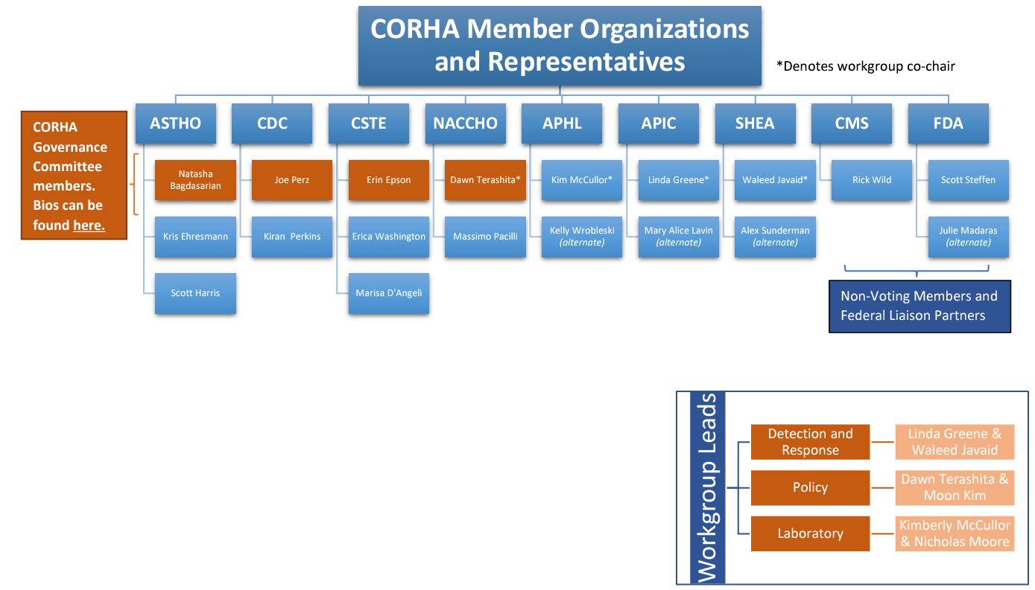


Slide 5
Membership Categories
Voting Members
Non-voting Federal Liaisons
Non-voting Workgroup Members
High-level Overview
Organization & Structure
Looking Forward
Strategic Map & Activities
Resources

Slide 6
Governance Committee
Natasha Bagdasarian, MD, MPH
Association of State and Territorial Health Officials (ASTHO) Representative
Co-chair
Erin Epson, MD,
Council of State and Territorial Epidemiologists (CSTE) Representative
Co-chair
Dawn Terashita, MD, MPH
National Association of County and City Health Officials (NACCHO) Representative
Joseph Perz, DrPH, MA
Centers for Disease Control and Prevention (CDC) Representative
High-level Overview
Organization & Structure
Looking Forward
Strategic Map & Activities
Resources

Slide 7
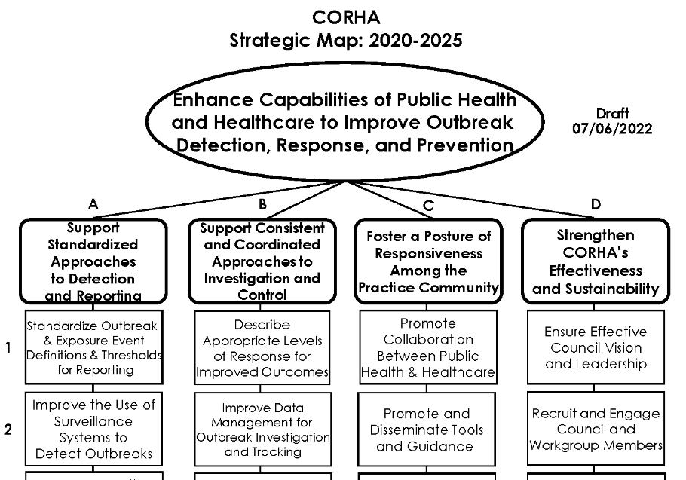

Slide 8
CORHA Workgroups
Detection and Response Workgroup
Laboratory Workgroup
Policy Workgroup
High-level Overview
Organization & Structure
Looking Forward
Strategic Map & Activities
Resources

Slide 9
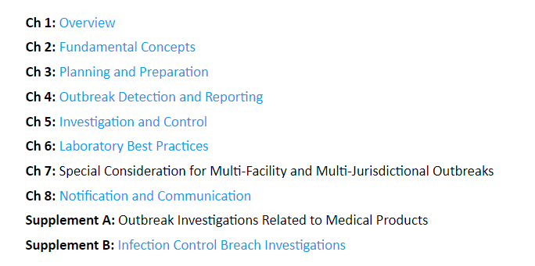
CORHA Principles and Practices for Healthcare Outbreak Response
High-level Overview
Organization & Structure
Looking Forward
Strategic Map & Activities
Resources

Slide 10


Detection and Response Workgroup
Co-Leads
Highlighted workgroup output:
Principles and Practices for Healthcare Outbreak Response (P&P) – multiple chapters
Standalone CORHA products (e.g., C. auris, COVID-19 reporting thresholds)
Pathogen- and setting-specific resource pages (e.g., dialysis settings, water-associated organisms)
Linda Greene, RN, MPS, CIC, FAPIC
Infection Prevention Consultant
Waleed Javaid, MD, FACP, FIDSA, FSHEA
Hospital Epidemiologist
Mount Sinai
High-level Overview
Organization & Structure
Looking Forward
Strategic Map & Activities
Resources

Slide 11


Laboratory Workgroup
Co-Leads
Highlighted workgroup output:
Principles and Practices for Healthcare Outbreak Response (P&P) – Chapter 6: Laboratory Best Practices
Additional laboratory resources – e.g., Guide to interpreting genotypic and phenotypic test results
Kimberly McCullor, PhD, MSc
Microbiology Section Manager
MI DHHS
Nicholas Moore, PhD, D(ABBM), MLS(ASCP)CM
Associate Director of Clinical Microbiology
Rush University Medical Center
High-level Overview
Organization & Structure
Looking Forward
Strategic Map & Activities
Resources

Slide 12

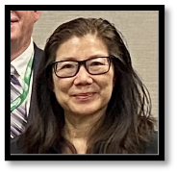
Policy Workgroup
Co-Leads
Highlighted workgroup output:
Principles and Practices for Healthcare Outbreak Response (P&P) – Chapter 8: Notification and Communication
Framework for HAI Outbreak Notification
Ongoing projects re: electronic health information access and public health data sharing
Dawn Terashita, MD, MPH, FACPM
Assoc. Dir. of Acute Communicable Diseases
LA County DPH
Moon Kim, MD, MPH
Medical Epidemiologist
LA County DPH
High-level Overview
Organization & Structure
Looking Forward
Strategic Map & Activities
Resources

Slide 13
Communications Task Force
Membership:
Led by NACCHO
CDC staff
CORHA support staff from NACCHO, ASTHO, CSTE
CORHA GC liaison representative
Output and Priorities:
CORHA Correspondence newsletter
CORHA Spotlight Series
Website Redesign
High-level Overview
Organization & Structure
Looking Forward
Strategic Map & Activities
Resources

Slide 14
Platforms & Software Solutions
File Management:
Basecamp
OneDrive/SharePoint
Teams
CSTE Connect
  Potential future resource/Basecamp alternative
Communications:
CORHA Website
CORHA Correspondence - Public facing. Sign up here.
CORHA Insider – email updates prepared by ASTHO and disseminated to CORHA members only.
High-level Overview
Organization & Structure
Looking Forward
Strategic Map & Activities
Resources

Slide 15
Notable Documents
Bylaws and Operating Guidance (CORHA Website)
Roster (Basecamp)
Strategic Map (CORHA Website)
Workgroup to Publication Process (Basecamp)
Meeting Materials (Basecamp)
CORHA Insider
High-level Overview
Organization & Structure
Looking Forward
Strategic Map & Activities
Resources

Slide 16
Support Staff & Leadership
Member Organization Staff
CORHA Leadership
The support staff from CORHA’s member organizations are here to support you as a new member, from answering one-off questions to fully understanding and growing into your role on CORHA.
Workgroup Co-Leads and CORHA Governance Committee members can offer both historical knowledge of CORHA’s work and invaluable feedback on current and planned activities.
High-level Overview
Organization & Structure
Looking Forward
Strategic Map & Activities
Resources

Slide 17
Next Steps for CORHA
Revisiting CORHA’s strategic map, currently active through 2025
  Continuing to identify ways to leverage CORHA’s unique position at the intersection of public health and healthcare to provide even more valuable resources to stakeholders.
New CORHA website in 2024
High-level Overview
Organization & Structure
Looking Forward
Strategic Map & Activities
Resources

Slide 18


Thank you!
Council for Outbreak Response:
Healthcare-Associated Infections
Antimicrobial-Resistant Pathogens
[Presenter name]
[Presenter email]

