Slide 1

Council for Outbreak Response:
Healthcare-Associated Infections
Antibiotic-Resistant Pathogens
Past, Present, and Future
“A little tour”

Slide 2

Background
CORHA was envisioned to meet a specific need:
To identify & develop consistent and coordinated approaches to:
  Speed up detection of HAI/AR outbreaks across the healthcare continuum including emerging infections.
  Develop tools to improve outbreak investigation.
  Contain outbreaks and prevent the spread of HAI/AR pathogens.
  Inform prevention activities.

Slide 3
Council for Outbreak Response:
Healthcare-Associated Infections & Antibiotic-Resistant Pathogens
(CORHA)
To improve practices and policies at the local, state and national levels for detection, investigation, control and prevention of HAI/AR outbreaks across the healthcare continuum, including emerging infections and other risks with potential for healthcare transmission.
Mission
Vision
Public health and healthcare collaborating effectively to protect patients and prevent harms from HAI/AR outbreaks.

Slide 4
CORHA Structure
ASTHO
Gerd Clabaugh, Iowa
CSTE
Marion Kainer, Tennessee
Co-chairs
Governance Committee
CDC
Joe Perz,
DHQP
NACCHO
Dawn Terashita, Los Angeles County
ASTHO
Nirav Shah, Illinois (beginning in 2018)
Joseph Miner, Utah
CDC
Elizabeth Mothershed, DHQP
CSTE
Wendy Bamberg, Colorado
Erin Epson, California
NACCHO
Sri Seshadri, Barren River District
Council
FDA
APIC
Linda Greene
CMS
Patti Meier
FDA
Julia Marders
SHEA
Waleed Javaid
Notes:
Should this be a stacked venn?

Slide 5
CORHA Roles and Responsibilities
Comprised of one member from each of 4 founding organizations
Suggest, vet, and approve additional member organizations to be voted upon by CORHA
Governance Committee
Council Members
Voting members as described in bylaws
Review and approve any product created by CORHA
Provide feedback on CORHA initiatives
May participate in and/or lead workgroups
Workgroups
Comprised of Council and non-Council members; Ad hoc members and SMEs
Convene regularly to develop products that address the strategic objectives and workgroup charges
Present products to CORHA (the Full Council) for vote and approval

Slide 6
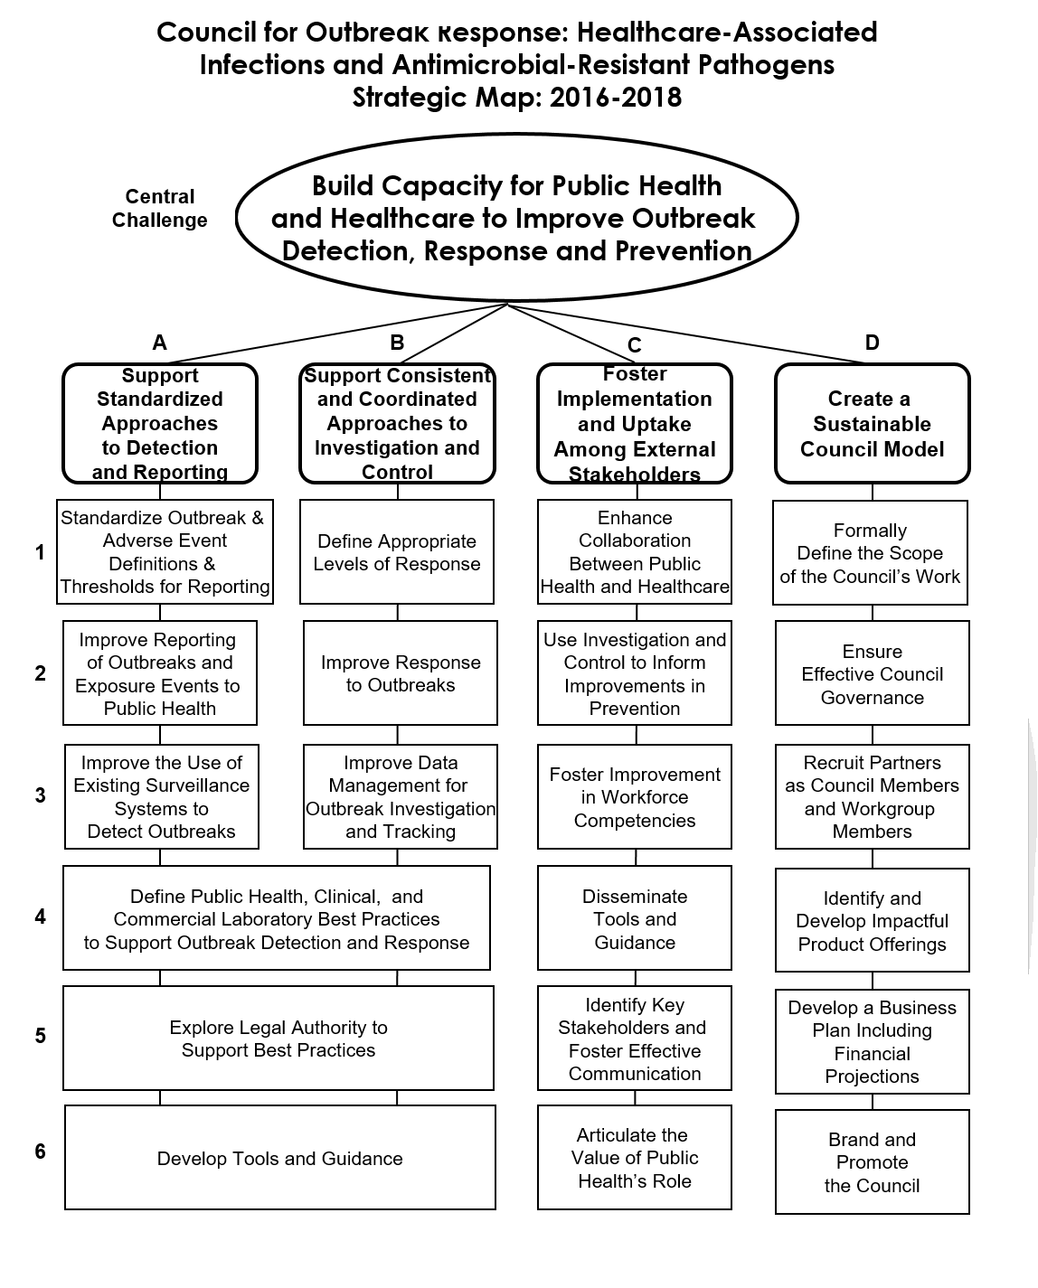

Slide 7
Key Accomplishments: Past and Present
Year 1
Year 2
Year 3
Developed:
Strategic Map and Priorities
Mission
Vision
Established Membership and Bylaws
Created Workgroups A and B
Identified priority pathogens
CORHA Marketing & Communications
Developed logo and website
Expanded membership
Workgroups:
Developed charges
Launched product development
Refined CORHA website content and launch
Workgroups:
Present workgroup products for vote
Release high-level outbreak guidance
2015-2016
2016-2017
2017-2018

Slide 8
CORHA Product Offerings
  High-level outputs related to strategic objectives
  E.g., Best practices for improve detection of potential outbreaks using existing data sources
  E.g., Laboratory best practices to support outbreak detection and investigations
  E.g., Suggestions for improving data management for outbreak investigation and response activity tracking
  Suite of event-specific reference tools
  Threshold for reporting and investigation
  Suggestions on how to improve reporting
  Suggestions on how to improve the use of existing surveillance data for detection
  Tools for investigation
  Suggestions for standardized control measures

Slide 9
CORHA Products and Resources: Present
Modeled after CIFOR’s Investigation of Clusters and Outbreaks Guidance
High-level outbreak guidance
CORHA products
pathogen definitions, thresholds for investigation, response tracking system, others as needed
External resources
materials from state and local health departments, academic partners, public health leaders
“Home” for CORHA-developed products, external resources vetted by experts, and high-level guidance
Developed and reviewed by Workgroups with input from SMEs
CORHA website
Collected and reviewed by Workgroups; selected external resources referenced in CORHA products

Slide 10
How it All Fits Together: Future
The CORHA website will serve as our external communications mechanism and the “home” for CORHA.
The high-level outbreak guidance will:
  Contribute to the scientific literature on how to investigate an HAI or AR outbreak and reinforce CORHA’s brand as a leader in outbreak investigation and control.
CORHA products will:
  Provide guidance re: pathogen- and setting-specific outbreak detection, response, investigation, and control. Products will be developed by representatives from PH and healthcare with subject matter expertise. Products will include links to high-quality resources from state/local public health and the PH and medical literature.
External resources will:
  Inform the development of CORHA products. The resources deemed to have the highest value for our consumers will be housed on the CORHA website.
High level guidance
CORHA Products
External Resources
CORHA Website
Notes:
Each circle is a standalone CORHA deliverable, but together they make the complete picture of what CORHA has to offer.

Slide 11
Discussion

