Slide 1

CORHA Communication & Marketing Plan
Summer-Fall 2017

Slide 2
Contents
Purpose and Objectives
CORHA Comm. Workgroup Staff Support Needs
Timeline and Deliverables
CORHA Product Clearance and Approval Process
CORHA Website Phases 1 and 2
Communication Style Guide (Attachment)
CORHA Talking Points (Pending)

Slide 3
Purpose and Objectives
The purpose of this communication plan is to achieve consistency in all CORHA communication and marketing products and activities. A cohesive communications package will solidify COHRA’s brand and ultimately help to achieve its mission and vision.

Slide 4

CORHA Comm. Workgroup Staff Support Needs
Identify specific tasks and goals you anticipate needing ASTHO/CSTE staff support to accomplish workgroup deliverables:
    Develop talking points
    CORHA website build out of additional pages
    Website Rollout
    Participate in workgroup calls
    Manage dedicated CORHA Email box
    Maintain subscription list
    Maintain key partner lists
Estimate the number of staff hours you expect will be needed to accomplish each of the task(s):
    Develop talking points (4 hours)
    CORHA website build out of additional pages (need input from a web developer)
    Website Rollout (10 hours)
    Participate in workgroup calls (1 hour a month ongoing)
    Manage dedicated CORHA Email box (1 hour per week depending on volume ongoing)
    Maintain subscription list (1 hour per week depending on volume ongoing)
    Maintain key partner lists (1 hour per week depending on volume ongoing)

Slide 5

Timeline & Deliverables
Activity | Deadline
Clearance/Approval Process Finalized | July 5, 2017
Phase 1 of Website to be completed (Enhancement) | July 14, 2017
Communications Style Guide Finalized | July 31, 2017
Phase 2 of Website to be completed (Additional Pages and Products) | July 31, 2017
Rollout of Website | August 7, 2017
Phase 3 of Website to be completed (Additional Pages & Products) | August 15, 2017
Talking Points | TBD

Slide 6

CORHA Product Clearance and Approval Process
CORHA-branded Workgroup Product:
  Review by Governance Committee; vote for approval by Full Council. To allow for prompt approval, consider voting via e-mail, and at quarterly meetings when schedules allow. If the Full Council does not approve a Workgroup product, Workgroup chairs will be responsible for addressing any concerns and presenting the documents again for a vote. Survey findings will require full Council review and approval, while survey documents will not. The Council however, should be aware of any CORHA-branded products or documents that are distributed.
CORHA Clearinghouse Resources:
  Materials from state/local health departments, including links to resources—review by Workgroup members considered sufficient; no need for Governance Committee or CORHA vote.
  Materials intended for the CORHA clearinghouse and developed by CORHA workgroups to follow process above.
Administrative Support Documents (letterhead, PowerPoint templates, etc.):
  Vote for approval by the Governance Committee.
Website Updates (fixing broken links, aesthetics, news, etc):
  No review necessary, staff to provide high-level overview on monthly Governance Committee calls for awareness.
  For changes that result in substantive changes to permanent content such as the “About Us” section of the website, Governance Committee should be made aware of the proposed changes, and be asked to review and approve such changes. This can occur during monthly Governance Committee calls or via e-mail if changes must be made quickly.
  CORHA bylaws language: CORHA (the Full Council) will vote on decisions including, but not limited to, the addition of Member Organizations, the creation of workgroups, and approval of workgroup products. A decision must be approved by at least two-thirds of the voting Member Representatives, each of which may cast one vote. If needed, voting may be delayed for representatives to consult with the organizations they represent for further discussion.

Slide 7
CORHA Website Phase 1
Enhancing the look of the website

Slide 8
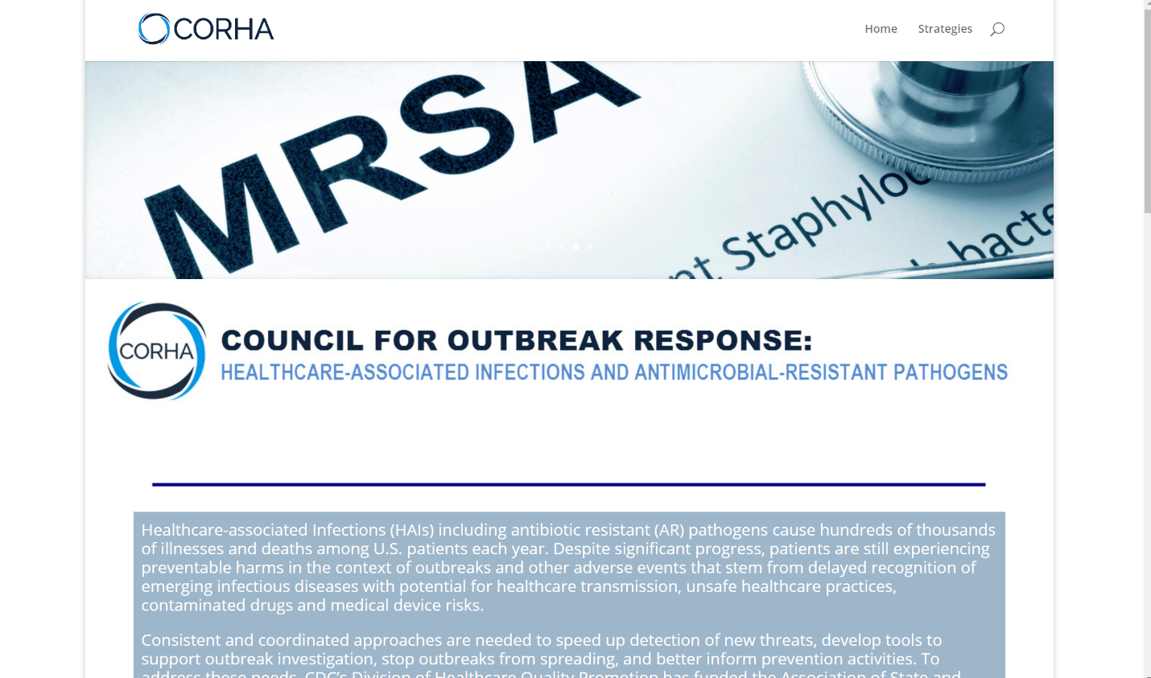
Replace the logo on the top left, with the elaborate logo (that spells out the CORHA acronym).
Decrease the white spacing between sections.
Change antibiotic to antimicrobial.
Change the blue background to match the light blue color in the CORHA logo.
(Color model: RGB; Red: 0; Green 153; Blue 255) <- This is can be customized to match the logo as much as much possible.

Slide 9
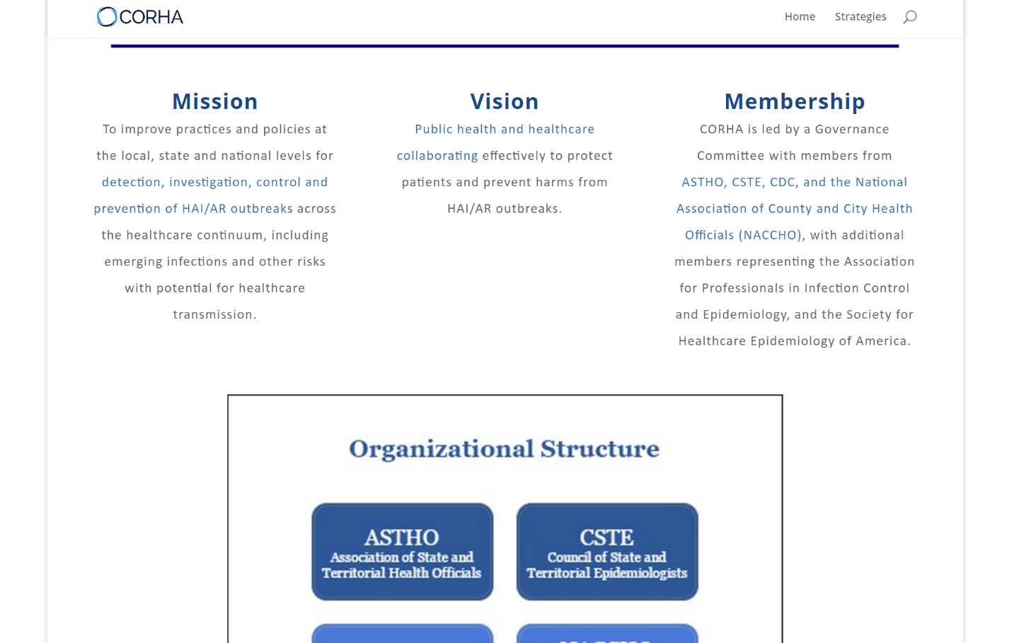
Please align the text under “Mission, Vision and Membership” to the left.
Change the light blue font color in the body, so it doesn’t appear as a hyperlink.

Slide 10
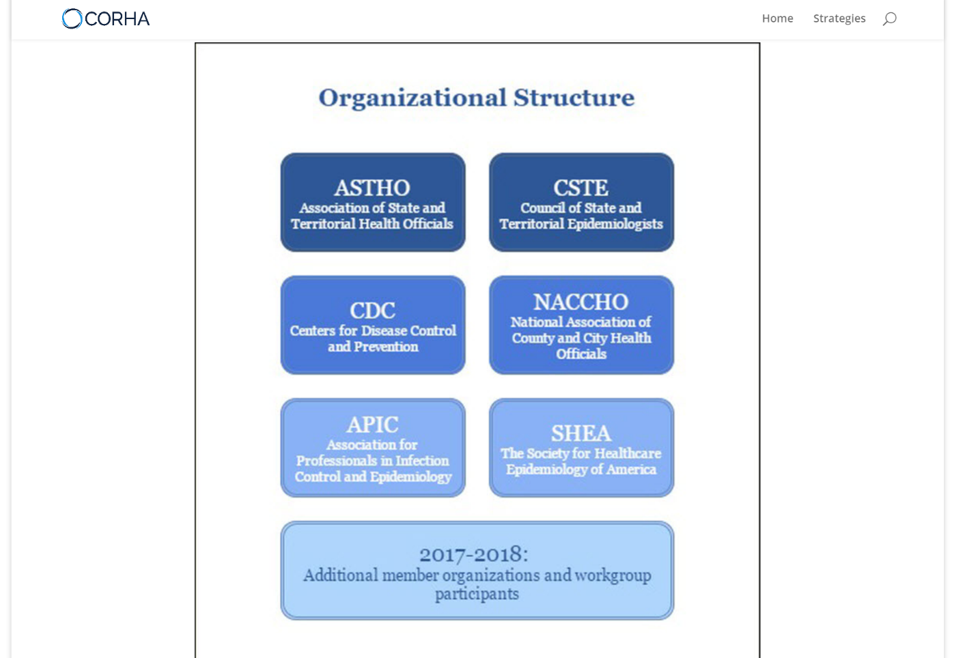
Is it possible to just list each organization’s logo horizontally, right underneath the slider images?
If not, please include hyperlinks to the organizations’ websites and remove the black border.

Slide 11
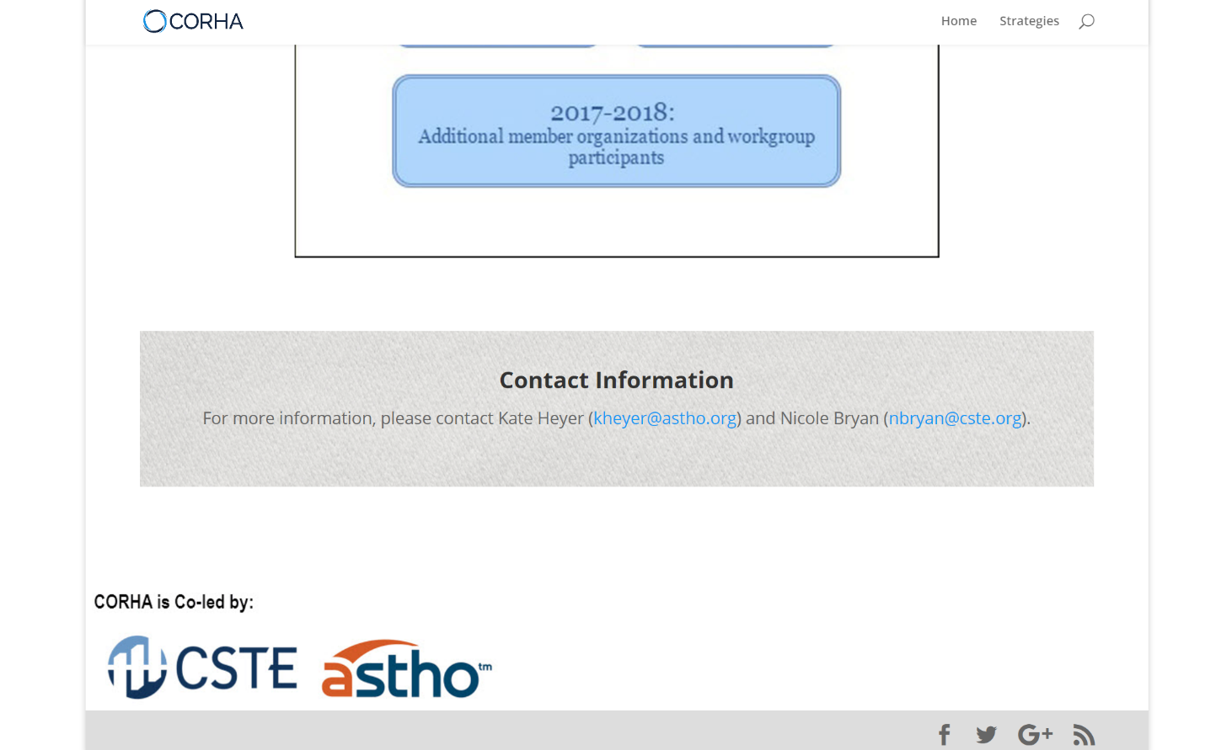
Decrease white spacing.
Center both logos.

Slide 12
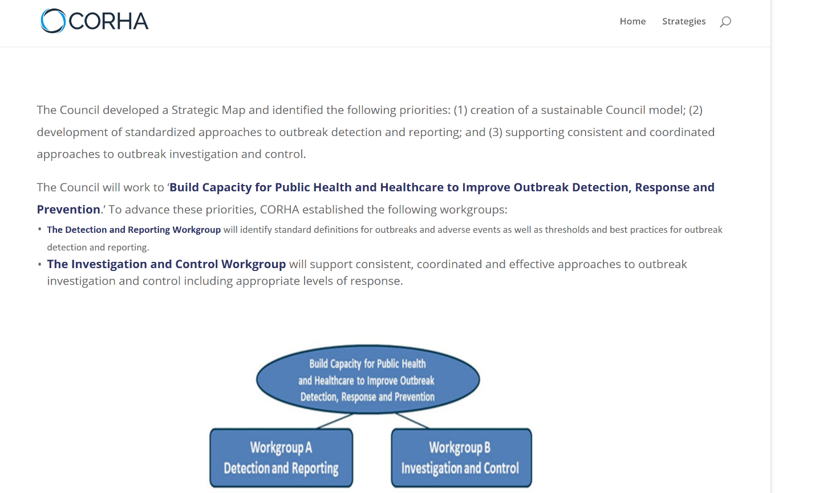
Rename “Strategies’ to Strategic Map.
Please use the same font size and color for the entire body of the text.
Please use a less blurry image of the chart.

Slide 13
CORHA Website Phase 2
Adding pages and products to the website

Slide 14
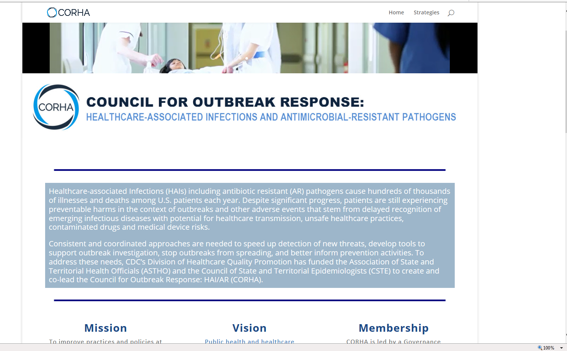

Add buttons for Resources, About Us, and Contact Us
Position/reduce this box to make space for the “connect with CORHA” subscription box
Connect with CORHA
Sign up to receive CORHA updates, tools and resources.
When people click on the graphic it should take them to another page where they can sign up to become part of our subscription list

Slide 15
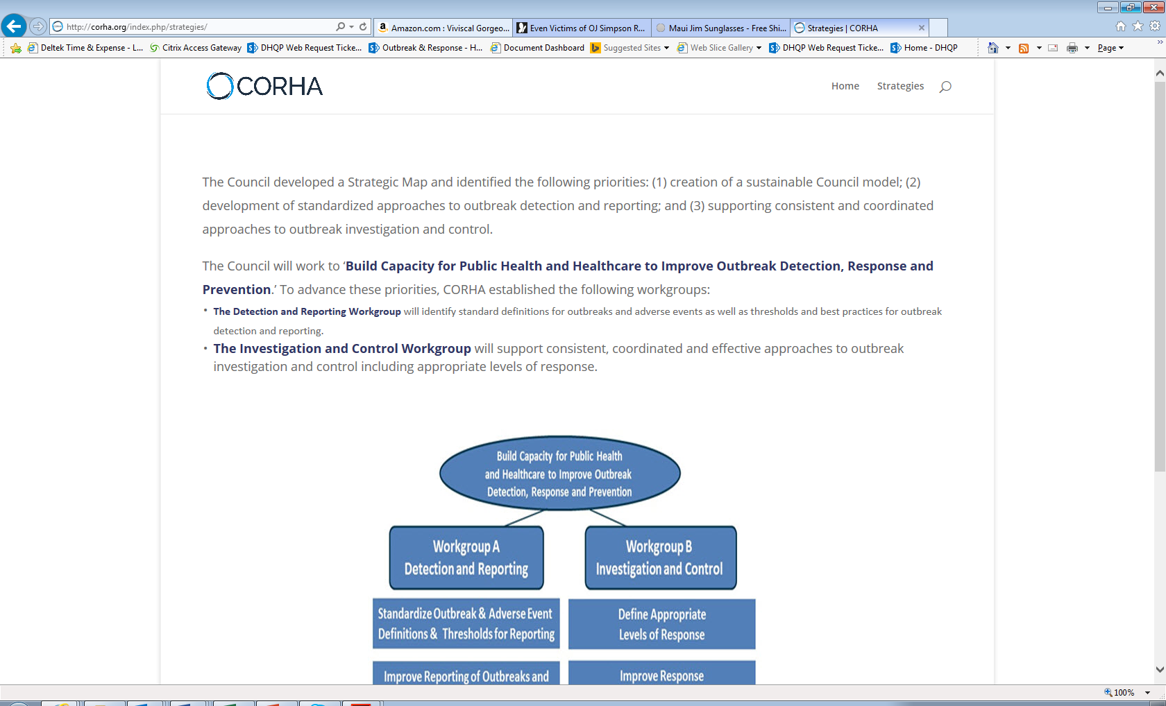
Add this wording
Add buttons for Resources, About Us, and Contact Us
COUNCIL FOR OUTBREAK RESPONSE:
HEALTHCARE-ASSOCIATED INFECTIONS AND ANTIBIOTIC-RESISTANT PATHOGENS
This page will remain hidden from public view until there are work products to post
Tools/Workgroup Products

Slide 16
Add this wording
Add buttons for Resources, About Us, and Contact Us
COUNCIL FOR OUTBREAK RESPONSE:
HEALTHCARE-ASSOCIATED INFECTIONS AND ANTIBIOTIC-RESISTANT PATHOGENS
Resources
CDC/SHEA Outbreak Response Training Program (ORTP) (Link: http://ortp.shea-online.org/)
Upcoming Webinar: Beating the Media Crush (Link: http://ortp.shea-online.org/webinars/webinar-beating-the-media-crush/)
Recorded Webinar: Conflict Management (Link: http://ortp.shea-online.org/webinars/webinar-conflict-management/)
Recorded Webinar: Communicating During a Crisis (Link: http://ortp.shea-online.org/webinars/webinar-communicating-during-a-crisis/)

Slide 17
Add this wording
Add buttons for Resources, About Us, and Contact Us
COUNCIL FOR OUTBREAK RESPONSE:
HEALTHCARE-ASSOCIATED INFECTIONS AND ANTIBIOTIC-RESISTANT PATHOGENS
About Us
The Council for Outbreak Response: Healthcare Associated Infections and Antimicrobial Resistance (CORHA) is composed of several interacting components: The Governance committee, Additional Member Organizations, Federal Liaison Member Organizations, and Workgroups. Together, these entities constitute the Full Cou8nicl which functions as the main body of CORHA. The Governance committee functions as the leadership for CORHA, providing guidance and advocacy.
CORHA Governance Committee Member Representatives
Gerd Clabaugh, MPA
Director at the Iowa Department of Public Health
Organizational Affiliation: ASTHO
Marion Kainer, MD, MPH, FRACP, FSHEA
Director of HAIs and AMR program at the TN Department of Health
Organizational Affiliation: CSTE
Dawn Terashita, MD, MPH
Medical Epidemiologist at the LA County Department of Public Health
Organizational Affiliation: NACCHO
Joseph Perz, DrPH, MA
Quality Standards and Safety Team Lead at the CDC
Organizational Affiliation: CDC
add photos and web links
Link name to: http://www.astho.org/Directory/Member-Bios/Iowa/
Link Name to: https://www.healthlawyers.org/Events/Biographies/Pages/KainerMarion.aspx
Link name to: https://www.passporthealthusa.com/locations/ca/los-angeles/executive-team/
Link name to: https://www.cdc.gov/media/releases/2012/docs/dpk-unsafe-injections-Perz-bio.pdf

Slide 18
Add this wording
Add buttons for Resources, About Us, and Contact Us
COUNCIL FOR OUTBREAK RESPONSE:
HEALTHCARE-ASSOCIATED INFECTIONS AND ANTIBIOTIC-RESISTANT PATHOGENS
Subscription page
Connect with CORHA
Sign up to receive CORHA updates, tools and resources
First Name
Last Name
Organization
Email Address

Slide 19

Communication Style Guide
(Attached)

Slide 20

CORHA Talking Points
(Pending)

