Slide 1

Past, Present, and Future
“A little tour”

Slide 2
CORHA was envisioned to meet a specific need:
To identify or develop consistent and coordinated approaches to:
  Speed up detection of new threats
  Develop tools to improve outbreak investigation
  Stop pathogens/outbreaks from spreading
  Inform prevention activities

Slide 3
Council for Outbreak Response:
Healthcare-Associated Infections &
Antibiotic-Resistant Pathogens (CORHA)
To improve practices and policies at the local, state and national levels for detection, investigation, control and prevention of HAI/AR outbreaks across the healthcare continuum, including emerging infections and other risks with potential for healthcare transmission.
Mission
Vision
Public health and healthcare collaborating effectively to protect patients and prevent harms from HAI/AR outbreaks.

Slide 4
ASTHO
Gerd Clabaugh, Iowa
CSTE
Marion Kainer, Tennessee
Co-chairs
Governance Committee
CDC
Joe Perz, DHQP
NACCHO
Dawn Terashita, Los Angeles County
ASTHO
Nirav Shah, Illinois (beginning in 2018)
Joseph Miner, Utah
CDC
Elizabeth Mothershed, DHQP
CSTE
Wendy Bamberg, Colorado
Erin Epson, California
NACCHO
Sri Seshadri, Barren River District
FDA
APIC
Linda Greene
CMS
FDA
Julia Marders
SHEA
Waleed Javaid

Slide 5
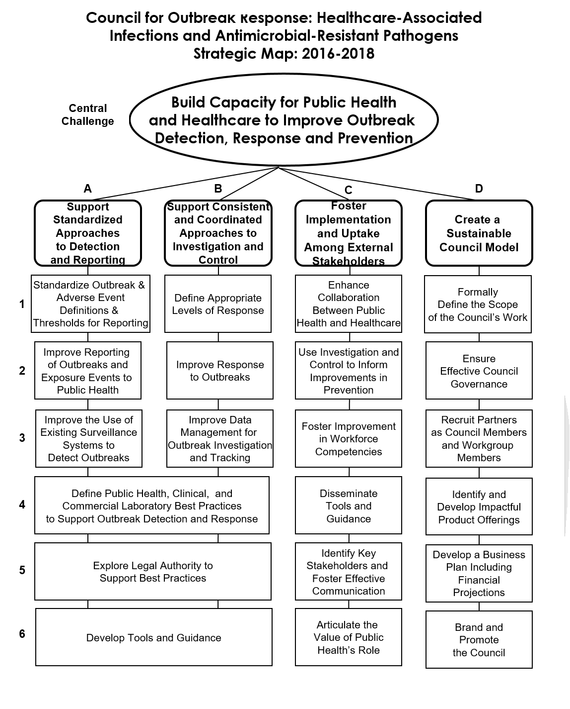

Slide 6
Key Accomplishments
-Developed Strategic map
-Set CORHA priorities
-Established Membership
-Identified priority pathogens
-Developed workgroup charges; launched CORHA product development
-Expanded CORHA membership
-Refined CORHA website content
-Presented 1st workgroup products for vote
-Released first draft of high-level outbreak guidance

Slide 7
CORHA Products and Resources
Modeled after CIFOR’s Investigation of Clusters and outbreaks guidance
High-level outbreak guidance
CORHA products
-pathogen definitions, thresholds for investigation, others as needed
External resources
-materials from state and local health departments, academic partners, public health leaders
Based on CIFOR’s Investigation of clusters and outbreaks guidance
“Home” for CORHA-developed products and external resources vetted by experts
CORHA website
Developed and reviewed by Workgroups with input from SMEs
Collected and reviewed by Workgroups; selected external resources referenced in CORHA products

Slide 8
“How it All Fits Together”
The CORHA website will serve as our external communications mechanism and the “home” for CORHA.
The high-level outbreak guidance will:
  Contribute to the scientific literature on how to investigate an HAI or AMR outbreak and reinforce CORHA’s brand as a leader in outbreak investigation and control.
CORHA products will:
  Provide guidance re: pathogen- and setting-specific detection, response investigation, and control. Products will be developed by representatives from PH and healthcare with subject matter expertise. Products will include links to high-quality resources rom state/local public health and the PH and medical literature.
External resources will:
  Inform the development of CORHA products and the resources deemed to have the highest value for our consumers will be housed on the CORHA website.

