Slide 1
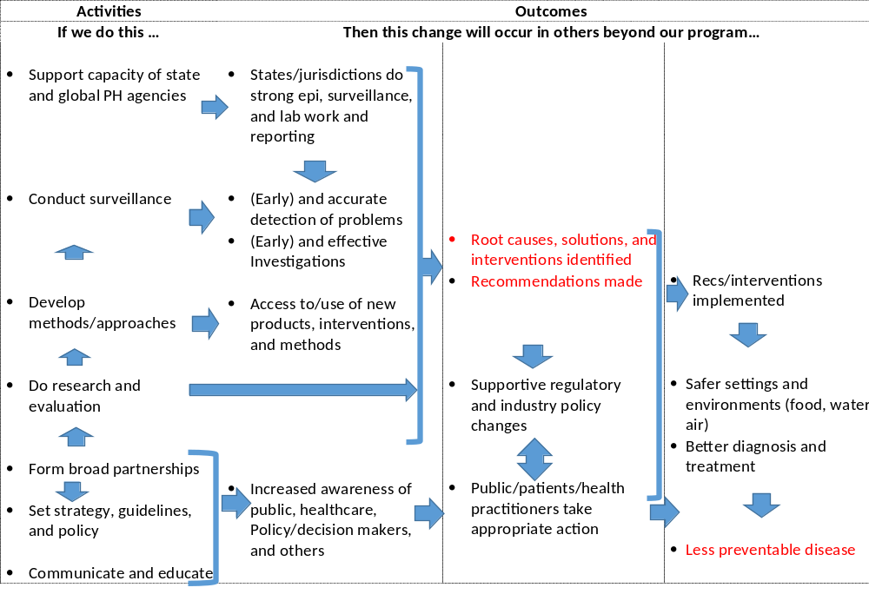
Simplified DFWED Logic Model
Invest more to drive us to the right-hand side of logic model
DFWED focused heavily on left 2 columns

Slide 2
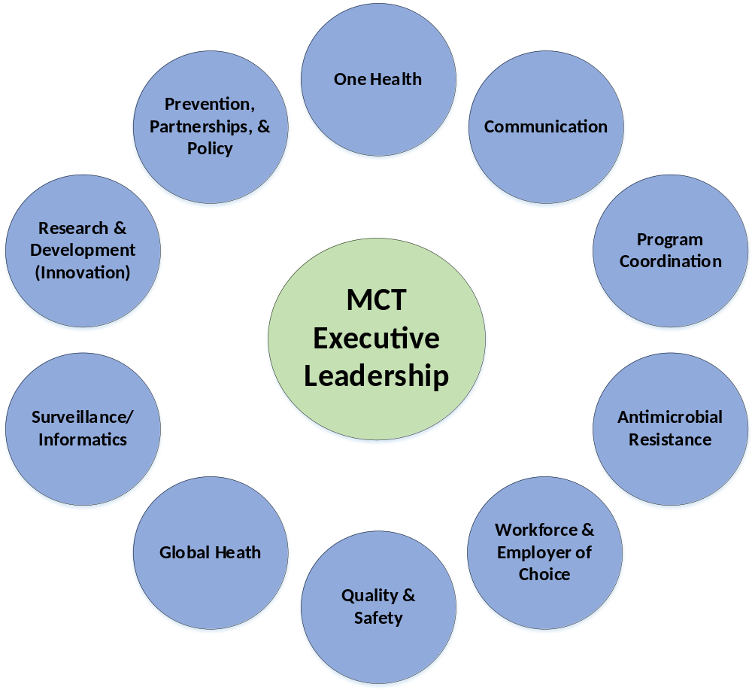
Mission Coordination Team (MCT)
Governance Framework
Chair: Megin Nichols
Chair: AD for Prevention
Chair: AD for Communication
Chair: Division Scientists (rotating)
Chair: AD for Program Support Coordination
Chair: AD for Surveillance
Chair: AD for Antimicrobial Resistance
Chair: AD for Global Health
Chair: Management Officer
* Framework may be modified as implementation plan unfolds.
Chair: Division Safety Officer
7/29/2019

