Slide 1
Screening for Alcohol Consumption in Emergency Departments:
A Nationwide Survey of Emergency Physicians
CSTE Alcohol Subcommittee
CSTE Annual Conference
June 11, 2018

Slide 2
Authors
Laura Tomedi
Anna Buckner
Mary E. Cox
Cameron Crandall
Kacy Crawford
Kari Gloppen
Valerie Goodson
Patrick Hindman
David Sklar
Stephen Uong

Slide 3
Excessive Alcohol Consumption as a Public Health Concern
The 3rd leading cause of preventable death in the US
In 2006-2010, led to approximately 88,000 deaths each year in the US
The economic costs in 2010 were estimated at $249 billion, or $2.05 a drink
9 in 10 people who drink excessively are NOT alcohol dependant
Mokdad AH, JAMA, 2004; Stahre M., Prev Chronic Dis, 2014. Sacks JJ, Am J Prev Med, 2015; Esser MB, Prev Chronic Dis, 2014

Slide 4


What is Excessive Drinking?
4
or more drinks on an occasion for women
Binge Drinking
Heavy Drinking
  ≥ 8 drinks per week for women
  ≥ 15 drinks per week for men
Any alcohol consumption by youth (< 21 years) or pregnant women
5
or more drinks on an occasion for men
www.cdc.gov/alcohol/fact-sheets/alcohol-use.htm

Slide 5
National Recommendations
United States Preventive Services Task Force
  Screen all adults aged 18 years or older for alcohol misuse and provide persons engaged in risky or hazardous drinking with brief behavioral counseling interventions to reduce alcohol misuse (B Recommendation)
The Community Preventive Services Task Force
  Recommends electronic screening and brief intervention to reduce self-reported excessive alcohol consumption and alcohol-related problems
www.uspreventiveservicestaskforce.org/Page/Document/UpdateSummaryFinal/alcohol-misuse-screening-and-behavioral-counseling-interventions-in-primary-care

Slide 6
Screening Tools for Excessive Alcohol Use
Alcohol Use Disorders Identification Test (AUDIT)
Abbreviated AUDIT-C
Single-question screen for binge-level alcohol consumption:
  “How many times in the past year have you had 5 (for men) or 4 (for women and all adults older than 65 years) or more drinks in a day?”
www.uspreventiveservicestaskforce.org/Page/Document/UpdateSummaryFinal/alcohol-misuse-screening-and-behavioral-counseling-interventions-in-primary-care

Slide 7
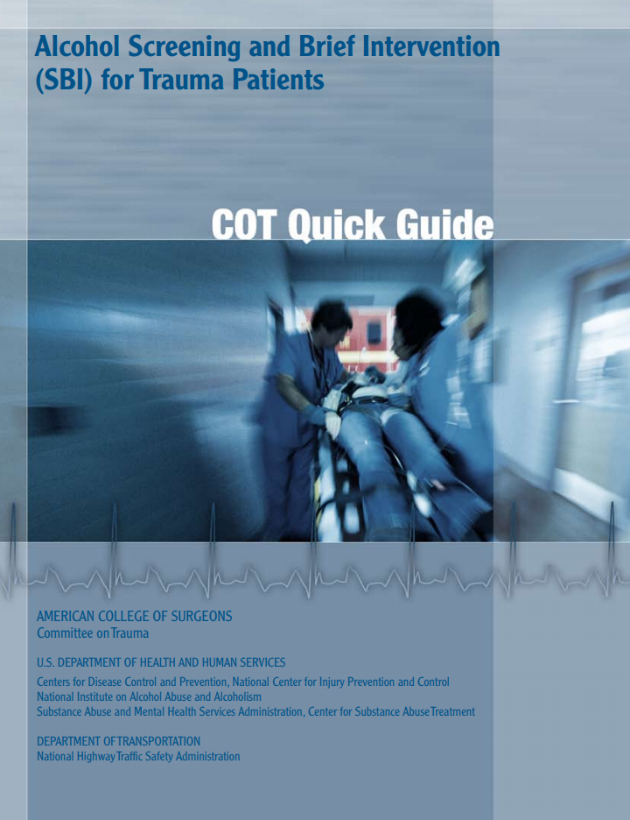
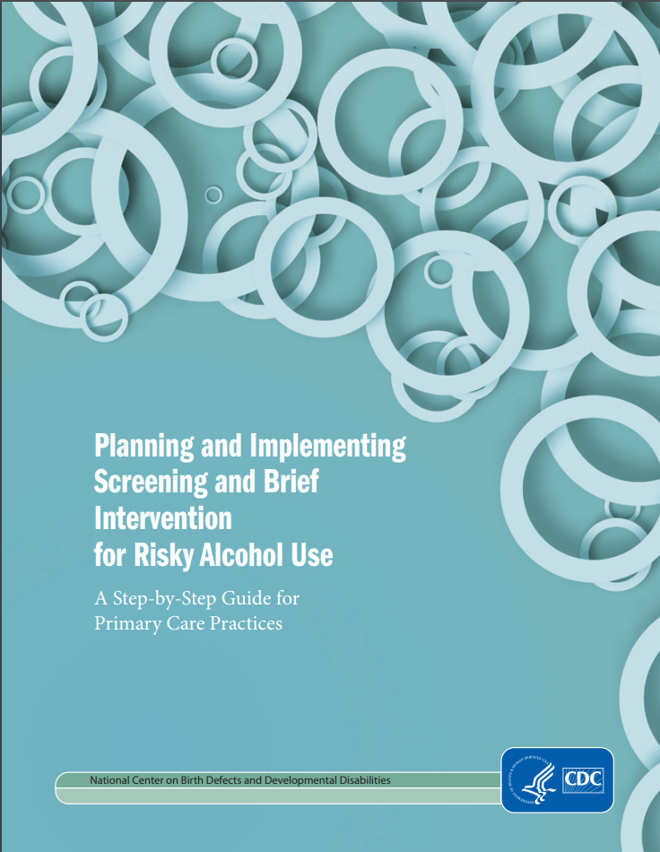
www.facs.org/~/media/files/quality%20programs/trauma/publications/sbirtguide.ashx & www.cdc.gov/ncbddd/fasd/documents/alcoholsbiimplementationguide.pdf

Slide 8
Alcohol Screening and Brief Intervention in the ED
In emergency care settings, it can reduce:
Excessive alcohol consumption
Alcohol-impaired driving
Readmissions for injury treatment
Subsequent ED visits
Desy PM, JEN, 2010; D'Onofrio G, Annals of emergency medicine, 2012; Mello MJ, Annals of emergency medicine. 2005

Slide 9
Alcohol Screening and Brief Intervention (ASBI) in the ED
Studies have reported alcohol screening rates from 8% to 68% in ED settings
Higher alcohol screening rates (up to 97%) have been achieved when the screening tool is incorporated into the ED electronic records
Desy PM, JEN, 2008; Cherpitel CJ, JSAD, 2009; Johnson JA, Ann of emer med. 2013

Slide 10
Study Objectives
Describe whether and how screening for alcohol consumption is done in ED settings
Describe barriers to and opportunities for improving the collection of alcohol information in EDs
Describe the perceptions and attitudes of ED physicians toward routine screening for alcohol consumption

Slide 11
Methods
CSTE alcohol subcommittee developed online questionnaire with Debbie Travers (ED Nurse and UNC Chapel Hill faculty) and members of the American College of Emergency Physicians (ACEP)
Questionnaire was disseminated online to members of ACEP’s established survey panel
  Representative of ACEP’s general membership

Slide 12
Results

Slide 13
Frequency of Screening of Excessive Alcohol Consumption by Emergency Physician Demographics

Slide 14
Excessive Alcohol Use Screening Characteristics by Frequency of Screening Among Emergency Physicians
 |  | Frequency of Screening, n (%) | Frequency of Screening, n (%)
 | Total N = 298 | Always n = 55 | Always n = 55 | Sometimes n = 243
Excessive Alcohol Screening Method
Recommended Screening Method* | 50 (16.9%) |  | 11 (22.0%) | 39 (78.0%)
Other Screening Method | 246 (83.1%) |  | 44 (17.9%) | 202 (82.1%)
Frequency of Results entered into Electronic Health Record
Always/Usually | 242 (81.2%) |  | 52 (21.5%) | 190 (78.5%)
Sometimes/Rarely | 46 (15.4%) |  | 1 (2.2%) | 45 (97.8%)
Never | 2 (0.4%) |  | 0 (0.0%) | 2 (100.0%)
Do not use EHR | 8 (2.7%) |  | 2 (25.0%) | 6 (75.0%)
Electronic Health Record System Reminder to Screen
Yes | 30 (10.5%) |  | 8 (26.7%) | 22 (73.3%)
No | 257 (89.5%) |  | 44 (17.1%) | 213 (82.9%)
Only respondents who "Always" or "Sometimes" screened were asked these questions *As recommended by the USPSTF (single question screener, AUDIT, and AUDIT-C)

Slide 15
Excessive Alcohol Use Screening Characteristics by Frequency of Screening Among Emergency Physicians
 |  | Frequency of Screening, n (%)
 | Total N = 298 | Always n = 55 | Sometimes n = 243
Use of Alcohol Consumption Information
To provide a brief intervention if they screen positive | 134 (45.0%) | 30 (54.5%) | 104 (42.8%)
To help guide the best treatment for the condition for which they presented at the ED | 209 (70.1%) | 41 (74.5%) | 168 (69.1%)
To facilitate the referral of patients to a substance use or behavioral health provider | 159 (53.4%) | 22 (40.0%) | 137 (56.4%)
To assess the quality of care that's being provided to ED patients | 21 (7.0%) | 9 (16.4%) | 12 (4.9%)
I'm not sure how to use the information | 16 (5.4%) | 0 (0.0%) | 16 (6.6%)
Only respondents who "Always" or "Sometimes" screened were asked these questions *Multiple responses possible

Slide 16
Frequency of Screening for Excessive Alcohol Consumption by Patient Type
Only respondents who "Always" or "Sometimes" screened were asked these questions

Slide 17
Reasons for Not Screening for Excessive Alcohol Consumption Among Emergency Physicians (n=290)
Response | % of Responses
Lack of time for screening | 32.9%
Lack of options for patients who screen positive | 21.4%
Other staff screen for excessive alcohol use (e.g. after a patient is admitted) | 12.2%
Alcohol screening is not useful/necessary | 7.9%
Concern about the acceptability of screening patients for excessive drinking | 5.8%
Lack of knowledge of screening measures or tools | 5.5%
Patient refuses | 5.1%
Patient does not have health insurance | 1.2%
Other | 8.0%
Only respondents who "Sometimes" or "Never" screened were asked these questions Multiple responses possible

Slide 18
Summary of Themes from Qualitative Data Provided by Emergency Physicians Regarding Excessive Alcohol Screening
Theme | Representative Quote
Routine screening is not relevant for all complaints in the emergency department | "If it is not relevant to why they are in the ED, I don't know that it adds value."
Will only screen if there is clinical reason to do so | "I only screen those in which it is, or could be, related to the presenting complaint."
There has been increased expectations for screening, and emergency physicians should not be expected to carry that role. | "We must be careful how we interpret the mission of emergency care. We can screen for many things but we need to stick to a core mission."
Responses were summarized from two questions that asked for another reason for not screening patients for excessive alcohol consumption (n = 23, 7.9% response rate) and for additional information about screening of emergency department patients (n = 60, 17.3% response rate).

Slide 19
Impact of characteristics on Always vs. Sometimes Screening (n = 238) for Excessive Alcohol Consumption
 | AOR* | 95% Confidence Interval
 |  | Lower | Upper
Use of Alcohol Consumption Information
To provide a brief intervention if they screen positive | 1.5 | 1.1 | 2.2
To help guide the best treatment for their condition | 1.4 | 0.9 | 2.1
To facilitate the referral to a SU/MH provider | 0.6 | 0.4 | 0.8
To assess the quality of care that's being provided | 1.8 | 1.0 | 3.2
*Adjusted for years after residency, gender, and EHR reminder

Slide 20
Impact of characteristics on Sometimes vs. Never Screening (n = 240) for Excessive Alcohol Consumption
 | AOR* | 95% Confidence Interval
 |  | Lower | Upper
Reasons for Not Screening for Excessive Alcohol Consumption
Lack of knowledge of screening measures or tools | 0.3 | 0.2 | 0.5
Lack of time for screening | 0.9 | 0.5 | 1.4
Lack of options for patients who screen positive | 1.1 | 0.7 | 1.6
Concern about the acceptability of screening patients for excessive drinking | 0.8 | 0.4 | 1.3
Alcohol screening is not useful/necessary | 0.8 | 0.5 | 1.4
Other staff screen for excessive alcohol use (e.g. after a patient is admitted) | 1.7 | 1.0 | 2.8
Patient does not have health insurance | 0.4 | 0.1 | 1.5
Other | 0.7 | 0.4 | 1.1
*Adjusted for years after residency and gender

Slide 21
Conclusions
Only 1 in 7 members of physicians in the ACEP survey panel screen patients with a recommended screening tool
  Only 1 in 30 always screen with a recommended screening tool
Frequently cited barriers include a lack of time and a lack of options for patients who screen positive
How screening information is used, whether other hospital staff screen, and lack of knowledge are important factors determining how often patients are screened for excessive alcohol use

Slide 22
Acknowledgements
Laura Tomedi, Anna Buckner, Kacy Crawford, Kari Gloppen, and Patrick Hindman’s contributions to this presentation were supported by Cooperative Agreement Number, 1 NU58DP001002-01, funded by the Centers for Disease Control and Prevention. Its contents are solely the responsibility of the authors and do not necessarily represent the official views of the Centers for Disease Control and Prevention or the Department of Health and Human Services.
This presentation was supported by the Council of State and Territorial Epidemiologists (CSTE), with funding from the Substance Abuse and Mental Health Services Administration (SAMHSA) through the Centers for Disease Control (CDC) cooperative agreement number 5U38OT00143. The contents are solely the responsibility of the author sand do not necessarily represent the official views of CSTE, SAMHSA, CDC, or the Department of Health and Human Services.
Debbie Travers, University of North Carolina, Chapel Hill
The CDC Alcohol Program
Other members of the CSTE Alcohol Subcommittee

Slide 23
Thank you!
Laura.Tomedi@state.nm.us

