Slide 1

Screening for Alcohol Consumption in Emergency Departments

Slide 2
Excessive Alcohol Consumption is a Public Health Concern
Excessive alcohol consumption:
Is a leading cause of preventable death in the US
Caused approximately 95,000 deaths each year in the US in
2011-2015
Resulted in economic costs estimated at $249 billion, or $2.05 a drink, in 2010
Mokdad AH, JAMA, 2004; Stahre M., Prev Chronic Dis, 2014. Sacks JJ, Am J Prev Med, 2015; Esser MB, Prev Chronic Dis, 2014

Slide 3
What is Excessive Drinking?
Binge Drinking – the most frequent, dangerous, and costly form of excessive alcohol consumption
  ≥ 4 drinks on an occasion for women
  ≥ 5 drinks on an occasion for men
Heavy Drinking
  ≥ 8 drinks per week for women
  ≥ 15 drinks per week for men
Any alcohol consumption by people who are under the legal drinking age or who are pregnant
www.cdc.gov/alcohol/fact-sheets/alcohol-use.htm

Slide 4
Excessive alcohol consumption is associated with
Cancer
Heart disease
Alcohol use disorder
Anxiety and depression
Learning and memory problems
Liver disease
Suicide
Violence
Motor vehicle crashes and other injuries
Other high-risk behaviors
Death
www.cdc.gov/alcohol/fact-sheets/alcohol-use.htm

Slide 5
National Recommendations
United States Preventive Services Task Force
  Recommends screening all adults aged 18 years or older for alcohol misuse and provide persons engaged in risky or hazardous drinking with brief behavioral counseling interventions to reduce alcohol misuse (B Recommendation)
The Community Preventive Services Task Force
  Recommends electronic screening and brief intervention to reduce self-reported excessive alcohol consumption and alcohol-related problems
www.uspreventiveservicestaskforce.org/Page/Document/UpdateSummaryFinal/alcohol-misuse-screening-and-behavioral-counseling-interventions-in-primary-care

Slide 6
Screening Tools for Excessive Alcohol Use
Alcohol Use Disorders Identification Test (AUDIT)
Abbreviated AUDIT-C
Single-question screen for binge-level alcohol consumption:
  “How many times in the past year have you had 5 (for men)
  or 4 (for women and all adults older than 65 years) or more drinks in a day?”
www.uspreventiveservicestaskforce.org/Page/Document/UpdateSummaryFinal/alcohol-misuse-screening-and-behavioral-counseling-interventions-in-primary-care

Slide 7
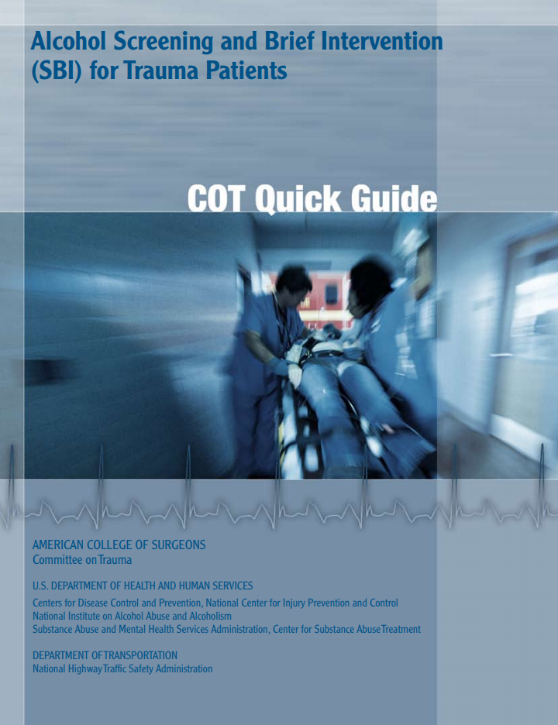
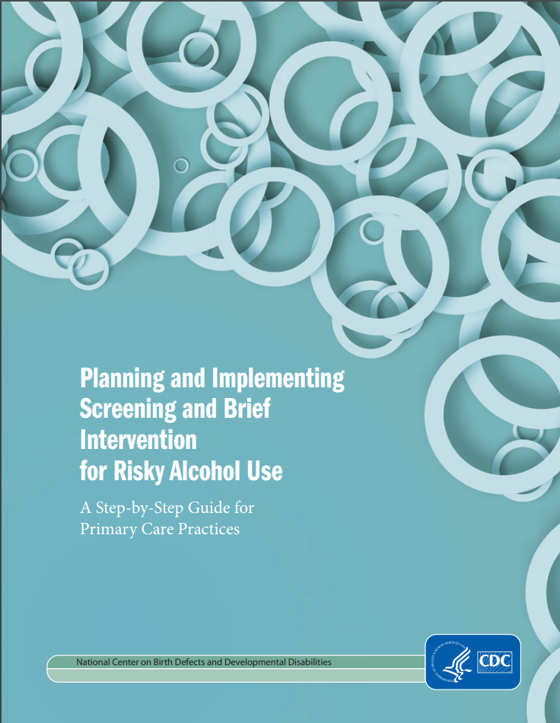
Alcohol screening implementation
www.facs.org/~/media/files/quality%20programs/trauma/publications/sbirtguide.ashx & www.cdc.gov/ncbddd/fasd/documents/alcoholsbiimplementationguide.pdf

Slide 8
Alcohol Screening and Brief Intervention (ASBI) in the ED
In emergency care settings, ASBI can reduce:
Alcohol-impaired driving
Readmissions for injury treatment
Subsequent ED visits
Excessive alcohol consumption – which will lead to reduction in associated harms
Desy PM, JEN, 2010; D'Onofrio G, Annals of emergency medicine, 2012; Mello MJ, Annals of emergency medicine. 2005

Slide 9
Alcohol Screening and Brief Intervention (ASBI) in the ED
Studies have reported alcohol screening rates from 8% to 68% in ED settings
Higher alcohol screening rates (up to 97%) have been achieved when the screening tool is incorporated into the ED electronic records
Desy PM, JEN, 2008; Cherpitel CJ, JSAD, 2009; Johnson JA, Ann of emer med. 2013

