Slide 1

Screening for Alcohol Consumption in Emergency Departments

Slide 2
Excessive Alcohol Consumption is a Public Health Concern
Excessive alcohol consumption:
  Is a leading cause of preventable death in the US
  Caused approximately 95,000 deaths each year in the US during 2011-2015
  Resulted in economic costs estimated at $249 billion, or $2.05 a drink, in 2010
Mokdad AH, JAMA, 2004; Stahre M., Prev Chronic Dis, 2014. Sacks JJ, Am J Prev Med, 2015; Esser MB, Prev Chronic Dis, 2014

Slide 3
What is Excessive Drinking?
Binge Drinking – the most frequent, dangerous, and costly form of excessive alcohol consumption
  ≥ 4 drinks on an occasion for women
  ≥ 5 drinks on an occasion for men
Heavy Drinking
  ≥ 8 drinks per week for women
  ≥ 15 drinks per week for men
Any alcohol consumption by people who are under the legal drinking age or who are pregnant
www.cdc.gov/alcohol/fact-sheets/alcohol-use.htm

Slide 4
Excessive alcohol consumption is associated with
Cancer
Heart disease
Alcohol use disorder
Anxiety and depression
Learning and memory problems
Liver disease
Suicide
Violence
Motor vehicle crashes and other injuries
Other high-risk behaviors
Death
www.cdc.gov/alcohol/fact-sheets/alcohol-use.htm

Slide 5
National Recommendations
United States Preventive Services Task Force
  Recommends screening all adults aged 18 years or older for alcohol misuse and provide persons engaged in risky or hazardous drinking with brief behavioral counseling interventions to reduce alcohol misuse (B Recommendation)
The Community Preventive Services Task Force
  Recommends electronic screening and brief intervention to reduce self-reported excessive alcohol consumption and alcohol-related problems
www.uspreventiveservicestaskforce.org/Page/Document/UpdateSummaryFinal/alcohol-misuse-screening-and-behavioral-counseling-interventions-in-primary-care

Slide 6
Screening Tools for Excessive Alcohol Use
Alcohol Use Disorders Identification Test (AUDIT)
Abbreviated AUDIT-C
Single-question screen for binge-level alcohol consumption:
  “How many times in the past year have you had 5 (for men)
  or 4 (for women and all adults older than 65 years) or more drinks in a day?”
www.uspreventiveservicestaskforce.org/Page/Document/UpdateSummaryFinal/alcohol-misuse-screening-and-behavioral-counseling-interventions-in-primary-care

Slide 7
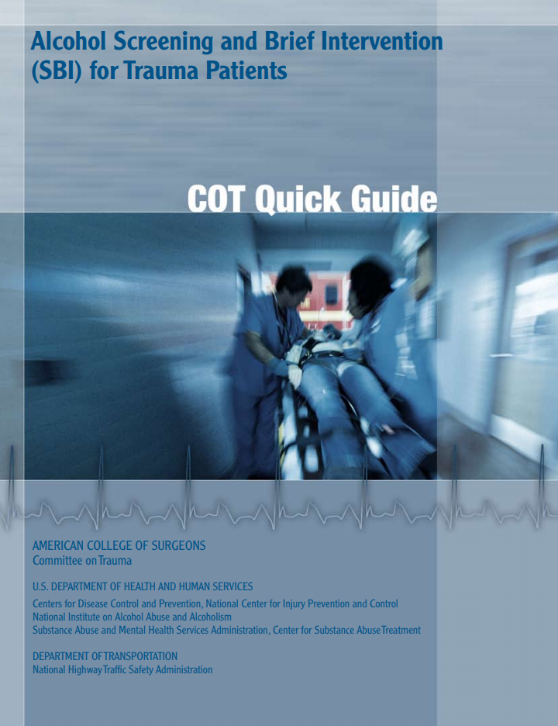
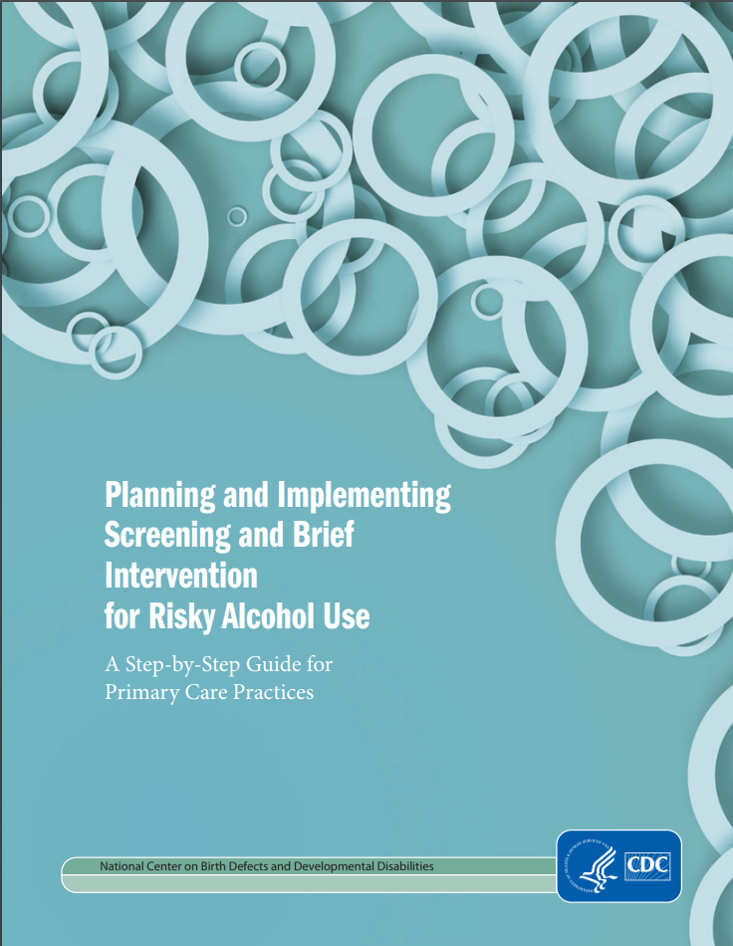
Alcohol screening implementation
www.facs.org/~/media/files/quality%20programs/trauma/publications/sbirtguide.ashx & www.cdc.gov/ncbddd/fasd/documents/alcoholsbiimplementationguide.pdf

Slide 8
Alcohol Screening and Brief Intervention (ASBI) in the ED
In emergency care settings, ASBI can reduce:
Alcohol-impaired driving
Readmissions for injury treatment
Subsequent ED visits
Excessive alcohol consumption – which will lead to reduction in associated harms
Desy PM, JEN, 2010; D'Onofrio G, Annals of emergency medicine, 2012; Mello MJ, Annals of emergency medicine. 2005

Slide 9
Alcohol Screening and Brief Intervention (ASBI) in the ED
Studies have reported alcohol screening rates from 8% to 68% in ED settings
Higher alcohol screening rates (up to 97%) have been achieved when the screening tool is incorporated into the ED electronic records
Desy PM, JEN, 2008; Cherpitel CJ, JSAD, 2009; Johnson JA, Ann of emer med. 2013

Slide 10
Study Objectives
Methods
Describe whether and how screening for alcohol consumption is done in ED settings
Describe barriers to and opportunities for improving the collection of alcohol information in EDs
Describe the perceptions and attitudes of ED physicians toward routine screening for alcohol consumption
CSTE alcohol subcommittee developed online questionnaire with Debbie Travers (ED Nurse and UNC Chapel Hill faculty) and members of the American College of Emergency Physicians (ACEP)
Questionnaire was disseminated online to members of ACEP’s established survey panel
  Representative of ACEP’s general membership

Slide 11
Frequency of Screening of Excessive Alcohol Consumption By Emergency Physician Demographics
RESULTS

Slide 12
RESULTS
Only 17% of ED physicians surveyed used a recommended screening tool (single question screener, AUDIT or AUDIT-C)
  Of these, 22% reported always screening, and 78% reported sometimes screening
81% of ED physicians surveyed reported always or usually entering screening information into Electronic Health Record (EHR)
  Only 10% of physicians surveyed receive reminders within their EHR to perform screening for excessive alcohol use
Reasons for performing excessive alcohol use screening included:
  To provide a brief intervention if they screen positive: 45%
  To help guide the best treatment for the condition for which they presented at the ED: 70%
  To facilitate the referral of patients to a substance use or behavioral health provider: 53%
  To assess the quality of care that's being provided to ED patients: 7%
  I'm not sure how to use the information: 5%

Slide 13
Frequency of Screening for Excessive Alcohol Consumption by Patient Type
RESULTS
Only respondents who "Always" or "Sometimes" screened were asked these questions

Slide 14
Reasons for Not Screening for Excessive Alcohol Consumption Among Emergency Physicians (n=290)
RESULTS
Response | % of Responses
Lack of time for screening | 32.9%
Lack of options for patients who screen positive | 21.4%
Other staff screen for excessive alcohol use (e.g. after a patient is admitted) | 12.2%
Alcohol screening is not useful/necessary | 7.9%
Concern about the acceptability of screening patients for excessive drinking | 5.8%
Lack of knowledge of screening measures or tools | 5.5%
Patient refuses | 5.1%
Patient does not have health insurance | 1.2%
Other | 8.0%
Only respondents who "Sometimes" or "Never" screened were asked these questions
Multiple responses possible

Slide 15
Summary of Themes from Qualitative Data Provided by Emergency Physicians Regarding Excessive Alcohol Screening
RESULTS
Theme | Representative Quote
Routine screening is not relevant for all complaints in the emergency department | "If it is not relevant to why they are in the ED, I don't know that it adds value."
Will only screen if there is clinical reason to do so | "I only screen those in which it is, or could be, related to the presenting complaint."
There has been increased expectations for screening, and emergency physicians should not be expected to carry that role. | "We must be careful how we interpret the mission of emergency care. We can screen for many things but we need to stick to a core mission."
Responses were summarized from two questions that asked for another reason for not screening patients for excessive alcohol consumption (n = 23, 7.9% response rate) and for additional information about screening of emergency department patients (n = 60, 17.3% response rate).

Slide 16
Impact of Characteristics on Always Vs. Sometimes Screening (N = 238) for Excessive Alcohol Consumption
RESULTS
 | AOR* | 95% Confidence Interval
 |  | Lower | Upper
Use of Alcohol Consumption Information
To provide a brief intervention if they screen positive | 1.5 | 1.1 | 2.2
To help guide the best treatment for their condition | 1.4 | 0.9 | 2.1
To facilitate the referral to a SU/MH provider | 0.6 | 0.4 | 0.8
To assess the quality of care that's being provided | 1.8 | 1.0 | 3.2
*Adjusted for years after residency, gender, and EHR reminder

Slide 17
Impact of Characteristics on Sometimes Vs. Never Screening (N = 240) for Excessive Alcohol Consumption
RESULTS
 | AOR* | 95% Confidence Interval
 |  | Lower | Upper
Reasons for Not Screening for Excessive Alcohol Consumption
Lack of knowledge of screening measures or tools | 0.3 | 0.2 | 0.5
Lack of time for screening | 0.9 | 0.5 | 1.4
Lack of options for patients who screen positive | 1.1 | 0.7 | 1.6
Concern about the acceptability of screening patients for excessive drinking | 0.8 | 0.4 | 1.3
Alcohol screening is not useful/necessary | 0.8 | 0.5 | 1.4
Other staff screen for excessive alcohol use (e.g. after a patient is admitted) | 1.7 | 1.0 | 2.8
Patient does not have health insurance | 0.4 | 0.1 | 1.5
Other | 0.7 | 0.4 | 1.1
*Adjusted for years after residency and gender

Slide 18
Summary of key results
Only 1 in 7 members of physicians in the ACEP survey panel screen patients with a recommended screening tool
  Only 1 in 30 always screen with a recommended screening tool
Frequently cited barriers include a lack of time and a lack of options for patients who screen positive
How screening information is used, whether other hospital staff screen, and lack of knowledge are important factors determining how often patients are screened for excessive alcohol use

