Slide 1
Screening for Alcohol Consumption in Emergency Departments
Prepared by the CSTE Alcohol Subcommittee, 2021
https://www.cste.org/group/Alcohol

Slide 2
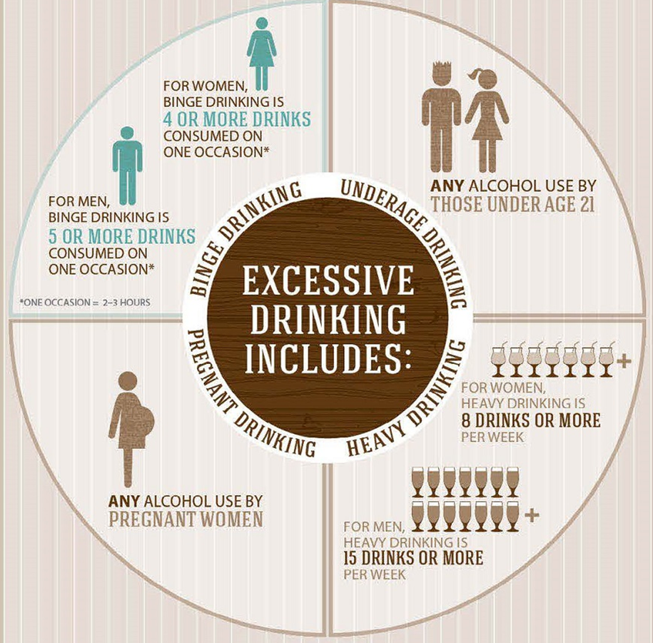
Excessive Alcohol Consumption is a Public Health Concern
Excessive alcohol consumption:
  Is a leading cause of preventable death in the US
  Responsible for more than 95,000 deaths annually in the US, on average, during 2011-2015
  Resulted in economic costs estimated at $249 billion, or $2.05 a drink, in 2010
Mokdad AH, JAMA, 2004; Stahre M., Prev Chronic Dis, 2014. Sacks JJ, Am J Prev Med, 2015; Esser MB, Prev Chronic Dis, 2014
https://www.cdc.gov/alcohol/onlinemedia/infographics.html

Slide 3
National Recommendations
United States Preventive Services Task Force
  Recommends screening all adults aged 18 years or older for unhealthy alcohol use in primary care settings, and providing persons engaged in risky or hazardous drinking with brief behavioral counseling interventions to reduce alcohol misuse (B Recommendation)
The Community Preventive Services Task Force
  Recommends electronic screening and brief intervention to reduce self-reported excessive alcohol consumption and alcohol-related problems
These recommendations do not apply to persons who have a current diagnosis of or who are seeking evaluation or treatment for alcohol abuse or dependence.
https://www.uspreventiveservicestaskforce.org/uspstf/recommendation/unhealthy-alcohol-use-in-adolescents-and-adults-screening-and-behavioral-counseling-interventions
Notes:
Make a note: clarify we’re recommending screening all adults, regardless of reason for being in ED

Slide 4
Screening all adult patients in Emergency Departments can impact outcomes
Routine Alcohol Screening and Brief Intervention (ASBI) in EDs can reduce:
Alcohol-impaired driving
Readmissions for injury treatment
Subsequent ED visits
Excessive alcohol consumption – which will lead to reduction in associated harms
Desy PM, JEN, 2010; D'Onofrio G, Annals of emergency medicine, 2012; Mello MJ, Annals of emergency medicine. 2005

Slide 5

ASBI works, but is underutilized
Previous studies have reported:
Alcohol screening rates from 8% to 68% in ED settings
Higher alcohol screening rates (up to 97%) have been achieved when the screening tool is incorporated into the ED electronic records
Desy PM, JEN, 2010; D'Onofrio G, Annals of emergency medicine, 2012; Mello MJ, Annals of emergency medicine. 2005

Slide 6
Screening for Excessive Alcohol Consumption in Emergency Departments: A Nationwide Assessment of Emergency Department Physicians
Study Overview
Stephen Uong, Laura E Tomedi, Kari M Gloppen, Mandy Stahre, Patrick Hindman, Valerie N Goodson, Cameron Crandall, David Sklar, Robert D Brewer
Published Open Access: Journal for Public Health Management Practice, March 2021
https://journals.lww.com/jphmp/Abstract/9000/Screening_for_Excessive_Alcohol_Consumption_in.99179.aspx

Slide 7
Study Objectives
Methods
Describe whether and how screening for alcohol consumption is done in ED settings
Describe barriers to and opportunities for improving the collection of alcohol information in EDs
Describe the perceptions and attitudes of ED physicians toward routine screening for alcohol consumption
CSTE alcohol subcommittee developed online questionnaire with Debbie Travers (ED Nurse and UNC Chapel Hill faculty) and members of the American College of Emergency Physicians (ACEP)
Questionnaire was disseminated online to members of ACEP’s established survey panel
  Representative of ACEP’s general membership

Slide 8
Results
Only 17% of ED physicians surveyed used a recommended screening tool
  Of these, 22% reported always screening, and 78% reported sometimes screening
  Most physicans (81%) who always or usually screen for excessive alcohol use enter the information into an Electronic Health Record (EHR)
Frequency of Screening for Excessive Alcohol Consumption by Patient Type
Only respondents who "Always" or "Sometimes" screened were asked these questions

Slide 9
Results
Top reasons for performing excessive alcohol use screening included:
  To provide a brief intervention if they screen positive: 45%
  To help guide the best treatment for the condition for which they presented at the ED: 70%
  To facilitate the referral of patients to a substance use or behavioral health provider: 53%
  Top reasons for NOT performing excessive alcohol use screening included:
Lack of time for screening: 32.9%
Lack of options for patients who screen positive: 21.4%
Other staff screen for excessive alcohol use (e.g. after a patient is admitted): 12.2%

Slide 10
Summary of key results
Only 1 in 7 members of physicians in the ACEP survey panel screen patients with a recommended screening tool
  Only 1 in 30 always screen with a recommended screening tool
Frequently cited barriers include a lack of time and a lack of options for patients who screen positive
Important factors for determining how often patients are screened for excessive alcohol use include: how screening information is used, whether other hospital staff screen, and lack of knowledge about screening or intervention

Slide 11
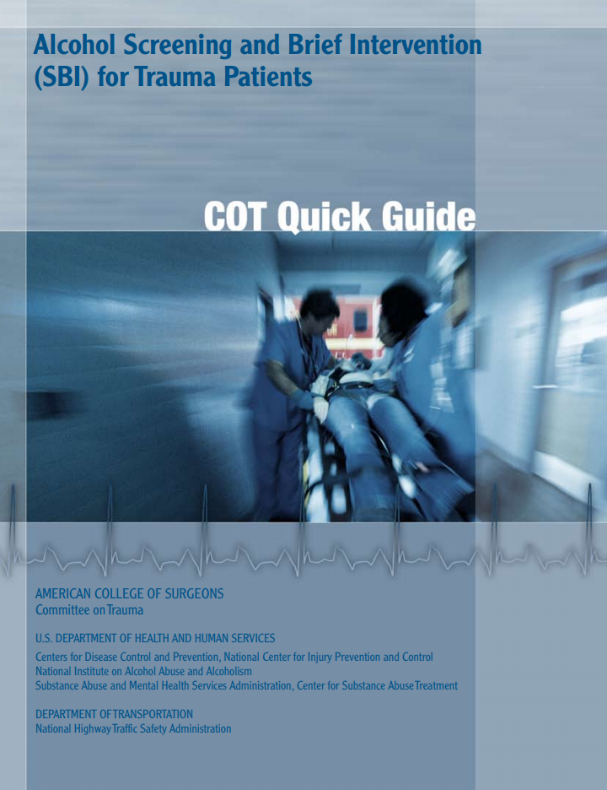
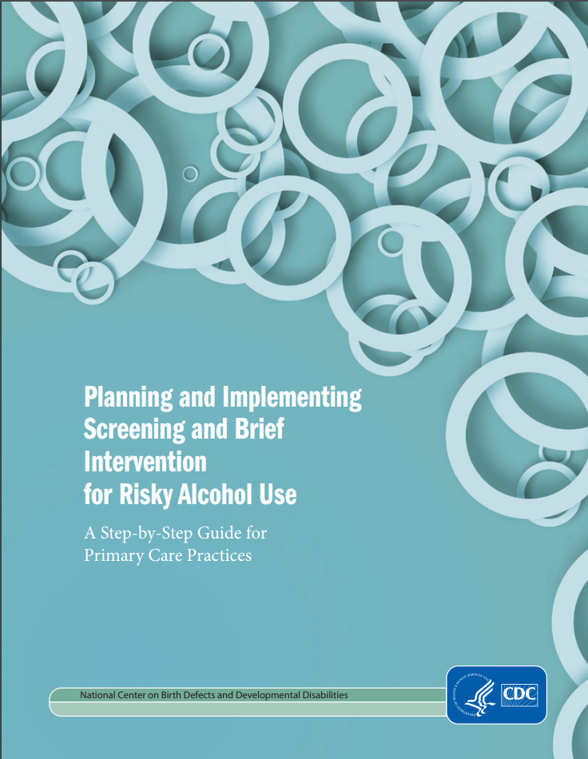
Implementing Alcohol Screening and Brief Intervention
www.facs.org/~/media/files/quality%20programs/trauma/publications/sbirtguide.ashx & www.cdc.gov/ncbddd/fasd/documents/alcoholsbiimplementationguide.pdf

Slide 12
Recommended Screening Tools for Excessive Alcohol Use in Patients 18 and older
Abbreviated Alcohol Use Disorders Identification Test-Consumption (AUDIT-C)
National Institute on Alcohol Abuse and Alcoholism’s Single Alcohol Screening Question (SASQ)
https://www.uspreventiveservicestaskforce.org/uspstf/recommendation/unhealthy-alcohol-use-in-adolescents-and-adults-screening-and-behavioral-counseling-interventions

Slide 13
AUDIT-C
AUDIT-C is a concise screening tool that uses the first three questions from the full AUDIT tool to assess for hazardous alcohol consumption in the past year.
Questions in the AUDIT-C | Potential Response Options
1. How often do you have a drink containing alcohol? | (0) Never [skip Q. 2 & 3] Less than monthly Monthly Weekly | (4) 2-3 times a week (5) 4-6 times a week (6) Daily
2. How many drinks containing alcohol do you have on a typical day when you are drinking? | (0) 1 drink 2 drinks 3 drinks 4 drinks | (4) 5-6 drinks (5) 7-9 drinks (6) 10 or more drinks
3. How often do you have (5 for men; 4 for women & men > age 65) or more drinks on one occasion? | (0) Never Less than monthly Monthly Weekly | (4) 2-3 times a week (5) 4-6 times a week (6) Daily
**A score of 7 or more for women and men over age 65, and 8 or more for younger men is positive.
Notes:
Practitioners can find a complete Manual for AUDIT from the WHO here: https://www.who.int/publications/i/item/audit-the-alcohol-use-disorders-identification-test-guidelines-for-use-in-primary-health-care

Slide 14
Single Alcohol Screening Question (SASQ)
Identifies binge-level consumption
Question: “How many times in the past year have you had [X] or more drinks in a day?”
  For female patients, X = 4
  For male patients, X = 5
A response greater or equal to 2 is considered positive
Notes:
Practitioners can read the clinical manual for SASQ from the National Institute on Alcohol Abuse and Alcoholism here: https://pubs.niaaa.nih.gov/publications/practitioner/cliniciansguide2005/guide.pdf

Slide 15
Brief Interventions for Patients who Screen Positive
Brief behavioral counseling interventions for adults who screen positive are associated with reduced unhealthy alcohol use
  Brief interventions typically involve general feedback (e.g. how the patient’s drinking fits with recommended limits, or how to reduce alcohol use)
  Can be administered online or using printed materials
Patients who screen positive on a brief screening instrument may benefit from referral to their primary care physician or a behavioral health specialist for follow-up with a more in-depth risk assessment
  Including screening results in the EHR can alert other care providers that further screening/intervention may be appropriate

Slide 16
Additional Resources
ASBI Recommendations from the US Preventive Services Task Force (including screening instruments developed for pregnant women and adolescents)
Manual for World Health Organization AUDIT Screening tool
Manual for NIAAA Single Alcohol Question Screening Question
Health Insurance Parity for Alcohol-Related Treatment
Health Insurance Losses due to Intoxication
SAMHSA - Coding for screening and brief intervention reimbursement
CDC - Clinical decision support for alcohol screening and brief intervention
CDC – Planning and Implementing Screening and Brief Intervention for Risky Alcohol Use: A Step-by-Step Guide for Tribal Communities

