Slide 1
State Surveillance:
What have we learned so far?
Council of State & Territorial Epidemiologists (CSTE) Marijuana Subcommittee
Julia Dilley PhD, Multnomah County & State of Oregon Public Health Division (Co-Chair)
Katelyn Hall MPH, Colorado Department of Public Health and Environment (Co-Chair)
Nikka Sorrells MPH, CSTE (Lead Staff)

Slide 2
Acknowledgements
Public health surveillance supported by partners in legalized states, especially:
Oregon: Katrina Hedberg, Duyen Ngo, Beth Vorderstrasse, Rob Hendrickson, Sandy Giffin, Esther Choo, Suzanne Zane
Colorado: Katelyn Hall, Elyse Contreras
Washington: Mary Segawa, Natasha Close, Trevor Christensen, Linda Lohdefinck
Alaska: Eliza Muse, Taz Mannix, Joe McLaughlin, Kathy Perham-Hester
Council of State and Territorial Epidemiologists (CSTE), Marijuana Surveillance Subcommittee: CSTE staff Nikka Sorrells, Valerie Goodson, Megan Toe
Research was supported by the National Institute on Drug Abuse (NIDA) of the National Institutes of Health (NIH) award 1R01DA039293. Research partners include those above and:
Multnomah County/Oregon Public Health Division: Julia Dilley (PI), Julie Maher, Steven Fiala, Erik Everson, Susan Richardson, Caislin Firth, Clyde Dent
Washington State DSHS Research & Data Analysis (RDA): Grace Hong
RAND Corporation: Beau Kilmer, Steven Davenport, Greg Midgette
Public Health - Seattle & King County: Laura Hitchcock, Lindsey Greto, Nancy McGroder
Looking Glass Analytics: Joe Kabel, Curtis Mack
Washington State Institute for Public Policy (WSIPP): Adam Darnell

Slide 3
Disclaimer
The contents of this presentation are solely the responsibility of the lead authors and do not necessarily represent the official views of the Council of State and Territorial Epidemiologists (CSTE).
The contents of this presentation are solely the responsibility of the lead authors and do not necessarily represent the official views of the Council for State and Territorial Epidemiologists (CSTE).

Slide 4

As required by the 2019 NACS Conference
I have signed a disclosure statement and
have no conflicts of interest to declare.

Slide 5
Objectives
Data highlights from established state behavioral surveillance systems in the first four states to legalize (Alaska, Colorado, Oregon, Washington)
Data highlights from emerging surveillance systems
Building surveillance capacity

Slide 6

Behavioral Surveillance
Youth school-based surveys (e.g., Youth Risk Behavior Surveys, YRBS)
Adult Behavioral Risk Factor Surveillance System (BRFSS)
Pregnancy Risk Assessment Monitoring Survey (PRAMS)

Slide 7
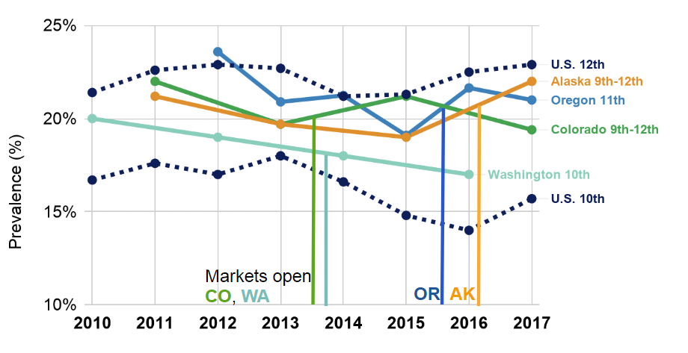
Youth cannabis use
Vertical lines show dates for opening of retail cannabis sales per state
NOTE: Vertical axis exaggerated to show distinctions; margins of error for annual estimates are typically +2-5%.
Data sources: Healthy Kids Colorado Survey, Washington State Healthy Youth Survey, Oregon Healthy Teens, Alaska Youth Risk Behavior Surveillance System, and Monitoring the Future

Slide 8
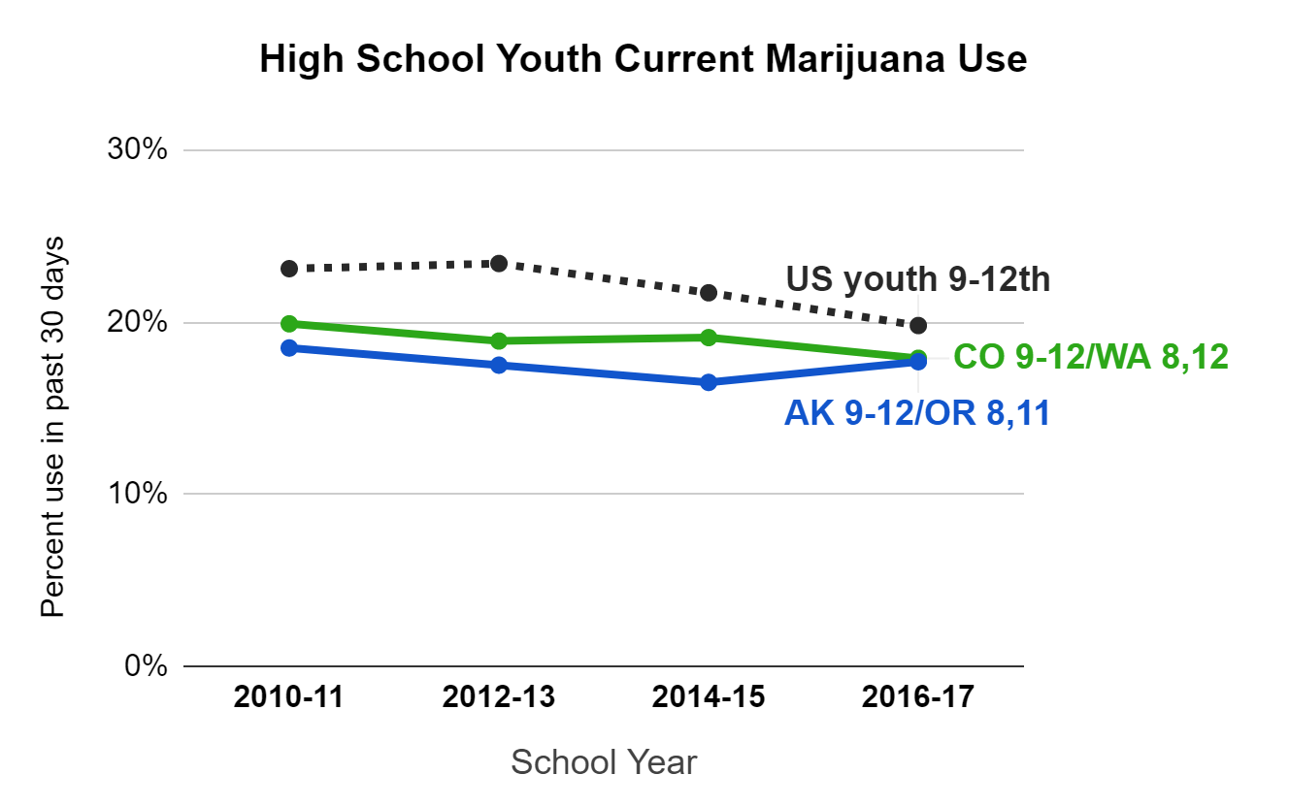
Youth cannabis use (simplified)
Vertical lines show dates for opening of retail cannabis sales per state
Markets open
CO/WA AK/OR
Data sources: Healthy Kids Colorado Survey, Washington State Healthy Youth Survey, Oregon Healthy Teens, Alaska Youth Risk Behavior Surveillance System, and US YRBS

Slide 9
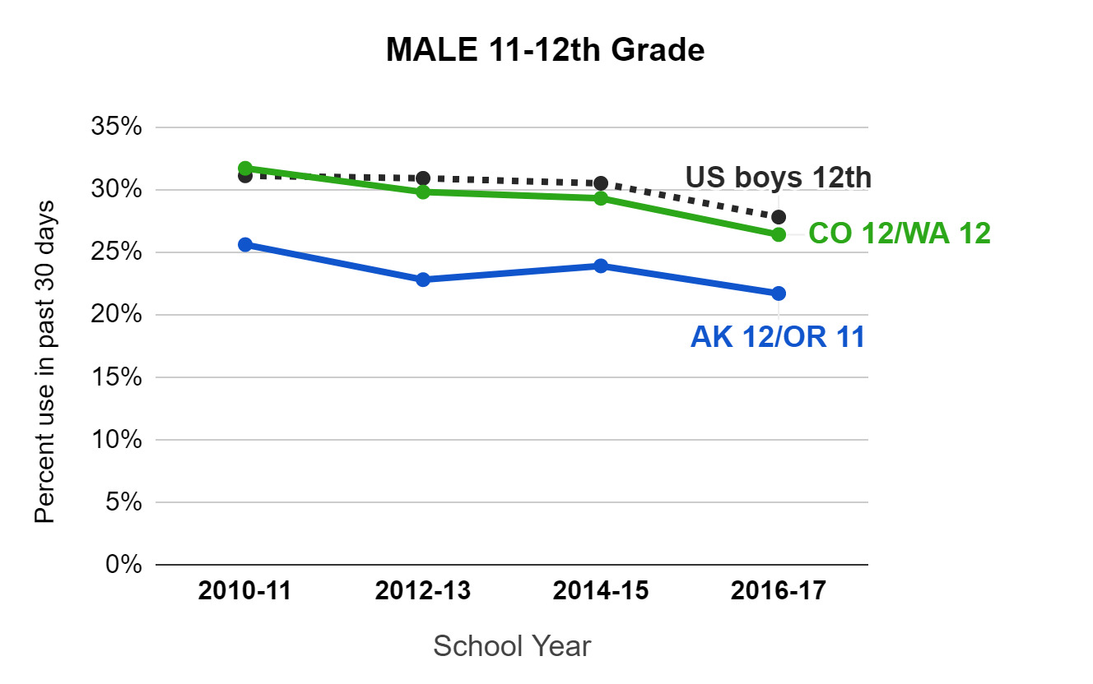
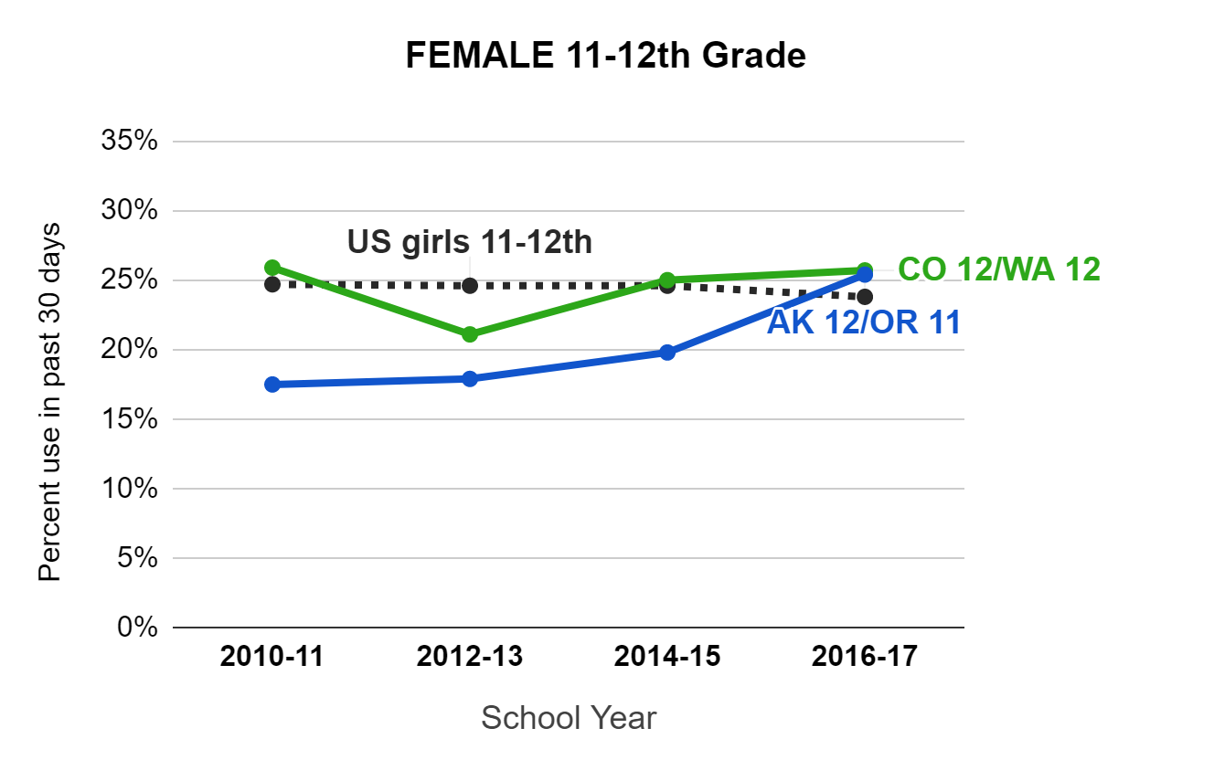
Youth cannabis use: age & gender
Vertical lines show dates for opening of retail cannabis sales per state
Markets open
CO/WA AK/OR
Markets open
CO/WA AK/OR
Data sources: Healthy Kids Colorado Survey, Washington State Healthy Youth Survey, Oregon Healthy Teens, Alaska Youth Risk Behavior Surveillance System, and US YRBS

Slide 10
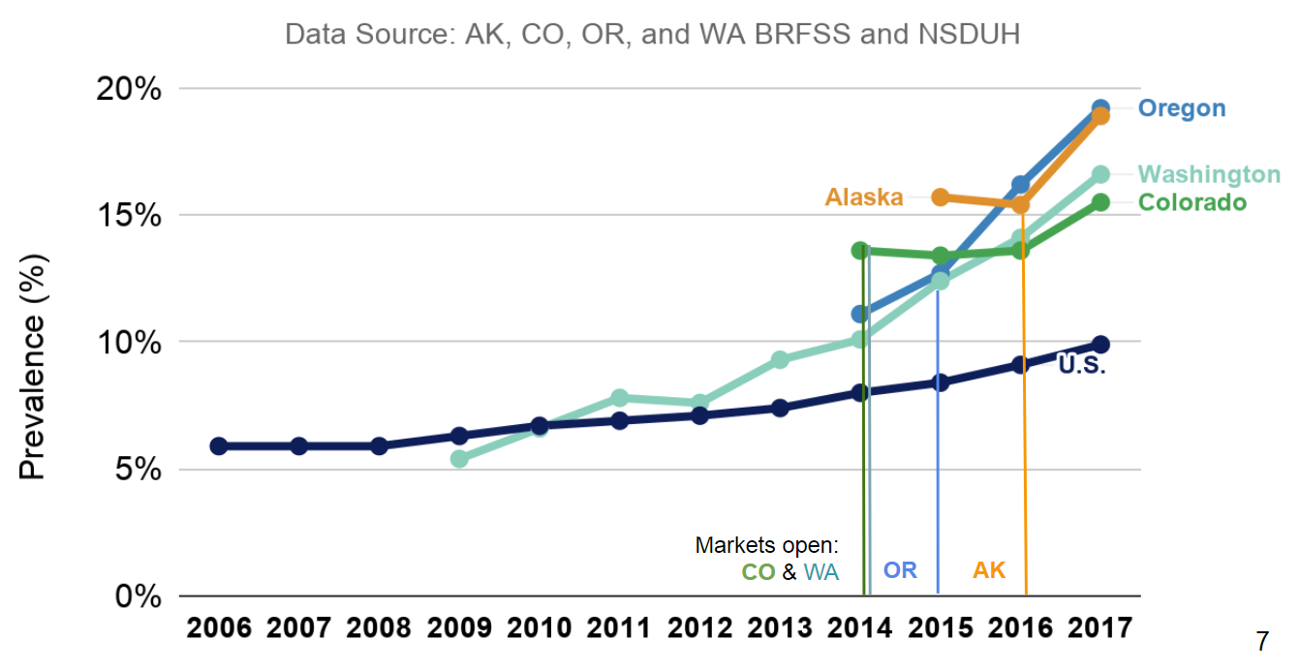
Adult cannabis use

Slide 11
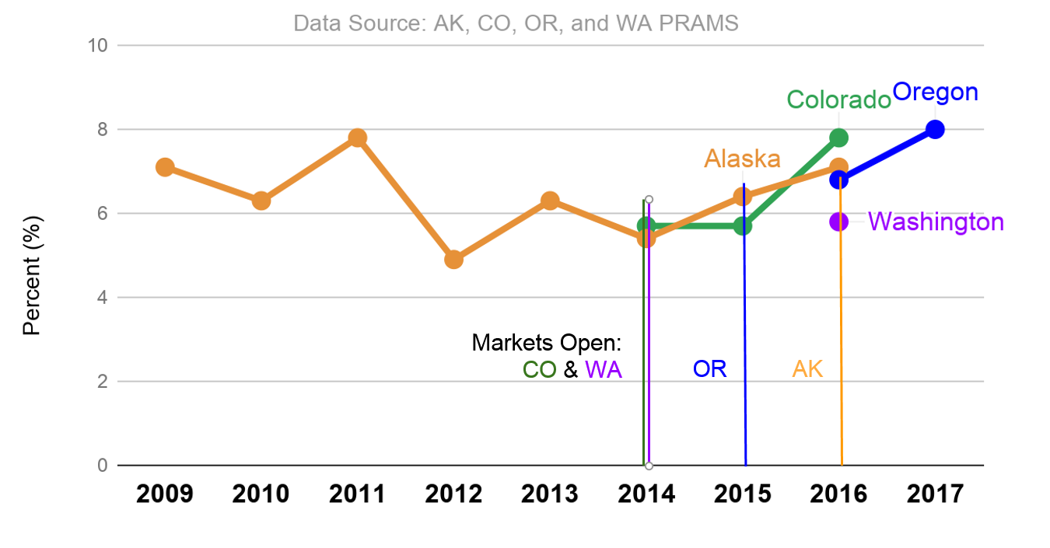
Marijuana use during pregnancy

Slide 12
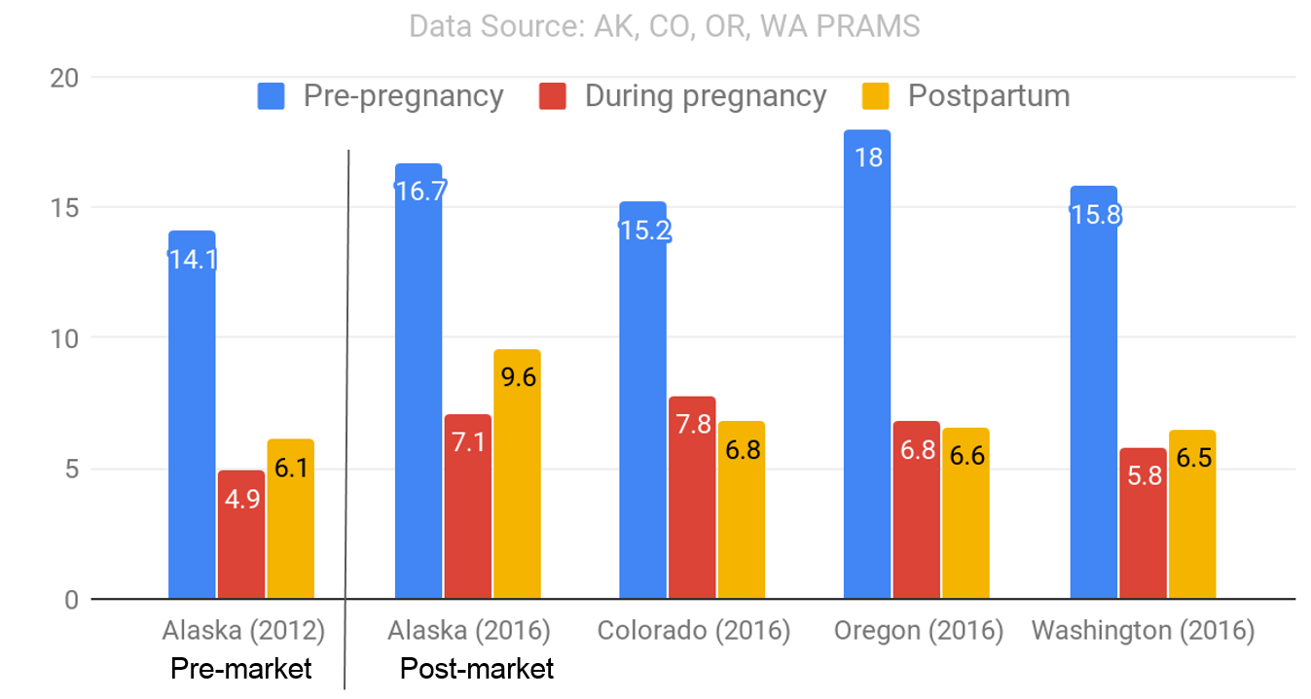
Marijuana use in pregnancy (cont.)
Postpartum use among breastfeeding women only:
4.4% CO (2016)
7.8% AK (2015-16)

Slide 13
Emerging Surveillance
Poison Center Calls
Hospitalizations
Retail Exposure
Product Sales
Advertising

Slide 14
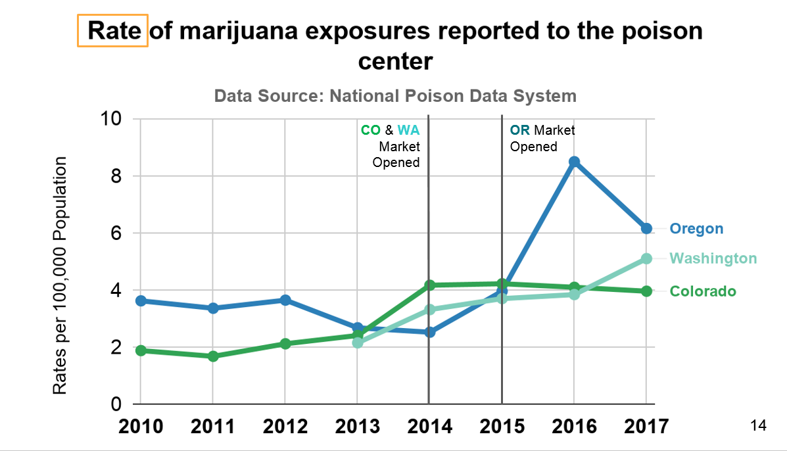
Poison Center Calls

Slide 15
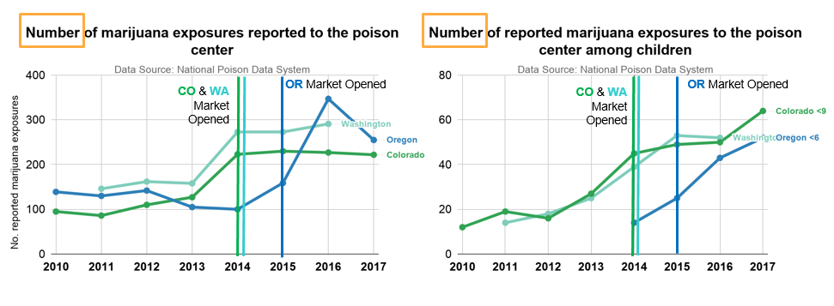
Poison Center Calls, by age group

Slide 16
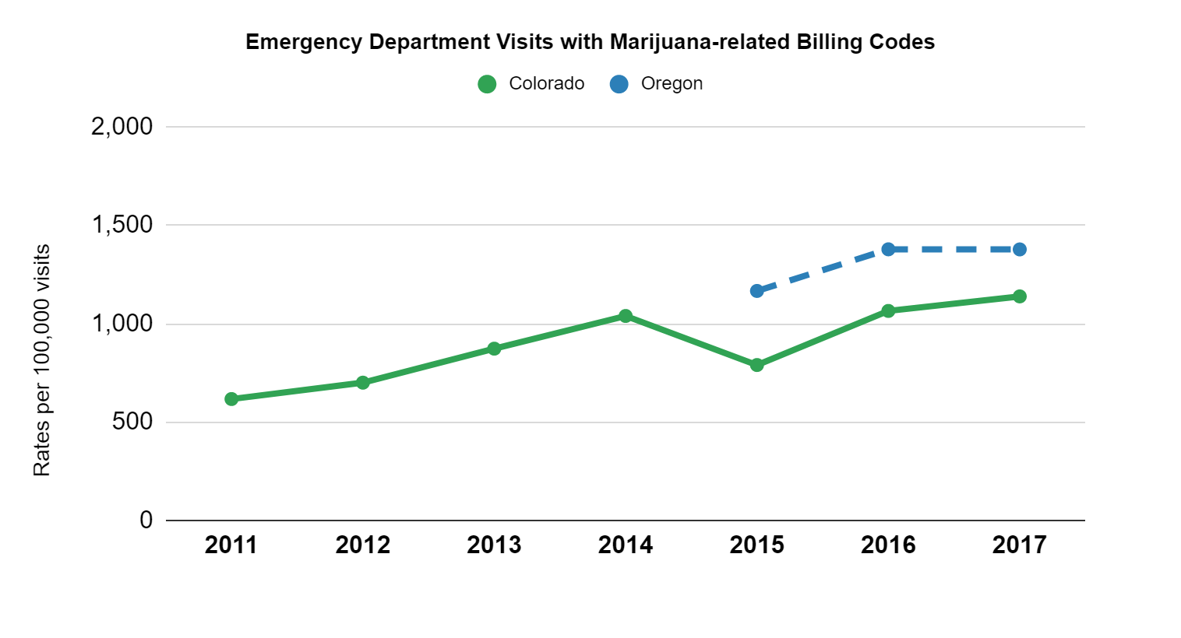
Emergency Department Visits
Markets open
CO OR

Slide 17
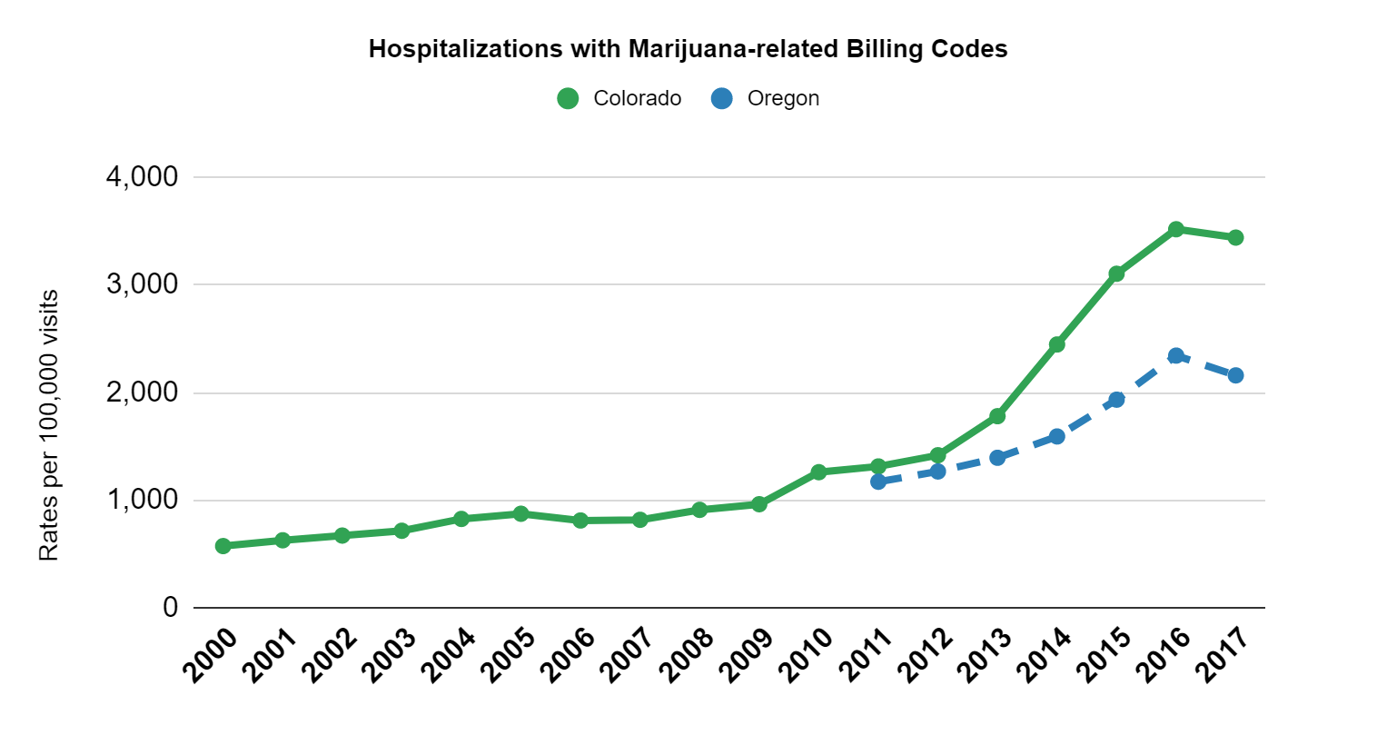
Hospitalizations
Markets open
CO OR

Slide 18
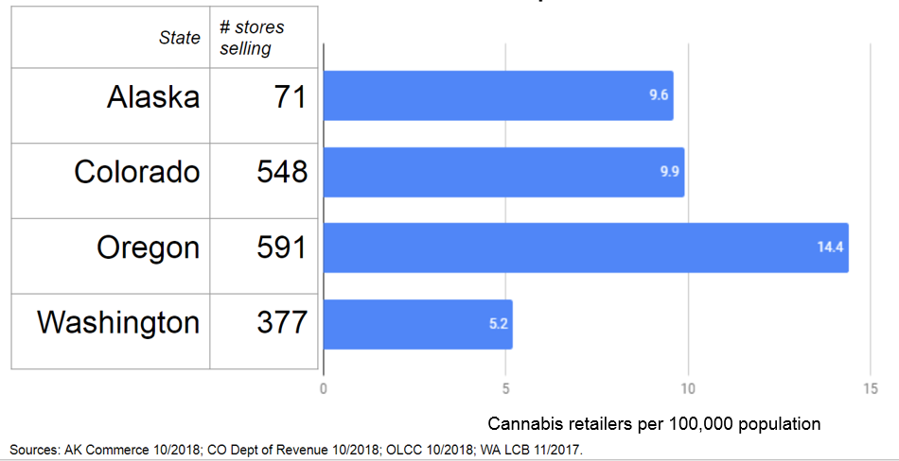
Market data: Active cannabis retail outlets by state

Slide 19
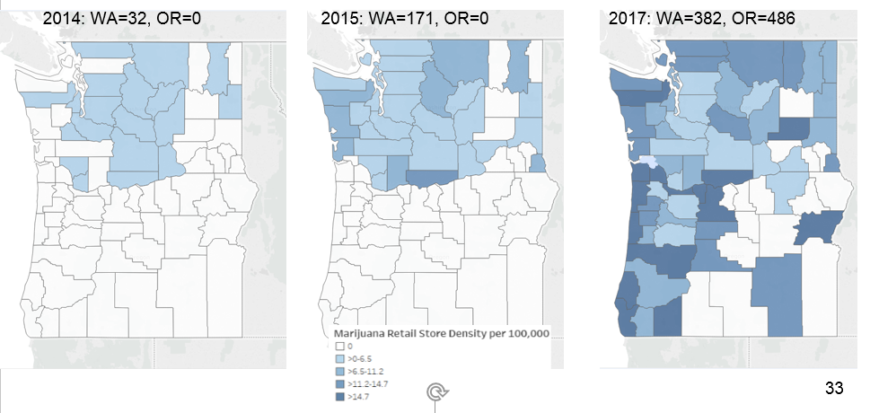
Cannabis retail outlets by county, WA and OR

Slide 20
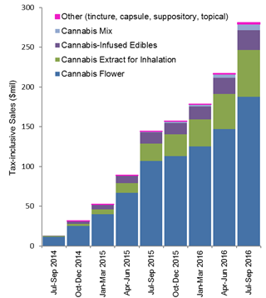
Product sales: amount, type
Washington State cannabis retail sales, 2014-2016
Total sales are increasing.
The amount and share of high-potency products among sales are increasing.
Monitoring price is also a priority.
Smart R, Caulkins JP, Kilmer B, Davenport S, Midgette G. Variation in cannabis potency and prices in a newly legal market: evidence from 30 million cannabis sales in Washington state. Addiction. 2017 May 27. doi: 10.1111/add.13886.

Slide 21
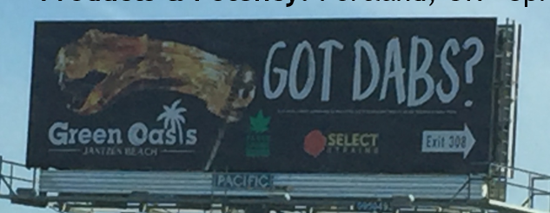
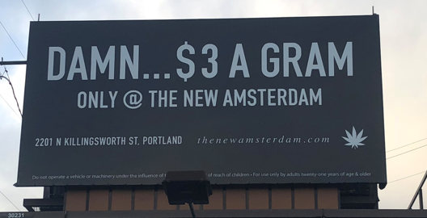
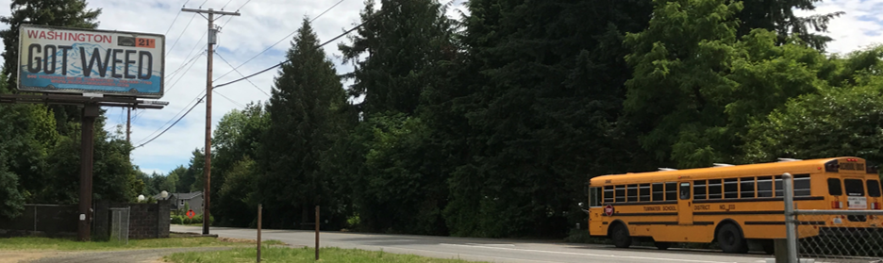
Advertising
Oregon: community-level exposure to cannabis advertising
55% of adults (2015-16)
  63% in communities with retail stores
72% of 8th grade youth (2017)
  85% in communities with retail stores
Adult data reported in Fiala SC, Dilley JA, Firth CL, Maher JE. (2018) Exposure to marijuana marketing after legalization of
retail sales: Oregonians’ experiences, 2015-2016. Am J Public Health. 108(1):120-127. doi: 10.2105/AJPH.2017.304136.
Youth data from Oregon Healthy Teens Survey 2017 (Fiala, Dilley, Firth, Maher, Everson – paper in preparation)

Slide 22
State Capacity
Council of State and Territorial Epidemiologists Marijuana Subcommittee
Assessment and ongoing support

Slide 23
Building Capacity for Marijuana-related Surveillance: CSTE
CSTE’s subcommittee continues to support development and sharing among surveillance peers and national efforts
Inventory of what data sources states are using or plan to use for monitoring + key informant interviews with surveillance leads from the first 8 legalized states
  Only 4 of 8 states had funding requirements for marijuana surveillance
  Each legalized state using between 12-21 data sources for monitoring
  Drivers: need for monitoring impact and informing policy, programs, understanding public health burden and equity issues
  Barriers: little or no funding/staff, little time prior to legalization, challenges with data stakeholder coordination
Source: Council of State & Territorial Epidemiologists (CSTE), Marijuana Subcommittee,
Marijuana Surveillance Environmental Scan, 2018. Access by Google-ing: CSTE Marijuana

Slide 24

Julia Dilley, PhD MES
Senior Research Scientist/Epidemiologist
Multnomah County Health Department
and
State of Oregon Public Health Division
julia.dilley@state.or.us
Katelyn Hall, MPH
Colorado Department of Public Health and Environment
katelyn.hall@state.co.us
Nikka Sorrells, MPH
Council of State and Territorial Epidemiologists (CSTE)
nsorrells@cste.org

