Slide 1
Syndromic Surveillance of
Cannabis-Related Outcomes:
Case Definitions, Challenges and Considerations
Rashid Njai, PhD, MPH, Health Scientist, Deputy Director for Non Infectious Diseases,
Centers for Disease Control and Prevention
Nimi Idaikkadar, MPH, Center for Surveillance, Epidemiology, and Laboratory Services,
Office of Public Health Scientific Services, Centers for Disease Control and Prevention,
Atlanta, GA
Notes:
Good afternoon, My name is Rashid Njai, a health scientist for the Deputy Director for Non Infectious Diseases at the CDC, and am I’m excited to speak with you about syndromic surveillance of cannabis-related outcomes: case definitions, challenges and considerations.

Slide 2

Syndromic Surveillance of
Cannabis and Related Outcomes:
Case Definitions, Challenges and Considerations
The authors have no disclosures to report
The findings and conclusions in this presentation are those of the authors and do not necessarily represent any official position of Centers for Disease Control and Prevention.
Notes:
I and my coauthor have no disclosures to report and the findings and conclusions in this talk are those of the authors and do not necessarily represent any official position of the CDC

Slide 3
Background
The use of syndromic surveillance systems has evolved over the last decade.
Syndromic surveillance now includes infectious and noninfectious disease as well as other topics.
Analysts in local, state, and national public health agencies often need to rapidly develop new syndromic categories, or improve upon existing categories, to enhance their surveillance efforts.
CDC’s National Syndromic Surveillance Program (NSSP) uses a visualization process to develop and refine syndrome definitions for public health programs.
Notes:
The use of syndromic surveillance systems has evolved tremendously through the application of technology and advancements in data collection over the last decade. Syndromic surveillance now includes infectious diseases, noninfectious disease and has been applied to other topics such as Mass gatherings (like the Super Bowl or conventions), Natural and man-made disasters (like hurricanes, fires, or the Deepwater Horizon oil spill) and even been used to understand emergency response to tragic events like the mass shooting in Las Vegas in 2017.
During these response efforts Analysts in local, state, and national public health agencies often need to rapidly develop new syndromic categories, or improve upon existing categories, to enhance their surveillance and augment response efforts.
Today I’d like to share with you the process of how subject matter experts like myself work with the CDC’s National Syndromic Surveillance Program (NSSP) to use a visualization process to develop and refine syndrome definitions for cannabis-related issues.

Slide 4
Syndromic Surveillance
National Syndromic Surveillance Program (NSSP) at the CDC promotes and advances development of a syndromic surveillance system for the timely exchange of syndromic data. (https://www.cdc.gov/nssp/)
Used improve nationwide situational awareness and enhance responsiveness to hazardous public health events and disease outbreaks to protect America’s health, safety, and security
Syndromic surveillance uses syndromic data and stat tools to detect, monitor, and characterize unusual activity for further public health investigation or response.
Notes:
The National Syndromic Surveillance Program (NSSP) at the CDC promotes and advances development of a syndromic surveillance system for the timely exchange of syndromic data. (https://www.cdc.gov/nssp/)
This data is then used to improve nationwide and local situational awareness as well as enhance responsiveness to hazardous public health events and disease outbreaks to protect America’s health, safety, and security
Though these data are being captured for different purposes, they are monitored in near real-time as potential indicators of an event, a disease, or an outbreak of public health significance. Public health practitioners use various surveillance systems and data sources in combination with syndromic data to enhance their understanding of events.

Slide 5
Why is Syndromic Surveillance important for cannabis?
As national and state trends for cannabis use have increased with the legalization of the drug so have cannabis-involved emergency department (ED) visits.
  localities and states have recognized the increasing importance of cannabis related syndromic surveillance
Two key issues:
  need for a standardized case definition for cannabis related ED visits to establish baseline rates as well as comparable estimates across locations
  a common validation method for ED visits potentially related to cannabis in order to monitor trends and address emergent issues
Notes:
As national and state trends for cannabis use have increased with the legalization of the drug so have cannabis-related emergency department (ED) visits.
With that, localities and states have recognized the increasing importance of cannabis related syndromic surveillance. Basically allowing for assessment of the burden that adverse events related to cannabis use puts on health systems
In doing this work, Two key issues have emerged:
1) One --the need for a standardized case definition (or query) for cannabis related ED visits in order to establish baseline rates as well as comparable estimates across locations and
2) Two --a common validation method for ED visits potentially related to cannabis in order to more accurately monitor trends, address emergent issues as well as plan for resource distribution to respond to cannabis related population health needs

Slide 6
Data sources considered for Syndromic Surveillance
NSSP National Data
  https://www.cdc.gov/nssp/
State/Local ED visit Data
National Poison Data System
  https://www.aapcc.org/data-system/
State/Local Poison Center Data
Notes:
As stated earlier the NSSP supports syndromic surveillance at both national and local levels. These Data include patient encounter data from emergency departments, urgent care, ambulatory care, and inpatient healthcare settings, pharmacy and laboratory data, notably this data is only able to be analyzed at the HHS region level. Whereas state and local level syndromic surveillance data has the ability to analyzed at a more granular level in order to do spatial analysis.
Other data sources that provide context may include the National Poison Data System which aggregates poison control reports, as well as additional data such as school and busi­ness absentee data, and even social media data that may present an emergent picture of public health events.

Slide 7
Query Building Methods
NSSP analyst develops a syndromic concept. An iterative process of developing a syndrome definition begins by testing related terms and identifying diagnostic codes in the chief complaint (CC) and discharge diagnosis (DD) code fields.
Next, analyst reviews the resulting list of CC text and DD codes to determine whether the query terms match the syndromic concept.
To efficiently summarize resulting CC terms and DD codes, the analyst uses R to enable the ESSENCE* application programming interface (API) to extract data from the chief complaint query validation data source (CCQV).
*Electronic Surveillance System for the Early Notification of Community-Based Epidemics
Notes:
Now I’d like to give you some insight on how a case definition query is created…
1) First, the NSSP analyst develops a syndromic concept. This iterative process of developing a syndrome definition begins by testing terms presumably associated with the topic of interest and by identifying diagnostic codes in the chief complaint and discharge diagnosis code fields.
2) Next The analyst manually reviews the resulting list of chief complaint text and diagnostic codes to determine whether the query terms match the syndromic concept.
3) Then To efficiently summarize resulting terms and diagnostic codes, the analyst uses R to enable the Electronic Surveillance System for the Early Notification of Community-Based Epidemics (or ESSENCE)* application programming interface (API) to extract data from the chief complaint query validation data source (CCQV).

Slide 8
Standard Syndromic Case Definition?
Cannabis CC/DD Version 1 Query*
^ marij^,or ,^ maraju^,or ,^ thc ^,or ,^ cbd ^,or ,^ cannab^,or ,^ canab^,or ,^ mj ^,or ,(,^ smok^,and, ^ pot ^,),or,(,^ smok^,and, ^ weed ^,),or ,^ hash ^,or ,^ hemp ^,or,^[;/ ]f121^,or ,^[;/ ]f12.1^,or ,^[;/ ]f122^,or ,^[;/ ]f12.2^,or ,^[;/ ]f129^,or ,^[;/ ]f12.9^,or ,^[;/ ]t407^,or ,^[;/ ]t40.7^
*The query contains chief complaint terms and discharge diagnosis codes (CC/DD). When running the Marijuana CC/DD category query, the results and graphs will render quickly, which is always positive for the community of practice. Currently, the development of standard queries is iterative in nature and a second version (Marijuana CC/DD V2) that will include even more synthetic marijuana terms is forthcoming. Newly revised cannabis queries (Version 2) will be implemented into ESSENCE and shared with the community of practice.
Notes:
I’ll give you a moment to look at here …the Recently implemented Marijuana or Cannabis Chief Complaint/Discharge Diagnosis (CC/DD) Version 1 category in ESSENCE… NSSP is pleased to share this “standard case definition” with the community of practice. Although this query was developed in collaboration with local partners and national SMEs —, it should be understood that query terms such as this may not apply to all sites. However, the goal is to develop a case definition query that serves as a useful start for states and locales who are just coming online with their syndromic surveillance efforts.

Slide 9
Challenge of Emerging Topics:
Cannabis-Related Products
Cannabidiol (or CBD oil)
  Cannabis-derived product
  Legality is questionable (Epidiolex FDA approved)
  Non-THC containing product (not a hallucinogen)
Synthetic marijuana
  Designer drug
  DOES NOT CONTAIN Cannabis
  Widely available as an unregulated supplement
  Reports of adverse health effects from synthetic marijuana use have increased
  Public Health Reports 2017;132(1 Suppl):65S–72S
Notes:
Now that you have some background on syndromic surveillance I’d like to discuss The challenge of emerging topics for Cannabis-related productsAnd in doing so share with you how syndromic surveillance was used to respond to a cannabis related adverse event. To set the stage, I need to briefly touch on Cannabidiol or CBD which is the second most prevalent of the active ingredients of cannabis. CBD oil by itself does not cause a “high” and the WHO states there is no evidence of public health related problems associated with the use of pure CBD. Additionally It is necessary to distinguish synthetic marijuana; which is a designer drug that does not contain marijuana but rather contains any of a variety of plants sprayed with laboratory-produced chemicals. Despite laws prohibiting the sale of synthetic marijuana, it is still widely available, often in colorful packages with cartoon-like characters and attractive brand names as an unregulated supplement. Using synthetic marijuana is popular, particularly among teenagers and young adults seeking an alternative to marijuana or a new experience with a hallucinogenic drug or those looking for a cheaper alternative to cannabis. Recently, reports of adverse health effects associated with synthetic marijuana use have increased. Public Health Reports 2017;132(1 Suppl):65S–72S.
Notable Study
Nolan ML, Kunins HV, Lall R, Paone D. Using Syndromic Surveillance to Identify Synthetic Cannabinoids or Marijuana Adverse Health Events in Virginia
Relevant CDC Investigations
Severe Illness Associated with Reported Synthetic Marijuana Exposure—Colorado, August–September, 2013
Acute Kidney Injury Associated with Synthetic Cannabinoid Use—Multiple States, 2012
The Value of Community of Practice Collaboration Investigating Illness Associated with Using Vape Oils
Synthetic cannabinoids (“synthetic marijuana,” “Spice,” “K2”) are various manmade chemicals that some people may use as an alternative to marijuana. These seemingly innocent little packages of “fake weed” can cause serious side effects that are very different from those of marijuana.
Synthetic cannabinoid products can be toxic. As a result, people who smoke these products can react with rapid heart rate, vomiting, agitation, confusion, and hallucinations. Some have to get help from emergency medical services or in-hospital emergency departments or intensive care units (10).
The collaborative aspects of the Community of Practice (CoP)—particularly when investigating a health problem—can fuel the imagination and broaden one’s ability to cast a wide net to identify records of interest. Better queries lead to actionable information. Here’s an example in which the CoP explored a health problem that expanded knowledge of query design.
The ESSENCE query sharing and discussions were enlightening. Vaping is a world unto itself. The language is unique, influenced by slang and regional differences. Vape oils, being unregulated, comprise any number of different compounds. By collaborating with state health departments on this public health project, DDNID SMEs and NSSP DAT learned how to develop syndromic surveillance queries that would capture broad keyword groupings related to the syndromes of interest and, specifically, to vape terminology.
CDC’s DDNID SMEs and NSSP DAT monitored overall trends of records associated with vape oils and exchanging information with NC DHHS and Utah Department of Health. Additionally, subject experts from the National Center for Environmental Health continued to monitor national poison center call data and to communicate with the Army, Marine Corps, and NC DHHS health officials on issues related to vaping CBD oil.
It is important to note that the origin of the syndromic surveillance queries came from the Utah Department of Health, which used a combination of poison center call data and emergency department syndromic surveillance to identify potential cases for their state-level investigation. An interesting takeaway for NSSP DAT was the query language and inclusion of brand names (see example below).
Sample Query (Vaping)
(,^ thca ^,or,^tetrahydrocannabinolic acid^,or,^ cbda ^,or,^cannabidiolic acid^,or,^ cbn ^,or,^cannabinol^,or,^ cbd ^,or,^cannabidiol^,or,^ thc ^,or,^tetrahydrocannabinol^,or,^sativex^,or,^epidiolex^,or,^hemp oil^,or,^cannahoney^,or,^hemp honey^,or,^ cbd rich^,or,^ vape ^,or,^alternate vape^,or,^cali stores^,or,^sana te premium oils^,or,^painbomb^,or,^morgue juice^,or,^michigan herbal remedies^,or,^green garden gold^,or,^dose of nature^,or,^ihempcbd^,or,^arisi_tol^,or,^yolo^,or,^hemp oil care^,or,^natural organic solutions^,or,^ canna pet^,or,^cibdex hemp^,or,^hemp salve^,or,^stanley brothers^,or,^charlottes web^,or,^natural alchemist^,or,^green roads health^,or,^ dabbing^,or,^ spice ^,or,^ bath salts ^,or,^ synthetic marijuana ^,or,^ cannabis ^,),andnot,(,^CBD stone^,or,^THC pt ^,)
Above is the sample query generated for vaping of synthetic cannabinoids. The syndrome definition process that led to the sample query used a number of relevant data fields and is detailed below.
Using N-gram analysis, which is extensively used in text mining, an NSSP analyst can show co-occurrences of words in a consecutive order. The co-occurrences of words can be a uni-gram which represents a single word, bi-gram for two words, and tri-grams for three words. The process tokenizes the chief complaint text and diagnosis code fields, with some pre-processing of the text and removal of stopwords. Uni-grams, bi-grams, and tri-grams are then calculated for the top 200 combinations along with term and diagnostic code co-occurrences. Other visualizations that can be used are network graphs, which show the connections between different chief complaints terms and also between discharge diagnosis codes and chief complaint terms. The use of these graphs provides an insight into the frequency and relationship between terms and codes.
The following are examples of data from chief complaint and discharge diagnosis categories for synthetic cannabinoid ED visits. For your reference, a series of histograms can show frequency of unigrams, bigrams, and trigrams identified during the development process (figures 1-5). Network graphs can be used to show co-occurrence of terms and diagnostic codes (figures 6-7). By using a range of graphs to develop syndrome definitions, the characteristics of chief complaint and discharge diagnosis fields can be viewed in multiple ways. All of these techniques are used to create, refine and validate query case definitions.

Slide 10
Adverse Event Timeline
Early Jan ‘18 Adverse Health Reports (CBD) NC Military Hospitals
NC DHHS gets notice from Army, Marines + Carolina Poison Center
CDC Subject Matter Experts engaged for further inquiry
Feb ‘18, CDC SMEs+ Local/ State surveillance and Synthetic Cannabinoid CofP draft Query
Notes:
In January 2018, local news stations in North Carolina reported that at least 60 people had presented to military hospitals at Fort Bragg and Camp Lejeune with symptoms including anxiety, irritability, combativeness, and seizures. Patients reported becoming ill after vaping or using products labeled as cannabidiol (CBD) oil (11). These cases raised concern because the reported symptoms were not consistent with known effects of CBD. Interestingly, a similar investigation in Utah found that a product labeled as CBD oil was counterfeit and contained a synthetic cannabinoid.
The North Carolina Department of Health and Human Services (NC DHHS) received notice of these cases with abnormal symptoms through the Army and Marine Corps, as well as through the Carolinas Poison Center (CPC), which receives calls from physicians related to emergency department visits. Upon receipt of the alerts from the CPC, North Carolina syndromic surveillance health officials learned of similar cases being reported to the Utah Poison Control Center. The adverse health event concerns were brought to CDC’s subject matter experts (SME) from the Deputy Director for Non Infectious Diseases (DDNID) and the National Center for Environmental Health (NCEH) in January 2018. By early February, CDC subject matter experts along with NSSP’s Data Analytics Team (DAT) began to explore how to monitor the potential adverse health effects related to “CBD oil” and to run a query at the national level to see how widespread this may be.
The CDC team began by developing a simple ESSENCE query for detecting symptoms at a national level. Simultaneously, the CDC team consulted with the Synthetic Cannabinoid Surveillance Community of Practice and syndromic surveillance experts at the North Carolina Department of Health and Human Services and the Utah Department of Health to better understand the local knowledge and queries being used to investigate CBD oil vaping.

Slide 11
Query Building Methods con’t
N-gram analysis
  extensively used in text mining, to show co-occurrences of words in consecutive order
  Unigram, representing a single word;
  Bigram for two words; or
  Trigram for three words.
  Tokenizes the chief complaint text and diagnosis code fields
Unigrams, bigrams, trigrams calculated for the top 200 combinations along with term and diagnostic code co-occurrences.
Network graphs provide insight into the frequency of and relationship between terms and codes.
* Electronic Surveillance System for the Early Notification of Community-Based Epidemics
Notes:
I’d like to next give you a better sense of how a query is developed realtime… Using N-gram analysis, which is extensively used in text mining, an NSSP analyst can show co-occurrences of words in a consecutive order. The co-occurrences of words can be a uni-gram which represents a single word, bi-gram for two words, and tri-grams for three words. Uni-grams, bi-grams, and tri-grams are then calculated for the top 200 combinations along with term and diagnostic code co-occurrences. Other visualizations that can be used such as network graphs, which show the connections between different chief complaints terms and also between discharge diagnosis codes and chief complaint terms. The use of these graphs provides an insight into the frequency and relationship between terms and codes.
The following are examples of data from chief complaint and discharge diagnosis categories for synthetic cannabinoid ED visits.
This process tokenizes the chief complaint text and diagnosis code fields, with some pre-processing of the text and removal of stop-words.
For your reference, a series of histograms can show frequency of unigrams, bigrams, and trigrams identified during the development process (figures 1-5). Network graphs can be used to show co-occurrence of terms and diagnostic codes (figures 6-7). By using a range of graphs to develop syndrome definitions, the characteristics of chief complaint and discharge diagnosis fields can be viewed in multiple ways. All of these techniques are used to create, refine and validate query case definitions.
The analyst applies N-gram analysis, which is extensively used in text mining, to show co-occurrences of words in consecutive order. Co-occurrences may be unigram, representing a single word; bigram for two words; or trigram for three words. The process tokenizes the chief complaint text and diagnosis code fields, preprocesses some text, and removes stop words.
Unigrams, bigrams, and trigrams are then calculated for the top 200 combinations along with term and diagnostic code co-occurrences. Other visualizations that can be used are network graphs, which show connections between different chief complaints terms and connections between discharge diagnosis codes and chief complaint terms.
Network graphs provide insight into the frequency of and relationship between terms and codes.

Slide 12
Results
A series of histograms can show frequency of unigrams, bigrams, and trigrams identified during the development process.
Network graphs can be used to show co-occurrence of terms and diagnostic codes.
By using a range of graphs to develop syndrome definitions, the characteristics of chief complaint and discharge diagnosis fields can be viewed in multiple ways.
R programming software can facilitate statistical visualization.
Notes:
Before I show you the result graphs from the ESSENSE data I want to give you an idea of what you are about to see:
What you’ll see first is A series of histograms that will show frequency of unigrams, bigrams, and trigrams identified during the development process.

Slide 13
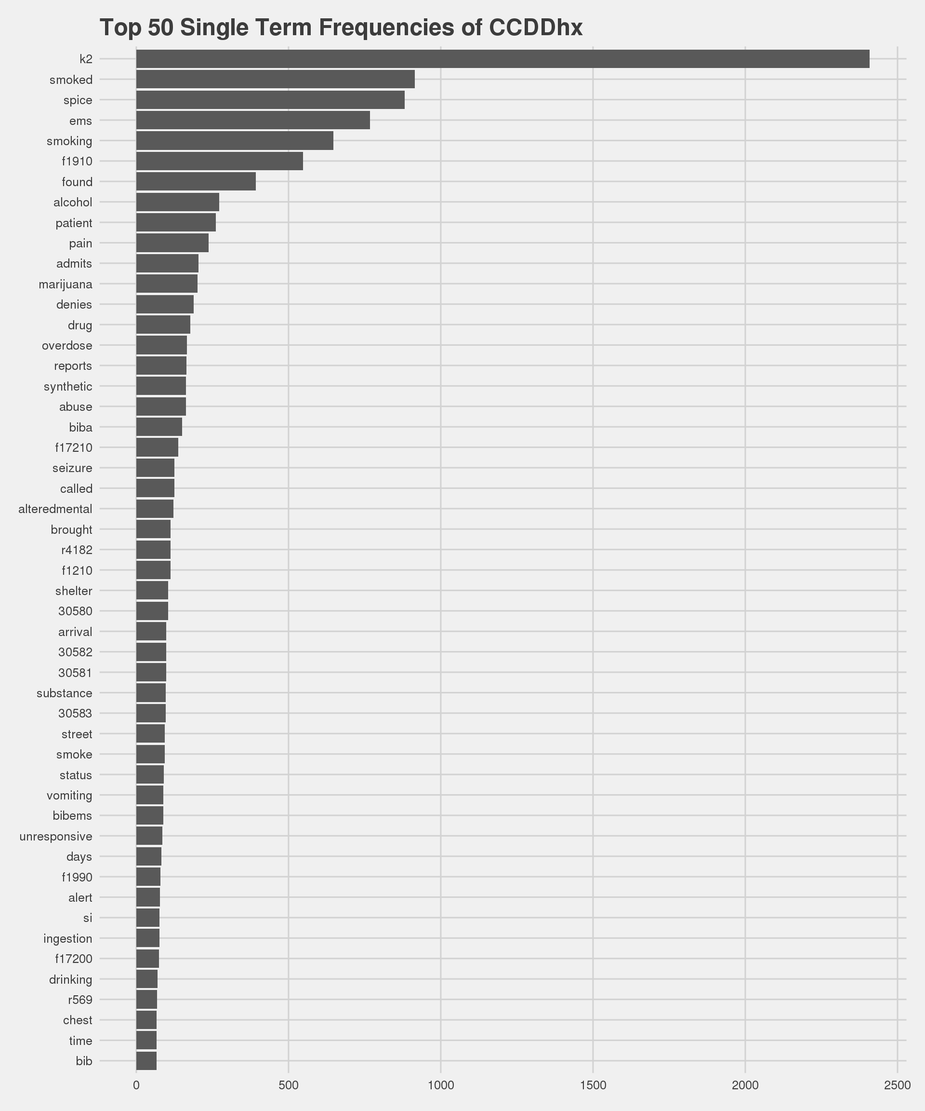
Single term CCDD
Notes:
Here are the Top single term or Unigram frequencies found: K2, smoked, spice, EMS, smoking, F19.10, found, alcohol, patient, pain, admits, marijuana to name a few ( in case you’re wondering F19.10 which is the ICD-10 code for other psychoactive substance abuse, uncomplicated)* is a billable specific code that can be used to indicate diagnosis for reimbursement purposes

Slide 14
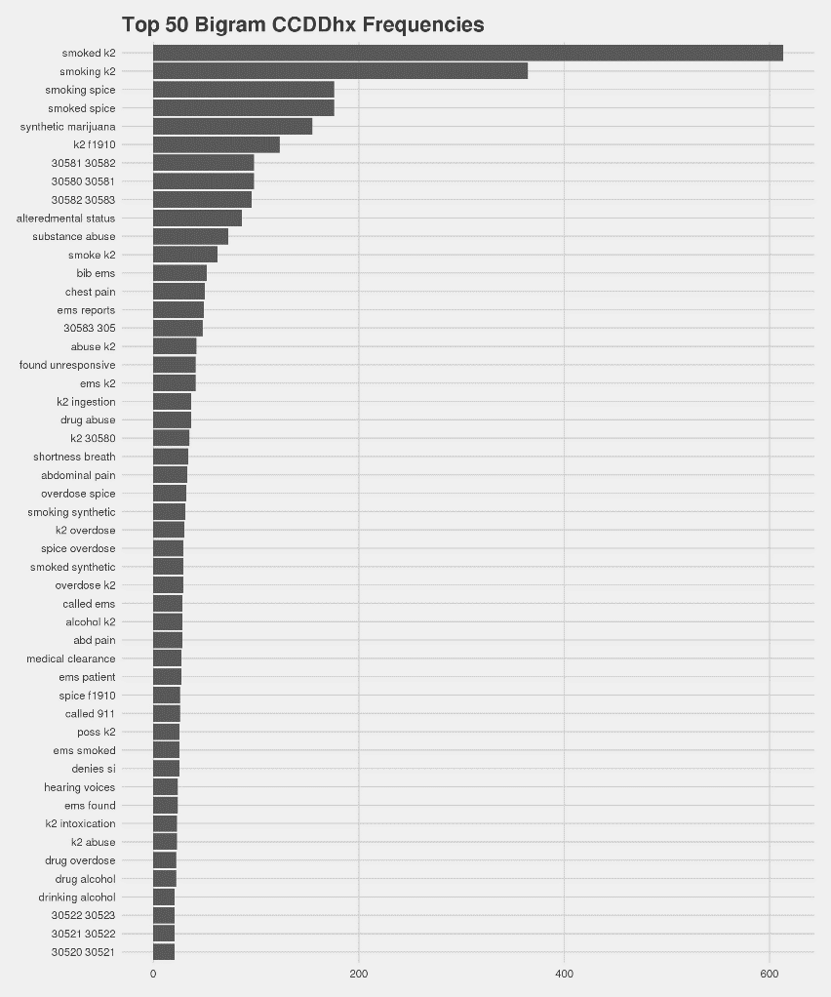
Bigram CCDD
Notes:
Next are the Top two word terms or Bigram frequencies found including: smoked K2, smoking spice, synthetic marijuana, k2 and f19.10 again
- Other psychoactive substance abuse, uncomplicated. Reminder F19.10 is a billable/specific ICD-10-CM code that can be used to indicate a diagnosis for reimbursement purposes.

Slide 15
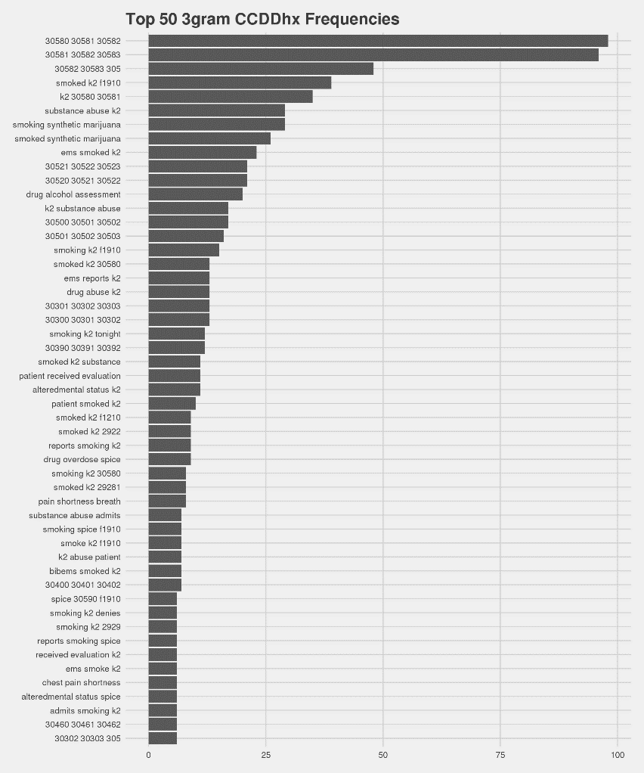
Trigram CCDD
Notes:
Lastly are the Top three word terms or Trigram frequencies found including: codes 305.80 to .82 which are actually ICD-9 codes that now convert to the ICD-10 code f19.10- or Other psychoactive substance abuse, uncomplicated. , you can also see substance abuse K2, EMS smoked K2, and drug alcohol assessment

Slide 16
Results
A series of histograms can show frequency of unigrams, bigrams, and trigrams identified during the development process.
Network graphs can be used to show co-occurrence of terms and diagnostic codes.
By using a range of graphs to develop syndrome definitions, the characteristics of chief complaint and discharge diagnosis fields can be viewed in multiple ways.
R programming software can facilitate statistical visualization.
Notes:
Next, I’m going to show you an example of a network graph that can be used to show the relationships between co-occurrence of terms and diagnostic codes. Recall again that all of these graphs are used in consultation with Subject Matter experts to develop syndrome case definition queries

Slide 17
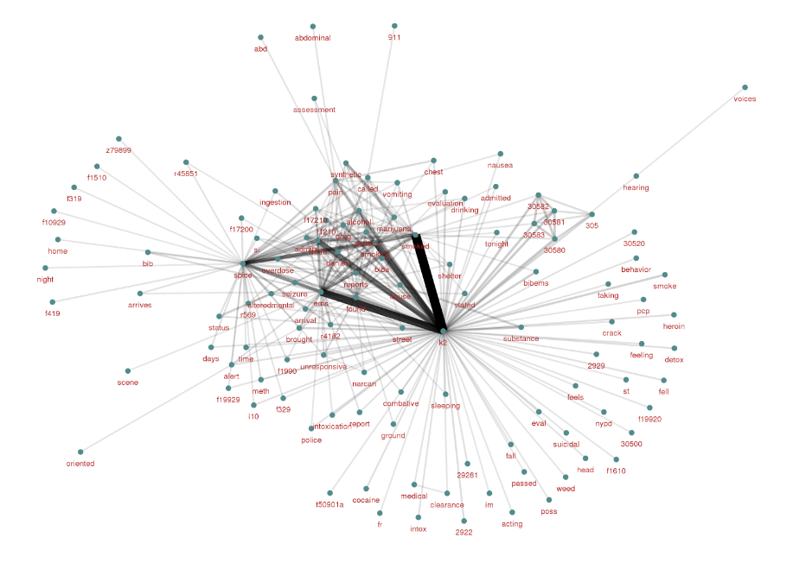
CCDD Network graph
Notes:
Shown here are the top 200 term relationships for synthetic cannabinoid vaping in this network graph. This graphic would be used to generate potential/ additional query terms for inclusion that may otherwise go undetected. I realize this is hard to see so I’ll call out some of the darker, heavier lines shown in this graph as stronger relationships. They include K2 (in the center), smoked, spice, overdose, EMS, patient, denies, admits, alcohol, and f12.10 or cannabis abuse uncomplicated F12.10 is a billable/specific ICD-10 code that can be used to indicate a diagnosis for reimbursement purposes.

Slide 18
Sample Query
(Vaping Synthetic Cannabinoids)
(k2,^ thca ^,or,^tetrahydrocannabinolic acid^,or,^ cbda ^,or,^cannabidiolic acid^,or,^ cbn ^,or,^cannabinol^,or,^ cbd ^,or,^cannabidiol^,or,^ thc ^,or,^tetrahydrocannabinol^,or,^sativex^,or,^epidiolex^,or,^hemp oil^,or,^cannahoney^,or,^hemp honey^,or,^ cbd rich^,or,^ vape ^,or,^alternate vape^,or,^cali stores^,or,^sana te premium oils^,or,^painbomb^,or,^morgue juice^,or,^michigan herbal remedies^,or,^green garden gold^,or,^dose of nature^,or,^ihempcbd^,or,^arisi_tol^,or,^yolo^,or,^hemp oil care^,or,^natural organic solutions^,or,^ canna pet^,or,^cibdex hemp^,or,^hemp salve^,or,^stanley brothers^,or,^charlottes web^,or,^natural alchemist^,or,^green roads health^,or,^ dabbing^,or,^ spice ^,or,^ bath salts ^,or,^ synthetic marijuana ^,or,^ cannabis ^,),andnot,(,^CBD stone^,or,^THC pt ^,)
Notes:
Here you see the resultant query from the data mining methods I’ve shared….
I can tell you anecdotally that The ESSENCE query sharing and discussions were enlightening. As Vaping is a world unto itself. The language is unique, influenced by slang and regional differences. So if you look closely you see terms such as morgue juice, green garden gold, charlottes web and natural alchemist. Vape oils, being unregulated, comprise any number of different compounds. By collaborating with state health departments on this public health response, CDC Subject Matter Experts and the NSSP DAT team learned how to develop a syndromic surveillance query that would capture broad keyword groupings related to the syndromes of interest and, specifically, to vape terminology.
CDC’s SMEs monitored overall trends of records associated with vape oils and exchanged information with NC DHHS and Utah Department of Health. Additionally, subject matter experts from the National Center for Environmental Health continued to monitor national poison center call data and to communicate with the DEA, Army, Marine Corps, and North Carolina health officials on issues related to vaping CBD oil.
It is important to note that the origin of the syndromic surveillance queries came from the Utah Department of Health, which used a combination of poison center call data and emergency department syndromic surveillance to identify potential cases for their state-level investigation. An interesting takeaway for NSSP DAT was the query language and inclusion of brand names (see example below).

Slide 19
Conclusions
Graphs enable analysts to visualize the relationship between the syndrome definition and search terms.
This process works for Cannabis-related syndromes of interest or broad topic areas, allowing generic trend series monitoring of the syndrome.
Once a syndrome has been developed, the analyst can consider spatial or temporal analysis.
Syndromic Surveillance Communities of Practice (CoP) are critical to the creation of case definition queries
Notes:
In conclusion…
Syndromic surveillance Graphs enable analysts to visualize the relationship between the syndrome definition and search terms.
This process works for Cannabis-related syndromes of interest or broader related topic areas, allowing generic trend series monitoring of the syndrome.
Once a syndrome has been developed, (local and state) analysts can consider spatial or temporal analysis.
Importantly, The collaborative aspects of a Community of Practice (CoP)—particularly when investigating a health problem—can fuel the imagination and broaden one’s ability to cast a wide net to identify records of interest. Better queries lead to actionable information. The example shared today is one in which the CoP explored a health problem that expanded the knowledge of query design.

Slide 20
Key Considerations
Importance of National Trend Data
  HHS Region limitations
  Communities of Practice (CoP)
State and local relationships and data sharing
  ED Health system data + Poison Center data
  More validation for a standard case definition
Cannabis-related issues
  CBD oil, vaping
  Synthetic Cannabinoids
Vulnerable populations
  Unintended Exposures among Children
  Elderly populations
Notes:
I’ll leave you by calling out these final considerations:
The Importance of National Trend Data ,Noting the HHS Region limitations, As well as the importance Communities of Practice (CoP)
And I can’t stress enough the need for strong State and local relationships and data sharing, Including looking at ED Health system data + Poison Center data in parallel, which allows for the review of triage notes that can additionally lead to better triangulation of the data, As well as the need for More validation studies for a standard case definition which can be applied universally
The expansion of Cannabis-related issues, Like the ones we discussed today ---CBD oil, vaping andSynthetic Cannabinoids
And Last but not least paying attention to Vulnerable populations such as, Unintended Exposures among Children, And increasing rates of use among Elderly populations with the potential of adverse events.

Slide 21
Thank YOU!
Acknowledgments:
  This presentation summarizes work done in collaboration with the Centers for Disease Control and Prevention, National Syndromic Surveillance Program and state and local partners as well as the CDC Syndromic Surveillance workgroup, CSTE Marijuana Surveillance Subcomittee and the Oregon Health Authority.
  Any questions?
  Rashid Njai, PhD, MPH,
    rnjai@cdc.gov
    Linkedin.com/in/rnjaiphd

