Slide 1
Marijuana Use Around Pregnancy
MI PRAMS 2016 - 2017 Combined Estimates

Slide 2
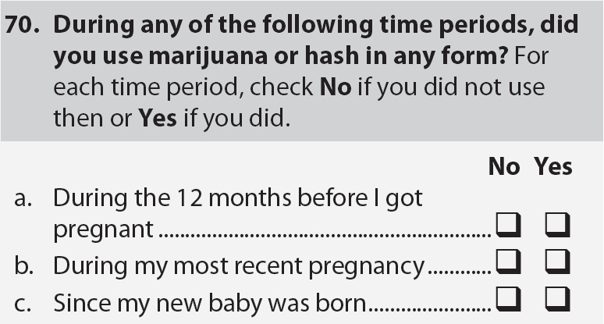
Marijuana or Hash Use Before, During, After Pregnancy
Few women chose to skipped this survey question
MJHSH_B4
  3.8% unweighted
  2.5% weighted
MJHSH_PG
  4.1% unweighted
  2.7% weighted
MJHSH_PP
  3.9% unweighted
  2.7% weighted
Notes:
UPDATE SKIPS TO 16-17 NUMBERS

Slide 3
USE AROUND PREGNANCY
~ 1/8 report any use before pregnancy
~ 1/30 report any use during pregnancy
  ~3/4 prepregnancy users quit by pregnancy
  Very few new users during pregnancy
~1/20 report any use following birth of their new baby
  ~1/5 pregnancy quitters resume
  Again, very few new users

Slide 4
Changes in Use
12 Months Before Pregnancy
During Pregnancy
After Pregnancy
BEFORE PREGNANCY | DURING PREGNANCY | AFTER PREGNANCY | TYPE OF CHANGE
NO | YES |  | New use during pregnancy*
YES | NO |  | Stopped before pregnancy
YES | NO | YES | Stopped before pregnancy, resumed after
NO | NO | YES | New use after pregnancy*
YES | YES | YES | Persistent use around pregnancy
* New users during pregnancy, after pregnancy are too small for any meaningful demographic breakdowns

Slide 5
Notes:
Look at weighted versus unweighted use for age

Slide 6
* Relative Standard Error exceeds 30%; Interpret with Caution

Slide 7
* Relative Standard Error exceeds 30%; Interpret with Caution

Slide 8
* Relative Standard Error exceeds 30%; Interpret with Caution

Slide 9
* Relative Standard Error exceeds 30%; Interpret with Caution

