Slide 1
Short collaborative project
ommon terminology

Slide 2
Issue
Terminology used in surveillance reporting (not within surveys) varies.
Some public health agencies have stated a preference for specific terms, especially “cannabis”
  “marijuana” can be viewed as negative (e.g., see Leafly article )
  “recreational” can imply a value about use, when we prefer public health language to be neutral
Changing terms can be difficult, especially a complete change
  Established services may be named “medical marijuana program”
  Legislation may have used specific terms

Slide 3
“Recommendations for Reporting”
1-page statement about this group’s opinion
Doesn’t bind anyone to anything, just stating a preference and giving reasons why
A relatively good “practice project” for road-testing our “recommendations” approach
  Issue applies to everyone
  Doesn’t require technical skill to have an opinion
  Thoughts?

Slide 4
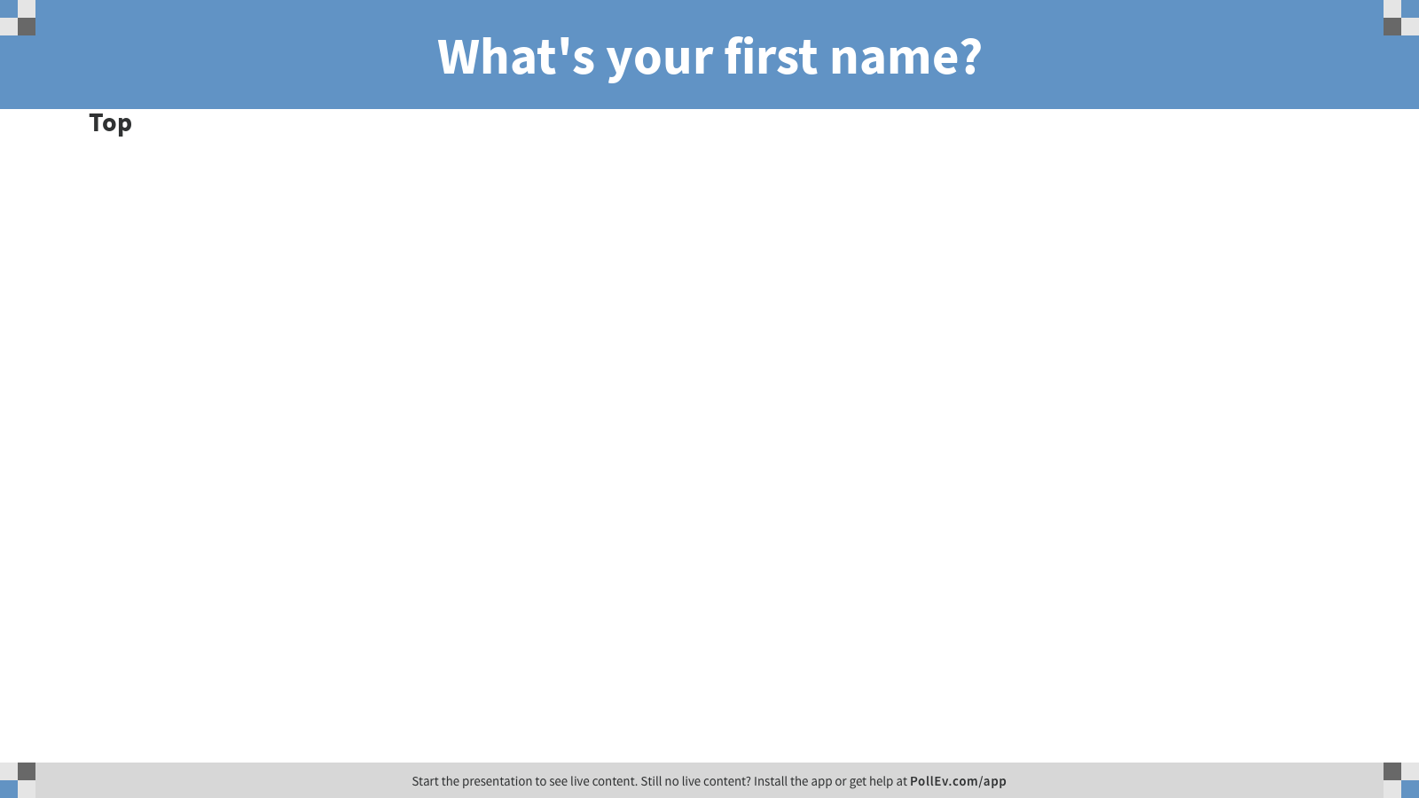
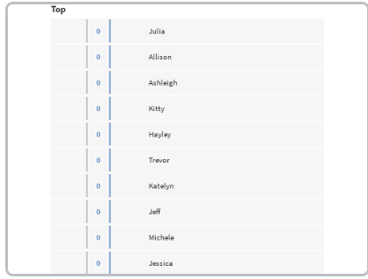
Notes:
Poll Title: What's your first name?
https://www.polleverywhere.com/discourses/IubhqVqoOrV7j7tjwCptE

Slide 5
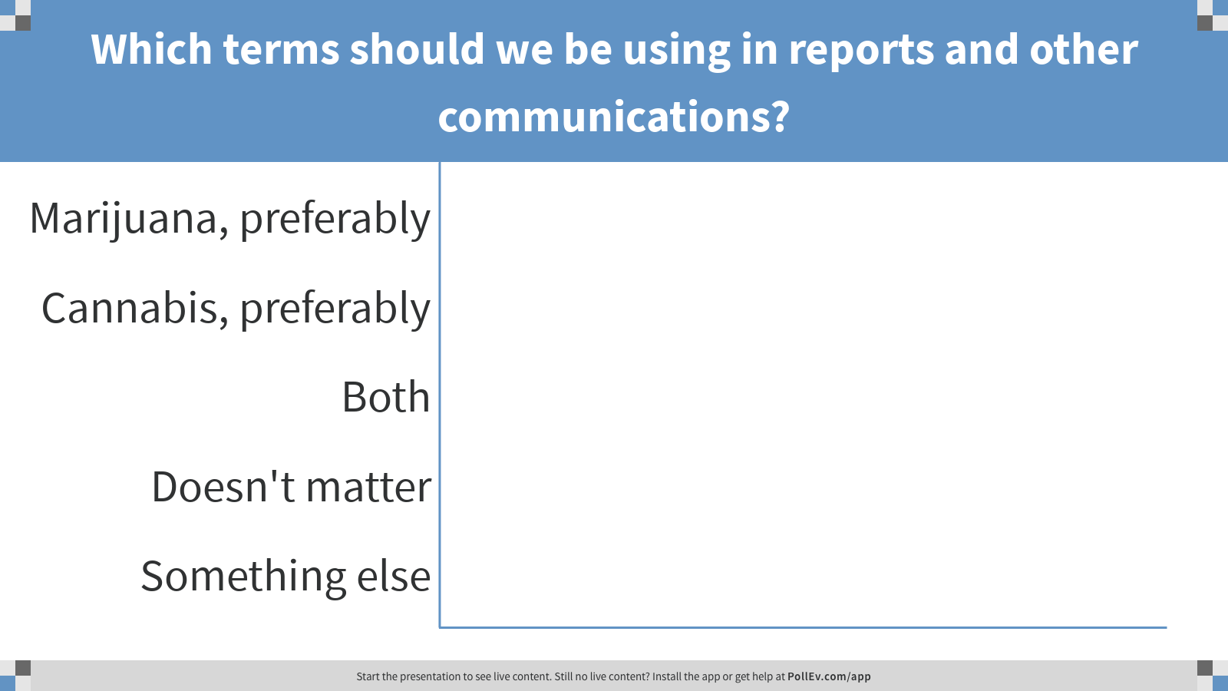
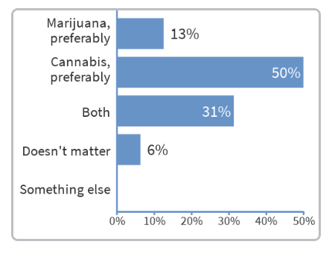
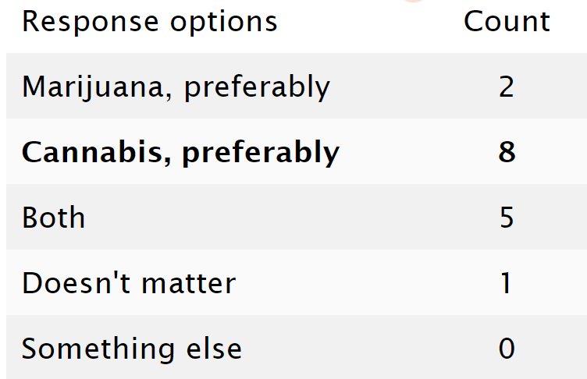
Notes:
Poll Title: Which terms should we be using in reports and other communications?
https://www.polleverywhere.com/multiple_choice_polls/55ZVzpNh1UyItTdIKpnn5

Slide 6
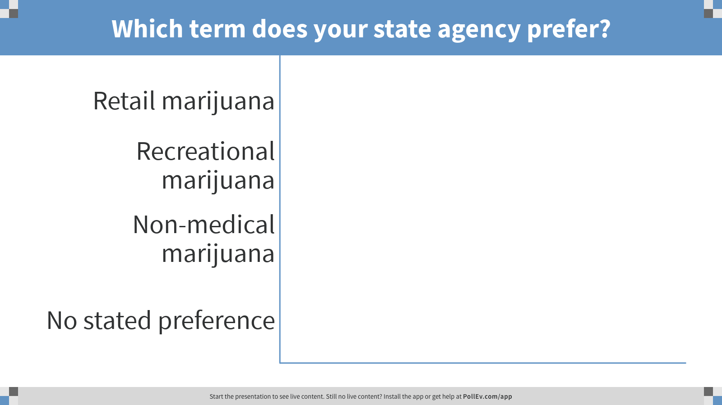
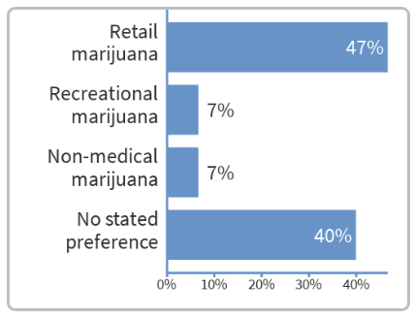
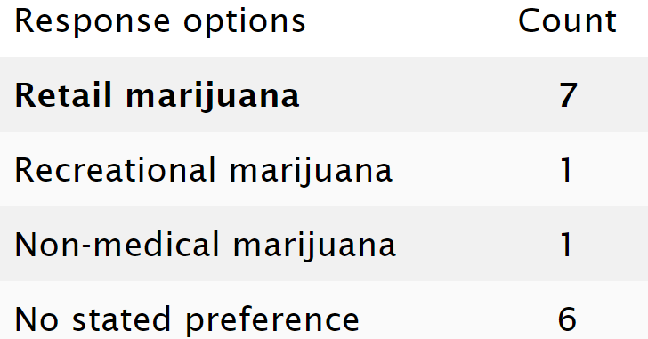
Ignores the “marijuana” vs. “cannabis” component of these terms
Notes:
Poll Title: Which term does your state agency prefer?
https://www.polleverywhere.com/multiple_choice_polls/sN2VNAFEUBm2nxWOJL2FQ

Slide 7
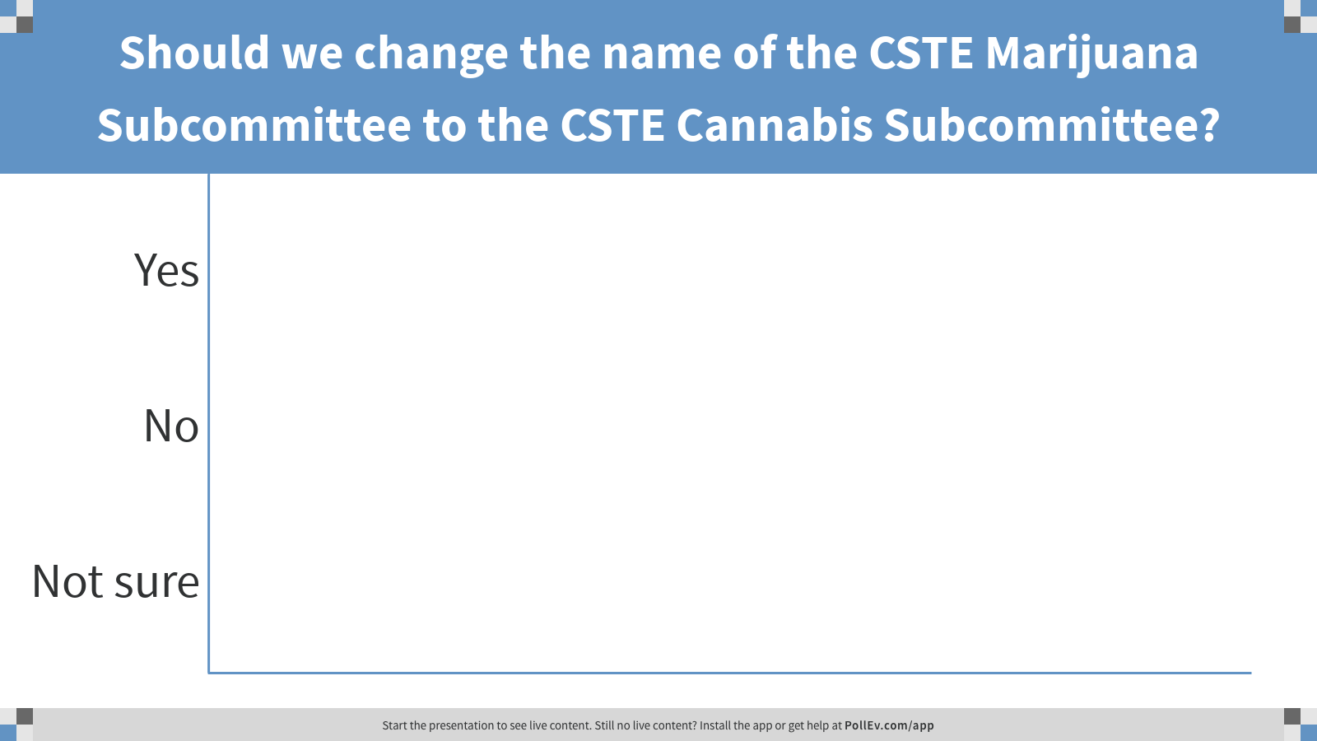
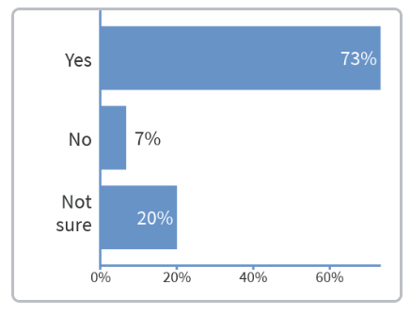
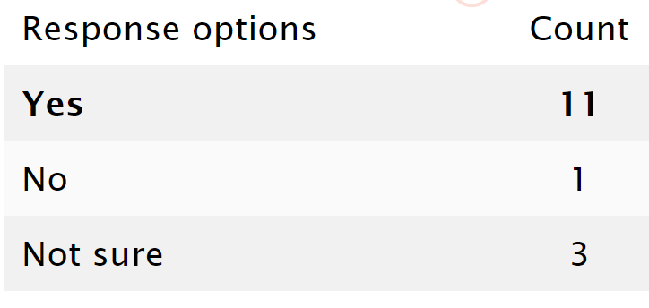
Notes:
Poll Title: Should we change the name of the CSTE Marijuana Subcommittee to the CSTE Cannabis Subcommittee?
https://www.polleverywhere.com/multiple_choice_polls/PgbtqtTlJkPwFDPuZ1L3Q

Slide 8
Next Steps
Action steps after we leave the room

Slide 9
Specific Actions
Nikka, Valerie, Katelyn, Julia will…
Upload final presentations & notes from our discussions to Basecamp over the next week
Circulate “language recommendations” document for your review/comment
Flesh out initiating a few other specific projects, depending on interest (maybe with a 2-year view)
Prepare for next Marijuana Subcommittee call (5/23/19, 10-11am PST)
  Invite others to participate in developing “recommendation” tools
  Planned to talk about “Market Dashboard” with a short presentation from regulatory agency folks
Prepare for what to share at the CSTE Conference in June
  We have a “roundtable” ~45 minutes on the agenda
  This may be a good time to finalize “language recommendations”

Slide 10
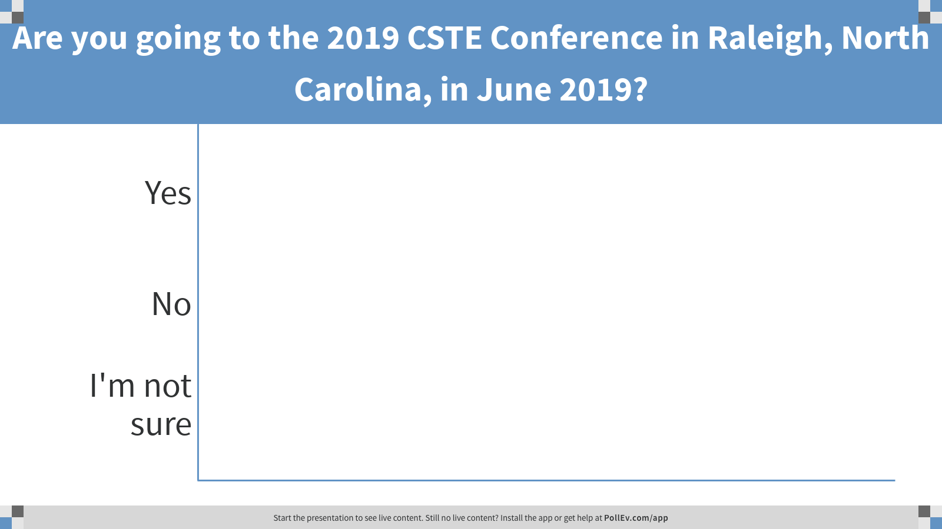
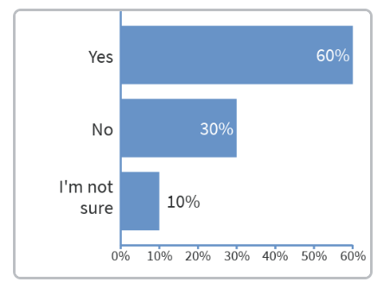
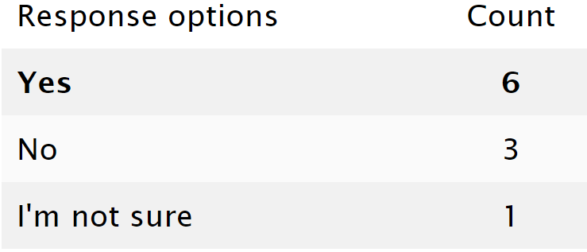
Notes:
Poll Title: Are you going to the 2019 CSTE Conference in Raleigh, North Carolina, in June 2019?
https://www.polleverywhere.com/multiple_choice_polls/25mbSvIZVzCvZMadwGcZk

Slide 11
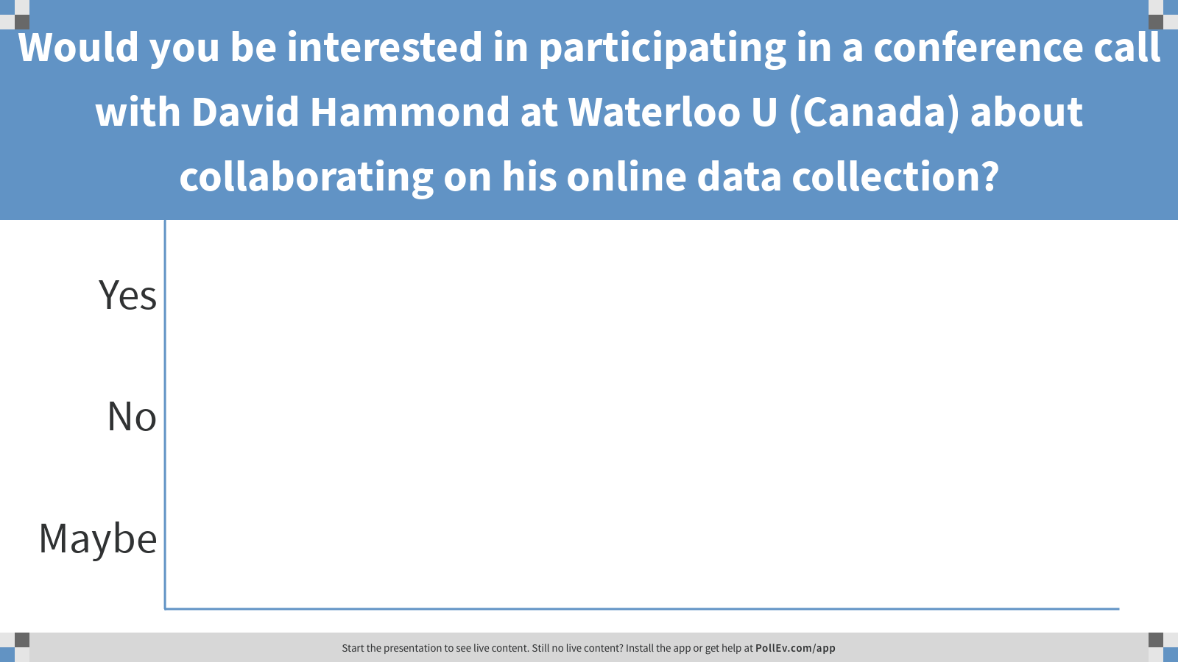
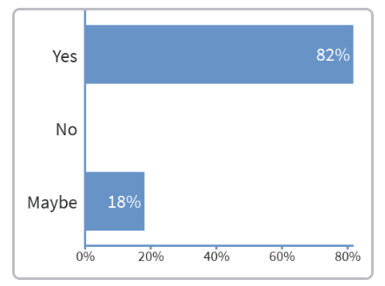
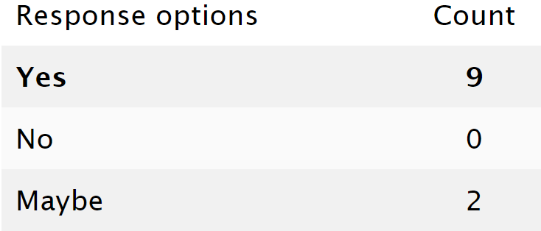
Notes:
Poll Title: Would you be interested in participating in a conference call with David Hammond at Waterloo U (Canada) about collaborating on his online data collection?
https://www.polleverywhere.com/multiple_choice_polls/sZPdkVyuZz2fq4L73meoA

Slide 12
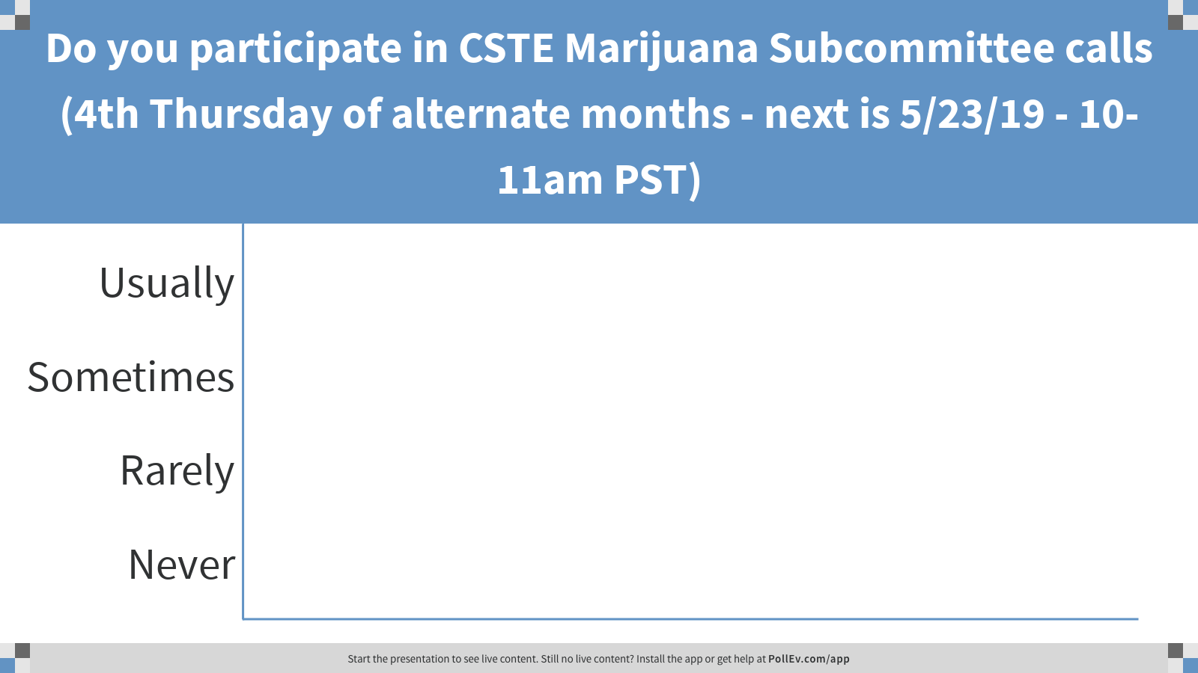
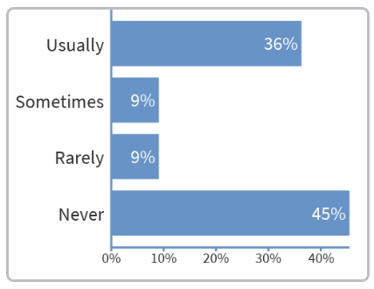
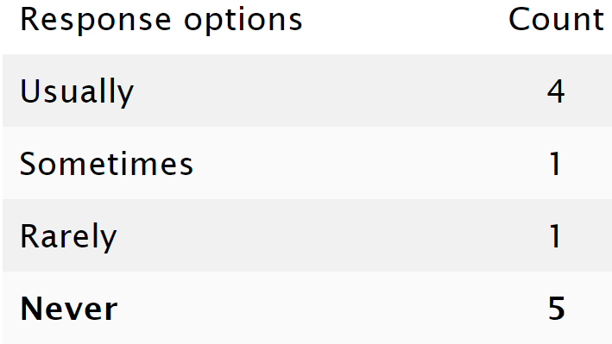
Notes:
Poll Title: Do you participate in CSTE Marijuana Subcommittee calls (4th Thursday of alternate months - next is 5/23/19 - 10-11am PST)
https://www.polleverywhere.com/multiple_choice_polls/2219gzIE8qmnELUXPlCqG

Slide 13
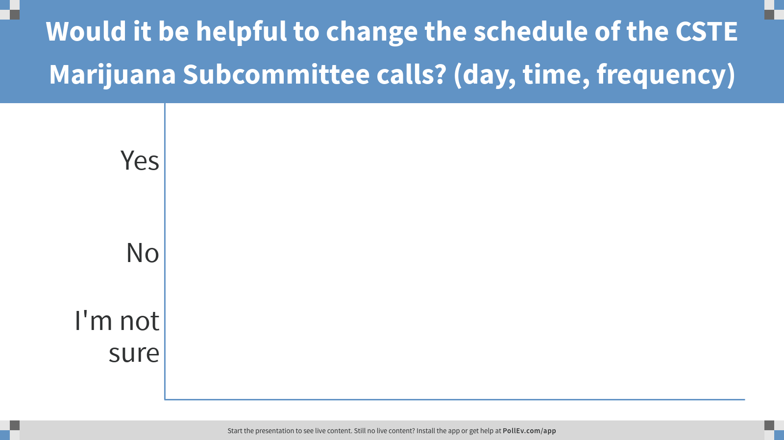
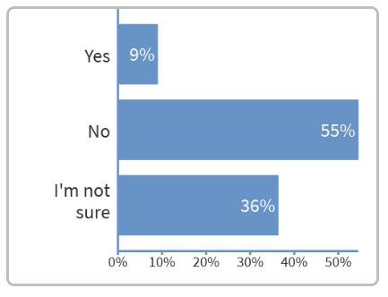
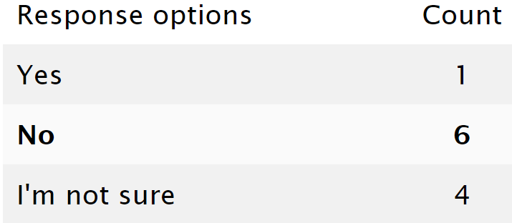
Notes:
Poll Title: Would it be helpful to change the schedule of the CSTE Marijuana Subcommittee calls? (day, time, frequency)
https://www.polleverywhere.com/multiple_choice_polls/Etq5y1K4ka10FmjfaBfXg

Slide 14
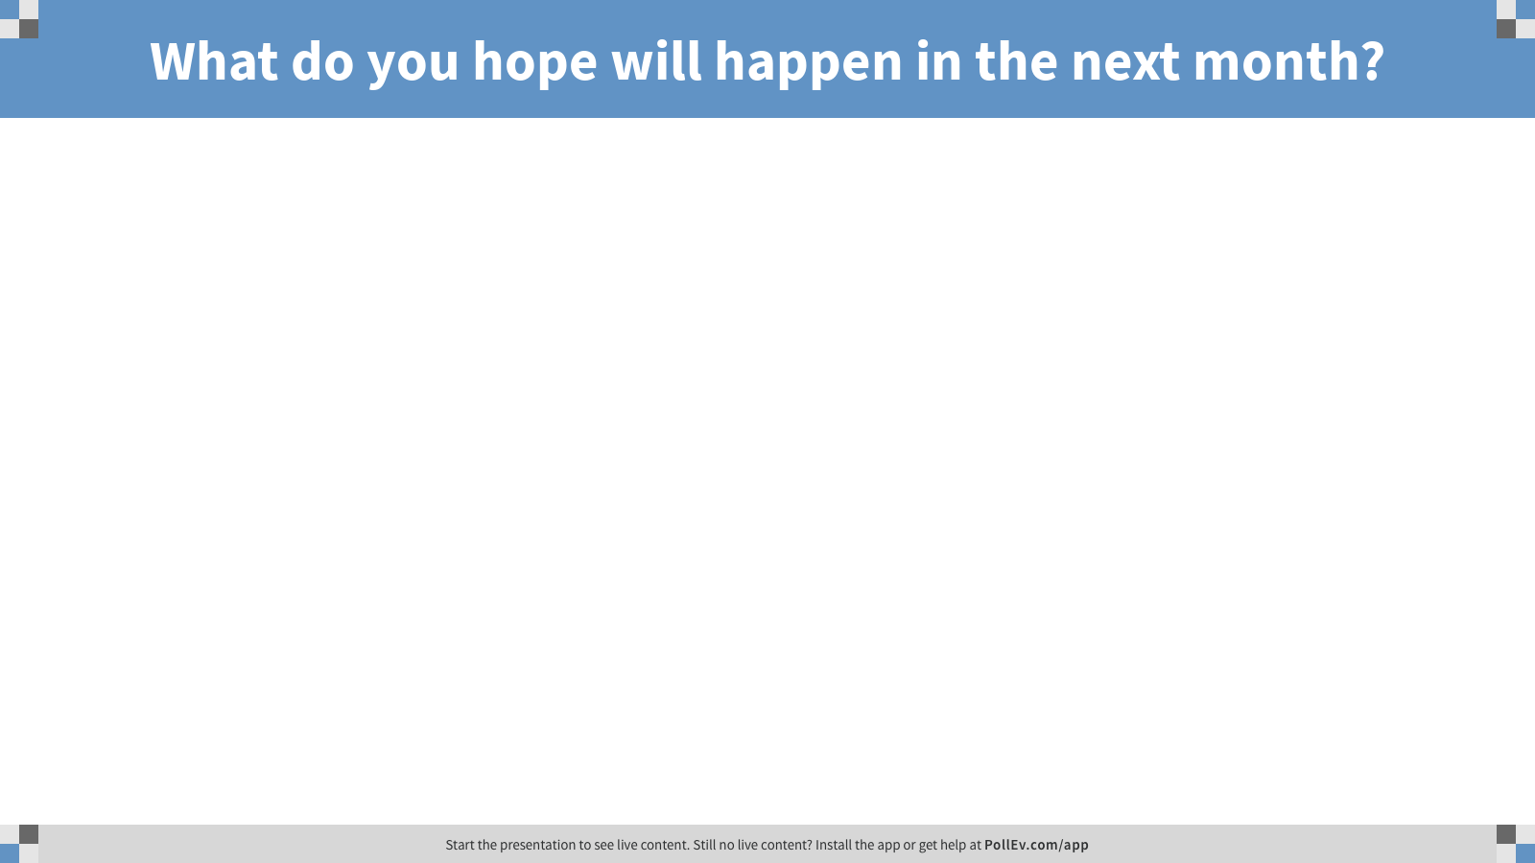
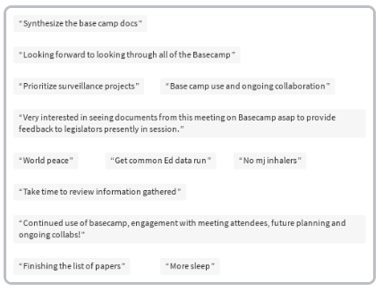
Notes:
Poll Title: What do you hope will happen in the next month?
https://www.polleverywhere.com/free_text_polls/7qLblEd8reK20qaqFJXhq

Slide 15
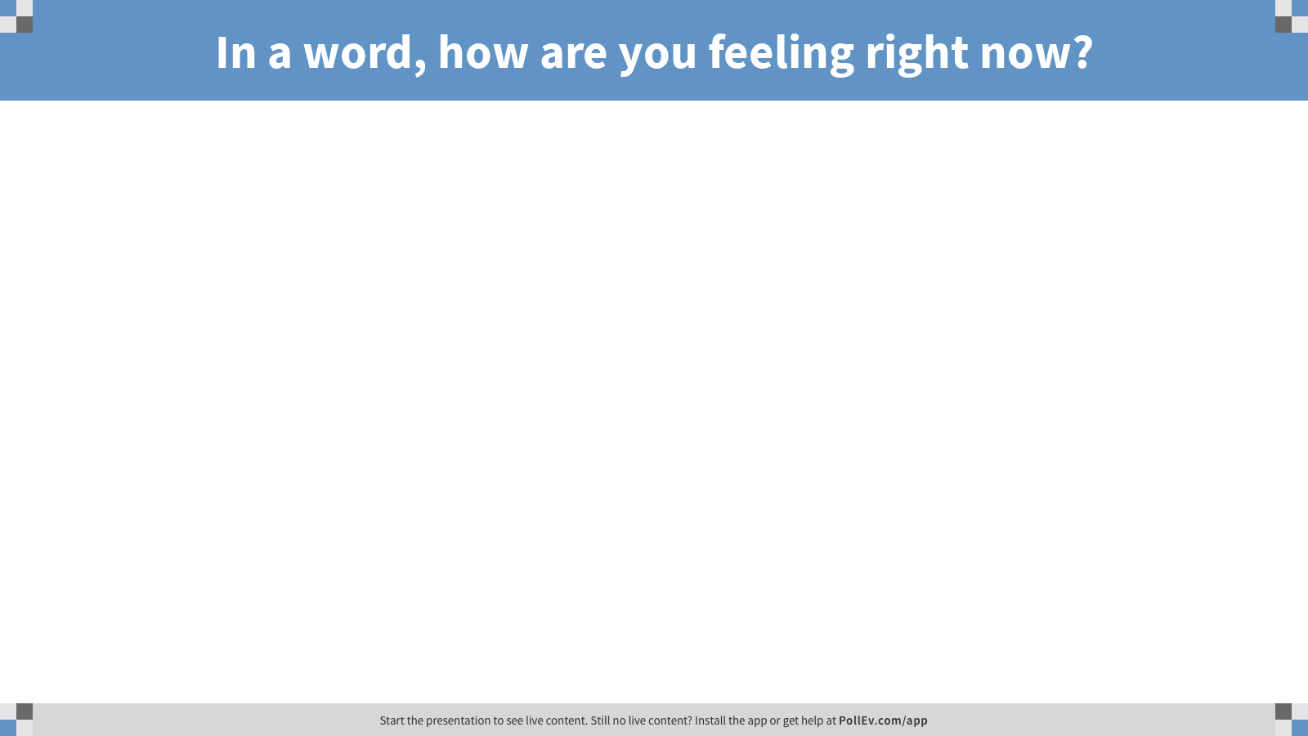
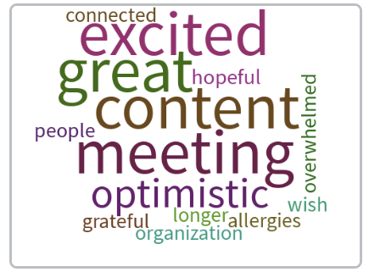
Notes:
Poll Title: In a word, how are you feeling right now?
https://www.polleverywhere.com/free_text_polls/fMfHj4iDGoLRXakJCiWKR

Slide 16
