Slide 1
CSTE Marijuana Surveillance Workgroup Meeting
May 1-2, 2019
Colorado Department of Public Health and Environment
4300 Cherry Creek S Dr, Denver, CO 80246

Slide 2
Day 1
“What’s the plan? How’s that going?”

Slide 3
8:45-9:00 Arrivals
Sign in
CDPHE Guest Name tags
Packets
  Agenda
  Registration list

Slide 4
9:00-9:15 Welcome/housekeeping
Housekeeping
  Restrooms
  Snacks
  Emergency exits
  Will be moving rooms after lunch
  Lunch will be on your own
Notes:
Katelyn will do
-pull boilerplate intro
-have Elyse intro with me

Slide 5
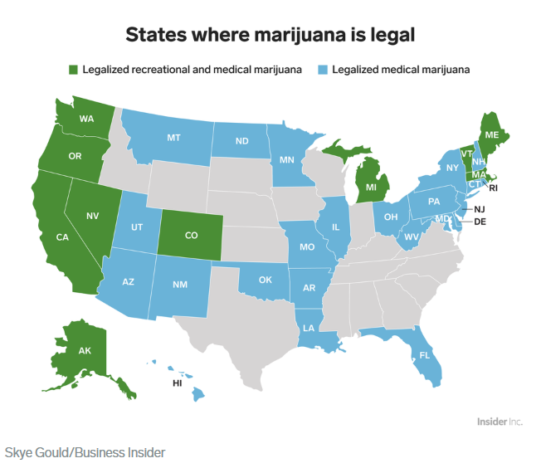

Who is in the room?
Representation from...
10 states with legalized recreational cannabis
(non-medical, retail)
4 states where legalization seems to be coming
Canada!
You are… Epidemiologists, administrators, program coordinators
Source: https://www.businessinsider.com/legal-marijuana-states-2018-1

Slide 6
What you have in common: Work on Surveillance
For the purpose of our discussions, cannabis or marijuana surveillance is defined as:
Continuous, systematic collection, analysis and interpretation of marijuana-related data needed for the planning, implementation and evaluation of public health practice.

Slide 7
9:15-9:30 Meeting Overview and Objectives
Goal: Build Marijuana/Cannabis-Related Public Health Surveillance Capacity
Objectives:
By the end of this workgroup meeting participants will:
Have access to available resources to support surveillance planning and examples of reports
Establish connections among peers who are working in different states to plan, implement and report on marijuana/cannabis public health surveillance activities
Understand the strengths and limitations of current common surveillance data systems
Identify approaches and opportunities to address surveillance weaknesses or challenges
Contribute to planning next steps for strengthening capacity
Objectives & agenda were developed with your input (copies of meeting survey results available if interested)
Sharing data, resources and experiences among peers, with the understanding that this is for the purpose of discussion and will not be shared publicly
Identifying limitations and weaknesses of available data systems, and how to address them, to understand how they can be most useful for surveillance
Focusing on the priority interests of the attendees, with the understanding that all topics of interest will not be covered
Notes:
Katelyn will do

Slide 8
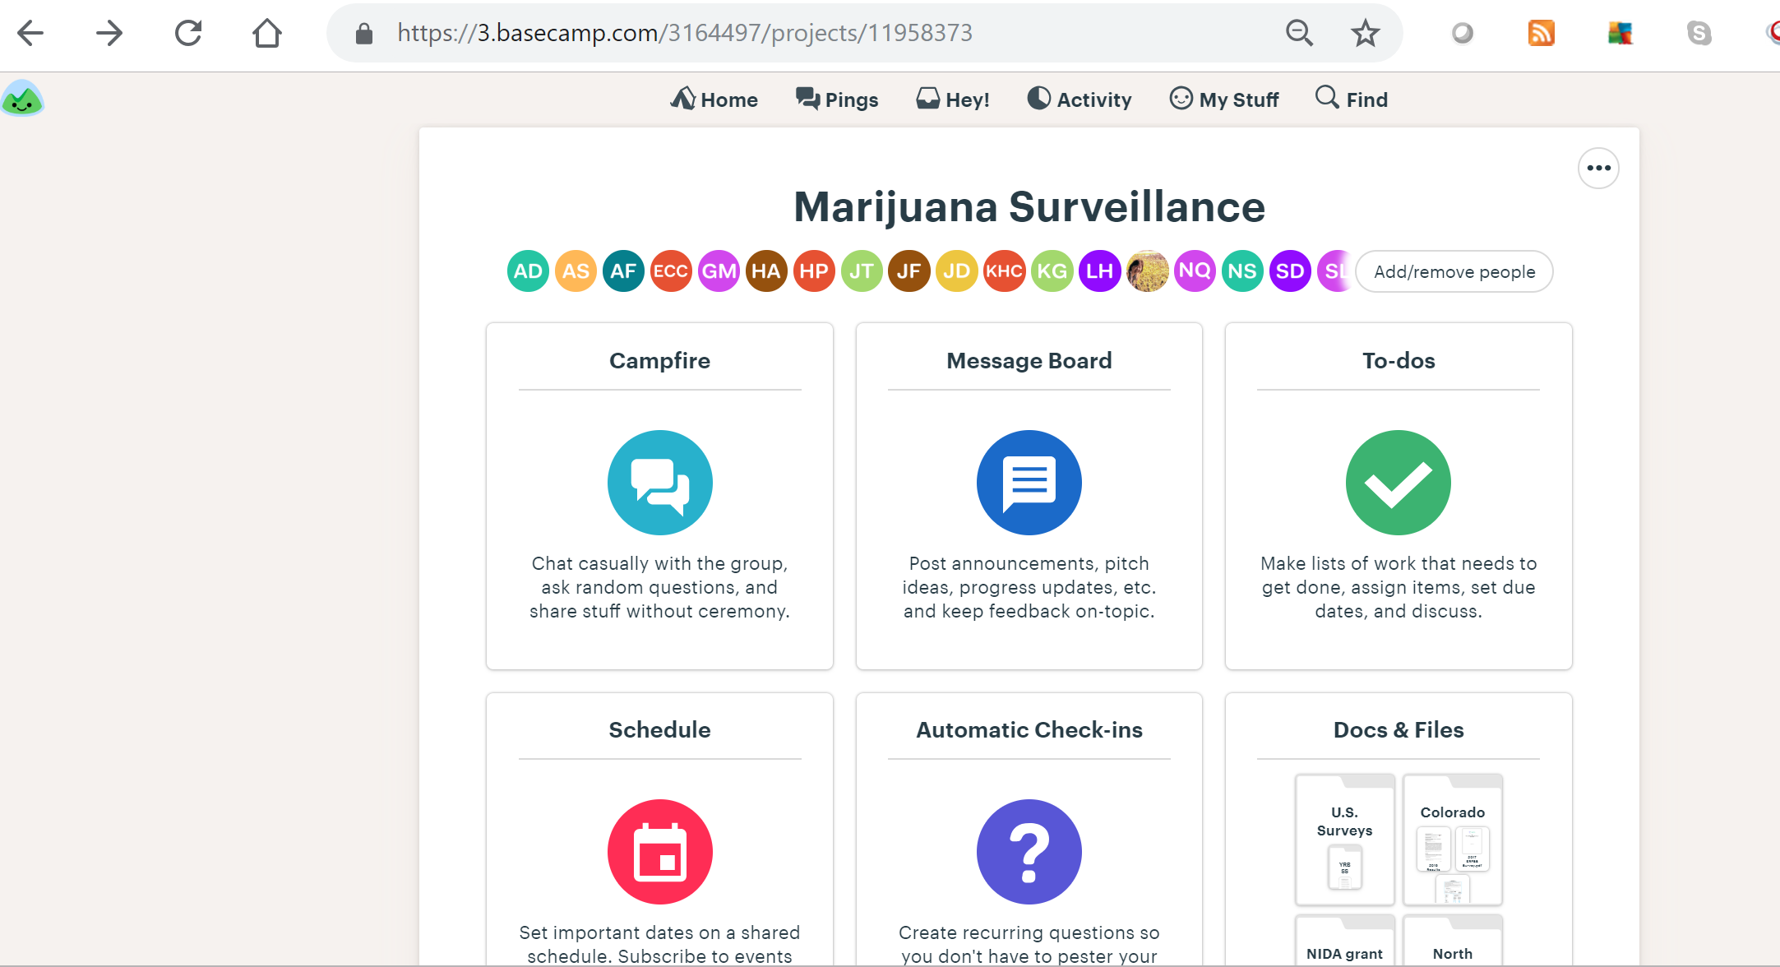
Welcome to Basecamp! Please explore & share

Slide 9
Introductions
Name
Jurisdiction
Field of work (epidemiologist, policy, administrative, etc)
If you could instantly be an expert in a subject, what would it be?

Slide 10
What we have to work with now

Slide 11
9:30-9:50 State of the State of Marijuana Surveillance
Organizations working on Capacity-Building (Nikka)
  CSTE
  Federal agencies: CDC/SAMHSA/NIDA
Efforts to Gather Resources (Julia)
  Environmental Scan & key informant interviews
  Self Assessment of Marijuana Surveillance in Your Jurisdiction
What’s Available Now for Surveillance Tools/Resources (Katelyn)
  Identifying “core” surveillance measures (and “potential” measures)
  Core surveillance questions
    BRFSS CORE module
    NSDUH state estimates
    YRBSS
  Established Queries for Syndromic Surveillance
  Literature Reviews
Notes:
Maybe instead of a presentation we can walk people through the resources on our “Basecamp”

Slide 12
Organizations Working on Capacity-Building
CSTE Marijuana Subcommittee
Purpose: Develop a national strategy to systematically monitor, characterize, and mitigate the public health impacts of marijuana
Activities:
Developed Recommendations for Strengthening Surveillance and Research of Marijuana and Health Outcomes in the United States
CSTE Marijuana Surveillance Environmental Scan Report
Convene relevant stakeholders to develop innovative approaches to improving the quality of Marijuana Surveillance
Federal agencies: CDC/SAMHSA/NIDA
Notes:
•CSTE is an organization of member states and territories representing public health epidemiologists
•CSTE members include applied public health epidemiologists and related professions who work in government, private-sector,non-profit, and academic contexts throughout the nation
•CSTE works to advance public health policy and epidemiologic capacity.
•CSTE provides information, education, and developmental support of practicing epidemiologists in a wide range of areas as well as expertise for program and surveillance efforts
The CSTE Marijuana Subcommittee was formed primarily in response to the increasing number of states that have legalized marijuana for retail use.
Provides a forum for states to share knowledge and resources that will facilitate improved communication, collaboration, standardization of surveillance methodologies, and development of evidence-based intervention strategies.
The subcommittee’s current primary project is to develop standardized data collection tools on marijuana use. These tools will enable states to compare data before and after marijuana legalization, among different demographics, and examine other public health concerns that may arise from legalization.

Slide 13
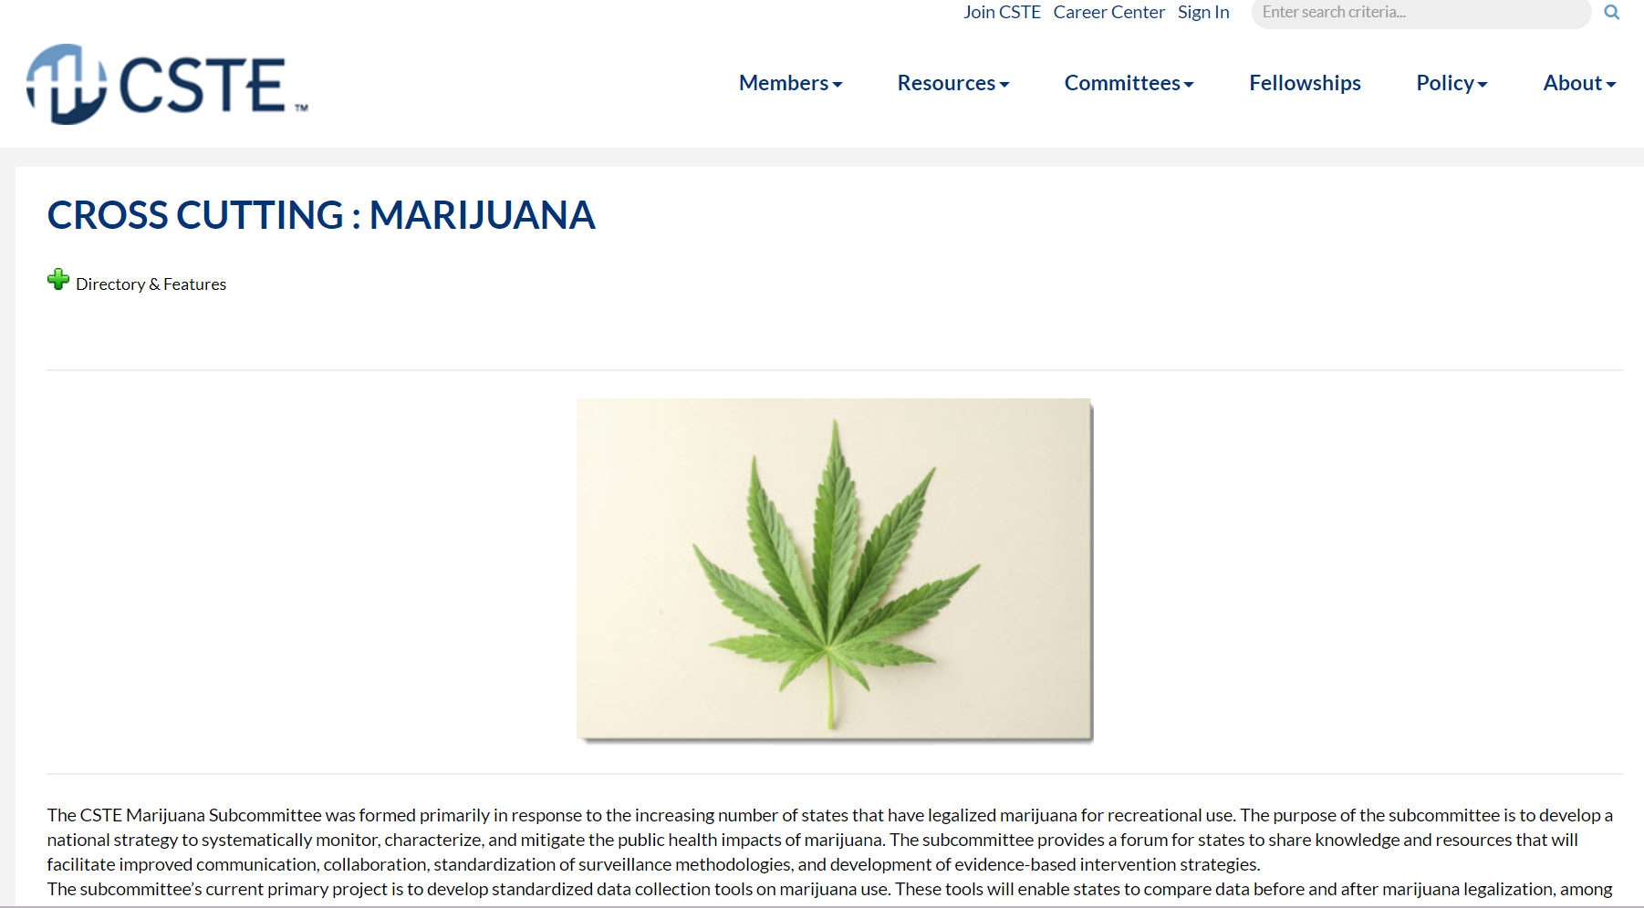
Efforts to gather resources
CSTE Marijuana Subcommittee
https://www.cste.org/members/group.aspx?id=150877
  Self-assessment
  Environmental Scan report (key informant interviews)
Notes:
(Julia)

Slide 14
Self Assessment of Marijuana Surveillance Data
Created with the Environment Scan and Key Informant Interviews as an assessment of marijuana surveillance and capacity
Designed to use with your stakeholders who are designing a surveillance plan for monitoring marijuana/cannabis-related public health indicators to formalized efforts and capacity
Access via basecamp link: https://3.basecamp.com/3164497/buckets/11958373/uploads/1765023210

Slide 15

Environmental Scan Report
Key informant interviews with 8 states
Lessons learned about implementing surveillance
Access vis CSTE Marijuana Subcommittee website or Basecamp Link https://3.basecamp.com/3164497/buckets/11958373/vaults/1764822045

Slide 16
Recommended Measures

Slide 17
National Survey on Drug Use and Health (NSDUH)
Lifetime use, past 30 day marijuana use
Other substance use too
State level estimates
PDAS and RDAS: https://www.datafiles.samhsa.gov/info/analyze-data-nid6
  Can query for data
  Can also go to data centers and perform analysis on the raw data

Slide 18
BRFSS Marijuana Optional Core Module
Past 30 day marijuana use, methods of use, reason for use
https://www.cdc.gov/brfss/questionnaires/pdf-ques/2018_BRFSS_English_Questionnaire.pdf
State added questions
  Colorado asks about times used marijuana and driving after recent use
    https://www.colorado.gov/pacific/cdphe/behaviorsurvey
  Oregon asks about using marijuana medicinally, how marijuana is usually obtained, and driving after using
    https://www.oregon.gov/OHA/PH/BIRTHDEATHCERTIFICATES/SURVEYS/ADULTBEHAVIORRISK/BRFSSRESULTS/Documents/2016/marijuana16.pdf

Slide 19
Youth Risk Behavior Surveillance System (YRBSS)
High school and middle school students
Lifetime marijuana use, age of first use, past 30 day use
https://www.cdc.gov/healthyyouth/data/yrbs/pdf/2019/2019_YRBS-Standard-HS-Questionnaire.pdf
  Colorado asks about perception of harm, perceptions of youth use, perceptions of use being wrong, methods of use, times used, driving after using, riding in the car with someone driving that has recently used, how obtained marijuana, using marijuana on school property
    https://www.colorado.gov/pacific/cdphe/hkcs
    https://public.3.basecamp.com/p/8MSr2BGtESKwy2fUZtCfJqVD
  Oregon asks about ease of obtaining marijuana, perception of harm, times used, source of marijuana, perceptions of use being wrong
    https://oregon.pridesurveys.com/
    https://public.3.basecamp.com/p/oFvDY25zgqpgGfZes47gbkAV

Slide 20
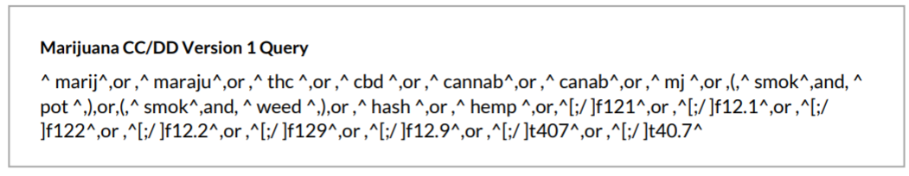
Established Queries for Syndromic Surveillance
NSSP query added in April 2018
https://www.cdc.gov/nssp/news/2018/04-april/nssp-update-2018-04-508.pdf
Oregon “base” query (from original Colorado work)
^ marij^,or ,^ maraju^,or ,^ thc ^,or ,^ cbd ^,or ,^ cannab^,or ,^ canab^,or ,^ mj ^,or ,(,^ smok^,and, ^ pot ^,),or,(,^ smok^,and, ^ weed ^,),or ,^ hash ^,or ,^ hemp ^,or,^f121^,or ,^f12.1^,or ,^f122^,or ,^f12.2^,or ,^f129^,or ,^f12.9^,or ,^t407^,or ,^t40.7^

Slide 21
Systematic Reviews of Cannabis and Health Effects

Slide 22
Literature Reviews
National Academy of Sciences report, January 2017
http://nationalacademies.org/hmd/reports/2017/health-effects-of-cannabis-and-cannabinoids.aspx
CDC Website on Marijuana, January 2017
https://www.cdc.gov/marijuana/
Colorado Department of Public Health and Environment, January 2019
https://www.colorado.gov/marijuanahealthinfo
World Health Organization, 2016 http://www.who.int/substance_abuse/publications/cannabis_report/en/

Slide 23

National Academies of Science (NAS)
Quick turnaround
Prioritized systematic reviews, only reviewing primary literature when systematic reviews not available
Did not include animal, lab or environmental studies (only human outcomes)
Includes review of medical efficacy
5 Levels of evidence
  Conclusive
  Substantial
  Moderate
  Limited
  No or Insufficient Information

Slide 24

Colorado Department of Public Health & Environment (CDPHE)
3 reports to date www.colorado.gov/marijuanahealthinfo
Translation to public health messages
Evidence base + findings from Colorado surveillance
6 levels of evidence
  Substantial
  Moderate
  Limited
  Mixed
  Body of research fails to show association
  Insufficient evidence
New literature review in dashboard online: https://www.colorado.gov/pacific/marijuanahealthinfo/public-health-statements
Notes:
Substantial evidence - robust scientific findings
Moderate evidence - association but studies have some limitations
Limited evidence - modest scientific findings with significant limitations
Mixed evidence - both supporting and non-supporting scientific findings
Body of research failing to show an association - moderate or substantial body of research
Insufficient evidence

Slide 25
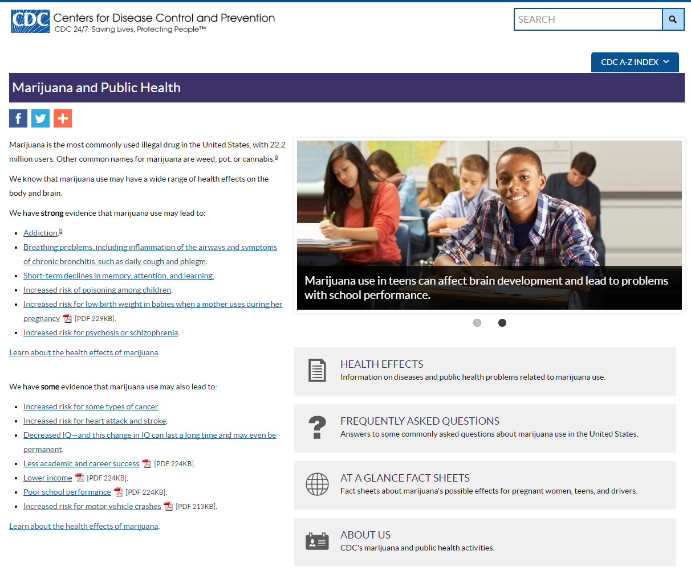
CDC Website
Information suitable for the public (3 fact sheets) as well as detailed summaries
Not a formal systematic review of evidence
2 levels of evidence
Strong
Some

Slide 26

World Health Organization (WHO)
Health and Social Effects of Nonmedical Cannabis Use
In addition to describing the evidence base for cannabis use and health:
Discusses neurobiology of cannabis use, disorders and treatment
Describes prevention and treatment approaches
Does not have “categories” of evidence

Slide 27
Take-Away Comparisons
NAS report is relatively narrow, carries the weight of a highly-respected scientific organization.
CDPHE report is more inclusive, and incorporates the perspective of applied public health.
CDC report is more friendly, well-known and hits the high points, but not a systematic review.
WHO report is light and not too detailed.

Slide 28
What do they agree about on critical topics?
(not exhaustive)
Substantial/Strong
  Dependence & addiction
  Symptoms of psychosis & schizophrenia
Moderate/Some
  Adolescent brain development, impact on education

Slide 29
Disagreement on critical topics? (not exhaustive)
Topic | NAS | CDC | CDPHE
Traffic Crashes | Substantial | Some | Substantial
Lung Cancer | Moderate for NO association (nothing on carcinogens) | Some | Mixed for long-term use on lung cancer; Substantial evidence on daily/near daily mj smoking and pre-malignant lesions;
Pregnancy outcomes | Insufficient for infant cognitive/behavior Insufficient for birth defects Substantial for birthweight | Strong | Moderate cognitive/behavioral impact on baby Limited for birth defects and mixed on low birthweight Biological evidence THC passes the placenta
Breastfeeding | n/a | Strong (implied) | Biological evidence for THC transfer to baby

Slide 30
Gaps and challenges to interpreting “evidence base”
Problems with the Studies
Inconsistent measures of exposure
  Frequency, modes of use
  How much was used, how potent the product
  Changing norms could influence reporting biases over time
Confounding
  Marijuana use highly correlated with tobacco use, often not separated from alcohol, other drugs
  Socio-economic factors often not controlled for

Slide 31
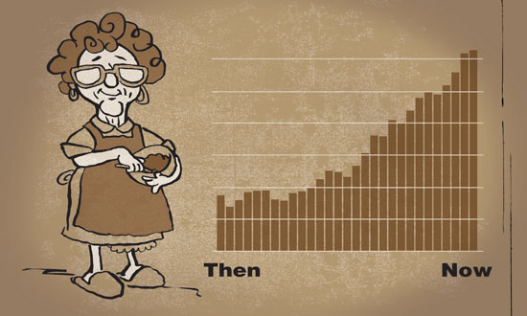
More Gaps & Challenges
Context Change
Changing potential exposures
vs. past studies
  Increasingly potent products
  More product types
  Increased availability and declining prices
Publication bias
  ...and perceptions of publication biases
Image credit: State of Alaska DHSS

Slide 32
Even More Gaps & Challenges
Reports communication of results
Very simple categories are easier to understand, but nuance of findings is lost
“Association” is not “Causality”
  Temporality is an issue, especially when used as a medication
“Association” is not the same as “big magnitude”

Slide 33
Sharing Our Data

Slide 34
9:50-10:15 Multi-State Data -- State Data Assembled Pre-Meeting
State profiles/timeline (Julia)
Retail density (Julia)
Survey data (adult, youth, pregnant moms) (Katelyn)
Notes:
Use our multi-state presentation
-Katelyn will update tables with the data
-keep presentation the same and then add the new data to slides with all states at the end
-WA data in email
-3 state no data -MI, ME, and Canada

Slide 35
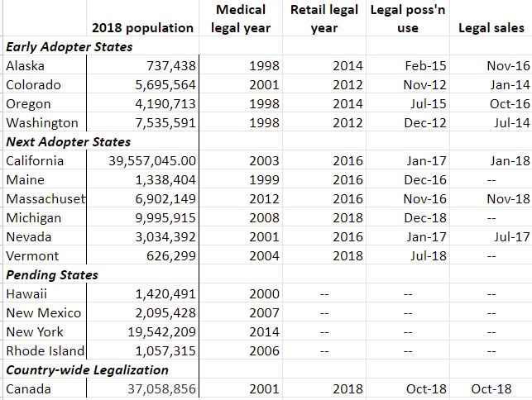
Jurisdiction
Profiles

Slide 36
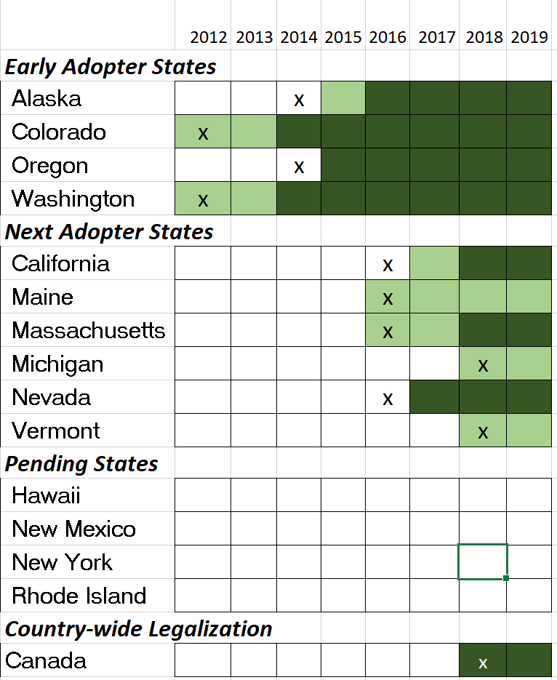
Implementation Timeline for Jurisdictions
X: non-medical
legalization
Possession/use legal
Retail sales

Slide 37
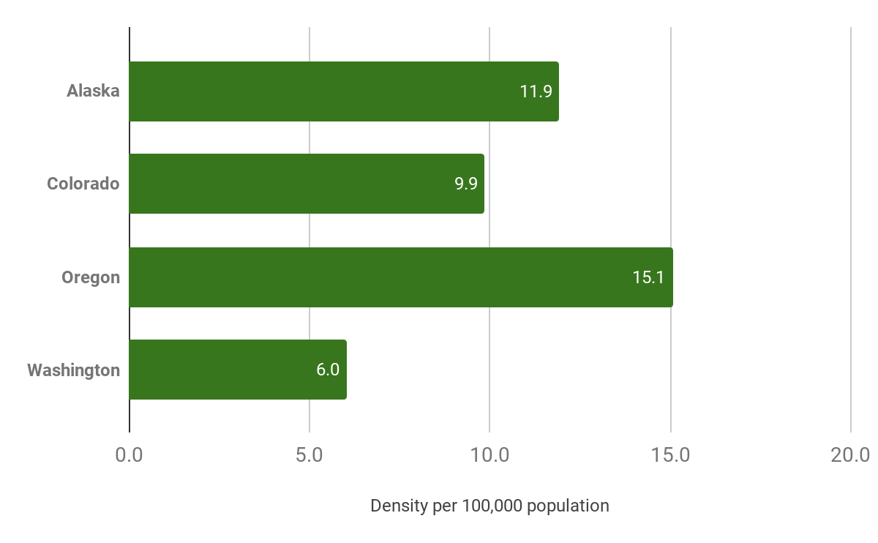
Retail Sales Outlets in Early Adopter States
Per capita retail outlets, updated May 2019
State | # outlets
AK | 88
CO | 562
OR | 631
WA | 455

Slide 38
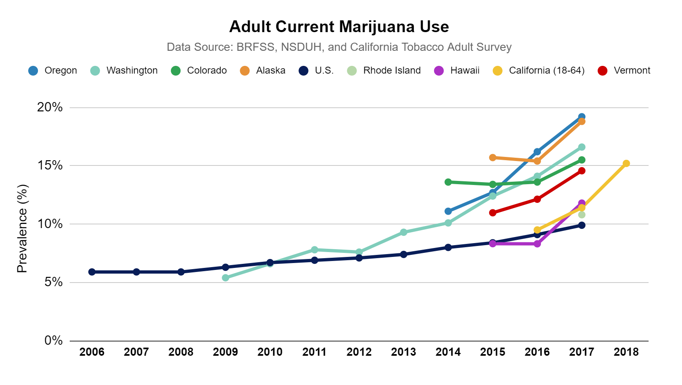

Slide 39
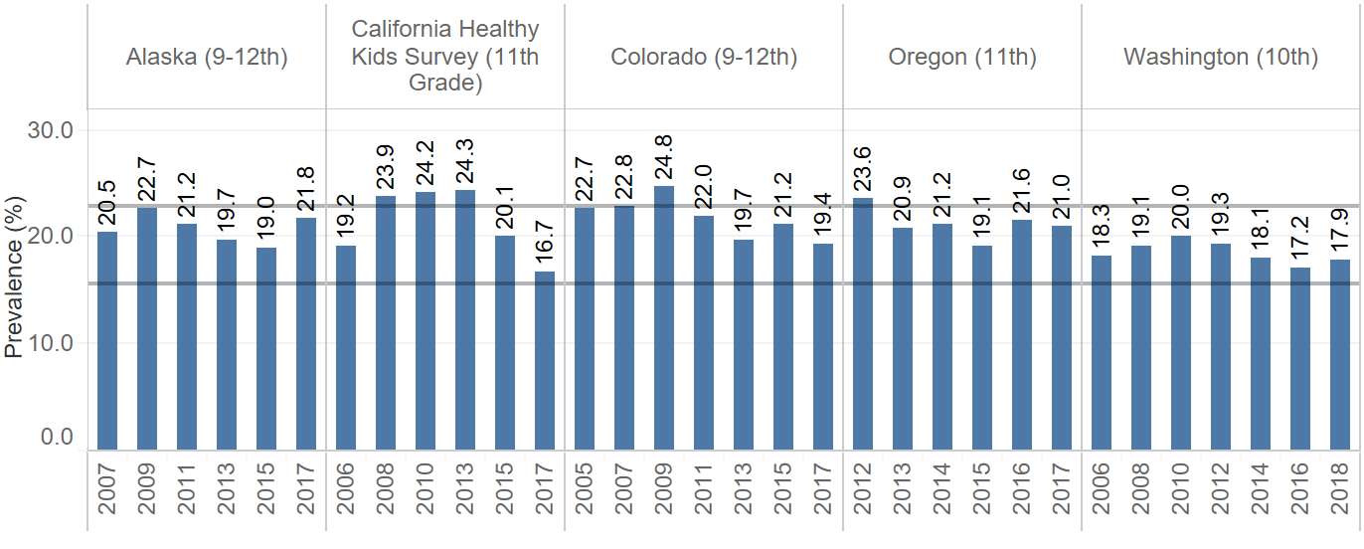
Youth Current Marijuana Use
AK, CA, CO, OR, and WA

Slide 40
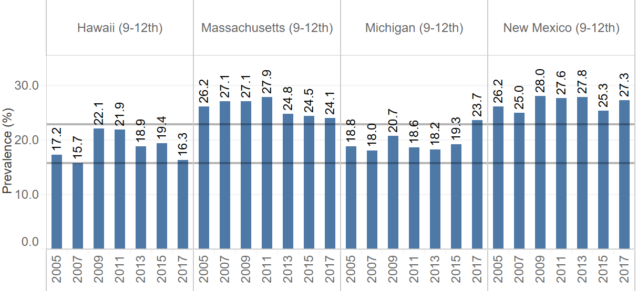
Youth Current Marijuana Use
HI, MA, MI, and NM

Slide 41
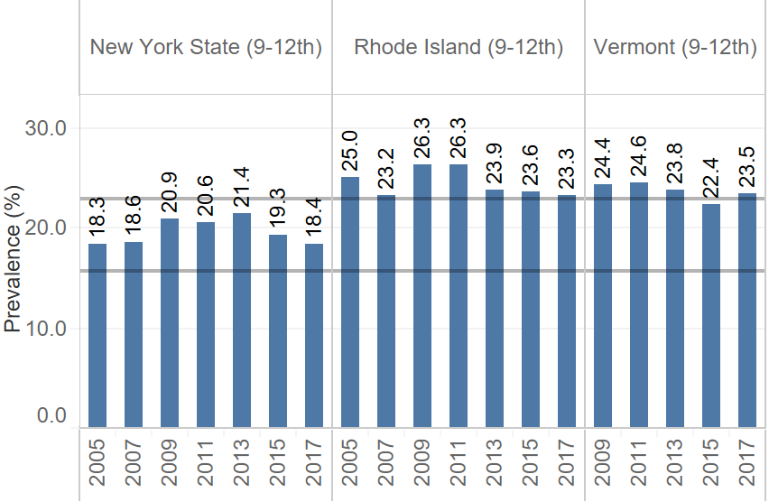
Youth Current Marijuana Use
NYS, RI, and VT

Slide 42
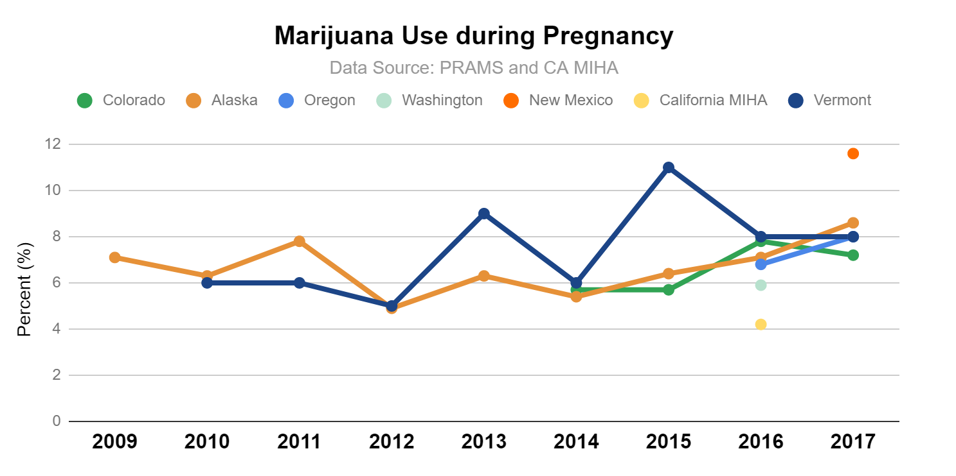

Slide 43
10:15-10:30 BREAK (15 minutes)

Slide 44
10:30-11:45 State Report Out on Surveillance Capacity (3 min per state, 5 min for Canada)
Your role
Your agency and where you’re located within your agency
Who is working with you and what you have to work with (funding, staff)
What (if any) directives you have from your agency/government
What you specifically need to accomplish in the next fiscal year (by June 2020)
Describe anything you provided electronically to the group’s “basecamp”

Slide 45
10 states with legalized
Recreational (non-medical, retail) cannabis
  All but VT have legalized retail sales
Multiple states where legalization seems to be coming (4 are here)
Source: https://www.businessinsider.com/legal-marijuana-states-2018-1

Slide 46
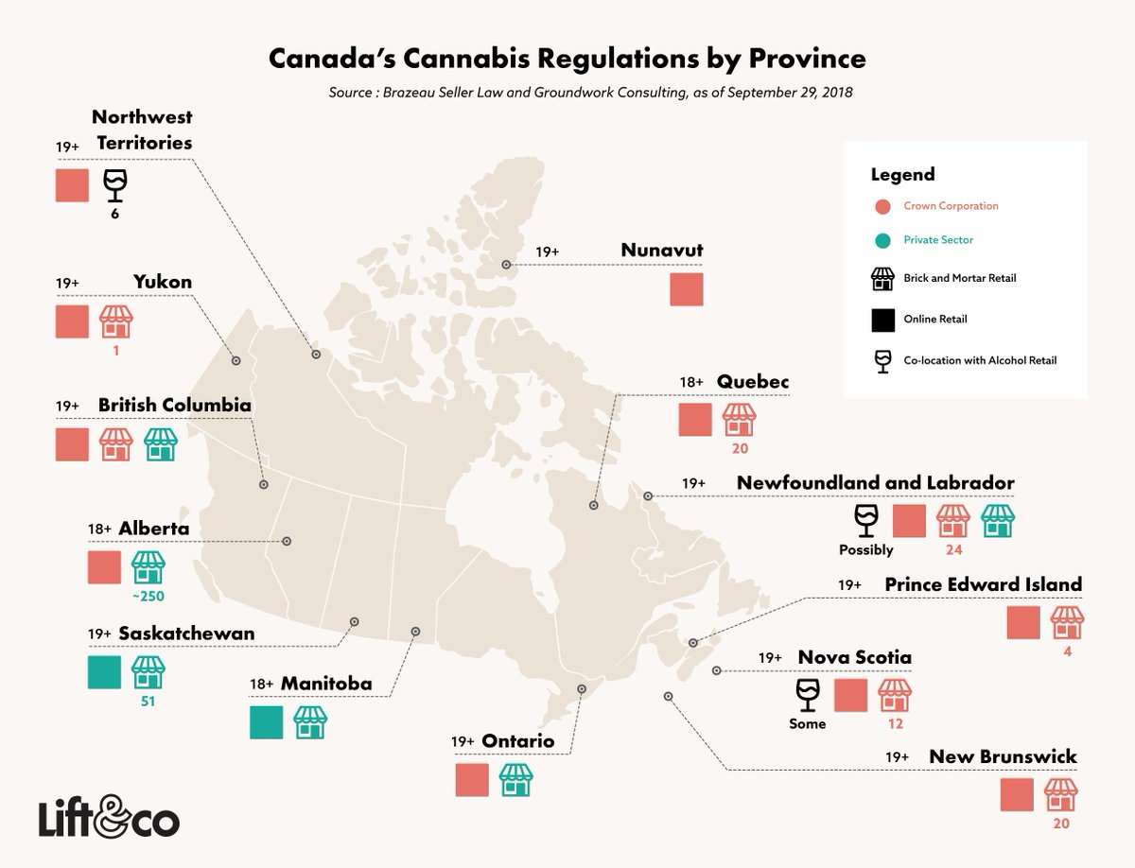

Slide 47
11:45-1:00 LUNCH (on your own)
Return to Sabin/Cleere Room in Building A after lunch

Slide 48
Speed Dating Instructions

Slide 49
1:00-2:30 Planning and Implementing Marijuana Surveillance
(“speed dating” discussions within subgroups by legalization status/dates)
What has helped you most in this work, so far?
What is frustrating you most in your work right now?
What is going well so far, or what is your greatest success?
What is the question you’re being asked most right now that you can’t answer, and who is asking?
What vulnerable populations are you most concerned about in context of legalization? (and/or are you doing to address disparities in your work right now?)
What is one thing you wish you had available, to help in your work?
What one relevant thing/asset/skill do you/your agency have to share with others to help this work?
Notes:
Julia will make a first slide with instructions
-may also have on the wall a schedule of the numbers
-may put on name tag, one of 3 colors and one of 6 numbers
-hopefully Valeria and Nikka can do the chimes and times

Slide 50
“Speed Dating” Report Out

Slide 51
2:30-2:45 BREAK (15 minutes)

Slide 52
2:45-3:45 Staying Connected and Building Capacity: Small Group Discussions by Topic
Beyond Surveillance: Beyond the “core” questions How to measure cannabis exposures
Disparities/vulnerable populations: working toward equity through surveillance in a legal cannabis context
Impaired driving: communicating about risk, measuring behaviors and outcomes
Intersection with tobacco/alcohol/other drugs: including substitution, complementarity, or polysubstance use
Notes:
Need to narrow these by the Qualtrics poll results
-May need questions for each of these
Print worksheets with topics

Slide 53
Pick a topic and discuss the following questions (20 mins)
Rotate to a new topic and discuss the new topic (20 mins)
Questions
What is the question you’re being asked most right now about this topic, and who is asking? (or what do you need to know?)
What is working now around this topic?
What are the barriers to addressing this topic?
What do we need to move forward to address this topic?

Slide 54
3:45-4:15 Roundtable Report Out: Staying Connected and Building Capacity (Nikka or Valerie lead)
Each group report out on questions
How CSTE can help to bridge gaps

Slide 55
4:15-4:30 Closing Remarks/Adjourn

Slide 56
Day 2
“Surveillance Quality Improvement”
Notes:
Safe storage: we care that it is assessible, not where but how to keep your mj, canada has questions for this quesitons
Maybe start with where do we store it?
Does your child know you have mj in your house
Maybe ask questions and then go to home and see
Has anyone gotten into your marijuana in your home?

Slide 57
9:00-10:00 Developing High-Quality Survey Questions with Cognitive Testing
By Dr. Ashley Brooks-Russell
What it Means and How to Do It, Assess priorities

Slide 58
15 minutes of discussion on cognitive testing (Julia)
Notes:
Highlight the CDC core indicators that need testing

Slide 59
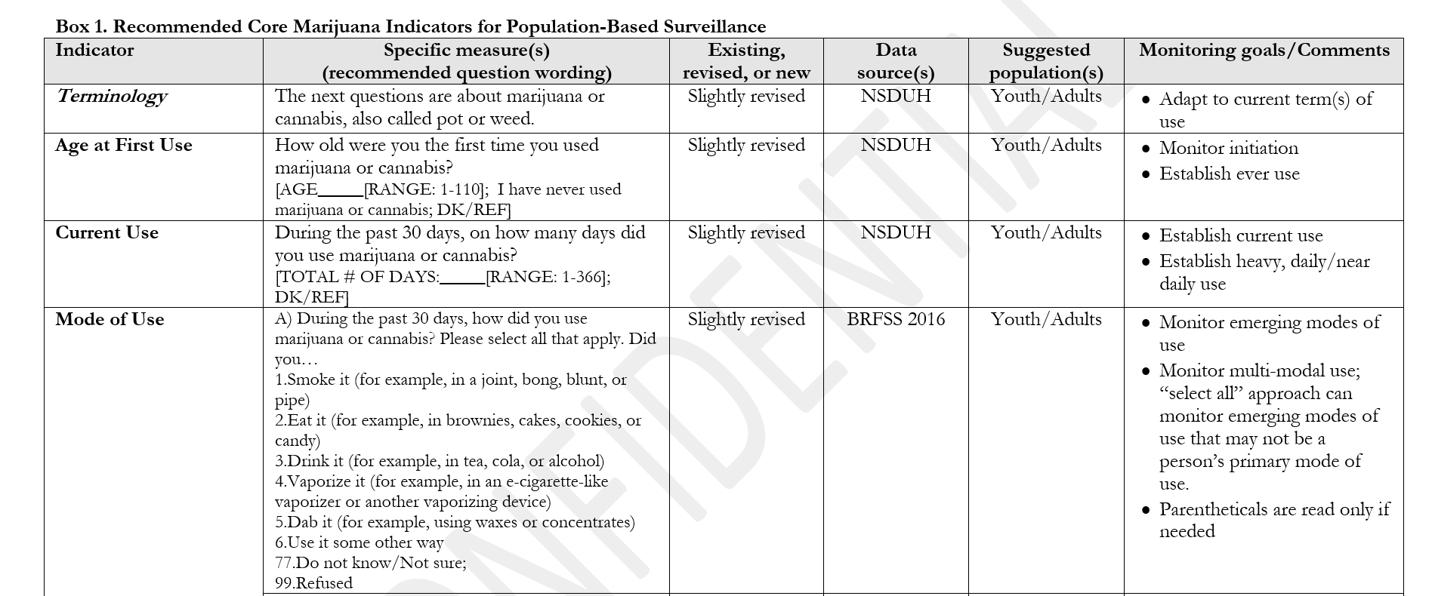
Sample key (core?) Indicators - late 2017

Slide 60
Key Indicators Summary
7 Core measures
Age first use - adult/youth
Current use/past 30 days - adults/youth
Mode of use - adults/youth
Frequency of use (# times per day or # hours stay high)
Reasons for use - medical, non, combined
SHS exposure in past 7 days
Impaired driving or riding in vehicle (while under influence,

Slide 61
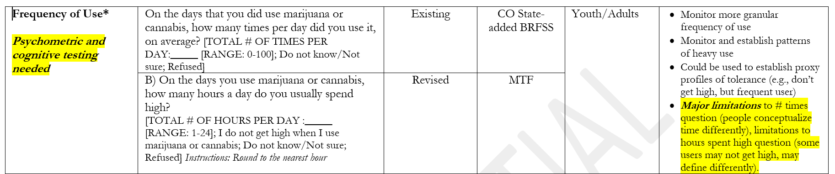
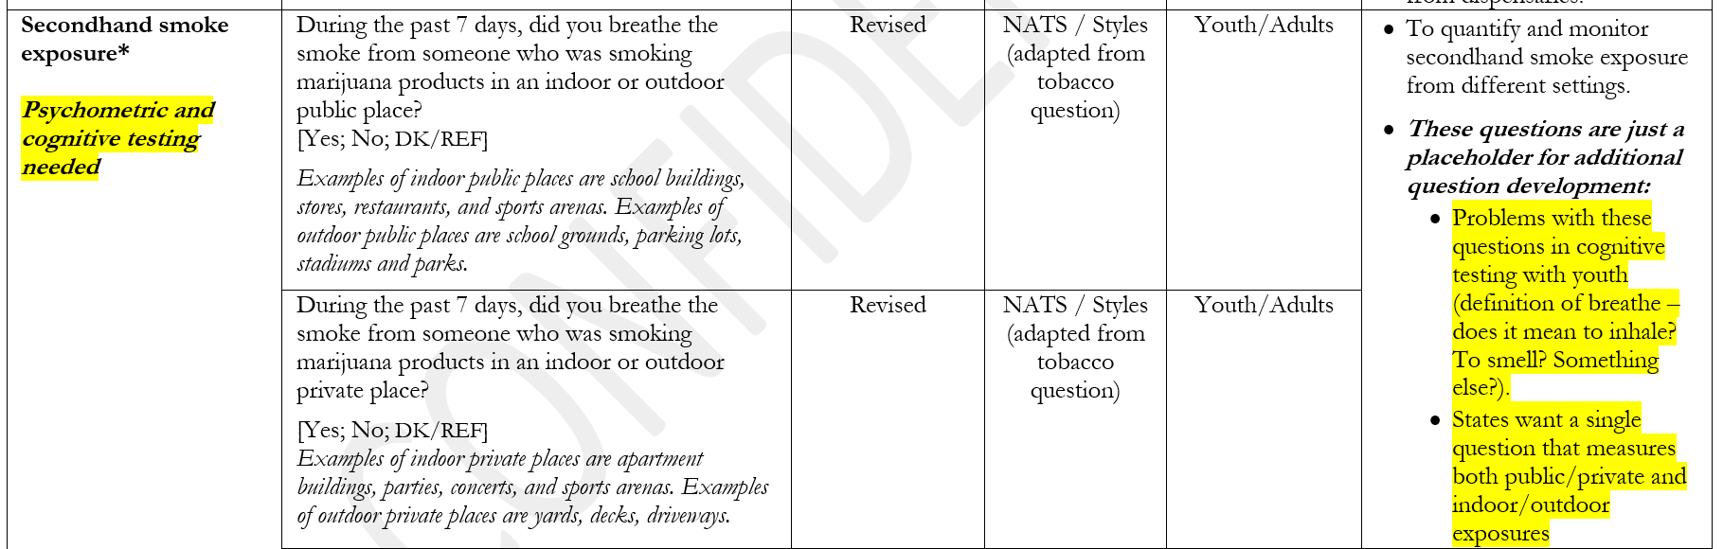
Flagged for needed testing

Slide 62
What do we need to check about our questions?
CBD
Evolving products
How to measure driving
How to measure “exposure/dose/frequency”

Slide 63
10:00-10:20 Complementary Surveys
Survey alternatives/non-traditional data collection
Canada survey (option to participate)
Colorado User Survey on Health (CUSH)
Child Health Survey (CO BRFSS callback)
What has been done in your state (country)?
Notes:
Katelyn will do

Slide 64
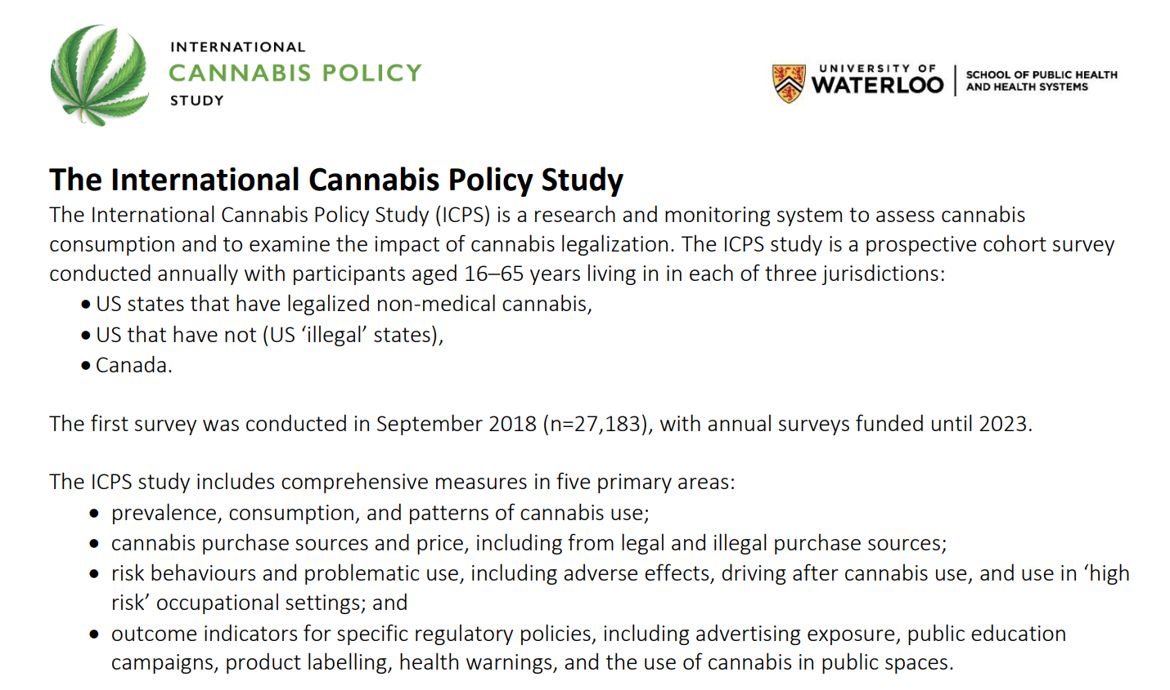

Slide 65
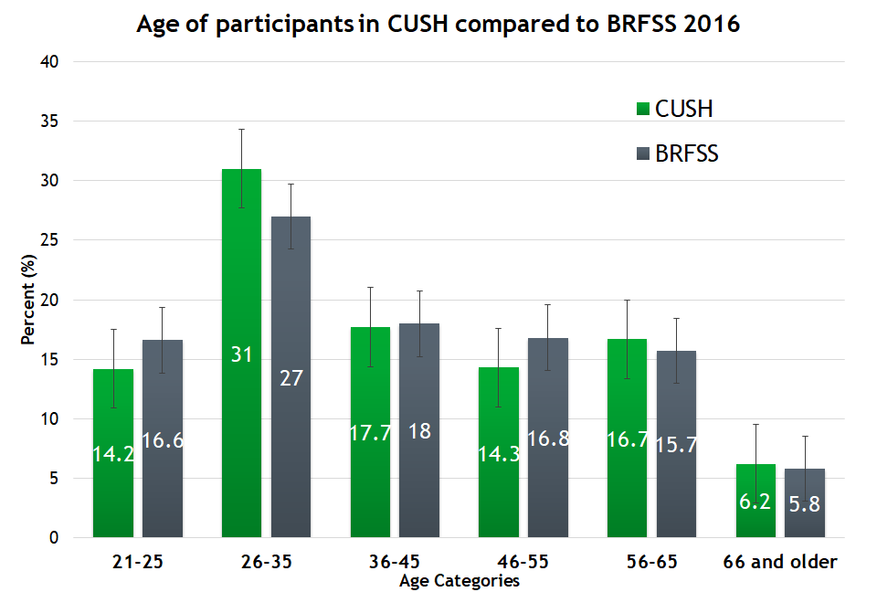
Cannabis Users Survey on Health (C.U.S.H)
Survey of regular (past 30 day) cannabis users to capture
  Detailed patterns of use
  Reasons for use
  Adverse outcomes of use
  How legalization changed use

Slide 66
Cannabis User Survey on Health (CUSH)
Among those that reported smoking marijuana we asked:
Question 1: When you buy or get marijuana to smoke, how much do you usually get at one time?
Answer: I usually get (<1g-3 g, 1/8th oz-3+oz) of (flower, hashish, pre-rolled joints, concentrates).
Question 2: How often do you buy or get this amount of marijuana product to smoke?
Answer: I usually buy or get this amount (<1-30+) times per (day, week, month, year).

Slide 67
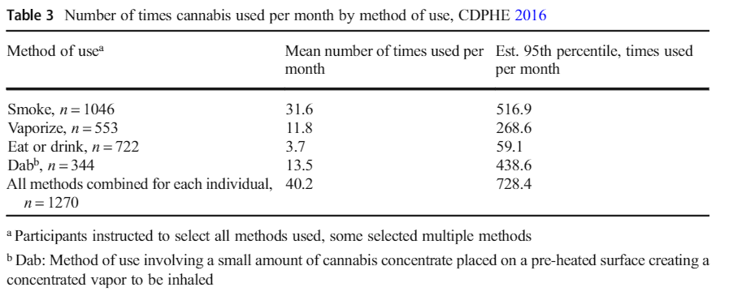

Slide 68
Amount of Cannabis Product (in grams) Obtained for Consumption, Per Month, CUSH 2016
Product Type | Mean Quantity (g), (IQR) | Est. 95th Percentile Quantity (g)
Flower or pre-rolled joints (n=1006) | 10.0 (8.7) | 184.6
Concentrate (n=373) | 3.2 (8.7) | 82.1
Pre-filled, vaporizer oil cartridges (n=191) | 1.0 (6) | 25.4
Edibles (n=626) | .08 (15.2) | 3.3
Other (n=30) | 2.9 (8.7) | 154.9

Slide 69
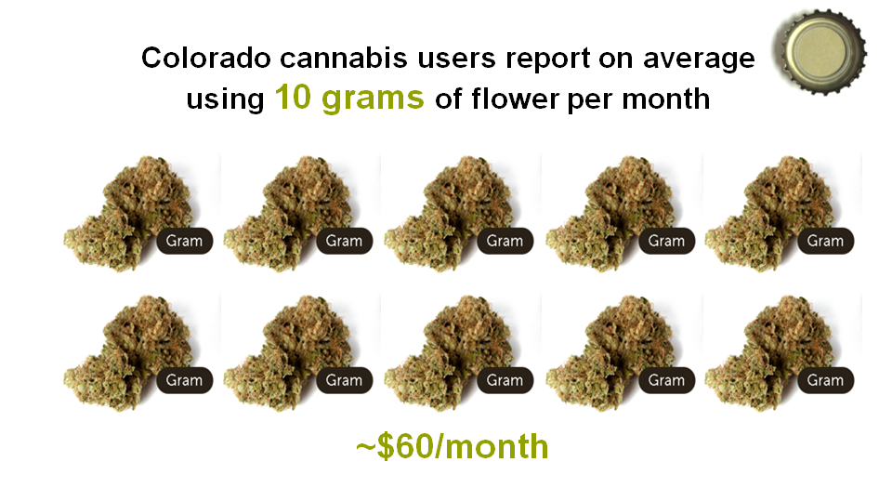

Slide 70
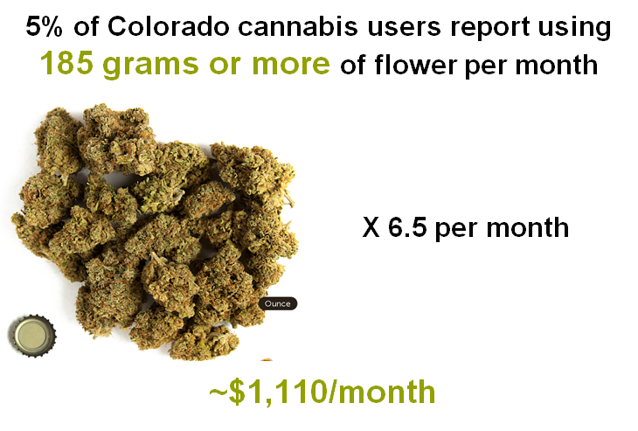

Slide 71
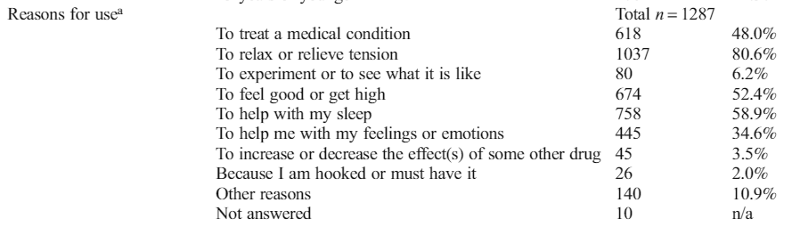
Cannabis Users Survey on Health (C.U.S.H)

Slide 72
Child Health Survey
Call back from BRFSS respondents that have children ages 1-14 living in the home
Asks about marijuana use in the home, method of use, and safe storage

Slide 73
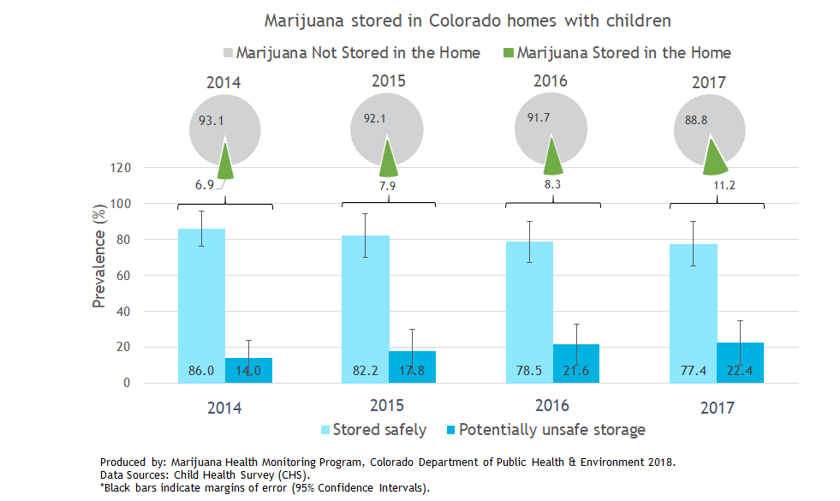

Slide 74
What has been done in your state (country)?
-psychometric testing on opioid users-NV
-may have been under influence when answering
-NHBS study-interview ppl at bars and give them cash-MI, in HIV programs
-PRICE of weed is website, but hard to access so now statistics Canada, cannabis hub, Canada is doing crowd source to see source of ppls marijuana
-using to calculate GDP
-CA spent a lot of money of formative research for campaign and will add to basecamp
-Used next door app to do follow-up on marijuana use-Valerie will get on basecamp

Slide 75
10:20-10:45 Measuring Cannabis-Related Health Outcomes and Assessing Quality of Measures: The Good, The Bad, The Ugly (Katelyn)
what’s still useful, even with limitations
  Discharge code-related outcome measures
  Syndromic Surveillance (Julia)
  Poison Center
Notes:
Katelyn will do

Slide 76
Cannabis Discharge Diagnosis Codes

Slide 77
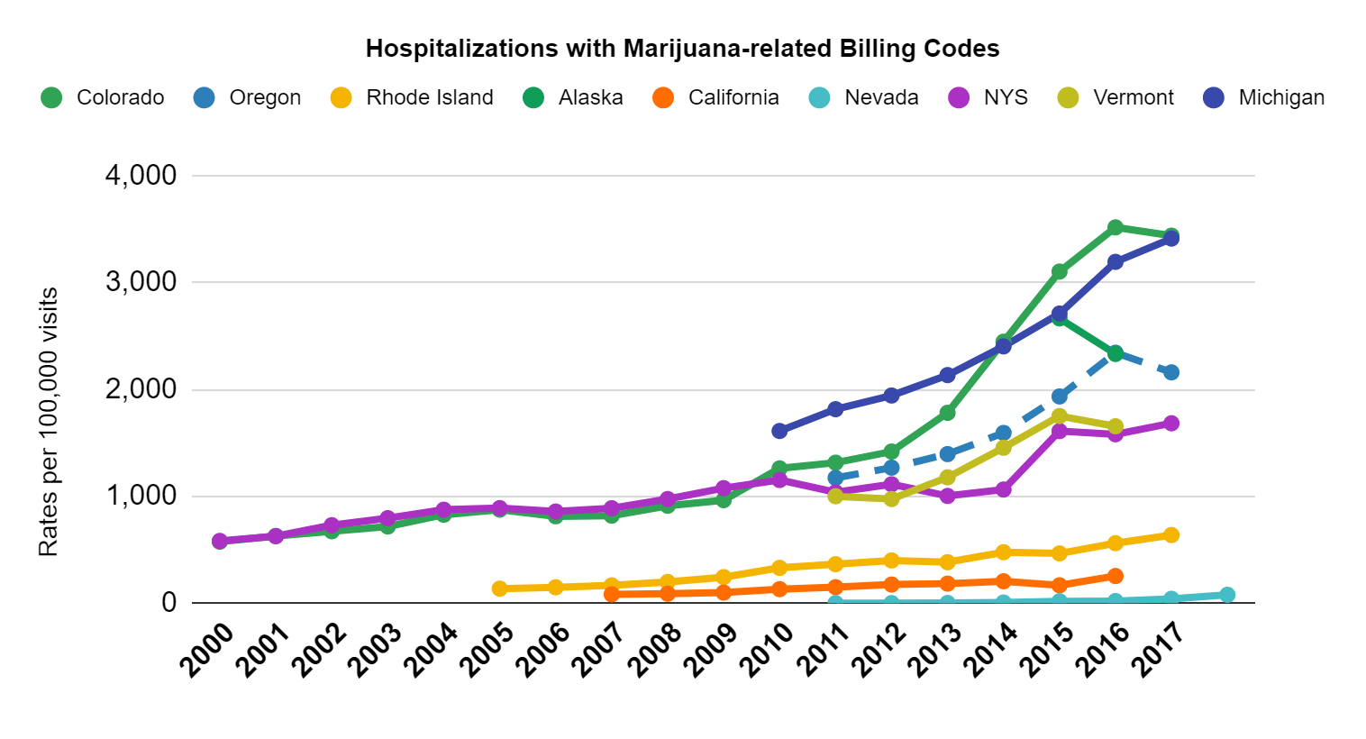

Slide 78
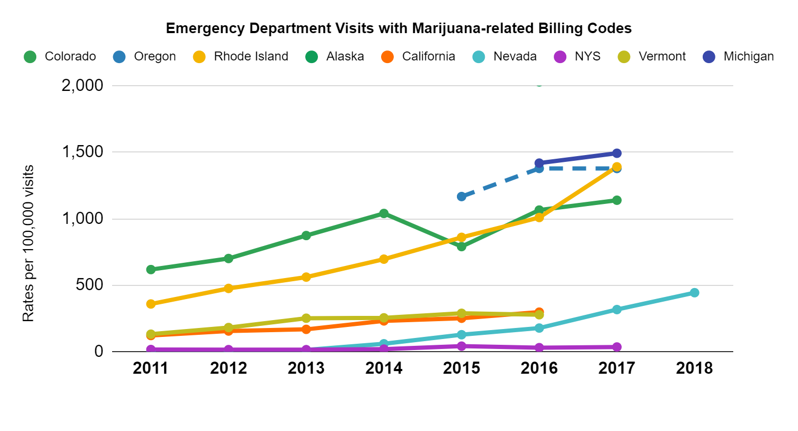

Slide 79

Cannabis ICD Diagnosis Codes
October 1, 2015 expanded 4 codes to ~50 codes
ICD-10-CM more specific to cannabis use, abuse, dependence, poisonings, adverse effects and underdosing

Slide 80
Common Critiques to Cannabis ICD Codes
Over counting
  i.e. Counting when a patient mentions using cannabis once in the 70s
  Counting a single patient multiple times
What does a cannabis poisoning mean??
  No clear clinical definition for a cannabis poisoning
Adverse effects coding in the context of cannabis
Influenced by changes in patient reporting or provider screening
  Patients with mental health conditions are more likely to be screened for substance use

Slide 81
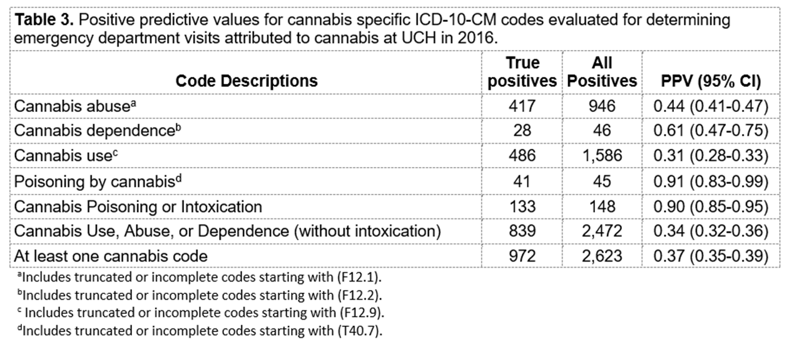

Slide 82
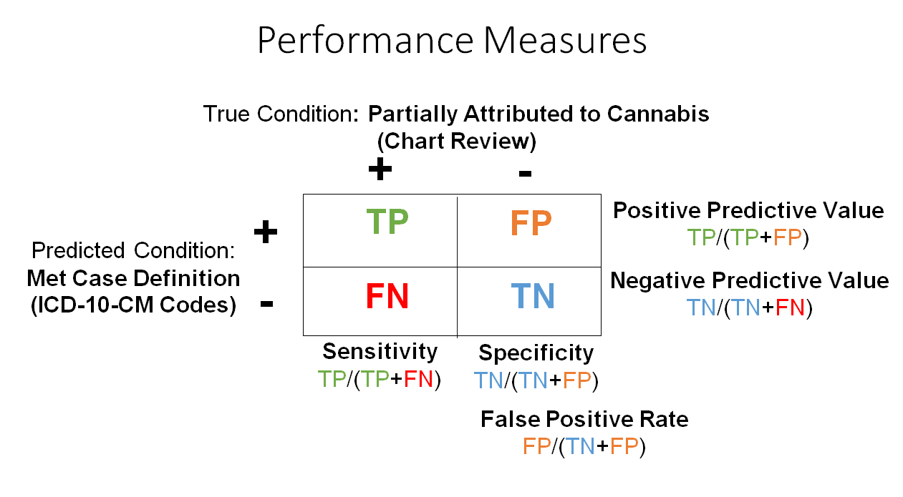

Slide 83
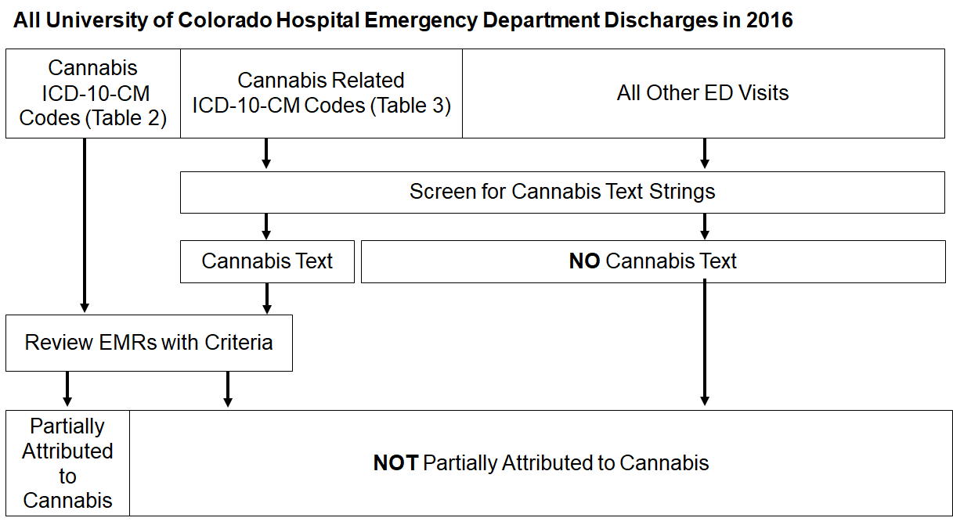

Slide 84
Indications of undercounting
In 2016, there were 2,491 ED visits with cannabis discharge codes at an academic hospital
  2,013 ED visits were found to have cannabis text indicating intoxication or recent use (within a month) and no cannabis discharge codes

Slide 85
CSTE Injury Subcommittee Drug Poison Indicator Workgroup
Performed analysis across several states examining ICD-10-CM coding
Examined primary diagnosis vs any mention approach
Examined expanding cannabis indicator to include adverse effects and behavioral F Codes (cannabis use, abuse, and dependence)

Slide 86
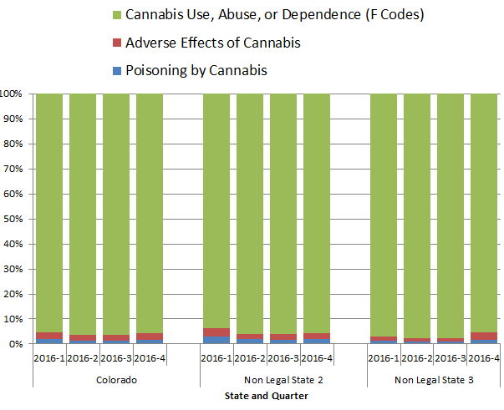
ED visits with any mention of cannabis ICD-10-CM codes

Slide 87
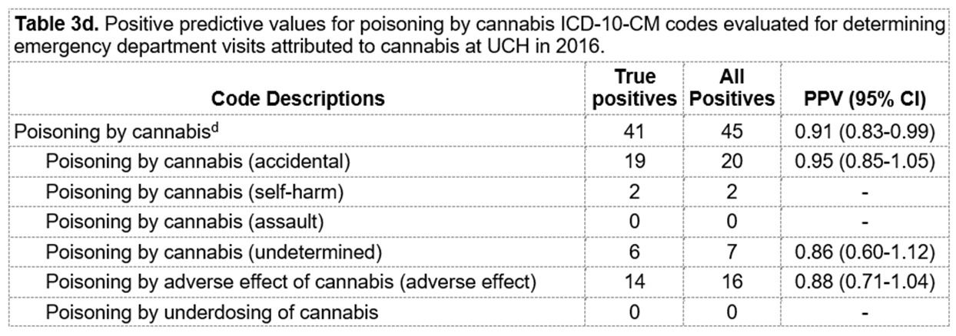

Slide 88
Marijuana Discharge Coding Takeaways
A case definition with any mention of marijuana poisonings, adverse effects, and use/abuse/dependence with intoxication would perform well identifying ED visits attributed to cannabis (~90% PPV)
  May be undercounting
Interpret as the occurrence of cannabis poisoning or intoxication discharge codes
  No temporal relationship thus no causality
F codes are important for measuring the burden of use and use with mental health symptoms
  May need to develop a burden indicator like the Alcohol subcommittee
Acknowledge the limitations of the data system

Slide 89
Cannabis in Syndromic Surveillance

Slide 90
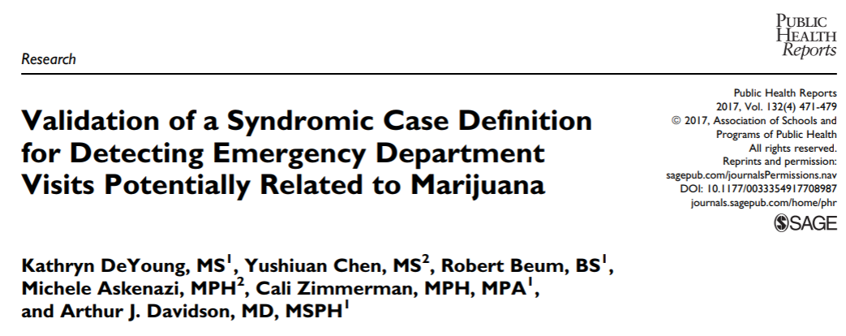
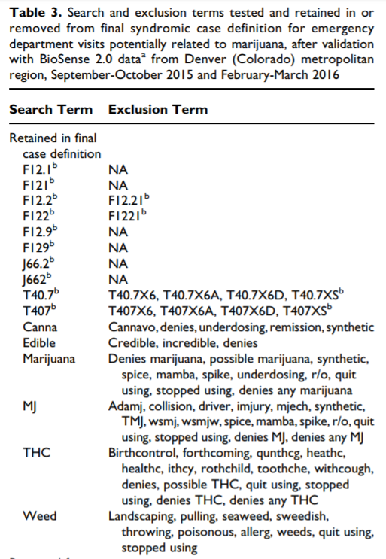
Calculated PPVs for cannabis ICD-10-CM codes and text
Non-traditional validation method
  Reviewed records in ESSENCE to determine true positives
    Reviewed by an epidemiologist not medical physician
  Not a clear clinical definition for true positives
ICD-10-CM codes performed at 99.4%
Cannabis text (Table 3) preformed at 100%
https://www.ncbi.nlm.nih.gov/pmc/articles/PMC5507418/pdf/10.1177_0033354917708987.pdf

Slide 91
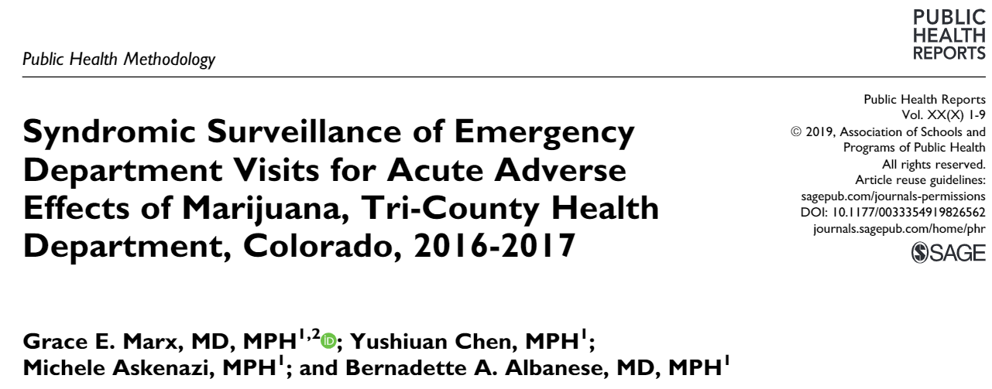
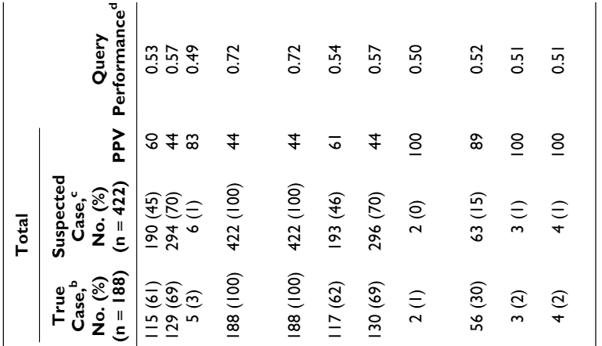
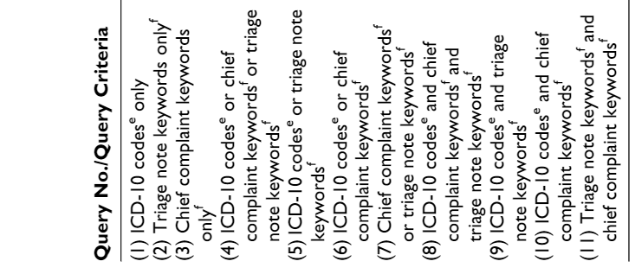
Calculated PPVs and query performance measure for ESSENCE queries (3 hospitals)
validation method:
  ED visits classified as a true case if the provider documented marijuana as being related or the likely cause for the patient’s symptoms (true positives)
PPVs varied by hospital from 36% to 64%

Slide 92
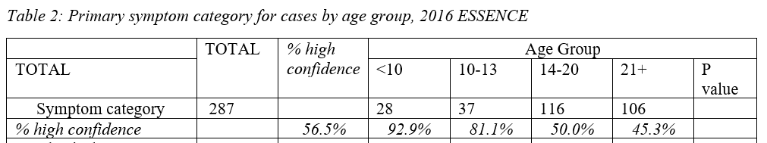
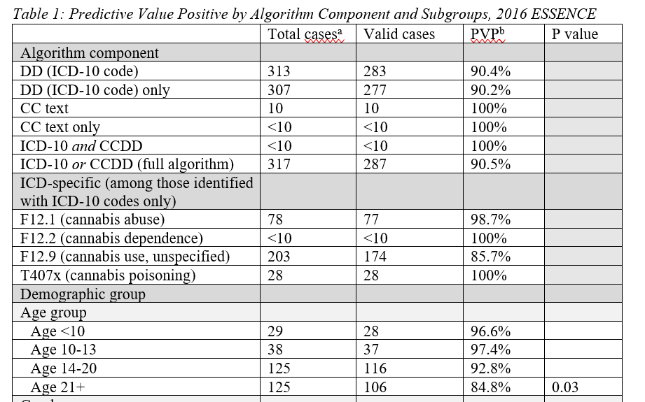
Oregon Syndromic Surveillance: 2-step validation

Slide 93
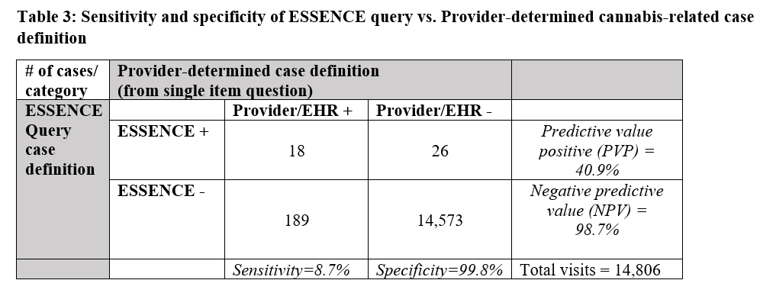
Oregon Syndromic Surveillance: 2-step validation

Slide 94
Sample considerations for “how to” use Syndromic Surveillance
Can use established marijuana query or write own (share base query)
Identifies clusters in time and space
  Outbreak in edibles or contaminated MJ product
Can be used in real time
Quality varies (including over time), depending on hospital reporting
Similar limitations as ED/hospital discharge data
  Diagnosis codes may not be the same as those listed in the discharge diagnosis
  Chief complaints often are not the best measure for why a patient is in the ED
May be a strong tool to use internally
Has potential to alarm public or stakeholders unnecessarily
Interpret similarly to ED/hospital discharge data

Slide 95
Cannabis in Poison Center Calls

Slide 96
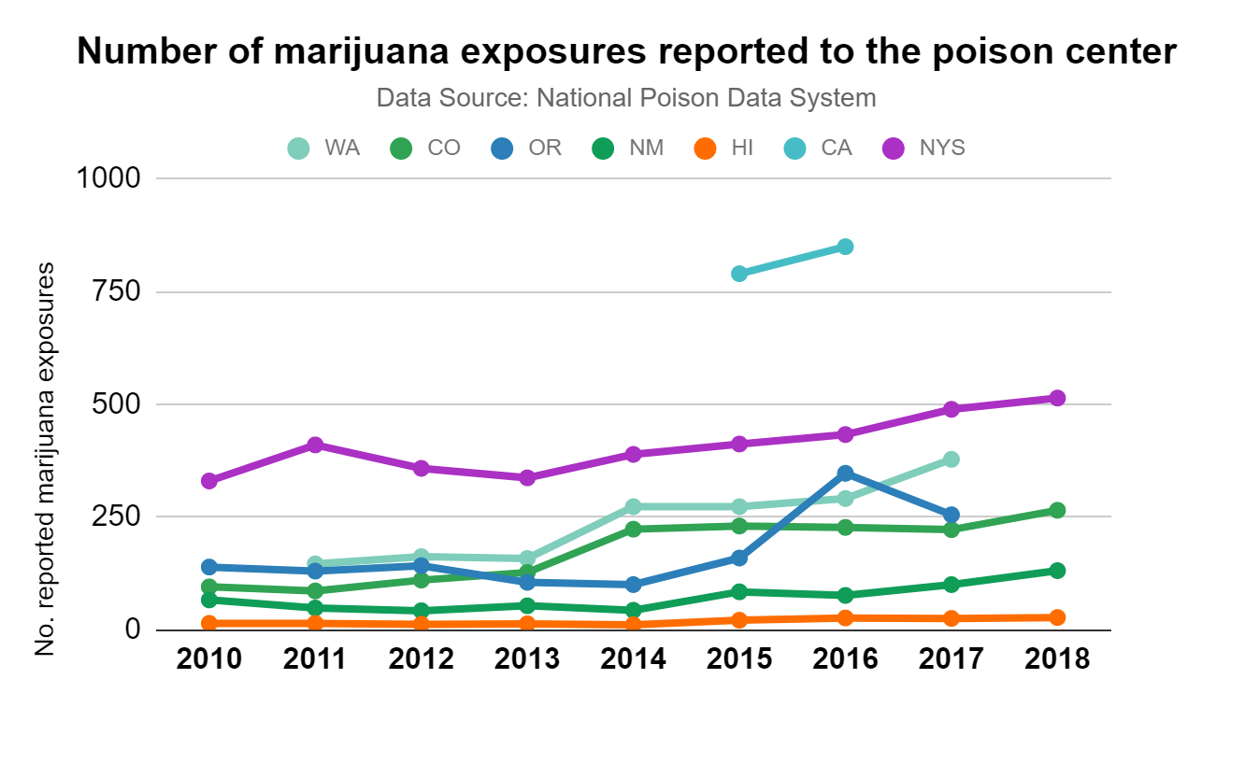

Slide 97
Poison Center Calls Limitations
Not every person with an cannabis related adverse health effect calls the poison center
  Captures the tip of the iceberg
Often providers are calling the poison center for guidance on treating a patient
  Especially with a new substance like newly legalized marijuana
  Can cause initial increases with legalization followed by decreases or a plateau as providers learn how to treat cannabis related adverse health events

Slide 98
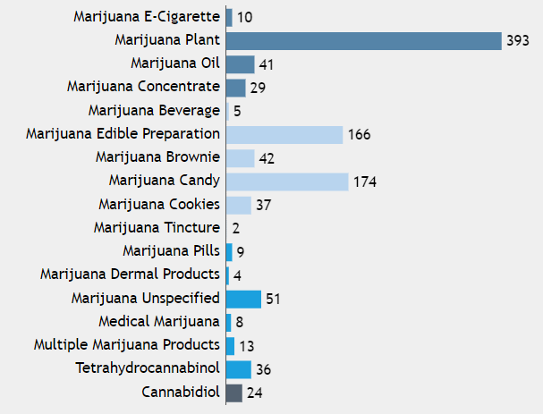
Poison Center Calls Strengths
Real time data
  Only resource to capture contaminated or bad products in real time
Standardized coding system for marijuana products
  Details down to edibles (cookies, candies, brownies), medical marijuana, pharmaceutical grade THC, concentrates, CBD added in 2019
  This coding allows for examining impacts of specific products
Follows patients to an outcome
  Documented symptoms, final outcomes, therapies performed
  Can use to identify new symptoms related to cannabis

Slide 99
How to Use Poison Center Calls
Contact local poison center and
  obtain access to National Poison Data System
or
  Request a query from the poison center
Calls may obtain information from more than one marijuana exposure
  Interpret at “Marijuana exposures reported to the Poison Center”
Can monitor counts over time
  If call volume changes over time, then can calculate rates of reported marijuana exposures over time per total call volume

Slide 100
Questions?

Slide 101
10:45-11:00 BREAK (15 minutes)

Slide 102
11:00-11:45 Highlight and Discuss Current Multi-State Marijuana Surveillance Projects – what is or could be happening right now?

Slide 103
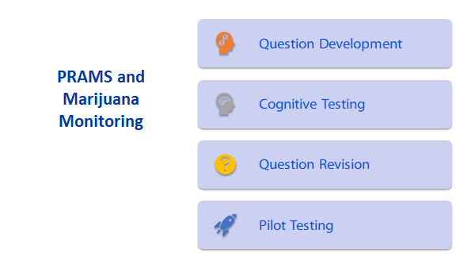
PRAMS CDC/CSTE project
FYI: PRAMS CDC/CSTE project in progress now (AK ME ND NM NY PA WV)
Analysis is being conducted by CDC, underway now

Slide 104
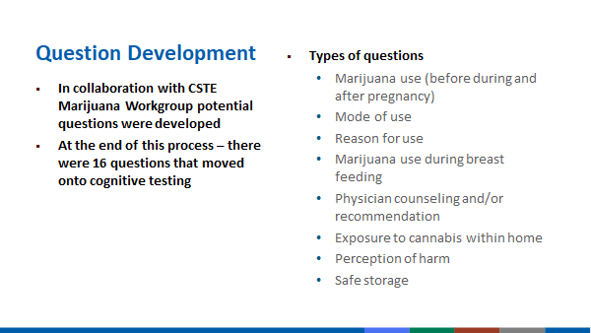
From Althea Grant (CDC) Presentation on Basecamp

Slide 105
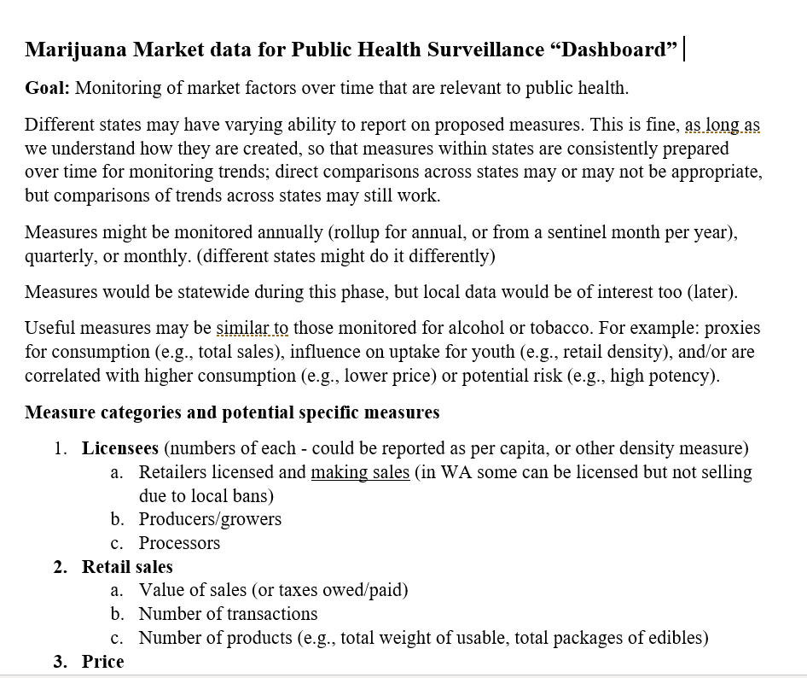
Dashboard on Sales/Market data
Establish common indicators so current and new states can communicate to their regulatory agencies
This may inform development of “seed to sale” tracking systems, or at least communicate public health interests up-front (rather than after systems are built)

Slide 106
Potential projects for CSTE Subcommittee
Recommendations about using data systems (strengths, limitations, how to analyze, key quality considerations) - 2-4 pages
ESSENCE/syndromic surveillance
Hospital/ED discharge
Poison Center
EMS data-text fields

Slide 107
Potential projects for CSTE Subcommittee
Recommendations about how to measure priority problems (assessment of potential data sources and limitations, key messages to address high-profile biased reports) - could be 2-5 pages
Cannabis-impaired driving
Cannabis-related deaths
Retail/market data dashboard**
Unintentional ingestions
Interactions with medications
Drug affected babies/children
**this has been started

Slide 108
Potential projects for CSTE Subcommittee
Collaborative projects to develop/improve questions for surveys (cognitive testing, other testing on selected questions like dose/exposure, driving)
Adult surveys
Youth surveys
Other surveys
Collaborative projects for alternative/complementary data collection
Survey modes: which? (online, social media)
Priority populations: which? (please specify)

Slide 109
What to do?
See POLL

Slide 110
12:15-12:30 Closeout/Adjourn

