Slide 1

Cannabis Legalization and Novel Data Sources for Regulation and Research
Using the ICPS to Understand Changing Patterns in a Maturing Legal Market
February 23, 2023
Alexander Colby, M.A., Research Analyst
Notes:
Good day, everyone!
Thanks, Julia, for allowing us to use this time to present some of our work and a huge thanks to all of you for coming. Today, I’m going to be discussing the International Cannabis Policy Study (or ICPS) and how we have been using this data in Massachusetts to understand evolving changes to our market over time. This study has been a great resource for understanding changes to both the legal and illicit markets here in Massachusetts, and with our time today we will be using the ICPS to provide a more nuanced understanding of these changes.
So without further ado, I’d like to start by providing a little context.

Slide 2
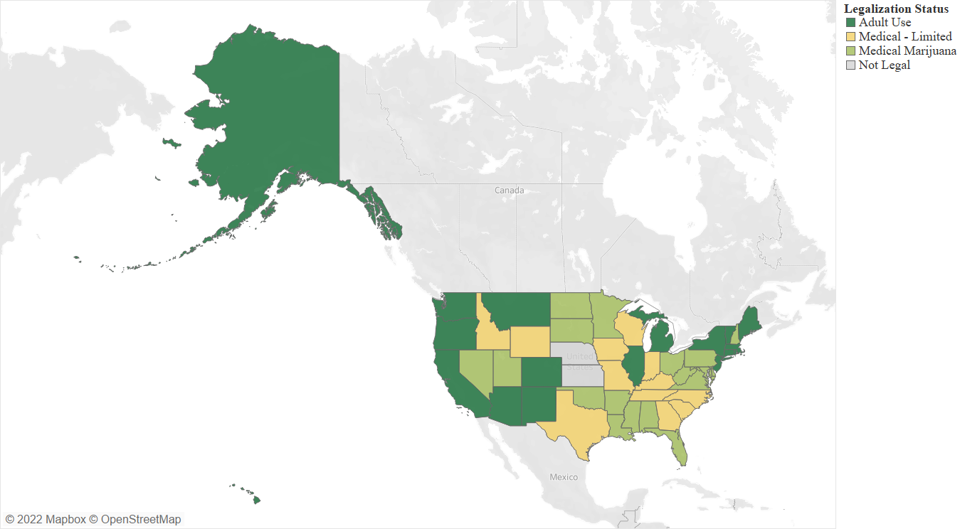
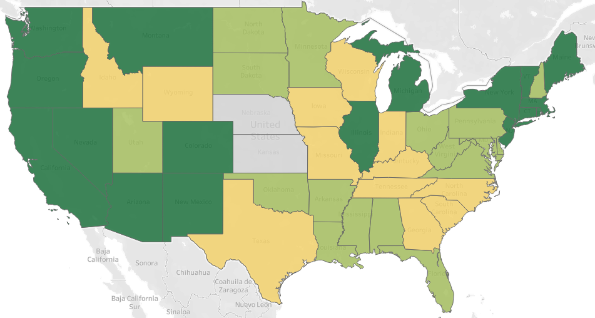
Cannabis Legalization
Legalization is enacted at state level
Important differences exist among cannabis laws, regulations, implementation, and fidelity of implementation across the 37 states with legal medical-use cannabis, the 19 with legal adult-use cannabis, and the 10 with currently active adult-use retail markets
Notes:
I’m sure we’re all mostly aware of these numbers, but just to review the current state of cannabis, of the fifty states, thirty-seven states have legalized some form of medical-use cannabis, 19 have legalized adult-use cannabis, and 13 of these states have now opened adult-use stores, with Vermont and New York opening their first stores in the past few months.
As cannabis regulators, we’re all aware of the heterogeneous patchwork of cannabis policy provisions that exist across the country. No state has the same policy or regulates cannabis the same as any other.

Slide 3
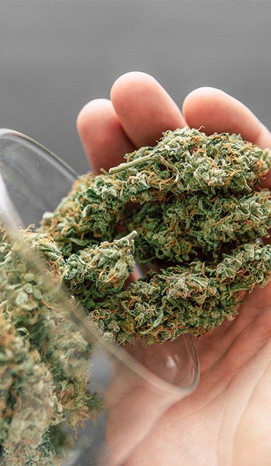
Unregulated Market
One major aim of all state cannabis regulators is to decrease the scope of illicit market (illegally cultivated and sold cannabis products)
Still prevalent in many adult-use cannabis states despite legalization
  California’s illicit market is much larger than legal market five years after legalization (Fuller, 2019; Nueves, 2021)
Illicit market products are seldom tested; consumers forced to use their own subjective ‘indicators’ to estimate the safety of the product being purchased (Belackova, 2020)
Difficulties assessing the illicit market
  Few ways to track illicit market sales
  Heavily reliant on self-report consumer data
Notes:
Despite the wide array of policies enacted, one can say for certain that a major aim of all 37 programs is to curb the growth and decrease the scope of the illicit market. Although legal markets are increasing in saturation in many states, the illicit market remains a challenge for regulators regardless of legalization status.
Yet the dangers of the illicit market extend far beyond decreases in legal market profit margins. The fact remains that illicit market products are seldom tested, so consumers are forced to rely on indicators like look and smell to determine whether the product they're about to consume is safe.
Inherent in the illicit market, is its design to be untraceable, thus, tracking the scope of the illicit market is difficult. In the absence of empirical sales figures, many researchers look to self reported consumer data to provide insights

Slide 4

Current Study
Research Mandate:
Goal: To assess the scope of illicit market activities through self-report consumer data collected from the International Cannabis Policy Study (ICPS)
Hypothesis: As the Massachusetts cannabis market increases in saturation, illicit market indicators should recede
Notes:
And this conundrum brings us to the current study. As many of you may know, we have a robust, legislatively mandated research mandate in Massachusetts, and one of the items we’re tasked with is examining the expansion or contraction of the legal and illicit markets in the state.
In accordance with this mandate and our goal of demonstrating a use case for the ICPS, the goal of our study today is to assess the scope of the illicit market through Massachusetts consumer data from the International Cannabis Policy Study.
The legal market in Massachusetts has expanded in size in recent years; particularly over the 2019-2021 survey period, so we hypothesize that as the market grows from 2019 to 2021, indicators of the illicit market should recede in size.

Slide 5

The ICPS Dataset
Self-report resident data: Evaluates the impacts of cannabis policy and regulatory measures on consumer perceptions and behaviors.
Surveys a wide array of indicators, including:
Patterns of use, prevalence, and means of consumption
Risky behaviors, such as driving after cannabis use and use at work
Perceived risks and social norms surrounding cannabis
Effectiveness of regulatory policies
Retail environment, both legal and illegal
Complement to industry-level data
Can be used alongside openly accessible industry data to estimate the scope of the illicit market
Notes:
And now for a brief explanation, but one I realize you all likely know. The major aim of the ICPS is to evaluate the impacts of cannabis policies and measures on consumer perceptions and behaviors surrounding cannabis.
The ICPS is useful for surveying a wide array of indicators, including patterns of use, prevalence and means of consumption; risky behaviors including using cannabis before driving or at work; perceived risks and social norms surrounding cannabis; the effectiveness of regulator policies and, as we’ll be surveying today, the retail environment in the state, both legal and illicit.
One thing to consider is that the ICPS can also be a brilliant complement to industry-level data to estimate the scope of the illicit market. Where industry data can provide nuanced information about the shops in business and their sales, this data can not inform how the prevalence of use of this store in comparison to other illicit market sources. This is where the ICPS comes in handy.

Slide 6
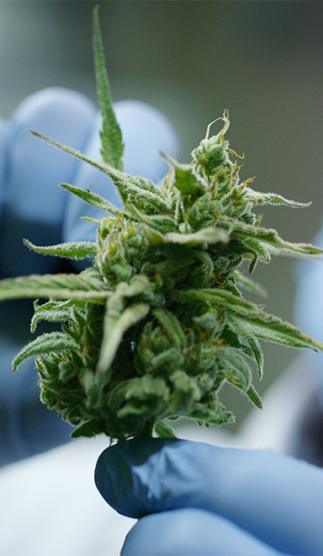
The ICPS Dataset
Illicit Market Indicators
Reported source of cannabis – In the past 12 months, have you gotten any type of marijuana from the following sources?
Percent legal purchase (Overall/By Type) - Overall, how much of the [marijuana/product type] that you used in the past 12 months was purchased from legal/authorized sources?
Reasons for avoiding the legal market - What were the main reasons you bought from illegal/unauthorized sources instead of legal/authorized sources?
Data: International Cannabis Policy Study (ICPS): Massachusetts Sample, 2019-2020
Notes:
As we mentioned previously, today we’re going to be using the ICPS specifically to estimate the current scope of the illicit market. In particular, I think analyzing these three questions should give us a good idea of what's going on in the illicit market. For starters, the ICPS asks respondents about where they’re purchasing their cannabis, from stores, to dealers, to growing their own, this question surveys from which sources respondents got their cannabis.
Since in many cases respondents could have purchased their cannabis from more than one source, ICPS also ask respondents about what percent of the cannabis they purchased was from a legal source. This question is asked both about cannabis generally, but also for different product types such as edibles, flower, and vaporizers.
Finally, the ICPS asks respondents about the main reasons they purchased from an illicit market source as opposed to a legal one. This allows researchers to better grasp why participants continue to look to the illicit market in the presence of a legal market.

Slide 7
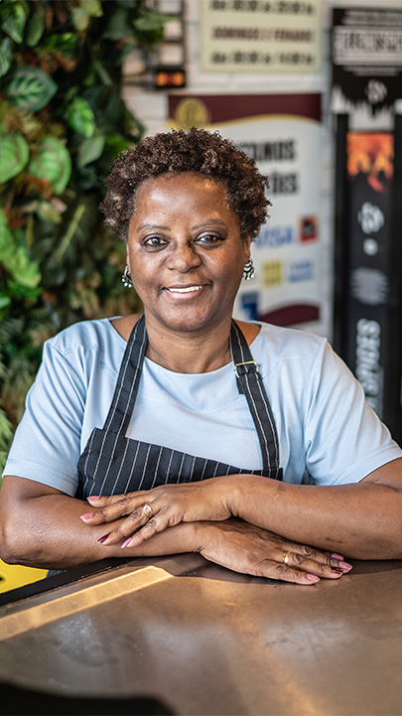
Survey Respondents
Variable | 2019 | 2020 | 2021 | Total
N | 2,476 | 2,207 | 1,763 | 6,446
Age (Mean) | 43 | 45 | 44 | 44
Female (%) | 77% | 66% | 67% | 70%
White (%) | 84% | 83% | 84% | 84%
Student (%) | 13% | 13% | 13% | 13%
Data: International Cannabis Policy Study (ICPS): Massachusetts Sample, 2019-2020
Notes:
For starters, here are the demographics for each of our three cohorts for the study. Our sample of Massachusetts residents was 44 years old, on average, 70% female and 84% white. Thirteen percent of respondents noted that they were currently enrolled students at a Massachusetts school, whether that be high school or university.

Slide 8
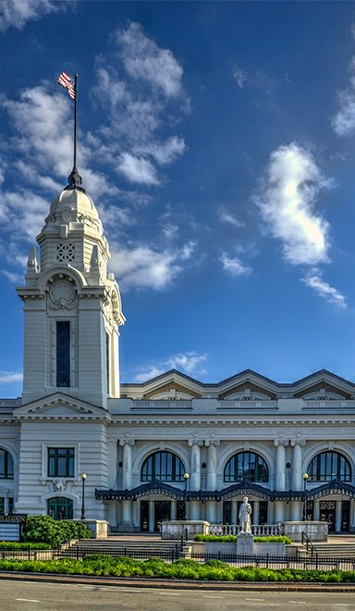
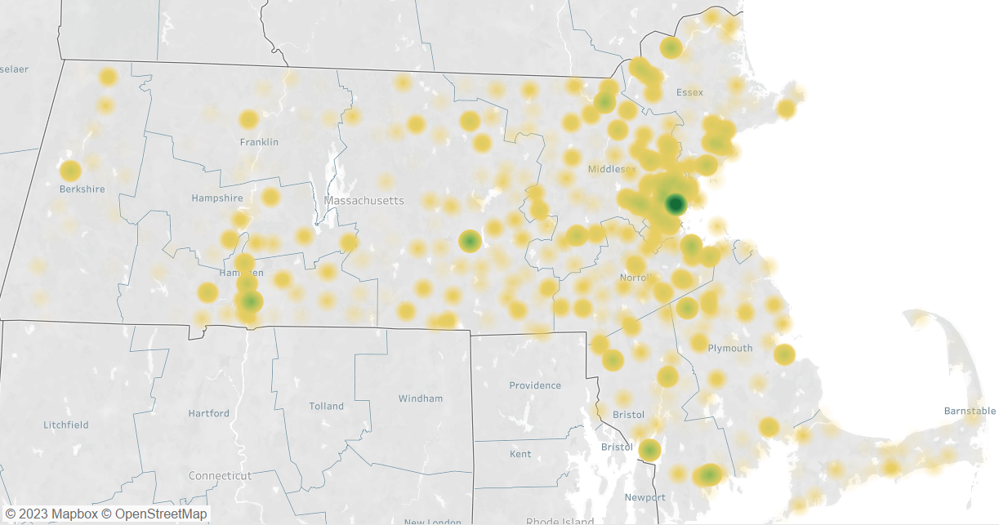
Survey Respondents
Data: International Cannabis Policy Study (ICPS): Massachusetts Sample, 2019-2020
Notes:
And here is a quick look at the population density of our sample based on respondents’ reported location, where dark green represents the highest density. As you can see many of our respondents are focused around Greater Boston.

Slide 9
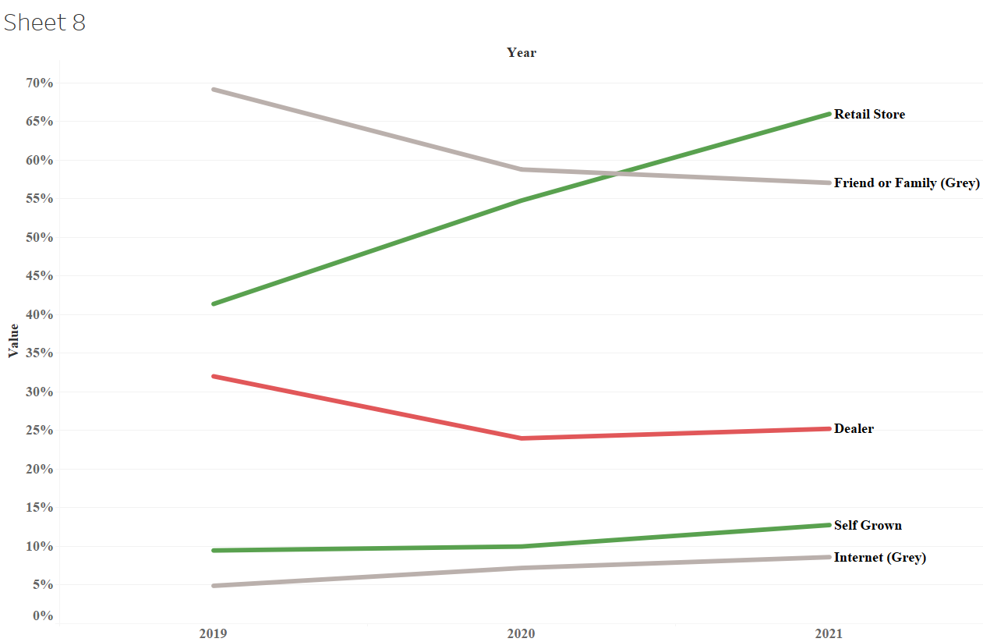
Reported Sources of Cannabis, 2019-2021
Store | 59% increase from 2019 (41.4%) to 2021 (66%)
Self-Grown | 34% increase from 2019 (9.5%) to 2021 (12.8%)
Dealers | 21% decrease from 2019 (32%) to 2021 (25.2%)
Friend/Family | 17% decrease from 2019 (69.2%) to 2021 (57%)
Internet Delivery | 75% increase from 2019 (4.9%) to 2021 (8.6%)
Source Type | Description
Legal Market | Source is explicitly legal
Grey Market | Source may be legal or illegal
Illicit Market | Source is explicitly illegal
Data: International Cannabis Policy Study (ICPS): Massachusetts Sample, 2019-2020
Notes:
We first look to reported sources of cannabis to determine where respondents are buying their products. Immediately, you’ll notice a massive increase to the number of respondents getting their cannabis from a store, from just over two in five respondents purchasing from a store in 2019, to almost two thirds in 2021. At the same time, the percent of respondents that reported growing their own cannabis increased from 9.5 to 12.8 %. Conversely, sourcing of cannabis from dealers has been on the decline, with just 25% of respondents reporting a dealer purchase in 2021, compared to 32% in 2019. Gray market sourcing from a friend or family member also declined over this period from 69 to 57%. These results demonstrate that along with the maturation of the legal market in Massachusetts has come major increases to legal market utilization and simultaneously decreases to dealer sourcing.

Slide 10
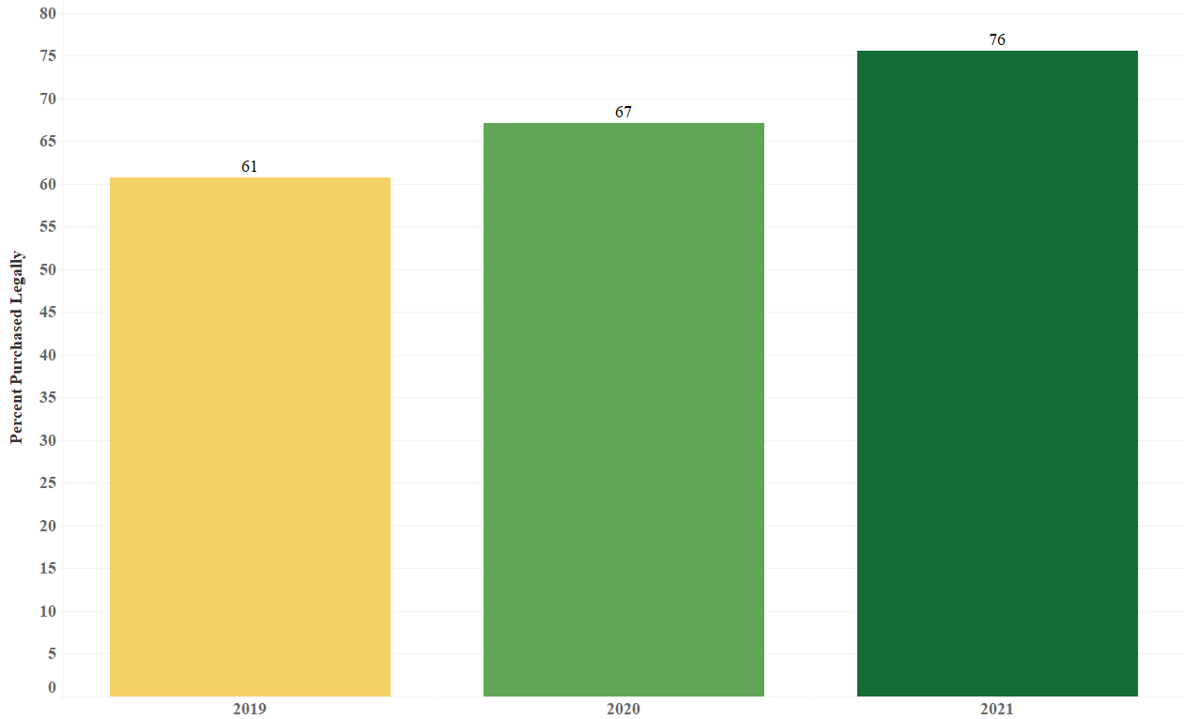
Cannabis Purchasing Trends – Percent Legal
Steady increases in the reported percent of cannabis purchased from legal sources
  61% in 2019, 76% in 2021
Data: International Cannabis Policy Study (ICPS): Massachusetts Sample, 2019-2020
Notes:
Now we go from reported sources of cannabis, to actual estimates of whether the legal or illicit market was used more heavily. Clearly, Massachusetts residents are showing a preference for legal market products over time, with the percent of cannabis purchased legally increasing from just over 60% in 2019 to over three-quarters in 2021.

Slide 11
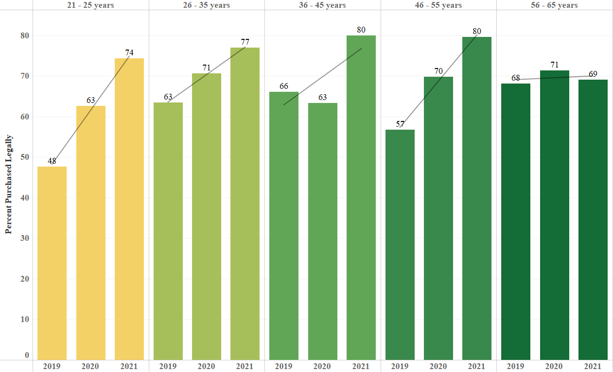
Percent Legal – By Age
+54%
+22%
+21%
+40%
+1%
Largest increase in the percent of cannabis purchased from legal sources was among 21-25-year-olds, the youngest demographic that can legally purchase
Legal purchases went from under half to almost three quarters of all cannabis purchases over 2 years
Data: International Cannabis Policy Study (ICPS): Massachusetts Sample, 2019-2020
Notes:
Yet this story gets even more fascinating when stratified by age. The major story appears to be increased adoption of the legal market by 21-25 year olds. Over just two years, the reported percent of weed purchased legally in this demographic went from 48 to 74%.

Slide 12
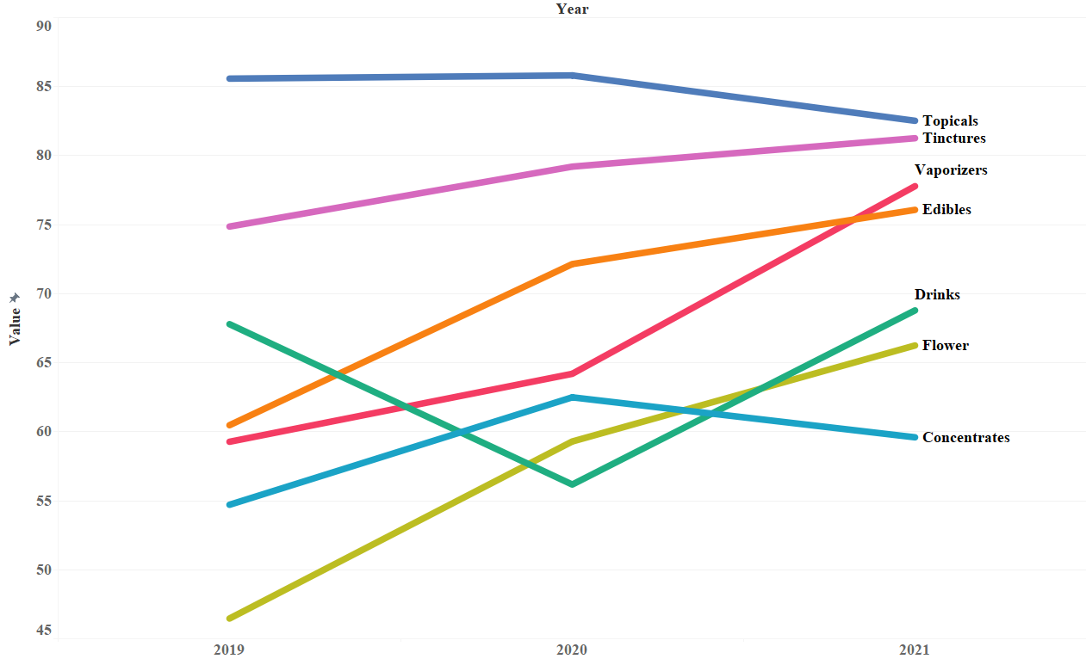
Percent Purchased Legally by Product Type, 2019-2021
Largest % Legal: Topicals (84.7), Tinctures (78.5)
Smallest % Legal: Flower (56.1), Concentrates (58.8)
Largest Growth:
  Flower: 43% change from 2019 (46.5) to 2021 (66.3)
  Vaporizers: 31% change from 2019 (59.3) to 2021 (77.8)
Only decrease in Topicals; 3.6% decrease from 2019 (85.6) to 2021 (82.5)
Data: International Cannabis Policy Study (ICPS): Massachusetts Sample, 2019-2020
Notes:
And next we look to the percent legally purchased by product type by year. Perhaps unsurprisingly, topicals and tinctures were predominantly sourced from the legal market, where cannabis flower and concentrates were still sourced from the illicit market almost half of the time. For flower, however, there has been a steady increase in legal market sourcing. In 2019, just 46.5% of cannabis flower came from the legal market. By 2021, almost two thirds was coming from the legal market. There was also a large increase to sourcing of vaporizers from the legal market, from 59.3% in 2019 to 77.8% in 2021. Only one product type; topicals, decreased, from 85.6% in 2019 to 82.5% in 2021.

Slide 13
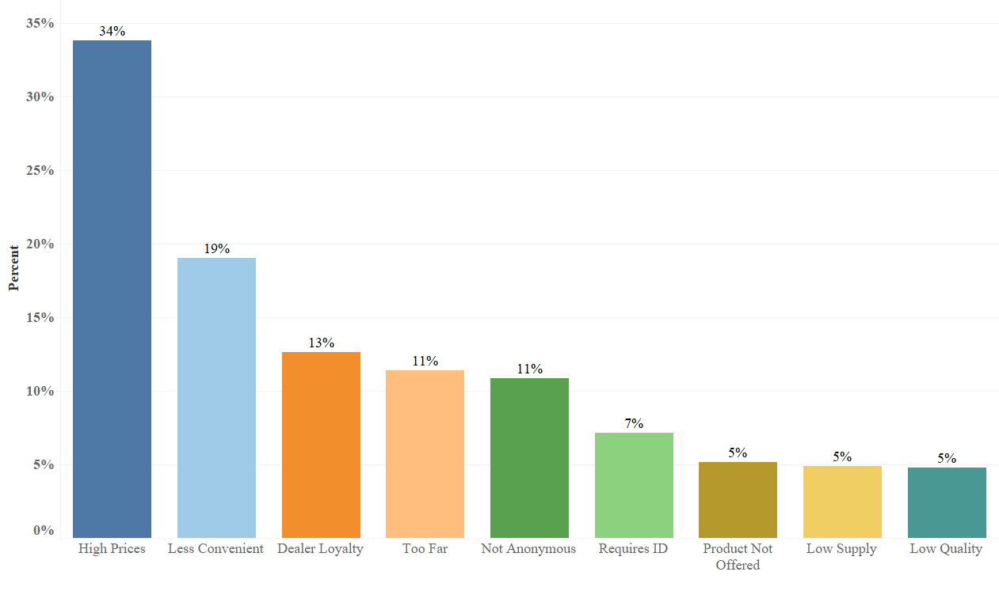
Reasons For Avoiding the Legal Market
Wide array of reasons for avoiding retail purchase
Over one-third avoided retail purchase because of high price of products
13% avoided retail purchase because of loyalty to a pre-existing cannabis dealer
Data: International Cannabis Policy Study (ICPS): Massachusetts Sample, 2019-2020
Notes:
Finally, we asked our respondents for the main reasons they bought from the illicit market instead of legal sources. As you can see, a wide array of reasons were reported for sourcing from this market but some were clearly reported more than others. In particular, high prices were a frequent reason, with over one-third of respondents avoiding the legal market due to its higher prices. Convenience was also obviously a concern, with 19% reporting the legal market was ‘less convenient’, and 11% reporting it was ‘too far’ away to consider purchase. Finally, 13% did not purchase at stores because of a loyalty to their dealer.

Slide 14
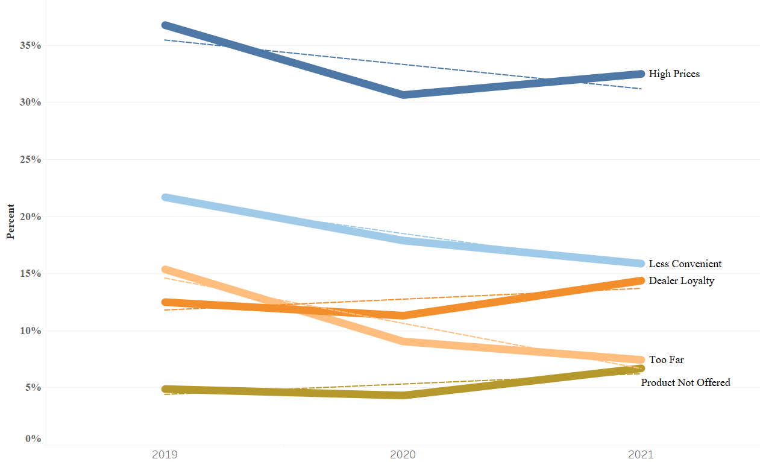
Reasons For Avoiding the Legal Market – Over Time
Large decreases in “Less Convenient” and “Too Far”
  Less Convenient: 2019 (22%) – 2021 (16%)
  Too Far: 2019 (15%) – 2021 (7%)
Increases in “Dealer Loyalty” and “Product Not Offered”
  Dealer Loyalty: 2019 (13%) – 2021 (14%)
  Product Not Offered: 2019 (5%) – 2021 (7%)
Data: International Cannabis Policy Study (ICPS): Massachusetts Sample, 2019-2020
Notes:
Once again, the story gets a lot more interesting when looked at over a two-year timespan. For starters, the perceived convenience of the legal market certainly increased, as there were major decreases to both those reporting the legal market as ‘less convenient’ or ‘too far’. There was also a modest decrease to those reporting ‘high prices’ as a reason, from 37 to 33%. We did also notice modest increases in ‘dealer loyalty’, from 13 to 14% and ‘product not offered’ from 5 to 7%.

Slide 15
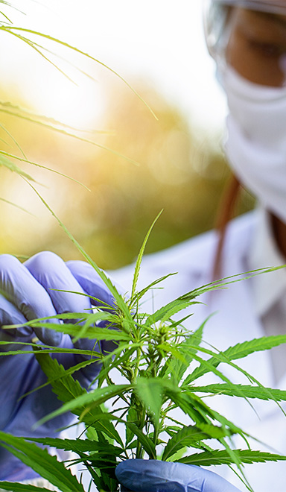
Discussion
Cannabis Sources
  Legal market sources are increasing, illicit market sources appear to be receding
  Percent sourcing from store: 41% to 66% over 2 years, percent sourcing from dealer: 32% to 25% over 2 years
Percent Purchased Legally
  Legal market adoption by consumers: 61% purchased legally in 2019, 76% in 2021
  Age: Largest increases among youngest legal demographic (21-25 yrs.) – 48% to 74% over 2-year span
Notes:
As you can see, by surveying just three simple questions asked of respondents on the ICPS we were able to pull a wide array of information about the evolving legal cannabis market in Massachusetts. For starters, our results indicate that legal sources like stores and home-growing are becoming the norm, where illicit market sources are receding.
Further evidence of the normalization of the legal market can be seen by surveying the percent of products purchased legally. Consumers are clearly adopting the legal market into their cannabis purchasing behaviors, with over three quarters of cannabis reported legally in 2021, compared to just 61% in 2019. These increases were the most extreme among 21-25 year olds, where respondents went from purchasing under half to almost three-quarters of their cannabis from the legal market.

Slide 16
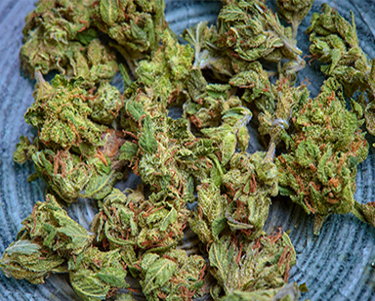

Discussion
Product Types
  Percent purchased legally increased for almost all product types
  Largest increases among flower, vaporizer products previously sourced heavily from illicit market
    Flower: Price drops in the legal market
      December 2019: $14.61/gram - December 2021: $12.86/gram (12% decrease)
      December 2022: $7.61/gram (48% decrease from 2019)
    Vaporizers: 59% to 78% purchased legally in 2 years
      Increase may be tied to concerns related to EVALI
Images retrieved from https://balagancannabis.com/
Data: Open Data Platform, Cannabis Control Commission
Notes:
Once again, the story unfolds even further once the percent purchased legally is looked at by product type. The percent of legal purchase increased for all but one product type from 2019 – 2021, topicals, which was still north of 82% after the decrease.
Almost all products increased in legal sourcing, but the increases were largest among flower and vaporizers; two products that were previously sourced heavily from the illicit market. The increases in flower may be related to the decrease in legal-market flower prices, which decreased by 12% from $14.61 per gram in December 2019 to $12.86 in December 2021. With flower prices now at just $7.61/gram as of December 2022, it seems likely that flower sourcing will continue to trends toward the legal market as prices come down.
We also saw an increase in legal vaporizer sourcing, from 59 to 78% over 2 years. Where the increase for flower is tied moreso to changes to the market itself, the increase in vaporizers was likely driven at least in part by the EVALI crisis, where illicit market vaporizers were heavily viewed as a culprit. It is likely that this public health scare discouraged the purchase of illicit market vaporizers, sending individuals to the legal market for their products.

Slide 17
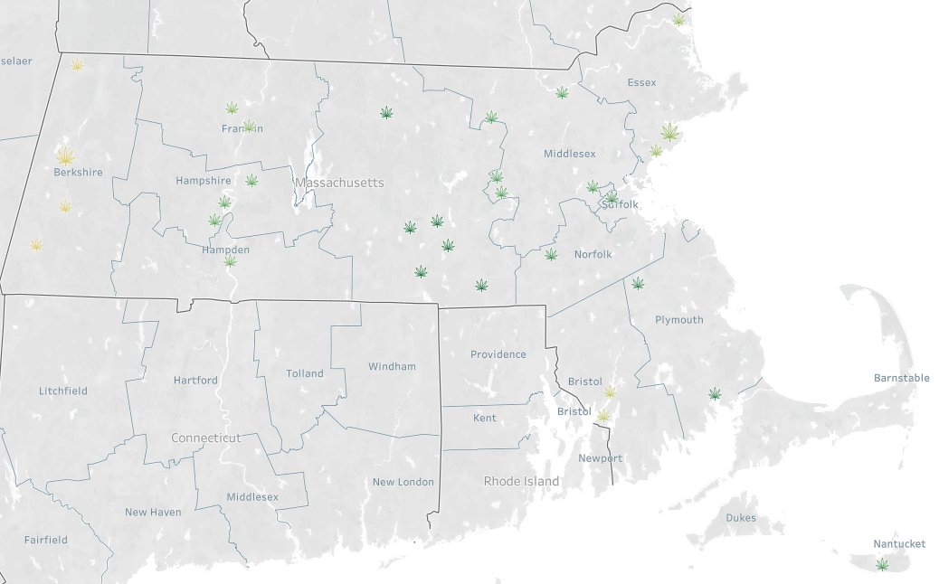
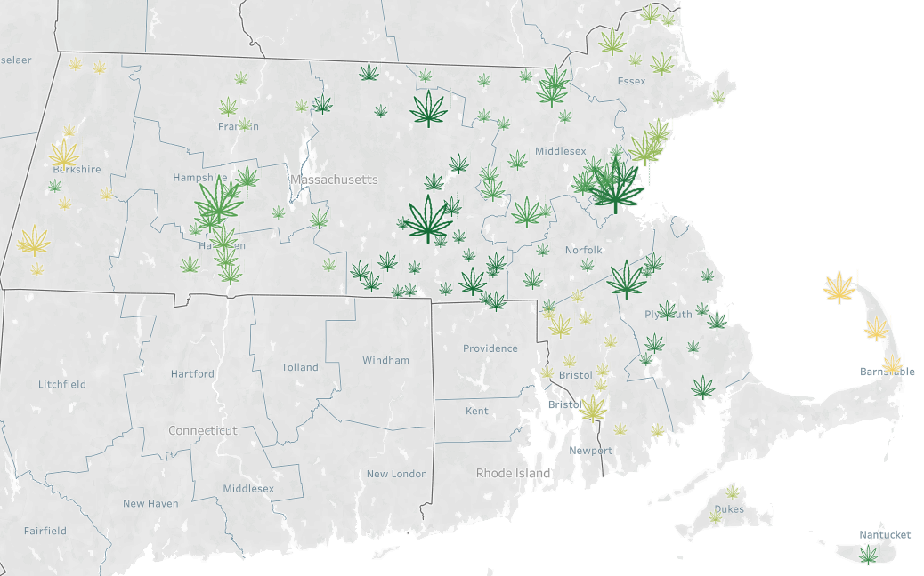
Market Saturation
Discussion
Reasons for avoiding the legal market:
  Fewer respondents report the legal market to be inconvenient, too far away; may signal that market is reaching saturation
  Convenience has increased, but respondents continue to look to the illicit market for products not available at legal stores or remain loyal to a pre-existing illicit market dealer(s)
Dec. 2019
Present
Data: Open Data Platform, Cannabis Control Commission
Notes:
Finally, we wanted to understand the reasonings for individuals not using the legal market despite its availability. During our first survey period in September 2019, the inconvenience of the newly established legal market was clear. Over just two years, the number of retailers in business increased from 64 to 161. Coinciding with this increase, the percent reporting the legal market was ‘less convenient’ decreased from 22 to 16% and the percent reporting the legal market was too far decreased from 15 to 7% Overall, these results seem to suggest that the market in Massachusetts is reaching saturation.
Although convenience has increased, our results suggest the illicit market is still a useful resource for many because it offers products that are not currently offered in legal markets. It remains an open question whether this will remain as an issue as the market continues to innovate and more products are developed for the legal market. It also remains to be seen whether those that use the illicit market because they are loyal to a coexisting dealer will eventually transition to the legal market as prices go down and perceived convenience goes up.

Slide 18

Conclusion
Estimating the scope of the illicit market remains a major challenge for researchers and regulators alike.
The ICPS is a highly useful dataset for evaluating the impacts of cannabis policy and regulatory measures on consumer perceptions and behaviors.
Examining the scope of the illicit market can be difficult, but the ICPS provides numerous questions that can help provide estimates of illicit market behaviors.
Notes:
In closing, we all know that estimating the scope of the illicit market is very difficult; their goal is to fly under the radar and remain unobserved.
Thankfully for us regulators, the ICPS provides highly useful data for examining consumer perceptions and behaviors related to the legal and illicit markets, which can help provide estimates of both legal and illicit market activity.

Slide 19
Questions?
Alexander Colby
Alexander.Colby@CCCMass.com
Notes:
Thank you again, everyone, for being here today.
I’d now like to open it up for any questions about the study. If any questions arise after today’s meeting, please don’t hesitate to contact me , my contact information is listed here! Thank you!

