Slide 1
Phase III: Polydrug Overdose
Case Definition Subgroup

Slide 2
Phase III: Polydrug Overdose
Hypotheses:
  Specific combinations of drugs (Jim Davis, NM; death certificate work)
    Benzodiazepines / Opioids
  Number of classes of drug on inpatient admissions
    Measure classes, not codes

Slide 3
Phase III: Polydrug Overdose
Drug Classes in Phase III
Methods (Approach):
  Divide drugs into classes (not codes)
  Look at combinations of classes
Cannabis
Opioids
_____Non-heroin opioids (Alone or in combination)
_____Heroin (Alone or in combination)
Psychostimulants
_____Ampthetamines
_____Non-Ampthetamines
Cocaine
Benzodiazepines
Alcohol Toxicity
Unspecified Psychodysleptics
Unspecified/Other Psychotropics

Slide 4
Phase III: Polydrug Overdose
Methods (Computational):
  Use programming techniques from Phase I and Phase II
  “Above the line” code
  Custis (MT) array statements
  Katelyn (CO) ODS output
  Molly (TN) Excel macros
  Pedro (CDC) traffic lighting

Slide 5
Phase III: Polydrug Overdose
Single Line Matrix: Louisiana, Provisional Data
Louisiana (Provisional Q1-Q3 2017) | Number
Cannabis | 265
Opioids | 2,444
_____Non-heroin opioids (Alone or in combination) | 1,969
_____Heroin (Alone or in combination) | 493
Psychostimulants | 521
_____Ampthetamines | 473
_____Non-Ampthetamines | 53
Cocaine | 412
Benzodiazepines | 1,529
Alcohol Toxicity | 587
Unspecified Psychodysleptics | 40
Unspecified/Other Psychotropics | 15

Slide 7
Row Substance | Cannabis | Opioids | _____Non-heroin opioids (Alone or in combination) | _____Heroin (Alone or in combination) | Psychostimulants | _____Ampthetamines | _____Non-Ampthetamines | Cocaine | Benzodiazepines | Alcohol Toxicity | Unspecified Psychodysleptics | Unspecified/Other Psychotropics
Cannabis | 265 | 16 | 11 | 5 | 18 | 18 | . | 19 | 19 | <5 | <5 | .
Opioids | 16 | 2,444 | 1,969 | 493 | 65 | 60 | 5 | 56 | 343 | 18 | <5 | <5
_____Non-heroin opioids (Alone or in combination) | 11 | 1,969 | 1,969 | 18 | 42 | 38 | <5 | 24 | 325 | 14 | <5 | <5
_____Heroin (Alone or in combination) | 5 | 493 | 18 | 493 | 23 | 22 | <5 | 32 | 18 | <5 | . | .
Psychostimulants | 18 | 65 | 42 | 23 | 521 | 473 | 53 | 12 | 32 | 6 | <5 | .
_____Ampthetamines | 18 | 60 | 38 | 22 | 473 | 473 | 5 | 12 | 32 | 6 | <5 | .
_____Non-Ampthetamines | . | 5 | <5 | <5 | 53 | 5 | 53 | . | . | . | . | .
Cocaine | 19 | 56 | 24 | 32 | 12 | 12 | . | 412 | 18 | 12 | 6 | .
Benzodiazepines | 19 | 343 | 325 | 18 | 32 | 32 | . | 18 | 1,529 | 52 | <5 | .
Alcohol Toxicity | <5 | 18 | 14 | <5 | 6 | 6 | . | 12 | 52 | 587 | <5 | <5
Unspecified Psychodysleptics | <5 | <5 | <5 | . | <5 | <5 | . | 6 | <5 | <5 | 40 | .
Unspecified/Other Psychotropics | . | <5 | <5 | . | . | . | . | . | . | <5 | . | 15

Slide 8
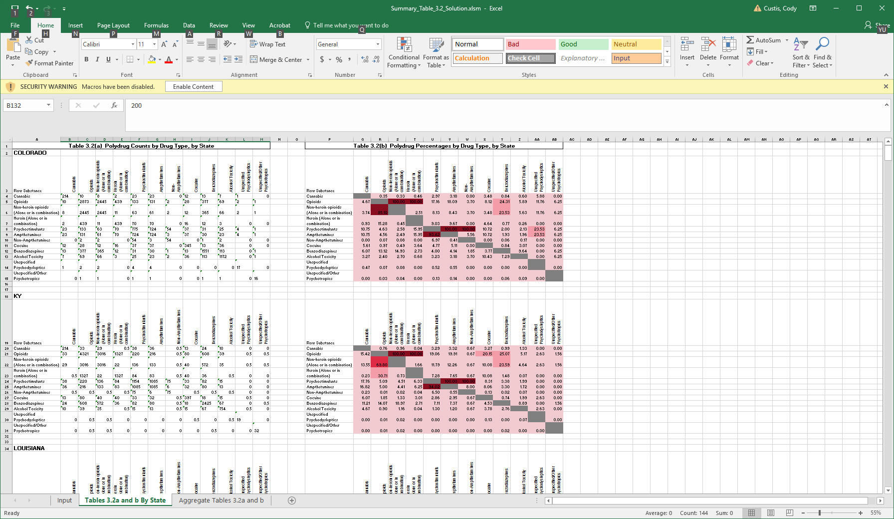

Slide 9
Table 3.2(b) Polydrug Percentages by Drug Type, National Total
Row Substance | Cannabis | Opioids | Non-heroin opioids (Alone or in combination) | Heroin (Alone or in combination) | Psychostimulants | Amphetamines | Non-Amphetamines | Cocaine | Benzodiazepines | Alcohol Toxicity | Unspecified Psychodysleptics | Unspecified/Other Psychotropics
Cannabis |  | 0.51 | 0.52 | 0.40 | 3.00 | 3.09 | 1.66 | 2.56 | 0.76 | 0.77 | 6.45 | 0.00
Opioids | 7.51 |  | 100.00 | 100.00 | 15.00 | 16.16 | 3.48 | 12.04 | 23.56 | 5.35 | 3.87 | 5.71
Non-heroin opioids (Alone or in combination) | 6.02 | 78.76 |  | 2.97 | 9.48 | 10.09 | 2.49 | 5.30 | 21.95 | 4.40 | 2.26 | 5.71
Heroin (Alone or in combination) | 1.30 | 21.89 | 0.83 |  | 5.52 | 6.07 | 0.17 | 6.74 | 1.61 | 0.87 | 1.61 | 0.00
Psychostimulants | 8.19 | 2.76 | 2.22 | 4.65 |  | 100.00 | 100.00 | 2.39 | 1.95 | 1.33 | 2.90 | 0.82
Ampthetamines | 7.61 | 2.68 | 2.13 | 4.61 | 90.10 |  | 6.97 | 2.33 | 1.83 | 1.14 | 2.90 | 0.82
Non-Amphetamines | 0.48 | 0.07 | 0.06 | 0.01 | 10.64 | 0.82 |  | 0.05 | 0.12 | 0.17 | 0.00 | 0.00
Cocaine | 8.09 | 2.57 | 1.44 | 6.58 | 2.77 | 3.00 | 0.50 |  | 1.05 | 2.73 | 7.10 | 0.00
Benzodiazepines | 6.94 | 14.61 | 17.28 | 4.56 | 6.56 | 6.82 | 3.81 | 3.06 |  | 9.93 | 2.58 | 2.45
Alcohol Toxicity | 2.99 | 1.41 | 1.47 | 1.04 | 1.91 | 1.80 | 2.32 | 3.36 | 4.21 |  | 3.87 | 2.45
Unspecified Psychodysleptics | 0.96 | 0.04 | 0.03 | 0.07 | 0.16 | 0.18 | 0.00 | 0.33 | 0.04 | 0.15 |  | 0.00
Unspecified/Other Psychotropics | 0.00 | 0.05 | 0.06 | 0.00 | 0.04 | 0.04 | 0.00 | 0.00 | 0.03 | 0.07 | 0.00

Slide 10
Phase III: Polydrug Overdose
Highlights:
  Cannabis and opioids
  Opioids and
    Amphetamines
    Cocaine
    Benzodiazepines
  Benzodiazepines and amphetamines
  Benzodiazepines and alcohol

Slide 19
Table 3.2: Polydrug Overdose - Non-Fatal, MISSOURI
Row Substance | Cannabis | Opioids | _____Non-heroin opioids (Alone or in combination) | _____Heroin (Alone or in combination) | Psychostimulants | _____Ampthetamines | _____Non-Ampthetamines | Cocaine | Benzodiazepines | Alcohol Toxicity | Unspecified Psychodysleptics | Unspecified/Other Psychotropics
Opioids | 0.39% | 3092 | 79% | 21% | 2.8% | 2.7% | 0.10% | 1.1% | 17% | 1.8% | 0.06% | 0.13%
_____Non-heroin opioids (Alone or in combination) | 0.4% | 100.0% | 2445 | 0.4% | 2.3% | 2.2% | 0.1% | 0.5% | 19.3% | 1.8% | 0.0% | 0.2%
_____Heroin (Alone or in combination) | 0.5% | 100.0% | 1.7% | 658 | 4.6% | 4.6% | #VALUE! | 3.5% | 6.1% | 1.7% | 0.2% | #VALUE!
* we can focus on the red to pull out the bullets of findings
Row Substance | Cannabis | Opioids | _____Non-heroin opioids (Alone or in combination) | _____Heroin (Alone or in combination) | Psychostimulants | _____Ampthetamines | _____Non-Ampthetamines | Cocaine | Benzodiazepines | Alcohol Toxicity | Unspecified Psychodysleptics | Unspecified/Other Psychotropics
Psychostimulants | 3.2% | 11.8% | 7.7% | 4.1% | 728 | 92.7% | 7.8% | 1.5% | 7.0% | 1.8% | 0.5% | 0.1%
_____Ampthetamines | 3.1% | 12.3% | 7.9% | 4.4% | 100.0% | 675 | 0.6% | 1.6% | 6.8% | 1.8% | 0.6% | 0.1%
_____Non-Ampthetamines | 3.5% | 5.3% | 5.3% | #VALUE! | 100.0% | 7.0% | 57 | #VALUE! | 8.8% | 1.8% | #VALUE! | #VALUE!
Row Substance | Cannabis | Opioids | _____Non-heroin opioids (Alone or in combination) | _____Heroin (Alone or in combination) | Psychostimulants | _____Ampthetamines | _____Non-Ampthetamines | Cocaine | Benzodiazepines | Alcohol Toxicity | Unspecified Psychodysleptics | Unspecified/Other Psychotropics
Cannabis | 140 | 8.6% | 6.4% | 2.1% | 16.4% | 15.0% | 1.4% | 6.4% | 9.3% | 1.4% | 2.9% | #VALUE!
Cocaine | 3.1% | 12.1% | 4.2% | 8.0% | 3.8% | 3.8% | #VALUE! | 289 | 2.4% | 3.5% | 1.4% | #VALUE!
Benzodiazepines | 0.5% | 20.9% | 19.2% | 1.6% | 2.1% | 1.9% | 0.2% | 0.3% | 2453 | 5.2% | 0.0% | #VALUE!
Alcohol Toxicity | 0.2% | 6.2% | 4.9% | 1.2% | 1.5% | 1.3% | 0.1% | 1.1% | 14.2% | 892 | 0.3% | #VALUE!
Unspecified Psychodysleptics | 7.4% | 3.7% | 1.9% | 1.9% | 7.4% | 7.4% | #VALUE! | 7.4% | 1.9% | 5.6% | 54 | #VALUE!
Unspecified/Other Psychotropics | #VALUE! | 15% | 15% | #VALUE! | 4% | 4% | #VALUE! | #VALUE! | #VALUE! | #VALUE! | #VALUE! | 27

Slide 20
Conclusions
Majority of states 80-90% of hospitalizations with drug overdoses are caused by one drug class
  NC has a much higher proportion of polydrug overdoses than other states

Slide 21
Discussion
What do we do with this information?

Slide 22
Phase IV: ED Drug Overdoses
Objective: Repeat important analyses from phases I-III in ED discharges
  One SAS Code with an ODS output excel file

Slide 23
Phase IV: ED Drug Overdoses Timeline

