Slide 1
Phase III: Polydrug Overdose
Case Definition Subgroup

Slide 2
Phase III: Polydrug Overdose
Hypotheses:
  Specific combinations of drugs (Jim Davis, NM; death certificate work)
    Benzodiazepines / Opioids
  Number of classes of drug on inpatient admissions
    Measure classes, not codes

Slide 3
Phase III: Polydrug Overdose
Drug Classes in Phase III
Methods (Approach):
  Divide drugs into classes (not codes)
  Look at combinations of classes
Cannabis
Opioids
_____Non-heroin opioids (Alone or in combination)
_____Heroin (Alone or in combination)
Psychostimulants
_____Ampthetamines
_____Non-Ampthetamines
Cocaine
Benzodiazepines
Alcohol Toxicity
Unspecified Psychodysleptics
Unspecified/Other Psychotropics

Slide 4
Phase III: Polydrug Overdose
Methods (Computational):
  Use programming techniques from Phase I and Phase II
  “Above the line” code
  Custis (MT) array statements
  Katelyn (CO) ODS output
  Molly (TN) Excel macros
  Pedro (CDC) traffic lighting

Slide 5
Phase III: Polydrug Overdose
Single Line Matrix: Louisiana, Provisional Data
Louisiana (Provisional Q1-Q3 2017) | Number
Cannabis | 265
Opioids | 2,444
_____Non-heroin opioids (Alone or in combination) | 1,969
_____Heroin (Alone or in combination) | 493
Psychostimulants | 521
_____Ampthetamines | 473
_____Non-Ampthetamines | 53
Cocaine | 412
Benzodiazepines | 1,529
Alcohol Toxicity | 587
Unspecified Psychodysleptics | 40
Unspecified/Other Psychotropics | 15

Slide 7
Row Substance | Cannabis | Opioids | _____Non-heroin opioids (Alone or in combination) | _____Heroin (Alone or in combination) | Psychostimulants | _____Ampthetamines | _____Non-Ampthetamines | Cocaine | Benzodiazepines | Alcohol Toxicity | Unspecified Psychodysleptics | Unspecified/Other Psychotropics
Cannabis | 265 | 16 | 11 | 5 | 18 | 18 | . | 19 | 19 | <5 | <5 | .
Opioids | 16 | 2,444 | 1,969 | 493 | 65 | 60 | 5 | 56 | 343 | 18 | <5 | <5
_____Non-heroin opioids (Alone or in combination) | 11 | 1,969 | 1,969 | 18 | 42 | 38 | <5 | 24 | 325 | 14 | <5 | <5
_____Heroin (Alone or in combination) | 5 | 493 | 18 | 493 | 23 | 22 | <5 | 32 | 18 | <5 | . | .
Psychostimulants | 18 | 65 | 42 | 23 | 521 | 473 | 53 | 12 | 32 | 6 | <5 | .
_____Ampthetamines | 18 | 60 | 38 | 22 | 473 | 473 | 5 | 12 | 32 | 6 | <5 | .
_____Non-Ampthetamines | . | 5 | <5 | <5 | 53 | 5 | 53 | . | . | . | . | .
Cocaine | 19 | 56 | 24 | 32 | 12 | 12 | . | 412 | 18 | 12 | 6 | .
Benzodiazepines | 19 | 343 | 325 | 18 | 32 | 32 | . | 18 | 1,529 | 52 | <5 | .
Alcohol Toxicity | <5 | 18 | 14 | <5 | 6 | 6 | . | 12 | 52 | 587 | <5 | <5
Unspecified Psychodysleptics | <5 | <5 | <5 | . | <5 | <5 | . | 6 | <5 | <5 | 40 | .
Unspecified/Other Psychotropics | . | <5 | <5 | . | . | . | . | . | . | <5 | . | 15

Slide 8
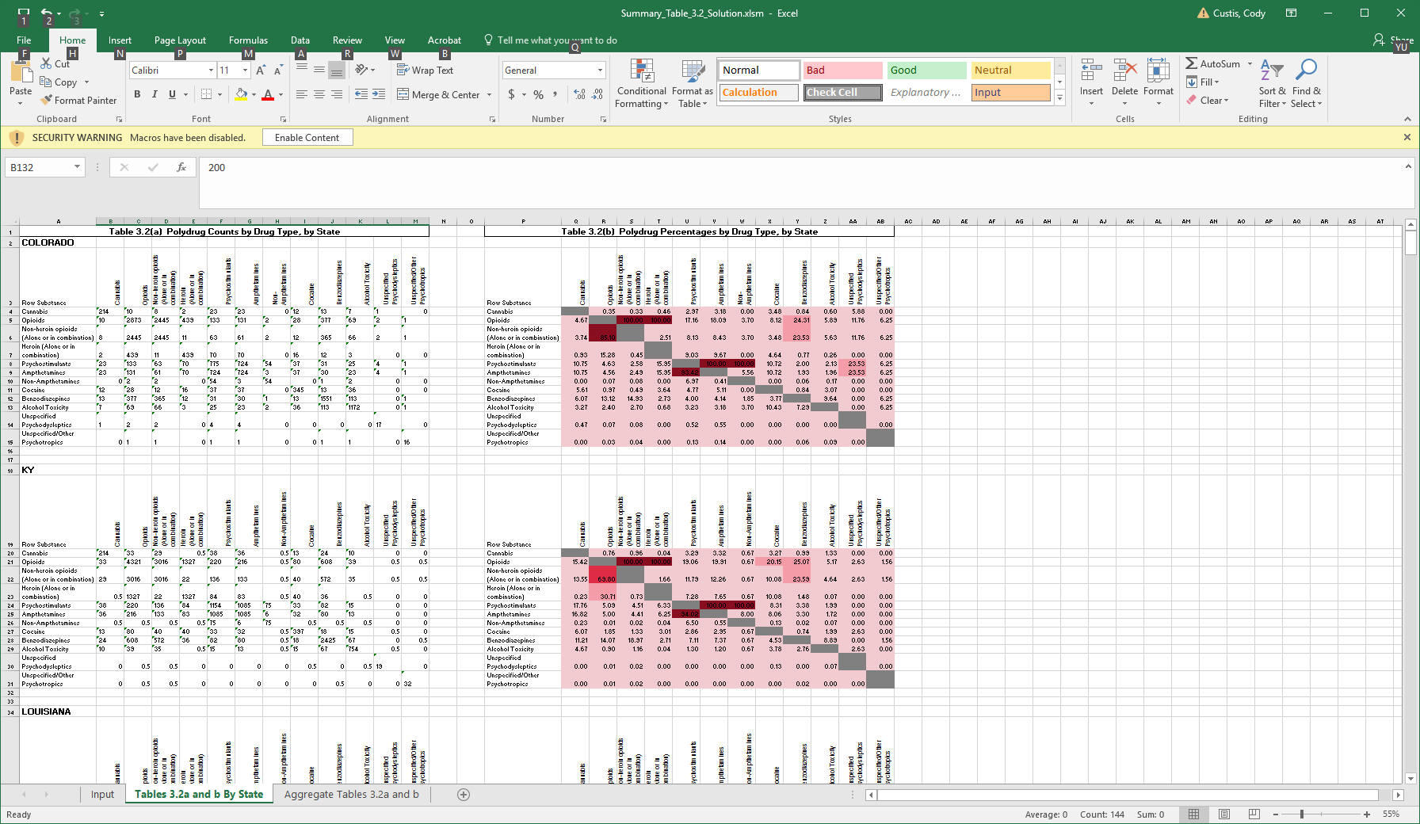

Slide 9
Table 3.2(b) Polydrug Percentages by Drug Type, National Total
Row Substance | Cannabis | Opioids | Non-heroin opioids (Alone or in combination) | Heroin (Alone or in combination) | Psychostimulants | Amphetamines | Non-Amphetamines | Cocaine | Benzodiazepines | Alcohol Toxicity | Unspecified Psychodysleptics | Unspecified/Other Psychotropics
Cannabis |  | 0.51 | 0.52 | 0.40 | 3.00 | 3.09 | 1.66 | 2.56 | 0.76 | 0.77 | 6.45 | 0.00
Opioids | 7.51 |  | 100.00 | 100.00 | 15.00 | 16.16 | 3.48 | 12.04 | 23.56 | 5.35 | 3.87 | 5.71
Non-heroin opioids (Alone or in combination) | 6.02 | 78.76 |  | 2.97 | 9.48 | 10.09 | 2.49 | 5.30 | 21.95 | 4.40 | 2.26 | 5.71
Heroin (Alone or in combination) | 1.30 | 21.89 | 0.83 |  | 5.52 | 6.07 | 0.17 | 6.74 | 1.61 | 0.87 | 1.61 | 0.00
Psychostimulants | 8.19 | 2.76 | 2.22 | 4.65 |  | 100.00 | 100.00 | 2.39 | 1.95 | 1.33 | 2.90 | 0.82
Ampthetamines | 7.61 | 2.68 | 2.13 | 4.61 | 90.10 |  | 6.97 | 2.33 | 1.83 | 1.14 | 2.90 | 0.82
Non-Amphetamines | 0.48 | 0.07 | 0.06 | 0.01 | 10.64 | 0.82 |  | 0.05 | 0.12 | 0.17 | 0.00 | 0.00
Cocaine | 8.09 | 2.57 | 1.44 | 6.58 | 2.77 | 3.00 | 0.50 |  | 1.05 | 2.73 | 7.10 | 0.00
Benzodiazepines | 6.94 | 14.61 | 17.28 | 4.56 | 6.56 | 6.82 | 3.81 | 3.06 |  | 9.93 | 2.58 | 2.45
Alcohol Toxicity | 2.99 | 1.41 | 1.47 | 1.04 | 1.91 | 1.80 | 2.32 | 3.36 | 4.21 |  | 3.87 | 2.45
Unspecified Psychodysleptics | 0.96 | 0.04 | 0.03 | 0.07 | 0.16 | 0.18 | 0.00 | 0.33 | 0.04 | 0.15 |  | 0.00
Unspecified/Other Psychotropics | 0.00 | 0.05 | 0.06 | 0.00 | 0.04 | 0.04 | 0.00 | 0.00 | 0.03 | 0.07 | 0.00

Slide 10
Phase III: Polydrug Overdose
Highlights:
  Cannabis and opioids
  Opioids and
    Amphetamines
    Cocaine
    Benzodiazepines
  Benzodiazepines and amphetamines
  Benzodiazepines and alcohol

Slide 11
Notes:
The poly drug combination of marijuana and opioids in overdose cases makes up a far larger percent of the total marijuana overdoses than it does out of total opioid overdoses.

Slide 12
Notes:
Heroin overdoses are more likely to involve amphetamines than non heroin opioid overdoses.
Heroin overdoses in western states are more likely to involve amphetamines

Slide 13
Notes:
Heroin overdoses are more likely to involve cocaine than non heroin opioid overdoses.
Heroin overdoses in eastern states are more likely to involve cocaine.

Slide 14
Notes:
Non heroin opioid overdoses are more likely to involve benzos than heroin overdoses.
There is no clear regional pattern.

Slide 15
Notes:
The poly drug combination of cocaine and opioids in overdose cases makes up a far larger percent of the total cocaine overdoses than it does out of total opioid overdoses.

Slide 16
Notes:
The poly drug combination of benzos and non heroin opioids in overdose cases makes up a slightly larger percent of the benzodiazepine overdoses than it does out of total non heroin opioid overdoses.

Slide 17
Notes:
The poly drug combination of benzodiazepines and amphetamines in overdose cases makes up a far larger percent of the total amphetamine overdoses than it does out of total benzodiazepine overdoses.

Slide 18
Notes:
The poly drug combination of benzodiazepines and alcohol in overdose cases makes up a larger percent of the total alcohol overdoses than it does out of total benzodiazepine overdoses.

Slide 19
Table 3.2: Polydrug Overdose - Non-Fatal, MISSOURI
Row Substance | Cannabis | Opioids | _____Non-heroin opioids (Alone or in combination) | _____Heroin (Alone or in combination) | Psychostimulants | _____Ampthetamines | _____Non-Ampthetamines | Cocaine | Benzodiazepines | Alcohol Toxicity | Unspecified Psychodysleptics | Unspecified/Other Psychotropics
Opioids | 0.39% | 3092 | 79% | 21% | 2.8% | 2.7% | 0.10% | 1.1% | 17% | 1.8% | 0.06% | 0.13%
_____Non-heroin opioids (Alone or in combination) | 0.4% | 100.0% | 2445 | 0.4% | 2.3% | 2.2% | 0.1% | 0.5% | 19.3% | 1.8% | 0.0% | 0.2%
_____Heroin (Alone or in combination) | 0.5% | 100.0% | 1.7% | 658 | 4.6% | 4.6% | #VALUE! | 3.5% | 6.1% | 1.7% | 0.2% | #VALUE!
* we can focus on the red to pull out the bullets of findings
Row Substance | Cannabis | Opioids | _____Non-heroin opioids (Alone or in combination) | _____Heroin (Alone or in combination) | Psychostimulants | _____Ampthetamines | _____Non-Ampthetamines | Cocaine | Benzodiazepines | Alcohol Toxicity | Unspecified Psychodysleptics | Unspecified/Other Psychotropics
Psychostimulants | 3.2% | 11.8% | 7.7% | 4.1% | 728 | 92.7% | 7.8% | 1.5% | 7.0% | 1.8% | 0.5% | 0.1%
_____Ampthetamines | 3.1% | 12.3% | 7.9% | 4.4% | 100.0% | 675 | 0.6% | 1.6% | 6.8% | 1.8% | 0.6% | 0.1%
_____Non-Ampthetamines | 3.5% | 5.3% | 5.3% | #VALUE! | 100.0% | 7.0% | 57 | #VALUE! | 8.8% | 1.8% | #VALUE! | #VALUE!
Row Substance | Cannabis | Opioids | _____Non-heroin opioids (Alone or in combination) | _____Heroin (Alone or in combination) | Psychostimulants | _____Ampthetamines | _____Non-Ampthetamines | Cocaine | Benzodiazepines | Alcohol Toxicity | Unspecified Psychodysleptics | Unspecified/Other Psychotropics
Cannabis | 140 | 8.6% | 6.4% | 2.1% | 16.4% | 15.0% | 1.4% | 6.4% | 9.3% | 1.4% | 2.9% | #VALUE!
Cocaine | 3.1% | 12.1% | 4.2% | 8.0% | 3.8% | 3.8% | #VALUE! | 289 | 2.4% | 3.5% | 1.4% | #VALUE!
Benzodiazepines | 0.5% | 20.9% | 19.2% | 1.6% | 2.1% | 1.9% | 0.2% | 0.3% | 2453 | 5.2% | 0.0% | #VALUE!
Alcohol Toxicity | 0.2% | 6.2% | 4.9% | 1.2% | 1.5% | 1.3% | 0.1% | 1.1% | 14.2% | 892 | 0.3% | #VALUE!
Unspecified Psychodysleptics | 7.4% | 3.7% | 1.9% | 1.9% | 7.4% | 7.4% | #VALUE! | 7.4% | 1.9% | 5.6% | 54 | #VALUE!
Unspecified/Other Psychotropics | #VALUE! | 15% | 15% | #VALUE! | 4% | 4% | #VALUE! | #VALUE! | #VALUE! | #VALUE! | #VALUE! | 27

Slide 20
Conclusions
Majority of states 80-90% of hospitalizations with drug overdoses are caused by one drug class
  NC has a much higher proportion of polydrug overdoses than other states
Illicit drugs are more likely to be found in combination with other illicit drugs than with other commonly prescribed drugs. Commonly prescribed drugs are more likely to be found in combination with other commonly prescribed drugs than with illicit drugs.
We are uncertain about the level of drug specificity in hospital and emergency department discharge data. This could vary by health system or region and have a big impact on these results.

Slide 21
Discussion
What do we do with this information?
Which analyses should be repeated for emergency department data?
Does anyone have information about the rate of confirmatory testing in their hospitals?

Slide 22
Phase IV: ED Drug Overdoses
Objective: Repeat important analyses from phases I-III in ED discharges
  One SAS Code with an ODS output excel file

Slide 23
Phase IV: ED Drug Overdoses Timeline

