Slide 2
Case Definition PHASE IV: Call to Action
December 6, 2018

Slide 3
Phase IV
Goal: Perform analysis to create an Emergency Department case definition for ICD-10-CM
Considerations:
  Phase I, Phase II, Phase III findings
  Parallel analysis from earlier phases
  Doesn’t have to be perfect to be useful

Slide 4
Phase IV
Timeline
  Dec 6: Workgroup Call
  Friday, Dec 21: Summary results to leadership
  Monday, Jan 7: Present results
Should be straightforward for Phase I,II,III jurisdictions

Slide 5
Phase IV
How straightforward:
Before:
LIBNAME HOSP 'E:\CHA Raw Data\Clean CHA data’;
%LET MYLIB = HOSP; /*ENTER LIBNAME */
%LET PREFIX= HOSP; /*ENTER YEARLY DATSET PREFIX (FOR LOOPING IN YEARLY DATA, SEE ABOUT THE PROGRAM #3) */
%LET DATASET = HOSP; /*ENTER TYPE OF DATA, HOSP OR ED */
After:
LIBNAME ED 'E:\CHA Raw Data\Clean CHA data’;
%LET MYLIB = ED; /*ENTER LIBNAME */
%LET PREFIX= ED; /*ENTER YEARLY DATSET PREFIX (FOR LOOPING IN YEARLY DATA, SEE ABOUT THE PROGRAM #3) */
%LET DATASET = ED; /*ENTER TYPE OF DATA, HOSP OR ED */

Slide 6
Phase IV
4.0: Table 0
4.1: Table 1.1a-(Maybe) Number of Drug T Codes Listed per Record
4.2: Table 1.1b-The Drug Class of the First Listed Drug T Code
4.3: Table 1.3-Frequency of Intent-(Looks at first listed T Code only, definition has to be relaxed to capture all intents)
4.4: Table 1.5- Presence of Other External Cause of Injury Codes (Need to do for both case definitions principal and any mention)
4.5: Table 1.6-Position of First Mentioned Drug T Code
4.6: Table 1.7-Primary Diagnosis for ED Visits with Any Mention Drug T Code
4.7: Table 1.9b-Frequency of Intent for Any Mention of Drug T Codes
4.8: Table 1.11a-Number Expired in ED with Principal Diagnosis of Drug T Code and
4.9: Table 1.11b-Number of Expired in ED with Any Mention of Drug T Codes
4.10: Table 2.3-Specific Drug Definitions and Investigation of Adverse Effects Intent Codes and Behavioral Health Codes (Do total Ns)
4.11: Table 2.4 (a-c)-Investigation of Potential Changes to PfS/DDPI Indicator Definitions. Excluding discharge codes of deceased/expired. (Total Ns)
4.12: Table 2.5
4.13: Table 3.2- Poly Drug Matrix

Slide 7
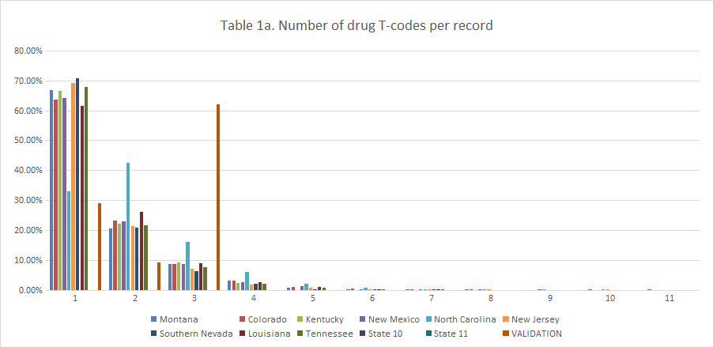
Notes:
Table 1a - Number of drug T-codes per record
What: This table shows the frequency distribution of the number of drug poisonings T-codes per record meeting proposed case definition 1. For example, in Montana, among inpatient hospital records that meet the criteria for case definition 1, there are 652 records with only 1 drug poisoning T-code and 201 records with 2 drug poisoning T-codes.
How: Identify records that meet the criteria for proposed case definition 1. Among these records, identify the number of drug poisoning T-Codes that appear in each record.
Why: This gives us a quick sense of how many poisoning visits involve multi-drug poisonings. If a high percentage of poisoning visits involve multiple drugs, it could have implications for how we choose to operationalize drug-specific sub-indicators (e.g. deciding whether sub-indicators should be mutually exclusive in the event that we use an any-mention approach). Depending on the results of this analysis, we could choose to take a deeper dive and determine which codes are most often grouped together.
Proposed Case definition 1 – Principal/first listed diagnosis
Search for a principal/first-listed diagnosis of T36 -T50 (All drug poisoning)
Includes unintentional, intentional harm, assault, and undetermined intent [with a 6th character of 1, 2, 3, or 4 (Exceptions: T36.9, T37.9, T39.9, T41.4, T42.7, T43.9, T45.9, T47.9, and T49.9 with a 5th character of 1, 2, 3, or 4)] Excludes adverse effects, underdosing (5,6), and invalid or missing intent.
Includes Initial encounters and Subsequent encounters (with a 7th character of A, D, or missing). Excludes sequelae (7th character of S).

Slide 8
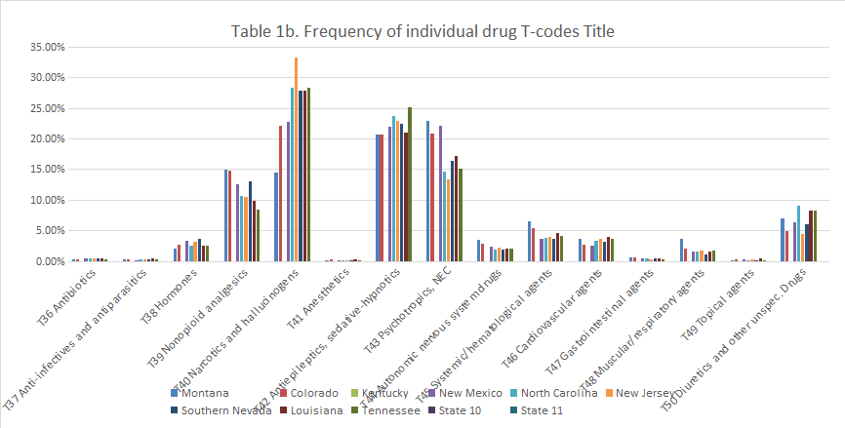
Notes:
Table 1b - Frequency of individual drug T codes (The Drug Class of the First Listed Drug T Code)
What: this table shows frequency distribution of individual poisoning T Codes across the dataset of records meeting proposed case definition 1.
How: Identify records that meet the criteria for proposed case definition 1. Among these records, identify the frequency with which each individual T code appears in the dataset (e.g. In MT, there are 214 instances of T40 across the dataset). Note that a T-code could appear in a single record more than once, for example, a single record might contain both T40.1 and T40.5, and in this case, you will count T40 twice. The total number of T codes you identify will be higher than the total number of drug poisoning records in your dataset.
Why: Specific codes allow us to identify which classes of drugs are responsible for the most poisoning admissions. Certain jurisdictions may see more poisonings based on geographic and legal variation, such as legality of cannabis, availability of licit and illicit opioids, and methamphetamine production. This information could determine which sub-indicators to prioritize in future explorations.
Proposed Case definition 1 – Principal/first listed diagnosis
Search for a principal/first-listed diagnosis of T36 -T50 (All drug poisoning)
Includes unintentional, intentional harm, assault, and undetermined intent [with a 6th character of 1, 2, 3, or 4 (Exceptions: T36.9, T37.9, T39.9, T41.4, T42.7, T43.9, T45.9, T47.9, and T49.9 with a 5th character of 1, 2, 3, or 4)] Excludes adverse effects, underdosing (5,6), and invalid or missing intent.
Includes Initial encounters and Subsequent encounters (with a 7th character of A, D, or missing). Excludes sequelae (7th character of S).

Slide 9
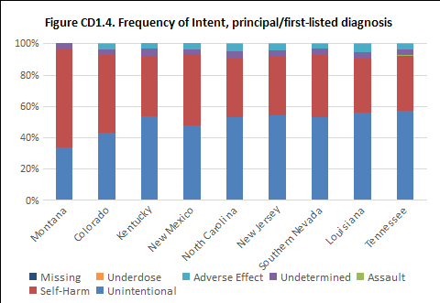
Notes:
Table CD1.4 - Frequency of Intent (Manner), (Allowing adverse effect, underdosing, and missing)
What: This table shows the frequency distribution of intent/manner among drug poisonings meeting case proposed definition 1 with the criteria for intent/manner relaxed.
How: Allowing for intent (5th or 6th character) of 1, 2, 3, 4, 5, 6, and missing/unknown, identify records that otherwise meet the criteria for proposed case definition 1. Identify the number of times each intent occurs.
Why: ICD-9-CM inconsistently captured intent for drug poisonings using a mix of required diagnosis codes and optional (for some states) external cause codes. ICD-10-CM consistently captures intent, underdosing, and adverse effects for drug poisonings within the diagnosis code, which is required for billing. ICD-10-CM includes the new concept of underdosing. This analysis will show the numeric impact of including or excluding values for intent/manner.
Proposed Case definition 1 – Principal/first listed diagnosis
Search for a principal/first-listed diagnosis of T36 -T50 (All drug poisoning)
Includes unintentional, intentional harm, assault, and undetermined intent [with a 6th character of 1, 2, 3, or 4 (Exceptions: T36.9, T37.9, T39.9, T41.4, T42.7, T43.9, T45.9, T47.9, and T49.9 with a 5th character of 1, 2, 3, or 4)] Excludes adverse effects, underdosing (5,6), and invalid or missing intent.
Includes Initial encounters and Subsequent encounters (with a 7th character of A, D, or missing). Excludes sequelae (7th character of S).

Slide 10
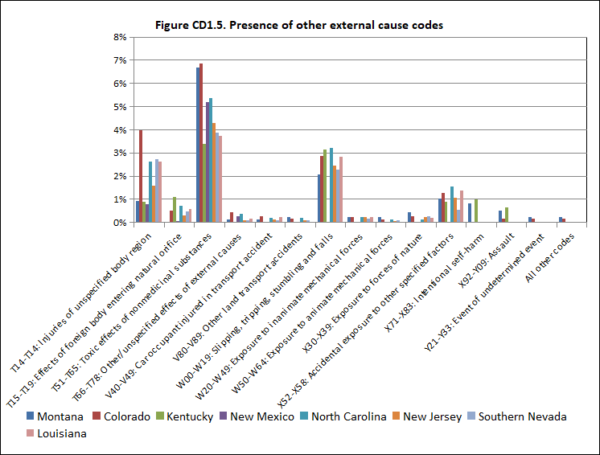
Notes:
Table 1.5 - Presence of other external cause codes
What: This table shows the frequency distribution of non-drug external cause codes present among records meeting the criteria for proposed case definition 1.
How: Identify records that meet the criteria for proposed case definition 1. Among these records, identify the first-valid, non-drug external cause code. Valid, non-drug external cause codes include: V00-V99, W00-X58, X71-X83, X92-Y08, Y21-Y33, Y35-Y38, T14.91, T15-T19, T51-65, T71, T73, T74, T75.0, T75.2, T75.3, and T76. Identify the number of times each non-drug external cause code appears as the first-valid, non-drug external cause code for a record.
Why: This analysis will show how frequently and which other external causes of injury are identified in the record concurrently with poisoning. This may help us to characterize cases picked up using the proposed case definition. Initial results from MT, NM, KY, and CO show relatively few drug-poisoning admissions are associated with other external causes.
Proposed Case definition 1 – Principal/first listed diagnosis
Search for a principal/first-listed diagnosis of T36 -T50 (All drug poisoning)
Includes unintentional, intentional harm, assault, and undetermined intent [with a 6th character of 1, 2, 3, or 4 (Exceptions: T36.9, T37.9, T39.9, T41.4, T42.7, T43.9, T45.9, T47.9, and T49.9 with a 5th character of 1, 2, 3, or 4)] Excludes adverse effects, underdosing (5,6), and invalid or missing intent.
Includes Initial encounters and Subsequent encounters (with a 7th character of A, D, or missing). Excludes sequelae (7th character of S).

Slide 11
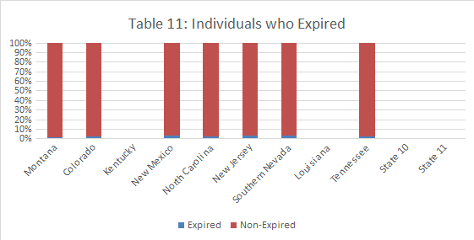
Notes:
Table 11 - Individuals who Expired
What: This table shows the ratio of drug hospitalizations with a disposition/discharge status of expired/deceased to all other drug hospitalizations meeting criteria for proposed case definition 1.
How: Identify records that meet the criteria for proposed case definition 1. Among these records, identify and flag records with any discharge status indicating the patient’s death (e.g. "Expired in a medical facility” or “Expired at home”).
Why: CDC’s ICD-9-CM PfS / DDPI toolkit indicators exclude individuals who expire, whereas injury and poisoning indicators from CDC do not currently examine discharge status. While the ultimate decision as to include or exclude individuals is driven by program needs, this table enables jurisdictions and policymakers to understand the magnitude of such a decision.
Proposed Case definition 1 – Principal/first listed diagnosis
Search for a principal/first-listed diagnosis of T36 -T50 (All drug poisoning)
Includes unintentional, intentional harm, assault, and undetermined intent [with a 6th character of 1, 2, 3, or 4 (Exceptions: T36.9, T37.9, T39.9, T41.4, T42.7, T43.9, T45.9, T47.9, and T49.9 with a 5th character of 1, 2, 3, or 4)] Excludes adverse effects, underdosing (5,6), and invalid or missing intent. Includes Initial encounters and Subsequent encounters (with a 7th character of A, D, or missing). Excludes sequelae (7th character of S).

Slide 12
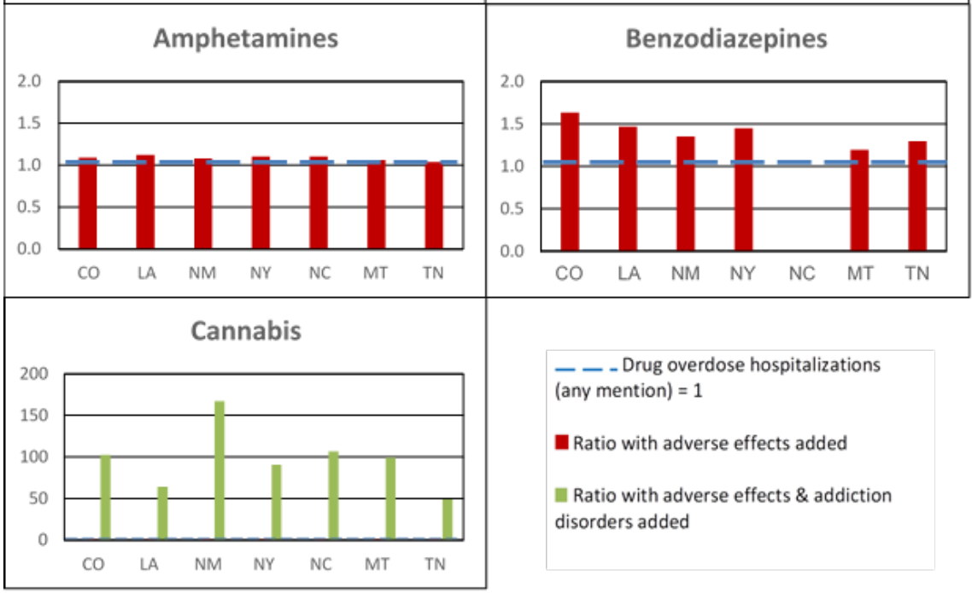
Figure CD 2.3 Ratio of cases identified when adverse effects and addiction disorders are added to CSTE case definition 2.1C (any mention)

Slide 13
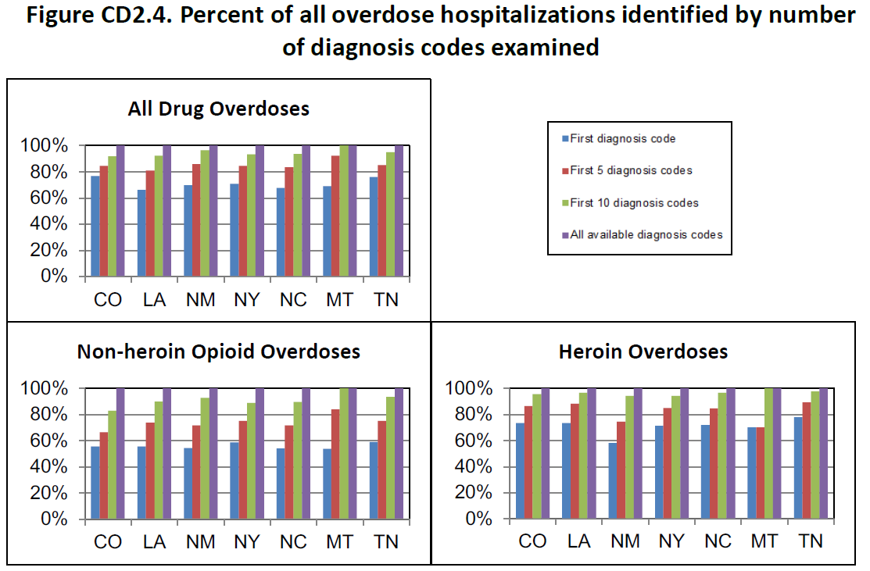
Notes:
Additional Analysis 2.4 (CD2.4): Investigation of Potential Changes to PfS/DDPI Indicator Definitions; repeats some earlier analyses but using PFS definitions
Purpose. PfS/DDPI indicators, which are used for DDPI/PfS cooperative agreement monitoring and
evaluation, are very similar to CSTE indicators for drug poisoning. However, there are some differences
that could affect the results of the workgroup’s exploratory analyses, thus the workgroup is analyzing
certain tables separately for the PFS/DDPI indicators in order to inform potential changes to the
indicators. PFS/DDPI indicators utilize an any-mention approach and exclude hospitalizations with
discharge codes of deceased/expired. These analyses were designed to investigate the effects of making
changes to the PfS/DDPI indicators. Specifically, this series of analyses investigates the impact of
changing the number of diagnostic fields included, using only the initial and missing encounters,
including counts of cases with both heroin and non-heroin opioid codes, and changing the
manner/intent included.

Slide 14
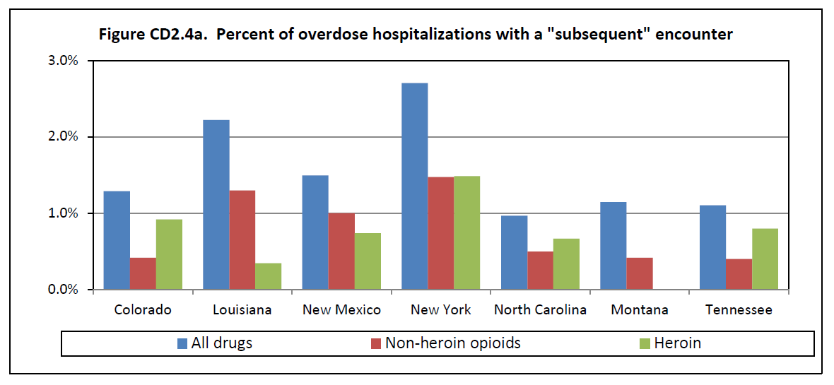

Slide 15
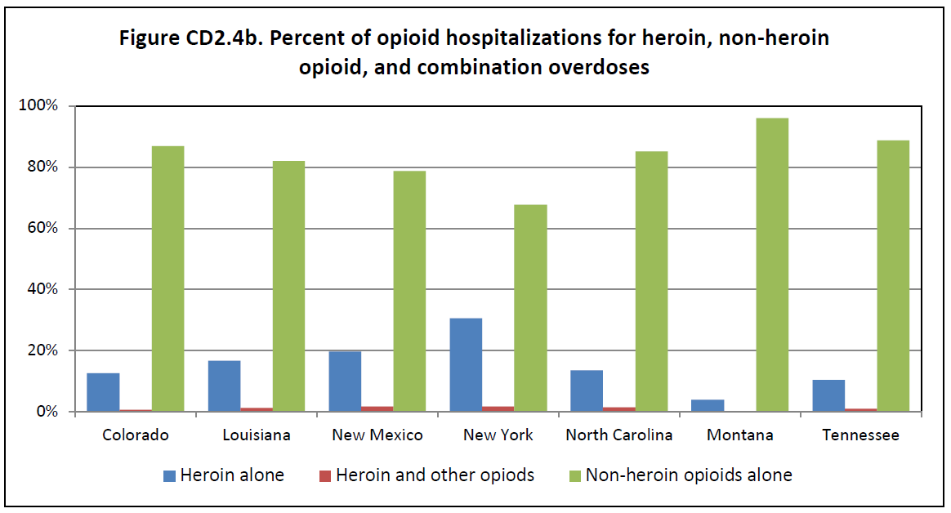

Slide 16
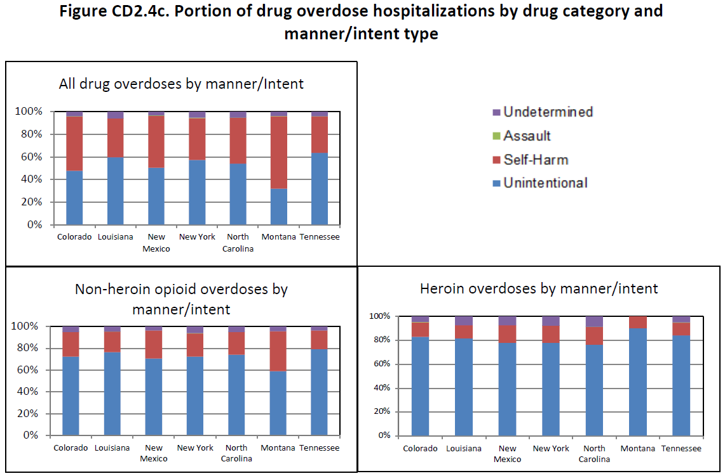

Slide 17
Table 2.5a. Number of poisoning hospitalizations with primary diagnosis vs. secondary diagnosis only
 | CO | LA | NC | NM | NY | MT
Primary Dx of Drug Poisoning | 4,877 | 4,081 | 9,565 | 1,674 | 16,164 | 977
Secondary Dx of Drug Poisoning (NOT primary) | 1,474 | 2,089 | 4,549 | 725 | 6,624 | 439
Table 2.5b. Number of cases with a secondary dx code before mechanism/manner code, by search order
Search Order | CO | LA | NC | NM | NY | MT
Prin Dx, External Cause, Secondary Dx | 1,332 | 1,971 | 4,264 | 613 | 5,690 | 400
Prin Dx, Secondary Dx, External Cause | 1,332 | 1,971 | 4,264 | 683 | 6,289 | 413
Notes:
Why are these important:
There is concern about how the search order affects the decision to assign a drug poisoning vs external cause code for surveillance. The current search pattern used for injury and poisoning is Principal Dx, External Cause, Secondary Dx. Based on work in Phase I, drug poisoning codes are in Secondary Dx fields, not External Cause fields. This table examines search order prioirty.
State Injury Indicators use the first valid external cause code. In the case of records with both drug poisoning and injury, these will be counted based on both coding practice and the search order of variables. These tables enable us to examine how drug poisoning overdose definition provides different numbers than injury and poisoning.

Slide 18
Table 3.2(b) Polydrug Percentages by Drug Type, National Total
Row Substance | Cannabis | Opioids | Non-heroin opioids (Alone or in combination) | Heroin (Alone or in combination) | Psychostimulants | Ampthetamines | Non-Ampthetamines | Cocaine | Benzodiazepines | Alcohol Toxicity | Unspecified Psychodysleptics | Unspecified/Other Psychotropics
Cannabis |  | 0.51 | 0.52 | 0.40 | 3.00 | 3.09 | 1.66 | 2.56 | 0.76 | 0.77 | 6.45 | 0.00 | 19.71
Opioids | 7.51 |  |  |  | 15.00 | 16.16 | 3.48 | 12.04 | 23.56 | 5.35 | 3.87 | 5.71 | 92.69
Non-heroin opioids (Alone or in combination) | 6.02 |  |  | 2.97 | 9.48 | 10.09 | 2.49 | 5.30 | 21.95 | 4.40 | 2.26 | 5.71 | 70.66
Heroin (Alone or in combination) | 1.30 |  | 0.83 |  | 5.52 | 6.07 | 0.17 | 6.74 | 1.61 | 0.87 | 1.61 | 0.00 | 24.72
Psychostimulants | 8.19 | 2.76 | 2.22 | 4.65 |  |  |  | 2.39 | 1.95 | 1.33 | 2.90 | 0.82 | 27.22
Ampthetamines | 7.61 | 2.68 | 2.13 | 4.61 |  |  | 6.97 | 2.33 | 1.83 | 1.14 | 2.90 | 0.82 | 33.00
Non-Ampthetamines | 0.48 | 0.07 | 0.06 | 0.01 |  | 0.82 |  | 0.05 | 0.12 | 0.17 | 0.00 | 0.00 | 1.79
Cocaine | 8.09 | 2.57 | 1.44 | 6.58 | 2.77 | 3.00 | 0.50 |  | 1.05 | 2.73 | 7.10 | 0.00 | 35.83
Benzodiazepines | 6.94 | 14.61 | 17.28 | 4.56 | 6.56 | 6.82 | 3.81 | 3.06 |  | 9.93 | 2.58 | 2.45 | 78.60
Alcohol Toxicity | 2.99 | 1.41 | 1.47 | 1.04 | 1.91 | 1.80 | 2.32 | 3.36 | 4.21 |  | 3.87 | 2.45 | 26.83
Unspecified Psychodysleptics | 0.96 | 0.04 | 0.03 | 0.07 | 0.16 | 0.18 | 0.00 | 0.33 | 0.04 | 0.15 |  | 0.00 | 1.97
Unspecified/Other Psychotropics | 0.00 | 0.05 | 0.06 | 0.00 | 0.04 | 0.04 | 0.00 | 0.00 | 0.03 | 0.07 | 0.00 |  | 0.28
 | 50.10 | 24.70 | 26.03 | 24.90 | 44.43 | 48.06 | 21.39 | 38.17 | 57.11 | 26.91 | 33.55 | 17.96
Notes:
The poly drug matrix shows which combinations of drugs are most commonly found in hospital records in the jurisdiction.

Slide 19
Phase IV
Hypotheses:
  Differences in manner / mechanism of inpatient vs ED (inpatient more self-harm, ED more overdose; classes treated in inpatient vs ED)
  Differences in coding specificity (possibly beyond Phase IV)
  Differences in number of codes
  Differences in ratio of primary to primary / secondary

Slide 20
Case Definition Phase IV Timeline

